Slide 1

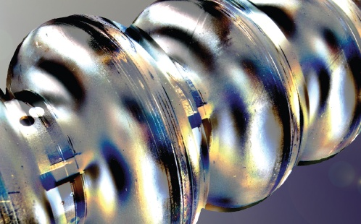
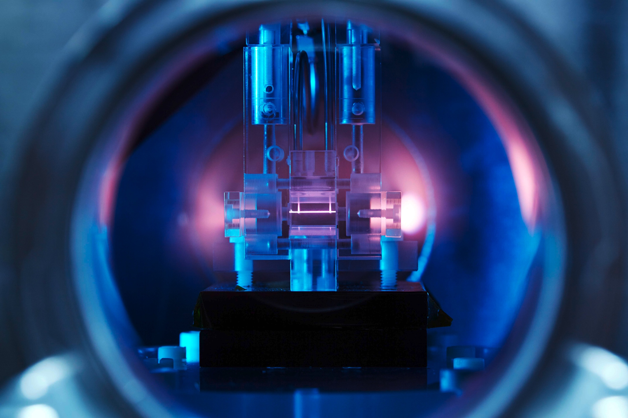
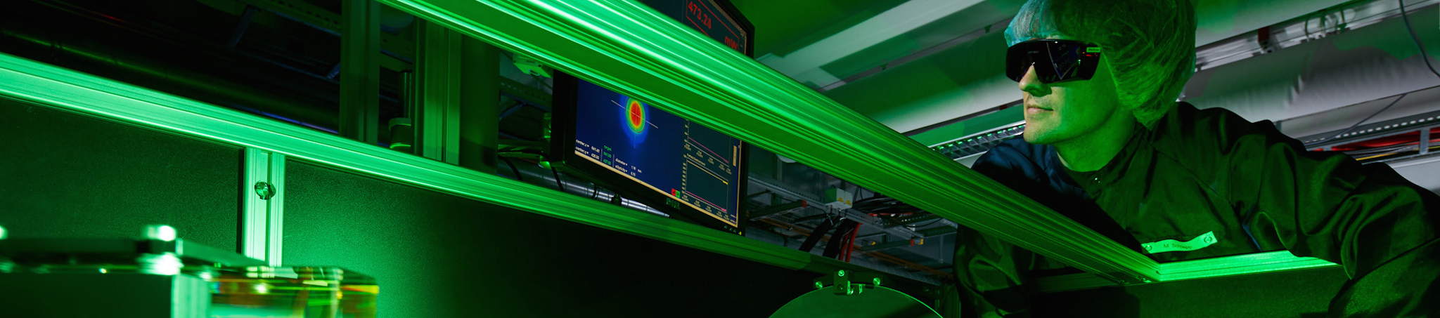
Precision
RF controls
… for accelerating structures
Helmholtz Program: Matter & Technology (MT)
PoF III Topic: Accelerator Research & Development (ARD)
DESY Research Unit: ARD - ST3
Sven Pfeiffer
Center Evaluation DESY, 5 – 9 February 2018

Slide 2
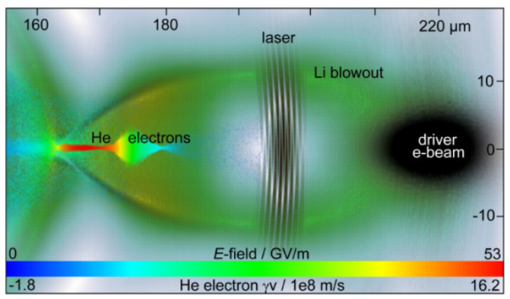
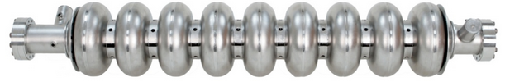
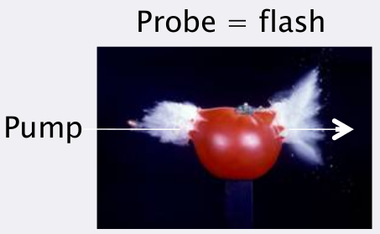
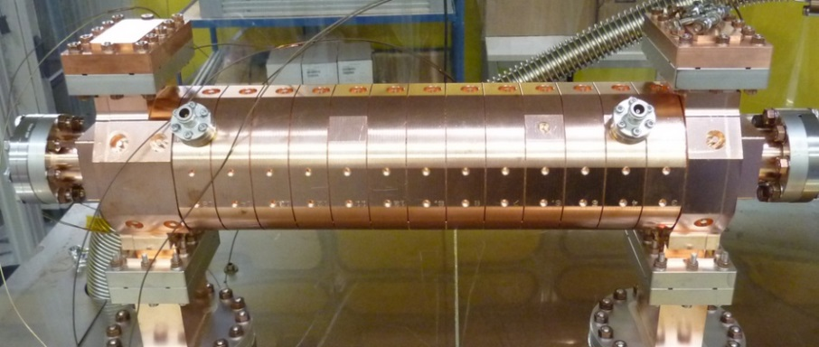
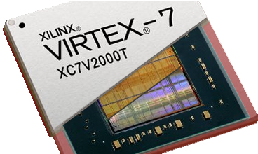
Precision RF controls
Energy gain
Energy chirp
Achieve a specified amplitude and phase stability
Electron beam
Cavity
Feedback and regulate the signal to be controlled
Important for e.g. FEL stability, pump-probe experiments, external injection into plasma bubble, …
Amplifier
~
Actuator
Low power ~V
High power ~MV
Master Oscillator
!
Cavity
  Bandwidth from 1 Hz to 1 MHz range
High power amplifier
  Klystron, solid state amplifier, inductive output tube
Master Oscillator (1.3 GHz, 3 GHz, 12 GHz, …)
  Local oscillators synchronized to master oscillator on fs level
  → See precision synchronization poster
Low Level RF system (Sensor, Controller, Actuator)
  Digital, high precision and low latency system
  Filtering, averaging, data processing on FPGA
  Key technology in last years
Local
Oscillator
Sensor
LLRF Controller
Diagnostic etc.
http://newsline.linearcollider.org/2012/03/29/advances-in-scrf-cavity-performance-in-the-technical-design-phase/tesla-type-cavity-2/
[1]
  http://www.hitechglobal.com/images/Virtex7_V2000T.jpg
[1] PhD Thesis, M. Heuer, 2017
http://pitz.desy.de/news/2011/galerie/

Slide 3
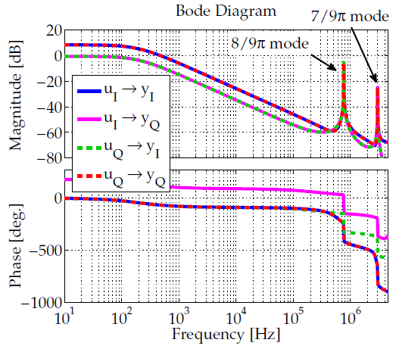
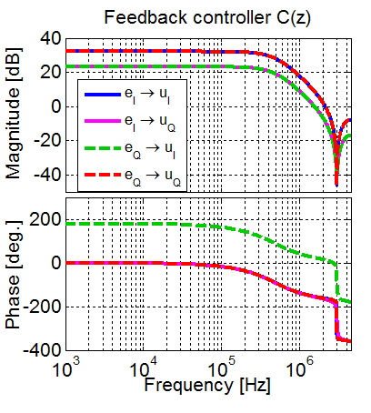
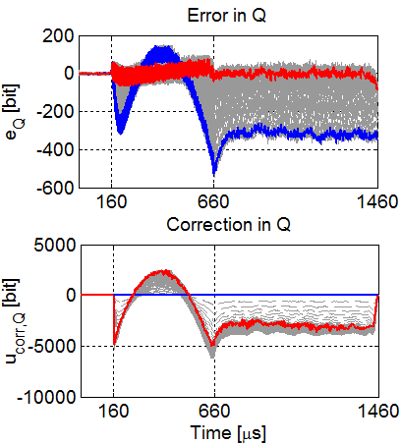
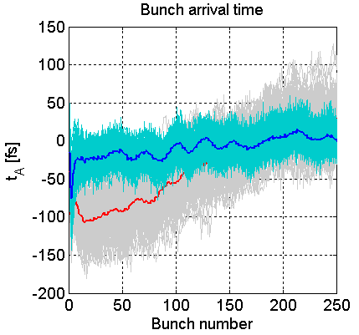
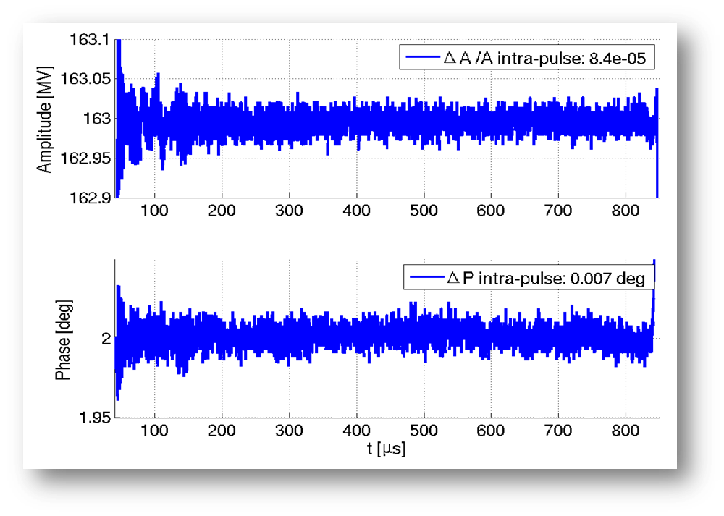
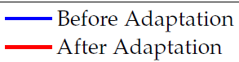
Precision RF controls
Specification for RF Field Control
ΔA/A < 0.01 % and Δφ < 10 mdeg.
Example at FLASH and European XFEL operated in pulsed mode
Electron beam
Cavity
System characterization
RF Feedback controller design
Iterative learning controller design
Beam-based feedback
Amplifier
~
Actuator
Low power ~V
High power ~MV
[1]
Master Oscillator
Sensor
[2]
LLRF Controller
Typical RF stability at XFEL/FLASH
ΔA/A ≈ 0.008 % and Δφ ≈ 7 mdeg.
26 fs (rms)
13 fs (rms)
[1] PhD Thesis, C.Schmidt, 2010
[2] PhD Thesis, S.Pfeiffer, 2014

Slide 4
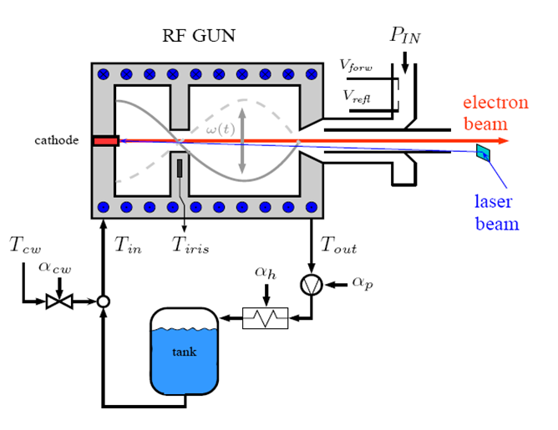
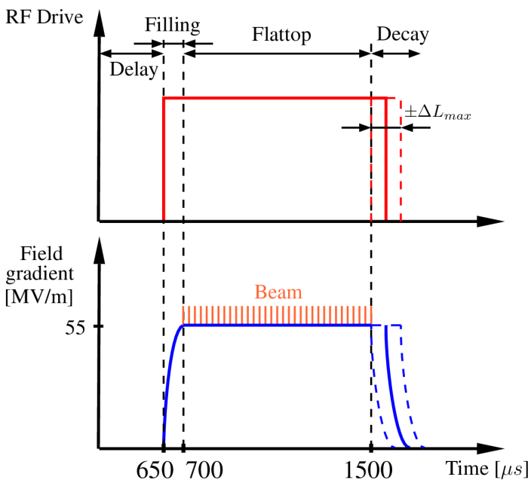
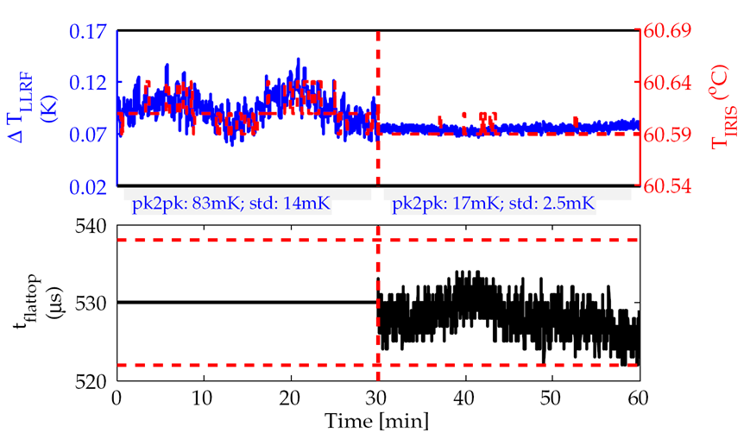




Disturbance minimization of RF-guns
Precise temperature regulation for RF-guns in pulsed mode
Use pulse width modulation to control temperature
  Too low/high temperature → RF pulse longer/shorter
Results at FLASH for RF-gun with long RF pulse length
  LLRF signals provide 20 µK temperature resolution
  Experience with LLRF feedback:
Permanently in operation at FLASH, XFEL & PITZ

Slide 5
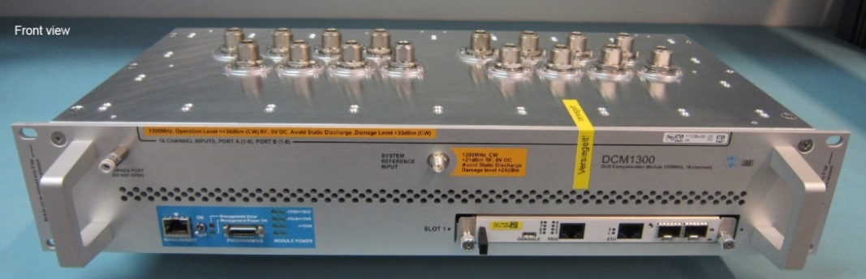
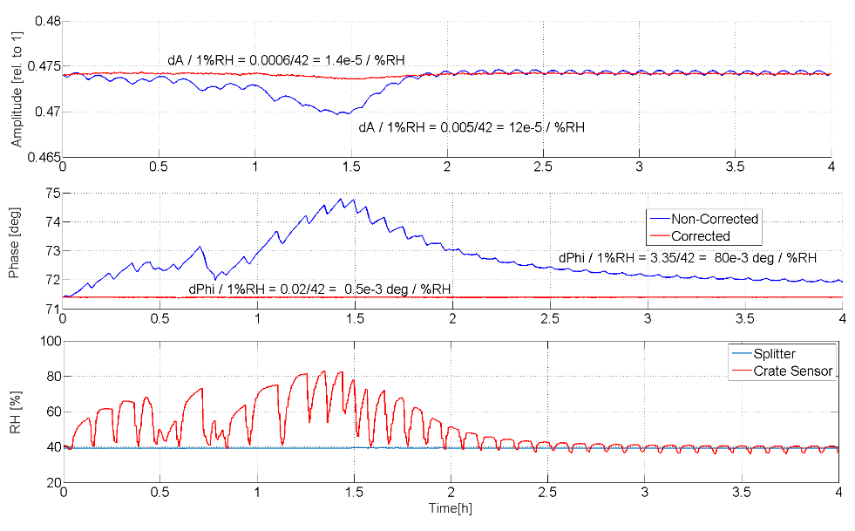



Drift Compensation Module (DCM)
Drift compensation for low level RF stations on a grand scale
Compensate temperature and humidity effects in electronics
Crucial factor for short- and long-term stability of the RF field
Verification in laboratory (and accelerator environment)
Adapted for 3.0 GHz and 3.9 GHz (REGAE, SINBAD, XFEL,…)
  Installation and tests Q1/2018 (new firmware)
Continuous wave DCM
  Pilot tone technique currently under test
[1]
Humidity response in lab:
1/160 reduction (@1.3GHz)
ELBE
& other L/S/C-band facilities
[1] PhD thesis: J. Piekarski
Notes:
0.1deg/% humidity @ 1.3 GHz
+-20% humidity change → +-2 deg. RF phase
Absolute amplitude and relative phase calibration from pulse to pulse
80mdeg ➔ 160 fs/% RH
0.5mdeg ➔ 1 fs/% RH

Slide 6
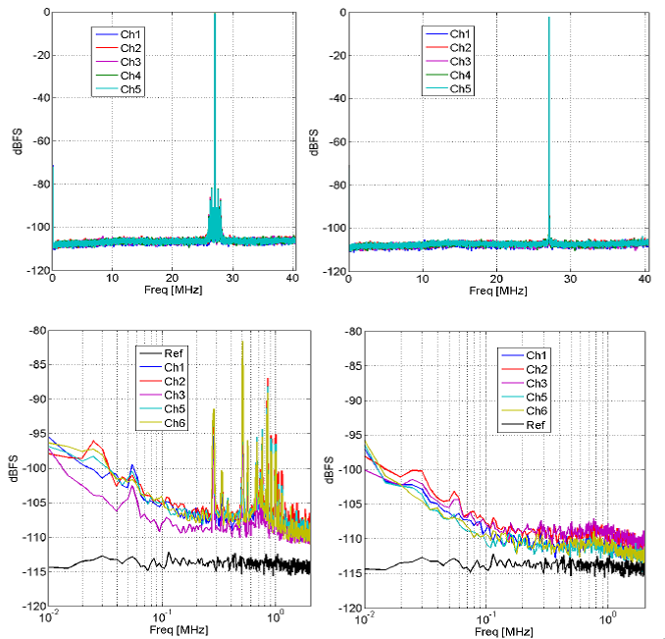

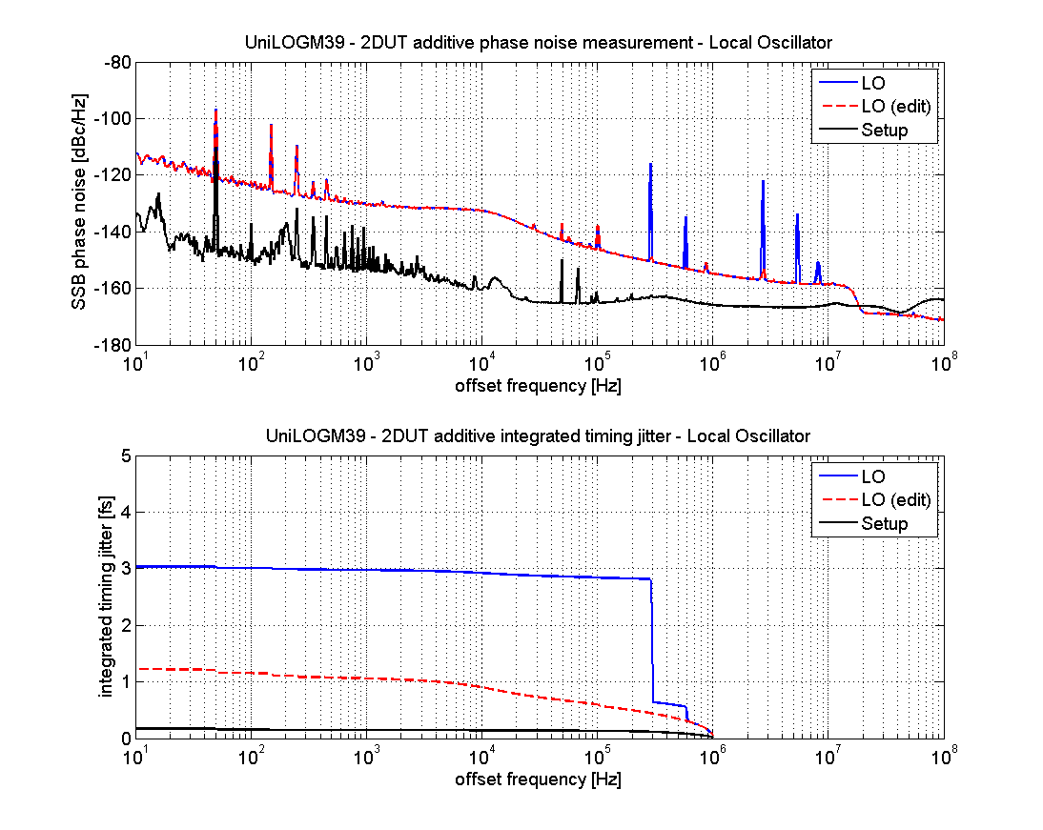
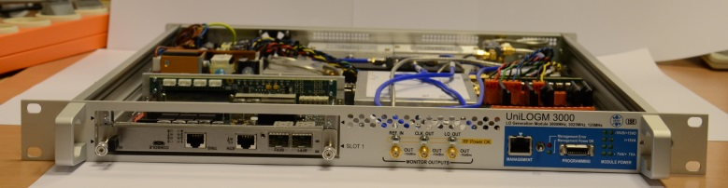
Further Optimizations and Developments
Early Rev.
Final Rev.
... towards attosecond regulation
f_{IF} = 27 MHz
2013
2015
Modification of 10 channel 125 MSPS SIS8300L digitizer board
Spectrum clean up
Several iterations required (PCB optimization)
Improved signal to noise ratio significantly
Close cooperation with industrial partner:
Development of Universal Local Oscillator Module (UniLOGM)
Range: 500MHz….6 GHz
Spurious spectral lines identified and optimized
@3.9 GHz
Integrated timing jitter:
<1.2fs@10Hz-1MHz
ELBE
& other L/S/C-band
facilities
identified

Slide 7
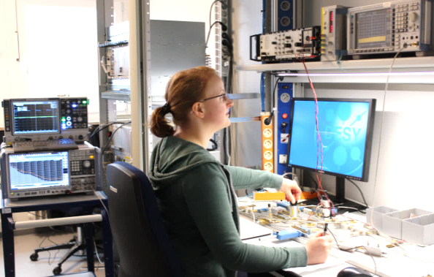

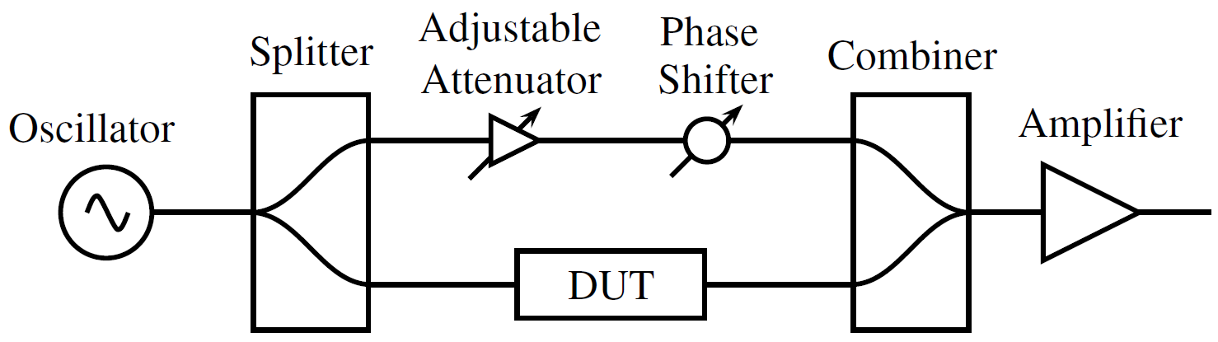
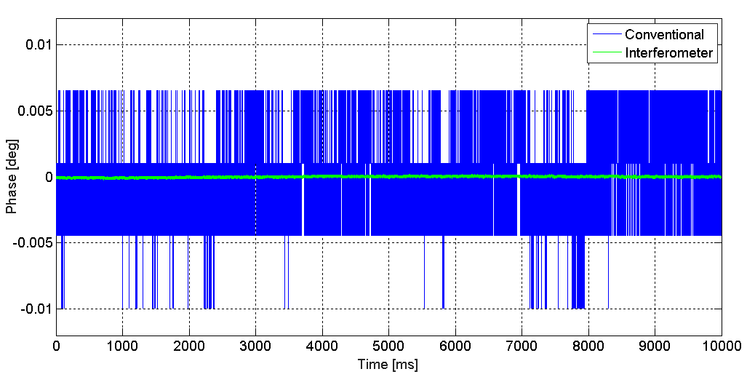
Study: Receiver with attosecond-resolution
In cooperation with TU Hamburg-Harburg (master student)
Laboratory measurement setup to precisely measure the phase
Device Under Test (DUT) is voltage controlled phase shifter
  Cavity probe signal in application
Interferometer based method to suppress the carrier
Outlook: Technical realization (2018-20??):
Many challenges to be addressed → long-term development
Pulsed mode vs. continuous mode operation
Carrier tracking algorithm, ...
Development of ultra low noise attenuator and phase shifter
…
Louise Springer
Reduction factor >50:
2.6mdeg (rms),
≈5.5fs
0.045mdeg (rms),
≈96as
@ 1.3GHz [0.1Hz, 20kHz]
Blue: signal in front of the interferometer (non-suppressed carrier)
Green: signal behind the interferometer (suppressed carrier)
CarrierSupp_noMod_M10_524k_20171129T1352.mat; SIS8300V2, DWC8VM1, fs =81.25MHz, IF=54MHz, N=512K, D=1600
Notes:
DWC scheme still needed!

Slide 8
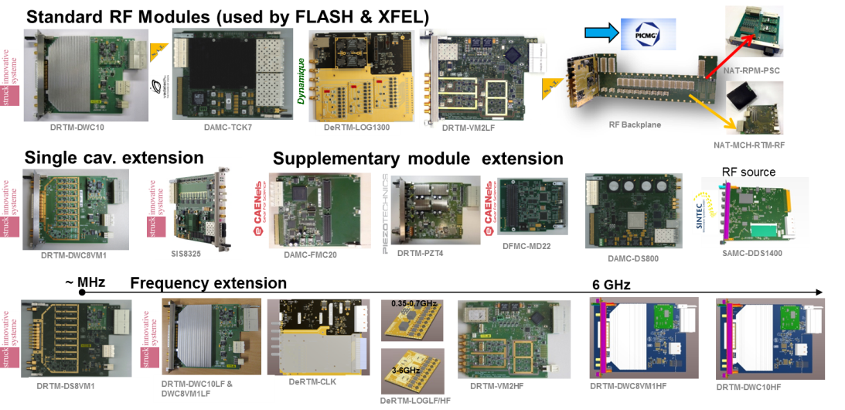

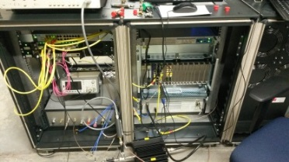
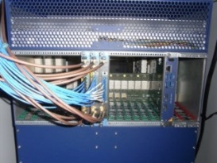
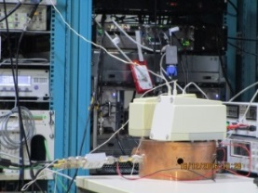
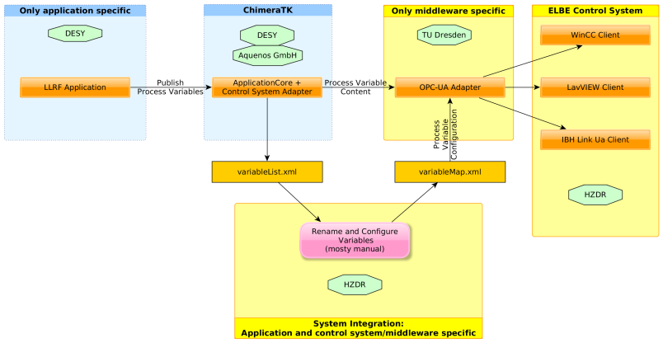
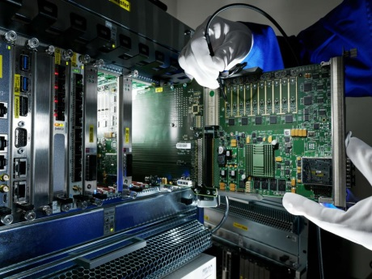


Technology Transfer and Cooperation
→ General Topics, Innovation, A. Willner
Foster the modern crate standard MicroTCA to industry and research…
>20 products developed, >10 licensed to industry
HGF Validation fund: „MicroTCA for Industry“, 2012-2014
  Extension of RF controls boards to cover wide application
    Wide frequency range: 10MHz - 6 GHz
    Supplementary modules
  Product licensed to industry, now available for other labs
Support for HGF research centers in ARD (ELBE/FLUTE/bERLinPro)
  System setup, share firmware/software, training of colleagues
  Access to facility, new algorithm development, topical workshops
Software framework (ChimeraTK)
  To be compatible with modern control systems
Awarded HGF Innovation Lab., 10/2016
  Ideal framework for Technology Transfer
  Several customers for LLRF system already
ELBE
Example: ChimeraTK for ELBE with OPC-UA adapter
MicroTCA Techology Lab.
Notes:
DESY was received an HGF award in order to build the MicroTCA Innovation Lab (or TechLab) which is the ideal framework for Technology Transfer and which has caught the interest of many customers for LLRF systems already.

Slide 9
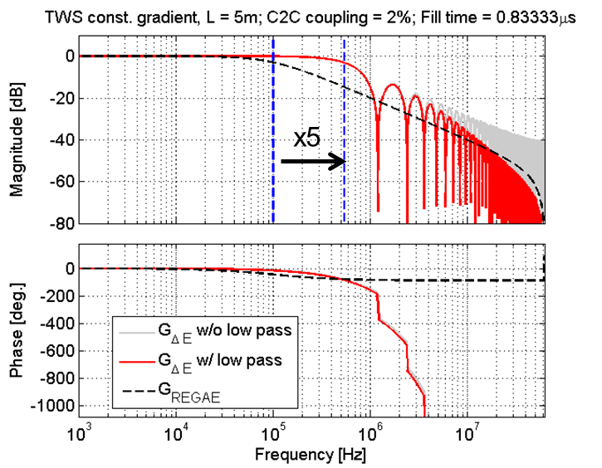
Summary and outlook
Precision regulation for now and in next years…
Thank you for your attention!
Key developments in last years
New modern crate standard established
    Product licensed to industry and available for other labs
    Additional components for drift minimization, local oscillator generation, laser-based synchronization, ...
    Optimization of components e.g. digitizer board, single cavity regulation scheme, …
RF regulation performance improved by factor of 10 in last 10 years
  New regulation algorithm were developed to achieve RF specification
  → Beam-based feedbacks with intra-train arrival time stability down to fs-level
  → Pulse width modulation for RF-guns
New developments in next years
  Focus on CW operation and ultra-short RF pulses
    First traveling wave structure at SINBAD in RF feedback
  Atto-second receiver development
  …

Slide 10
Backup Slides

Slide 11

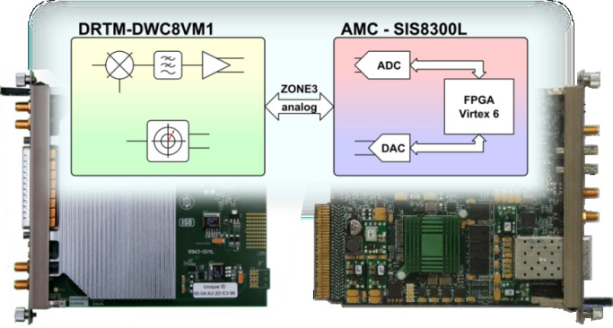
Classification of additional examples
Few highlights…
Electron beam
Cavity
Disturbance minimization for RF-guns
Drift compensation module
Digitizer Optimization & LO Generation Module
Receiver with atto-second resolution
Amplifier
~
Actuator
Low power ~V
High power ~MV
Master Oscillator
Sensor
LLRF Controller
Notes:
Other resonant modes acc./decelerate beam
Loaded QL (unloaded Q₀ and/or external Q_{ext})

Slide 12
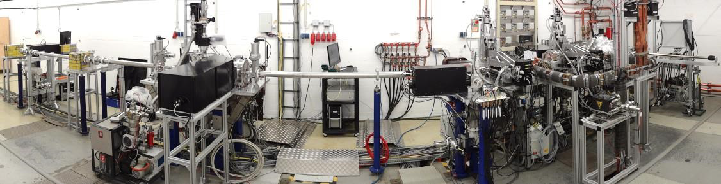
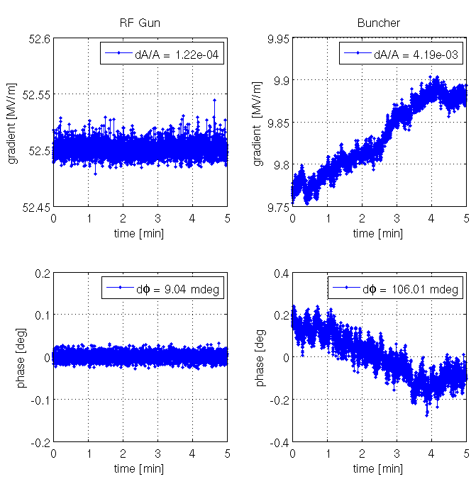


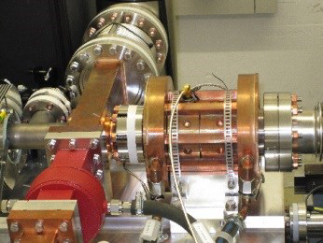
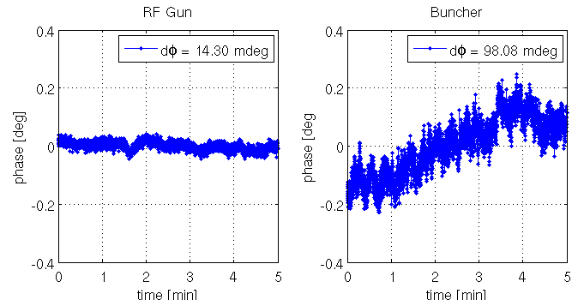

Sub-10 fs RF Regulation at REGAE
Electron Beams for Time Resolved Diffraction Experiments
Test facility for laser driven plasma-wakefield acceleration (LAOLA)
Generation of sub-10 fs electron bunches
  Timing stability: <10 fs at the target
  Very low charge: 150..300 fC
RF parameter of the REGAE accelerator:
  RF-gun and buncher cavity @ 2.998 GHz (S-band)
  6 μs pulse length and up to 50 Hz repetition rate
  Driven by one klystron, with motorized waveguide phase shifter
  Pre-amplifier from XFEL-TDS
Single cavity regulation
  RF-gun in feedback
  Buncher is uncontrolled
Achieved RMS phase stability:
In-loop: 9.0 mdeg (8.3 fs)
Out-of-loop: 14.3 mdeg (13.2 fs)
Out of loop
Notes:
LAOLA: Laboratory for Laser- and beam-driven plasma Acceleration

Slide 13
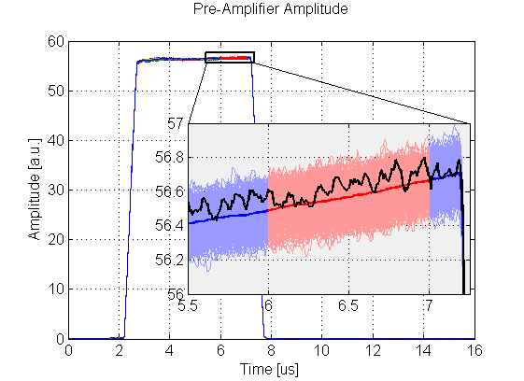
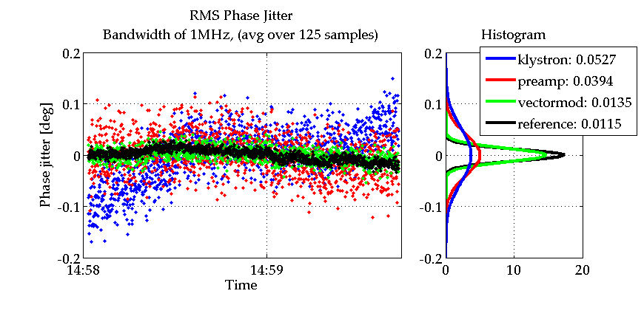

Pre-selection of components
Bandwidth: 200kHz@3GHz
Phase noise and timing jitter analysis at REGAE
Electron beam
Cavity
Analysis along the actuator chain to identify main noise sources
  High speed sampling ( ADC ~$\frac{1nV}{\sqrt{Hz}}$ )
  Averaged in region of interest: 1 μs (125 samples)
  => 1 MHz ADC bandwidth (200 kHz cavity BW)
Pre-amplifier and klystron (modulator) increase noise factor
  dφ = 0.012…0.053 deg.
Find limiting elements in signal chain and replace/optimize them!
→ Here pre-amplifier was broken!
Amplifier
Low power ~V
High power ~MV
~
Actuator
Master Oscillator
Sensor
ADC
ADC
ADC
ADC
dφ
11.5 fs
13.5 fs
39.4 fs
52.7 fs
750 pulses (1 minute)
Mean (bold blue/red line)
1 chosen RF pulse (black)
LLRF Controller
ADC sampling with 125 MHz
Average over 1µs gives 1 point in time plot

