Slide 1

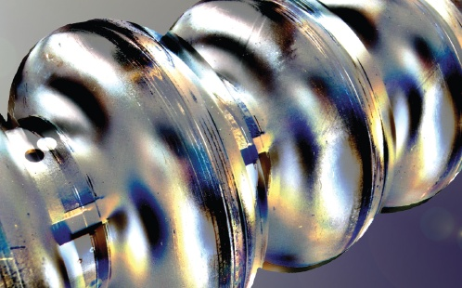
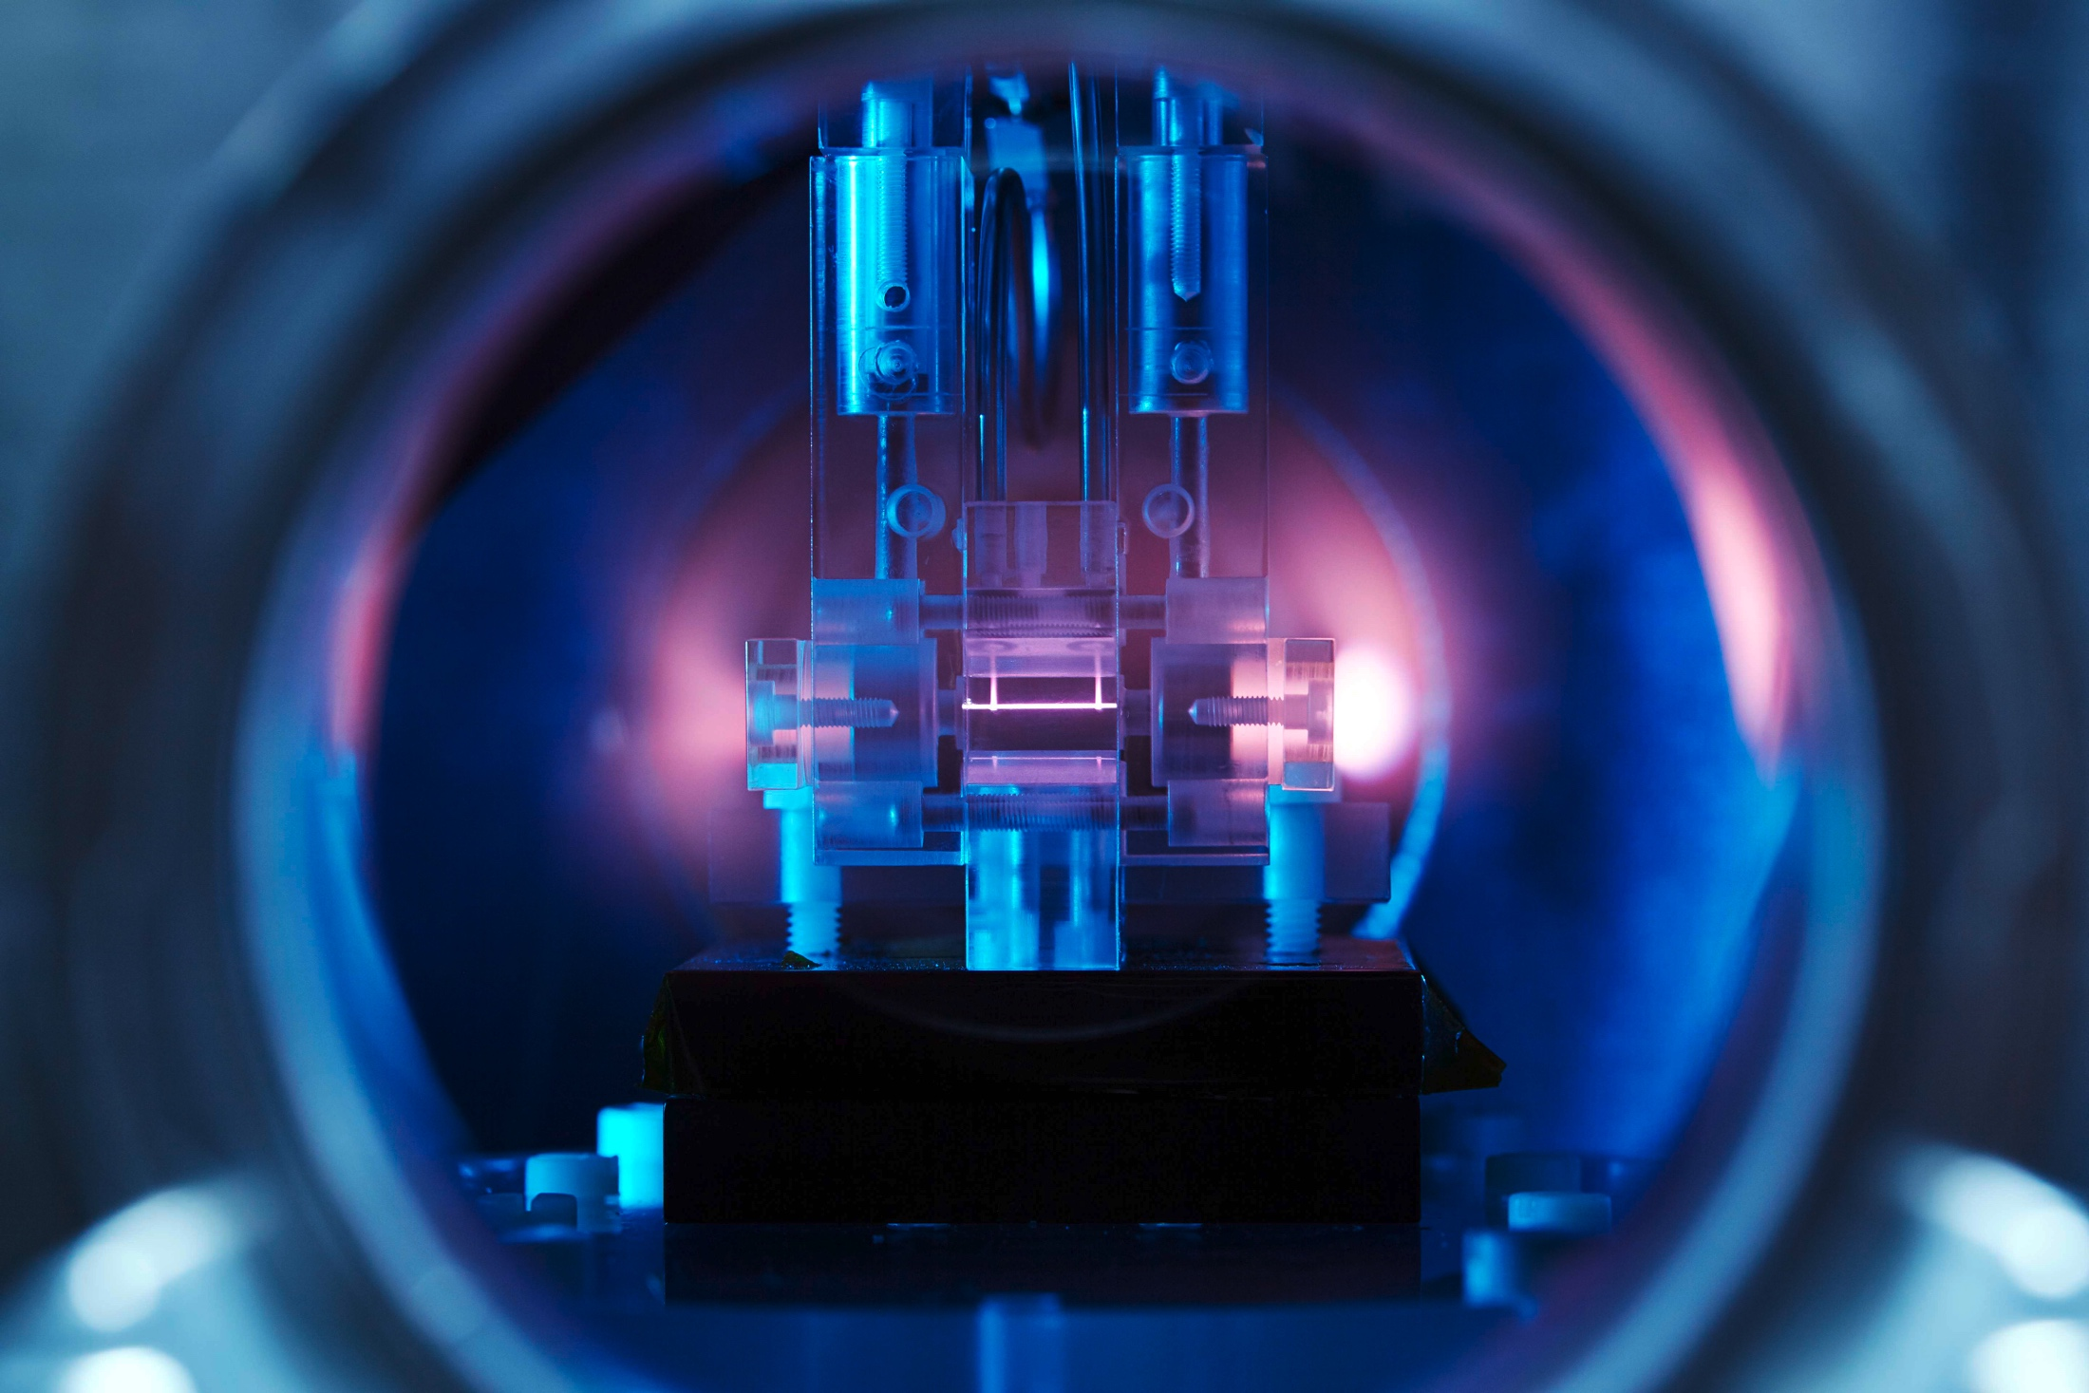
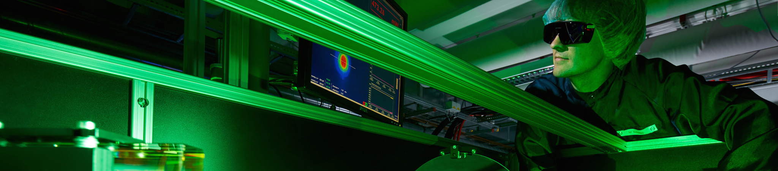
Superconducting
Cavity R&D
Towards continuous wave operation
Helmholtz Program: Matter & Technology (MT)
PoF III Topic: Accelerator Research & Development (ARD)
DESY Research Unit: ARD - ST1 Superconducting Technology
Detlef Reschke
Center Evaluation DESY, 5 – 9 February 2018

Slide 2
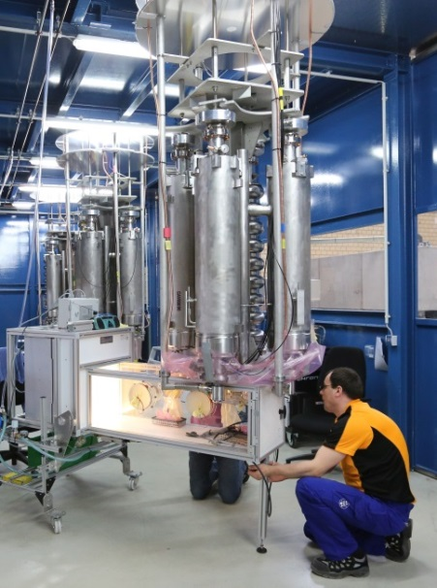
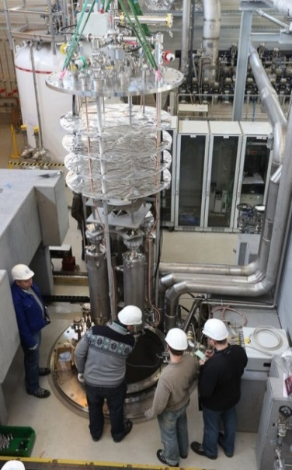
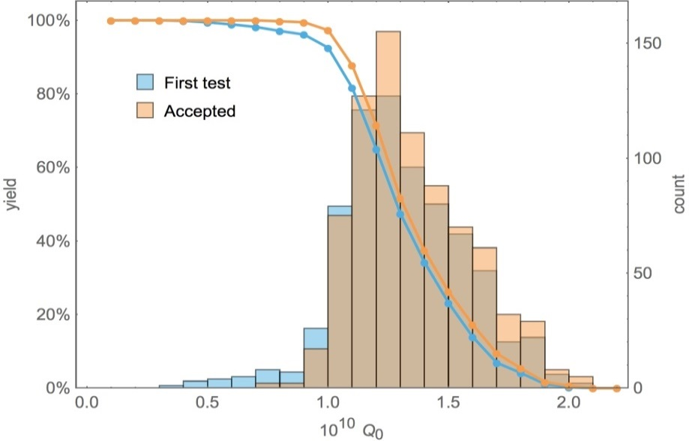
European XFEL Cavity Production in Retrospect
World largest industrial cavity production
Successful European XFEL cavities
More than 800 high-performing cavities mechanically manufactured and surface treated in industry under supervision of DESY and INFN Milano
Specification for Nb material, fabrication and surface treatment based on
state-of-the-art of 2009 including:
  Fine-grain niobium sheets
  Electropolishing (EP) for smooth surfaces, high-vacuum heat treatment,
  ultra-clean final water rinsing and assembly
All series cavities usable for module assembly
Cavity performance in the vertical acceptance test exceeded specification
  Average accelerating gradient: ~30 MV/m and average Q-value 1.4 x 10¹⁰
  (average design gradient 23.6 MV/m and Q-value 1.0 x 10¹⁰)
The Q-value defines the dynamic fraction of the cryo losses with
1/Q-value ~ P_{rf-loss} ~ P_{cryo,dyn}
W. Singer et al., PhysRevAccelBeams.19.092001 (2016)
W. Singer et al., Supercond. Sci. Technol. 28 (2015) 0850014
D. Reschke et al., PhysRevAccelBeams.20.042004 (2017)

Slide 3
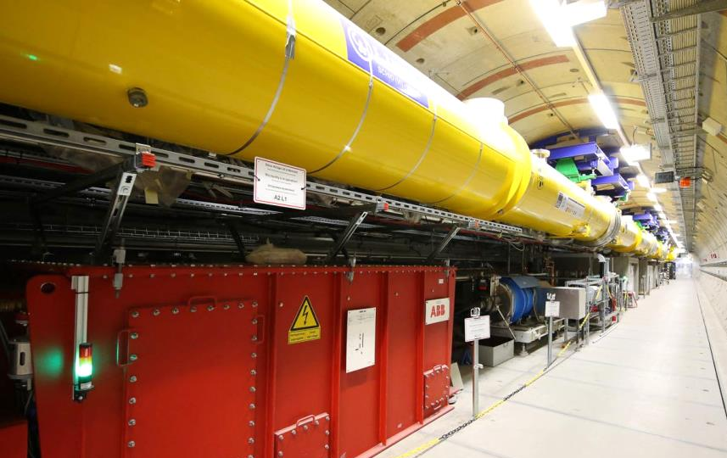
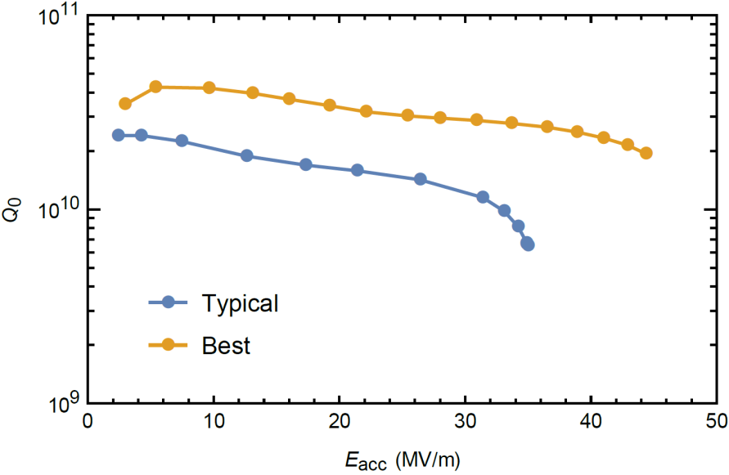
Goals of SRF Cavity R&D
Towards highest quality factors at high gradients
European XFEL cw upgrade
Proposed European XFEL upgrade to support cw operation requires replacement of 17 cryomodules in the low energy part of the accelerator
Highest achievable Q-values for low dynamic losses in cw mode and high accelerating gradients in pulse mode are necessary for the new 136 cavities
  R&D after the European XFEL cavity fabrication
  During the European XFEL cavity production almost no R&D activity was possible at DESY
  In the last year we restarted our R&D activities based on highly-experienced “old stagers” and young scientists, with a strong emphasis on surface analysis

Slide 4
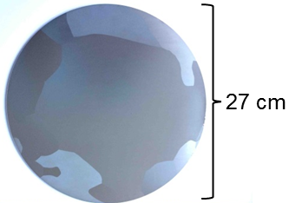
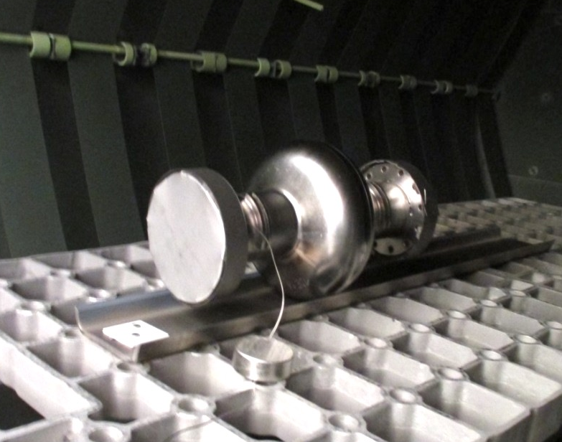
DESY R&D topics within ARD
Improved niobium material and surface treatment
  Two R&D topics were identified
    Large-grain niobium disks for cavity production based on the existing world-leading experience at DESY
  Nitrogen infusion – a novel surface treatment applying a partial pressure of nitrogen during heat treatment recently developed at Fermilab
    Important for DESY to establish expertise in this relatively new field
Common advantages of both R&D activities
  Effective wrt. an improved cavity performance
  High potential for a better fundamental understanding
  Modifications of the existing proven cavity production process
  Based on previous experiences
  Realistic within given time frame

Slide 5
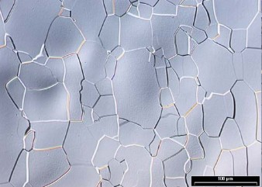
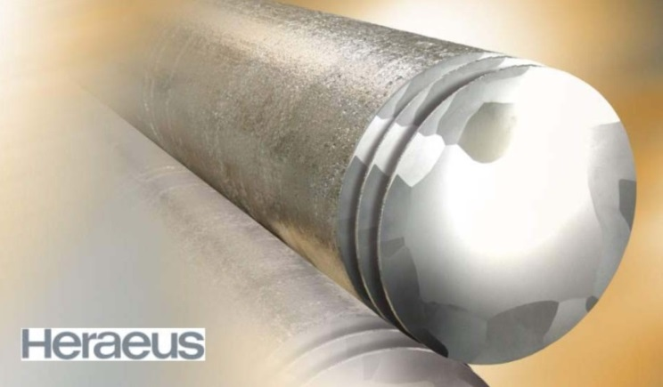
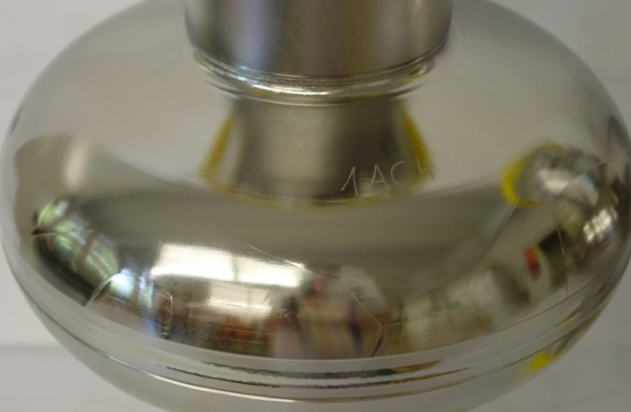
Cavities made of Large-Grain Niobium Disks
Material – beyond standard production
Fine-grain (fg) niobium:
Established industrial production of rolled sheets with a typical
grain size of ~50 µm
  Well-known mechanical and physical properties; commercially available;
  used for all recent SRF accelerator projects
  (European XFEL, LCLS-2, ESS, MESA)
    Multi-step fabrication process requires thorough QC/QA including eddy current scanning
Large-grain (lg) niobium:
Cut niobium disks from the ingot with a typical grain size of a few cm
  First R&D done during preparation phase for European XFEL
W. Singer et al., PhysRevSTAB.16.012003 (2013)
A. Ermakov et al 2008 J. Phys.: Conf. Ser. 97 012014

Slide 6
Performance of Large-Grain Niobium Cavities
Higher Q-value
11 nine-cell cavities and several one-/three-cell cavities fabricated with world-class cavity performance
Vertical test results
About 20% higher Q-value on average for standard EP surface treatment up to 15 MV/m
  No difference in accelerating gradient
Large-Grain XM-3 pre-series cryomodule
European XFEL pre-series cryomodule XM-3 with
7 large-grain + 1 fine-grain cavities
cw operation with excellent results and stability.
→ stable operation at 17 MV/m and Q-value of 2.3 x 10¹⁰ at 2K
Long term (>7y) operation of two further lg cavities in FLASH modules

Slide 7
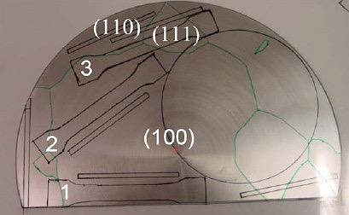
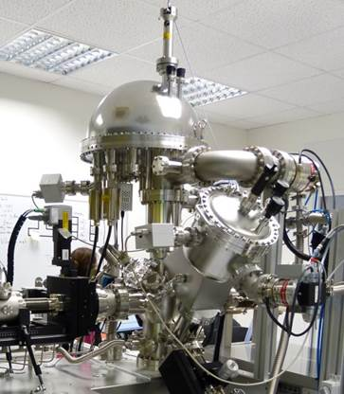
R&D for Large-Grain Niobium Cavities
Engineering and surface analysis
Material specification to be defined
  Well-defined cutting process for less risk of contamination,
  good surface roughness and better thickness tolerances
  Compatibility with Pressure Equipment Directive (PED).
  → Investigation of mechanical properties for lg disks from different vendors
Specification for mechanical forming and welding process to be defined
Goal of a stable industrial high-performance cavity production
Surface-sensitive characterization techniques down to atomic level applied on samples
  Investigation of grain boundaries (less than fg)→ responsible for rf losses?
  Identification of sample surface properties which correlate with cavity performance
Collaborations with Heraeus Deutschland GmbH & Peking University

Slide 8
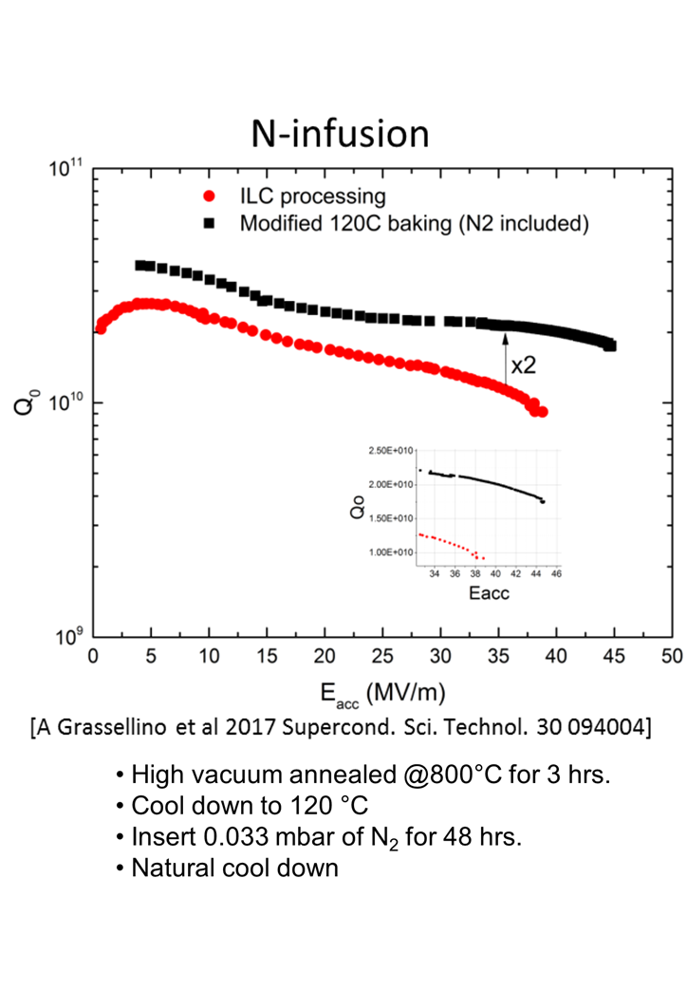
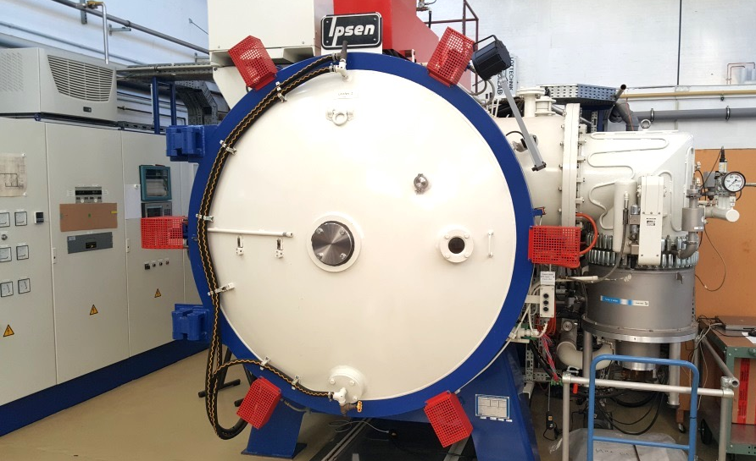
Heat Treatments in a Partial Pressure of Nitrogen
Improvement of the surface treatment process
Recently, significant developments in surface treatment have been made by applying a partial pressure of nitrogen during the heat treatment
Nitrogen infusion
  Heat treatments at 800°C and 120°C merged with a partial pressure of nitrogen at 120°C.
  No additional final EP treatment (as in standard EP process) necessary
  High Q-values and high gradients reported, but process still not reproducible
Nitrogen infusion at DESY
  Process and furnace infrastructure for clean and well-defined handling of cavities
  First cavity treatments have not reproduced Fermilab results
  → Indications of a possible (hydro)-carbon contamination of our furnace
  Ongoing investigations on the improvement of the cavity process
  → Process parameters are compared with Fermilab, JLab and KEK
  → Qualified single-cell cavity and samples sent to Fermilab
  → Collaboration with industrial cavity vendor started

Slide 9
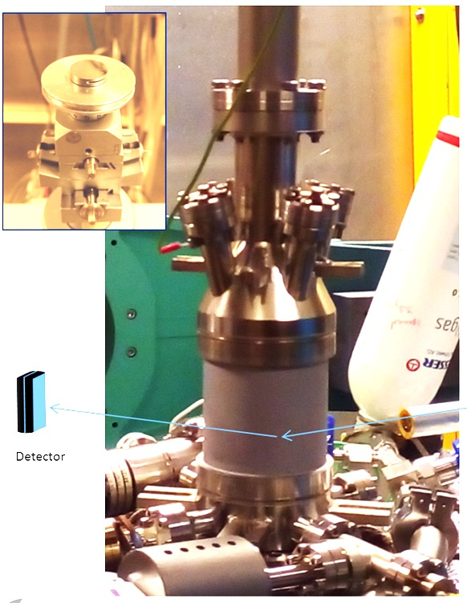
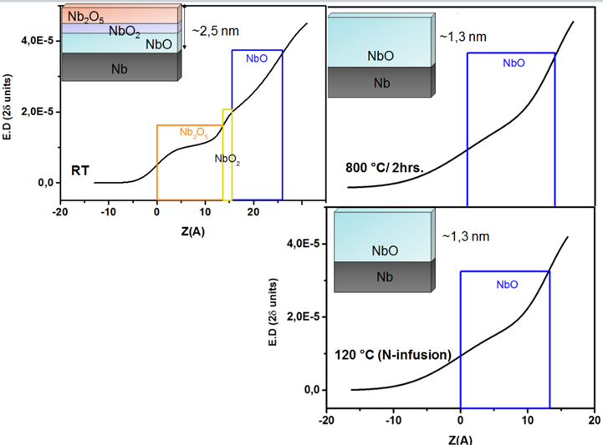
Nitrogen Infusion at DESY
Surface analysis of samples emphasized
Surface-sensitive characterization techniques down to atomic level of samples in parallel to surface treatments and vertical rf testing of cavities are applied
To understand the role of nitrogen in the infusion process:
  Sample treatment in a suitable UHV chamber on high-purity, UHV-annealed single crystal Nb (100) – as a model system.
  Basic understanding of the surface wrt. oxides, nitrides, hydrides and interstitials (in-situ XRR and XRD experiments, XPS, SEM, AFM).
First results of In-situ XRR & XPS:
NbO phase is present, but no nitride phase identified after Nitrogen Infusion process
A. Dangwal Pandey et al., submitted to Journal of Materials Science
see Poster #31

Slide 10
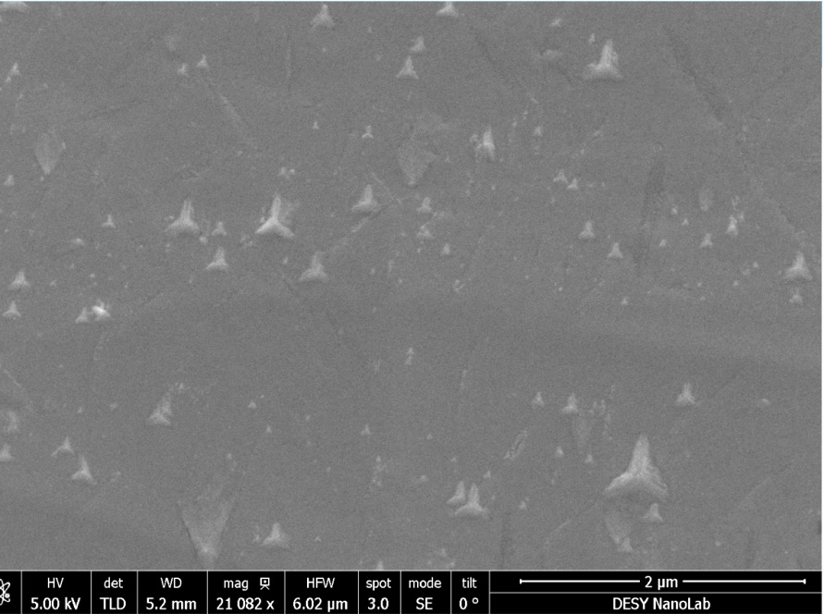
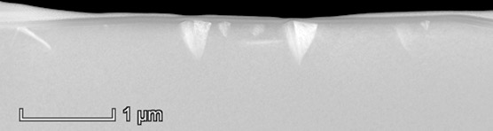
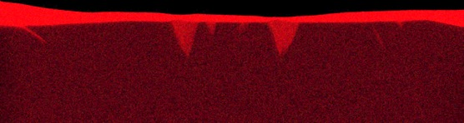
Next Activities on Nitrogen Infusion
Deepen our understanding and establish the process
SEM after heat treatment
2 μm
Composition and relevance of the star-like structures found on samples after heat treatment in DESY vacuum furnace (TEM at TU Hamburg)
For samples and cavities:
  Compare single-crystal, large-grain and fine-grain samples for effects of
  grain boundaries and grain orientation
  Investigate impact of gases other than nitrogen → Interstitial gases in Nb
Focus: Optimum parameter set for robust and reproducible nitrogen infusion process with the ultimate goal of industrialization
‘star-like’ precipitates identified as carbon using advanced surface analysis techniques
TEM on FIB Cuts
TEM-EDS: Carbon

Slide 11
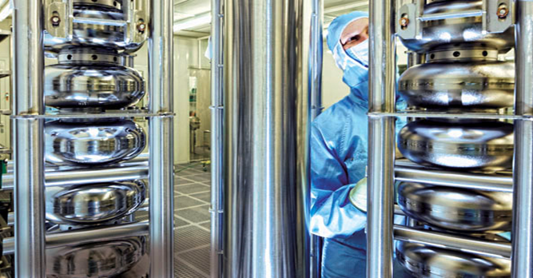
















Summary
Over twenty years of R&D, culminating in the successful production of over 800 cavities for the European XFEL, has established DESY as a world-wide center of excellence for SRF technology
The cavity fabrication processes for LCLS-2 and ESS are strongly based on the those developed by DESY and INFN Milano for the European XFEL cavity production
R&D has restarted in the last year as part of ARD, focusing on Large-Grain Niobium and the Nitrogen Infusion process, in support of a cw upgrade of the European XFEL and an improved fundamental understanding of SRF
Collaborations with national and international partners from universities,
labs and industry
The addition of advanced surface analysis capabilities to the existing world-class SRF infrastructure and expertise will guarantee DESY’s continued excellence and leadership in SRF technology

Slide 12
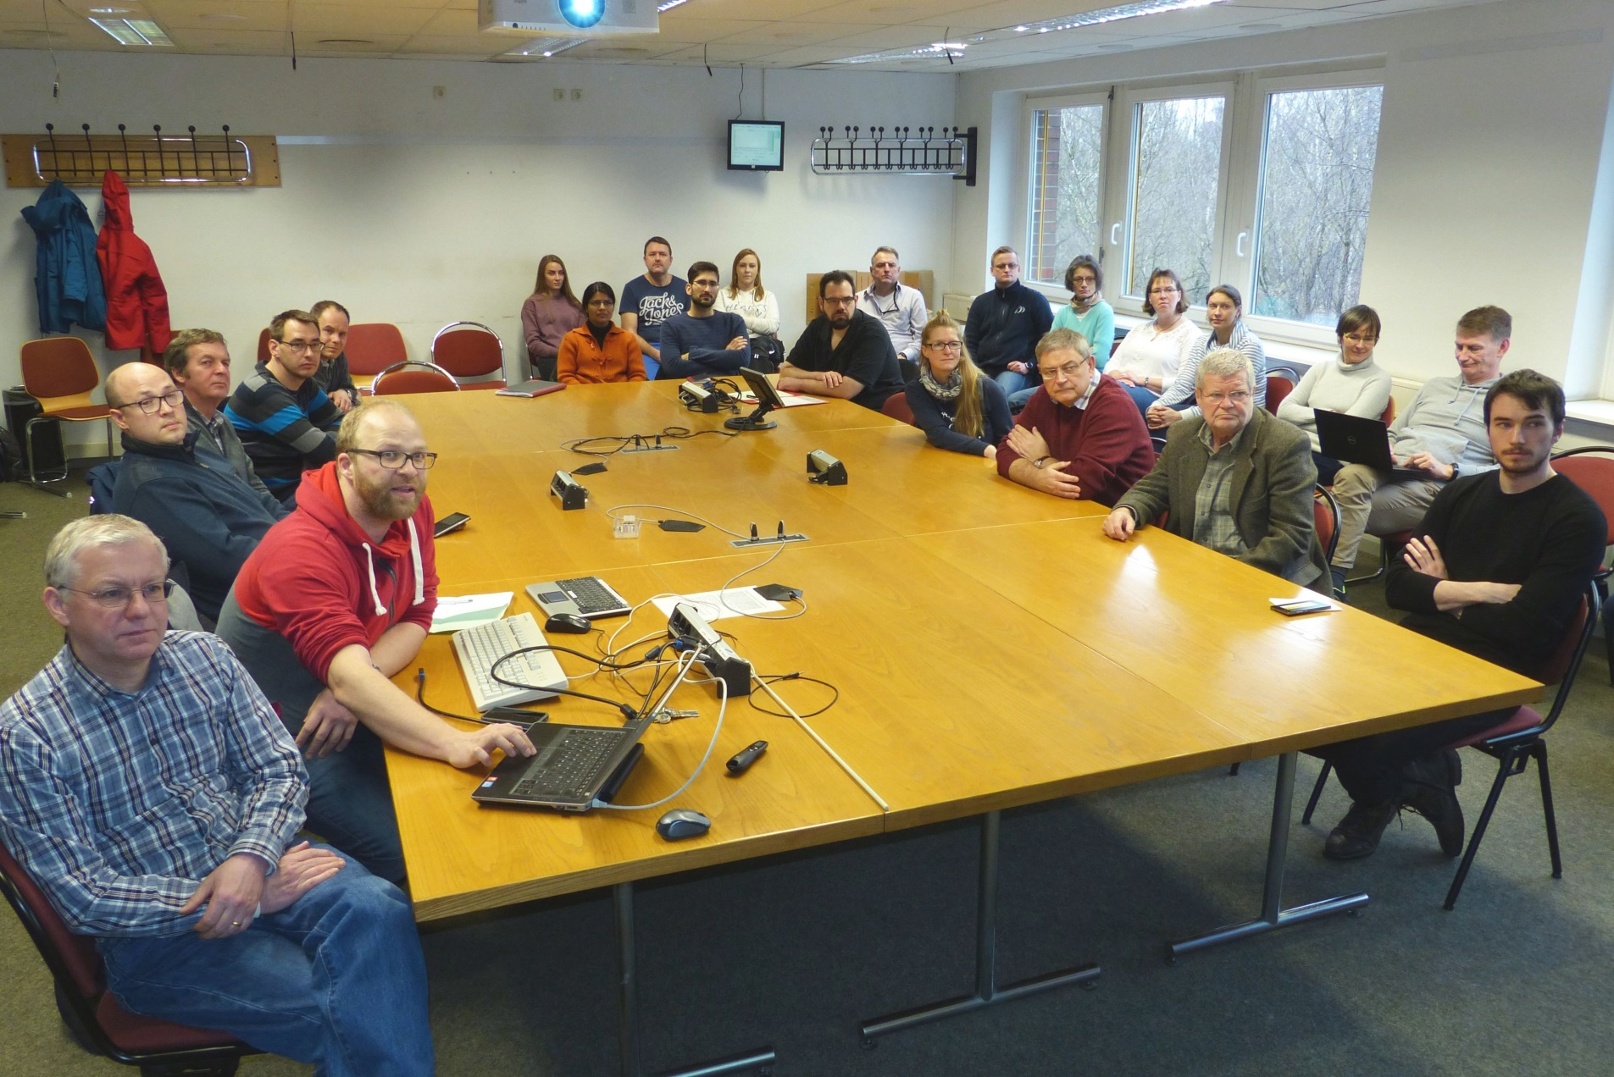
The Team is the Star
Our greatest asset is our experts

