Slide 1


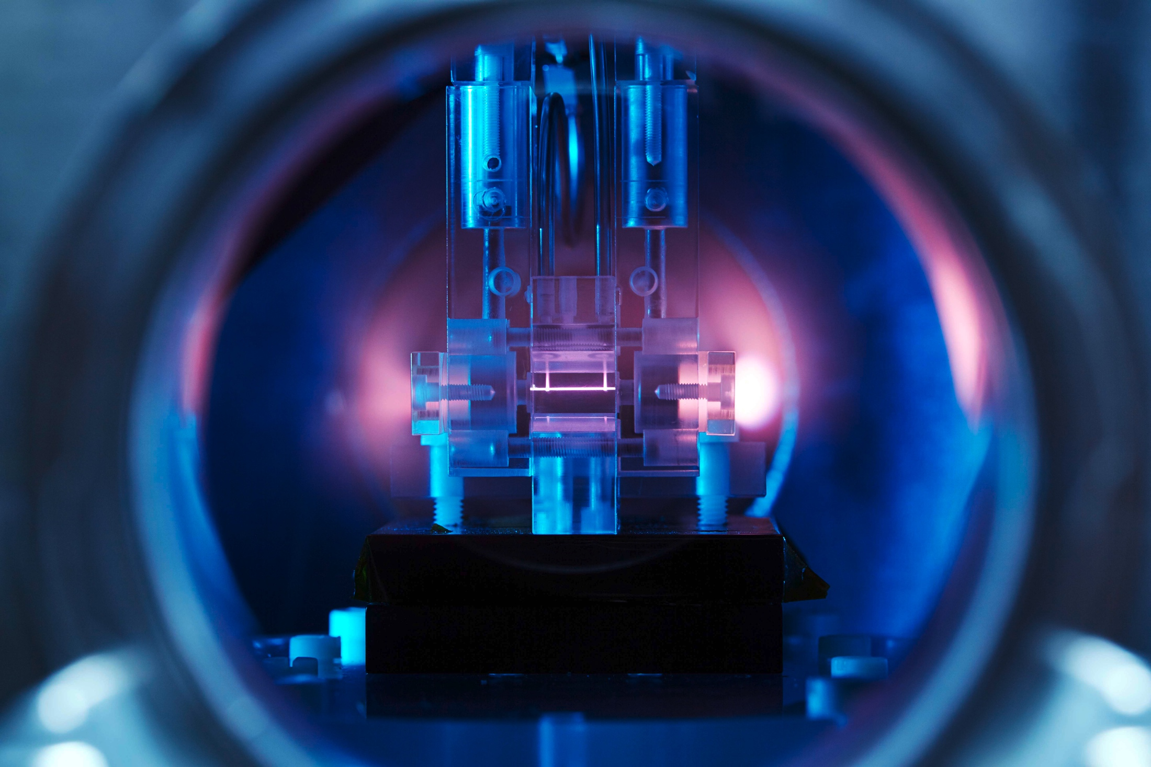
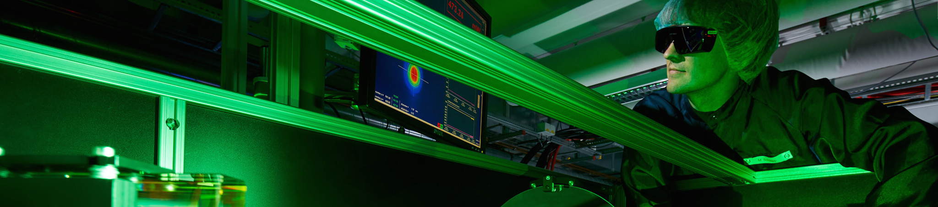



XUV Seeding at FLASH
Helmholtz Program: Matter & Technology (MT)
PoF III Topic: Accelerator Research & Development (ARD)
DESY Research Unit: ARD/ST3 "ps - fs Electron and Photon Beams"
Christoph Lechner
Center Evaluation DESY, 5 – 9 February 2018

Slide 2

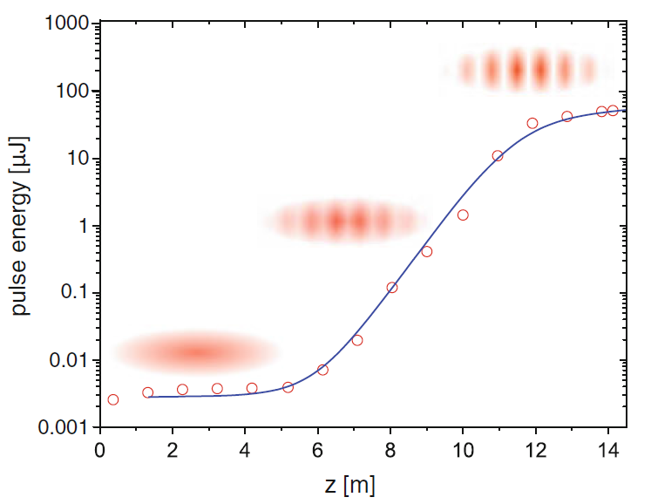
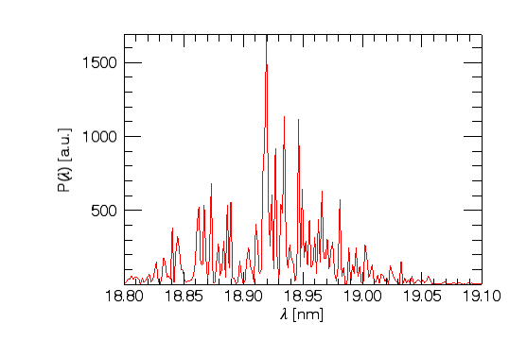
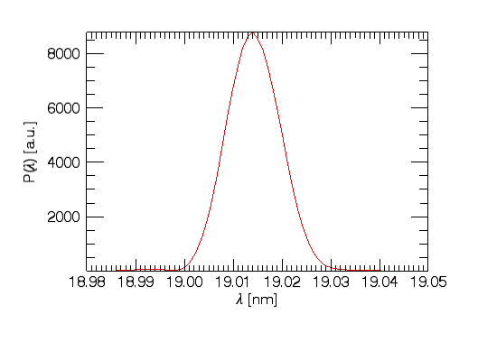

Introduction: Principle of the Free-Electron Laser
=> ultra-short photon pulses with GW-peak power
SASE operation
Stochastic start-up
Noisy spectrum
Seeded operation
FEL controlled by external, coherent light pulse
Seeding transforms the FEL into a fully coherent light source

Slide 3

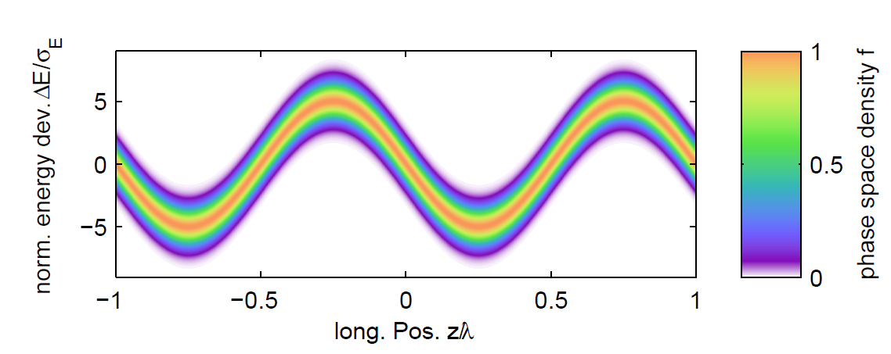
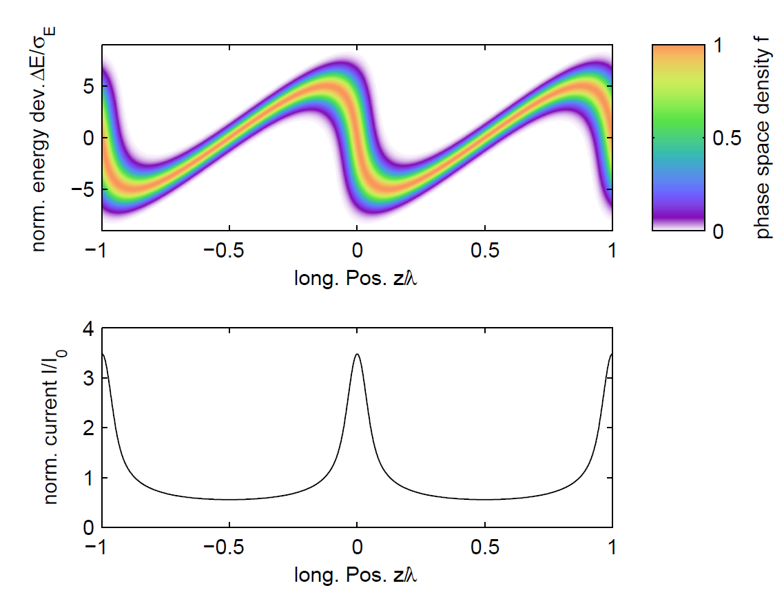

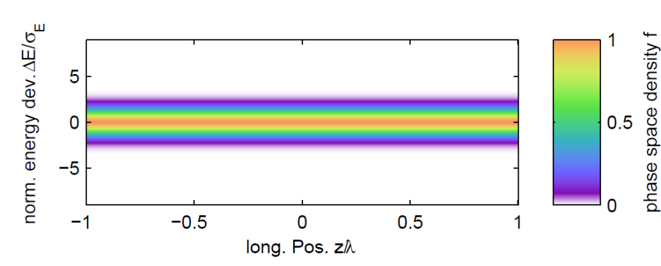
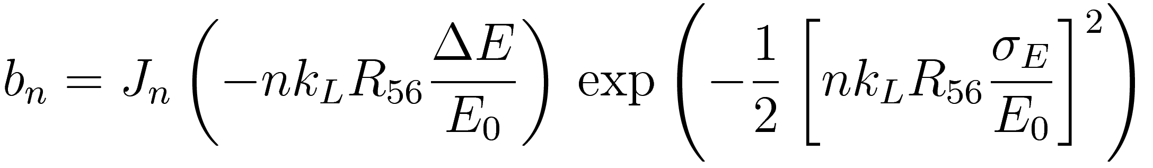
High-Gain Harmonic Generation (HGHG)
chicane
modulator
radiator
Bunching factor at harmonic n
Proposed in:
L.H. Yu, Phys. Rev. A 44, 5178 (1991)

Slide 4
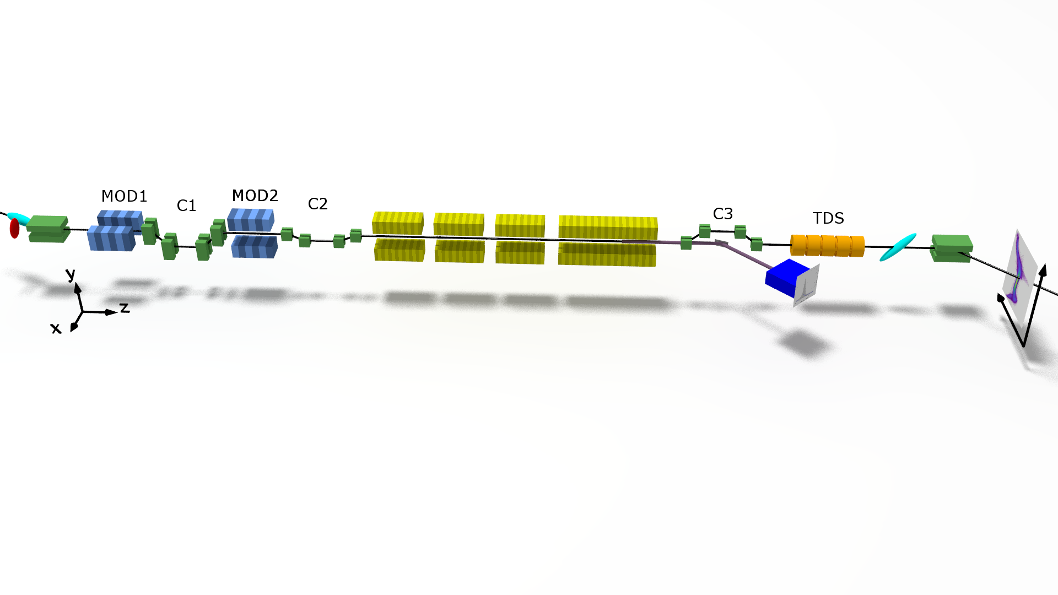
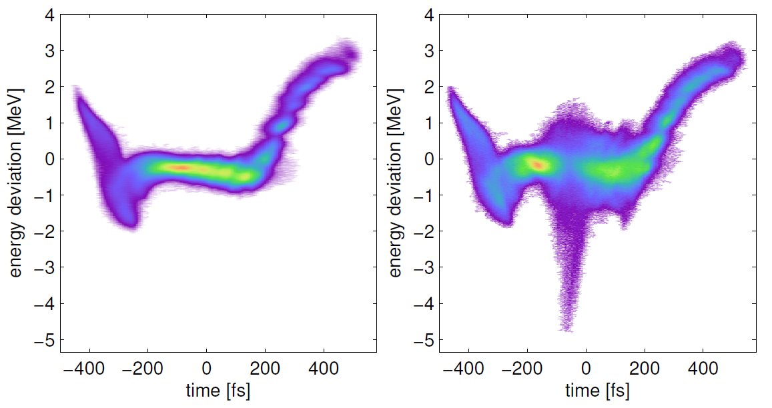
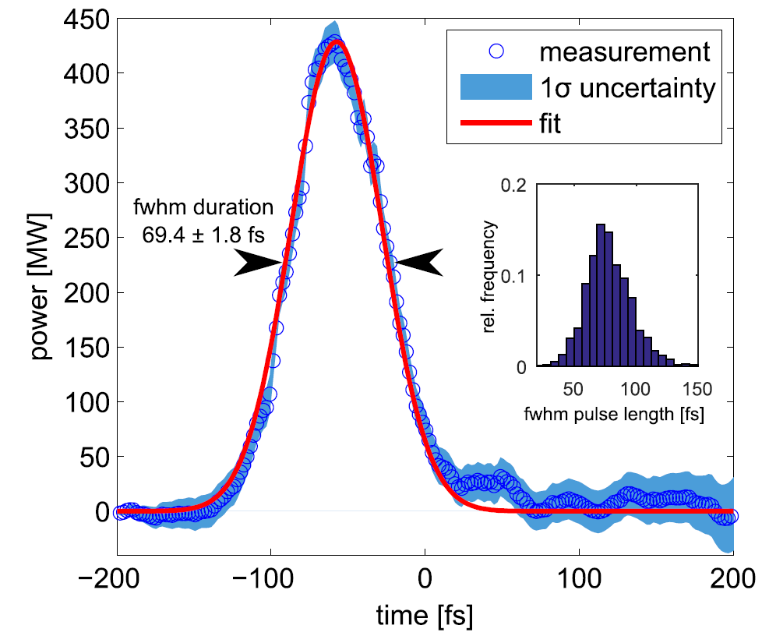
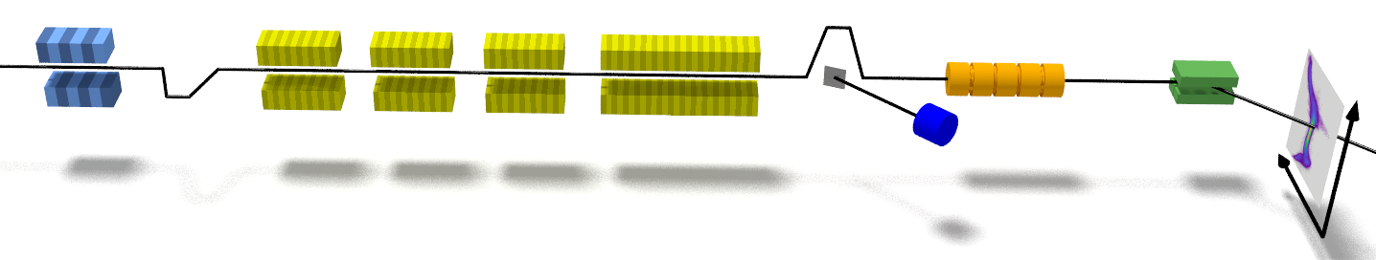
Generation and Analysis of Seeded FEL Pulses at sFLASH
Extraction from Electron Bunches with RF Deflector
seeded area
Electron beam energy | 685 MeV
Peak current | 0.62 kA
Seed laser wavelength | 267 nm
Demonstrated for SASE FELs at LCLS: C. Behrens, et al., Nat. Commun. 5, 4762 (2014)
modulator
radiator
TDS
First measurement at seeded FEL:
T. Plath, et al., Sci. Rep. 7, 2431 (2017)
chicane
sFLASH

Slide 5
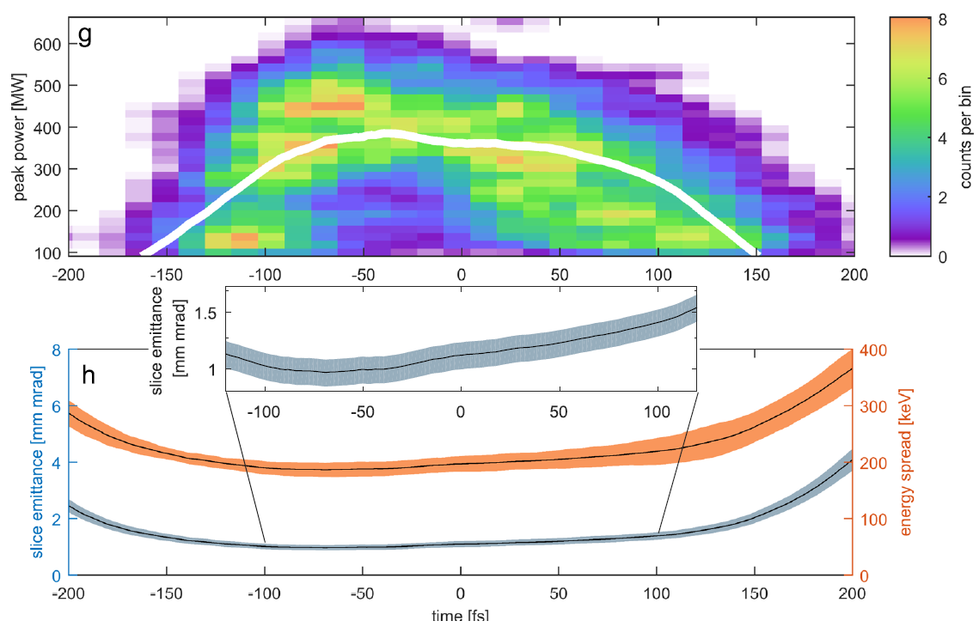
Generation and Analysis of Seeded FEL Pulses at sFLASH
Seed pulse is probe for local FEL performance
Extraction from Electron Bunches with RF Deflector
Measured emittance and current profiles and Ming Xie formalism very nicely model lasing in different regions of electron bunch
Unique hardware configuration (TDS setup at the exit of seeded FEL) enables detailed study of the seeded FEL
time [fs]
T. Plath, et al., Sci. Rep. 7, 2431 (2017)

Slide 6
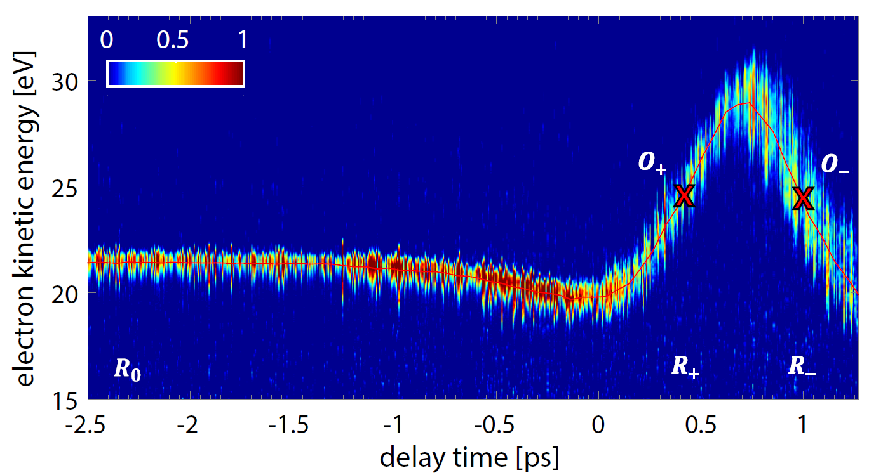
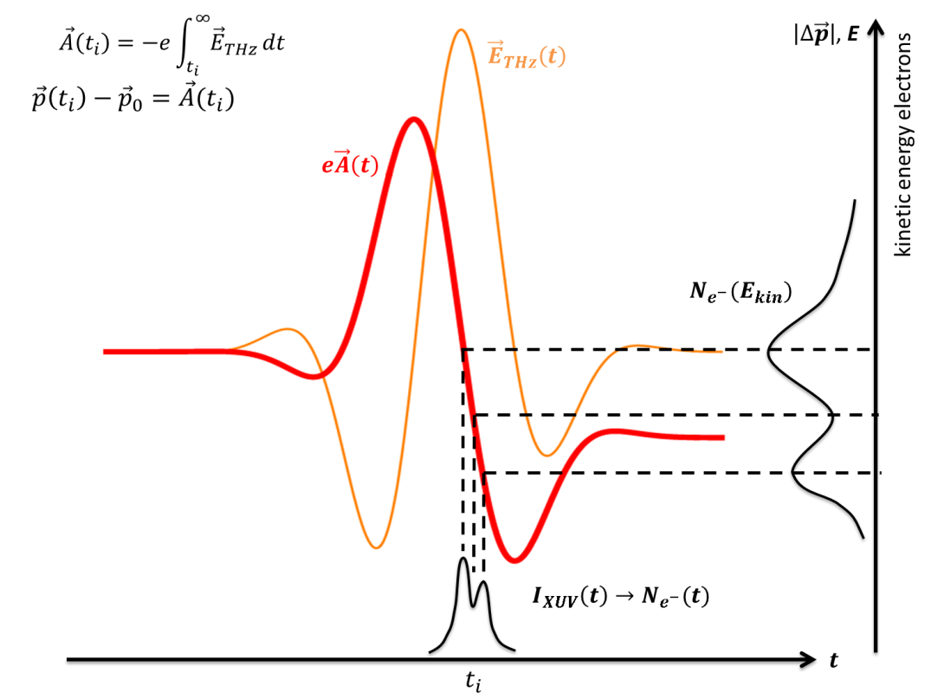
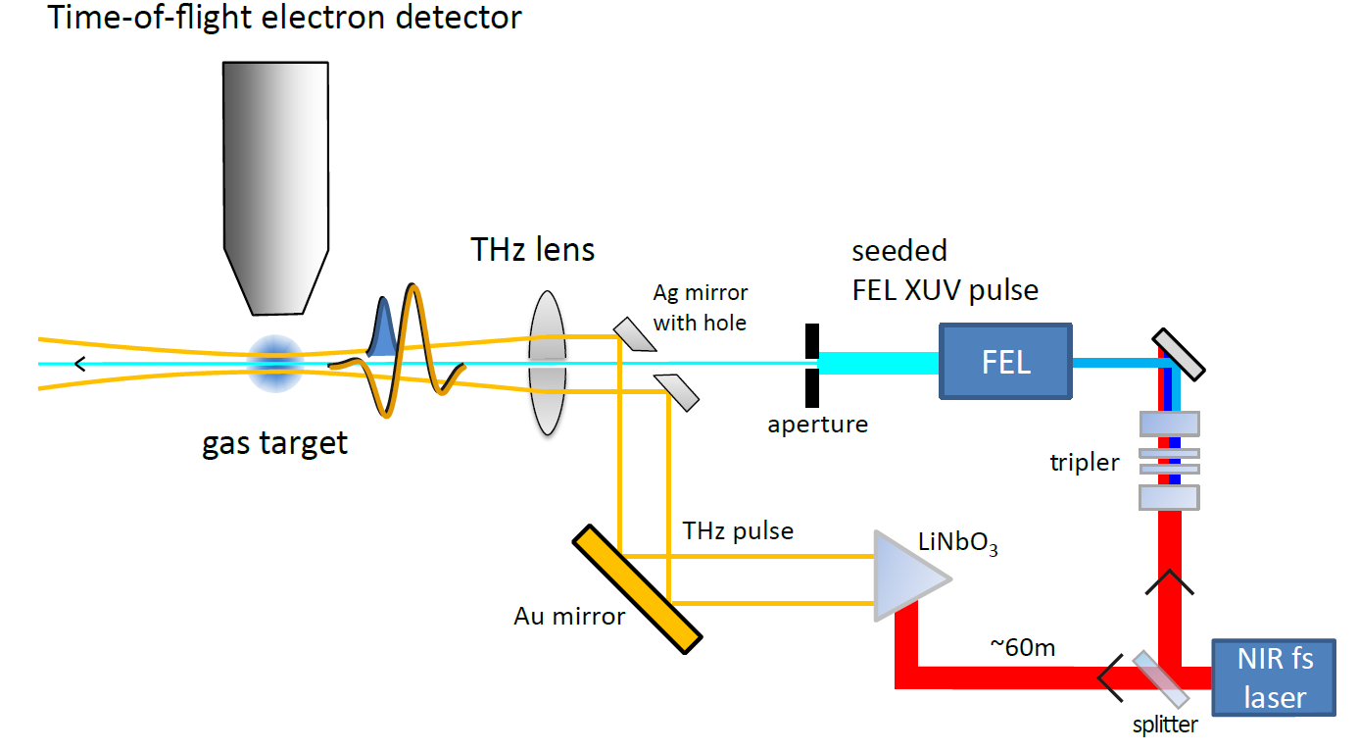
THz Streaking of Photon Pulses
Newly applied at DESY for seeded pulses
Time-of-flight electron detector
Combining measurements at both slopes gives access to
chirp
duration
of photon pulses
seed
source
THz
source
A. Azima, et al., New J. Phys. 20, 013010 (2018)

Slide 7
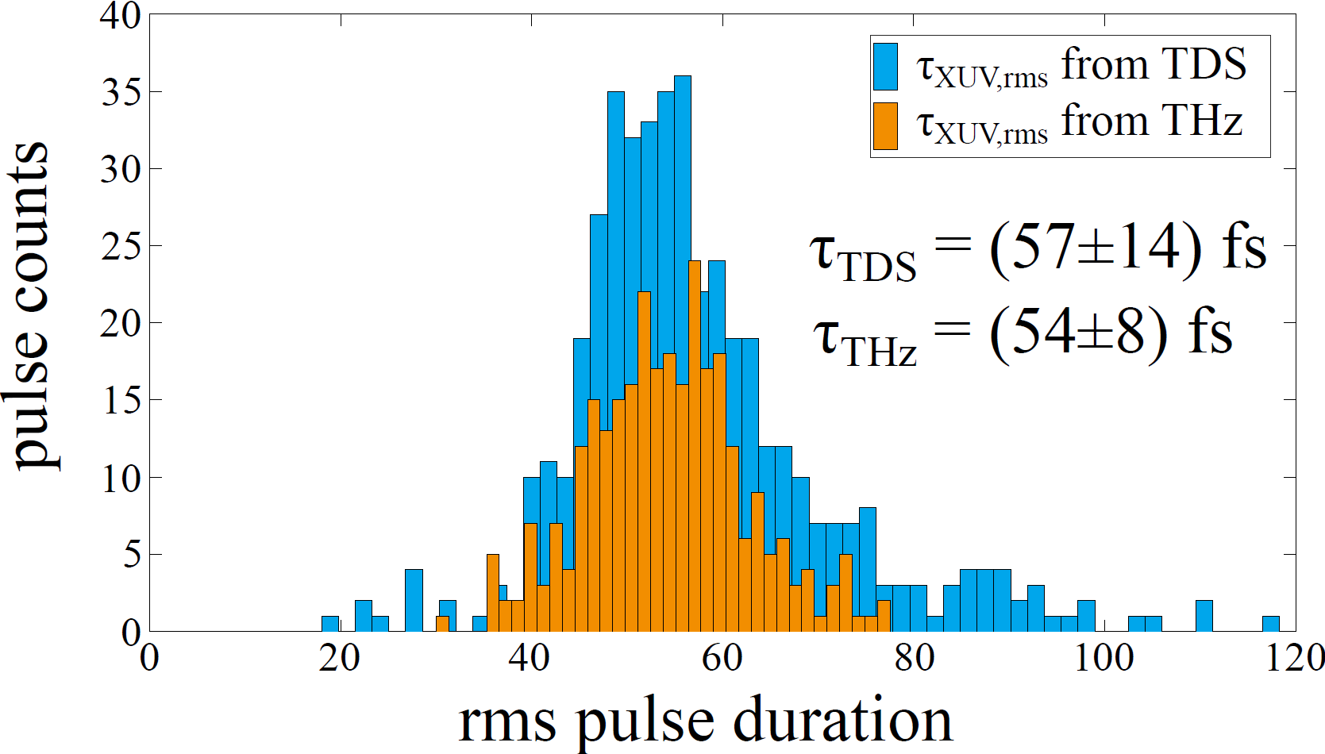
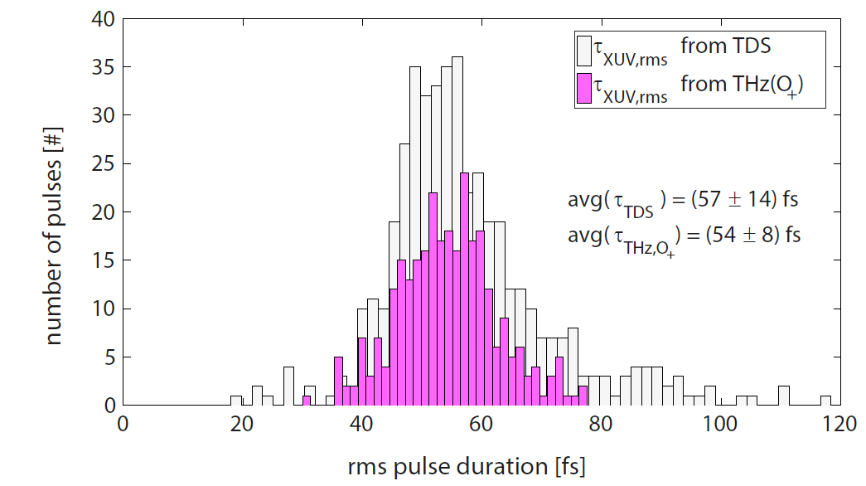
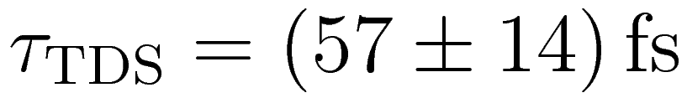
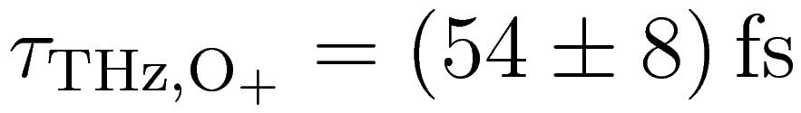
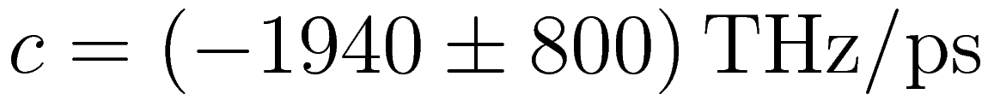
Bringing It Together
Comparison of the two characterization methods
TDS-based analysis:
Non-invasive
Access to envelope of FEL pulses
THz streaking:
Access to optical phase of FEL pulses
Chirp of seeded FEL pulses
c=(-1940±800) THz/ps
With THz streaking:
Access optical phase of FEL pulses
Chirp of seeded FEL pulses
A. Azima, et al., New J. Phys. 20, 013010 (2018)

Slide 8
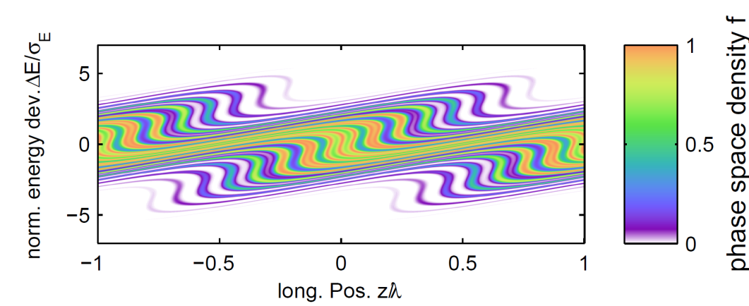
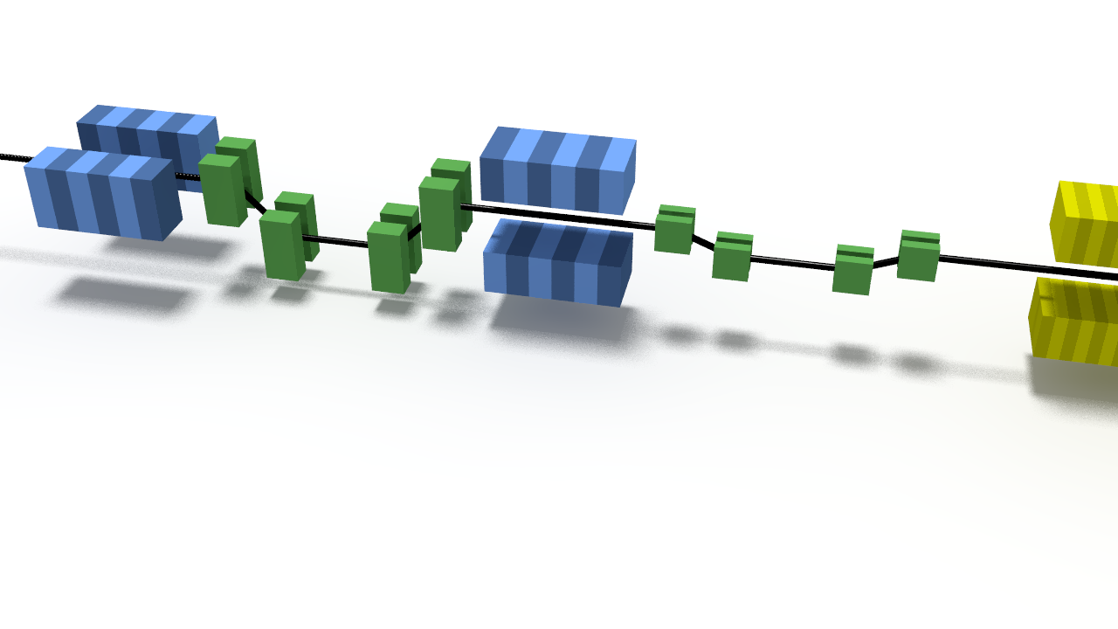
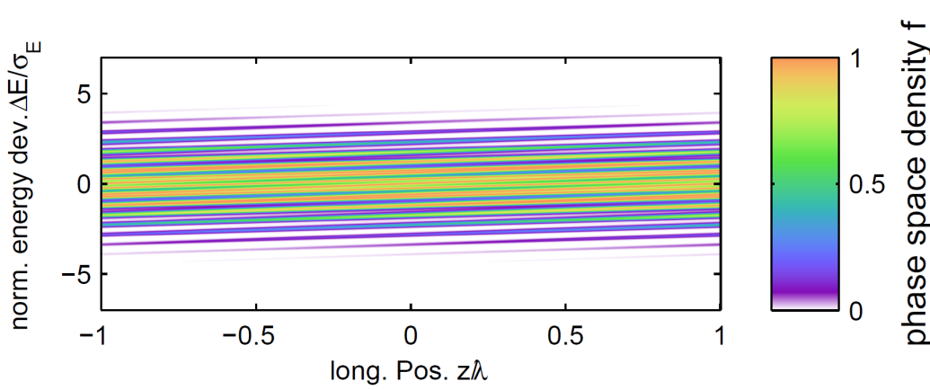
Outlook: Echo-Enabled Harmonic Generation
Echo-enabled harmonic generation (EEHG):
Seeding adds less energy spread to electron beam
Electron beam imperfections have smaller impact on generated photons
Promising candidate for seeding at significantly higher harmonics
G. Stupakov, Phys. Rev. Lett. 102, 074801 (2009)

Slide 9
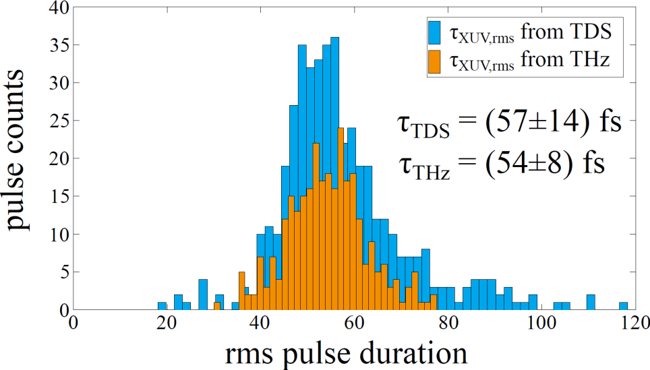
Summary
DESY is one of the photon science labs developing seeding in the last decade
sFLASH is a dedicated seeding test facility at FLASH
HGHG seeding was implemented to support first photon science experiments at sFLASH, therefore profiting both accelerator and photon science
Highlights include
  Direct-HHG seeding at 38nm (S. Ackermann, et al., Phys. Rev. Lett. 111, 114801 (2013)), shortest wavelength demonstrated so far with this technique
  HGHG seeding down to 11th harmonic (24.2 nm)
  World-wide first TDS measurements of seeded FEL process
  World-wide first THz streaking of seeded photon pulses: allows determining optical phase of FEL pulse, a critical information for frontier photon science
Next steps:
  Improved HGHG seeding for ARD and photon science experiments
  Study of an EEHG option for FLASH and its upgrades

Slide 10

Thank you for your Attention
Sven Ackermann*, Armin Azima, Jörn Bödewadt*, Hauke Biss, Martin Dohlus, Nagitha Ekanayake*, Vanessa Grattoni, Kirsten Hacker*, Mehdi Kazemi, Leslie L. Lazzarino, Christoph Lechner, Bastian Manschwetus, Theophilos Maltezopoulos*, Velizar Miltchev, Tim Plath, Andreas Przystawik, Yannik Ristau, Sergey Usenko, Mathias Vogt, Johann Zemella,
Ralph Assmann, Markus Drescher, Bart Faatz, Ingmar Hartl, Wolfgang Hillert, Shaukat Khan, Tim Laarmann, Jörg Rossbach, Wilfried Wurth
* former team member

Slide 11
Additional Slides

Slide 12
Spectral Properties of FEL Radiation
SASE FEL
Start-up from shot-noise
Bunch length exceeds several cooperation lengths
Multiple modes are present, noisy spectrum
fraction of electron bunch coherently radiating
With Seeding
Coherent signal over a longer distance
Spectrum is only a single Gaussian mode

Slide 13

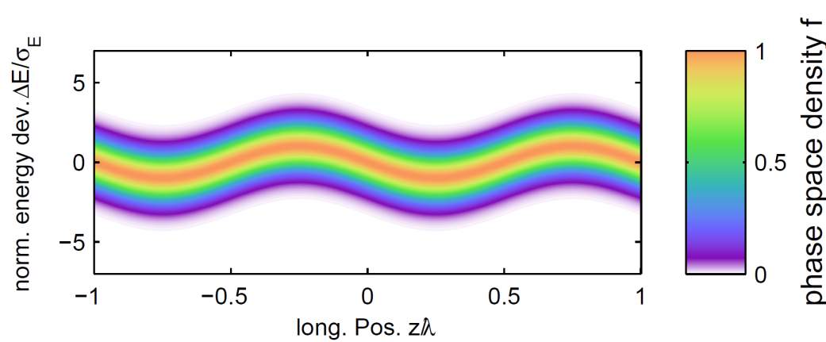
Outlook: Investigation of EEHG Seeding
Modulator 2
Chicane 1
Chicane 2
Modulator 1
G. Stupakov, PRL 102, 074801 (2009)
XUV Seeding at FLASH | Christoph Lechner |

Slide 14
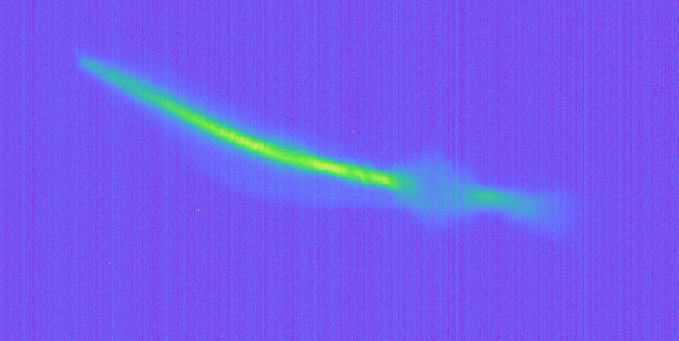
Seed S1
PRELIMINARY

Slide 15
Outlook: Investigation of EEHG Seeding
Modulator 2
Chicane 1
Chicane 2
Modulator 1
G. Stupakov, PRL 102, 074801 (2009)
XUV Seeding at FLASH | Christoph Lechner |

Slide 16
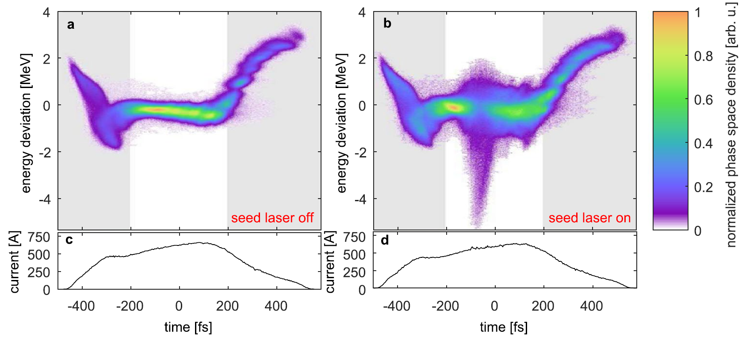
Time-Resolved Characterization of Photon Pulses
Extraction from Electron Bunches with RF-Deflector
T. Plath, et al., Scientific Reports 7, 2431 (2017)
sFLASH

Slide 17
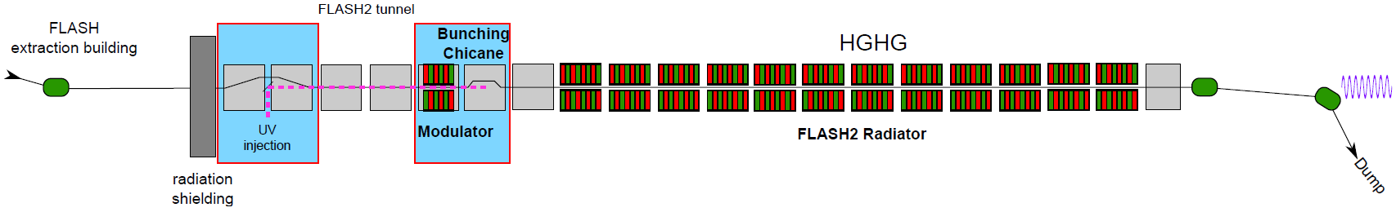
Conceptual Design for Seeding at FLASH2
already existing FLASH2 undulator
Rebuild currently unused beamline section
Step-by-step implementation proposed:
  Phase 1A: 10Hz single-pulse HGHG seeding
  Phase 1B: 100kHz “burst mode” HGHG seeding
  Phase 2: “Echo-enabled harmonic generation” (EEHG) seeding
HGHG seeding at h=14 (approx. 19 nm) with 1-GeV electron beam
With “harmonic afterburner” seeded operation at 50 nm – 10 nm
FEL peak powers exceeding 1 GW

Slide 18
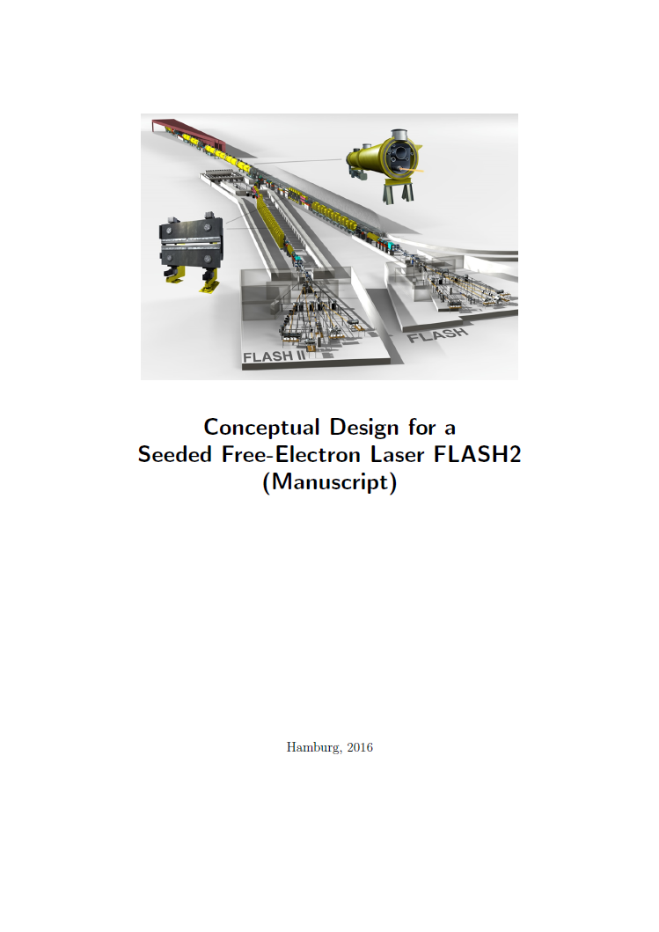
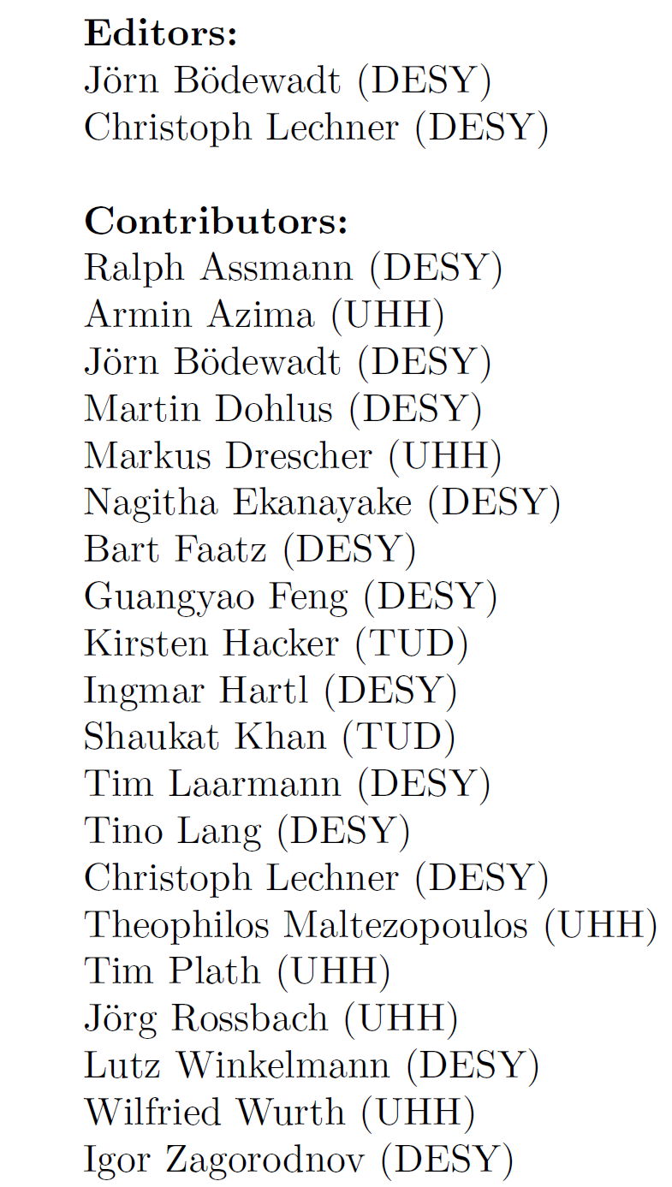
Conceptual Design for Seeding at FLASH2

