Slide 1

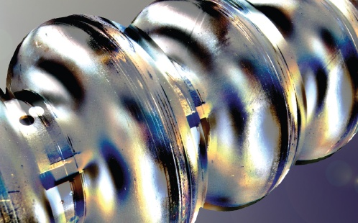
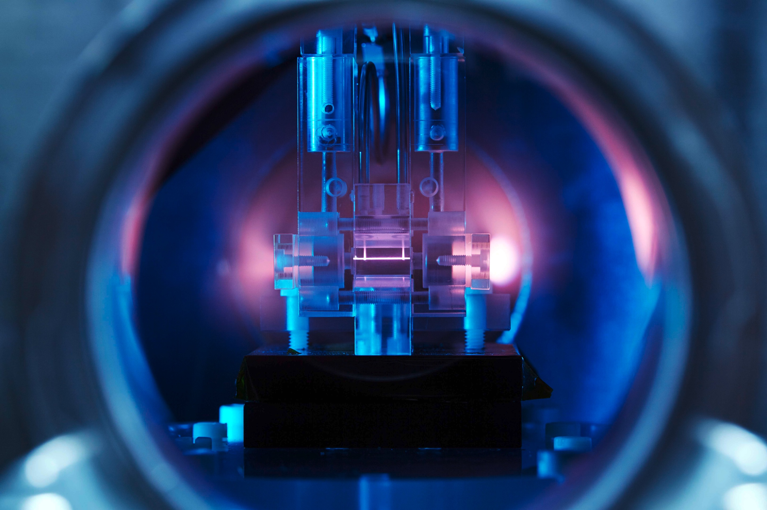
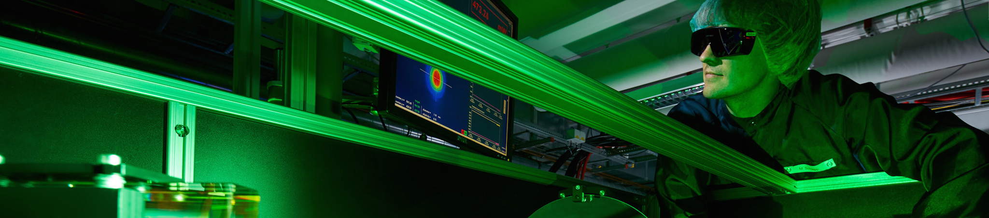
Sub-femtosecond Injector Design and
X-Band TDS
Helmholtz Program: Matter & Technology (MT)
PoF III Topic: Accelerator Research & Development (ARD)
DESY Research Unit: MPY1
Dr Barbara Marchetti
Center Evaluation DESY, 5 – 9 February 2018

Slide 2
Outline
SINBAD-ARES Photo-Injector
X-band TDS Project

Slide 3
Outline
ARD Team MPY-1 in DESY-M:
R. Assmann, U. Dorda, J. Zhu, D. Marx, G. Vashchenko, T. Vinatier, F. Burkart, Y. Sumera, P.A. Walker, F. Lemery
and R. Brinkmann, K. Floettmann, W. Hillert
Essential support of DESY technical groups
SINBAD-ARES Photo-Injector
Production of sub-fs e-bunches with conventional RF technology
X-band TDS Project

Slide 4

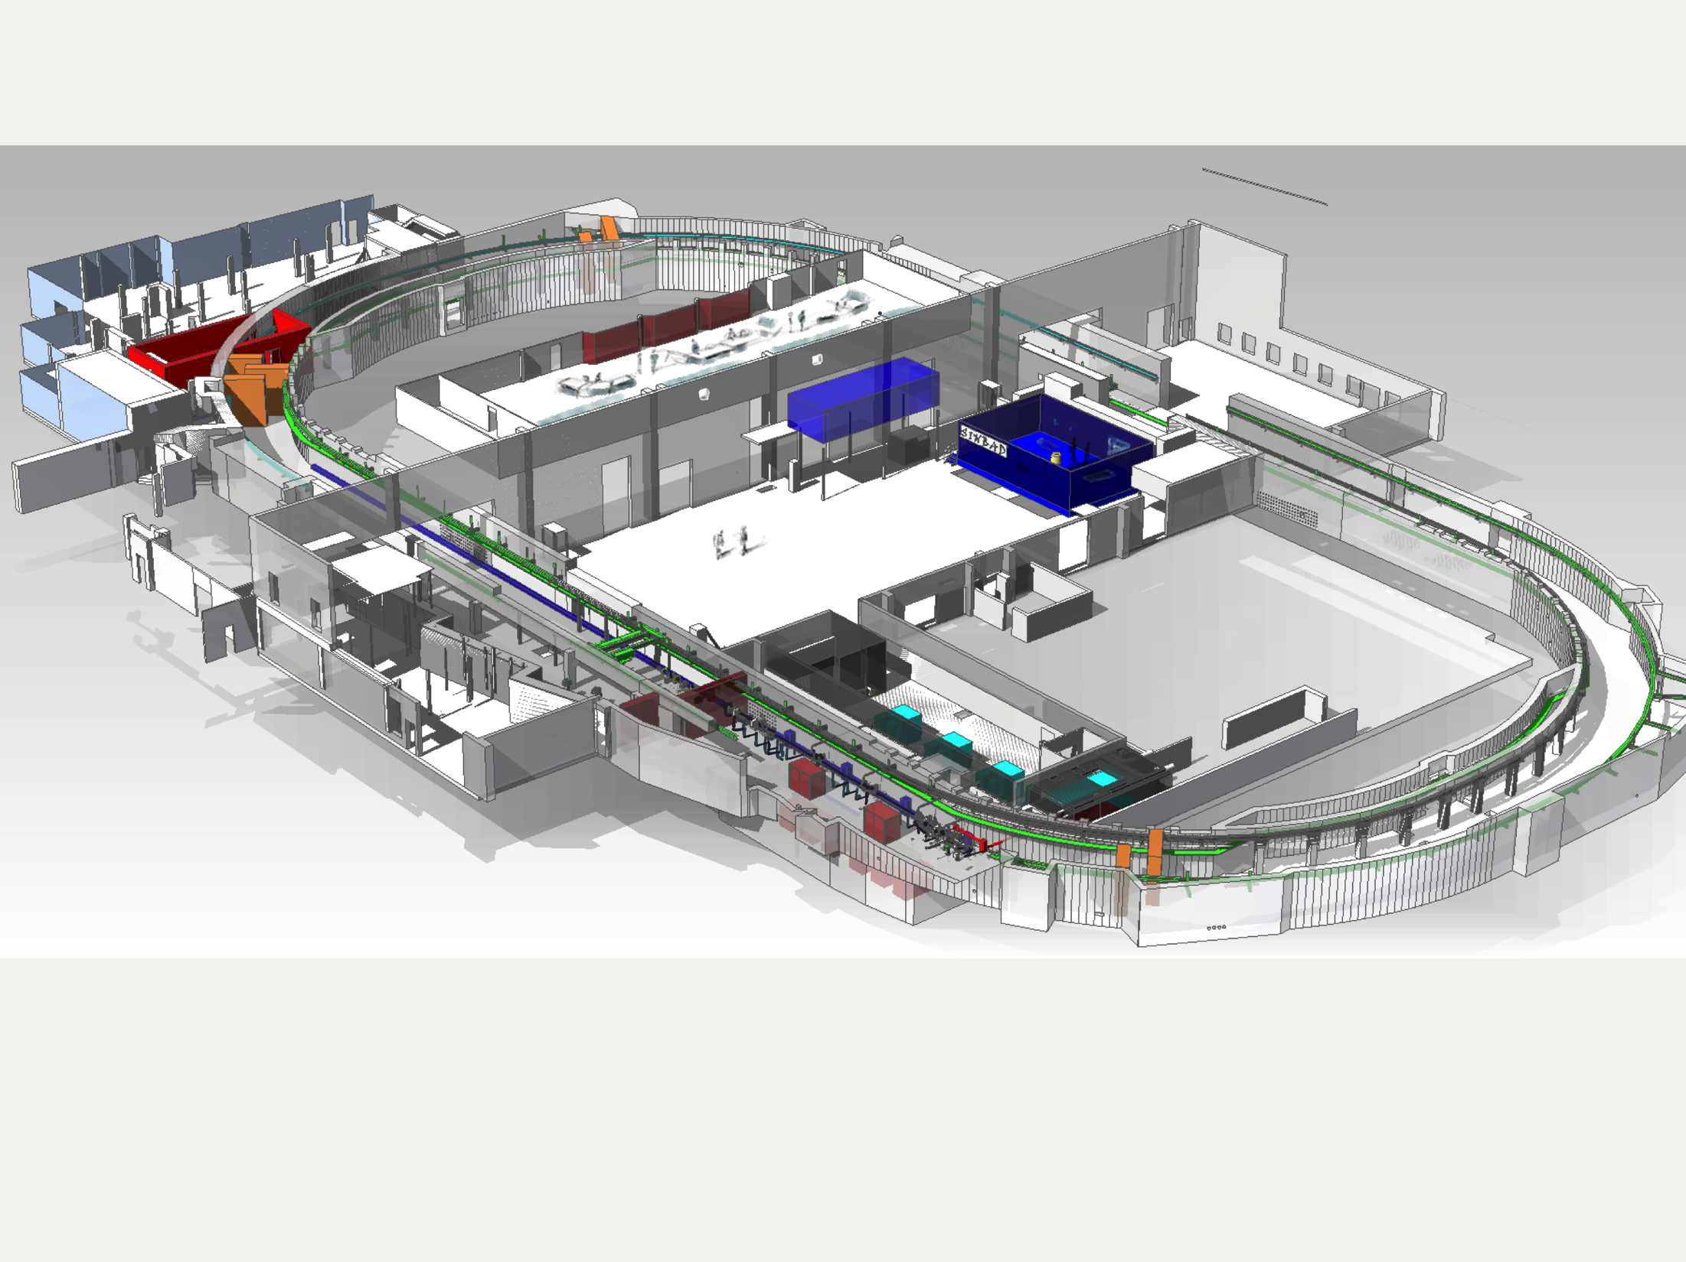
SINBAD-ARES photo-injector
ARES = Accelerator Research Experiment at Sinbad
PL: U. Dorda. LS: R. Assmann
Photo-injector goal:
Production of high brightness fs long e-bunches for injection into novel compact high gradient accelerators (LWFA, DLA, THz driven accelerators etc.)
ARES linac

Slide 5
SINBAD-ARES photo-injector
ARES = Accelerator Research Experiment at Sinbad
PL: U. Dorda. LS: R. Assmann
Photo-injector goal:
Production of high brightness fs long e-bunches for injection into novel compact high gradient accelerators (LWFA, DLA, THz driven accelerators etc.)
Photo-injector parameters:
  2.998 GHz normal conducting linac
  10-50 Hz rep. rate, single bunch mode
  Energy: 100 MeV (compressed beam)
  Typical final bunch charge : 0.5-30 pC
  Typical final bunch length : sub-fs to few fs
  Arrival time jitter < 10fs RMS
  Normalized transverse emittance < 0.5mm*mrad
ARES linac

Slide 6
SINBAD-ARES photo-injector
ARES = Accelerator Research Experiment at Sinbad
Why a “conventional” photo-injector for studying novel accelerators?

Slide 7
SINBAD-ARES photo-injector
ARES = Accelerator Research Experiment at Sinbad
Why a “conventional” photo-injector for studying novel accelerators?
Conventional RF technology allows to produce a stable and reproducible e-bunch

Slide 8
SINBAD-ARES photo-injector
ARES = Accelerator Research Experiment at Sinbad
Why a “conventional” photo-injector for studying novel accelerators?
Conventional RF technology allows to produce a stable and reproducible e-bunch
The quality of the acceleration in novel accelerators depends on the quality of the injected beam (e.g. bunch length, emittance, arrival time stability, energy) → flexible widely tunable Working Points

Slide 9
SINBAD-ARES photo-injector
ARES = Accelerator Research Experiment at Sinbad
Why a “conventional” photo-injector for studying novel accelerators?
Conventional RF technology allows to produce a stable and reproducible e-bunch
The quality of the acceleration in novel accelerators depends on the quality of the injected beam (e.g. bunch length, emittance, arrival time stability, energy) → flexible widely tunable Working Points
Well known beam dynamics codes have not yet been benchmarked with experiments in this special beam parameter range → extending our understanding of beam dynamics

Slide 10
SINBAD-ARES photo-injector
ARES = Accelerator Research Experiment at Sinbad
Why a “conventional” photo-injector for studying novel accelerators?
Conventional RF technology allows to produce a stable and reproducible e-bunch
The quality of the acceleration in novel accelerators depends on the quality of the injected beam (e.g. bunch length, emittance, arrival time stability, energy) → flexible widely tunable Working Points
Well known beam dynamics codes have not yet been benchmarked with experiments in this special beam parameter range → extending our understanding of beam dynamics
Characterization of ultra-short (~fs), low charge (~sub-pC) bunches is challenging → test novel diagnostics devices → see also second part of this talk.

Slide 11
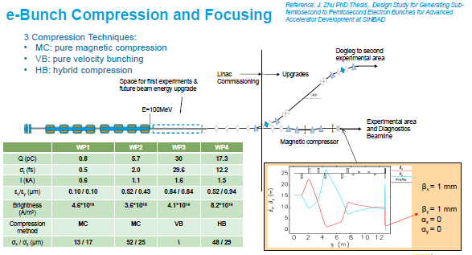
Technical Highlights
The conceptual design of the accelerator has been completed.

Slide 12
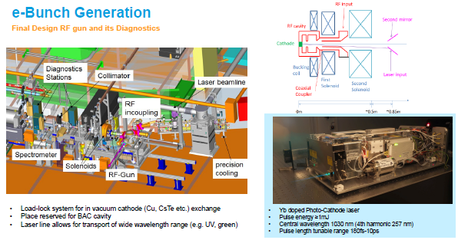
Technical Highlights
The conceptual design of the accelerator has been completed.
The technical design of the accelerator and its procurement is ongoing. It will proceed in stages.

Slide 13
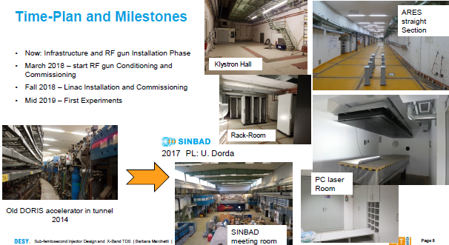
Technical Highlights
The conceptual design of the accelerator has been completed.
The technical design of the accelerator and its procurement is ongoing. It will proceed in stages.
Infrastructure ready.
RF gun installation ongoing.
Commissioning foreseen to start soon this year.

Slide 14
Outline
SINBAD-ARES Photo-Injector
Joint Project involving different teams from DESY:
FLASHForward
FLASH2
SINBAD
possibly XFEL
+ external collaboration with CERN and PSI
Essential support of DESY technical groups
X-band Transverse Deflectance Structure (TDS) Project
Longitudinal Diagnostics for
ultra-short e-bunches

Slide 15
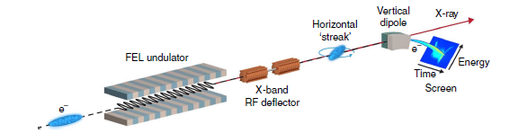
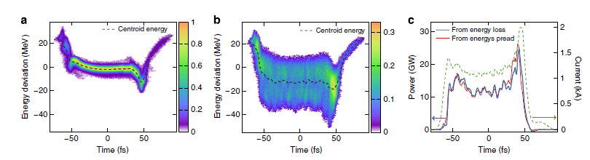
Measuring e-Bunches with sub-fs Resolution
State of the Art of X-Band TDS Systems
Measurement of the energy spread induced by the FEL process at SLAC
Achieved temporal Resolution < 1fs for soft X-rays
C. Behrens et al., „Few-femtosecond time-resolved measurements of X-ray free electron laser“ , Nat. Comm. 4762 (2014).

Slide 16
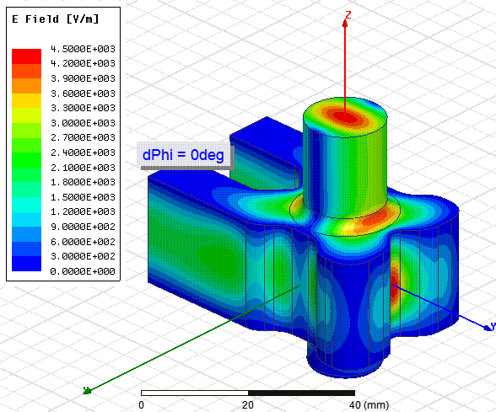
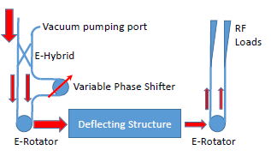
Novel X-band TDS Concept with Variable Polarization
Phase difference between port 1 and port 2:
0 degree -> vertically streaking field
180 degree -> horizontally streaking field
Variable Polarization Circular TE11 Mode Launcher
A. Grudiev, CLIC-note-1067 (2016)
Very precise azimuthal symmetry in manufacturing required!

Slide 17
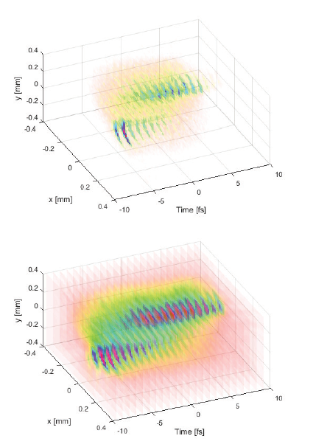
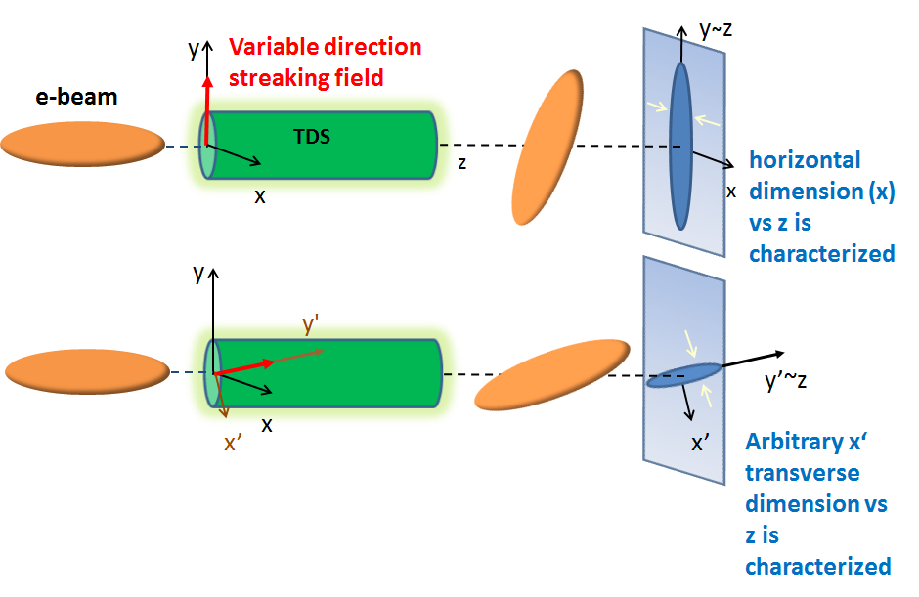
Novel Applications in Beam Diagnostics
Example of beam reconstruction
(simulation) for the ARES linac
3D Charge Distribution Reconstruction in the Real Space
Real beam at the screen
(TDS off)
Reconstructed beam at the screen
Exciting new opportunities for e-bunch characterization e.g.:
slice emittance measurement on different planes
3D charge reconstruction
efforts towards 6D beam phase space reconstruction
Reference: D Marx et al 2017 J. Phys.: Conf. Ser. 874 012077

Slide 18


Collaboration DESY-CERN-PSI
Goal: build and test the first prototype
Status of the Project:
Collaboration Agreement under Signature by Directorates of the three Parties
Common Mechanical Design of the Structure fulfilling the requirements of many experiments:
  FLASHForward, FLASHII, SINBAD at DESY. XFEL observer of the project.
  ATHOS beamline at SwissFEL
The cavities are realized using PSI tuning free assembly procedure
First Review Meeting (October 2017) about Tolerances Evaluation gave positive feedback
Test of the prototype cavity with beam at DESY (FLASHForward beamline)
If the test of the prototype is successful, six other cavities will be produced for the experiments
Reference: “X-Band TDS Project”, MOPAB044, Proc. IPAC 2017

Slide 19
Summary and Conclusion
The ARES linac at SINBAD has been designed to produce ideal ultra-short high brightness bunches to
  Test and fully characterize novel acceleration techniques aiming for stable and reproducible acceleration;
  Perform beam dynamics studies and R&D on novel beam diagnostics.
  The installation of the RF gun is ongoing and its commissioning will follow soon this year.
The X-band TDS Project is an example of R&D project in the direction of novel diagnostics techniques
  A novel TDS design with possibility of changing the streaking direction of the field is being realized thanks to a collaboration with CERN and PSI
  Studies on applications of the novel feature of the cavity for e.g. allowing 3D charge reconstruction of an electron bunch have been performed and DESY will provide the infrastructure for testing the prototype cavity with e-beam.
Thank you for your attention.

