Slide 1

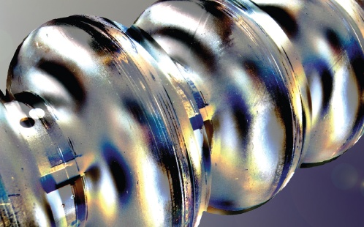
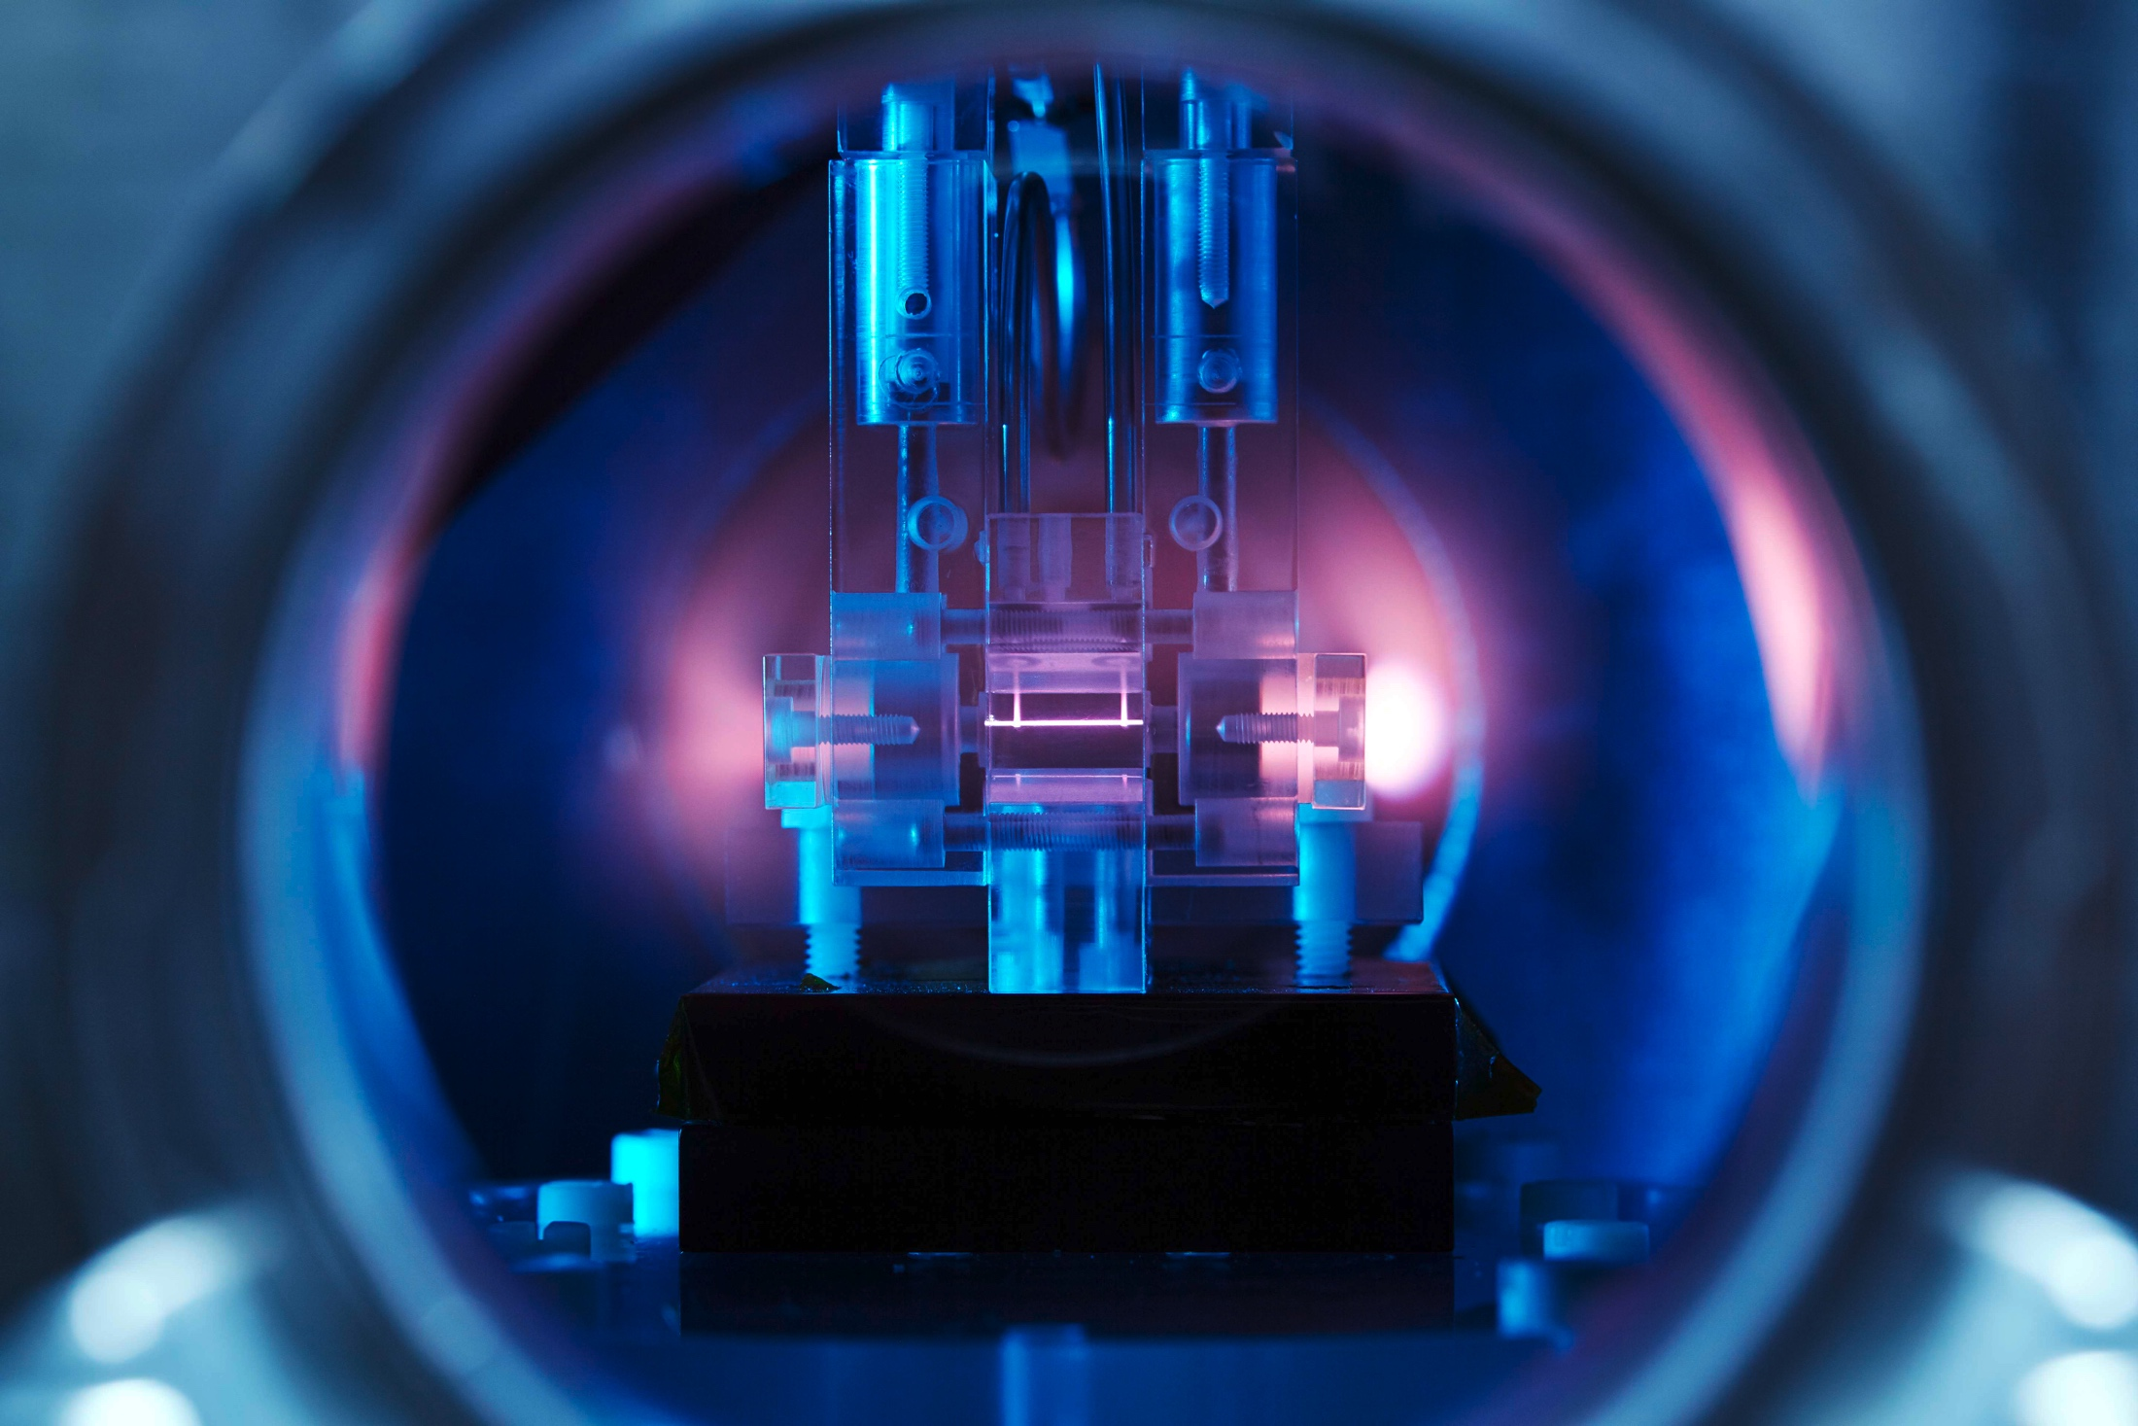
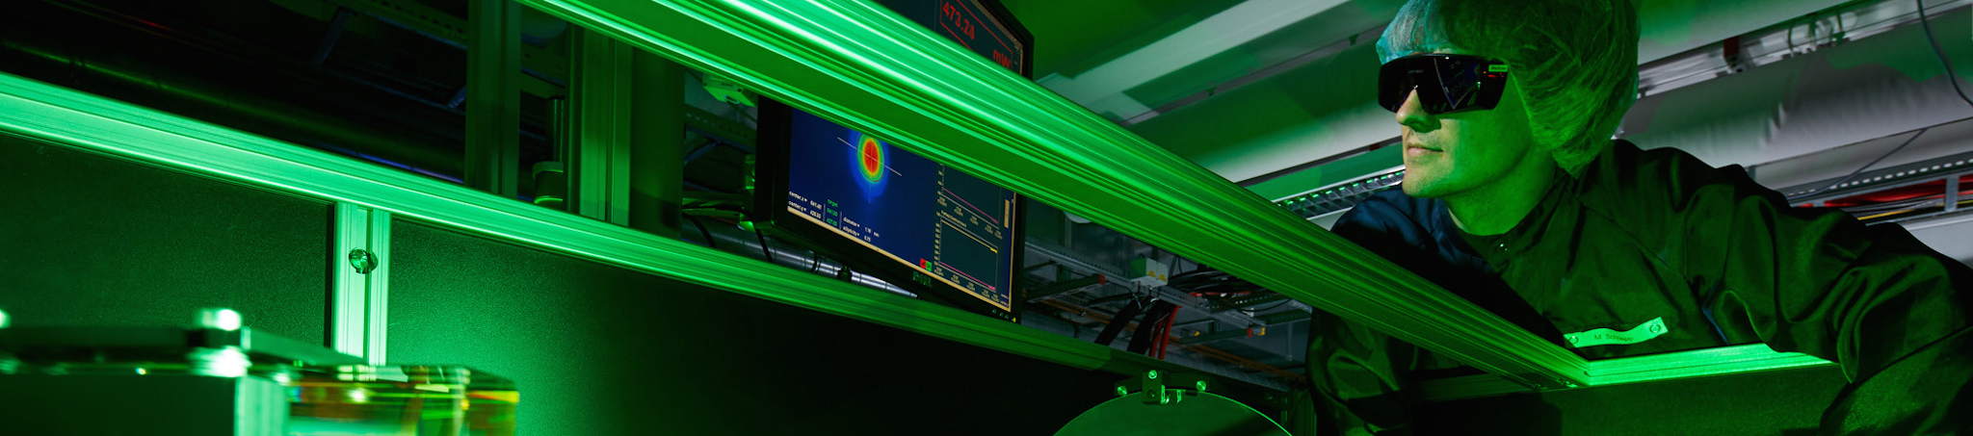
Ultra-short bunches at FLASH
Helmholtz Program: Matter & Technology (MT)
PoF III Topic: Accelerator Research & Development (ARD)
DESY Research Unit: Accelerator Research & Development (ARD, ST3)
Juliane Rönsch-Schulenburg, Siegfried Schreiber
Center Evaluation DESY, 5 – 9 February 2018

Slide 2
Introduction
User frequently asks for short FEL pulses
Reducing the length of the electron bunch reduces the length of the SASE-FEL pulse
Drive this reduction of FEL pulse length to its limits, which is a so-called single-spike

Slide 3
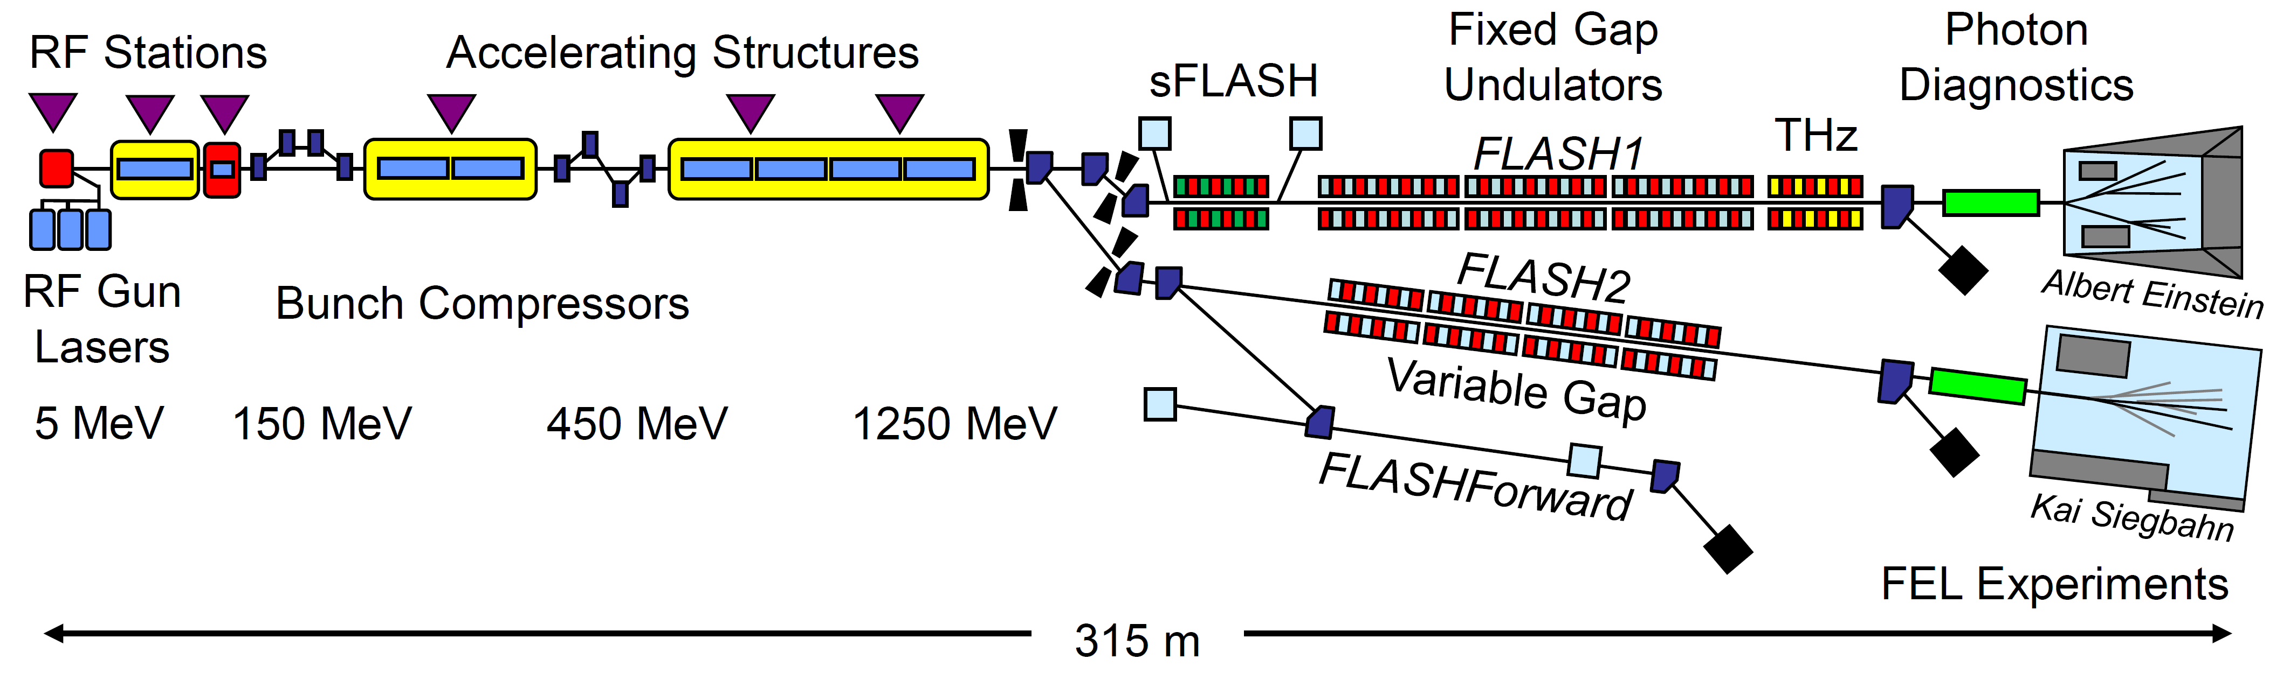
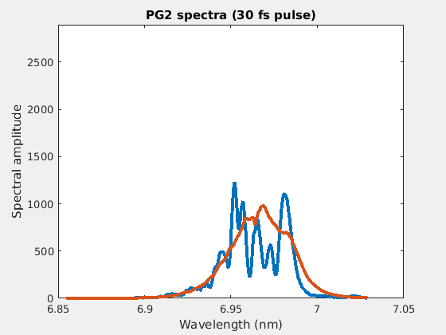
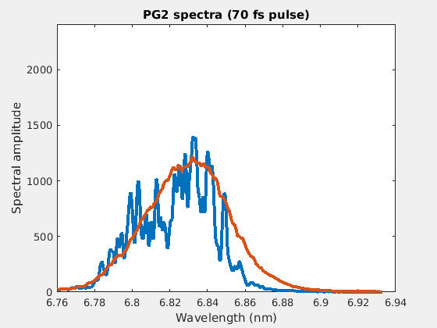

FLASH
(~ 100-120 fs pulses)
Compression Factor C
C ≈ 32-65
(~ 40 fs pulses)
130 - 220
2000
6500 fs
≈ 100-200 fs
Q ≈ 1000 pC
250-150 pC
15 pC
→ 30 - 50 fs
Space charge forces require to reduce the charge
RF tolerances limit possible compression
→ 3 fs
The minimum radiation pulse duration :
$$τ (\text{FWHM}) = \frac{{M λ}_{r} L_{sat}(λ_{r}, γ)}{5 c λ_{u}}$$

Slide 4
Short bunches at FLASH
Compression Factor C
C ≈ 70
Streak camera measurement of injector laser
130 - 220
2000
6500 fs
≈ 100-200 fs
Q ≈ 1000 pC
250-150 pC
15 pC
→ 30 - 50 fs
Space charge forces require to reduce the charge
RF tolerances limit possible compression
→ 3 fs
C ≈ 50 → 330
1000 fs
30 fs → 3 fs
Q ≈ 100 pC → 15 pC

Slide 5
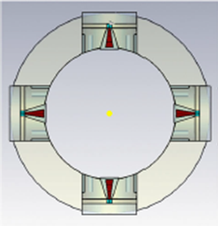
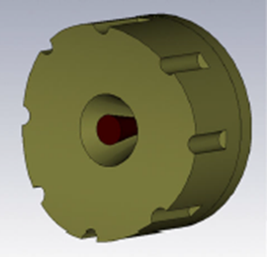
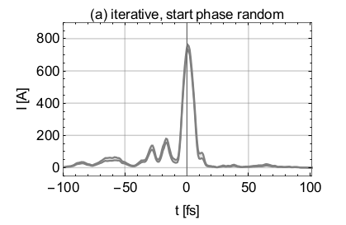
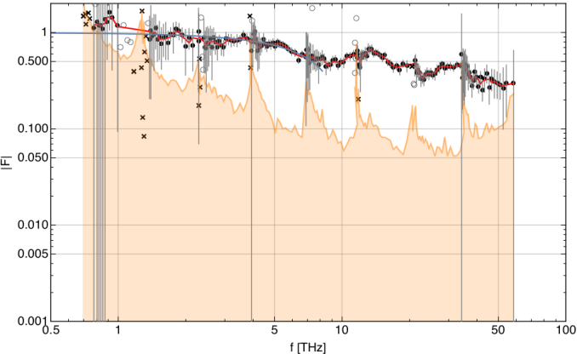
Ultra-short bunches at FLASH
In 2010, when short pulse studies started, FLASH was typically operating in a charge regime from 0.5 nC to 2 nC
Requirements
  Beam diagnostics for low charge and short bunch operation
  Especially important: beam-arrival time, bunch length
  Precision controls of RF accelerator tolerances & femtosecond synchronization
Proof of principle experiment has been performed in 2014
Benefit for general accelerator research
  beam-arrival time monitor (BAM) prototypes are used also at XFEL in a modified version
  Development of IR-spectrometer for measurement of a few fs pulses together with FLASHForward
7+/-1 fs (FWHM)
→ ~3 fs (rms)

Slide 6
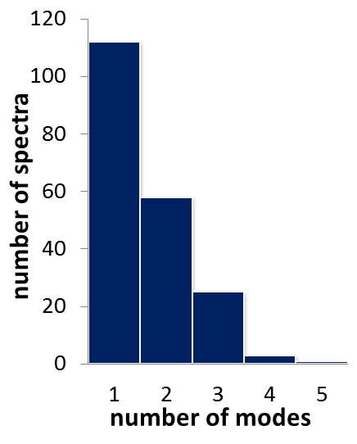
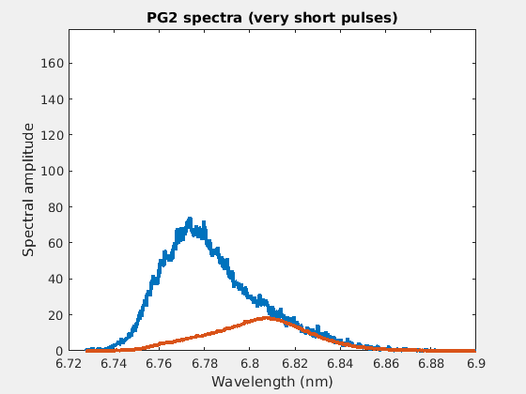
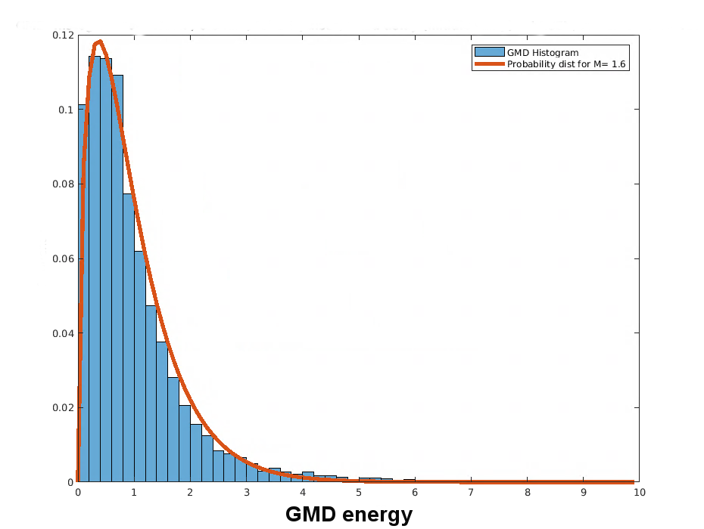
Single-spike operation
>50% of the shot were pure single spikes
For 6.8 nm XUV radiation at FLASH1
(2016)
M = 1.6
M = 1.6
frequency
GMD energy

Slide 7
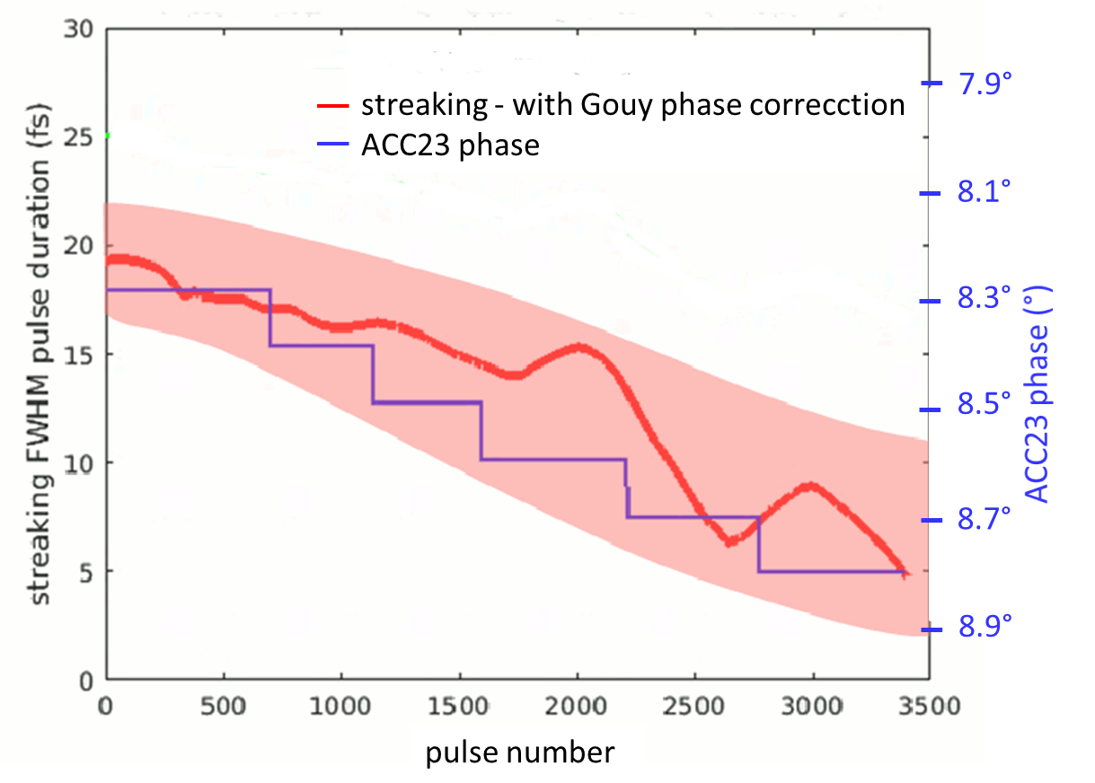
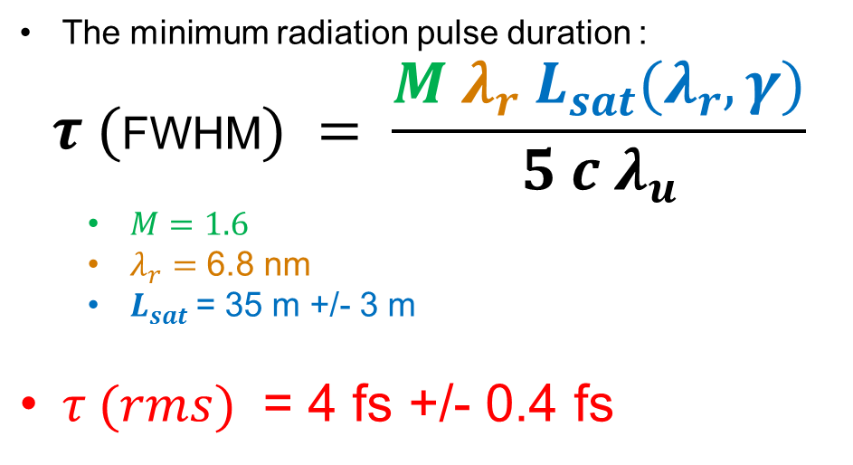
Ultra-short pulses
For 6.8 nm XUV radiation at FLASH1
The minimum radiation pulse duration :
$$τ (\text{FWHM}) = \frac{{M λ}_{r} L_{sat}(λ_{r}, γ)}{5 c λ_{u}}$$
  $M=1.6$
  $λ_{r}=$ 6.8 nm
  $L_{sat}$= 35 m +/- 3 m
$τ (rms)$ = 4 fs +/- 0.4 fs
115
Bunch Compression factor
~ 3 fs +/- 1.7 fs (rms)
180
M = 1.6

Slide 8
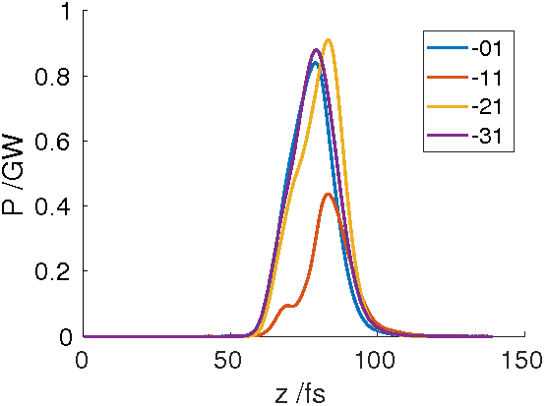
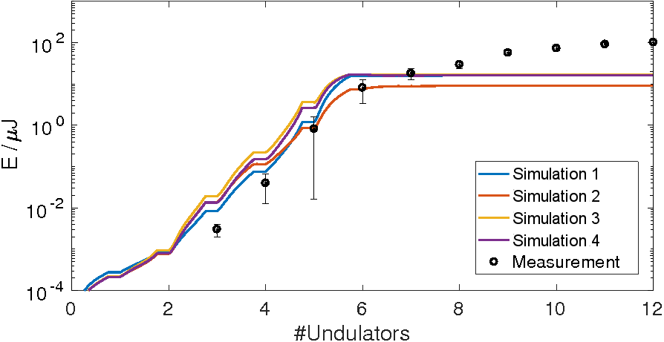
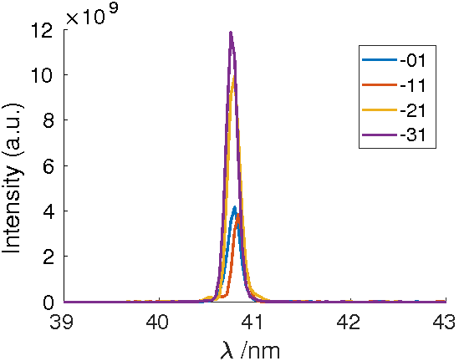
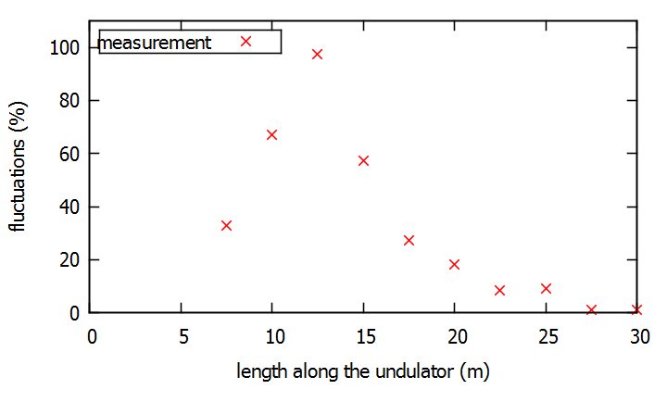
FLASH2: single-spike
For 41 nm XUV radiation at FLASH2
Time (fs)
number of undulators
Results:
maximum fluctuation: 97%
→ number of modes: 1.05
FEL pulse duration: 6 fs (rms)
Wavelength (nm)

Slide 9
Summary
The ultra-short pulse studies started in 2010
Proof-of-principle experiment successfully finished in 2014
Ultra-short pulses with single-spikes could be produced in FLASH1 & FLASH2
  FLASH1: pulse duration: 3 fs +/- 1.7 fs (rms), 1.6 modes in average @ 7nm
  FLASH2: pulse duration: 6 fs (rms), 1.05 modes in average @ 41nm
Most diagnostics have already been upgraded to low charge operation
Upgraded beam-arrival time monitors (BAM) will be installed this summer
Ultra-short pulses available for users operation since end of 2016
  Thus the ARD topic has been transformed into MML topic

