Slide 1
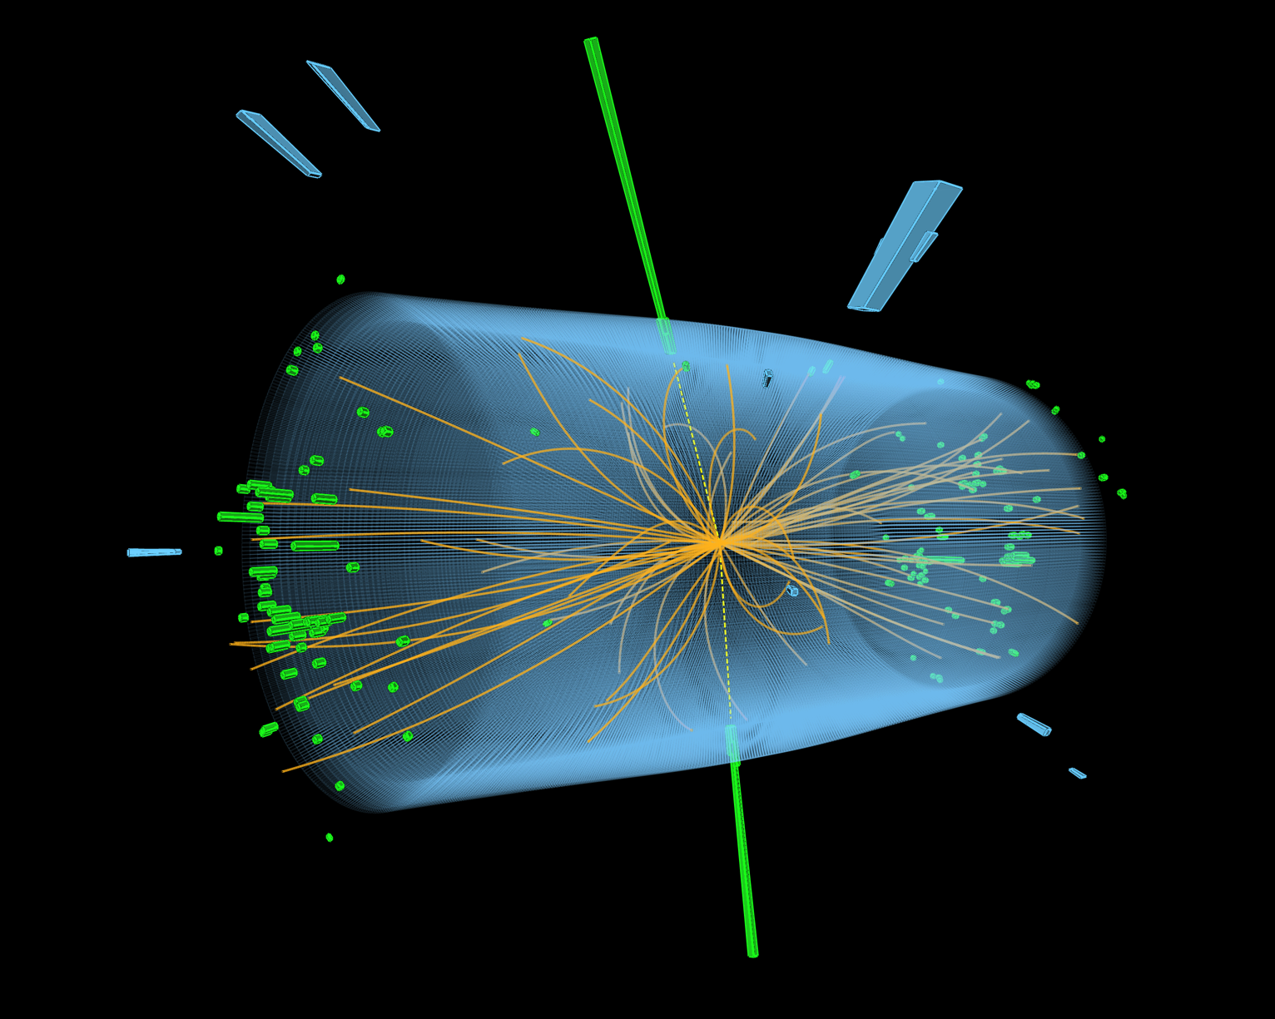
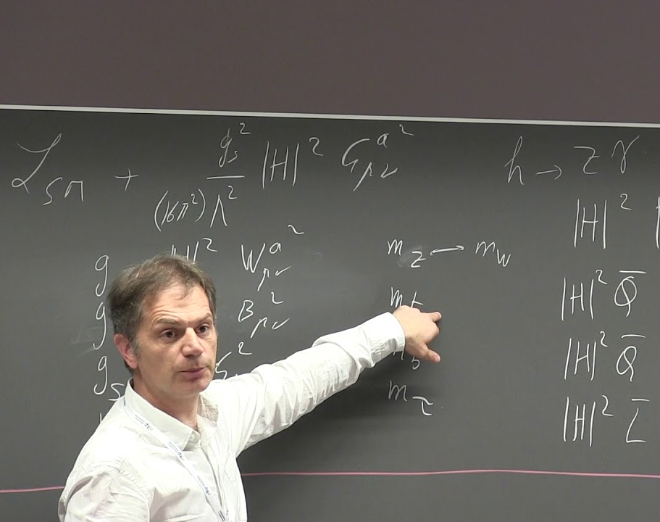
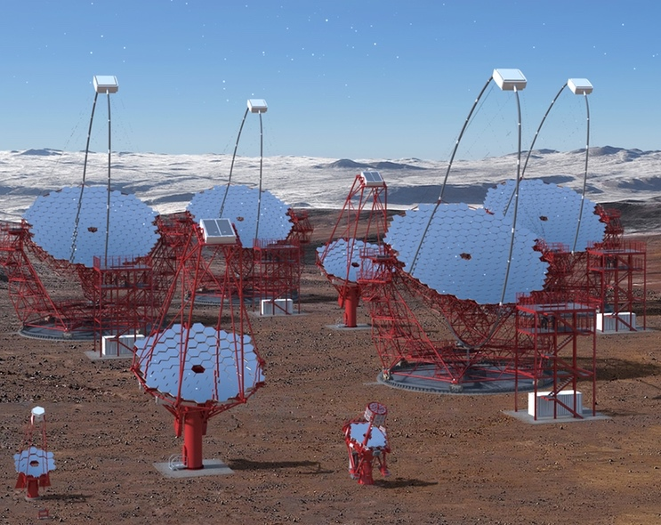

The LK2 Facility
TIER-2 Center
Status and Future Development
Helmholtz Program: Matter and the Universe (MU)
DESY Research Unit: TIER-2 Center
Volker Guelzow
Center Evaluation DESY, 5 – 9 February 2018

Slide 2
The distributed TIER-2
TIER-2 Structure and major accumulated “Key Performance Indicators”
Objective: Science Driven
Employees: 19 FTE
Scientific Computing
Budget: > 5.5 Mio € full cost
Development
dCache
Liaison Programs
External Project
Support
Education
Interdisciplinary Computing Facility
ILC
TIER-0/1
IceCube/CTA
TIER-1
WLCG
TIER-2
BELLE II
Maxwell
HPC
NAF
Regional, Raw
44,000 Cores and 177 TeraBytes of core memory
Central Storage Facility
15 PetaBytes on Disk and 7 PetaBytes on Custodial Storage (TAPE)

Slide 3
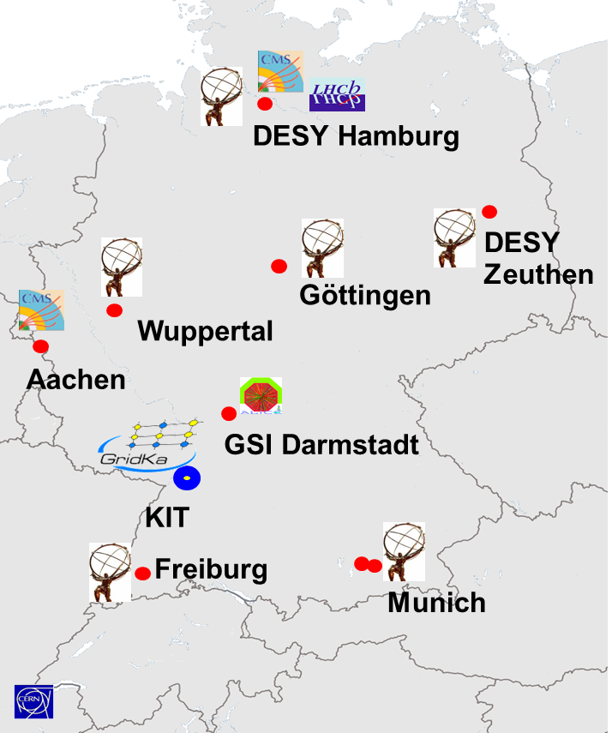
DESY’s contribution to the German WLCG share
Scientific Computing Infrastructure and Roles
German sites, contributing to WLCG
DESY’s share of the German WLCG Infrastructure
DESY
KIT
UNI/MPI
Availability and Reliability
According to the monthly “Availability and Reliability” report by the WLCG monitoring system, DESY is mostly rated 100% for both and 99% in very rare cases.

Slide 4
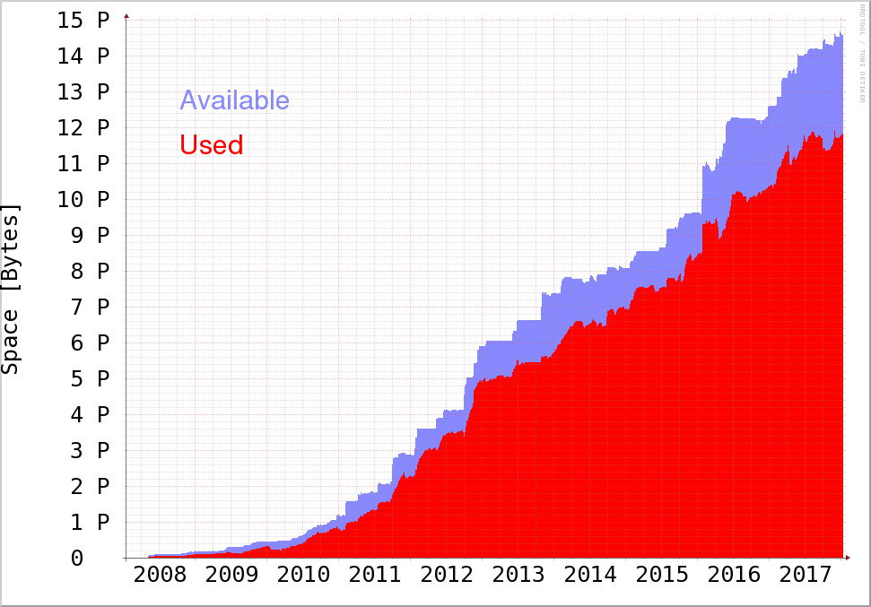
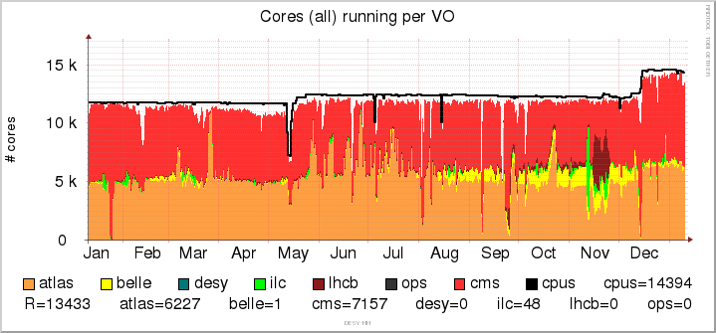

Resource usage
Grid Computing, Storage
German share of Atlas and CMS Resources
Used and available
GRID HEP storage space
CMS
Atlas
PetaBytes
German Share (MoU)
15
CPU Utilization of the GRID Facility
Additional
space for the
NAF
10
Max available Cores
Additional
space for
the NAF
Relative
5
Sum of official ATLAS, CMS and BELLE pledges for 2017
CMS
Atlas
Belle II
0

Slide 5
International Impact of the TIER-2 Center
Relative share of normalized CPU hours w/o the TIER-0
Atlas
CMS
Sites on this plot summarize to 37% of total resources
Sites on this plot summarize to 45% of total resources
DESY
KIT
Belle II
TIER-1
TIER-2
Sites on this plot summarize to 55% of total resources

Slide 6
National Analysis Facility
The DESY Grid and the DESY NAF allow for complementary usage of the same data source
The NAF is optimized for fast turn-around, development and interactive workflows
  while the Grid is optimized for large scale, production-like workflows.
There are more than 600 users registered.
Essential advantage: Direct access to the entire TIER-2 GRID storage.
The utilization is about 78,5% - which is excellent for an interactive facility.
The Farm offers ~7000 CPU cores in total.
”User Committee Meetings” monthly organized by “Scientific Computing” to collect feedback and quality control.
DESY/Theory
DESY
Experiments
Non
German
German
Institutes
Uni-HH
NAF User Affiliation Distribution

Slide 7

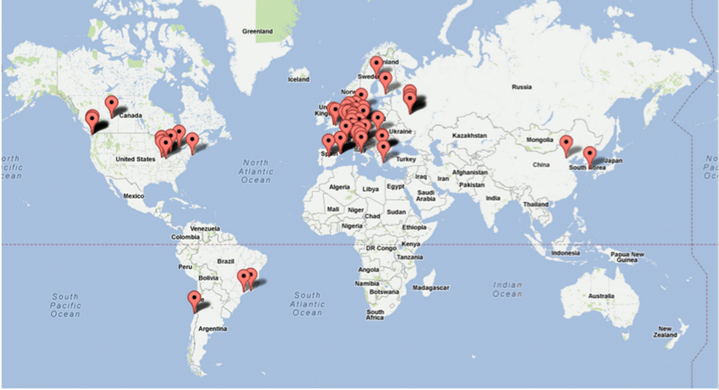
dCache Development
Distributed Scalable Mass Storage System
Collaborative development with headquarters in Hamburg
Collaborators
  DESY (Hamburg), Fermilab (Chicago), Nordic Data Grid Facility, NDGF(Scandinavia), HTW Berlin, JINR (MoU in preparation)
Available under Open Source License
Involved in large European Software and Infrastructure Projects
  EMI, INDIGO-DataCloud, eXtreme DataCloud
  More than 1.5 Million Euros EU funding
In WLCG dCache data management is used
At 9 TIER-1 centers out of 13
Which is an equivalent of 71% of total TIER I storage
At ~60 TIER-2 centers
At all German centers
Used by many other communities and experiments
DESY Storage and Archive based on dCache.
DESY operates 7 dCache instances in total.

Slide 8
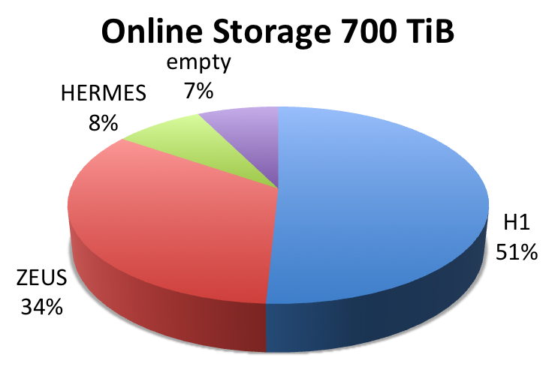
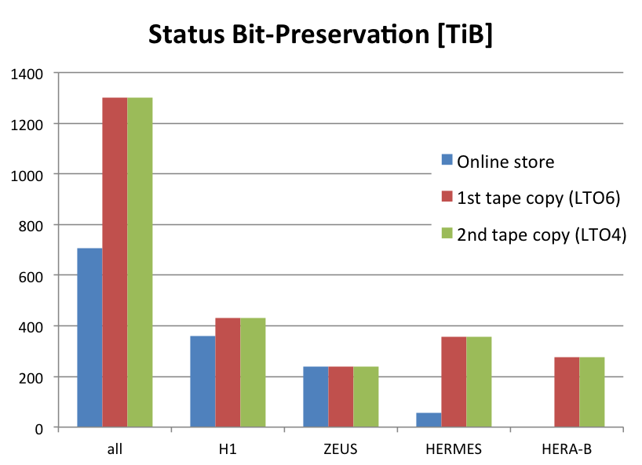




HERA Data Preservation
Bit-Preservation
The HERA data archive is finalized
Online disk store filled in dCache; 2 tape copies written.
Archive content and procedures for adding / restoring data documented.
Small additions to the heritage data are possible.
Restoring data from the tape archive to the online store successfully exercised.
Publications since 2013
H1 and ZEUS combined: 2 papers
H1: 12 papers
ZEUS: 15 papers
HERMES: 12 papers

Slide 9
User Interaction, Education & Knowledge Transfer
Managed by Scientific Computing
Interaction with users and boards,
  The TIER-2 Center is user driven and subject to resource review boards and experiment boards on computing.
  Scientific Computing members are participating in User Boards (NAF, CUC, ...).
  They are members of governance and scrutiny boards and various other committees.
Education & Knowledge transfer
  SC is supporting the Summer Students programs.
  SC contributes to the the GridKA School of computing with tutorials on compute and storage topics.
  SC supports the “Dual Study” model and organizes lectures for apprentices.
  SC is giving lectures at technical and applied Universities.
  Springer Journal "Computing and Software for Big Science" Membership in editorial board.

Slide 10
A Strategy for the Next-Generation TIER Center
Transition from the LK2 Facility TIER-2 Center to the Interdisciplinary Analysis Facility (IAF)
TIER-2 Centre
User communities mainly in HEP
LHC (CMS, Atlas, LHCb) , Belle & Belle II, ILC, ...
Interdisciplinary Analysis Facility (IAF)
HEP Users : LHC, Belle II, ILC ...
Astro Particle Experiment : CTA
Research with Photons : Petra III / IV , FLASH , European XFEL
Accelerator Research
Theory
The new “Scientific Computing” concept will become a key part of the LK II facility
Notes:
Diese Seite braucht ein Bild …siehe Kommentare naechste Seite
Sollte zur Theory nicht auch simulation, control systems etc. wie auf der naechstesn Seite in der Wolke?

Slide 11
Scientific Computing Development @ DESY
Scientific Computing is a key feature for research and is an integral part of the LK II facility
Scientific Computing
Simulation
Automation and Control Systems
Data Analytics
Machine Learning
in the program MT
Hardware Acceleration
Software Engineering
Data Management and Storage

Slide 12
Scientific Computing Development @ DESY
A key feature for research and also part of the LK II facility
Scientific Computing is considered as one of the key topics for the research at DESY.
The following key activities are currently being prepared or intensified:
Building an internal Virtual Group for Scientific Computing across divisions.
Preparation of the topic „Data Management and Analytics“ in the program “Matter & Technology”.
Scientific Computing will significantly contribute to the planned Center for Data and Computing Science (CDCS) on a regional level.
Scientific Computing will consolidate and strengthen the effort to acquire National, European & International Projects.

Slide 13
Virtual Group „Scientific Computing“ at DESY
Across DESY divisions
Common Topics
FH Division
LK 1
SW development
Analysis
Methods
Algorithms
HPC
Optimization
Big Data
LK 2 (TIER-2)
Grid computing
Big Data Management
Cloud
FS Division
LK 1
SW development
Analysis
Methods
Algorithms
LK 2
PETRA III & FLASH
Support for scientific & industrial users
Near Real time Analysis
Data Management
M Division
LK 1
Modelling and Simulation
Analysis methods Algorithms
LK 2
PETRA III &FLASH
Accelerator control
Data Processing Data Acquisition
Data Analysis
Data Visualization
ZN
LK1
Simulations
Methods
Algorithms
Technology
HPC
Optimization Analysis
SW Development
LK II (TIER-2)
Grid computing
Big Data Management
Technologies & Methods
The virtual group spanning divisions
Algorithms
HPC, GPU Optimization
Parallelization
Clouds and Virtualization
Policies and Coordination
Visualization

Slide 14
The topic Data Management and Analysis
in the POF program „Matter & Technologies“
A new Topic in POF 4 as part of the research area “Matter” : Matter and Technology
Focus on scientific issues in “Matter”.
Institutionalize cross research field cooperation with the research area „Information“
Foster cooperation between research centers in “Matter”
Research Area „Matter“
Research Area „Information“
From Matter to Material and Life
Matter and Technology
Computing &
Dataintensive Science
From Knowledge
to Action
Data Management and Analysis
Accelerator Research and Development
Big Data Analysis
IT Security
Matter and the Universe
Detector Technologies and Systems
Methods,
Algorithms & Tools
Supercomputing

Slide 15
Centre for Data and Computing Science (CDCS).
On a regional level
DESY
UHH, TUHH,
HAW
Cooperation
Education
CDCS
Center for
DMA
Software Development
International
Science Park HH
Campus partners
XFEL, MPSD, EMBL
Research professorships,
common appointments
Industry
cooperations
Technology
PARK
Helmholtz cooperations
New DMA Program +
New research area Information
CISPA
Graduate School
„Data and Computing Science“
(Helmholtz support)
International /
European
cooperations
User service
Facilities
PETRA III/IV, FLASH, XFEL
(LK II)
Interdisciplinary
Analysis
Facility
(LK II)
User service
Cooperation centers
CFEL
CSSB
TIER-2 Center
LHC Computing
CERN
Service/operation
CTA–SDMC
Zeuthen

Slide 16
Collaborations (National, European)
Acquiring 3rd-party money for e-Infrastructure development at DESY
 | Project | Topic | Status | External Funding
European | XDC | Data management software | Until 2019 | 404 k€
 | HNSciCloud | Commercial cloud procurement | Until 2018 | 345 k€
 | EOSC-pilot | Interoperability, science case | Until 2018 | 518 k€
 | INDIGO DataCloud | Data management software | Ended 2017 | 844 k€
 | Calipso + | Data Analysis as a Service | Until 2020 | 96 k€
 | EUCall | Bridging EU Laser and X-Ray Research | Until 2018 | 227 k€
National | HDF | German Data Federations (Mostly Hardware) | Until 2020 | 6.400 k€
 | HAF | Analysis software stack | Until 2020 | 259 k€
 | HGF Incubator | - Proposal writing - Development Infrastructure | Until 2020 | 200 k€

Slide 17



Collaboration with National and International Projects
Project involvement from 2015 to 2020
Continuous involvement of “Scientific Computing” in large national and European Projects.
Partner in setting up the European Open Science Cloud, EOSC initiative, the future of the European Research Infrastructure.
“Scientific Computing” contributes to high level management of those projects as: Work package leaders, tasks leaders, members of technical and project management boards.
Hardware
People
6.2 M
3.1 M
Total external funding from 2015 to 2020

Slide 18
Summary
The DESY TIER-2 center is an essential component of the German LHC contribution.
It delivers 1/3rd of the German Resources to WLCG with secured funding.
A sophisticated and reliable data management makes DESY outstanding
The DESY TIER-2 center is among the Top 5 performing WLCG centers.
The DESY TIER-2 Centre has a clear strategy become the central „Interdisciplinary Analysis Facility“, supporting Photon Science and others sciences.
The strength of the DESY TIER-2 center is the tight link to the users.
The DESY TIER-2 Centre is very active in scientific computing and education.
The DESY TIER-2 Centre is part of a emerging Scientific Computing Strategy in the Lab.

Slide 19
The END

Slide 20
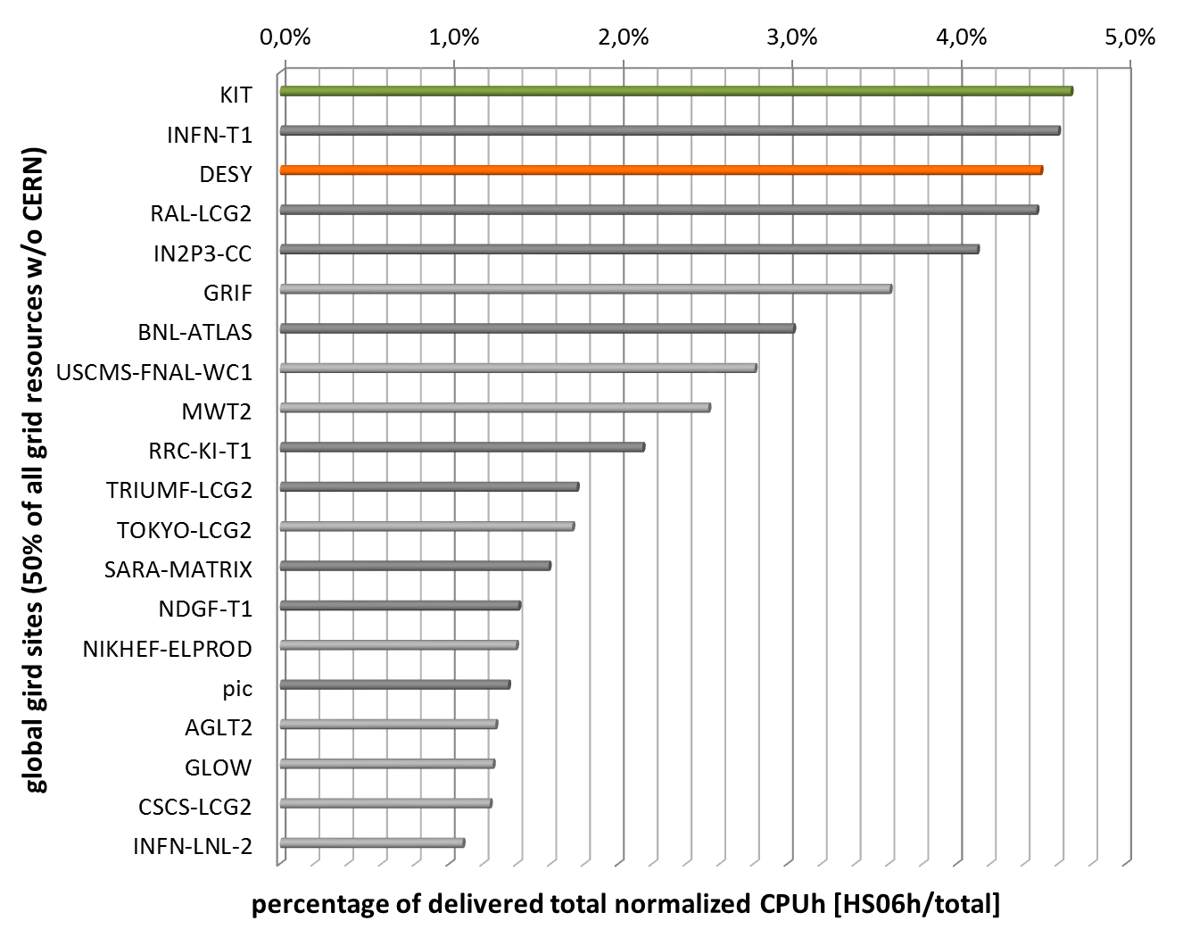
Resource Usage
DESY – Computing European Grid Initiative EGI
2015-2017

