Slide 1
High Field Electrodynamics with X-ray FELs
D. Reis and C. Pellegrini
SLAC National Accelerator Laboratory
UCLA Department of Physics and astronomy,

Slide 2
Strong-field QED@SLAC Working group
AMO: Bucksbaum and Reis
Astrophysics and Cosmology: Abel and Blandford
HEDS: Fiuza and Glenzer
Accelerator: Hogan and Yakimenko
FEL: Huang and Pellegrini
Laser: Fry
HEP: Brodsky
Strong-field QED theory: Meuren (Princeton)

Slide 3
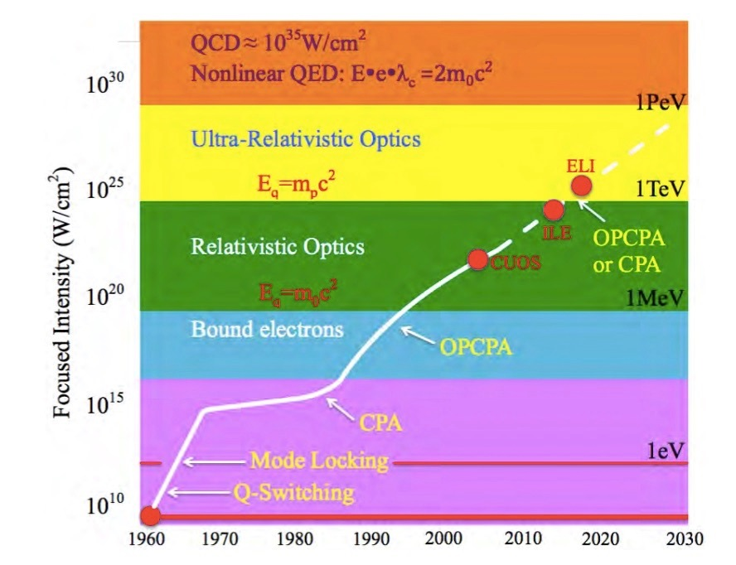
New strong-field and collective phenomena only accessible above QED critical intensity/field
Current and future light sources far from this limit.
Only possible by combining high energy particles with laser (relativistic boost)
4γ² intensity
2γ field
SLAC
E144
Ponderomotive Energy [λ²/1µm²]
LCLS,
SACLA
XFEL
Modified from https://eli-laser.eu/media/1019/eli-whitebook.pdf

Slide 4
SFQED@FACET-II
Precision measurement using 100 TW, focused to 4µm
ω =1.55 eV, η = 17, Υ= 3
strong-field Compton, quantum rad. reaction
strong-field Pair production
ω =4.8 eV, η <<1, Ψ = 0
ω =1.55 eV, η = 17, Υ= 1.6
ω =1.55 eV, η <<1, Υ = 0, circ pol.
ω =1.55 eV, η < 17, Υ< 0.4
Vacuum birefringence

Slide 5
Introduction
We consider the possibility and opportunity offered by the LCLS-II X-ray FEL to reach peak power in the TW range, for about 10 fs pulse duration, to explore high field electrodynamics in electron-photon collisions with electron energy of 6 to 10 GeV and photon energy of 4 to 8 keV.
We show that we can reach this goal, with power densities at the interaction point larger than 10²³ W/cm², electric fields about ten times larger than the Schwinger critical field, and normalized amplitude smaller than one.
This regime is different and complementary to that obtained for electron-photon collisions using PW visible lasers.

Slide 6
LCLS-II effective power density for γ-γ and e-γ interactions.
We assume 1 TW, 10 nm spot size.
LCLS-II e-γ ≈10³³ W/cm²
LCLS-II ≈3×10²³ W/cm²
SLAC
E144
New strong-field and collective phenomena only accessible above QED critical intensity/field
Current and future light sources far from this limit.
Only possible by combining high energy particles with laser (relativistic boost)
4γ² intensity
2γ field
Ponderomotive Energy [λ²/1µm²]
LCLS,
SACLA
XFEL
Modified from https://eli-laser.eu/media/1019/eli-whitebook.pdf

Slide 7
LCLS-II 3 bunches high field experiment schematic
e
e
Focusing X-ray mirror
X-rays
e
Electron focusing lenses
LCLS copper linac
The system uses the capability of the LCLS-II copper linac to accelerate multiple electron bunches with different time delays. The first two electron bunches, separated by about 1 ns, generate a high power X-ray pulse which is reflected back, focused and interacts with the third electron bunch. An additional electron lens can be used to better focus the electron beam. The third bunch delay is in the range of tens of nanoseconds.

Slide 8
The LCLS-II HXR variable gap undulator
The first 7 undulator section are used tp generate a SASE seed signal. This is filtered by a 4 mirrors monochromator and amplified in the remaining 25 sections.

Slide 9
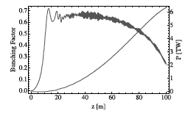
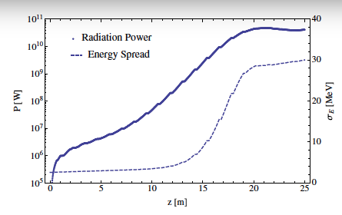
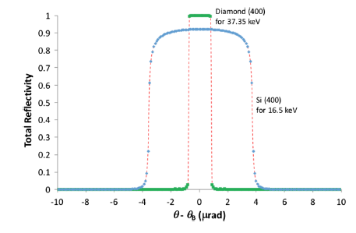
The Double Bunch XFEL*
y
y
y
Chicane
t
t
t
t
~ 1ns
Seed generating FEL
High efficiency tapered amplifier
Monochromator
and X-ray delay
The DBFEL increases the efficiency of energy transfer, and the peak power.
*C. Emma, Y. Feng, D. Nguyen, A. Ratti, and C. Pellegrini, Phys. Rev. Acc. and Beams 20, 030701 (2017).
Characterization of the LCLS “nanosecond two-bunch” mode for X-ray Speckle Visibility Spectroscopy experiments, Y. Suna et al., SPIE 10237, 102370N-1-10 (2017).

Slide 10
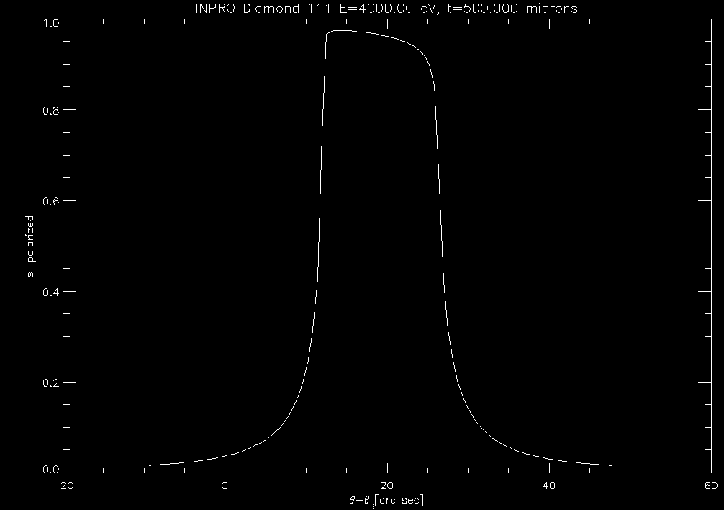
The 4-crystals monochromator
The monochromator works well between 4 to 8 keV. The lateral displacement h changes between 13 cm at 4 keV to 37 cm at 8 keV.
Diamond (1,1,1) reflectivity curve at 4 keV.

Slide 11
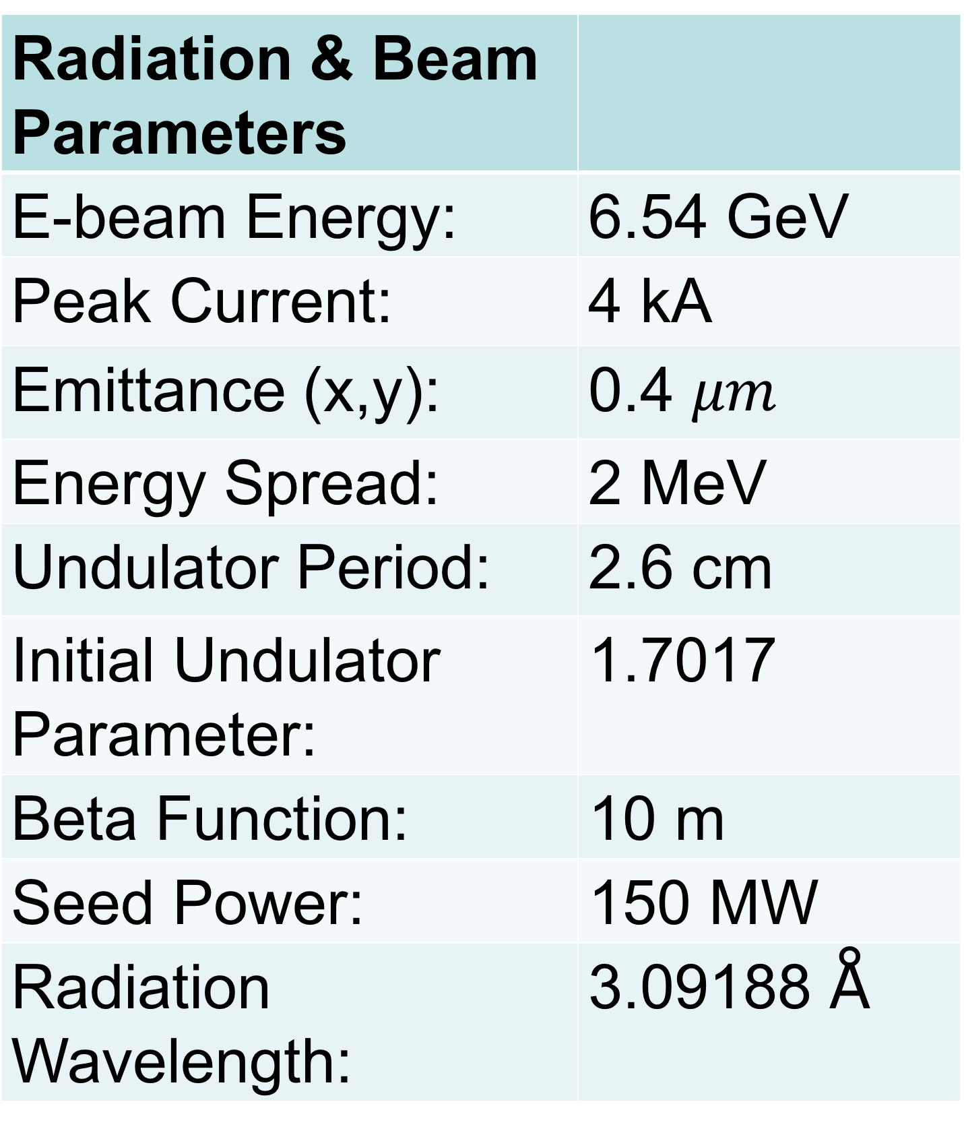
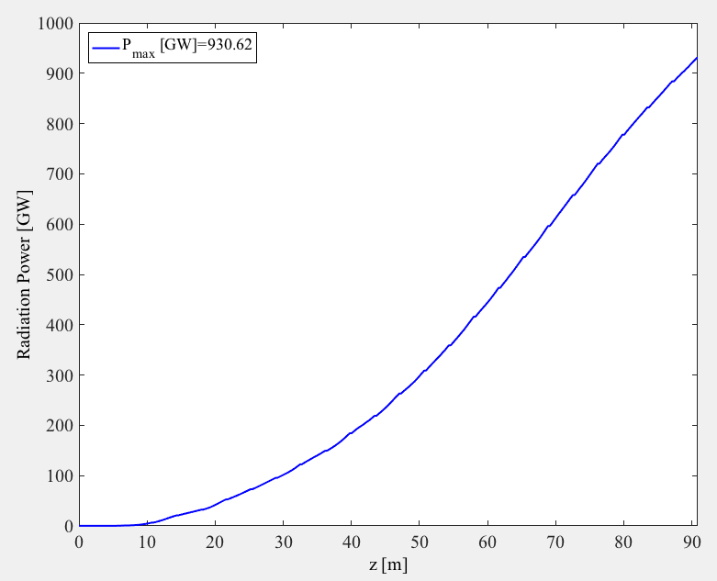
Genesis simulations for LCLS-II copper linac
and HXR undulator
Power vs undulator length
The electron beam parameters are conservative and the undulator length has been reduced by 4m, again to be on the conservative side..

Slide 12
Focusing system layout 4 mirrors @ 8 keV
Undulator
flat mirror
H-KB
V-KB
V-KB
H-KB
z
Distance from undulator end
3 mrad / 800 mm
17 mrad / 120 mm
Vertical
Horizontal
Horizontal
Vertical
Source-IP (m) | 360 | 360
Demag 2nd set | 20 | 10
q1= | 3.540 | 1.777
Demag 1st set | 100 | 200
p1= | 354.045 | 355.363
p2= | 2.3 | 2.6
q2 (focal distance)= | 0.115 | 0.26
Absolute M1 position | 354.045 | 355.363
focus 1 position | 357.585 | 357.14
M2 position | 359.885 | 359.74
Courtesy D. Cocco

Slide 13
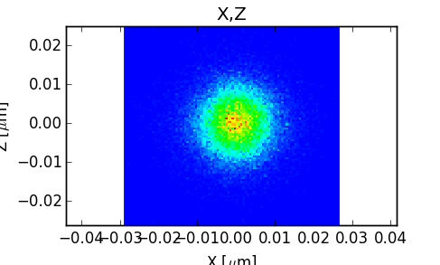
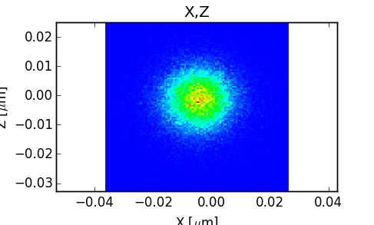
Spot properties @ 8 keV
12.2 X 12.9 nm FWHM
14.4 X 13.9 nm FWHM
Ideal spot / no slope/shape errors
Using 0.3 nm rms on the 800 mm mirror (the best value we have measured so far) and 1 nm rms on the 130 mm mirrors (estimated from polishing and metrology limits)
Peak Power density starting with 1 TW at the source (8 mJ)
4.3 x10⁺²³ W/cm²
(including reflectivity and elongation)
3.4 x10⁺²³ W/cm²
(including reflectivity and elongation)
Courtesy D. Cocco

Slide 14
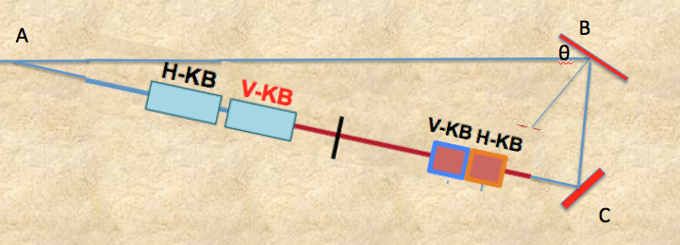
The optical system for reflection and focusing
The system has two parts: reflecting crystal mirrors to turn back the photon pulse by more than 180º; four KB mirrors to focus the photons to a 10 nm spot size. For the reflection we use two diamond crystals (1,1,1). Operating at 4.45 keV photon energy, the Bragg angle is 42.57 degrees and the Darwin width is 57 μrad. The reflectivity is about 95%, a total loss of 10%. The photon relative energy width is 6.2x10⁻⁵, comparable with that of the amplified radiation. With two mirrors the total bending angle is 189 degrees, giving a crossing angle of 9 degrees for the electron photon interaction. With these choices and assuming the circle radius to be 0.5m, we have AC=AB=5.9 m.

Slide 15
LCLS-II effective power density for γ-γ and e-γ interactions.
We assume 1 TW, 10 nm spot size.
LCLS-II e-γ ≈10³³ W/cm²
LCLS-II ≈3×10²³ W/cm²
SLAC
E144
New strong-field and collective phenomena only accessible above QED critical intensity/field
Current and future light sources far from this limit.
Only possible by combining high energy particles with laser (relativistic boost)
4γ² intensity
2γ field
Ponderomotive Energy [λ²/1µm²]
LCLS,
SACLA
XFEL
Modified from https://eli-laser.eu/media/1019/eli-whitebook.pdf

Slide 16
Basic numbers for LCLS-II
LCLS X-ray pulse power density and electric field at focal point.
Assume P₀=1TW, pulse duration 10 fs, energy/pulse=10 mJ.
Assume that we can focus to σ₀ =10 nm (done in Japan)
Normalized laser amplitude
Repetition rate, 120 Hz.

Slide 17
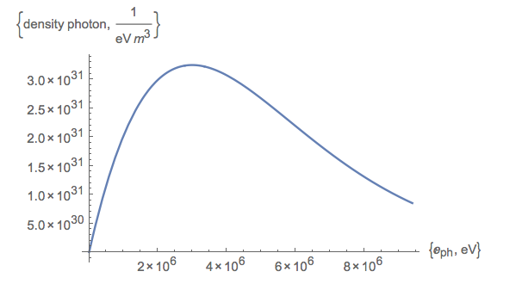
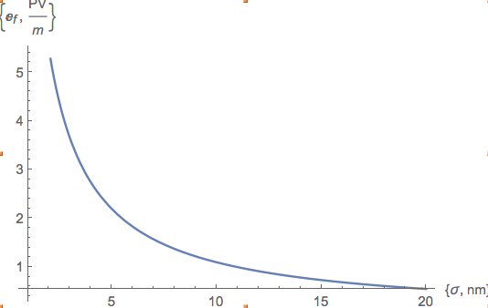
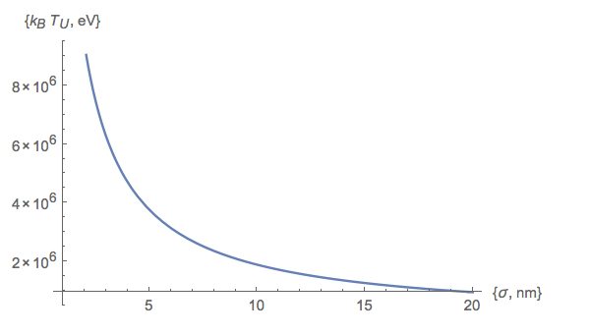
Unruh radiation
An accelerated electron sees the vacuum photons as a gas at a temperature
where k_{B} is Boltzman’s constant, and a is the acceleration. In the focus of the X-ray pulse, the field is 1.1x10¹⁵ V/m and the acceleration is ~10³¹m/s². The corresponding temperatures are 8560 K , k_{B}T=0.74 eV, in the first case or 4x10¹⁰ K, k_{B}T=2X10⁶ eV

Slide 18
Conclusions
LCLS-II with the copper linac can provide interesting parameters for a program to study high field, nonlinear electrodynamics.
The program is complementary to that based on PW optical wavelength lasers. At LCLS-II the field seen by a highly relativistic electron (E>6 GeV) at the X-ray pulse focus is much larger than the Schwinger field, while the normalized intensity is less than one. With PW laser the normalized intensity is always larger than one. A comparison between the two cases is very interesting.
The possibility of observing phenomena like the Unruh radiation gives a good scientific motivation and encourages work in this area.

