Slide 1
Design considerations of the LUXE beamline
Laser Und XFEL.EU Experiment
Florian Burkart
Hamburg, 23/08/2018

Slide 2
Agenda
01 Location at the XFEL
02 Experimental Scenarios and Beam Parameters
03 Beam line design and Integration
04 Conclusion and Outlook

Slide 3
Location at the XFEL
End of UN2 Begining of Dump
3039 m – 3145 m
(660 m)
(137 m)
XTD7
XTD5
(204 m)
UN1
XS4
UN2
XTD8
XTD3
(263 m)
(365 m)
(480 m)
(595 m)
(546 m)
XS1
(301 m)
(221 m)

Slide 4
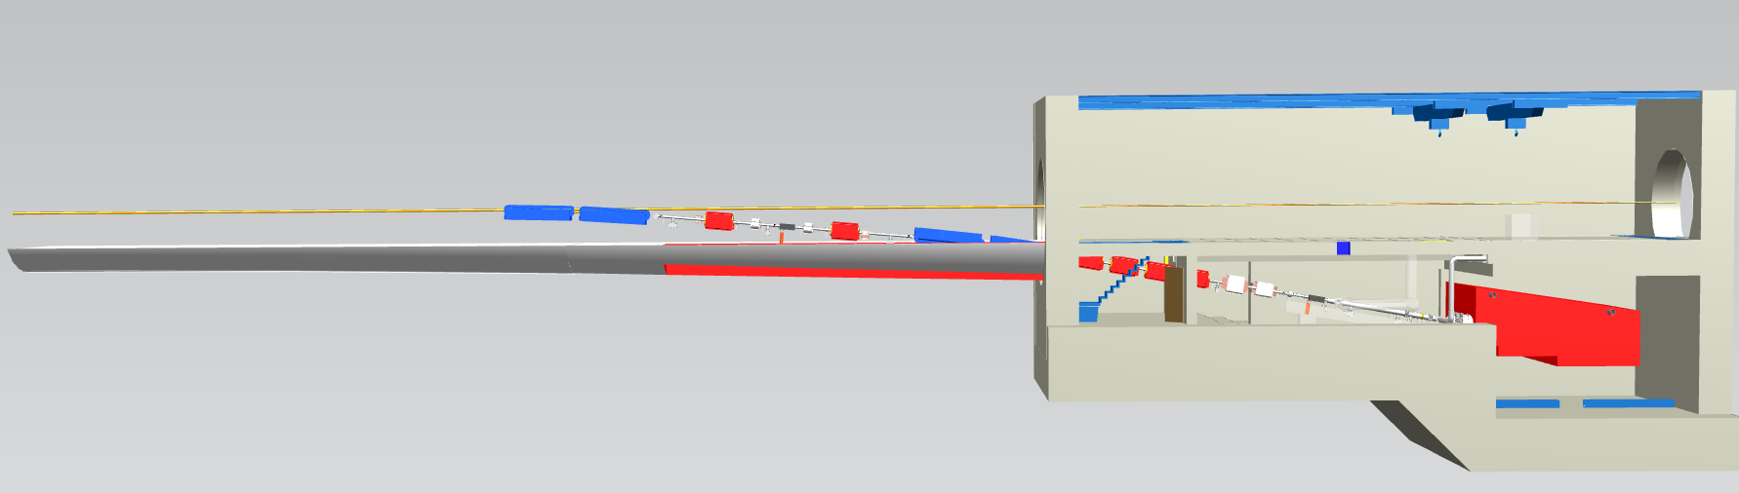
Dump Area – XTD5, XSDU1

Slide 5
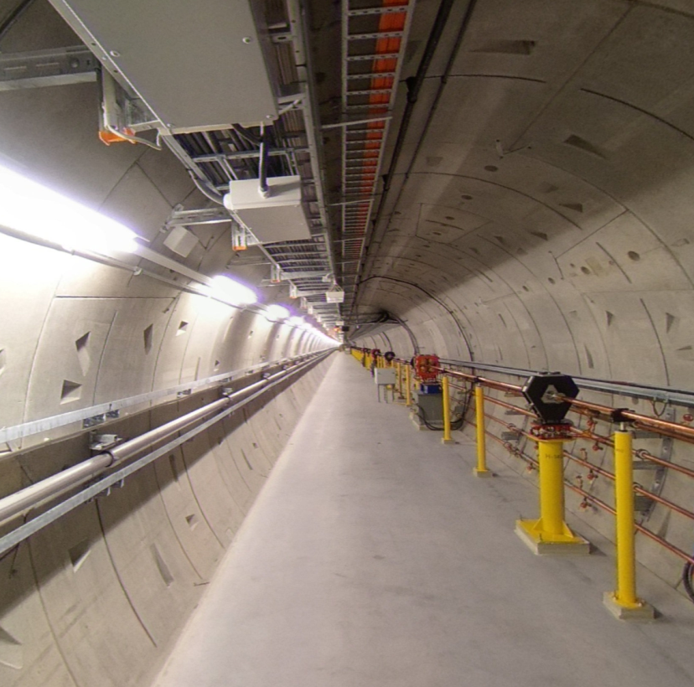
How it looks like in the tunnel...

Slide 6
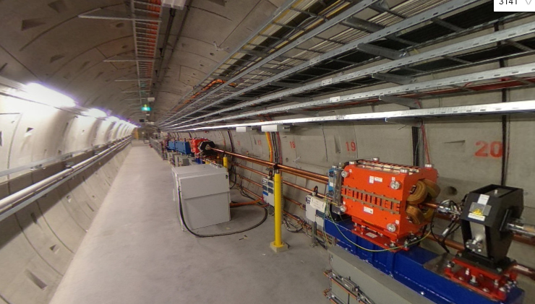

Slide 7
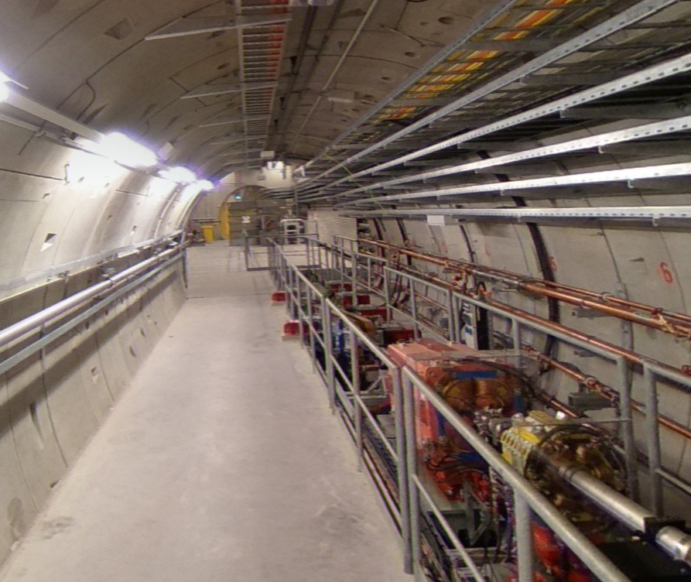

Slide 8
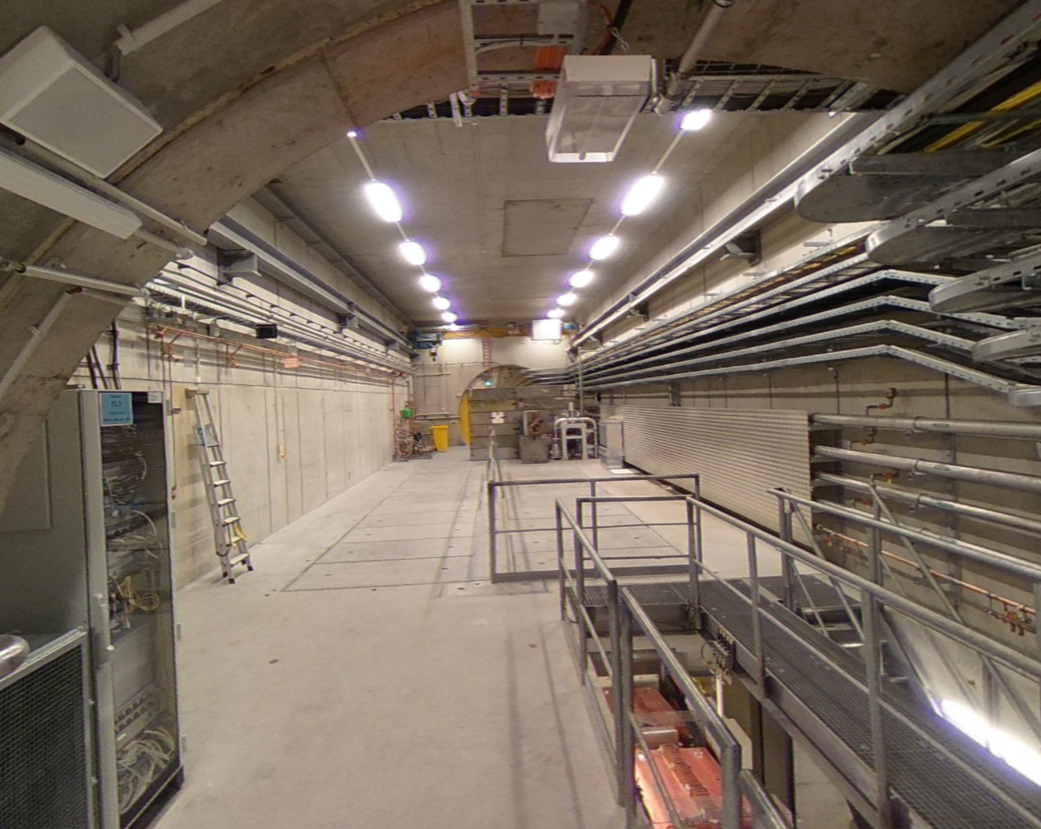
Nice location, but:
In case of a severe beam dump failure (dump exchange), the full
experimental setup has to be removed.

Slide 9
Experimental Scenarios and e⁻ Beam Parameters
Option 1: collide electron beam with laser pulse
Option 2: collide electron beam with foil → photon generation → collide photons with laser pulse
Electron beam parameters:
Electron energy: 17.5 GeV
Bunch intensity: 1 nC ( 6.25E9 e-)
Spotsize @ IP: σ = 5 μm
Repetition Rate: 1 – 10 Hz

Slide 10
Option 1: Electron - Laser
Collimation
PDET
IP
Mirror
Laser
e⁺
Photon converter
Dipole
Dipole
CAL
γCAL
e⁺
γ
γ
e⁻
Triplet
pulse
e⁻
Dump
1bunch
Mirror
Dipole
17.5 GeV e⁻
EDET
E < 16 GeV
XTD5
Kicker & Septa
Dipole
XSDU1
Dump
Single bunch kicker helps machine protection.
Space efficient design.
Kicker and Septa design can be copy-pasted.

Slide 11
Option 2: Photon - Laser
Collimation
PDET
IP
Mirror
Photon converter
e⁺
Laser
Photon converter
Dipole
Dipole
CAL
γCAL
e⁺
γ
γ
e⁻
Triplet
e⁻
Dump
pulse
1bunch
Dipole
Mirror
17.5 GeV e⁻
EDET
E < 16 GeV
XTD5
Kicker & Septa
Dipole
XSDU1
Dump

Slide 12
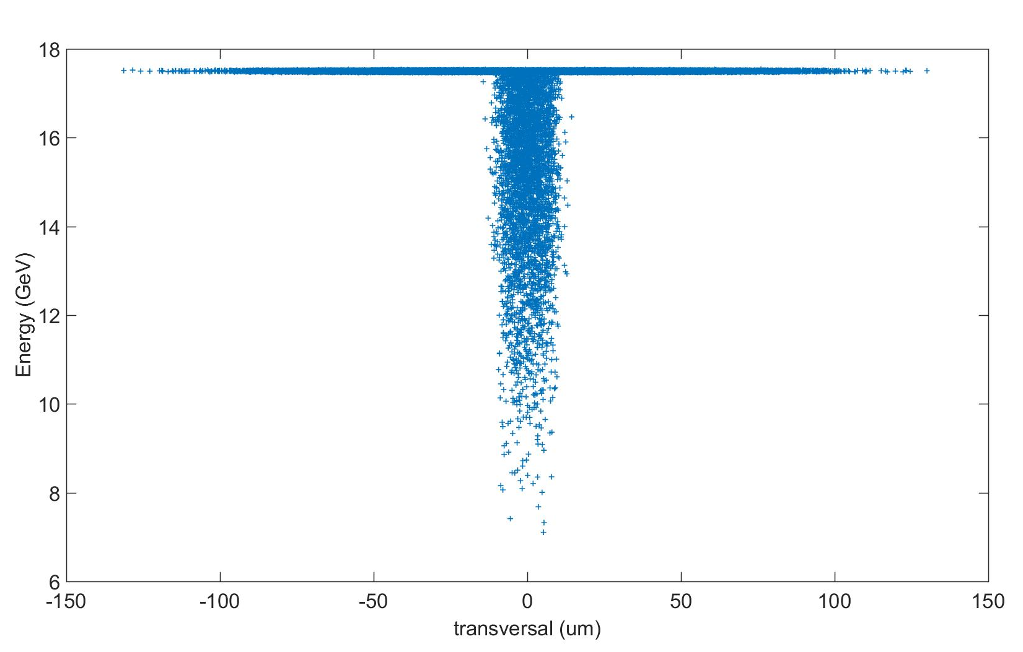
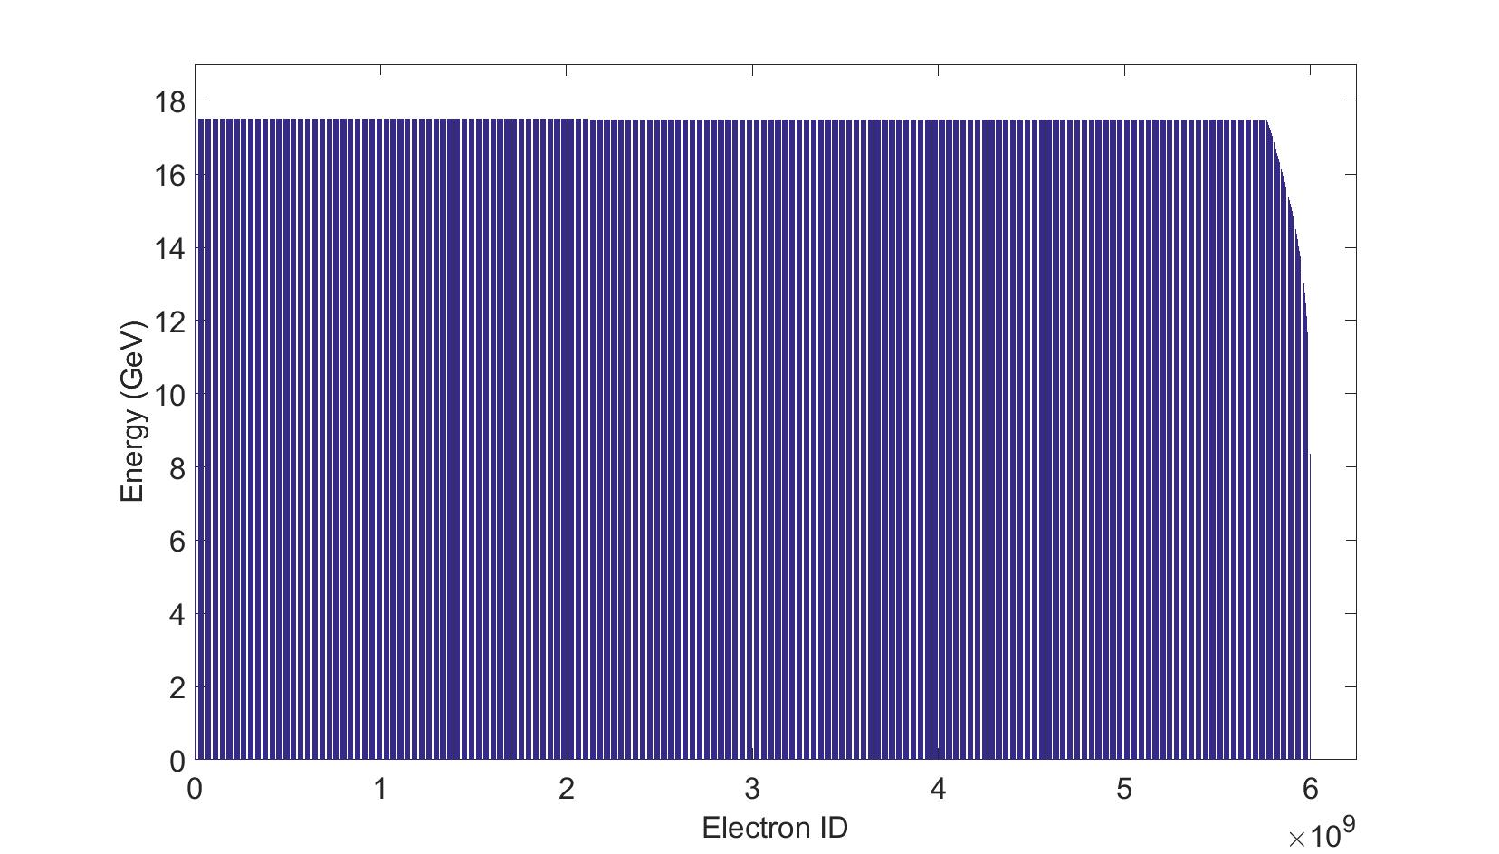
Electron distribution downstream of IP
Electron energy distribution simulation parameters:
E_{e-} : 17.5 GeV
σ_{x,y} : 30 μm
Laser Intensity: 1E20 W/cm²
Wavelength: 800 nm
Spotsize: 100 μm²
Transversal distribution
Energy intensity distribution
Courtesy: A. Hartin
New simulation with updated parameters running…

Slide 13
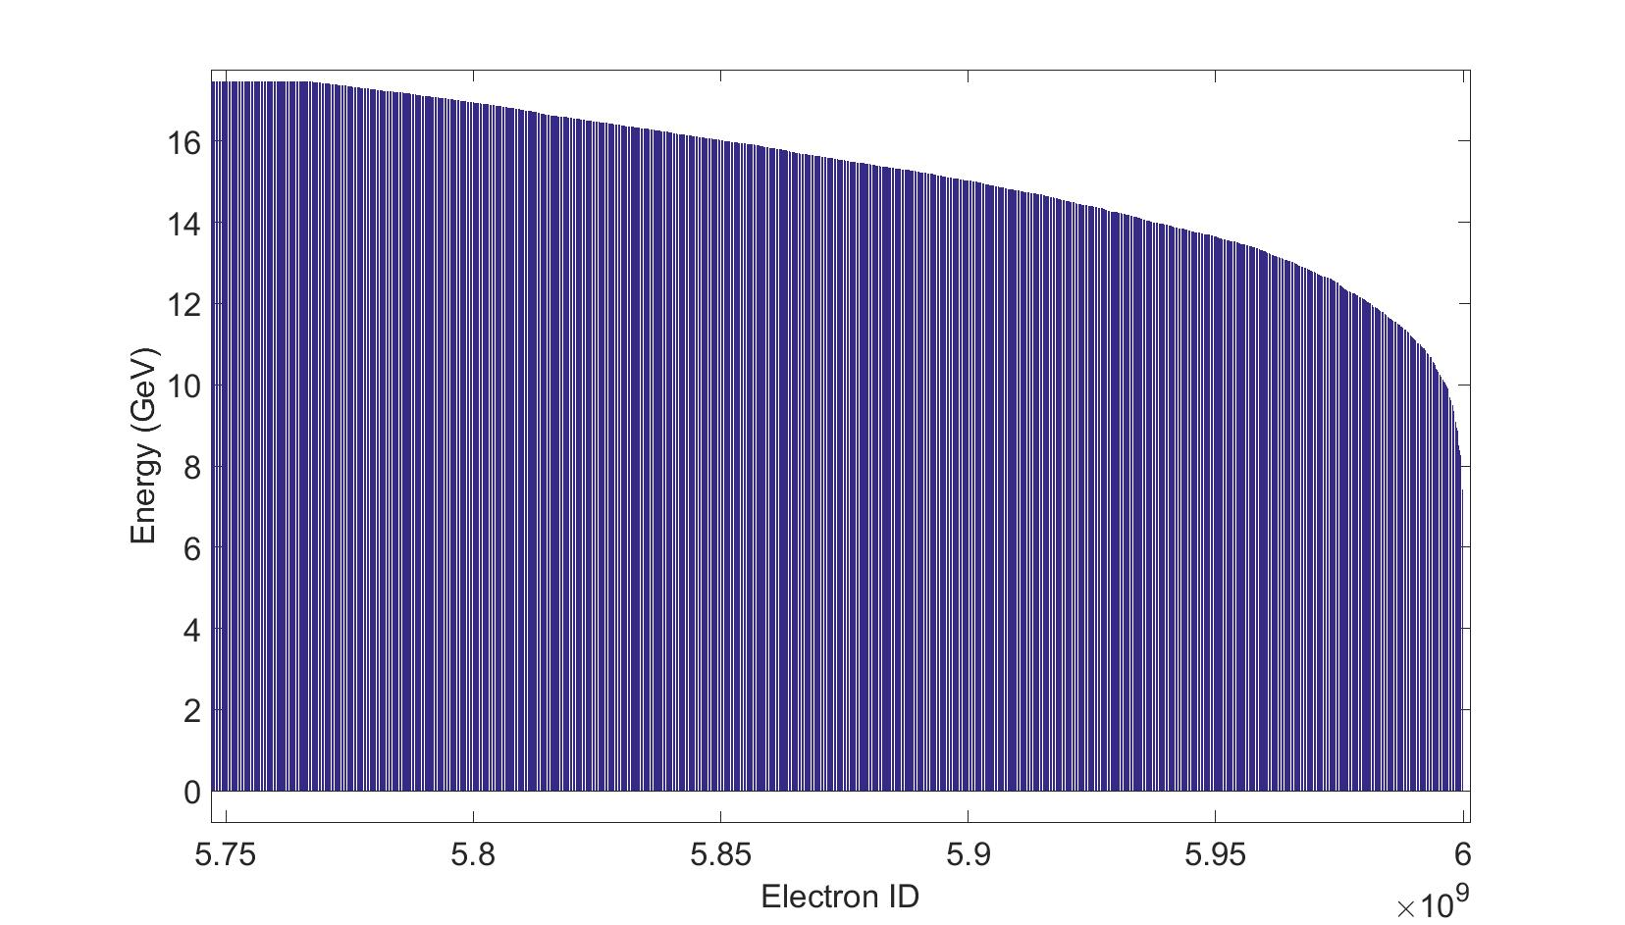
Energy – Intensity distribution, Zoom
~ 5 % of the bunch is below nominal energy.
Down to 5 GeV.

Slide 14
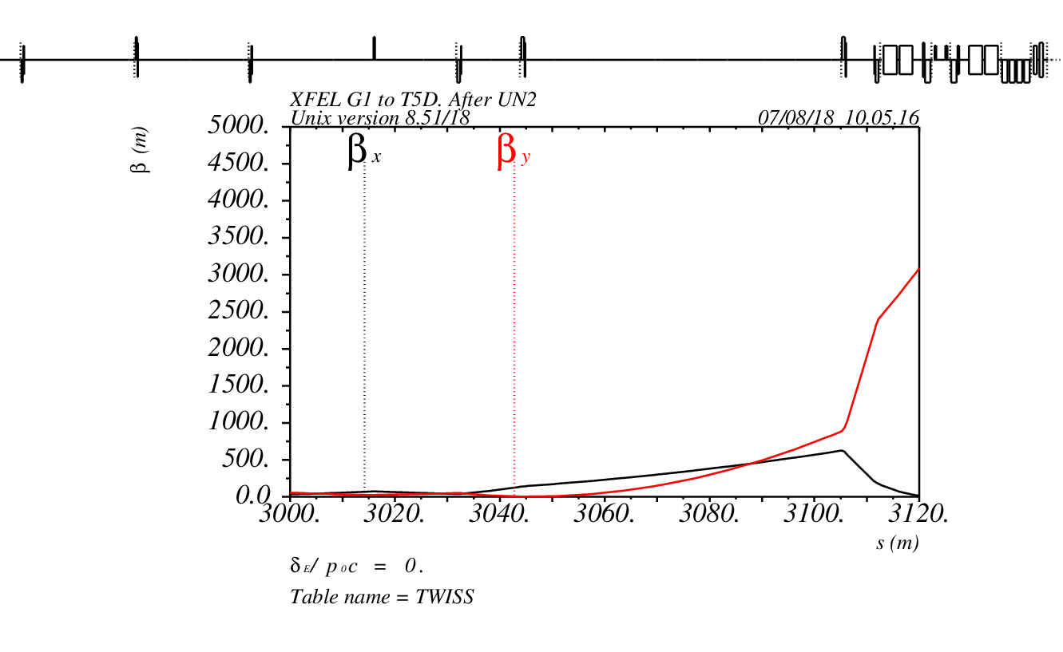
Optics in XTD5
Bends
UN2

Slide 15
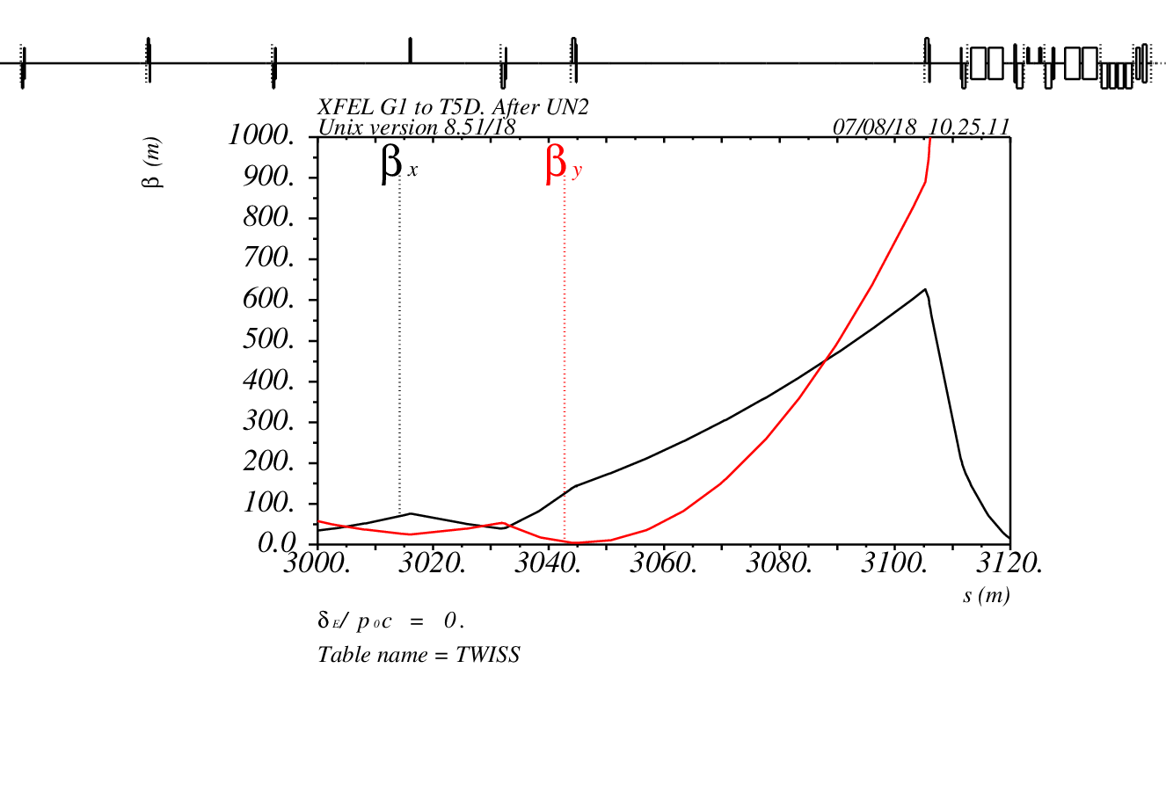
Optics in XTD5 with extraction to LUXE
Septa
Kicker

Slide 16
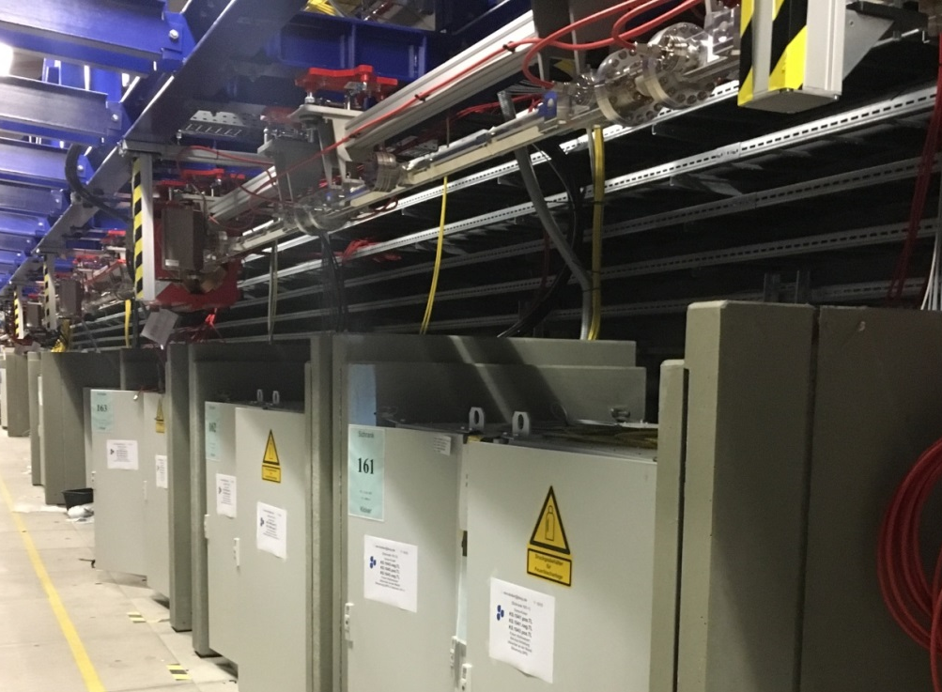
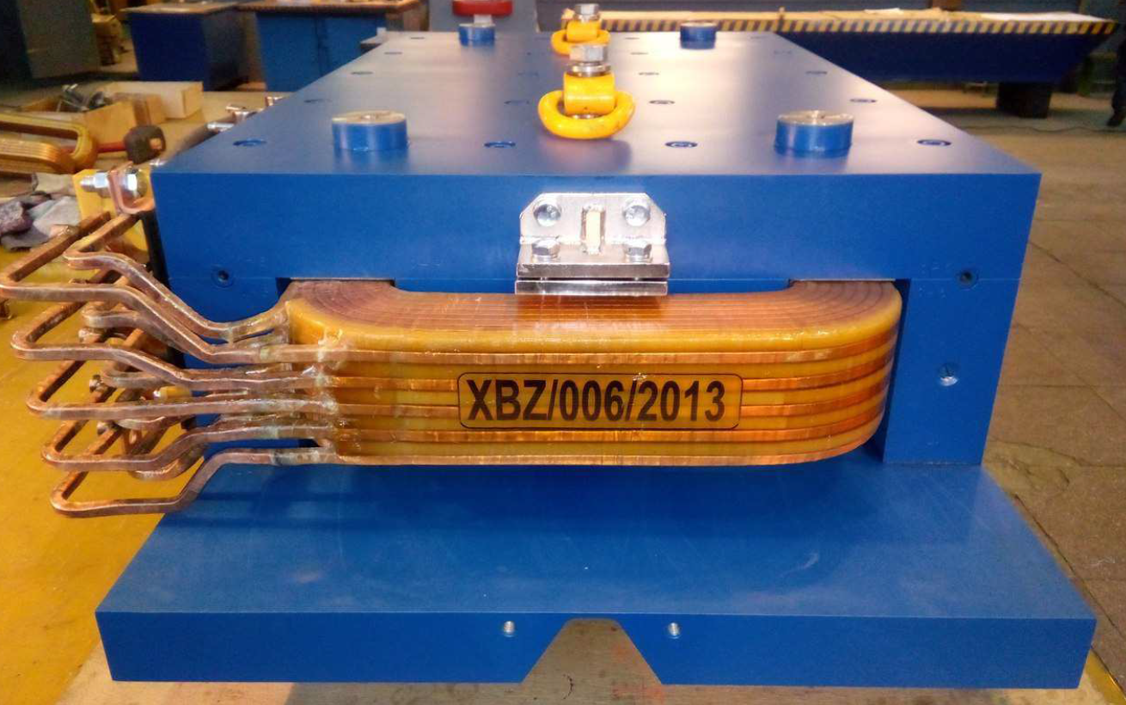
Kicker and Septa parameters
 | Kicker
Pulse Form | Burst
Pulse Width | 30 ns
Rise / Fall Time | 10 ns
Kick angle per element | 6.25 μrad
Number of elements | 10
Aperture | 30 mm
Active length | 2 m
Pulser Voltage | 5 kV
Pulse Current | 100 A
 | Septum
Type | Lambertson
Deflection angle | 35 mrad
Active length | 1 m
Septum bar width (incl. beam pipe) | 5 mm (10 mm)
Number of elements | 4
FOTOS

Slide 17
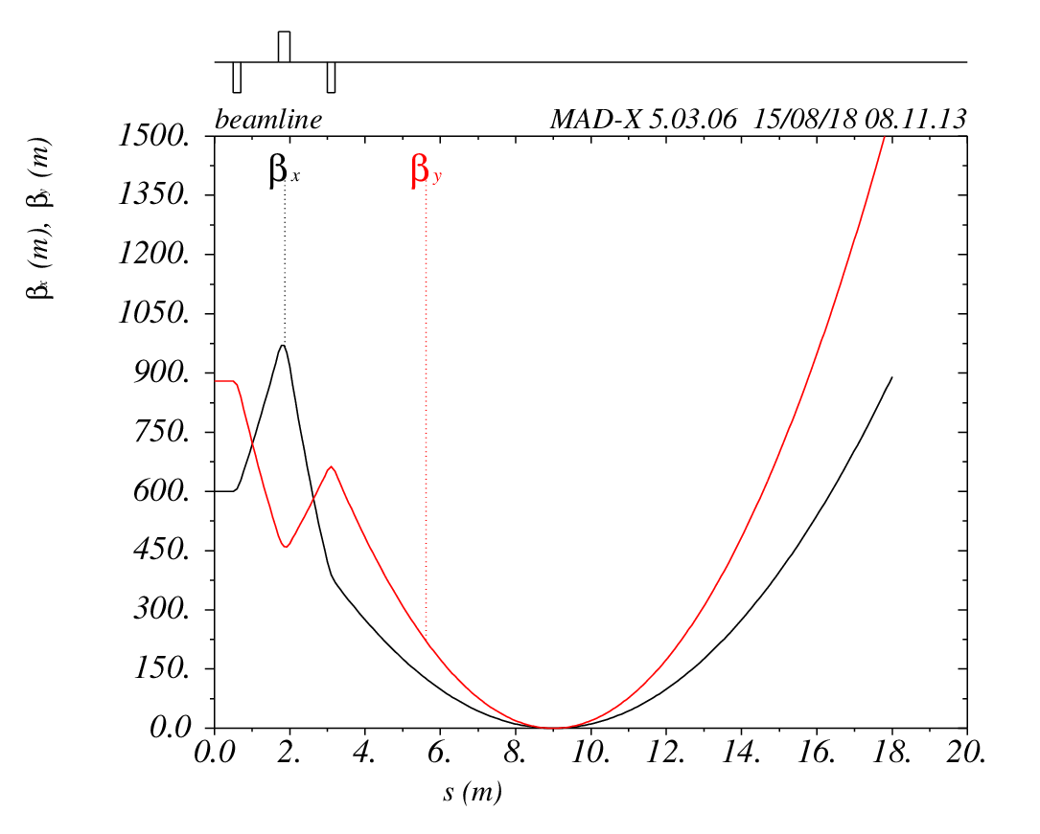
Final focus optics – downstream of Septum
Beam size at the IP: σ = 5.4 μm

Slide 18
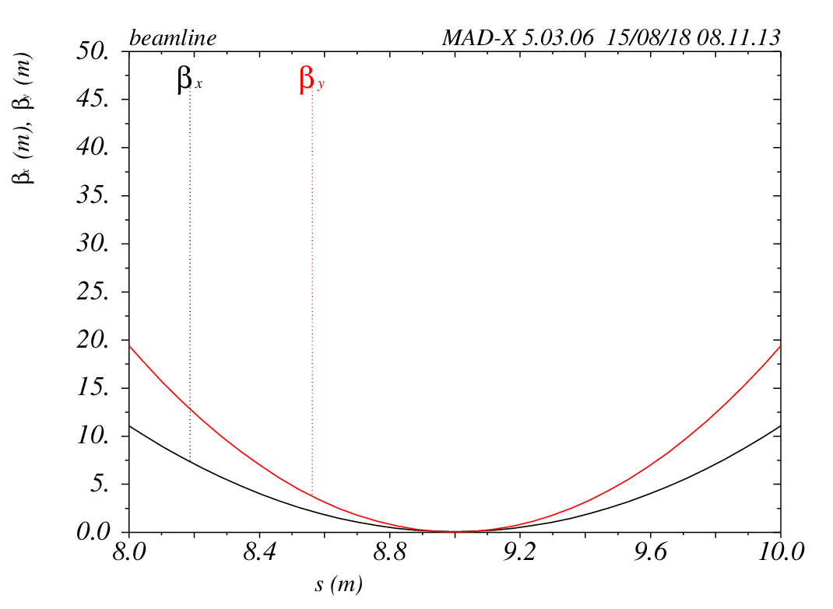
Final focus optics - Zoom
Beam size at the IP: σ = 5.4 μm
Distance to first Quad: 9 m

Slide 19
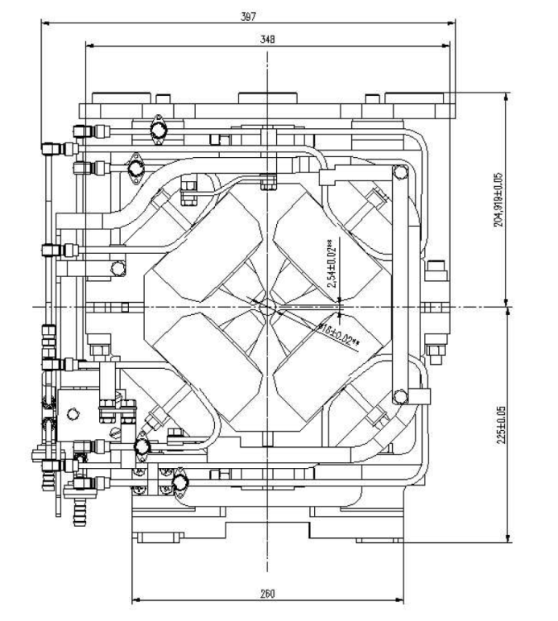
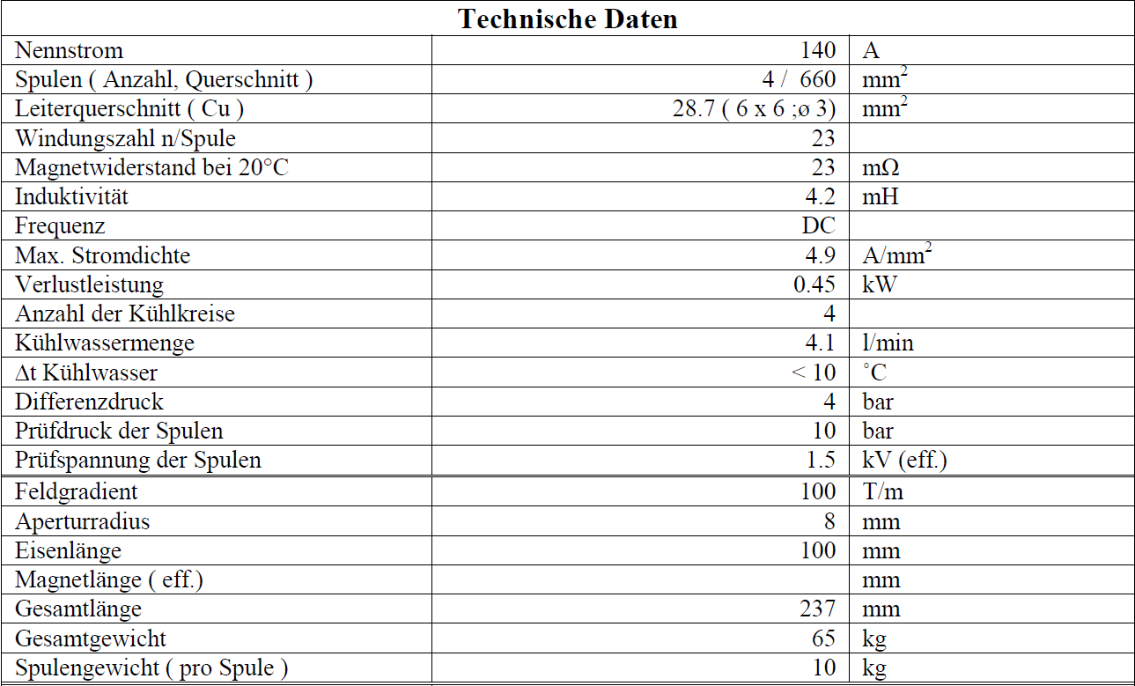
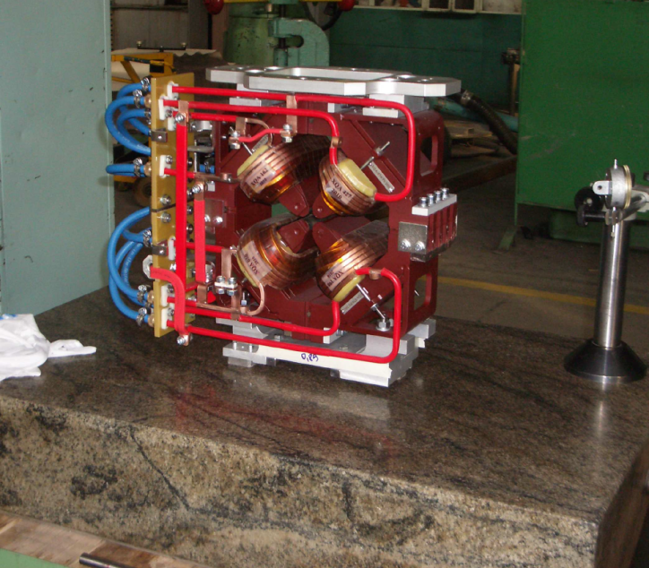
Triplet Magnet Parameters
Gradient: 100 T/m
Length: 10 cm
Aperture: 16 mm

Slide 20
Schematic CAD Integration
Kicker/Septa
Bend
Triplet
IP
Dump
Downstream of IP design to be studied.

Slide 21
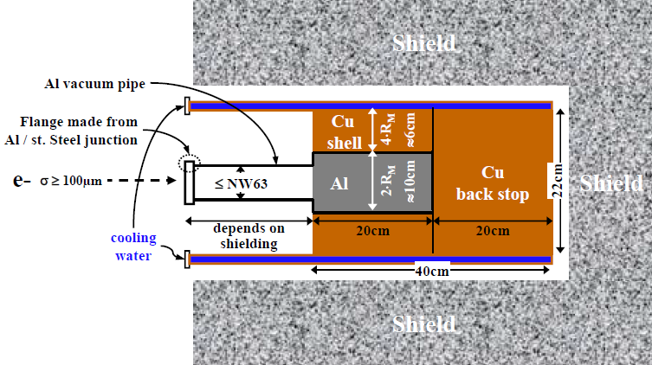
Single Bunch Beam Dump
First design considerations
~ 200 W power deposition
Al-Cu design, size and dimensions to be discussed.
In vacuum – Design of the beam window to be studied.
Shield dimensions to be discussed with radiation protection
Injector Beam Dump Design

Slide 22
Outlook - next steps
Optics design
  Beam quality after UN2?
  Spectrometer design
  Collimator design
  Beam Instrumentation requirements
Detector design
Laser beamlines and interaction region design.
Evaluate required shielding
  Single Bunch Dump
  General Radiation protection
Background to Detectors
Safety and Integration

Slide 23
Conclusion
First design considerations.
Possible location of the experiment with space constraints found in XTD5 / XSDU1
Re-use or copy existing design of magnets and elements.
Input from various groups.
IP, spectrometer and detector design ongoing.
Integration studies ongoing.
Layout and achievable parameters look feasible.

Slide 24





Acknowledgements
R. Assmann, R. Brinkmann, W. Decking, N. Golubeva, A. Hartin, I. Hartl, B. Heinemann,
J. List, E. Negodin, M. Schmitz, M. Wing, …
Thank you

Slide 25
Dr. Florian Burkart
Department: MPY1
Florian.Burkart@desy.de
Phone: 040-8998 3039

Slide 26
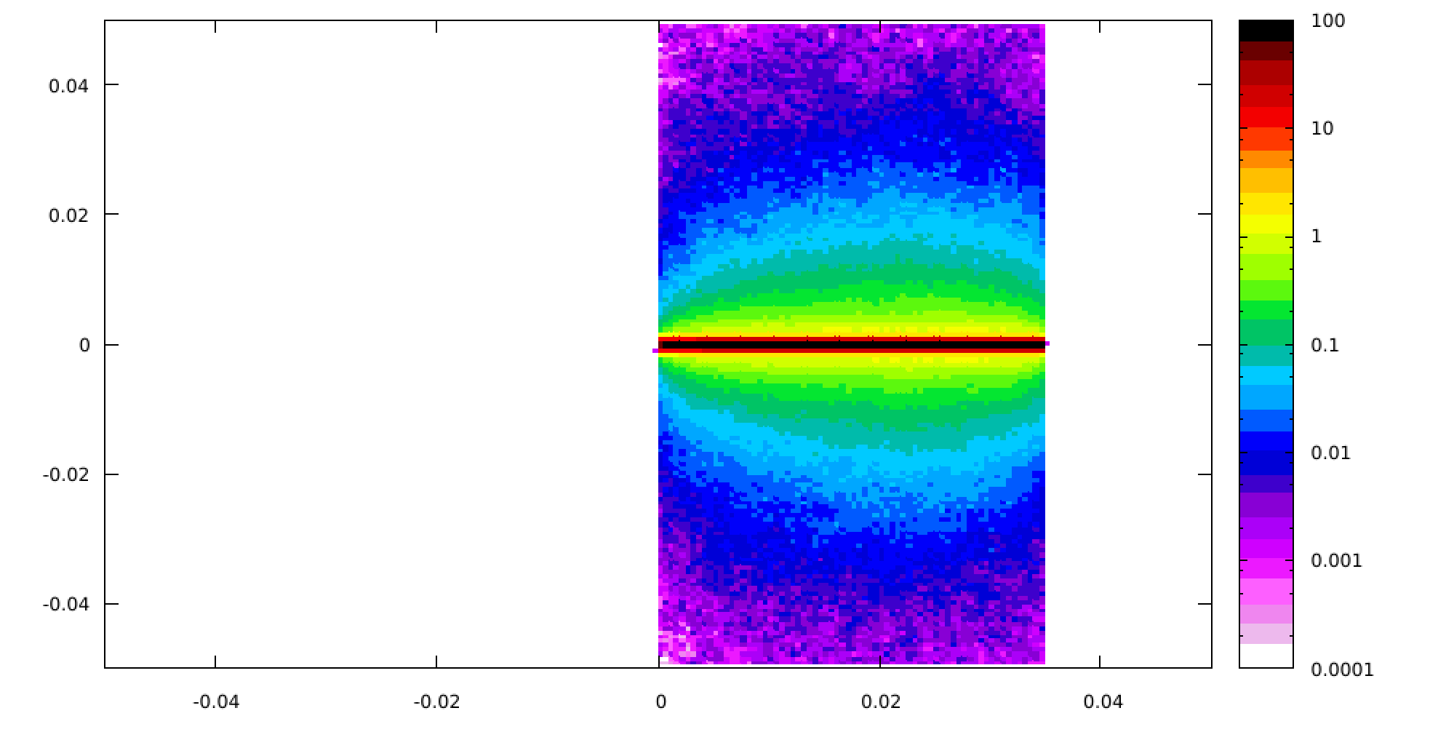
Foil survival
Tungsten, 0.035 cm, 5 μm e- spot size
T: 80 K
Pressure waves, to be studied
Transversal (cm)
E_{dep} (GeV/cm³/e⁻)
beam direction (cm)

Slide 27
Optics in XTD5 with extraction to LUXE
Septa
Kicker

Slide 28
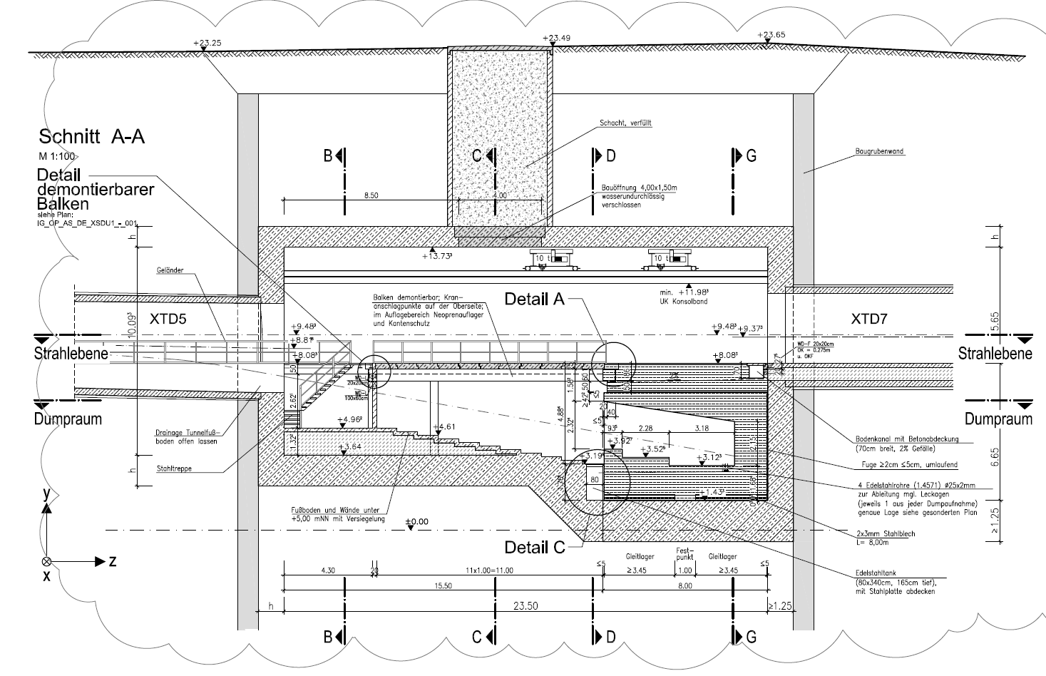
Dump Area

