Slide 1
Tests on Chess 2 ASIC
Dionisio Doering, Yubo Han_{IHEP} , Pietro Caragiulo, Larry Ruckman, Camillo Tamma, Mazin Khader_{UIUC}, Murtaza Safdari, Su Dong

Slide 2
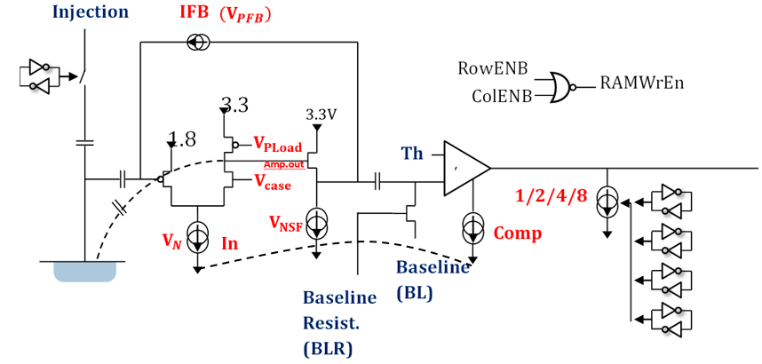
Pixel description

Slide 3
Outline
Review:
Several tests on the new std resistivity board #02.
Change to use (35μs-delay and 50ns-width) Qinj instead of inversed of inv-Qinj.-> cleaner start
Different hit counts observed with different Qinj Pulse height->hit efficiency vs threshold has strange valley structure
simultaneous readout of multiple pixels have apparent impact on efficiency.-> need more systematic examination
Current main bias sensor:
- Main problem: large leakage current when LV turns out
- Adding higher resistance (R18) to HV bias low pass filter helps stability
- Checking resistance and voltages on each pin, and try to isolate source of culprit:
=> Removing fuses on carrier to disconnect LV supply lines
=>Tristate FPGA signal pins to high impedance
=> Removing carrier resistors to disconnect control lines

Slide 4
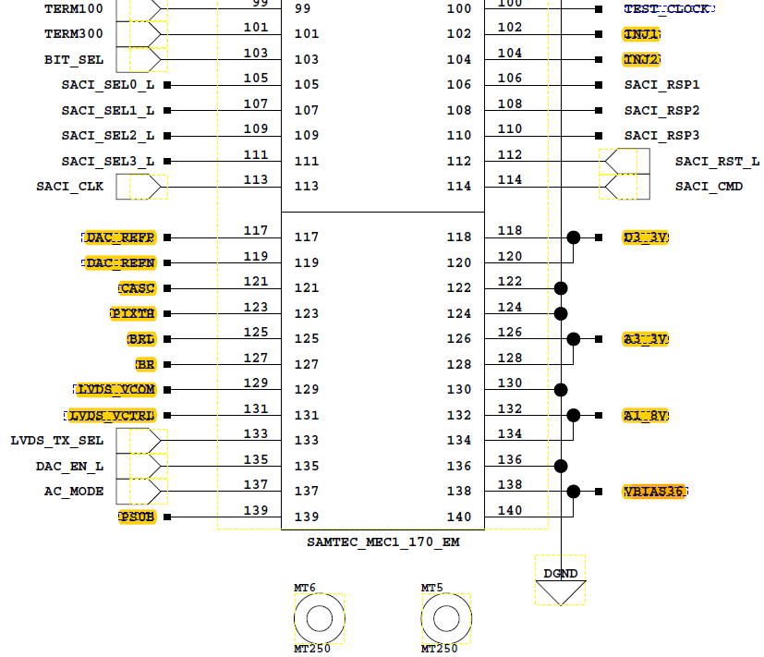
Bias tests
Main problem: bias the two std resistivity daughter board ( #01 and #02 )
daughter board #01: large current once powered on the carrier board.
daughter board #02: always see large current
—Replace the broken bias voltage supply cable
—>normal and stable without plugging in the daughter board.
Connecter:
Resistance check: on carrier board and the two daughter board without powered on.
—>different resistance of VBias pin to the GND observed on the two board.
Board #01: 4.4KOhm. Board #02: 7MOhm
Voltage check: the power supply pin on the carrier board with power on
—> still observe 2.52V or 3.27V with erased FPGA (didn’t noticed at first)
Erasing the FPGA: only the pin marked by yellow bar were left (exclude the power supply).
LVDS_VCOM, LVDS_VCTRL,DAC_REEP,DAC_REFN, BRL,BR,CASC,PIXTH

Slide 5
Bias tests
Erasing the FPGA: only the pin marked by yellow bar were left (exclude the power supply).
LVDS_VCOM, LVDS_VCTRL,DAC_REEP,DAC_REFN, BRL,BR,CASC,PIXTH
—remove the resistance on the carrier board connected with all the port above one by one and do the bias tests.
—change R18 to 10kOhm
—> daughter board #01: still CMPL once add the low voltage power supply.
daughter board #02: will get ~ -70μA with bias voltage at -3V(changing till CMPL)
~ -20μA with bias voltage at -2V(changing but stable)
the results of the daughter board #02 will not affected by the low voltage power supply.
—remove the fuses of the 4 power supply pin
—>daughter board #01: ~-3.0μA without power on the carrier board
CMPL once power on
daughter board #02: ~ -40μA without power on
CMPL once power on
R18: the R connected with PSUB. Increase to act as a low pass filter-> optimize the bias voltage.

Slide 6
Summary
Several bias tests have been done.
Daughter board #01 always have large current once powered on the board.
Daughter board #02 could only add no more than -3.7V as bias voltage without low power supply(before the fuses were taken off).
Gradually bring back FPGA digital signals and control line voltages to pin point source of the large leakage current.

