Slide 1
CKF validation

Slide 2
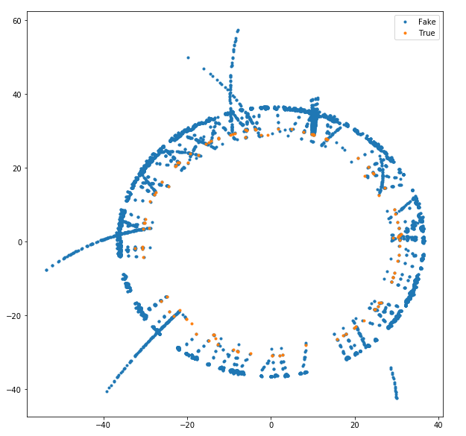
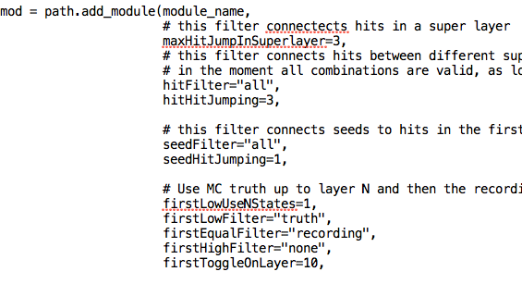
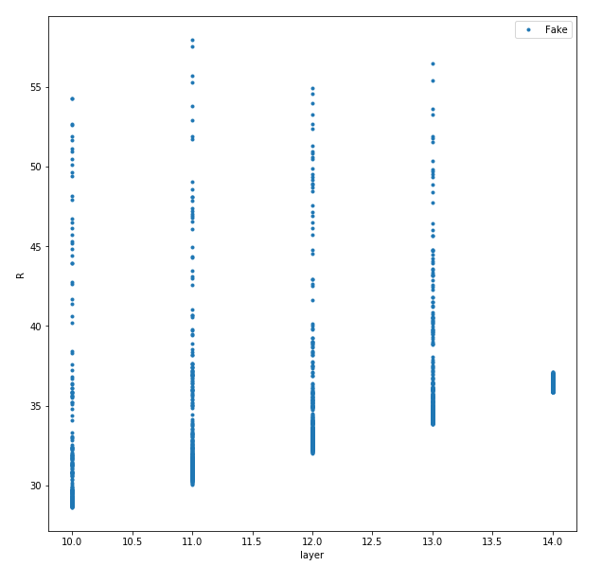
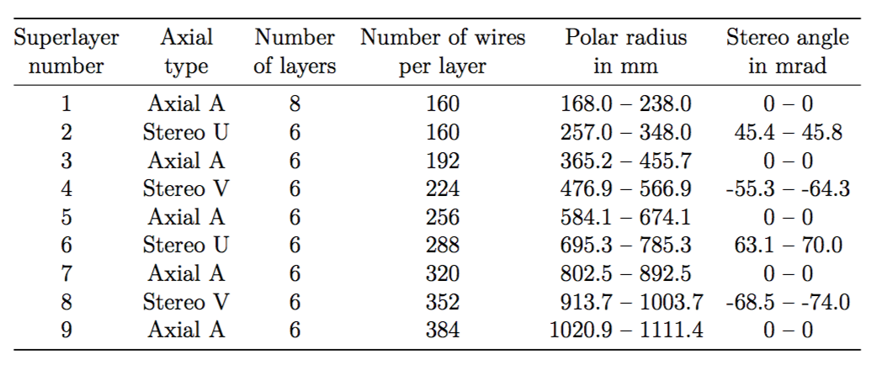
Abnormal hit position
R cm?
Layer

Slide 3
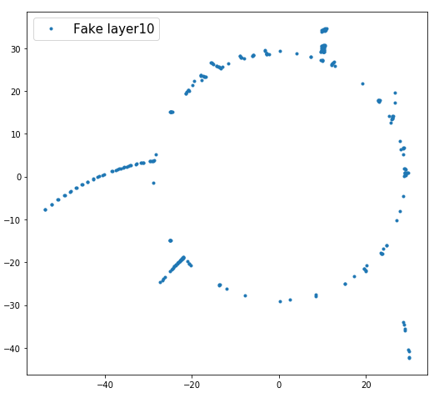
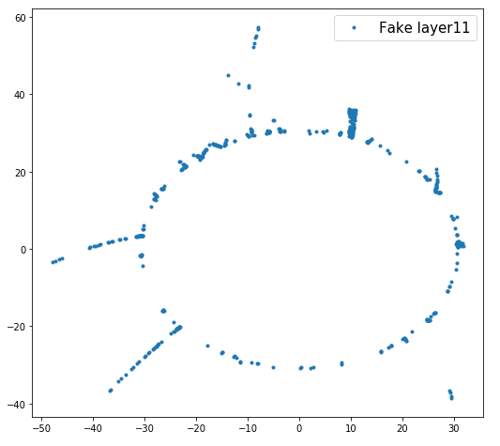
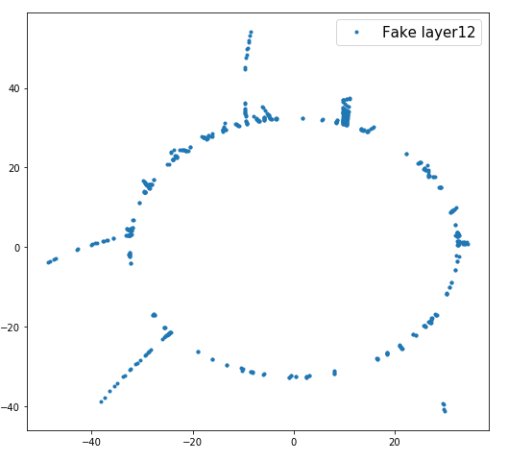
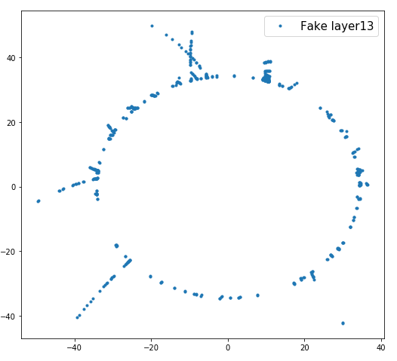
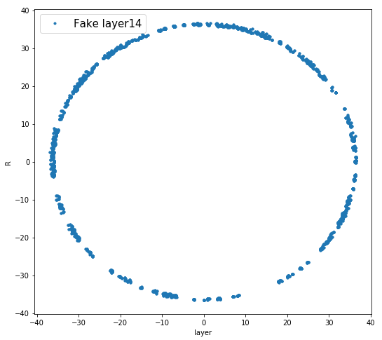
Abnormal hit position

Slide 4
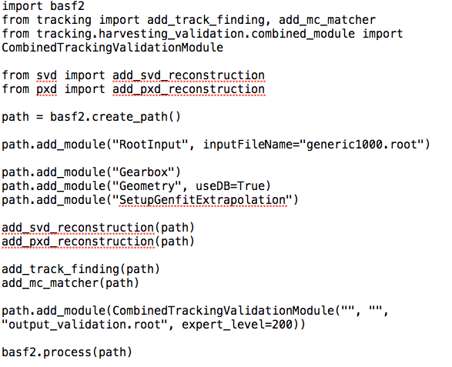
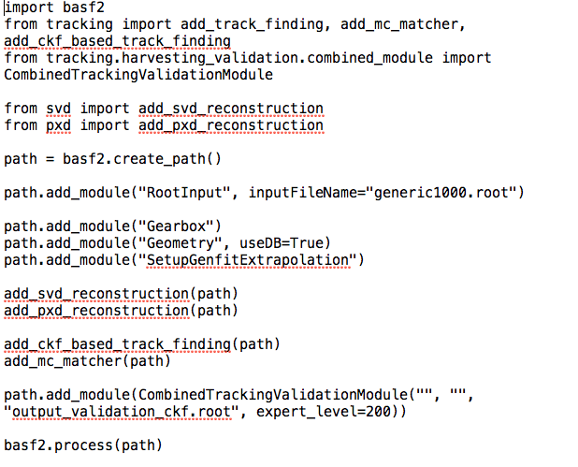
CKF based tracking validation
MC: Y(4S) events
b2run_simulation -p 10 -d TrackingDetector -n 1000 -g generic generic1000.root
Default track finding
CKF based track finding

Slide 5
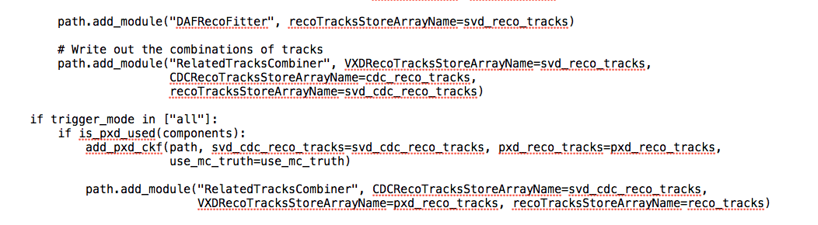
CKF based tracking validation
MC: Y(4S) events
b2run_simulation -p 10 -d TrackingDetector -n 1000 -g generic generic1000.root
Default track finding (default option)
CKF based track finding (default option)
Why add PXD hit at the end?

Slide 6
Performance comparison (mc tree)

Slide 7
Performance comparison (pr tree)

Slide 8
Eff. And purity
PR
  Matched
  Clone
  Fake(bg,ghost)
MC
  Found / matched
  Merged
  missing
MC
PR
Eff = Green/Red+Green
Purity=Green/Blue+Green
How to get tracing finding eff.?

Slide 9
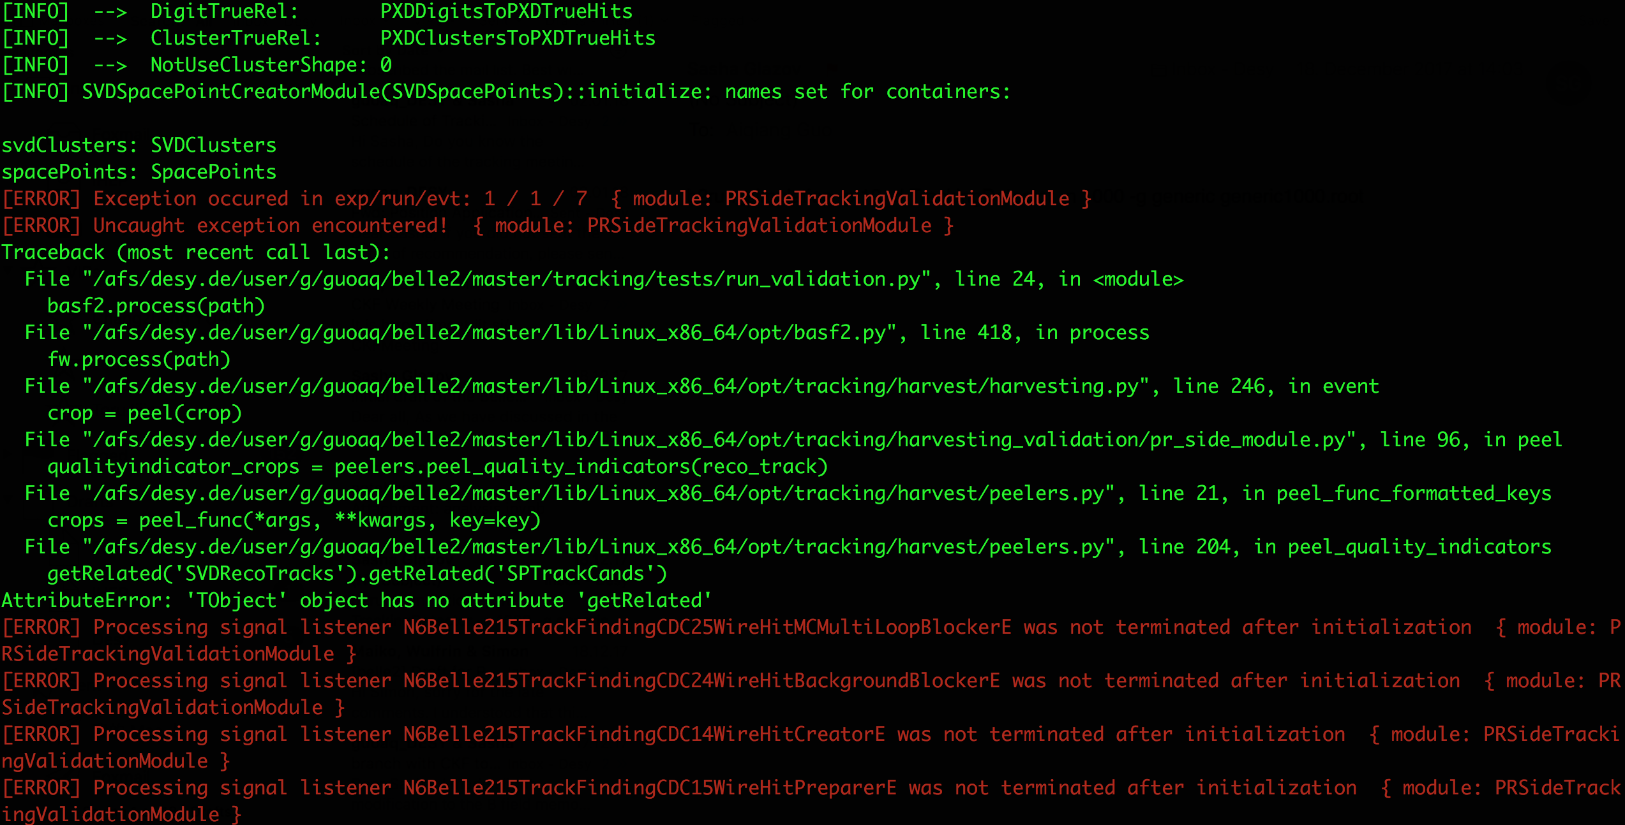
Some issue
The run_validation.py script will be crashed in the latest master branch. Sasha give a solution:
+# if not space_point_track_cand:
+# space_point_track_cand = reco_track.getRelated('SVDCDCRecoTracks').\
+# getRelated('SVDRecoTracks').getRelated('SPTrackCands’)

Slide 10
Next step
Compare the performance in different option.

