Slide 1
Tests on Chess 2 ASIC
Dionisio Doering, Yubo Han_{IHEP} , Pietro Caragiulo, Larry Ruckman, Camillo Tamma, Mazin Khader_{UIUC}, Murtaza Safdari, Su Dong

Slide 2
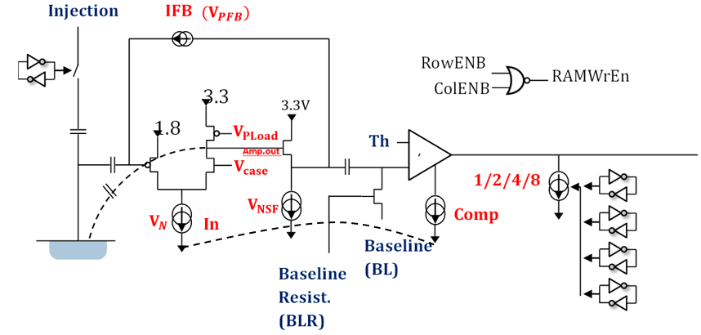
Pixel description

Slide 3
Outline
Bias test:
Increase the upper limit of the bias voltage supply to 2mA
IV curve of the 3 daughter board.
(Std resistance: #01,#02 High Resistance:#19)
Tests with bias voltage added:
Qinj tests with different bias voltage
Using a red LED as a signal source to test the sensor.

Slide 4
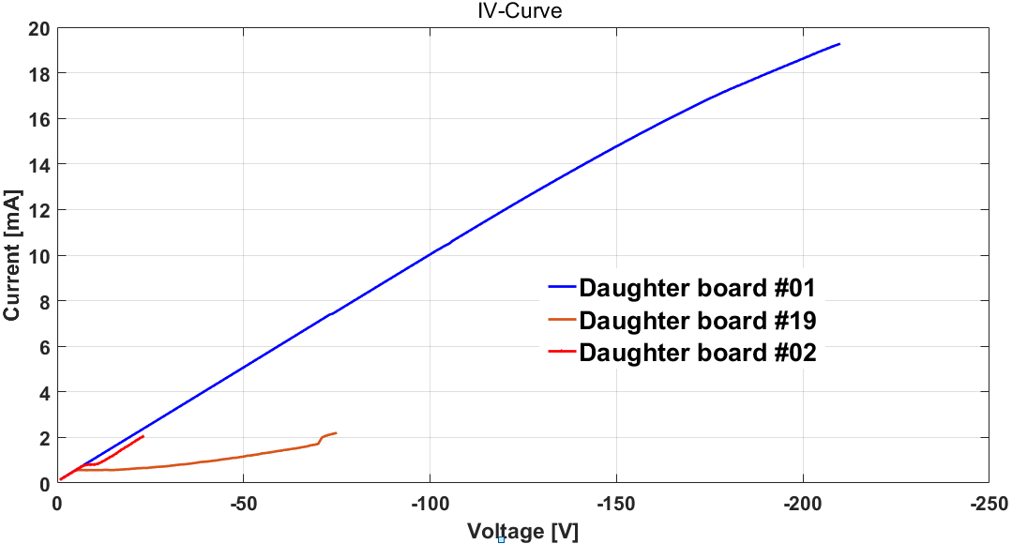
IV-Curve
IV-Curve of 3 boards:
Std Resistance board: #01, #02
High Resistance board: #19
#01: current keep increasing
#02: have a flat region at voltage -8V~-9V
#19:
->stop linearly increasing at -5V and keep ~0.57mA till -15V.
->gradually increased to 2mA (the upper limit)

Slide 5
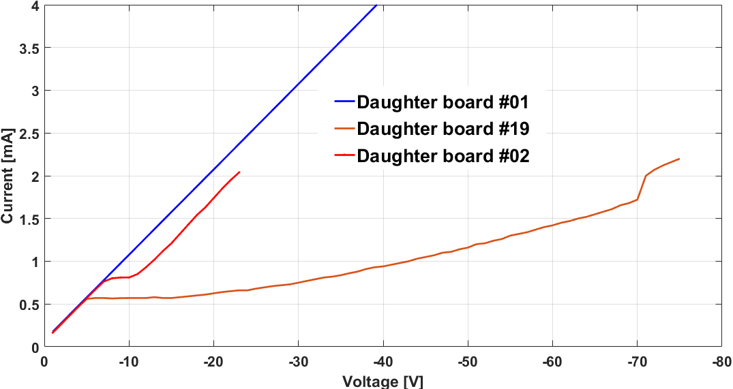
IV-Curve
IV-Curve of 3 boards:
Std Resistance board: #01, #02
High Resistance board: #19
#01: current keep increasing
#02: have a flat region at voltage -8V~-9V
#19:
->stop linearly increasing at -5V and keep ~0.57mA till -15V.
->gradually increased to 2mA (the upper limit)

Slide 6
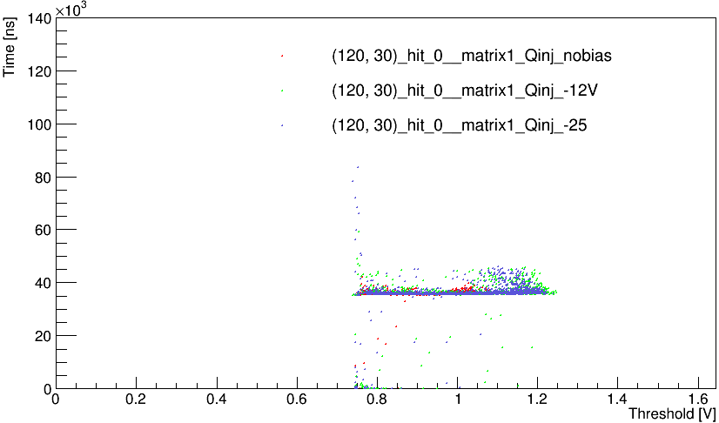
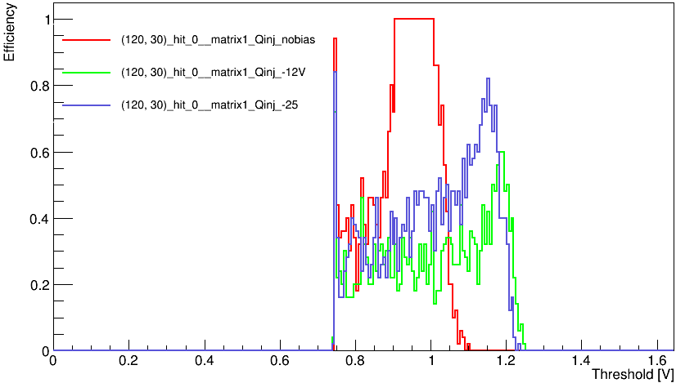
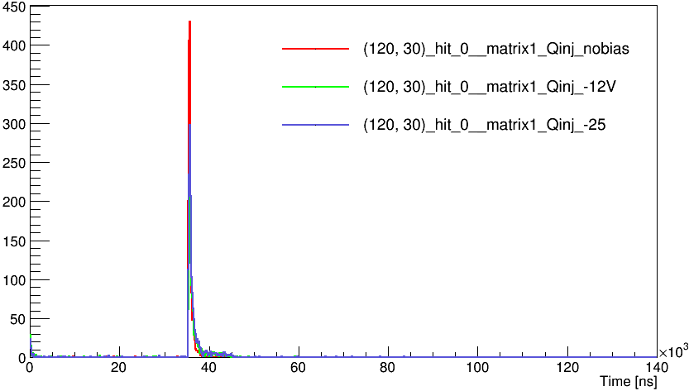
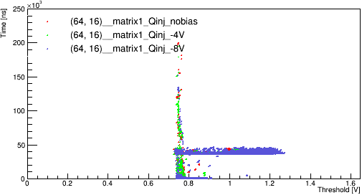
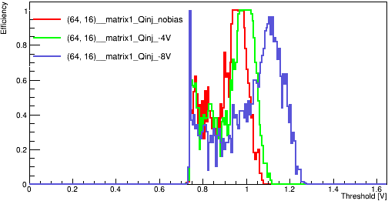
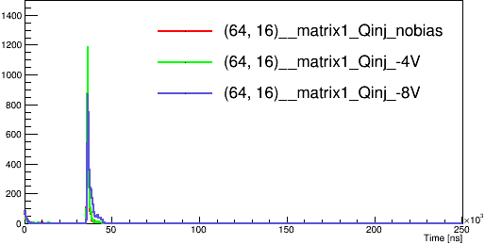
Qinj tests with bias voltage
#daughter board 19
Default conf
Qinj delay: 35μs
width: 10μs
BL: 0.75V
One pixel enabled: Pixel (120,30)
normal tests with different bias voltage: (0v, -12v, -25v)
#daughter board 02
Default conf
Qinj delay: 35μs
width: 10μs
One pixel enabled: Pixel (64,16)
normal tests with different bias voltage: (0v, -4v, -8v)
Qinj signal extended to larger threshold with bias voltage added -> coupling with the Qinj capacitance?

Slide 7
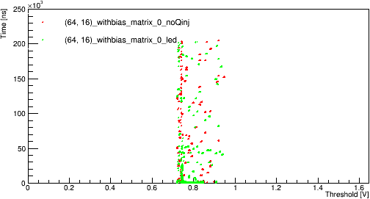
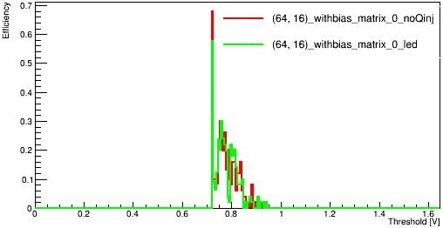
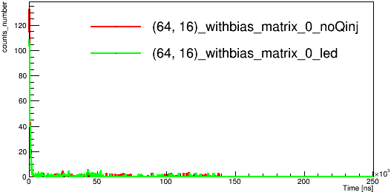
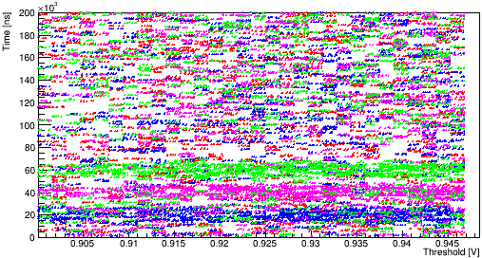
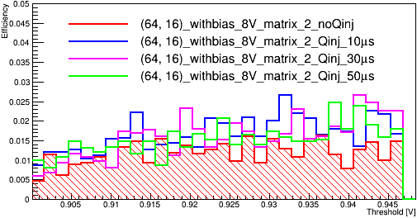
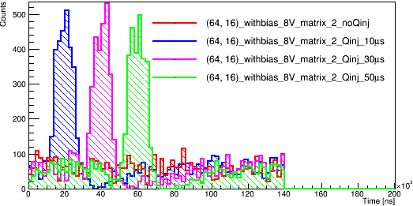
Tests using red led on #02 board with bias voltage
#daughter board #02
Default conf
Threshold vs time
Threshold vs efficiency
Time vs hit number
Tests:
Using a red led as signal source instead of Qinj.
Bias voltage -8V: Daughter board #02 could hold at ~0.86mA at -8V.
Red led: synchronically trigged by Qinj Pulse.
1st column:
Threshold: 0-1.65V
Qinj delay： 35μs.
2nd column:
look into (0.9~0.95V)
More statistic.
different Qinj delay:
10μs, 30μs, 50μs
0.9~0.95V -> Try to find a region only with signal.
Different peak corresponding to different Qinj delay observed.
No big difference on the efficiency and similar noise level -> signal too small?

Slide 8
Summary and Next
Manage to add bias voltage on the 3 board.
#01: current will hold at certain voltage but will increase with bigger bias voltage
#02: similar to #01 but will have a small region (-8V~-9V) with same current. Have try higher voltage.
#19: will hold ~0.57mA from -5V to -15V then gradually increase till a break around -70V.
Normal Qinj tests with bias voltage: changed the range of Threshold with signal -> coupling with the circuit?
Tests using LED as a signal source
Light from the LED is observed as signal source.
Need more statistics and signal size vs threshold not that distinctive compared to noise -> signal too small?
Next:
More systematic tests on how bias voltage affect noise and signal threshold.
Laser diode at 650nm and 850nm to probe intensity, depth and spatial variations
( some improved mechanical setup needed: shielding from light, laser diode holder and control)
Trigged readout in test beam

