Slide 1
Implementation of CKF for CDC and SVD TF
Sasha Glazov, Miraim Kuenzel, Aiqiang Guo

Slide 2
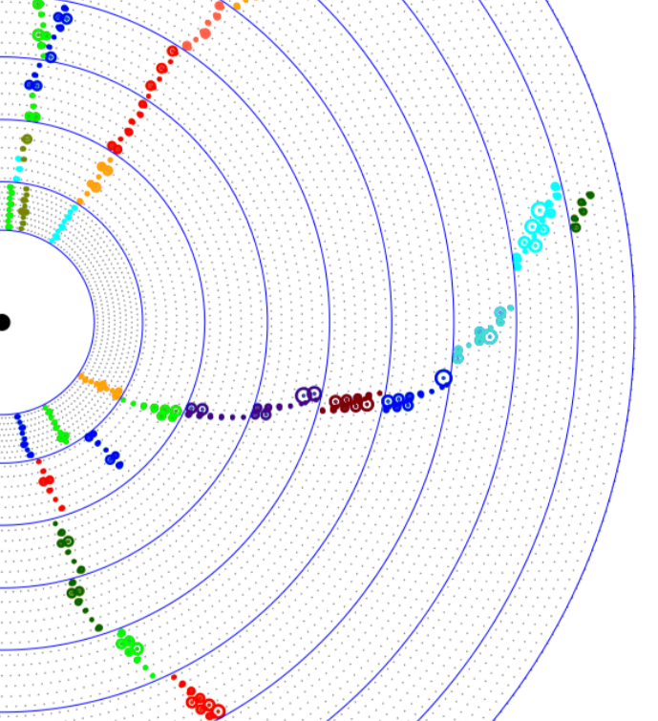
Work flow of CKF based TF
Implemented by Nils
Stand-alone CDC tracking
Stand-alone SVD tracking
Merge CDC →SVD
For unmerged CDC track, add extra SVD hits with CKF
For unmerged SVD track, add extra CDC hits with CKF
Extrapolate to PXD with CKF
Miraim is working on it

Slide 3
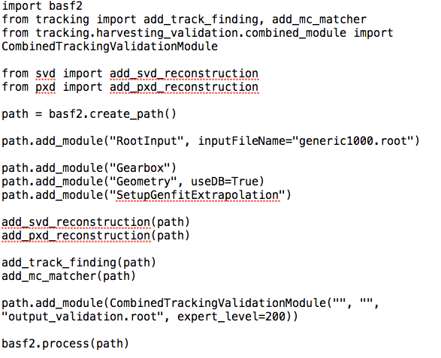
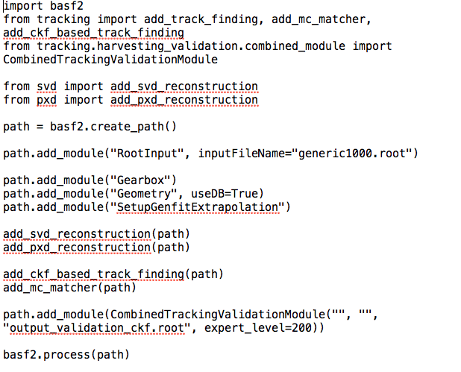
CKF based tracking validation
MC: Y(4S) events
b2run_simulation -p 10 -d TrackingDetector -n 1000 -g generic generic1000.root
Default track finding
CKF based track finding

Slide 4
Hit Efficiency

Slide 5
Hit purity
5

Slide 6
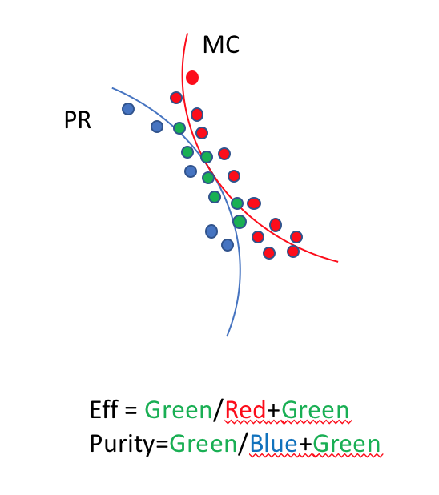
Hit purity
6

Slide 7
TF efficiency

Slide 8
SVD to CDC CKF
Stand-alone CDC tracking
Stand-alone SVD tracking
Merge CDC →SVD (CKF)
For unmerged CDC track, add extra SVD hits with CKF
For unmerged SVD track, add extra CDC hits with CKF
Extrapolate to PXD with CKF
filter1
KF step
filter2
filter3
KF up.

Slide 9
The implementation
The current strategy is as follows:
Load all the needed items: VXD seed tracks and CDC hits
Turn every loaded object into one CKF state
Implement the seed-hit and hit-hit relations(those may be based on clusters, segments or layers)
Hits allowed by the relation maps have to survive the following chain: filter 1 - Kalman step - filter 2 -Kalman update - filter 3(Use NResults where possible)
The result is written out as one (preferred) or more reco tracks

Slide 10
The filter variables
Filter 1 and 2 (already fully implemented) will be distance-based filters, filter 3 will probably be a χ² filter
  Filter 1: distance xy
  Filter 2: distance mSoP xy
For test purposes, I simulated one- and two-muon events with a particle gun, assuming a uniform distribution in the momentum spectrum between 0.2 and 3.5 GeV

Slide 11
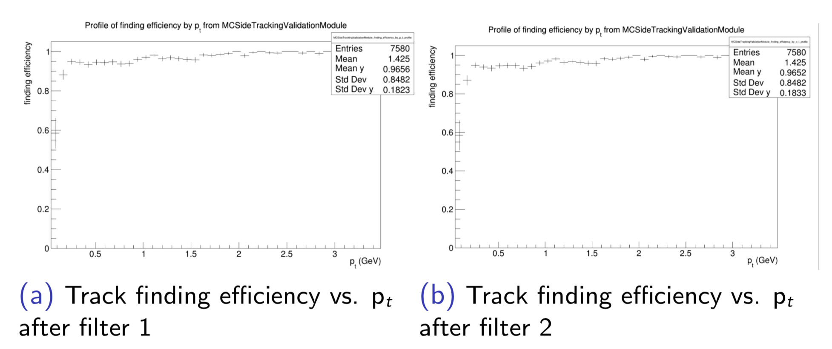
Track finding efficiency (𝜇)
M. Kuenzel

Slide 12
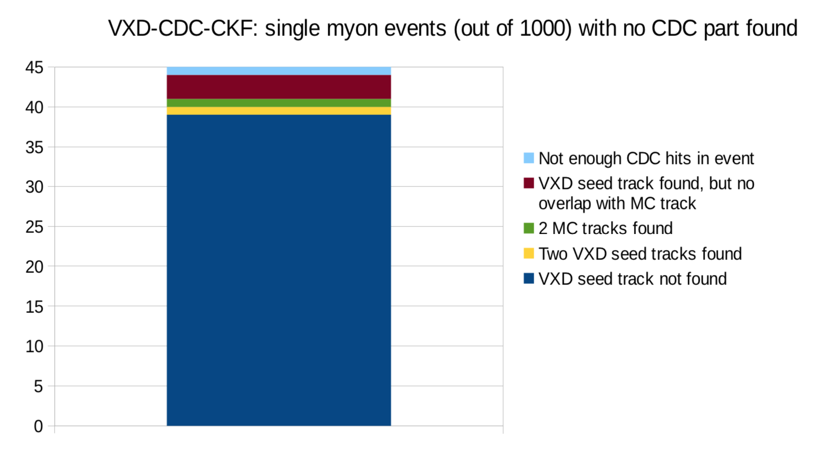
Which tracks are missing
M. Kuenzel
Alone beam
Limited SVD hits
Muon decay
Low momentum
Circle track
SVD hit too small

Slide 13
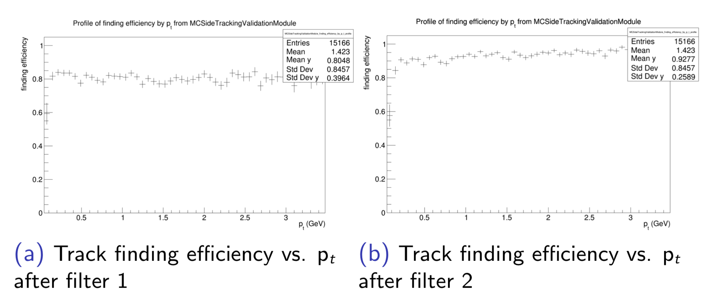
Track finding efficiency (𝜇𝜇)
M. Kuenzel

Slide 14
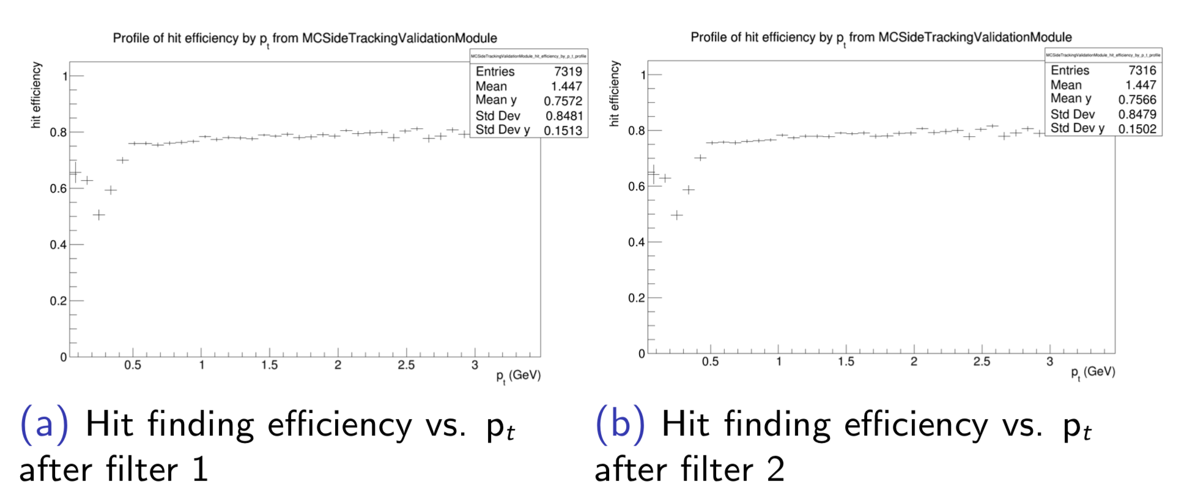
Hit finding efficiency (𝜇)
M. Kuenzel

Slide 15
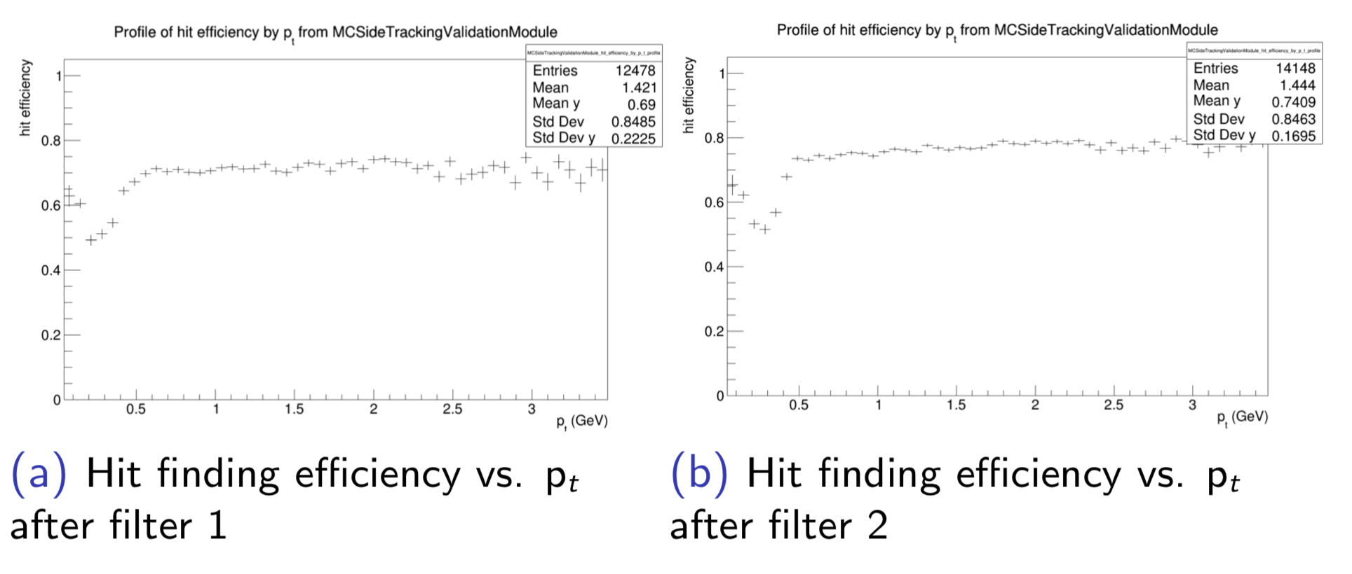
Hit finding efficiency (𝜇𝜇)
M. Kuenzel

Slide 16
Summary and outlook
CDC to SVD CKF is validated roughly. Reasonable efficiency improvement is observed.
SVD to CDC CKF implementation is on going.
Filter 1 and 2 are implemented and first efficiency plots were produced using one- and two-muon events.
Next step:
More parameters of CKF will be investigated.
Filters will be optimized
Validate the algorithmen with more background.
Thank You!

Slide 17
Back up

Slide 18
Efficiency and Purity
PR
  Matched
  Clone (1 MC 2 PR)
  Fake(bg,ghost)
MC
  Found / matched
  Merged (2 MC 1 PR)
  missing
MC
PR
Eff = Green/Red+Green
Purity=Green/Blue+Green

