Slide 1
Comparison of Vibration Data
Sabine Cunis
PSPO
Feb. 2nd , 2018

Slide 2
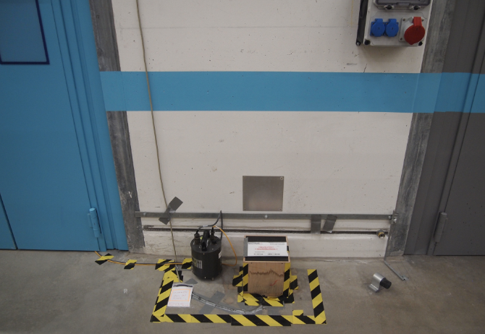
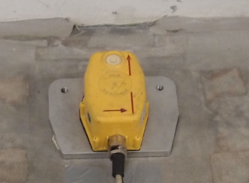
… measurements in the SPB area … close to the pillar holding the ceiling currently with two devices
Geophone
  installed (glued to the ground) by Heiland
  providing daily readouts
  for analysis of building and vibrational input of installed technical infrastructure
Seismometer, guralp 6TD, MEA-S8_XFEL
  can be placed wherever there is a network socket and 220V
  connected to vibration client
  for online monitoring as well as analysis of history data
Measurement position 2, (MP2), … now a guralp seismometer and the geophone can measure in parallel
How well are these measurements comparable?

Slide 3
Overview :
We are measuring the vibrations at the experiment hall.
  Up to now the company Heiland takes measurements to monitor the building and installation process to see, whether and how well the building qualifies for research in the nano range.
  This contract ends and they are going to write their final report.
We will continue to do vibration measurements to analyse possible disturbances of experiment results.
1. We want to compare our measurements to those of company Heiland
  We can show that obtained data can be compared directly
2. We tried to analyse the impact of vibrations which can be observed.
  We chose the chiller in the SPB rack room as supected culprit (it is vibrating heavily!)
    We could see, that the chiller has influence on the hutch structure, but seemingly not on the hall floor …
  … but we additionally found other frequencies, which should be explained … perhaps by TS (?)

Slide 4
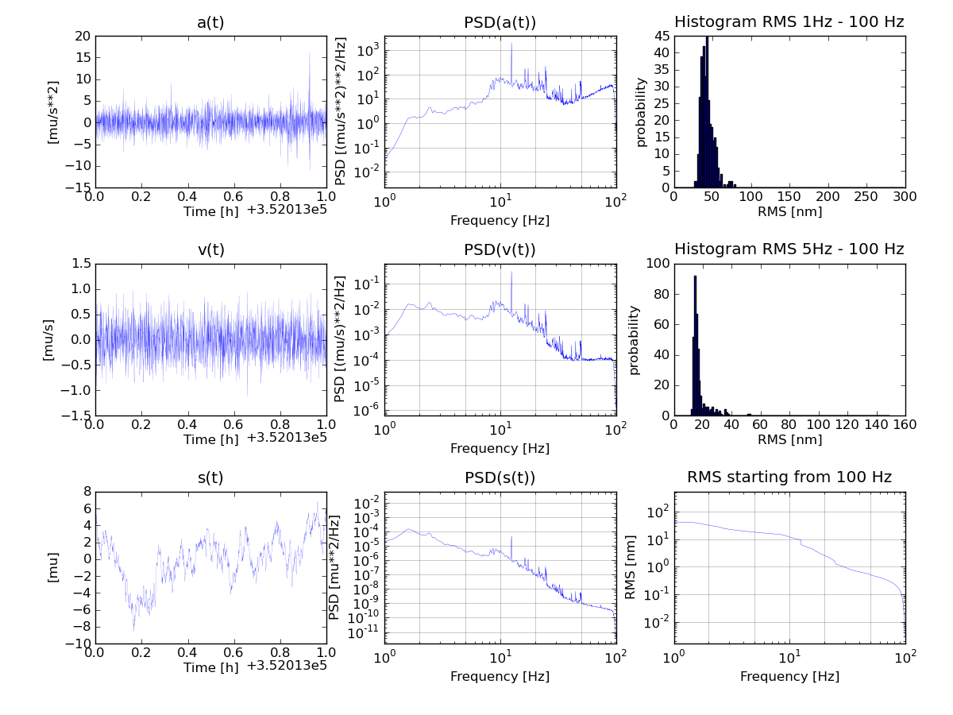

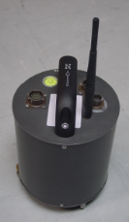
Overview of data processing
(graphical presentation by Gerd Wellenreuther)

Slide 5
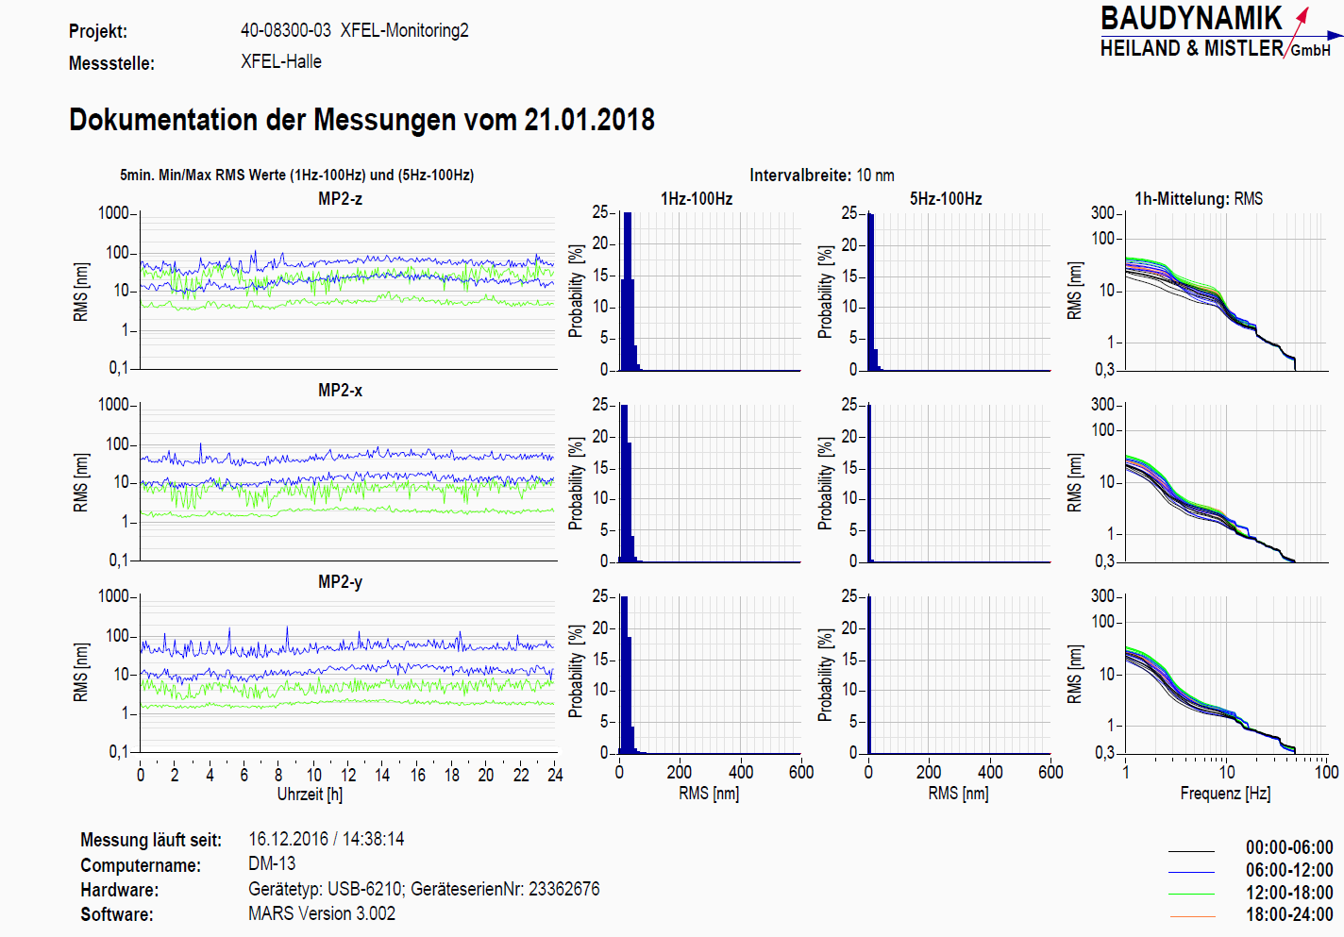
… geophone data from a Sunday … (RMS data submitted as ascii files)

Slide 6
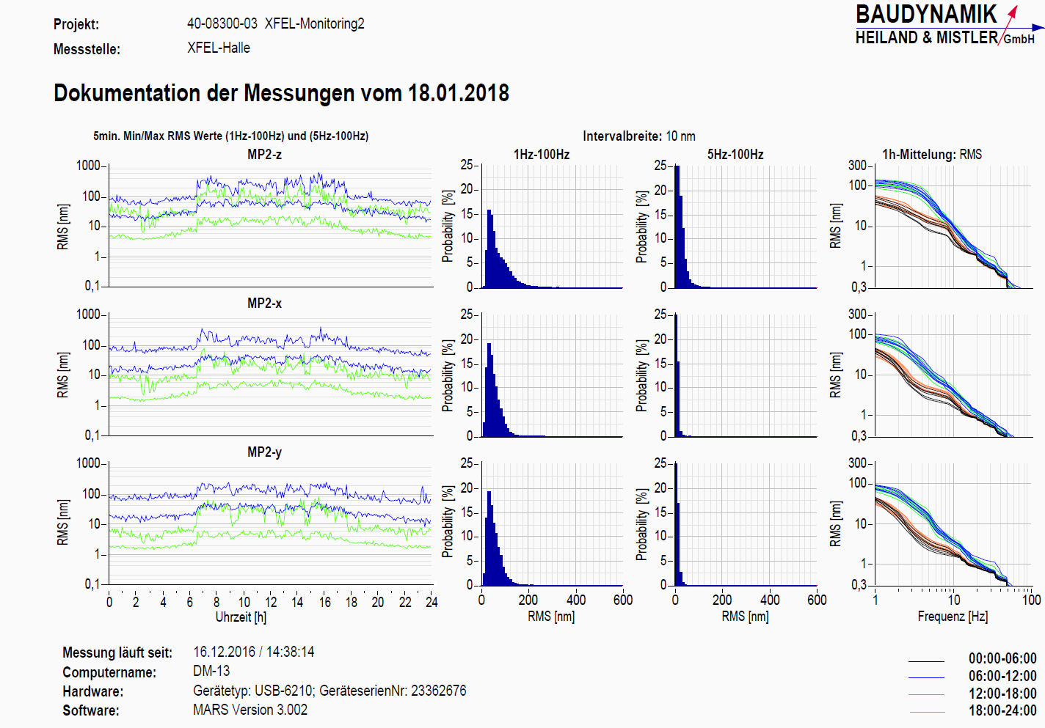
… as compared to a typical workday

Slide 7
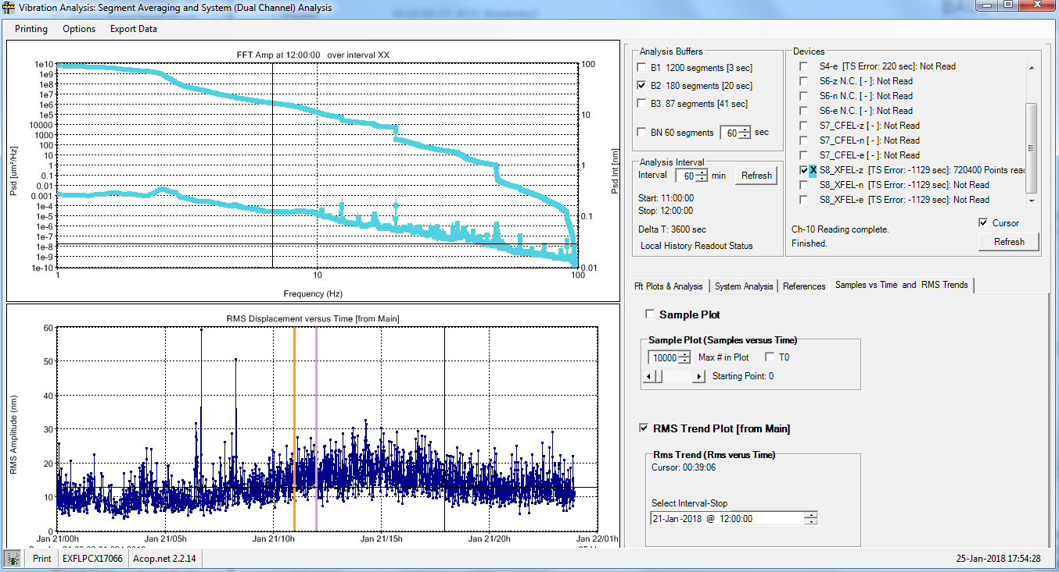
Seismometer data … such hourly RMS data can also be obtained via the readout software by Mark Lomperski (DESY – MIN)

Slide 8
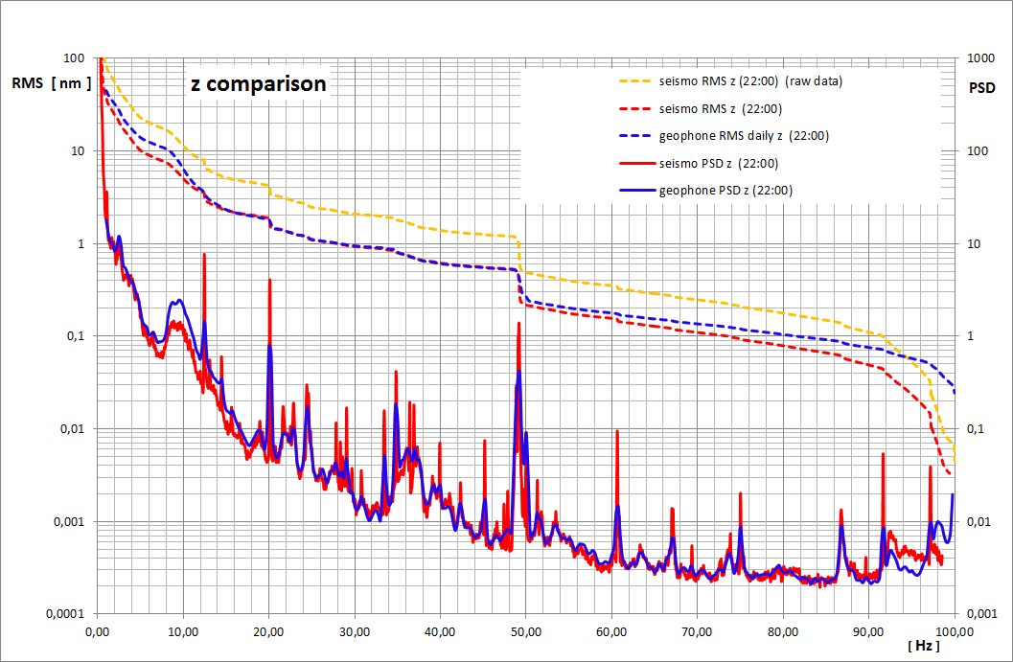
… data from both devices can be matched easily

Slide 9
Comparability is given
It is possible to compare these data.
The observed displacement is in the same order of magnitude and can easily be matched by a constant factor ( … here it is 2,25)
The observed peaks are at the same position. Peak height only depends on data resolution (…averaging).

Slide 10
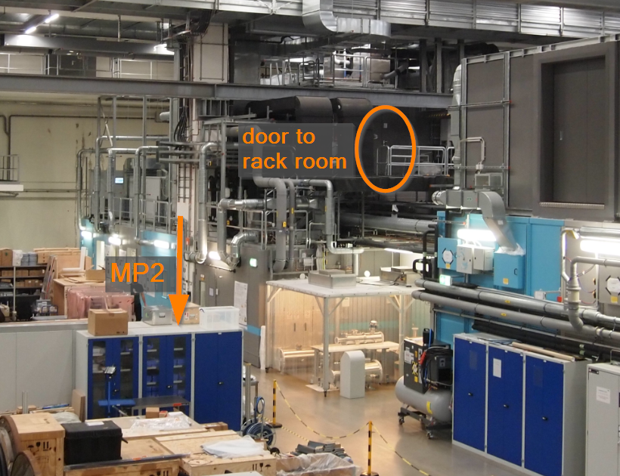
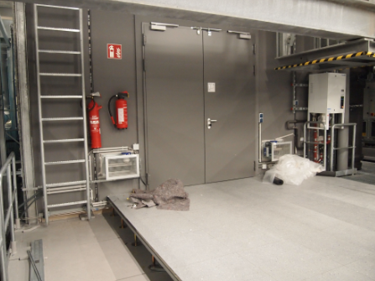
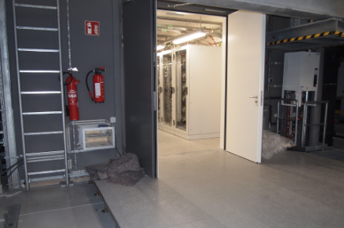
… now comparison of some “worst case“ data (SPB chiller) with the standard monitoring data (MP2)

Slide 11
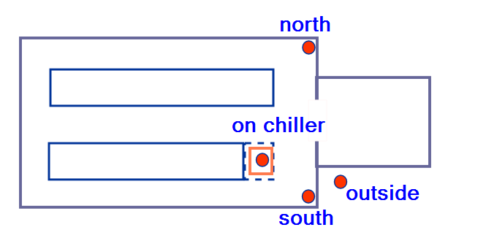
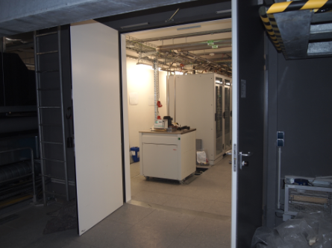
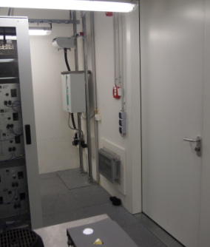
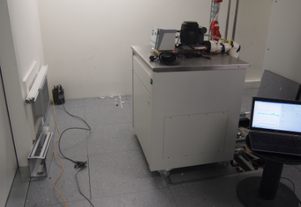
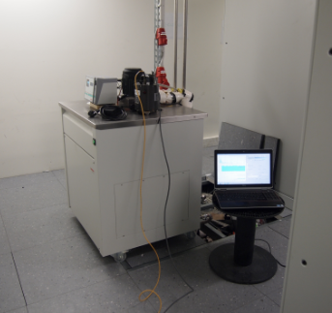
… seismometer positions at SPB-rck with chiller

Slide 12
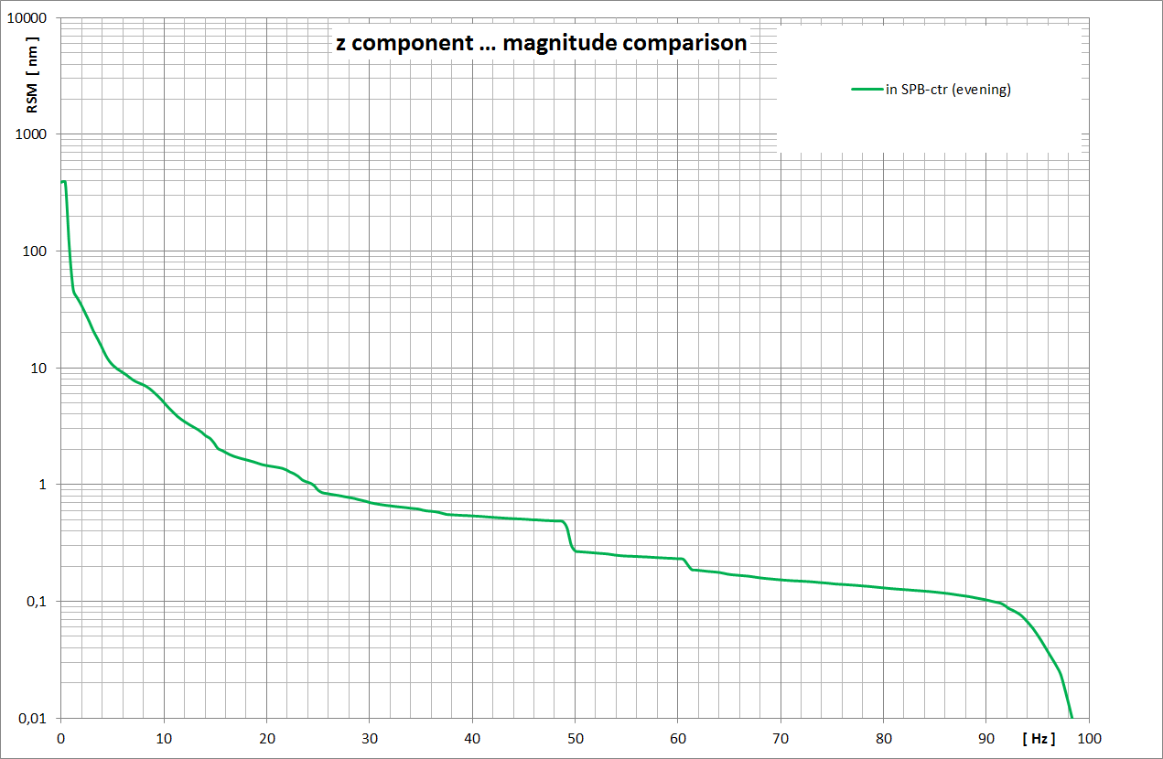

Slide 13
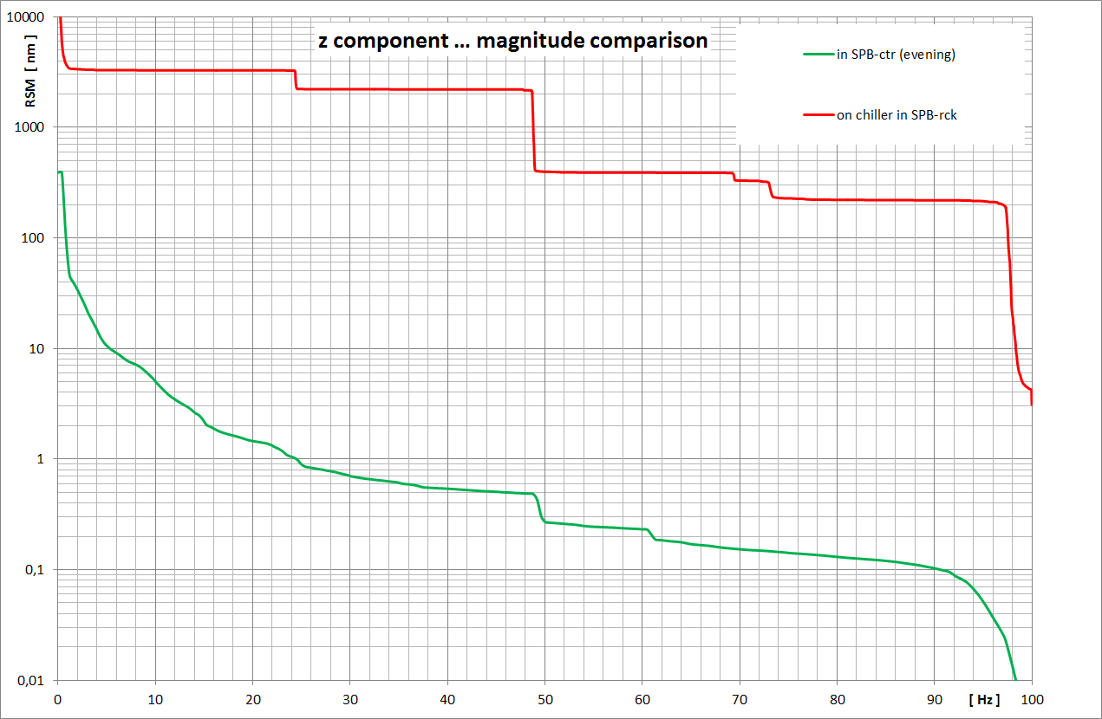

Slide 14
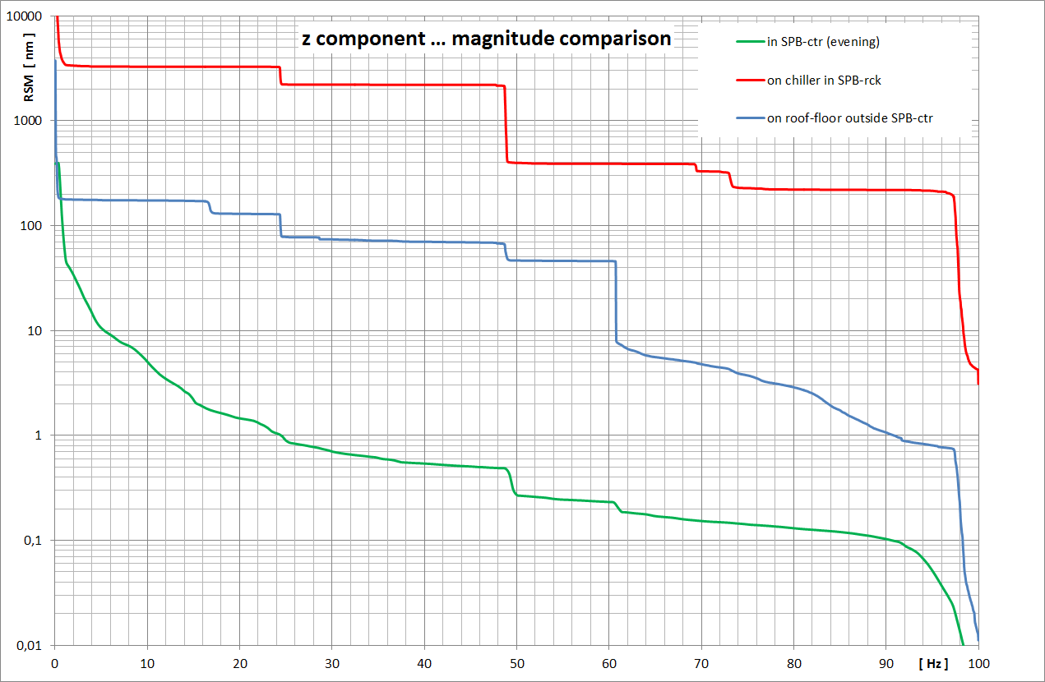

Slide 15
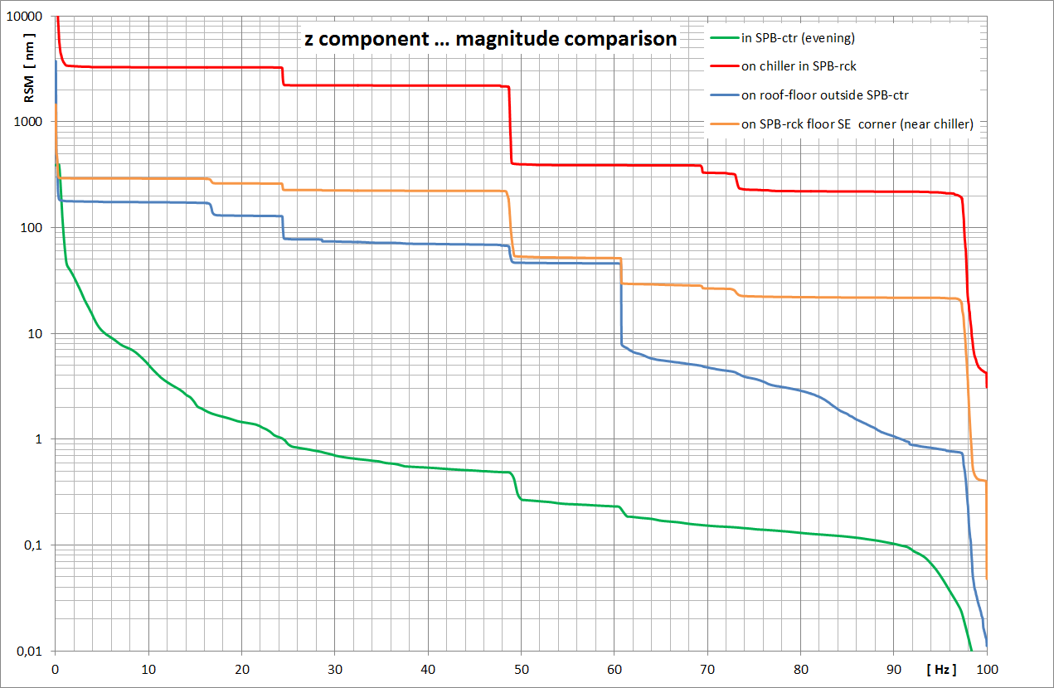

Slide 16
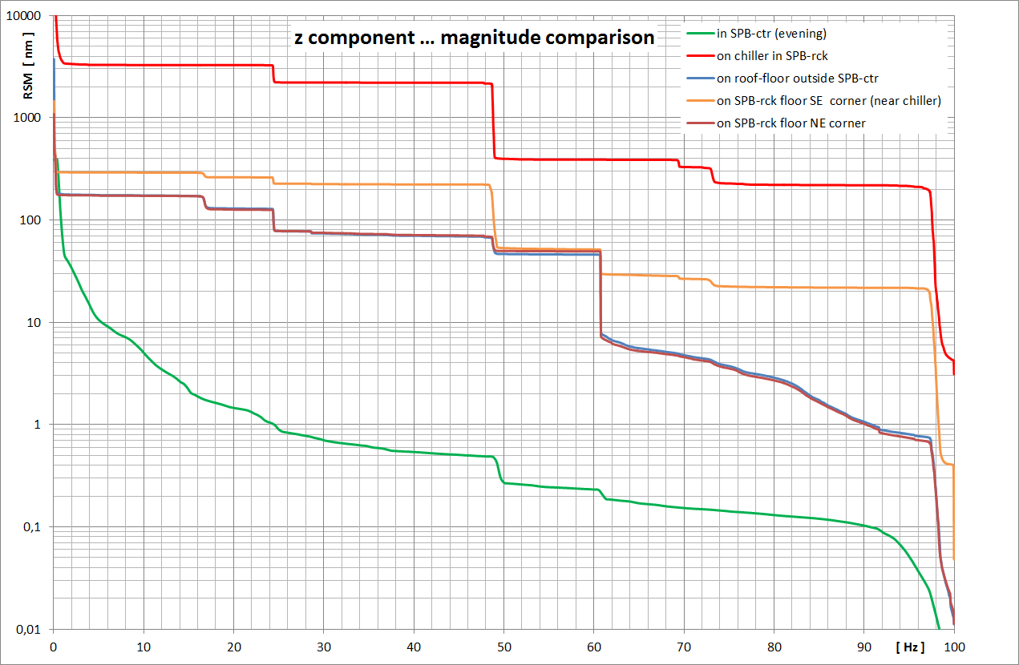

Slide 17
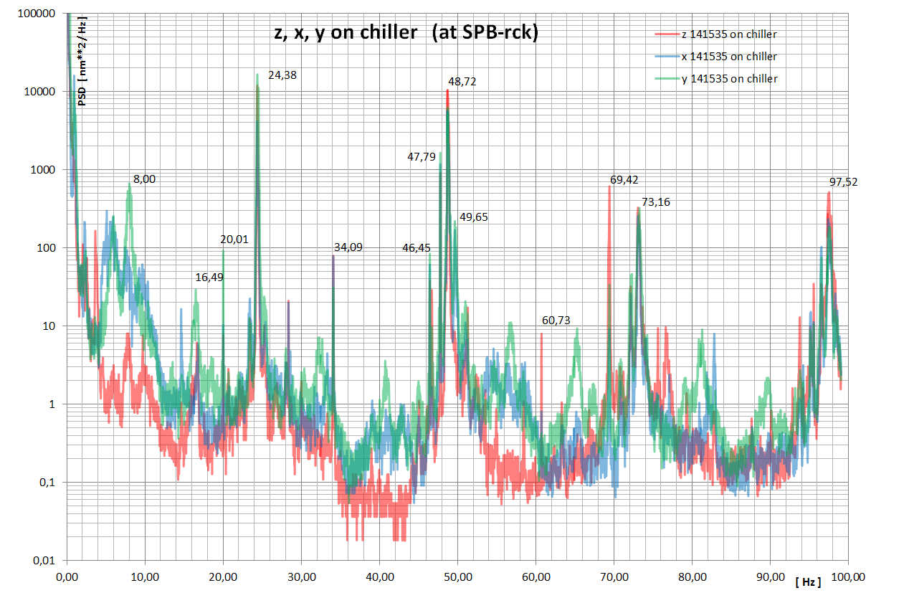
… to identify the spectral peaks of the chiller …
?
?
?

Slide 18
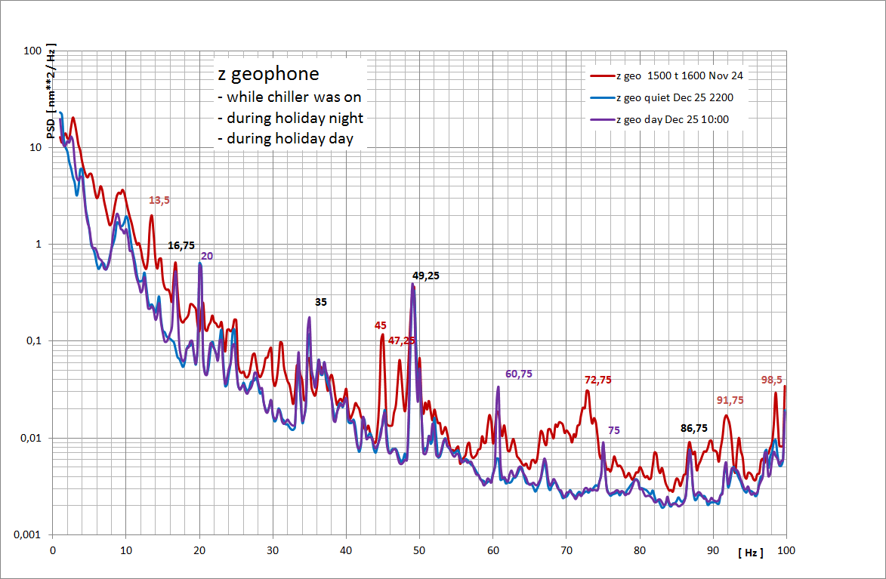
… what the geophone at MP2 showed …
more prominent during holidays
not during night
24,4
48,7
73,2
97,5

Slide 19
… what can we observe typically?
there always is some broader peak around 10 Hz
    …cultural , environmental noise somewhere around 8 Hz
we see a big peak at ca. 49 Hz
    … not at 50 Hz … although a smaller narrow one can be seen there too
others near 16, 20, 25, 32, 35, 61, 87, 98 … Hz
…
  one has to observe them over a longer time
  some appear regularly
  one needs to see, when they go on and when they go off …

Slide 20
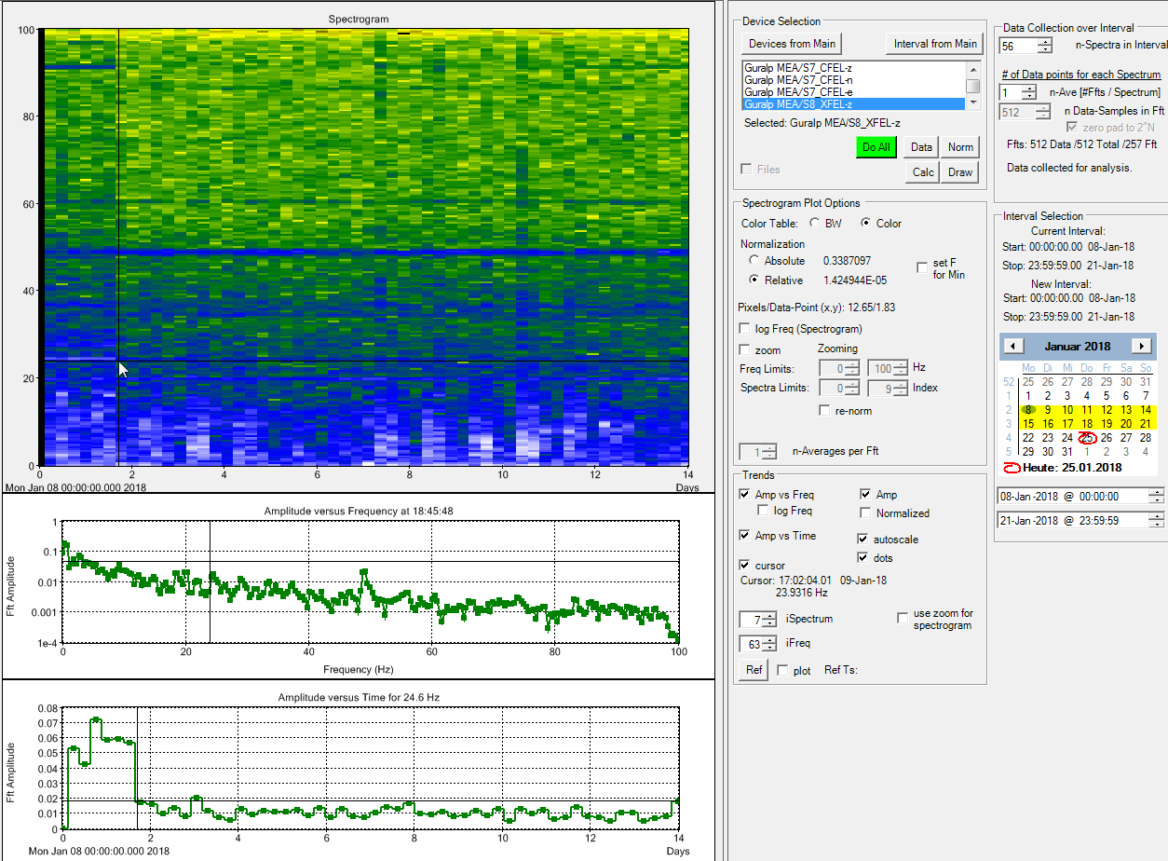
spectrogram of 14 days … Jan. 8th to Jan. 21st … (at MP2)
hi
lo
up to Jan. 9th 14:00 the seismometer was at SPB-exp … from then on at MP2

Slide 21
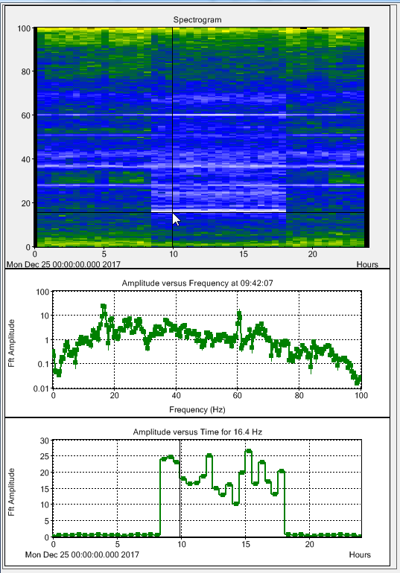
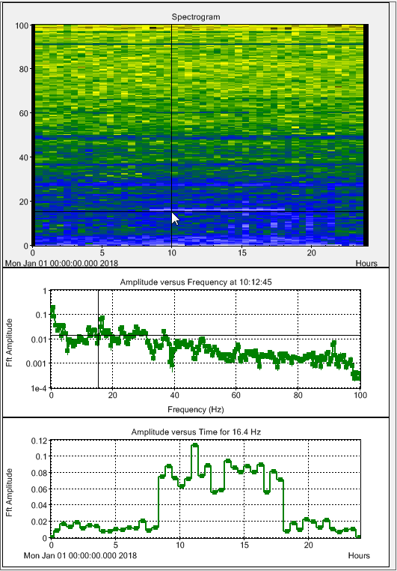
… here the ominous 16,4 Hz … going on and off regularly
spectrogram Dec. 25th … still upstairs in SPB-rck
spectrogram Jan. 1st … downstairs at SPB-exp

Slide 22
Summary
… sources for those peaks so far are not clearly identifiable
… besides general “ambient, environmental“ noise there also are special technical sources of vibrations … e.g.
  air conditioning, … fans, … pipes with cooling water, …
  pumping equipment …
  … and a chiller in the rack room above the experiment hutch
  …
good news is,
that the vibrations produced by the chiller in the rack room seem not to have a major influence on the hall floor.

