Slide 1
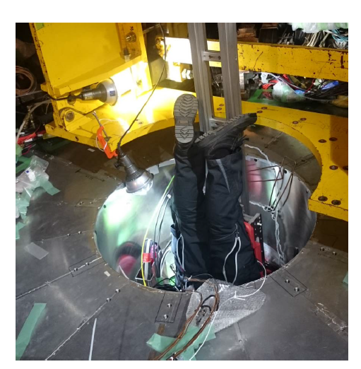
B2GM Closeout
(February 9, 2018 at KEK)
T. Browder (University of Hawai’i)
SVD Ladder Mount Team
VXD Cable Installation in the hole
Notes:
I will be brief since we are all tired and have more meetings ahead.

Slide 2
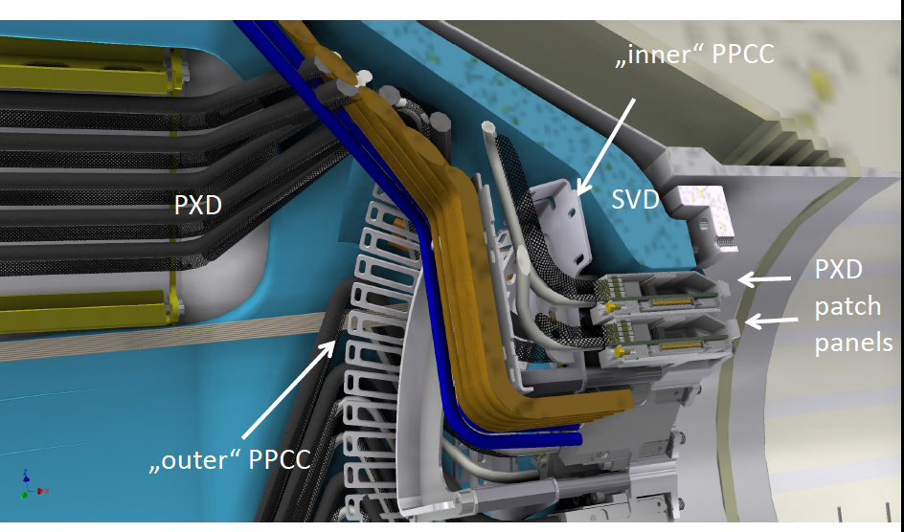
Belle II Multi-Media
Time lapse movie of SVD half shell ladder mount.
Many crises and difficulties were overcome. Looking forward to the next and final half-shell of the SVD. (expected in April).
Looking forward to
PXD integration and testing.
CAD rendering

Slide 3
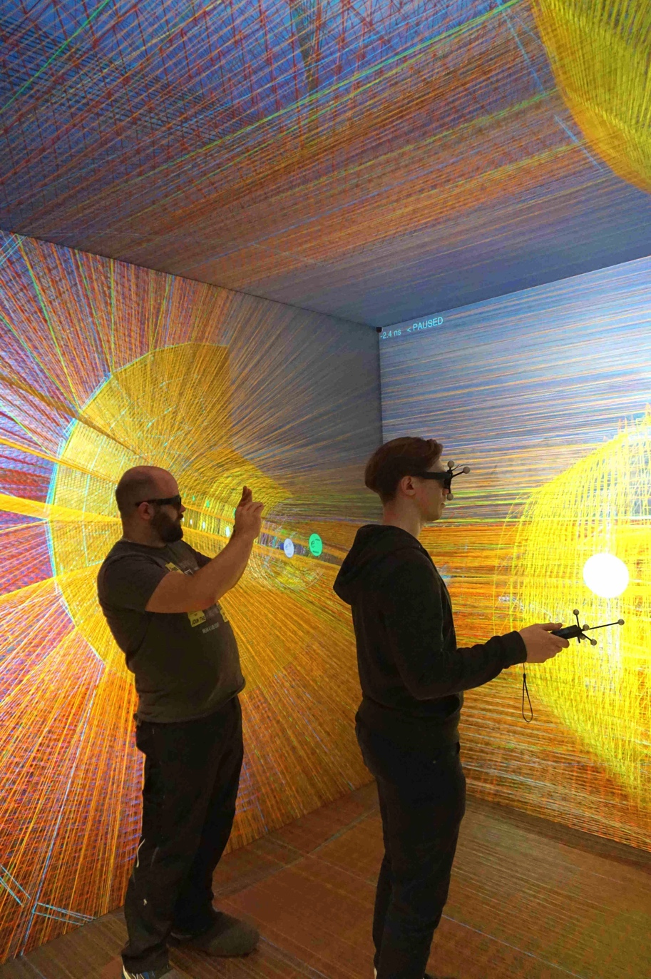
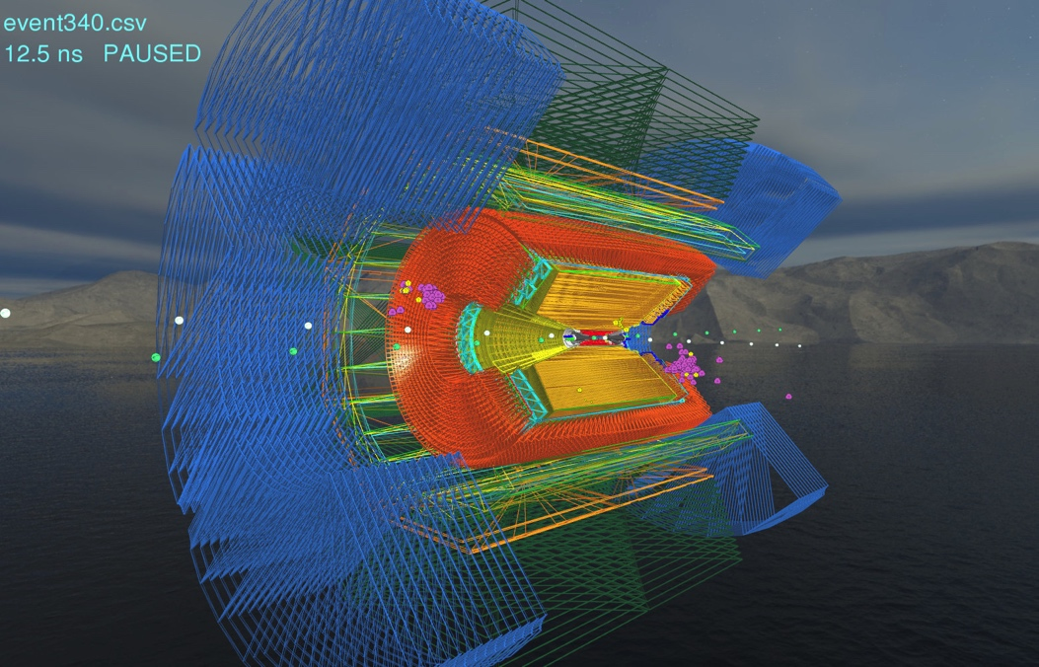
Gretchen =
Belle II Virtual Reality Cave
One step further starting from Virginia Tech’s Belle II Virtual Reality (VR) system.
Michael Bender et al.
Notes:
More multi-media

Slide 4
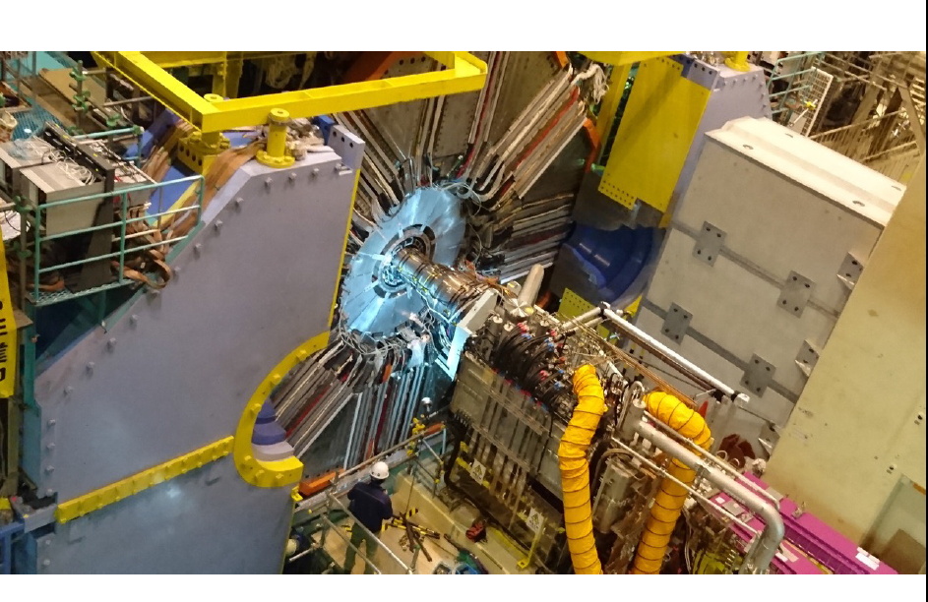
The reality, Feb 8, 2018
Notes:
Photo credit: I. Adachi

Slide 5
The Big Picture
*The first “Global” Cosmic ray running for the outer detector took place during two periods in July and August 2017. More cosmic data without a B field was taken in November. Some very promising results (CDC, ECL) but still major readout integration problems in TOP, KLM etc.
Endcap detectors integrated (ARICH, FWD ECL) [but ARICH cooling is insufficient]
Superconducting final focus fully integrated !
DAQ stress tests at 30kHz almost completed
GRID computing/software stress-tested. Two “dress rehearsals”. “1st Data challenge” coming soon.
About to start Phase II and first collisions→a major transition for the experiment
Completion of SVD and PXD production in late spring 2018
Notes:
What is the big picture ? So much is going on. Some unexpected problems but amazing progress.

Slide 6
Tentative schedule (Feb. 2018 version)
Calendar year
2016
2017
2018
2019
・・・
Japan FY
JFY2016
JFY2017
JFY2018
JFY2019
Summer shutdown
(power saving)
Summer shutdown
(power saving)
Summer shutdown
(power saving)
Plan as of Feb 2017 (Old)
w/ QCS
w/ Belle II (no VXD)
w/ full Belle II
Phase 1
w/o QCS
w/o Belle II
Phase 2
Phase 3
MR renovation for phase 2, including
installation of QCS and Belle II
VXD installation
MR startup
HER start
LER start
DR installation & startup
DR commissioning
Phase-3 will start in Feb. 2019
Updated plan (Feb 2018)
w/ QCS
w/ Belle II (no VXD)
w/o QCS
w/o Belle II
Phase 2
w/ full Belle II
Phase 1
DR beam commissioning starts this week
Phase 3
VXD installation
MR renovation for phase 2, including
installation of QCS and Belle II
HER start
MR startup
LER start
DR installation & startup
DR commissioning
現在
2018. 1. 31
Notes:
Please examine the lower half of the slide

Slide 7
Near-term milestones for Phase 2 Operations
~February 1st -present:
DAQ stress tests and DAQ integration without a magnet field.
(Detector experts are available and working)
Feb 14: Cosmic ray running with the 1.5 T magnetic field (full Belle II shift coverage. Will have the B field on during night and owl shifts. During the day, the B field will be off.
Last chance to fix readout integration and DAQ problems.)
March 6: HER beam turns on (full Belle II shift coverage and BEAST, BCG shift coverage).
Belle II may be turned off initially, BEAST will always be on.

Slide 8
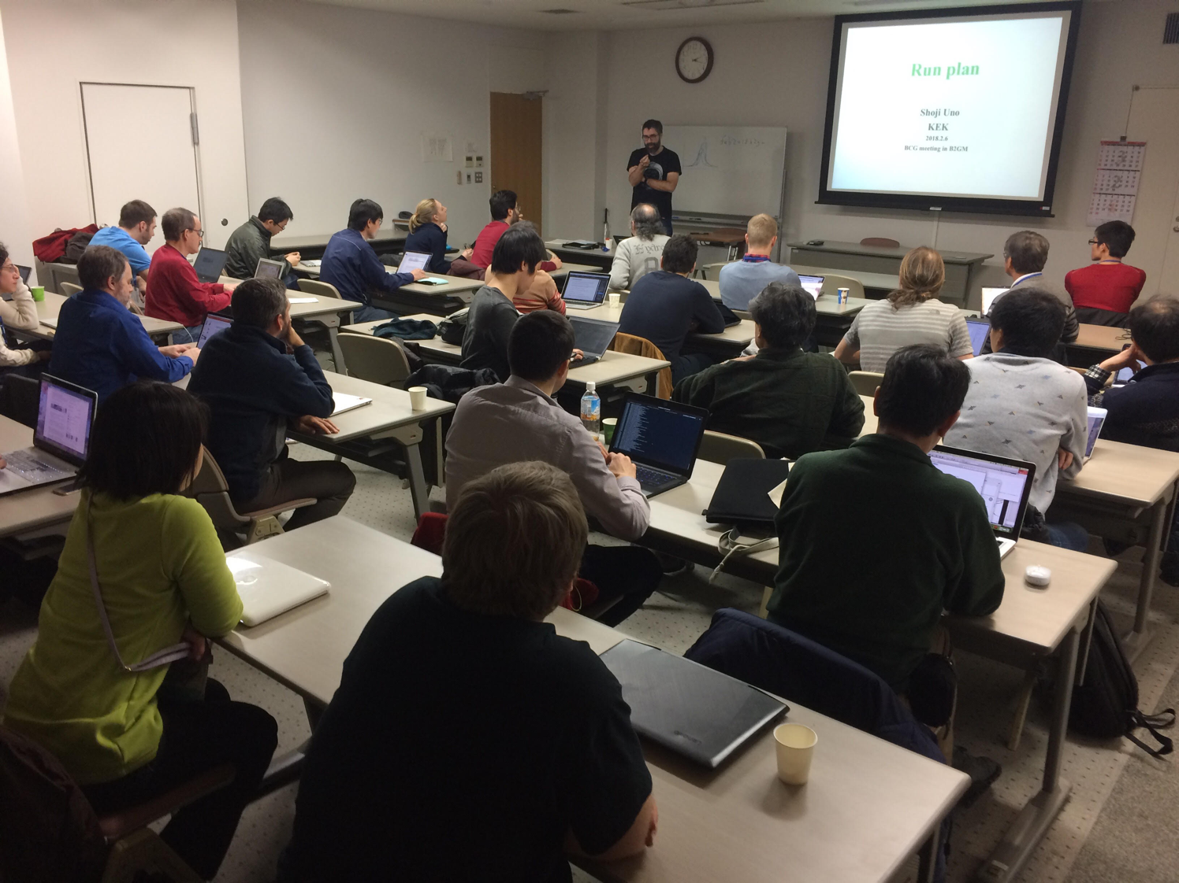
First meeting of the BCG (Belle II Commissioning Group, 32 members)
Very lively exchanges. Get ready SuperKEKB !
Notes:
Very lively

Slide 9
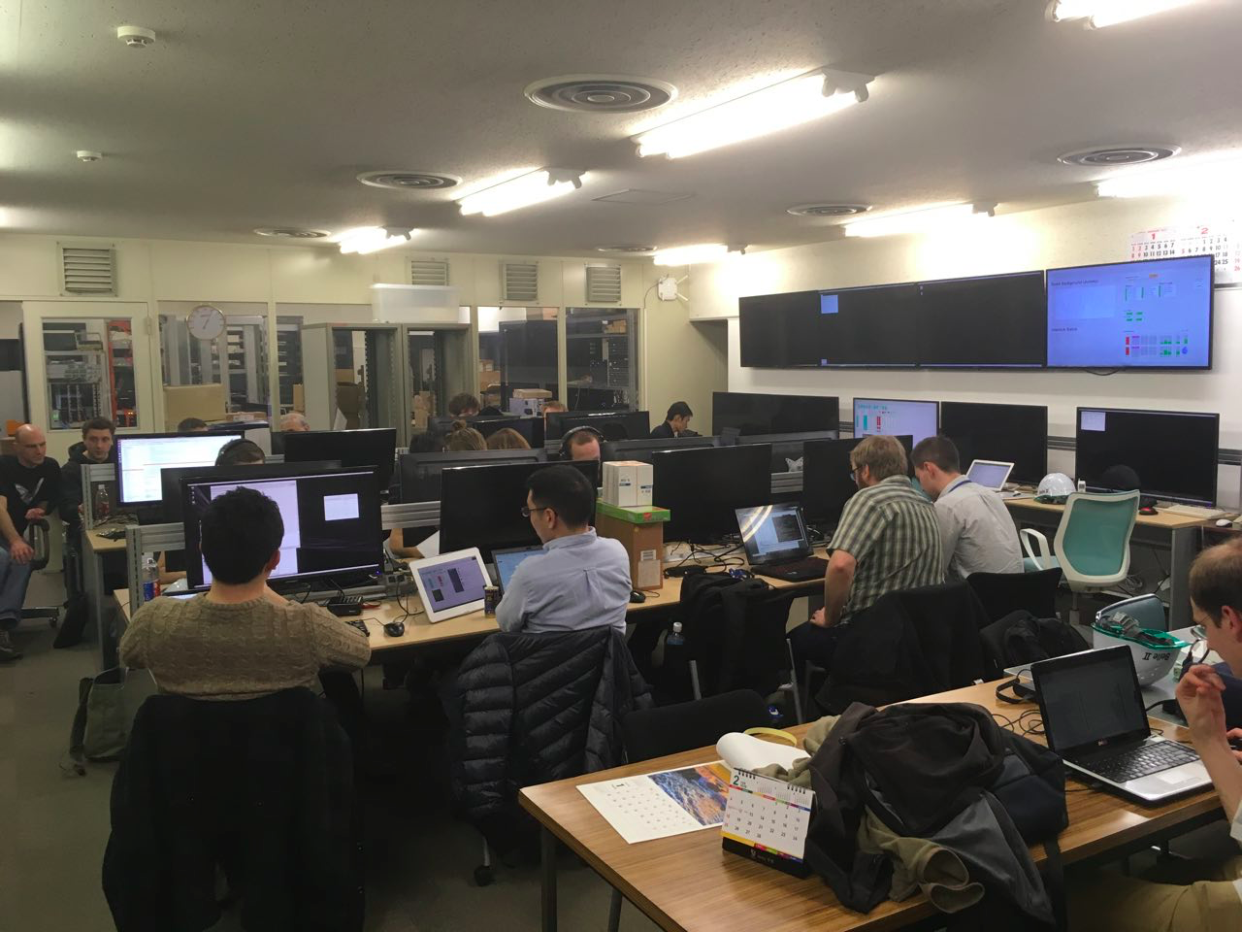
Transitions
Photo:
G. Casarosa
Tsukuba B3 is no longer place for quiet reflection and meditation.
Yikes. The temperature is now 30⁰ C !
Notes:
Thermal regulation problem.

Slide 10
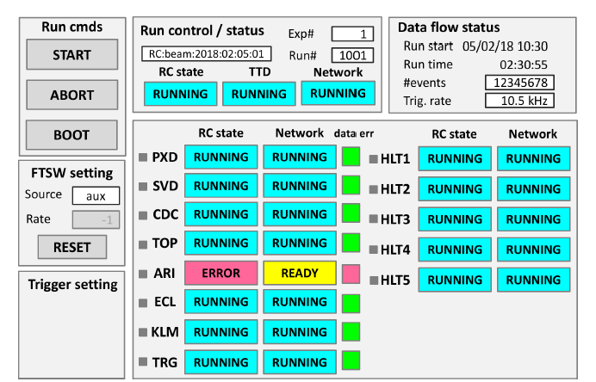
Sign up for experimental shifts !!!
The URL link is at
https://confluence.desy.de/display/BI/Belle+II+Control+Room+Shifts
Simplified non-expert panel.
(to be released soon).

Slide 11
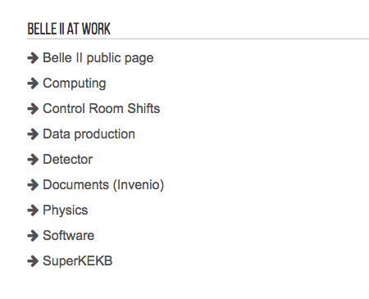
Main Belle II web page
Some details of the shift policy still need refinement e.g. division in shift blocks, shift manager etc
Thanks to Longke Li

Slide 13
Two new issues for 2018
There will soon be physics performance plots and perhaps even physics results or plots. (Finally !)
Can we continue to have open B2GMs ? At a minimum, the physics section should be closed to those who are not members of the collaboration.
For 2018 summer conferences such as FPCP2018 or ICHEP2018, the performance plots should be shown, checked and “blessed” at the June B2GM.
Plots improved after the B2GM should be checked in consultation with the physics coordinator.

Slide 14
No luminosity records….yet !
Wait until late spring or summer 2018.
Record Attendance: 260 registered participants at this B2GM.
Good secretarial support from the KEK Laboratory for the B2GM
We thank Higuchi-san, Motohashi-san, (Belle II secretaries);
Arimoto-san, Sakimoto-san(International Office).
Professor Shoji Uno, venue manager and security guard;
and microphone handlers….Uno is a new IPNS deputy director
Registration (with help from students)
Coffee Breaks
Special Snacks
Cleanup every morning !
Party preparation
(this time help on the clean-up from ~20 graduate students; reduced fee).

Slide 15
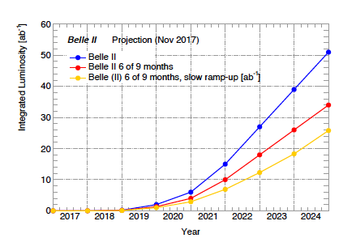
Upcoming Reviews
Full BPAC Review of Belle II/Belle (Feb 12-14 [Mon-Wed], 2018 )
https://kds.kek.jp/indico/event/26523/
Draft presentations should have been posted a week early for internal review !!
Some scenarios
Need 9 months of operations and a fast-turn on.
We need more data !!!
P. Urquijo
With apologies to Herodotus, Thucydides, Sparta, Persia…

Slide 16
Upcoming Meetings (incl. B2GM’s)
18th Belle II Software Workshop, May 14-18, 2018, DESY, Germany
https://kds.kek.jp/indico/event/26287/overview
June 18-22, 2018 at KEK, Belle II General Meeting
Oct 15-19, 2018 at KEK, Belle II General Meeting
Dates of Feb 2019 B2GM to be decided soon.

Slide 17
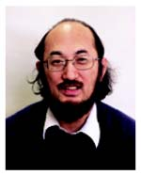
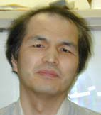
Other Announcements
One of the giants of Belle II and Belle, Professor Yoshi Sakai is retiring from KEK effective March 31st, 2018. He will continue as a Belle II and Belle member as KEK emeritus but will be moving to an administrative position at IPMU in Kashiwa-no-ha.
H. Ozaki, the leader of tracking at Belle and author of TRASAN, important contributor to Belle II tracking is also retiring in March
But he will continue in a position at KEK.

Slide 18
More flag raisings
Last B2GM there was a ceremony for France.
The KEK directorate has organized a flag raising ceremony for Israel at Tsukuba Hall with the Israel Ambassador to Japan and Prof. Abi Soffer on Feb 22, 2018

Slide 19
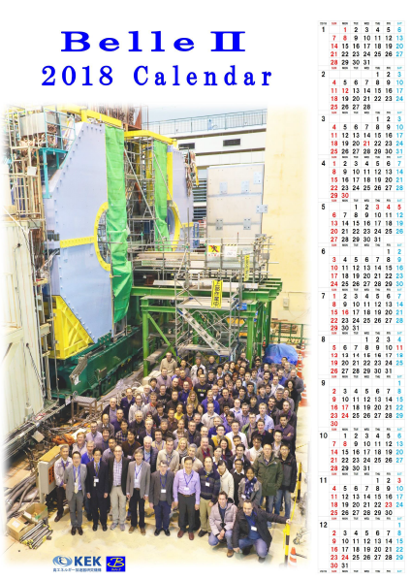
Backup materials

Slide 20
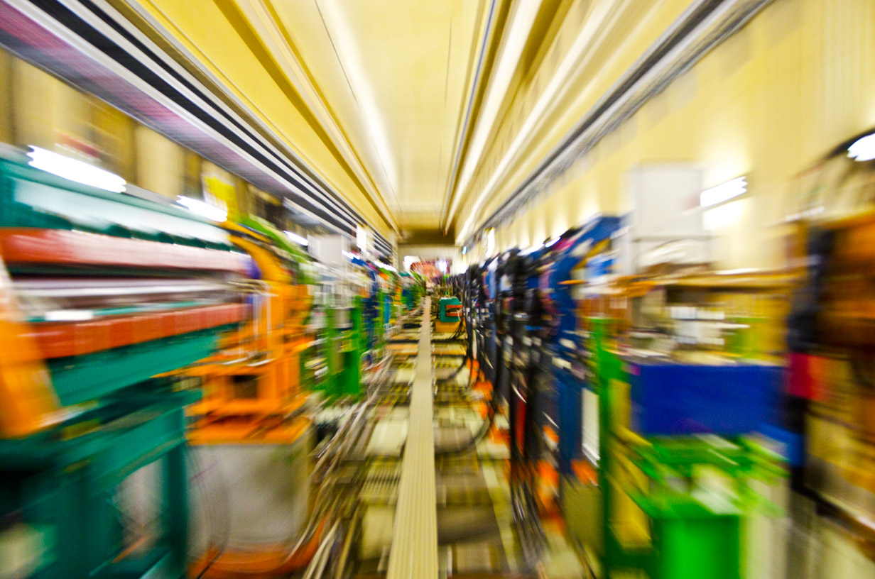
Photo: M. Friedl

Slide 21
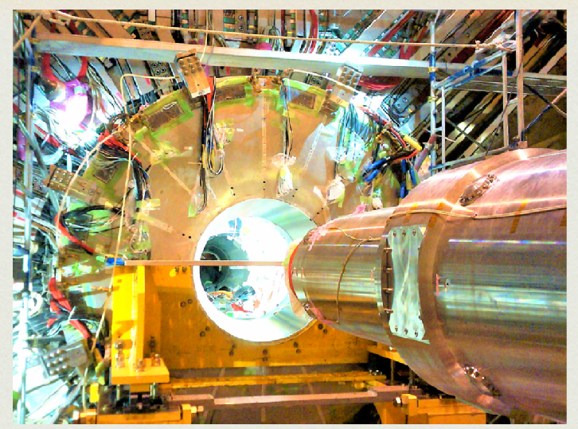
Reality
Photo: Alberto Aloisio
“Down the rabbit hole, QCSL entering a new world of science and discovery”

Slide 22
SuperKEKB/Belle II schedule
Oct. 2017
Calendar year
2016
2017
2018
2019
・・・
Japan FY
JFY2016
JFY2017
JFY2018
JFY2019
Summer shutdown
(power saving)
Summer shutdown
(power saving)
Power saving
after mid July 2018
Summer shutdown
(power saving)
(end Feb. – mid Jul. 2018)
w/ full Belle II
phase 1
w/o QCS
w/o Belle II
phase 2 (MR)
phase 3
w/ QCS
w/ Belle II (no VXD)
MR renovation for phase 2, including
installation of QCS and Belle II
MR startup
HER start
VXD installation
LER start
Assumes phase 3 operation
9 months/year
DR installation & startup
DR commissioning
Jan 20, 2018: So far, we have followed this schedule. Due to delays in the endcap integration and ARICH cooling problem, lost ~two weeks.
HER startup: Feb 23rd→March 5th.
Phase III can start in Feb 2019 (not Jan 2019).

