Slide 1
Bunch Compression Operation at the European XFEL
Bolko Beutner
Operator Training
February 2018

Slide 2
FEL Performance
FEL performance is determined by the peak current and the emittance – the charge density in 6D.
Low emittance and high peak current beams are required in the undulators, but not available at feasible electron sources.
Typically long beams are produced with low emittance and the compressed later.

Slide 3
Basic Principle

Slide 4
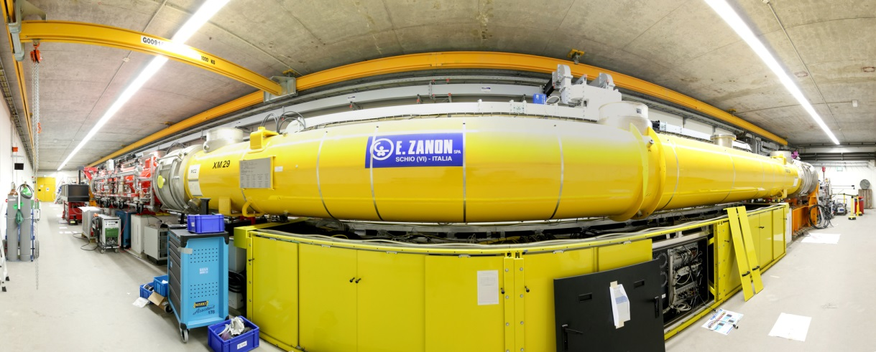
Energy Chirp Generation

Slide 5
“Non-linear” Compression
Linear Compression:
Non-Linear Compression:

Slide 6
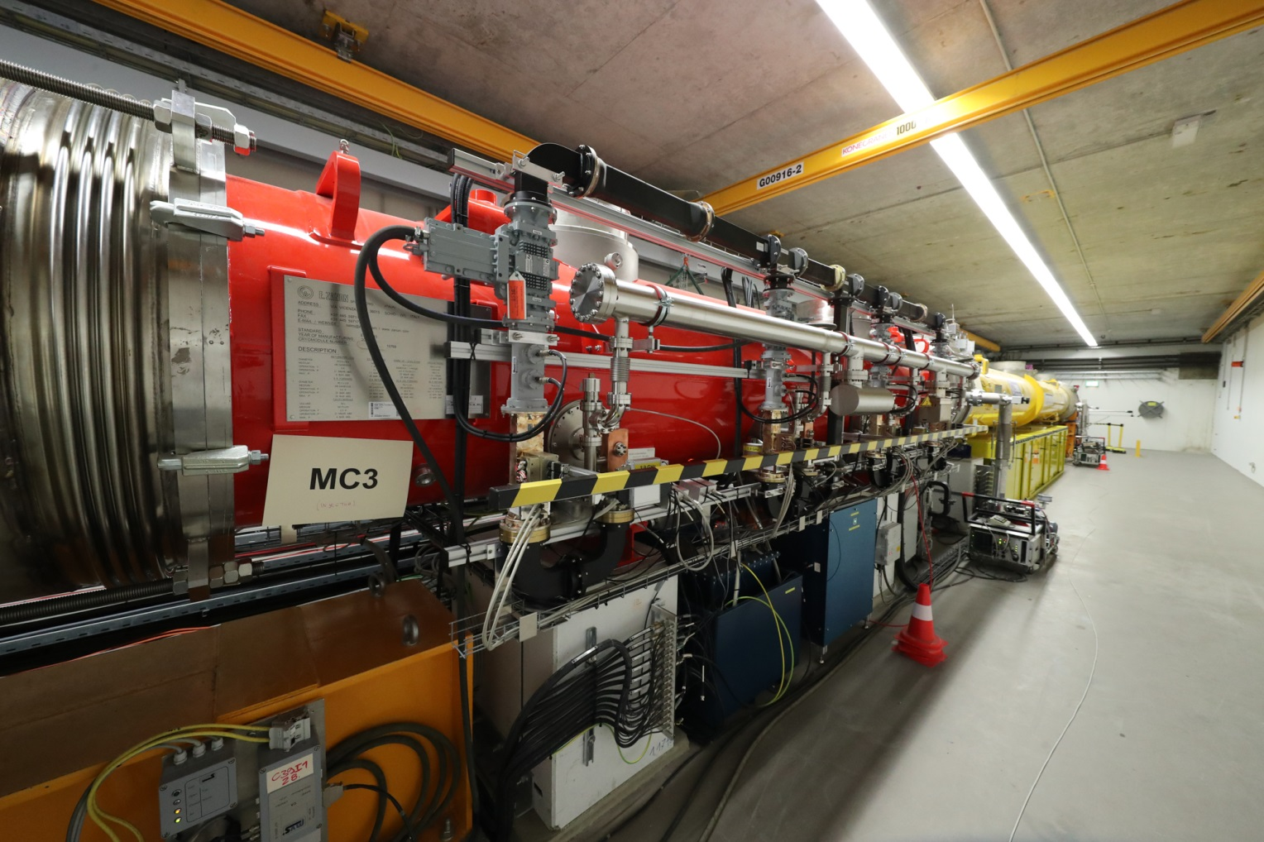
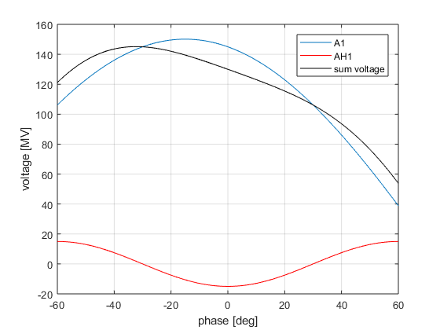
Phase Space Linearisation
Higher harmonic RF system is used to remove non-linear chirp
3rd harmonic (3.9GHz) at XFEL and FLASH

Slide 7
Sum Voltage
Setup of RF phase and voltages to get a certain energy chirp is cumbersome
RF parameters can be directly calculated from the Taylor coefficients (energy, chirp, curvature) at the beam position
Tuning one of the Taylor coefficients do not change the others, especially the beam energy is not changed (provided that the on-crest phases are correct)

Slide 8
Sum Voltage Effects
Chirp (mostly A1 phase):
Curvature (mostly AH1 voltage):
Third Order “Skewness” (AH1 voltage and phase):
Current profiles

Slide 9
Multi-Stage Compression
Too much compression at low energies will lead to space-charge dilution of the beam
Too little compression in the early stage lead to problems with transport of long beams
Too strong chicanes distort the beam due to synchrotron radiation emission
=> Multi-stage compression

Slide 10
BC0

Slide 11
BC1

Slide 12
BC1
Screen
station
Collimator
BPM

Slide 13
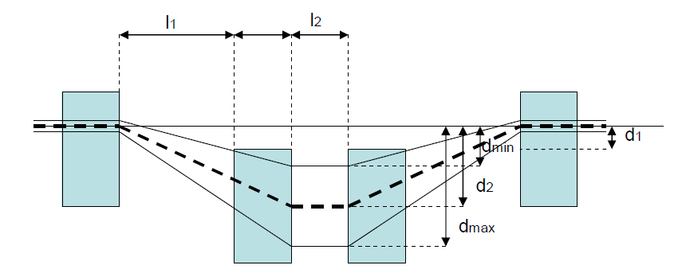
XFEL BC Overview

Slide 14
Chamber Overview
Screen
Collimator
Not to scale!

Slide 15
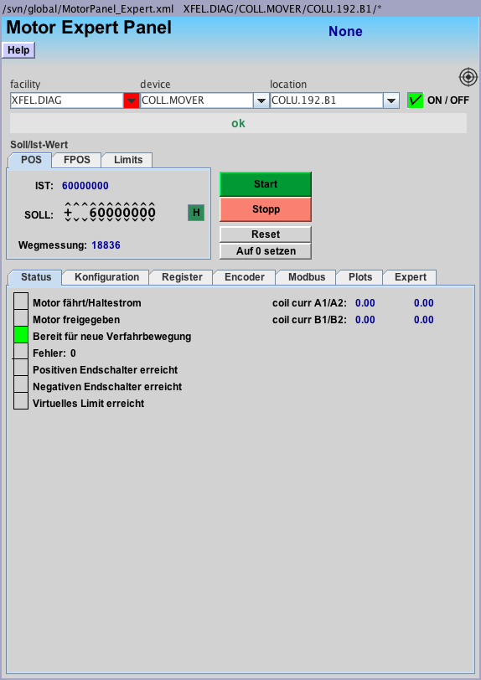
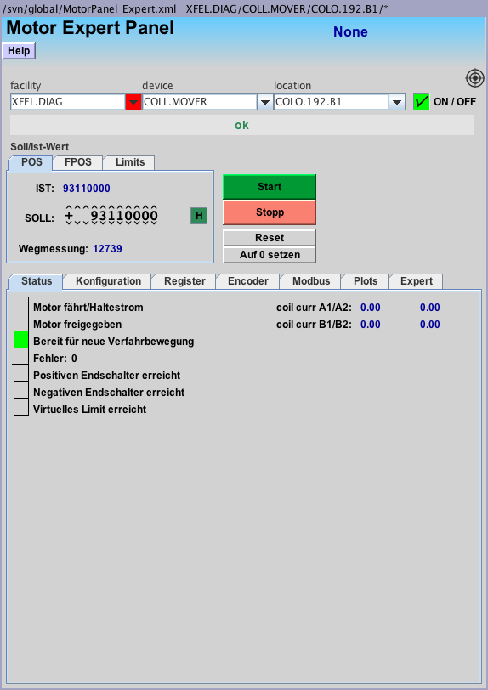
BC Collimator Control
Set “Sollwert” and the press “start”
Move collimators to in direction 0 to remove them
COLU is down “unten”, COLO is up “oben”

Slide 16
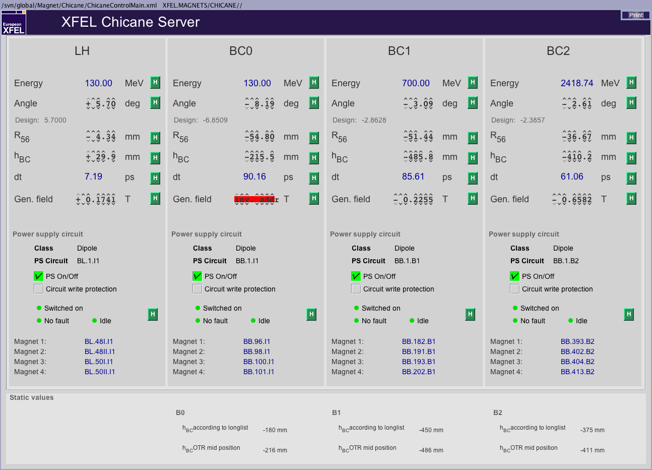
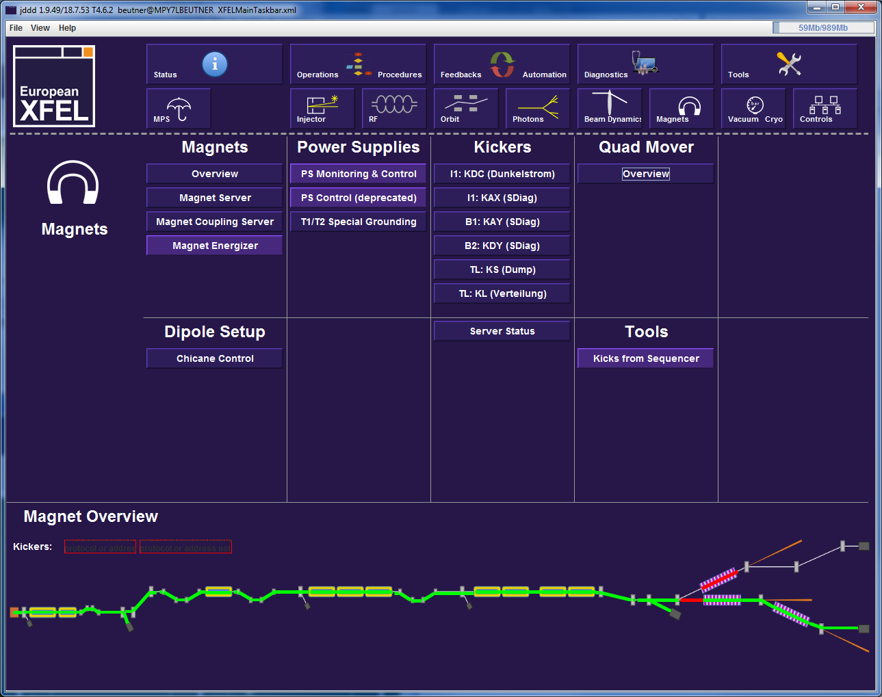
Dipole Setup

Slide 17
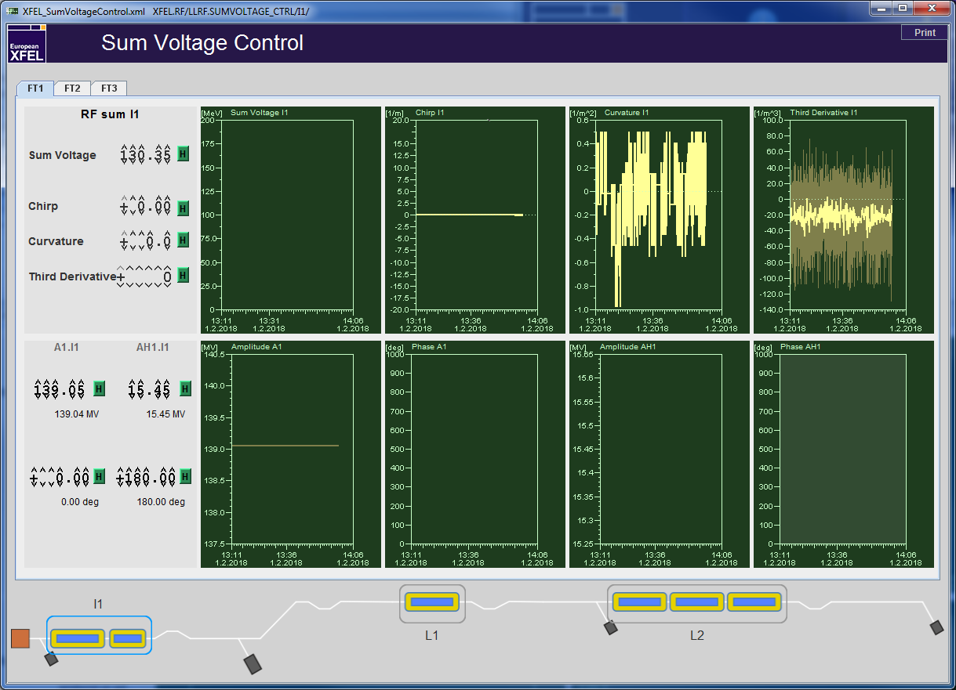
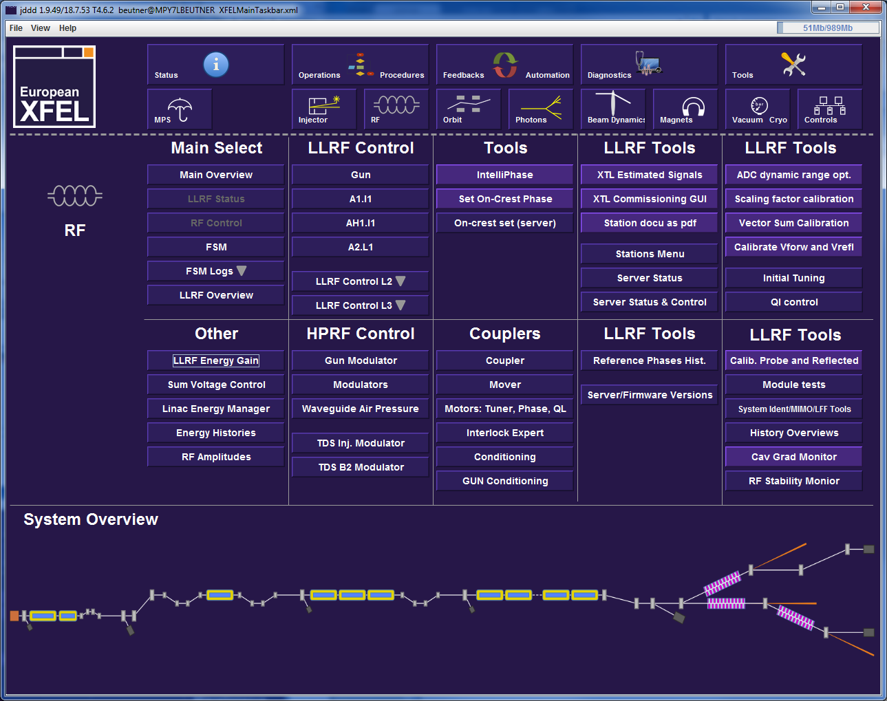
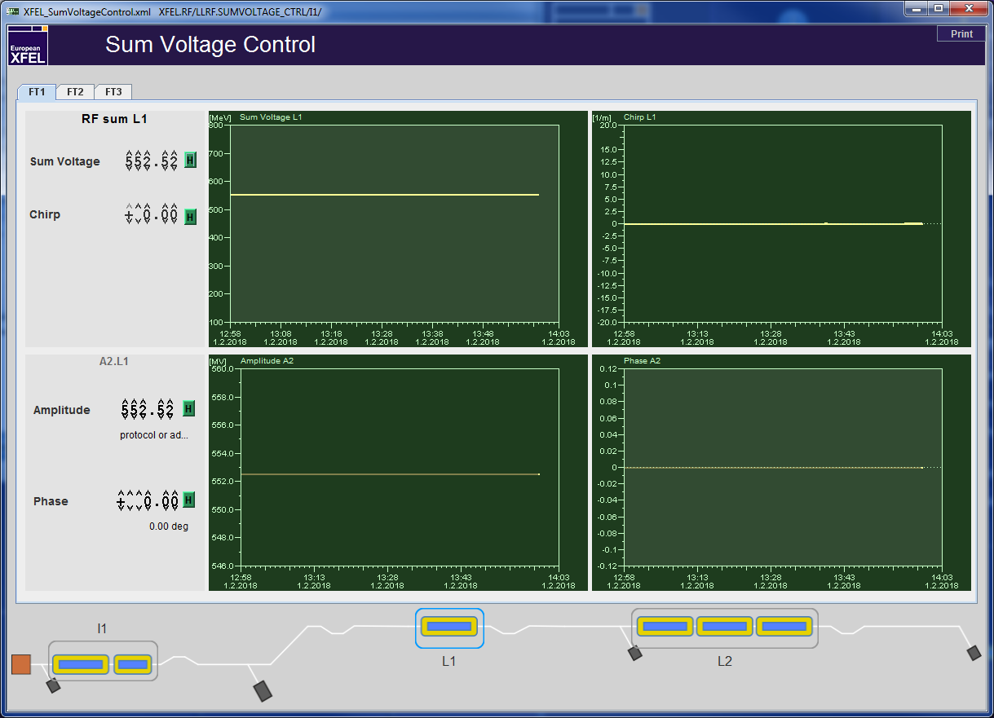
RF Setup and Tuning

Slide 18
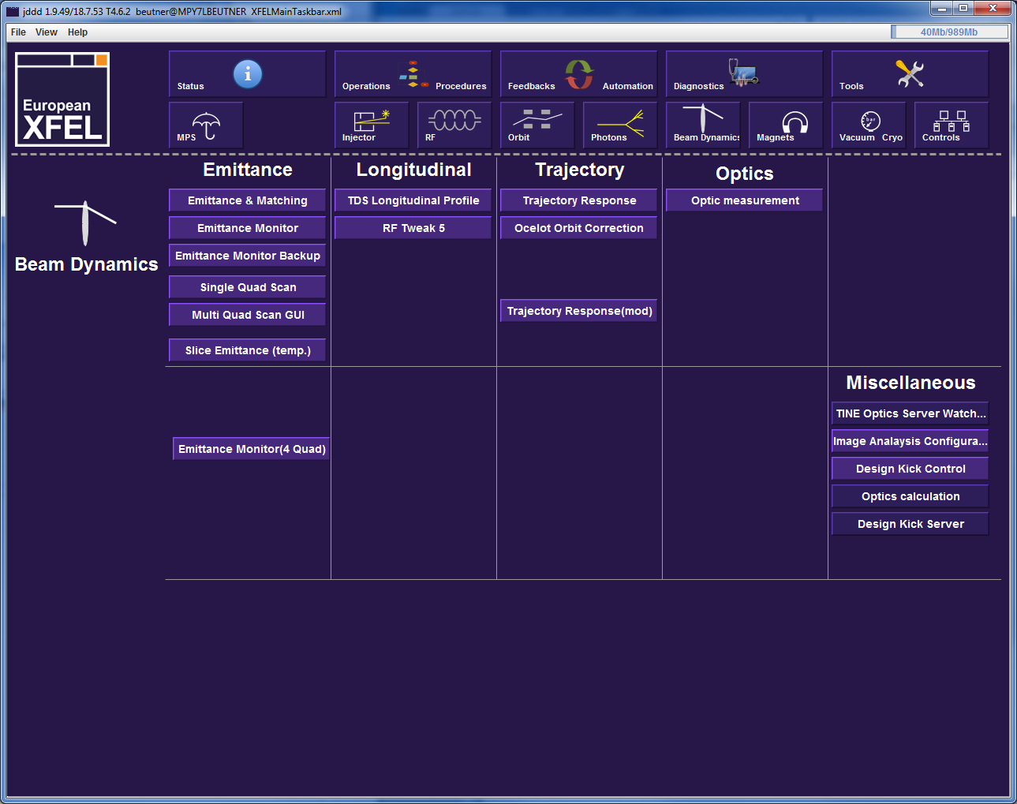
“Online” Simulations

Slide 19
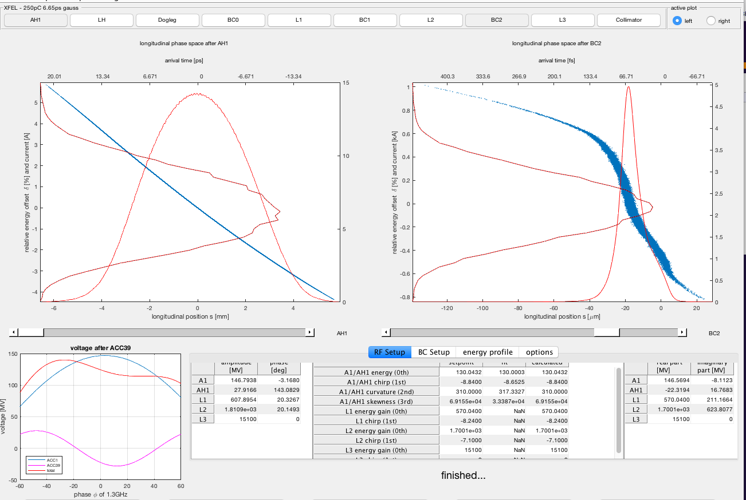
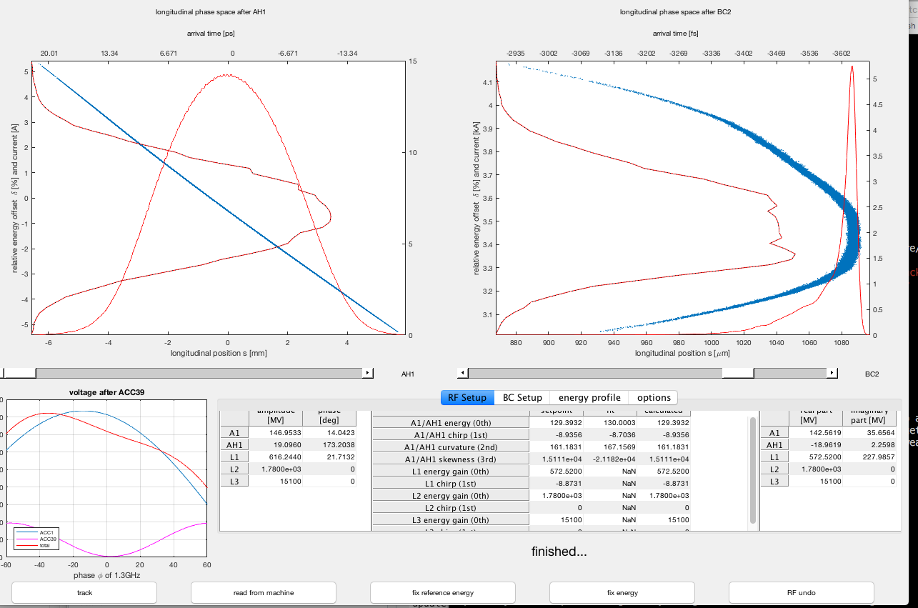
RFTweak 5 GUI
Fast 1D longitudinal simulations of bunch profile
“read from machine” button
“semi”-expert tool

Slide 20
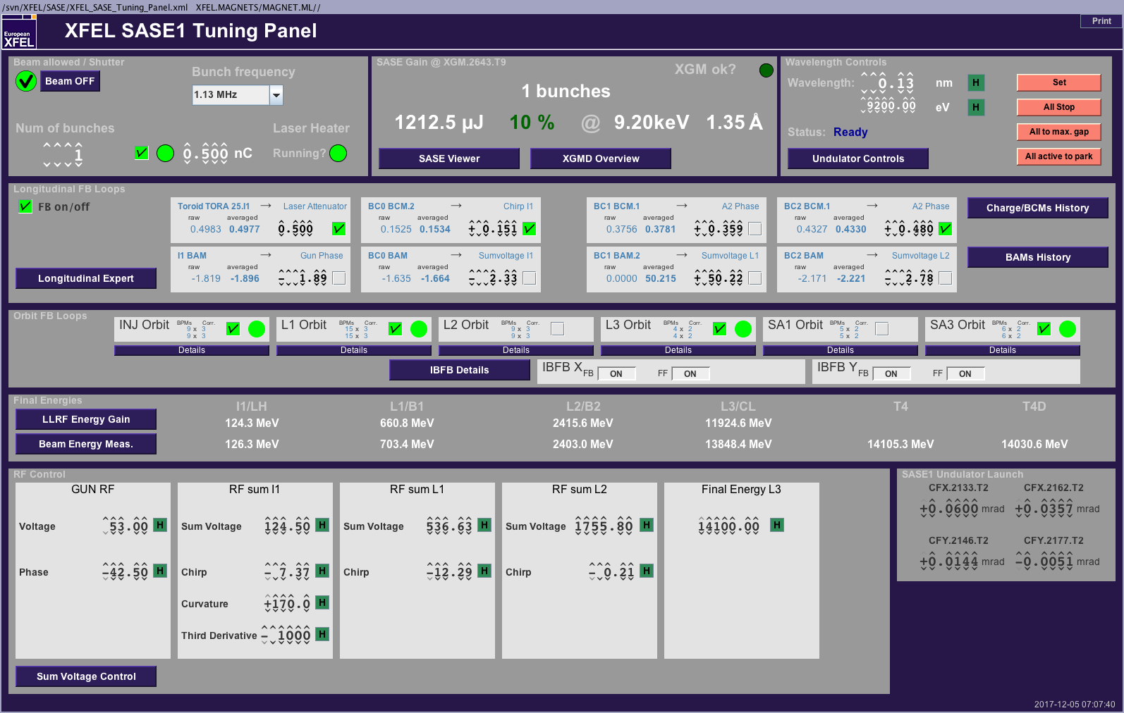
BCM
Diffraction Radiation downstream of the chicanes depends on compression
Diffraction radiators must be moved in
BCM Signals are kept to tuned values with the compression feedback

Slide 21
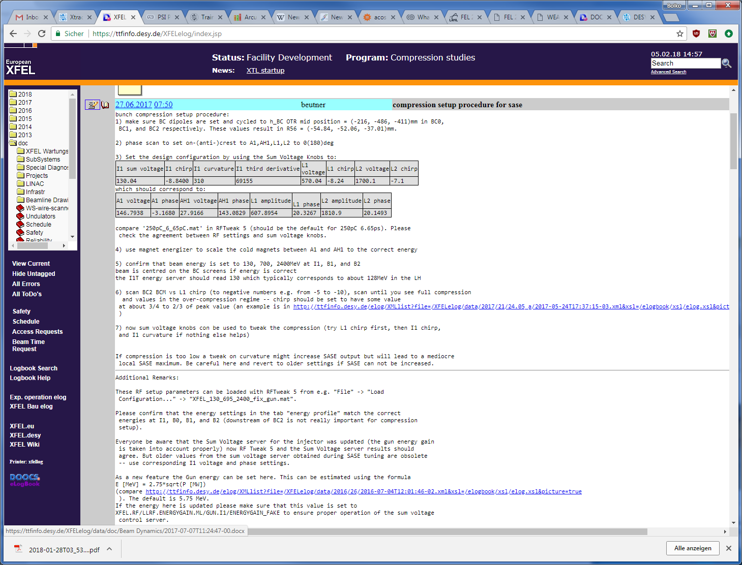
Compression Setup Procedure
BC dipoles are set and cycled to h_BC OTR mid position = (-216, -486, -411)mm in BC0, BC1, and BC2 respectively.
phase scan to set on-(anti-)crest to A1,AH1,L1,L2 to 0(180)deg
Set design RF parameters
use magnet energizer to scale the cold magnets between A1 and AH1 to the correct energy
confirm that beam energy is set to 130, 700, 2400MeV at I1, B1, and B2
now sum voltage knobs can be used to tweak the compression (try L1 chirp first, then I1 chirp, and I1 curvature if nothing else helps)
This is work in progress!
Procedure will be updated in elog /doc/Beam Dynamics/…

Slide 22
Thank You for Your Attention!

Slide 23
Questions?
Literature:
Igor Zagorodnov and Martin Dohlus, “Semianalytical modeling of multistage bunch compression with collective effects” Phys. Rev. ST Accel. Beams 14, 014403 – Published 13 January 2011
ICFA Beam Dynamics Newsletter No. 38, ( http://icfa-usa.jlab.org/archive/newsletter/icfa_bd_nl_38.pdf )
Various PhD theses: Frank Stulle ( http://www-library.desy.de/cgi-bin/showprep.pl?desy-thesis-04-041 ), BB (http://www-library.desy.de/cgi-bin/showprep.pl?desy-thesis-07-040 ), …
In-house Experts: Martin Dohlus, Igor Zagorodnov, Torsten Limberg, BB

Slide 24
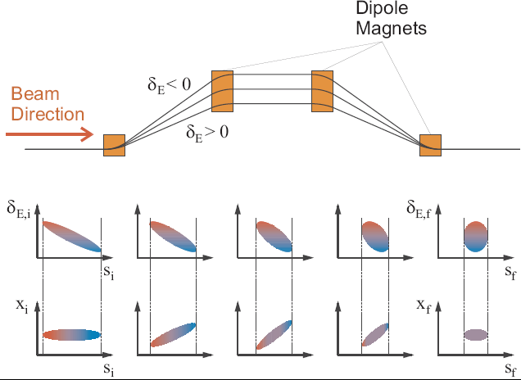
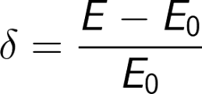
Bunch Compression – with Formulas

Slide 25
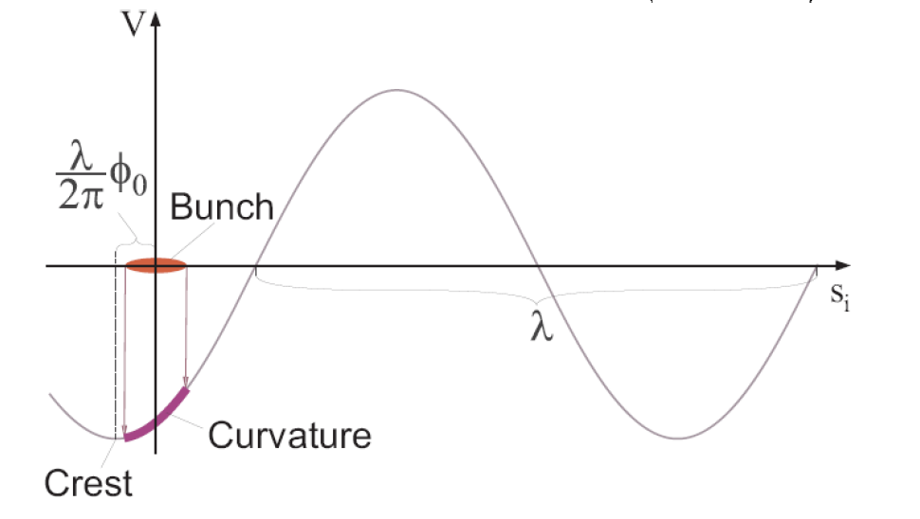
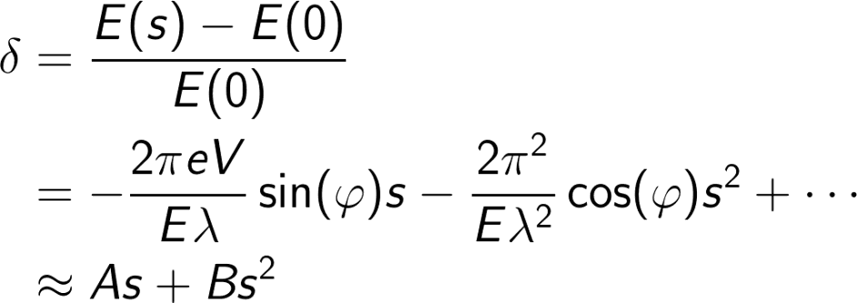
Energy Chirp Generation

Slide 26
Linear Compression

Slide 27
Linear Compression with Uncorrelated Energy Spread
each particle i has an individual “random” energy offset
Typically the “full” compression is avoided…

Slide 28
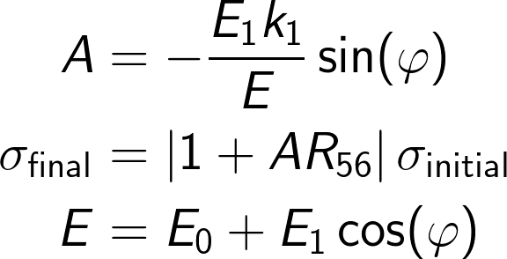
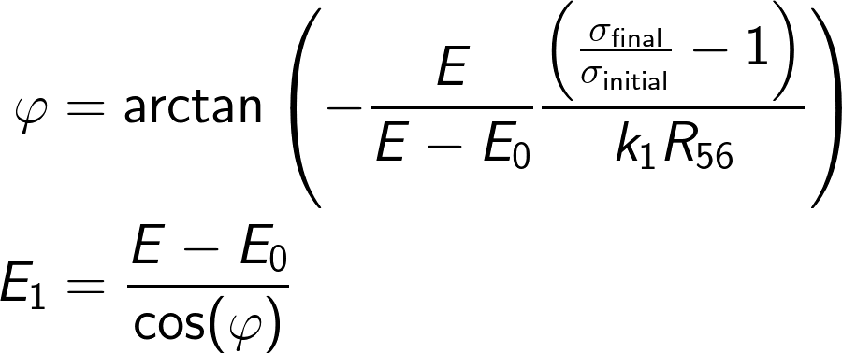
Simple Compression Setup
E₀,k₁,0 deg
E₁,k₁,phi
total energy E
Is this Ok?

Slide 29
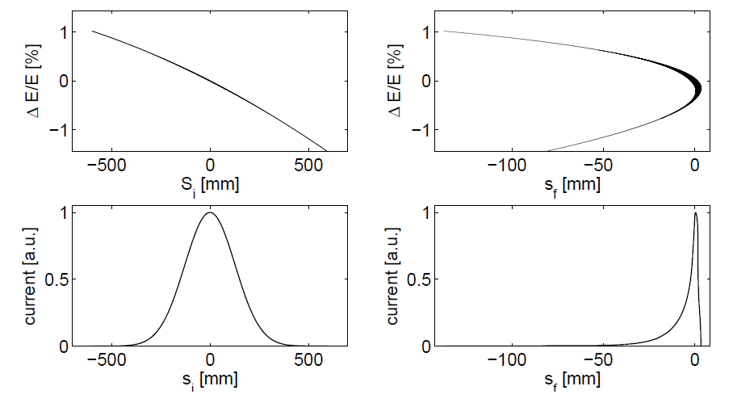
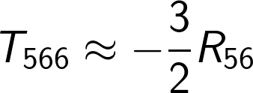
Non-linear Compression
E₀,k₁,0 deg
E₁,k₁,phi
total energy E
Can we tune the T₅₆₆-term to compensate the E₁ quadratic-term?
No since
This is NOT Ok!

Slide 30
Linarised Compression
E₀,k₁,0 deg
E₁,k₁,phi
E₂,k₂,180deg
total energy E

Slide 31
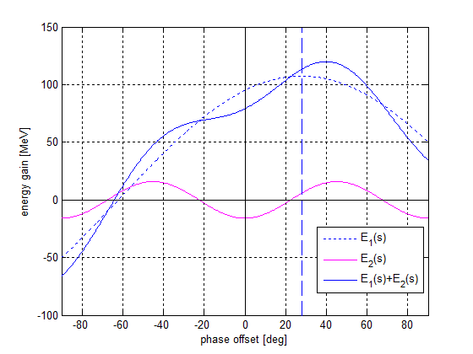
Energy Compensation
E₀,k₁,0 deg
E₁,k₁,phi
E₂,k₂,180deg
total energy E
Compensation of energy loss is required while the slope must be maintained.

Slide 32
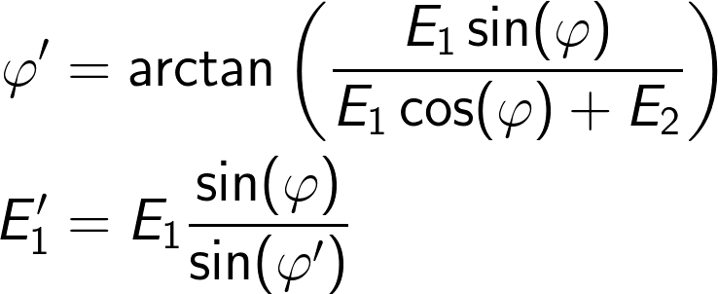
Energy Compensation
E₀,k₁,0 deg
E₁,k₁,phi
E₂,k₂,180deg
total energy E
Compensation of energy loss is required while the slope must be maintained.

Slide 33
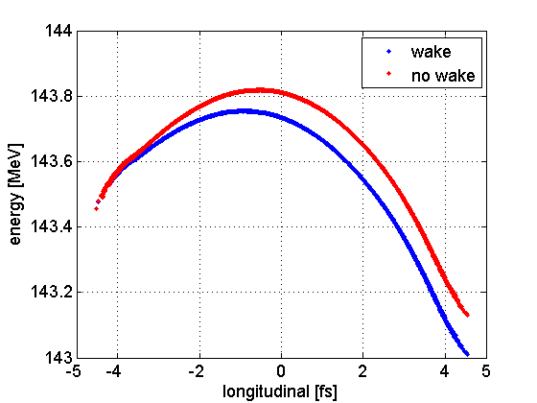
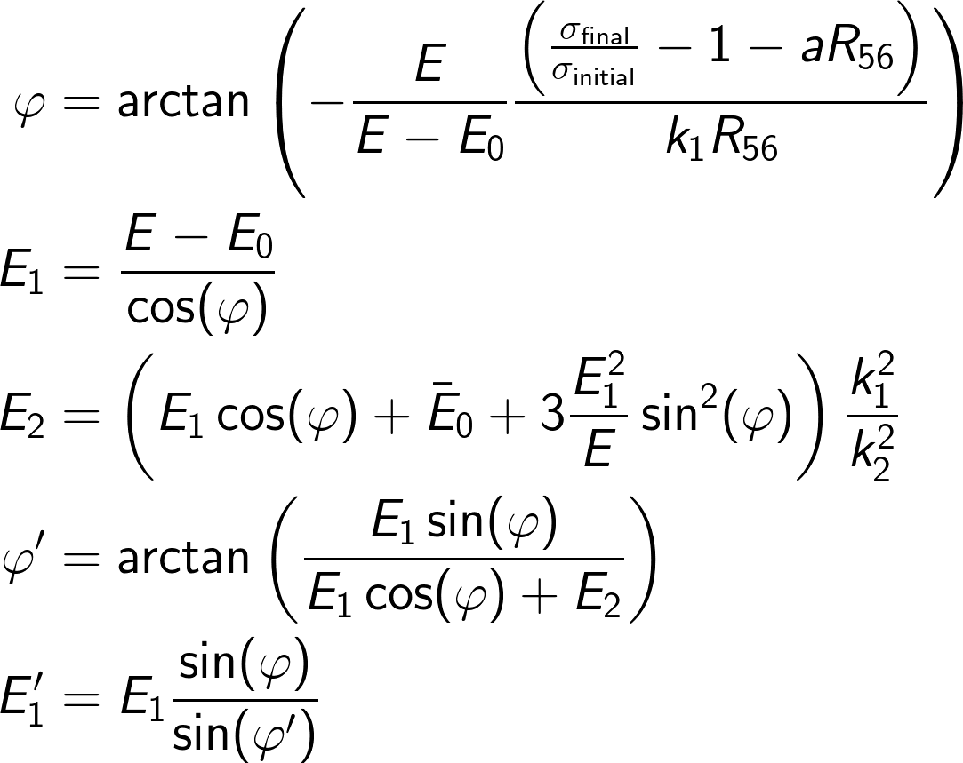
(Almost) General Solution for Single Stage BC
E₀,k₁,0 deg
E₁,k₁,phi
E₂,k₂,180deg
total energy E
head
If x-band is not operated “anti-on-crest” an additional linear compression term plays a role.

Slide 34
The End

