Slide 1
Smart Policy Driven Data Management and Data Federations
enabled by the H2020 eXtended Data Cloud project
Presenter: Patrick Fuhrmann
With contributions by Daniele, Marica, Oliver, Paul and Giacinto

Slide 2
XDC Objectives
The eXtreme DataCloud is a software development and integration project
Develops scalable technologies for federating storage resources and managing data in highly distributed computing environments
Focus efficient, policy driven and Quality of Service based DM
The targeted platforms are the current and next generation e-Infrastructures deployed in Europe
European Open Science Cloud (EOSC)
The e-infrastructures used by the represented communities
Stolen from
Daniele Cesini

Slide 3
The Einfra-21-2017 Call
(a) Support to Public Procurement of innovative HPC systems, PPI
(b) Research and Innovation Actions for e-Infrastructure prototypes
1 - Universal discoverability of data objects and provenance
2 – Computing e-infrastructure with extreme large datasets
Service prototypes should follow common interfaces to access and analyse underlying data collected/stored in different platforms, formats, locations and e-infrastructures […] tested against requirements of very large or highly heterogeneous research data sets.
Funds development of service prototypes at TRL6+
Bring to TRL8 and include in a unified service catalogue in 2018+
Budget per proposal: 2.5-3M€
Stolen from
Daniele Cesini

Slide 4
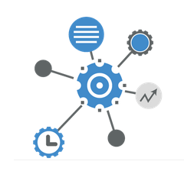
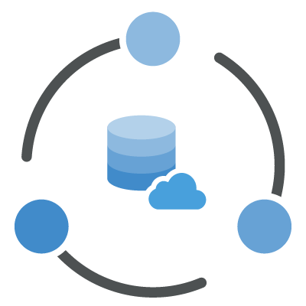
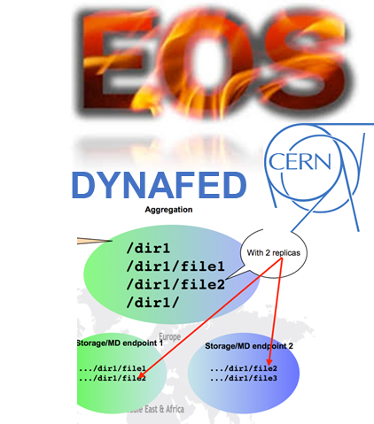
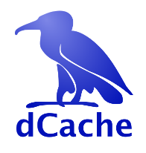
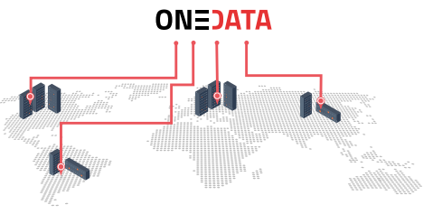
XDC Foundations
XDC take the move from
the INDIGO Data management activity
the experience of the project partners on data-management
Improve already existing, production quality, Federated Data Management services
By adding missing functionalities requested by research communities
Must be coherently harmonized in the European e-Infrastructures
Stolen from
Daniele Cesini
FTS
INDIGO PaaS Orchestrator
INDIGO CDMI Server

Slide 5
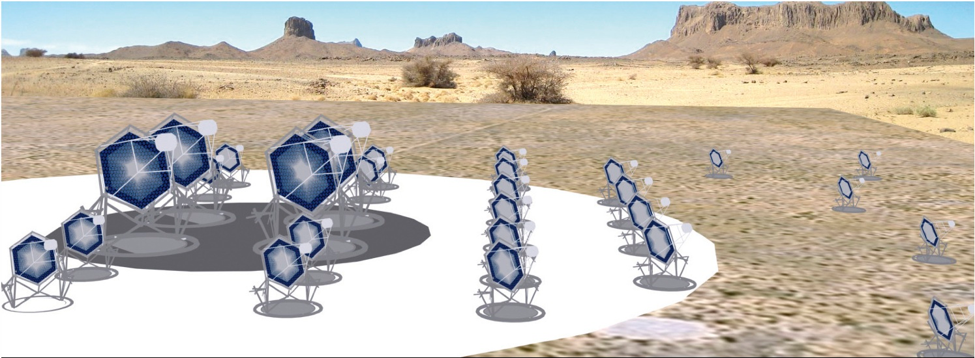
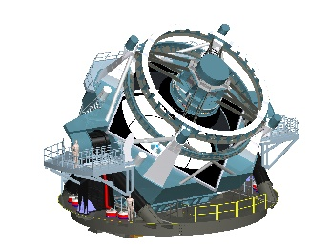
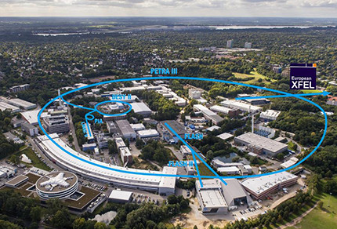
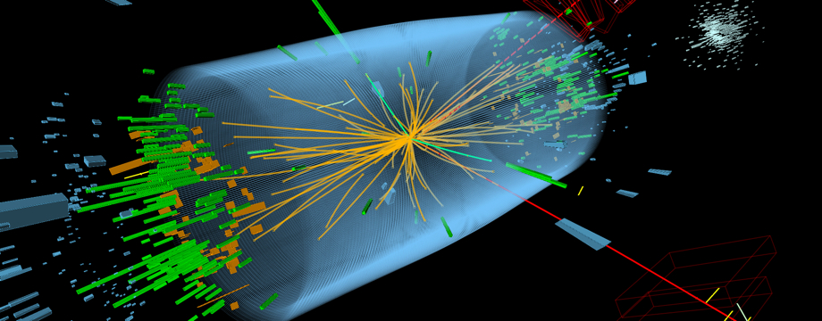
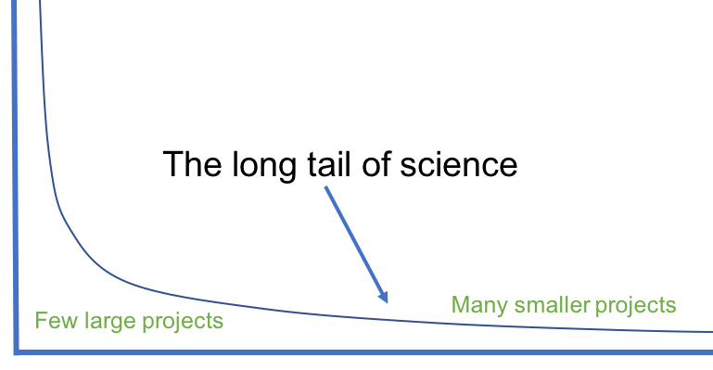
Represented research communities
Stolen from
Daniele Cesini

Slide 6
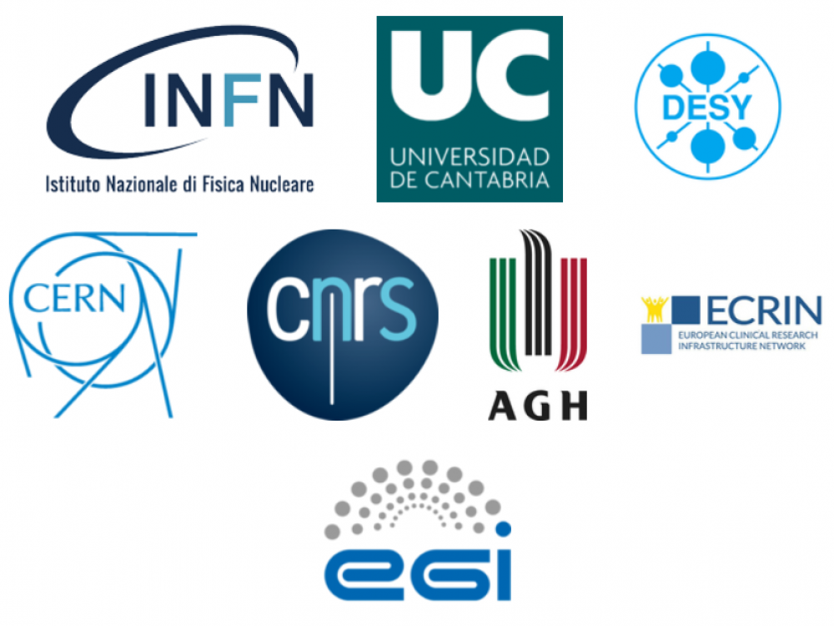
XDC Consortium
ID | Partner | Country | Represented Community | Tools and system
1 | INFN (Lead) | IT | HEP/WLCG | INDIGO-Orchestrator, INDIGO-CDMI(*)
2 | DESY | DE | Research with Photons (XFEL) | dCache
3 | CERN | CH | HEP/WLCG | EOS, DYNAFED, FTS
4 | AGH | PL |  | ONEDATA
5 | ECRIN | [ERIC] | Medical data
6 | UC | ES | Lifewatch
7 | CNRS | FR | Astro [CTA and LSST]
8 | EGI.eu | NL | EGI communities
Stolen from
Daniele Cesini
8 partners, 7 countries
7 research communities represented + EGI
XDC Total Budget: 3.07Meuros
XDC started on Nov 1st 2017 – will run for 27 months until Jan 31st 2020

Slide 7
Project Status
Started on Nov 1st 2017
Detailed requirements collection from user communities completed
Definition of the detailed architecture ready in May
Creation of the Pilot Testbed started
Currently reserved for internal communities
Under discussion the possibility to open to external users
Liaisons initiated with other DM development projects and EOSC-related initiatives
EOSC-Hub
EUDAT
DEEP-HybridDataCloud
RUCIO development team
All EINFRA-21 projects
StoRM
Stolen from
Daniele Cesini

Slide 8
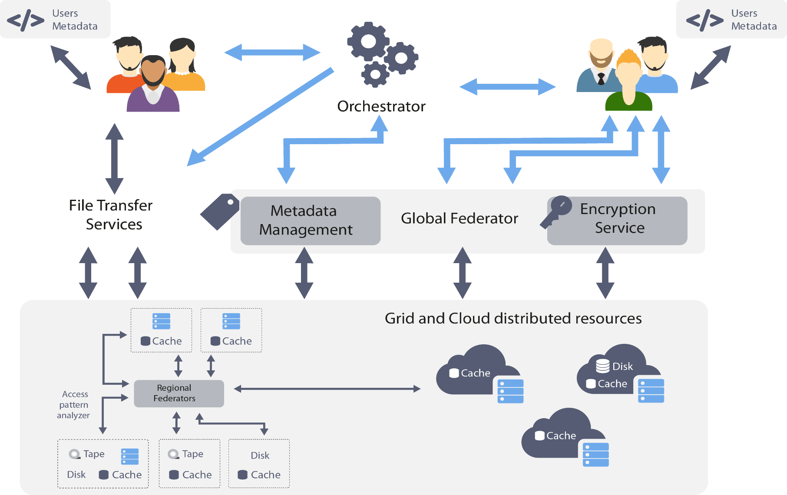
XDC high level architecture
Stolen from
Daniele Cesini

Slide 9
The Release Plan
Event with User Communities – Jun 18-22 2018, Santander – joint with DEEP
XDC reference releases – 1 - Oct-Nov 2018
XDC reference releases – 2 - Oct-Nov 2019
Functionalities and scalability demonstrated - Jan 2020
Stolen from
Daniele Cesini

Slide 10
What is this XDC WP 4 about ?
Implementing a configurable data workflow orchestration, in terms of data location and storage quality (QoS).
Providing managed and unmanaged data caching services at all levels.
Providing event based interfaces to external systems
Generating events to the XDC orchestration services when data is entering the XDC system.
Generating events to external compute clusters when data is ready to be processed.
Federating heterogeneous data sources, building a virtual horizontal infrastructure-specific data space.

Slide 11
Disclaimer
Architecture Discussions are still ongoing

Slide 12
Some words on the toolbox

Slide 13
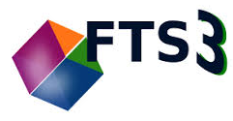
WP4 Production Level Components
Orchestration
c
c
c
Storage
Rucio
INDIGO
Orchestrator
dCache
QoS
CDMI
xRootD
Cache
Federation

Slide 14
Storage, Cache ...
Don’t need further introduction
dCache
xRootD Cache Including http plug-in

Slide 15
Federation, Orchestration
Dynafed
Federates endpoints to a virtual global namespace.
Supports http, WebDAV, S3
Can make use of Name Mapping Databases
FTS
Orchestrates reliable wide area data transfers
Supports multiple protocols, GridFTP, http, xrootd
Can select most appropriate source
Has knowledge on network topology and health

Slide 16
Rucio in a shoebox
Applications
The Daemons
Productions, Analysis, End-User, data export, physics Meta-datda
Rucio
Conveyor: Transfer Daemon – in charge of file transfers
Reaper: File Deletion Service
Undertaker: Data Expiration manager
Transmogrifier: Data Placement Policies / Subscriptions
Judge: Replication Rule Engine
Hermes: Messaging
Auditor: Consistency Manager
Data Rebalancing
Clients
CLU’s Python clients
CORE
Authentication, Authorization
Account, Scope, Data Identifier, Namespace, Meta-Data, Replica,
Registry, Subscription, Rules, Locks, Quota, Accounting
Daemons
Analytics
Transfer, Deletion
Popularity, accounting, metrics,
Measures, reports
Middleware
Rucio Storage Element, FTS3, Networking
Stolen from the Rucio Tutorial

Slide 17
The INDIGO PaaS Orchestrator
The INDIGO PaaS Orchestrator is a component of the PaaS layer that allows to instantiate resources on Cloud Management Frameworks (like OpenStack and OpenNebula) and Mesos clusters.
It takes the deployment requests, expressed through templates written in TOSCA YAML Profile 1.0 and deploys them on the best cloud site available. In order to do that
it gathers SLAs, monitoring info and other data from other platform services,
it asks to the cloud provider ranker for a list of the best cloud sites.
The exposed REST APIs are consumed by the Future Gateway portal.
Stolen from the INDIGO PaaS Orchestrator GitHub

Slide 18
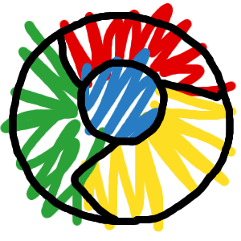
INDIGO-DataCloud CDMI QoS
Storage Broker Webservice
DESY
PSNC
GPFS / HPFS
CDMI
KIT
StoRM
CNAF
As example for a PaaS service
BARI

Slide 19
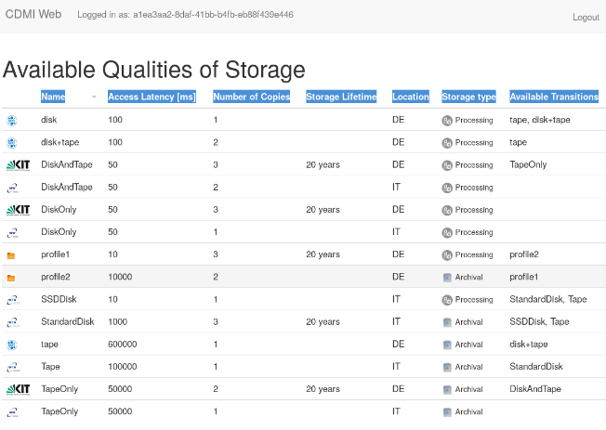
INDIGO-DataCloud CDMI QoS
Quality of Service in storage (Broker Page)
Access Latency [ms]
Number of Copies
Storage Lifetime
Location
Available Transitions
DESY
KIT
PSNC
INFN

Slide 20
QoS in dCache

Slide 21
The orchestration

Slide 22
Expected Control Flow
Rucio
INDIGO
Orchestrator
?
TOSCA
Control
Control
Quality of
Storage
Data Location
Location
dCache

Slide 23
The simple X-FEL Use Case
XDC-Orchestration Team
Rucio
“new file” Event
INDIGO
Orchestrator
Transfer file command.
Start ‘job’ commands
Online
System
QoS command
Analysis
Calibration
Burst
Handling
dCache

Slide 24
Now on the caching part

Slide 25
Prerequisite considerations
:
=
,
dCache
Headnode
+
+ n
*
Namespace
ResourceMGR
Data Pools

Slide 26
Access: control and data flow
Center

Slide 27
Cached Access: control and data flow
In production for years e.g. NDGF, Michigan
Center
Somewhere else

Slide 28
Examples
Denmark
Sweden
Norway
Finland
dCache
CERN
Budapest (Wigner)

Slide 29
Current situation (naturally)
Proprietary

Slide 30
However, it would be nice to have ...
CERN
Advantages
DESY
no additional software stack needed at sites.
Still disadvantage
Local data not accessible in case data link is down or central service not available

Slide 31
Better would be ....
Sync Namespace
Request
CERN
DESY

Slide 32
Next Time .....
Request
CERN
DESY
Advantages
Same software stack as we currently have at the sites.
After the data has been transferred to the local storage system, a name space entry has been created locally and the data is available at the local site independently of the remote network link and the availability of the central service.

Slide 33
Putting it together
xRootD Cache Including http plug-in

Slide 34
Not discussed
The interactions with Dynafed:
at all levels, Dynafed can federate primary and cached storage spaces.
It can be accessed directly by clients or it can be used to feed caches with a federation of primary storage spaces.
Beside the caching mechanisms discussed above, WP4 will provide a squid like cache based on the xrootd framework including its http plug-in. This will provide a zero-maintenance storage space.
The QoS in Storage definition within RDA and its implementation.
The interactions of OneData (XDC WP5) with the components discussed above.

Slide 35
Summary
XDC WP4 will provide the basic software stack to support a European wide, heterogeneous data management infrastructure, including data flow orchestration and smart caching. WP4 is particularly targeting experiments with extremely high volume and data throughput requirements.
WP4 will be build upon a toolbox of well established and production grade software components.
All involved contributors have a long tradition in providing professional big data software and to run high performance, data centric computer centers.
The output of XDC WP4 is already considers in a set of proposals currently being submitted to the H2020 program.

