Slide 1
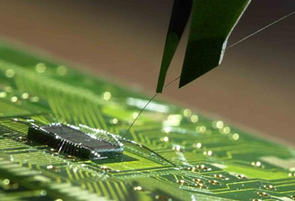
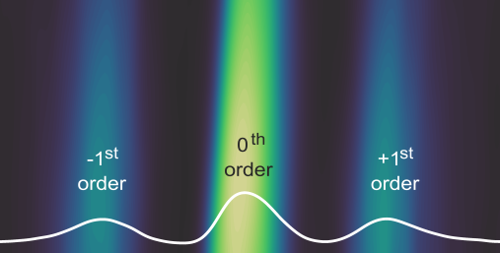
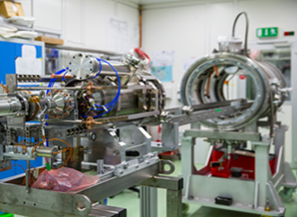



Matter and
Technologies
Matter and Technologies in POFIV:
Where are we going?
Ties Behnke (DESY)
Spokesperson of the program

Slide 2
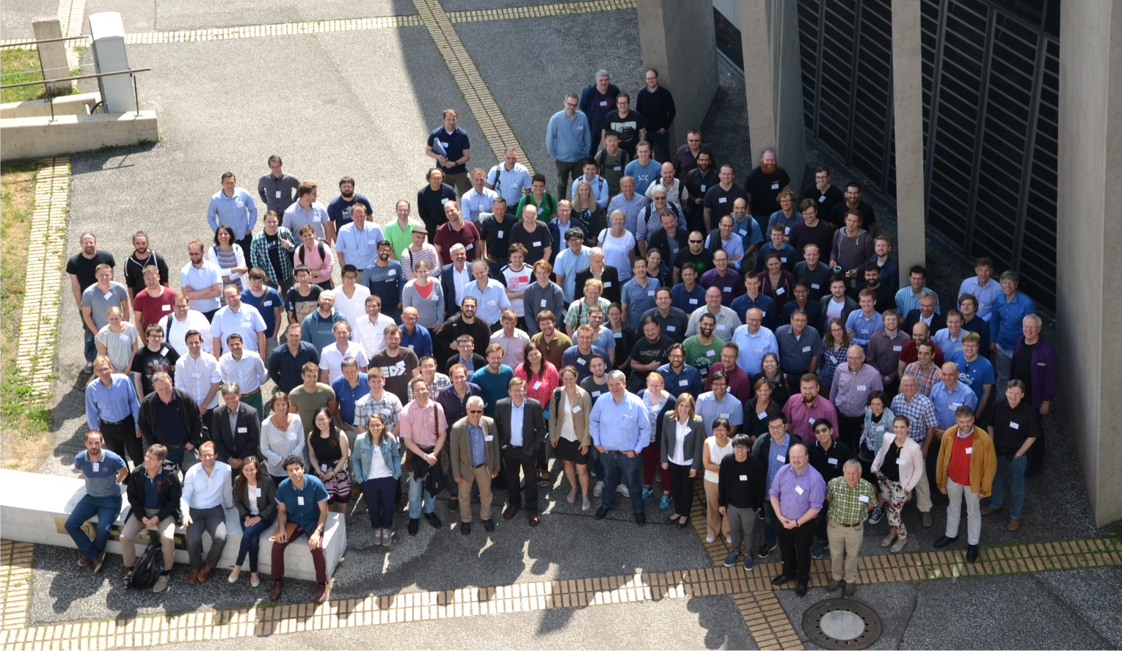
Fourth annual meeting

Slide 3
Now for the really exciting stuff

Slide 4

Reminder: POF at Helmholtz
MATTER
Matter and the Universe
From Matter to Materials and Life
Matter and Technologies
The Helmholtz Association no longer invests its resources in individual institutions, but in cross-center research programs ➔ program-orientated funding (POF)
Matter and Technologies is one program within the research field MATTER.
Currently we are in the third POF period (until 2019).
Therefore: We need to prepare for POF IV.

Slide 5
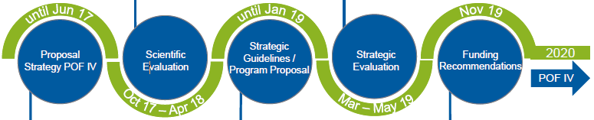


Five Steps to POF IV
Proposal for the POF IV Strategy
Scientific Evaluation of the Centers
Strategic Guidelines/Program Proposal
Strategic Evaluation
Funding Recommendations

Slide 6
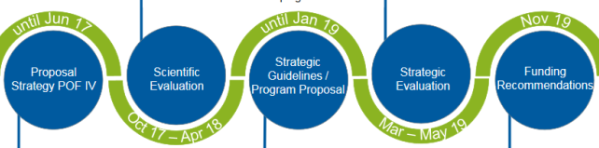

The review: global results
MT results in centers:
DESY | FZJ | GSI | HZB | HZDR | KIT
5 | 4 | 5 | 4 | 4 | 5
Overall grades for ARD and DTS:
ARD | 4.5
DTS | 4.3
Recommendations:
Develop DDL
Install DMA

Slide 7

After the review is before the review: the show goes on
Start values for the budget (Helmholtz)
Strategic guidelines from the BMBF
  High level guidelines (BMBF→ program)
  Goals (program → BMBF)
Program proposal
Program review
Funding recommendation
Implementation phase
POFIV
Summer 2018
February 2019
Summer 2019
Fall 2019
May/ June 2020
until 2021
2021-2027
STEP 3
STEP 4
STEP 5
Very preliminary, based on Tuesdays senat session

Slide 8
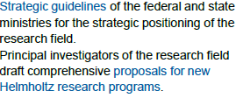
STEP 3, part 1: Strategic Guidelines
High level guidelines for MT,
driven by the funding agencies
  Non negotiable part
  Goals, to be defined in a dialogue
  with the funding agencies
Guidelines are currently being drafted, iterated with funding agencies.

Slide 9
Strategic guidelines
Current state of discussions, not yet official!
Die zentralen Forschungsziele des Programmes sind:
Das Studium der Physik der Beschleunigung geladener Teilchen ist ein zentrales Anliegen des Programmes. Neue Konzepte und Technologien sollen im Hinblick auf die Erzeugung höchster Brillanz, Luminosität, Stabilität, Kompaktheit und neuer Strahlqualitäten entwickelt werden.
Grosse Fortschritte sollen im Verständnis der Physik des Nachweises von Strahlung erreicht werden. Ziel ist es, konkrete Detektorsysteme zu entwickeln, die an die physikalischen Grenzen der Orts-, Energie- und Zeitauflösung gehen.
Die Digitalisierung des wissenschaftlichen Prozesses in den Forschungsfeldern in Materie ist eine zentrale und große Herausforderung. Große Fortschritte sind in diesem Bereich notwendig, um mit innovativen Methoden Wissen aus Daten zu extrahieren, die in Materie in extremen Mengen, mit extremen Raten und hoher Komplexität entstehen.

Slide 10

STEP 3, part 2: PROPOSAL
The program proposals: summer 2019
Matter report: about 300 pages.
Outline:
That means: 10-15 pages per topic
Overview
Research Program
Topics
Program Organization
Resources
List of publications related to the proposal
Curricula Vitae of Principal Investigators

Slide 11

STEP 4: Strategic evaluation
The strategic evaluation for matter: Sept-Nov 2019
Chair for Matter: Ursula Bassler
The four dimensions of the evaluation:
  Objectives
  Work plan
  Scientific Quality and Resource planning
  Impact & Risks

Slide 12

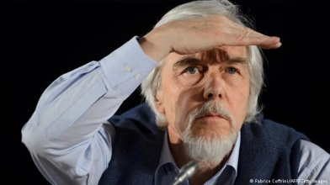
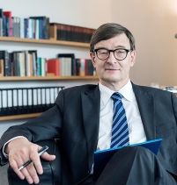
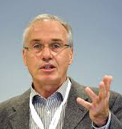
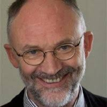
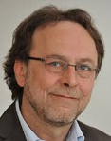
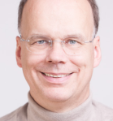
Step 4: The strategic Review
Participants in the actual review:
The panel
The Senate member responsible for Matter: R.D.Heuer
A representative of the senate commission
The president of the Helmholtz association
Funding agencies
Program speakers, topic speakers
Scientific directors of the centers

Slide 13
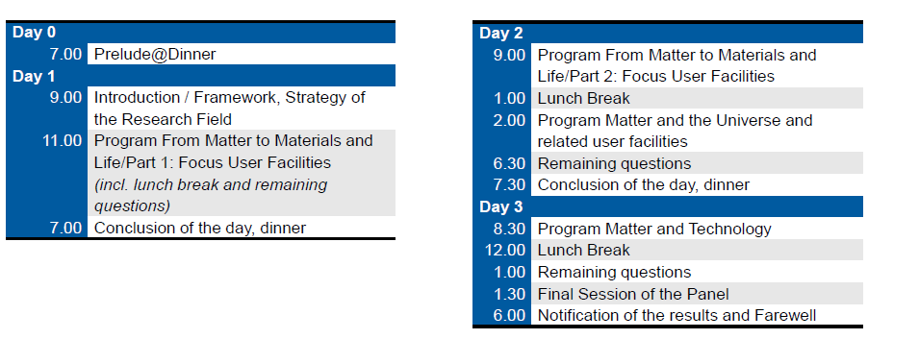
STEP 4: Strategic evaluation
AGENDA
Preliminary agenda exists:

Slide 14
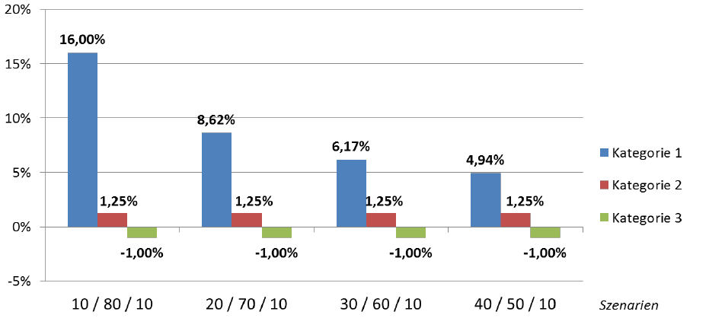
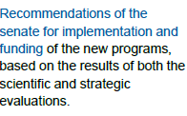
STEP 5: Funding Recommendations
Based on the strategic evaluation there will be funding recommendations
Three categories:
  1: outstanding in all four dimensions
  2: very good in all four dimensions
  3: everything else
The 3. category will get reduced funding, the 2. half of the average increase, and the 1. the remaining increase

Slide 15
MT: our role in the strategic review
There will be no major review event as it was in POF III
The impact however on the program is potentially huge
We will need your support during the preparations to be sucessful

Slide 16
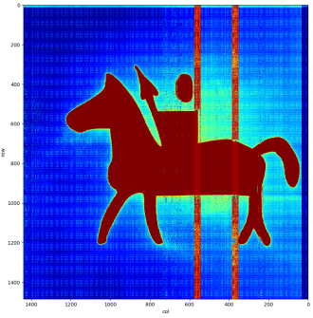
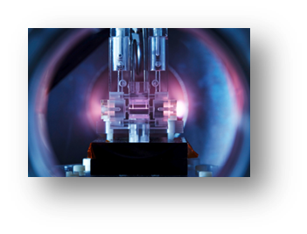
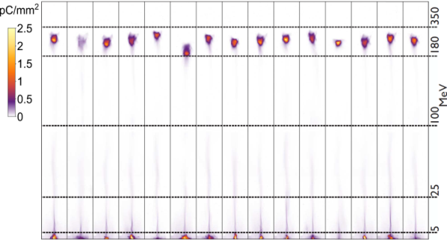
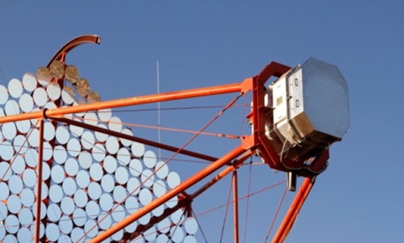

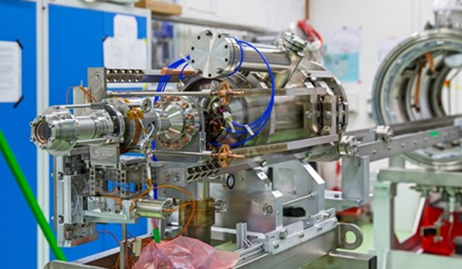
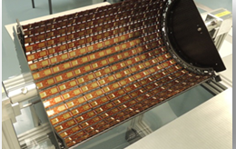
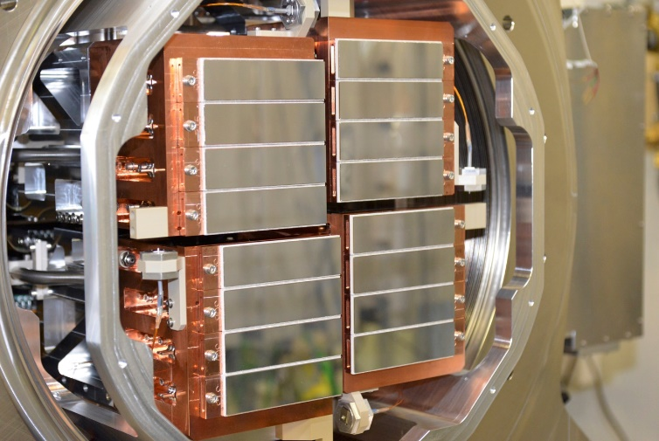

Elements of success
Excellent scientific quality

Slide 17
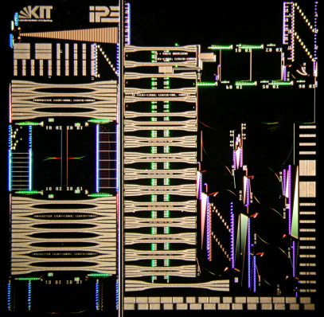
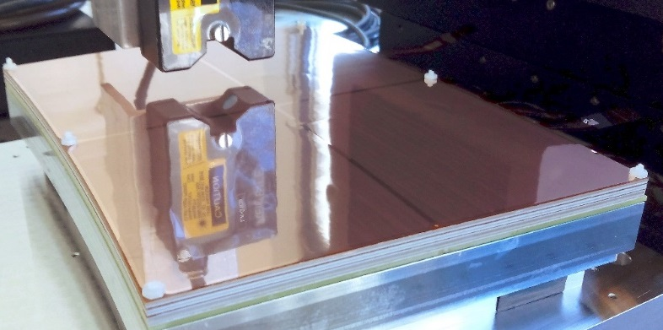
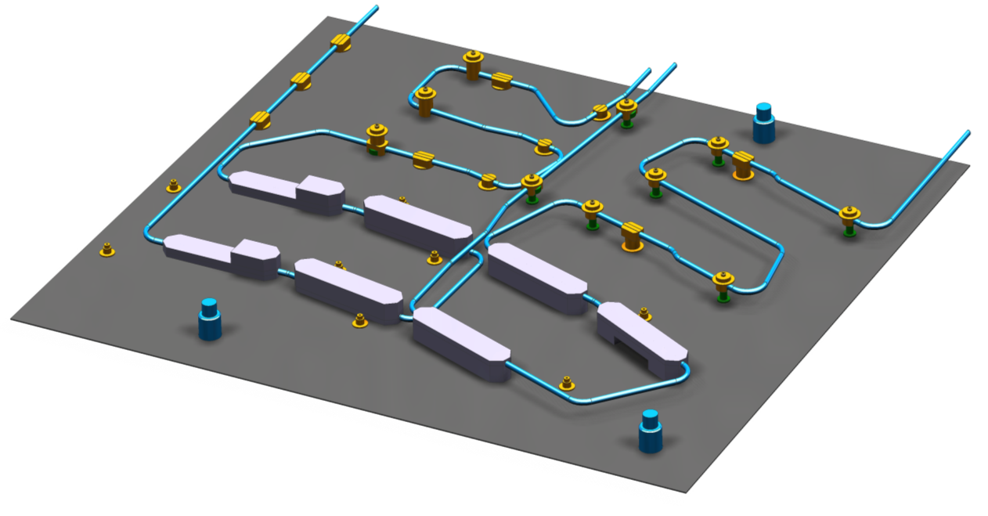
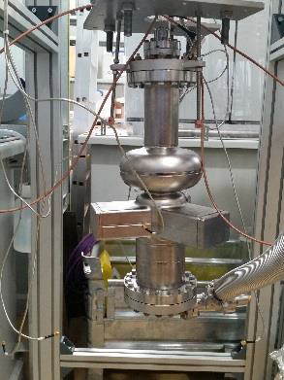
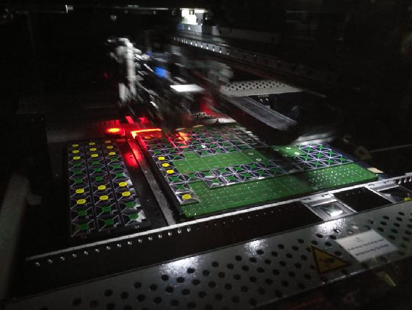
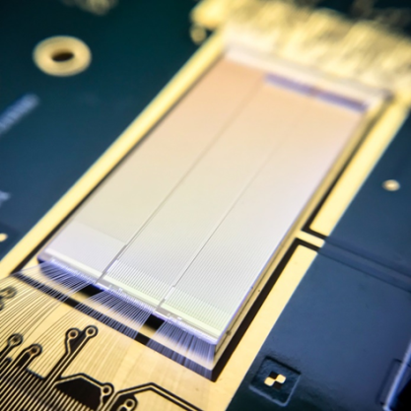
Elements of success
Excellent scientific quality
Exciting technologies
  All review boards love plasma acceleration: its new, its high impact, its exciting
  We need to “sell” our activities to be as exciting as this.
  We need to show concrete examples of “game changers”

Slide 18
Elements of success
Excellent scientific quality
Exciting technologies
  All review boards love plasma acceleration: its new, its high impact, its exciting
  We need to “sell” our activities to be as exciting as this.
  We need to show concrete examples of “game changers”

Slide 19
Elements of success
Excellent scientific quality
Exciting technologies
  All review boards love plasma acceleration: its new, its high impact, its exciting
  We need to “sell” our activities to be as exciting as this.
  We need to show concrete examples of “game changers”
Clear added value
  Why should we do MT? Show clear added value
  Utilize fully the possibilities and opportunities
  Highlight common projects, sharing of resources

Slide 20
Elements of success
Excellent scientific quality
Exciting technologies
  All review boards love plasma acceleration: its new, its high impact, its exciting
  We need to “sell” our activities to be as exciting as this.
  We need to show concrete examples of “game changers”
Clear added value
  Why should we do MT? Show clear added value
  Utilize fully the possibilities and opportunities
  Highlight common projects, sharing of resources
Look outside the box
  Look beyond your community
  Lets explore more connections between ARD and DTS
  Integrate DMA fully into our portfolio

Slide 22
Fourth annual meeting

Slide 23
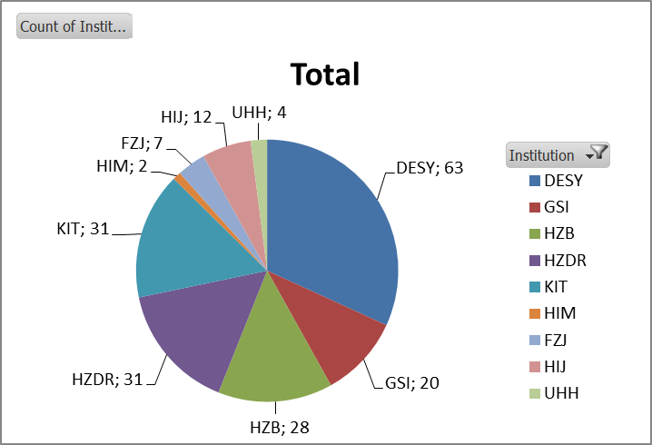
Annual meeting
Number of registrants: 204
Broad participation from
all centers

Slide 24
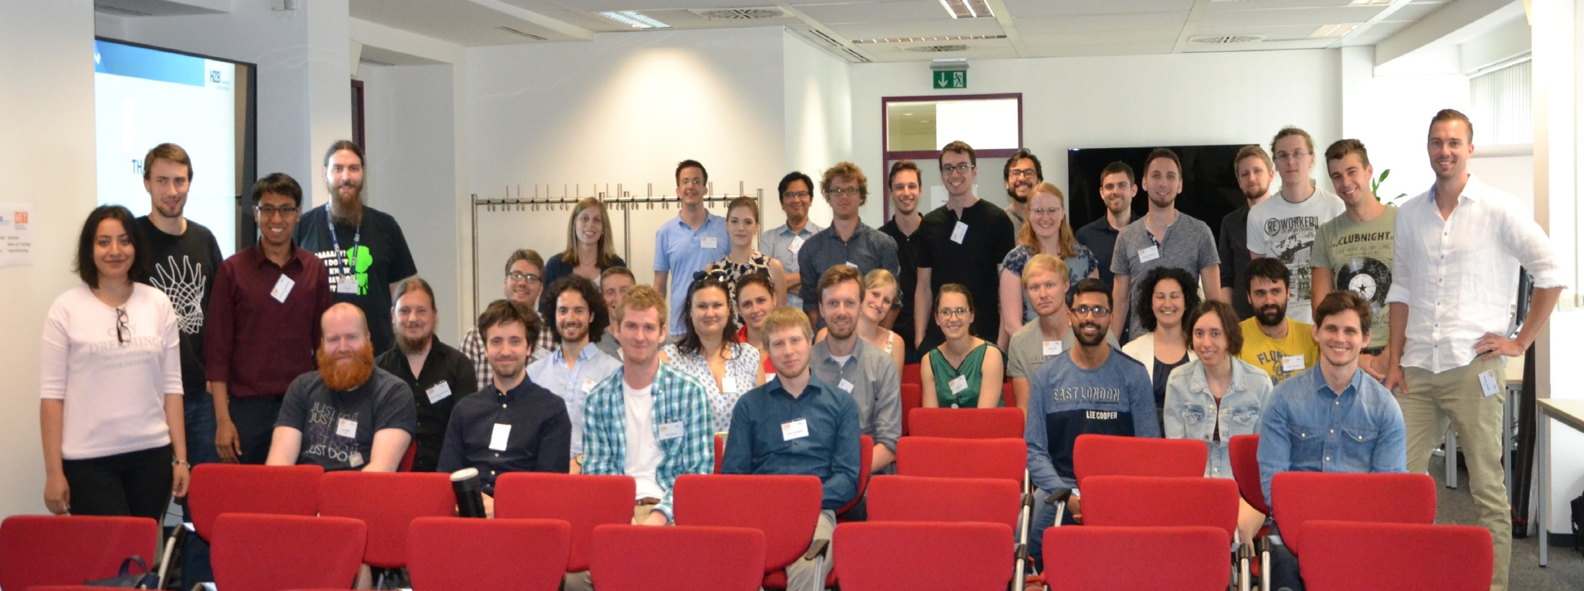
Student retreat

Slide 25
Thanks
Students help
Anny Gorah
Paul Volz
Felix Andreas
Marten Koopmans
Student retreat, HZB tour and photographer
Paul Goslawski
Thank you very much to HZB for being such a good host
Thank all of you you very much for coming!
Registration, preparatory work
Sandra Fischer
Ines von Scheibner
Overall organisation, the soul of the meeting:
Roswitha Schabardin

