Slide 1


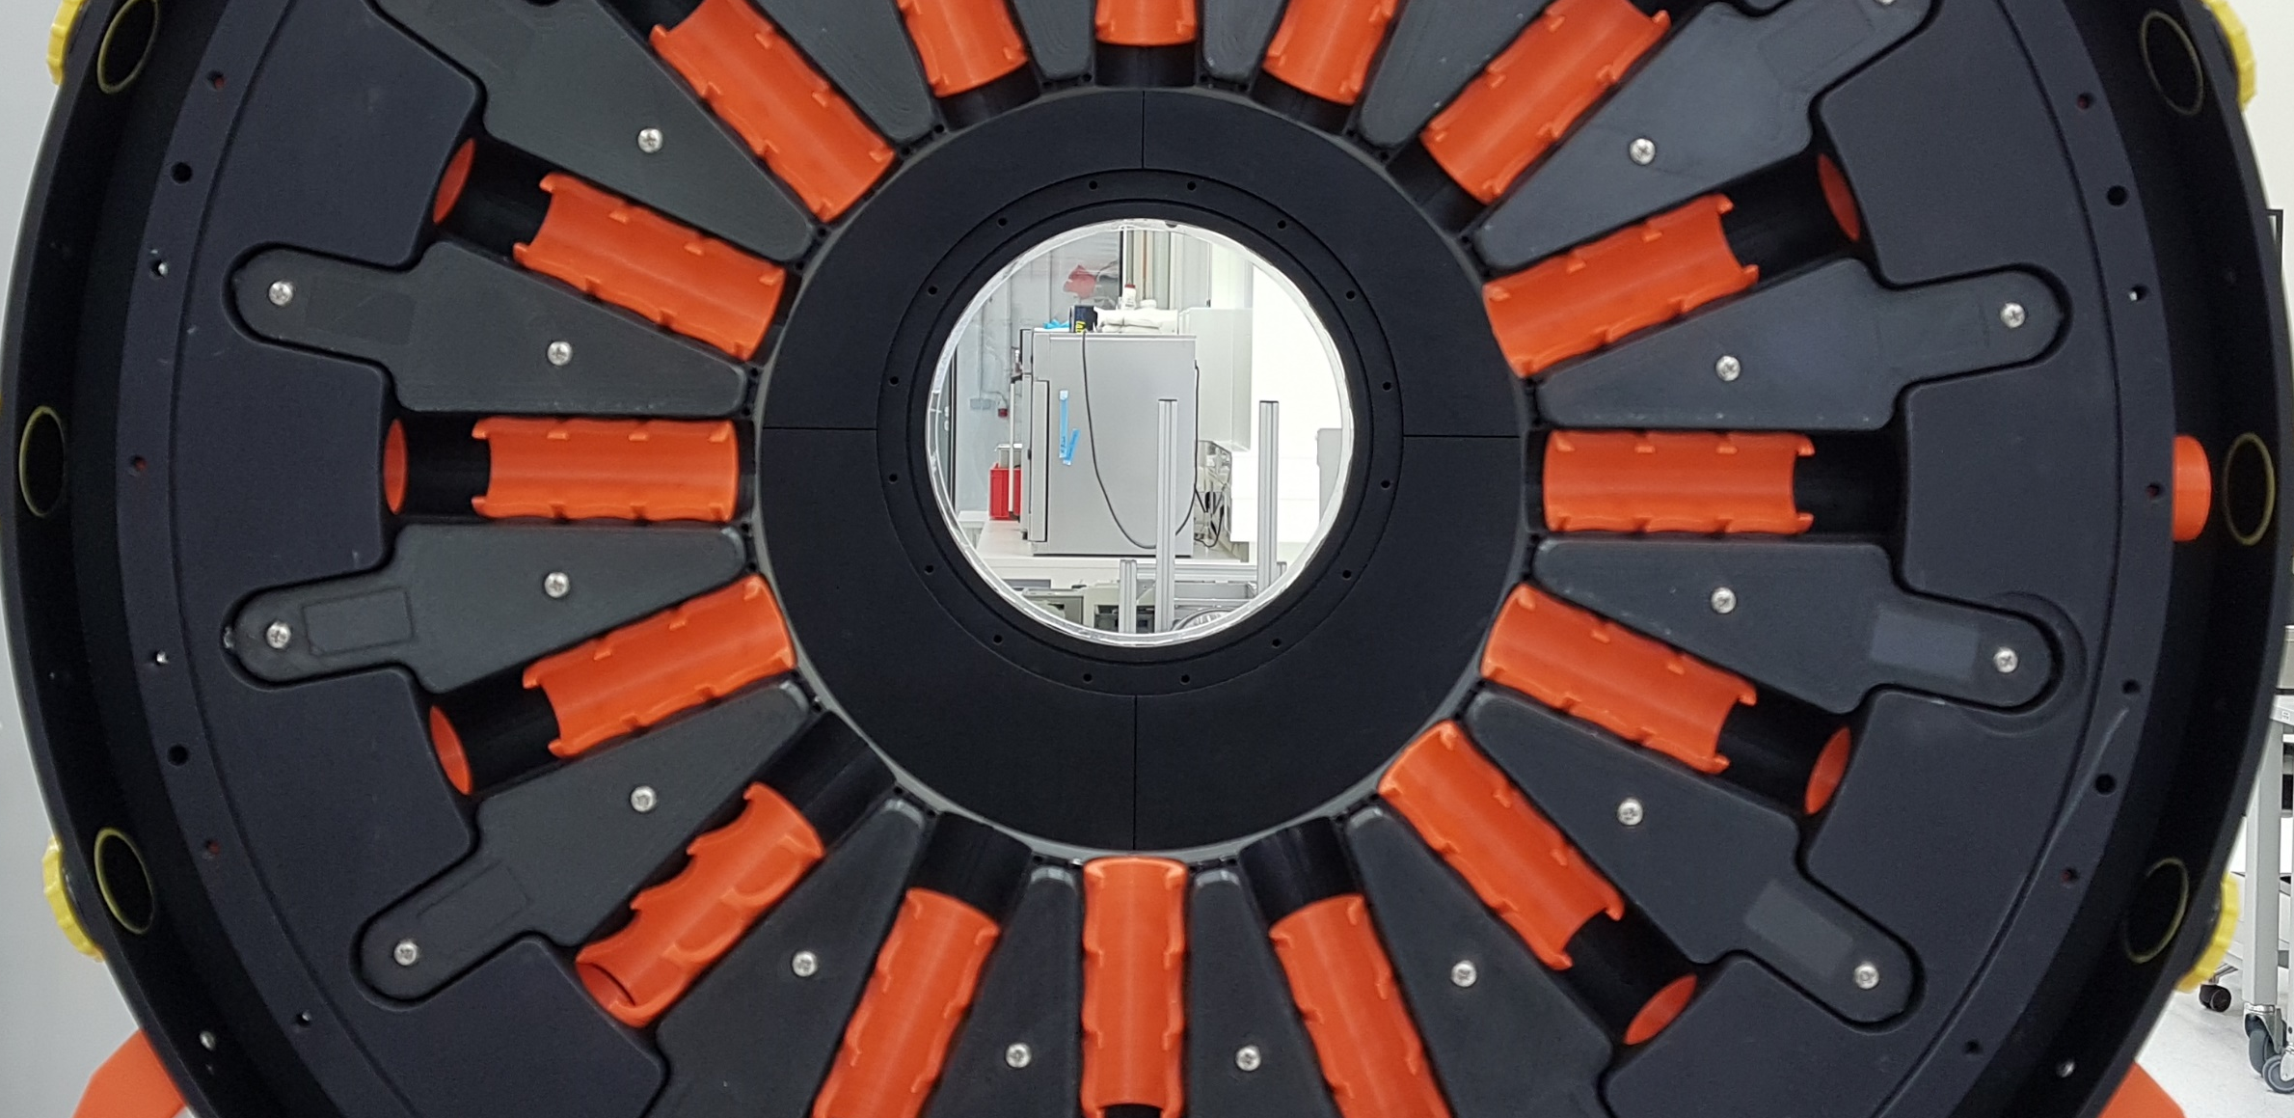
Liquid Cherenkov detector as a
diagnostic tool for relativistic heavy ions (TOF measurements)
Natalia Kuzminchuk - Feuerstein
Bernd Voss, Oleg Bogdanov, Elena Rozhkova,
Christoph Scheidenberg
Matter and Technologies AM, Berlin June 12 – 14, 2018

Slide 2
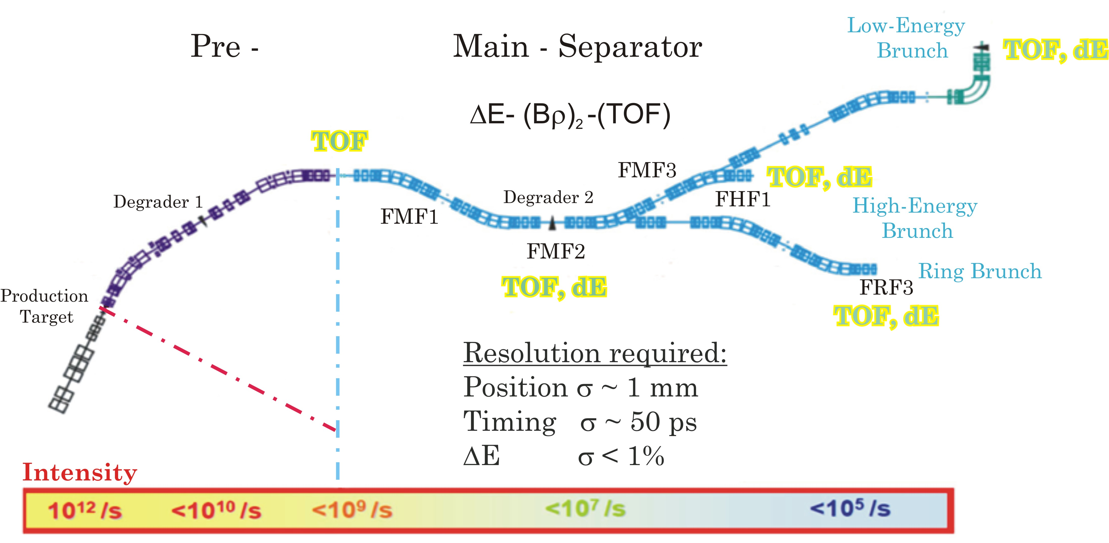
TOF focal plane detectors
High rate and radiation dose detector
time resolution σ < 50 ps, path length 60 - 80 m
active area 380 / 200 mm x 80 / 50 mm
particle rate up to 10⁷ ions / spill
radiation dose @FMF2 1Gy / h

Slide 3
Motivation: Cherenkov Radiation
Cherenkov radiation (ChR) – is an electromagnetic radiation emitted when a charged particle passes through a medium at a velocity greater than the phase velocity of light in that medium: is emitted at a specific angle θ_{C} with respect to the strait-line trajectory (or to velocity direction)
Cherenkov angle:
The number of Cherenkov photons created at threshold velocity
(including energy loss in the radiator)
Altapova V.R., Bogdanov O.V., Pivovarov Yu.L.,
NIM B 256 (2009) pp.109-113
Cherenkov light is a promt event and therefore ideal for timing measurements
At Super FRS @ FAIR:
heavy ions at E=300 MeV/u÷1.5 GeV/u → β=0.65 ÷ 0.92
Required material with high reftactive index n!

Slide 4
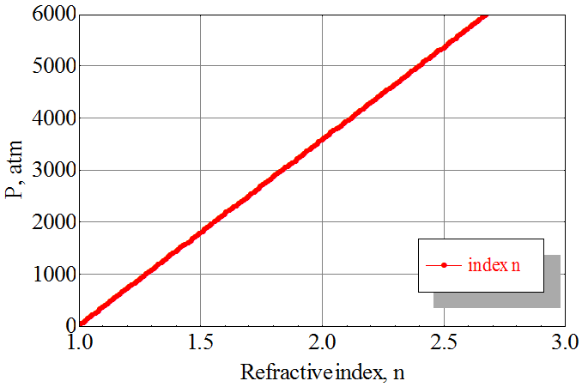
Material for Cherenkov Radiator:
Solid, Gas or Liquid?
Contra
Solid:
  Particle rate resistance
Liquid:
  With > n increases toxicity, presence of color centers and viscosity
Gas:
  very low refractive index: n_{typ.}=1.0003 (β≈0.99)
  Pressure dependency of n
Gas
n(420 nm)=1.00029 (P₀=1 atm)
Threshold velocity:
β=1/n≈0.9999 (55 GeV/u)
→ not suitable

Slide 5
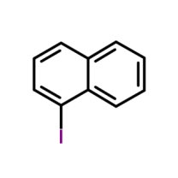
Liquid radiator: Iodine Naphthalene
Iodine Naphthalene (C₁₀H₇I):
n_{D} =1.7001 @ 589 nm
ρ=1.738 g/cm³
Threshold velocity:
β=1/n≈0.59 → E ~ 220 MeV/u
Dispersion curve
Application of liquid radiator allows
the circulation of the active material
and therefore to greatly reduce the effects of the degradation of the optical performance expected after exposure to the high ion rates at the Super-FRS
Otto Schott Research Centre Mainz-Marienborn

Slide 6
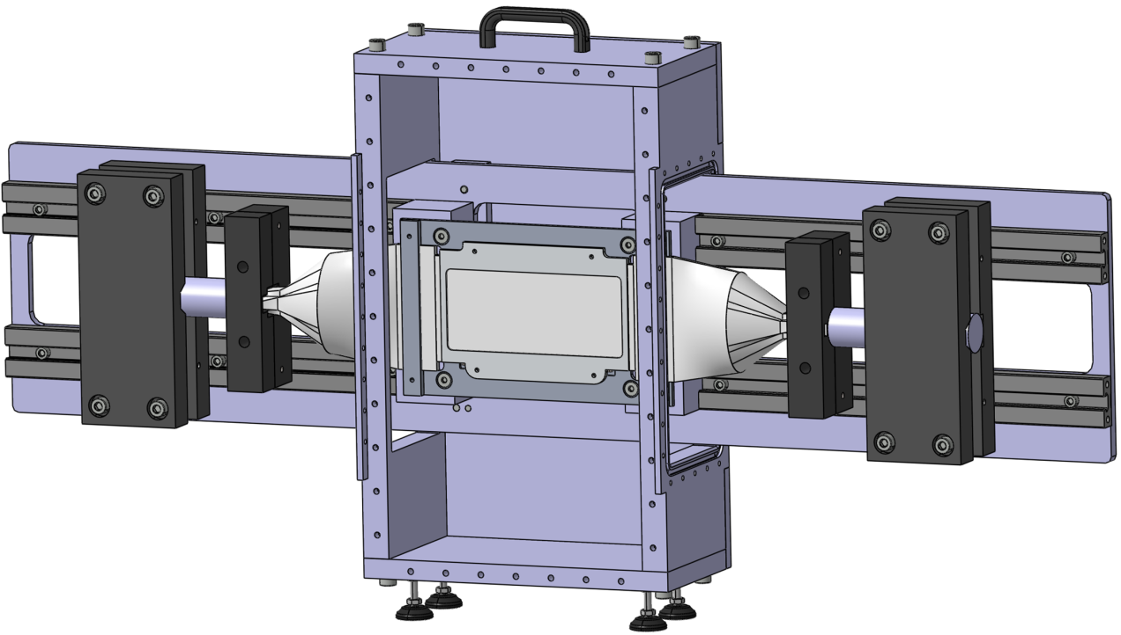
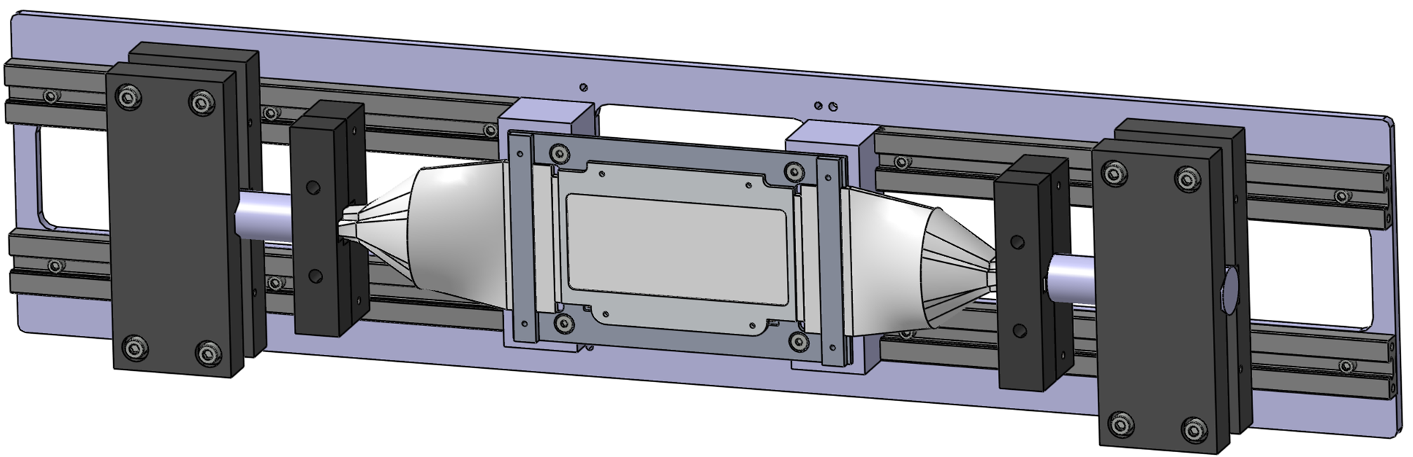
Prototype detector design
N. Kuzminchuk-Feuerstein et. al., NIM A 866 (2017) 207
Light tight box
[1160 x 420 x 140 mm]
420 mm
Ion beam
1160 mm
PMT L
Light guides
PMT R
Cuvette filled with C₁₀H₇I
Windows: borosilicate glass;
Side: N-SF10 glass plates;
Araldite 2020
Coating: Aluminium [0.15 µm]

Slide 7
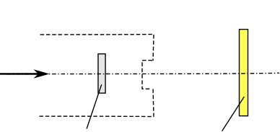
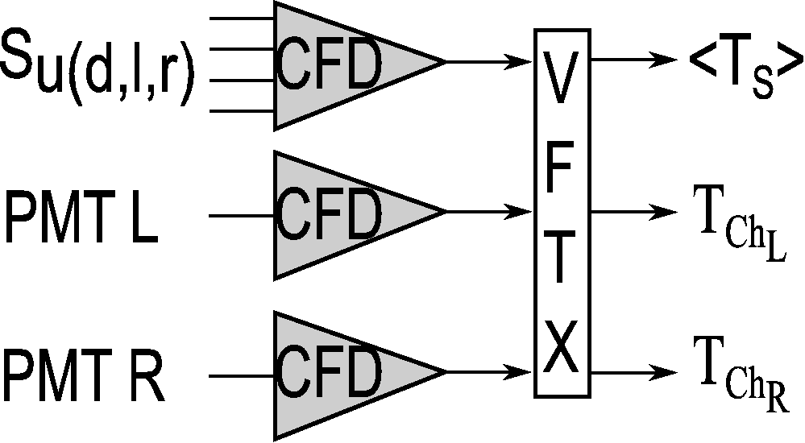
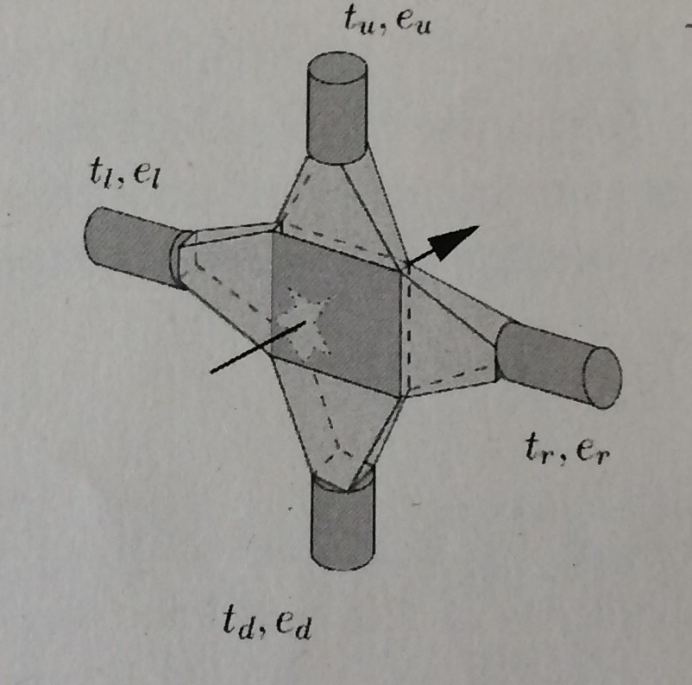
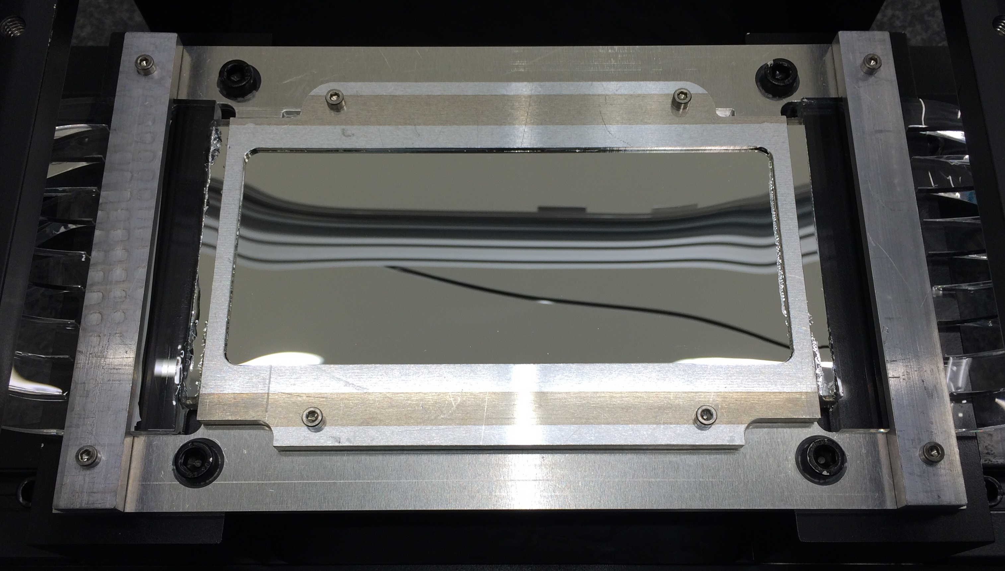
TOF Measurements with ¹²⁴Xe ions at CaveC
Detector arrangement Data Acquisition
4 x PMTs
S_{u (d,l,r)}
¹²⁴Xe
[600 MeV/u]
PMT L PMT R
vacuum
(S) (Ch)
PMT Assembly:
HAMAMATSU H6610 (R5320)
New cuvette construction:
T263 borosilicate glass [0.1 mm]
L:W:H 170 x 5.2 x 85 mm
Higher number of Cherenkov photons
Bigger signal amplitude
Better coupling between cuvette and light
guides

Slide 8
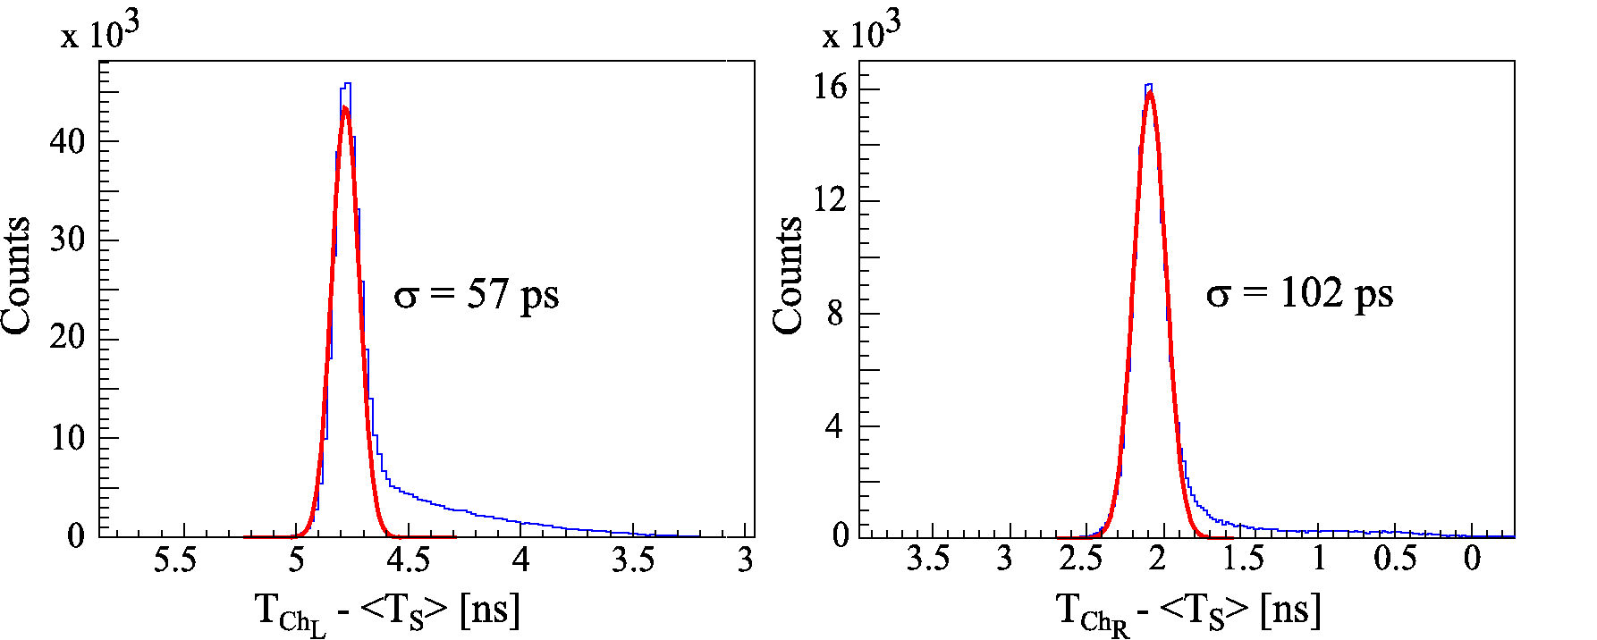
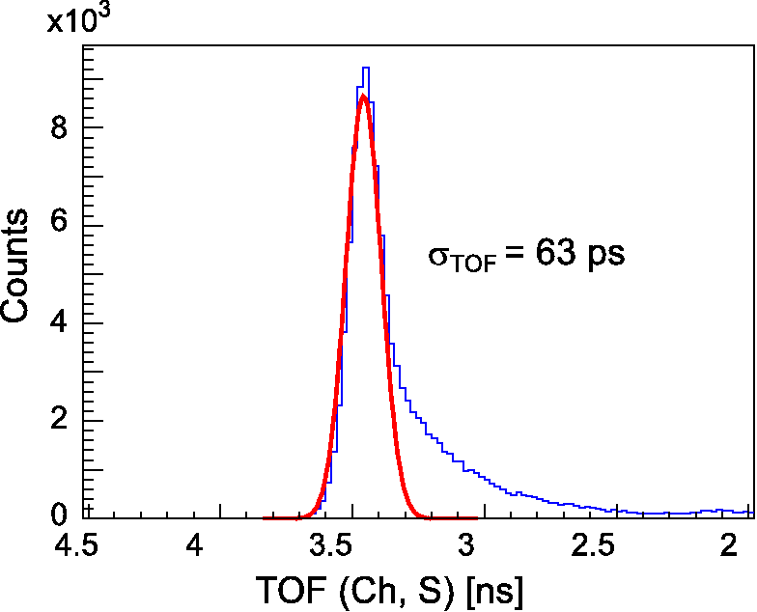
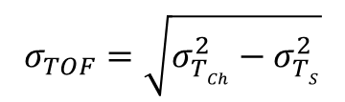

Time-of-Flight Spectra (¹²⁴Xe ions)
$TOF (Ch,S)$=<$T_{Ch}$>-<$T_{S}$>
$$σ_{TOF}=\sqrt{σ_{TCh}^{2}−σ_{TS}^{2}}$$

Slide 9
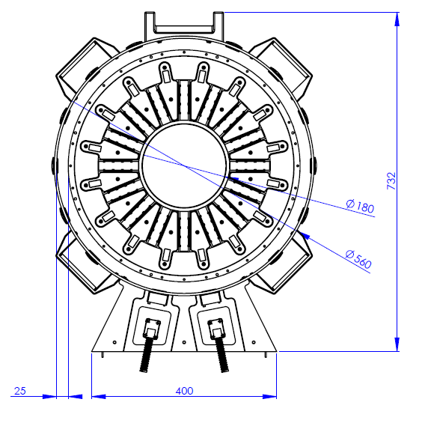
New modular design of a prototype of a TOF - Cherenkov detector
36 mm
Light tight
housing
ø 560 mm
PMT₁
Active
media
16 PMTs
732 mm
16 LEDs
LED driver
circuit boards
Beam
PMT₉
Overall ø 560 mm
ø 18 mm active media disk
1 – 5 mm thickness
16 PMTs XP1918 Photonis [ø 15 mm]
16 LEDs for calibration
Driver circuit boards to control LEDs
HV supply

Slide 10
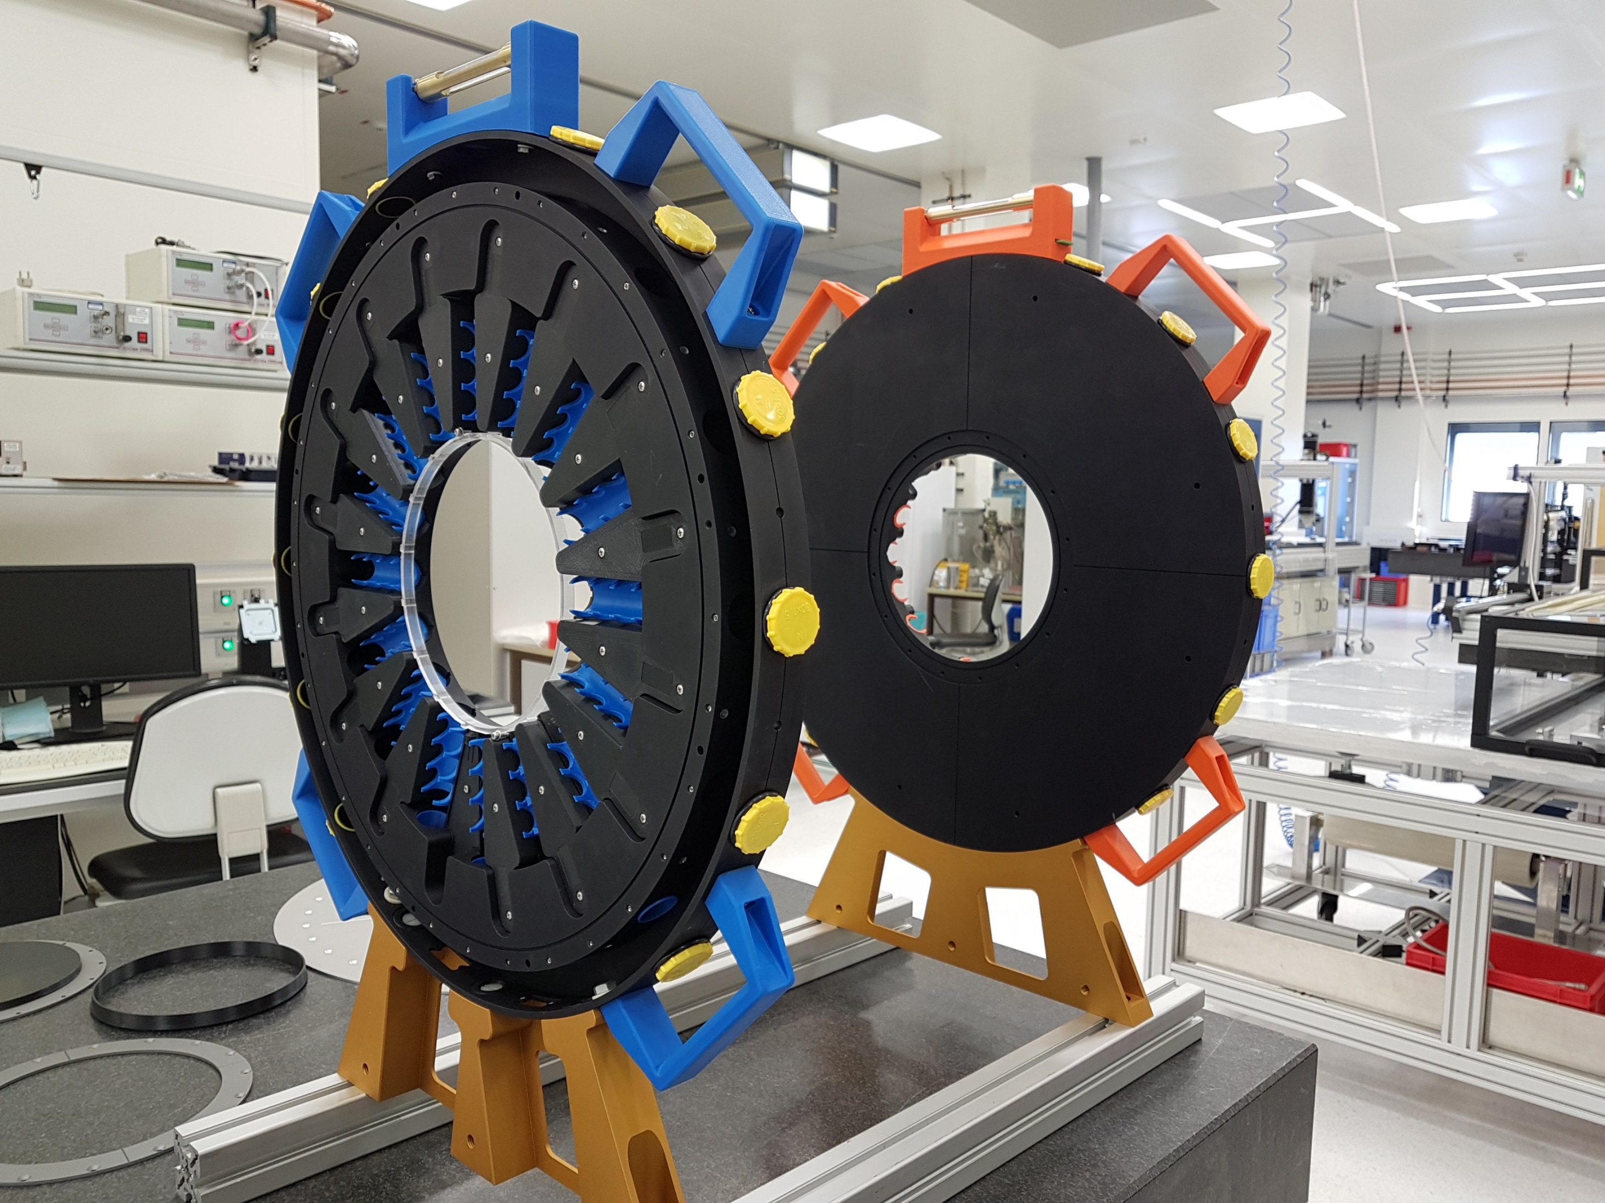
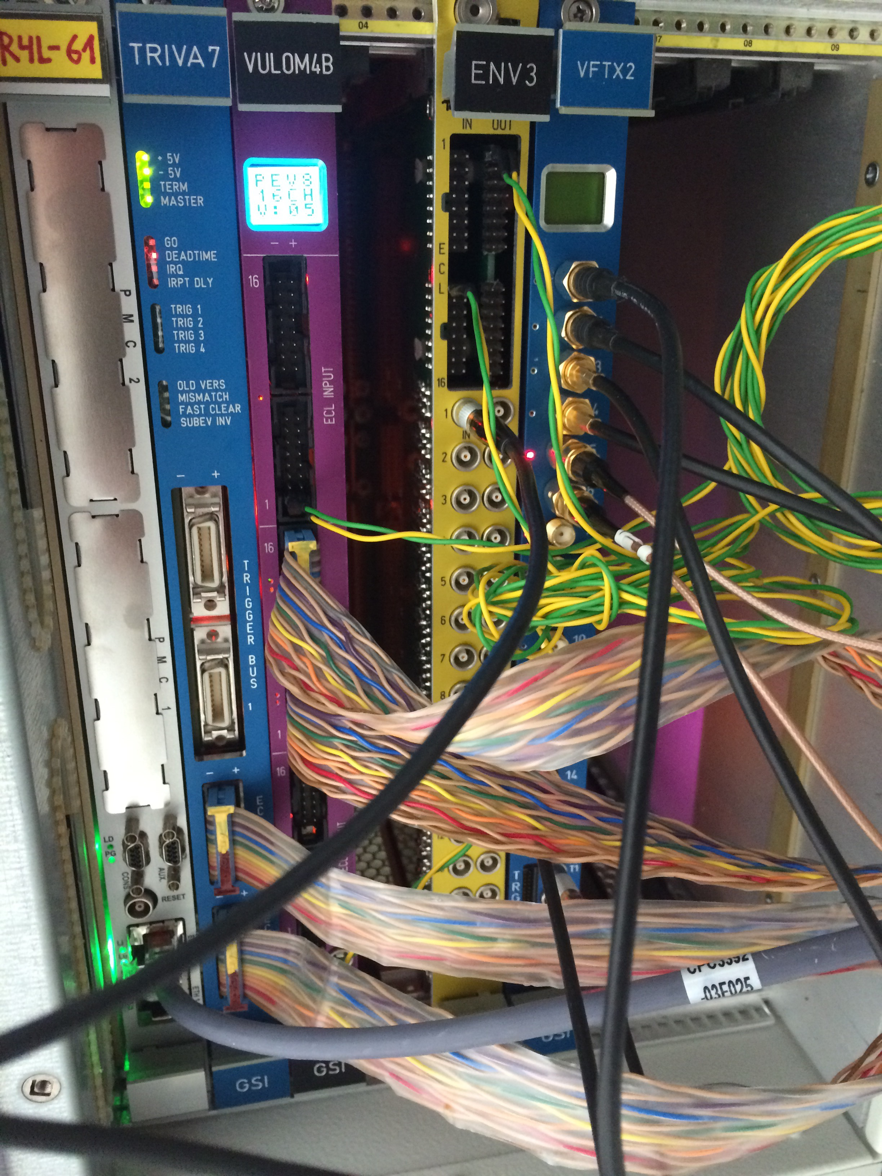
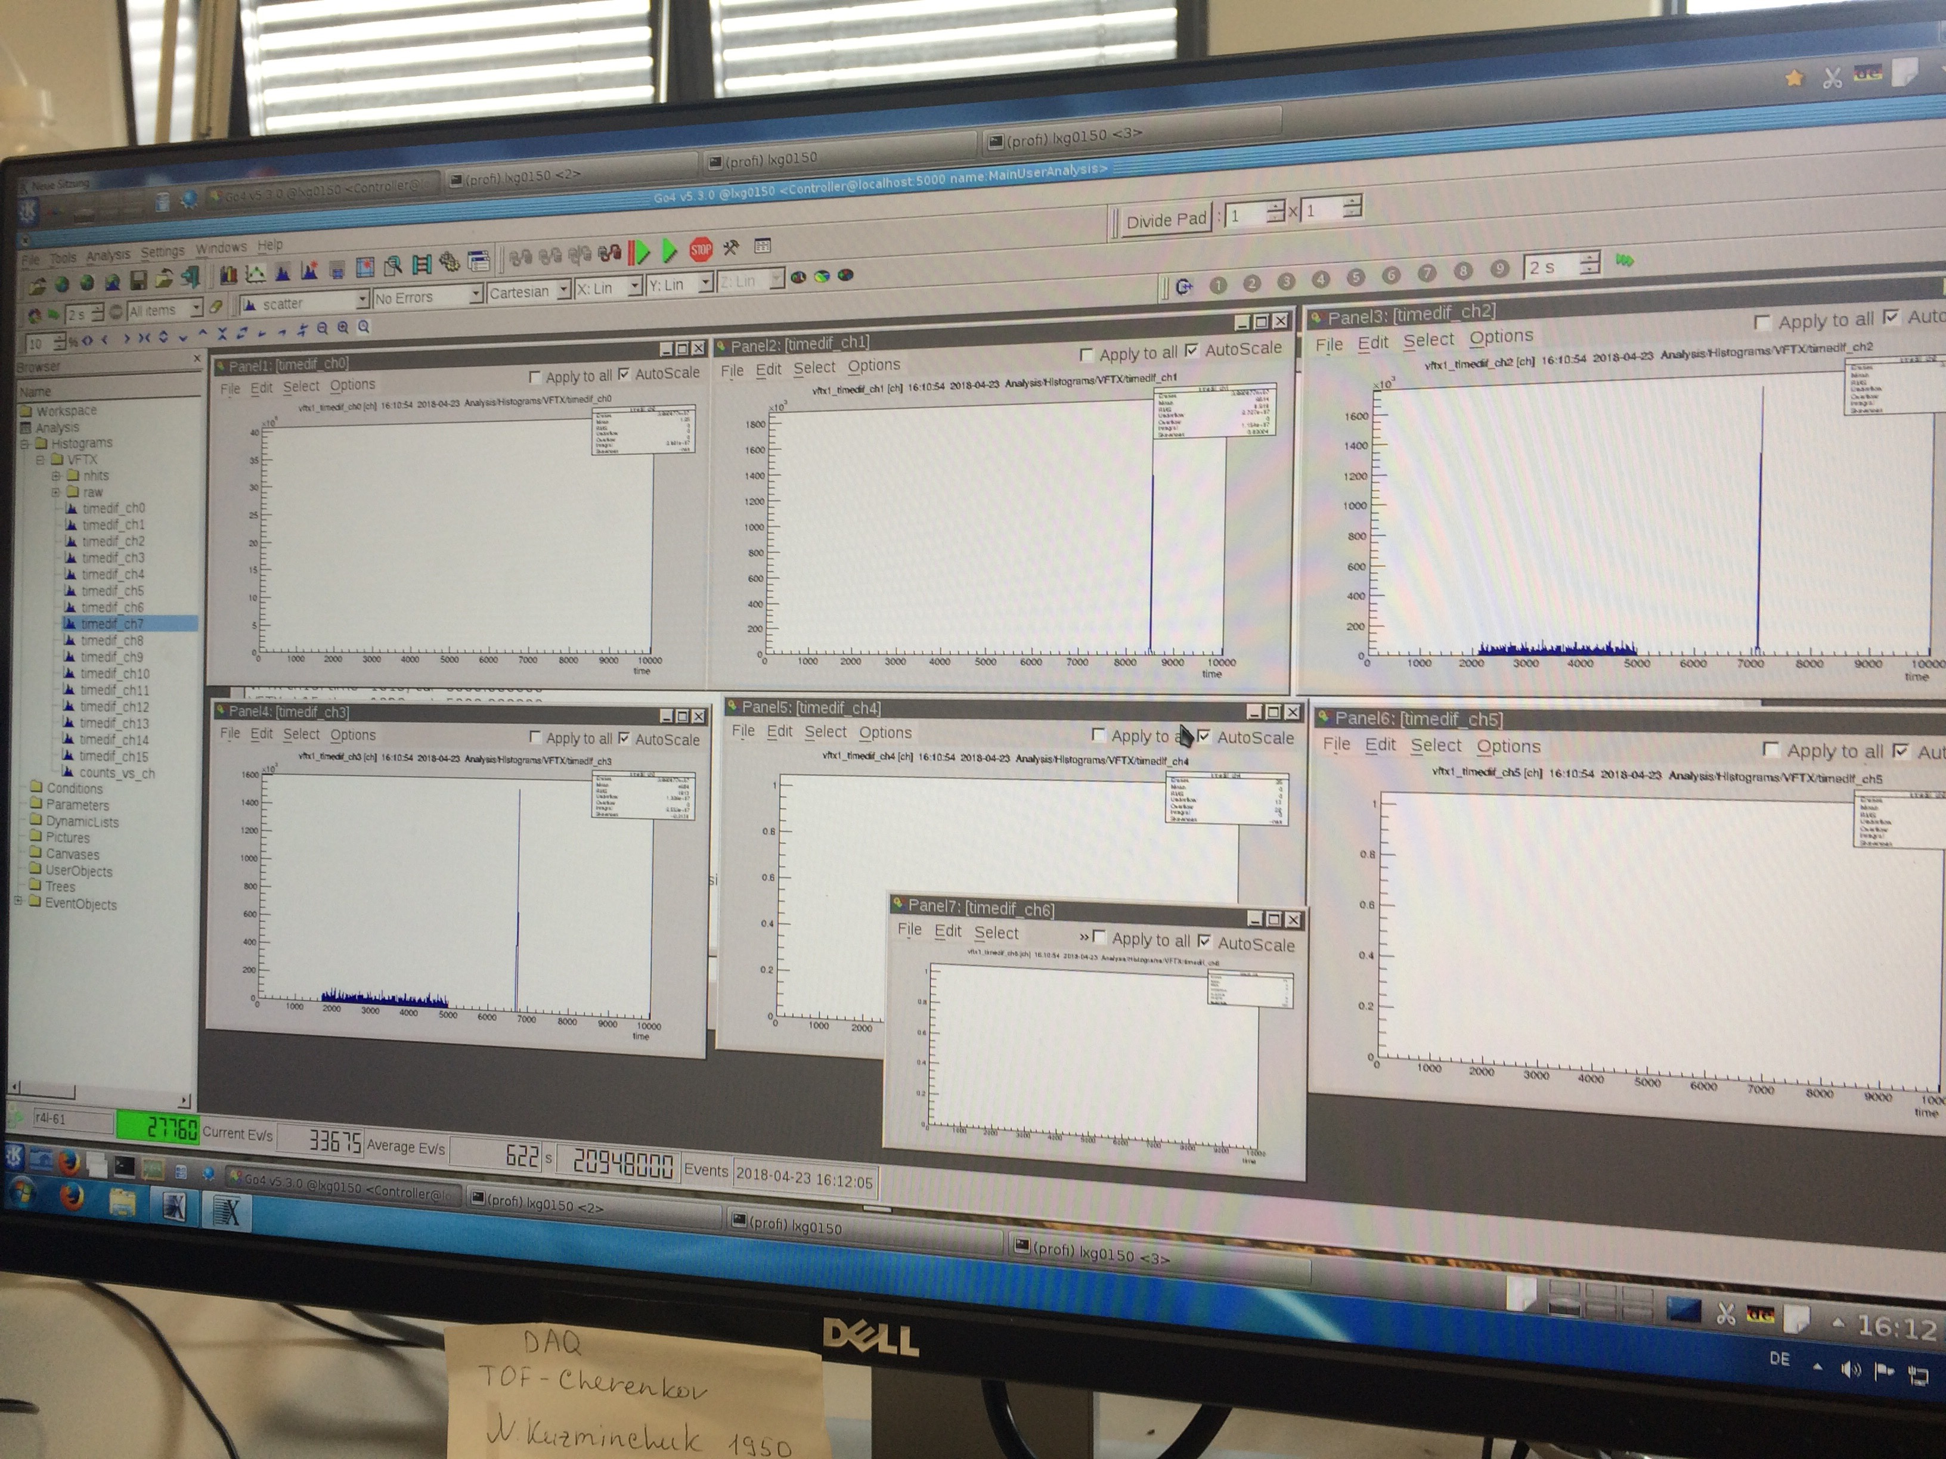
Calibration and DAQ
Requirements :
PMT1
LED1
To correct the difference in signal transit path
To monitore the temporal resolution (σ)
LEDs pulse width in ns range
To trigger 16 LEDs in sequence
PMT2
LED2
Circuit board
to control LED
R. Siegert, Bachelor Thesis,
Hochschule RheinMain, Rüsselsheim.
Data Acquisition
VFTX TDC [16 Ch.] is read
out by GSI DAQ MBS
running on RIO4
in progress

Slide 11
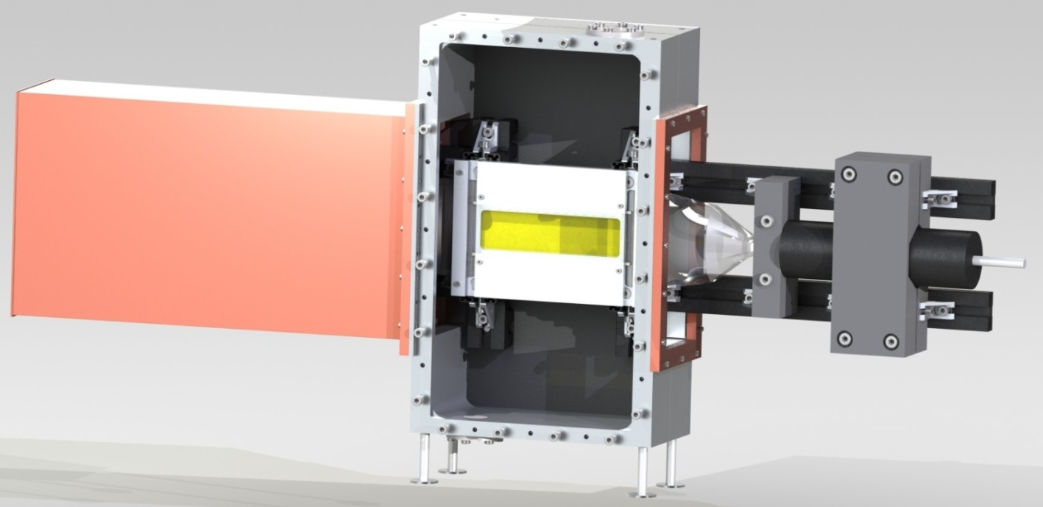
Summary and Outlook
For the future TOF measurements a Cherenkov detector employing a liquid radiator (C₁₀H₇I) is proposed, designed and constructed
Principal operation was approved in the beam time with ⁵⁸Ni ions at SIS18 (CaveC) (2014)
First TOF measurements was performed at SIS18 (CaveC) with ¹²⁴Xe ions (600 MeV/u) using improved construction: σ = 63 ps
So far, we have not reached any limitation in the particle rate, which has shown any degradation of the optical properties of the liquid: accumulated number of particles ~ 11 x 10¹¹
A new modular design to increase the timing intrinsic resolution and not to limit to a certain application (different active media, thickness)
New measurements with ¹⁰⁷Ag, ²⁰⁸Pb - ions possible in 2018 to test the rate capabilitity of the detector (up to 10⁷ /s), TOF measurements and DAQ

Slide 12
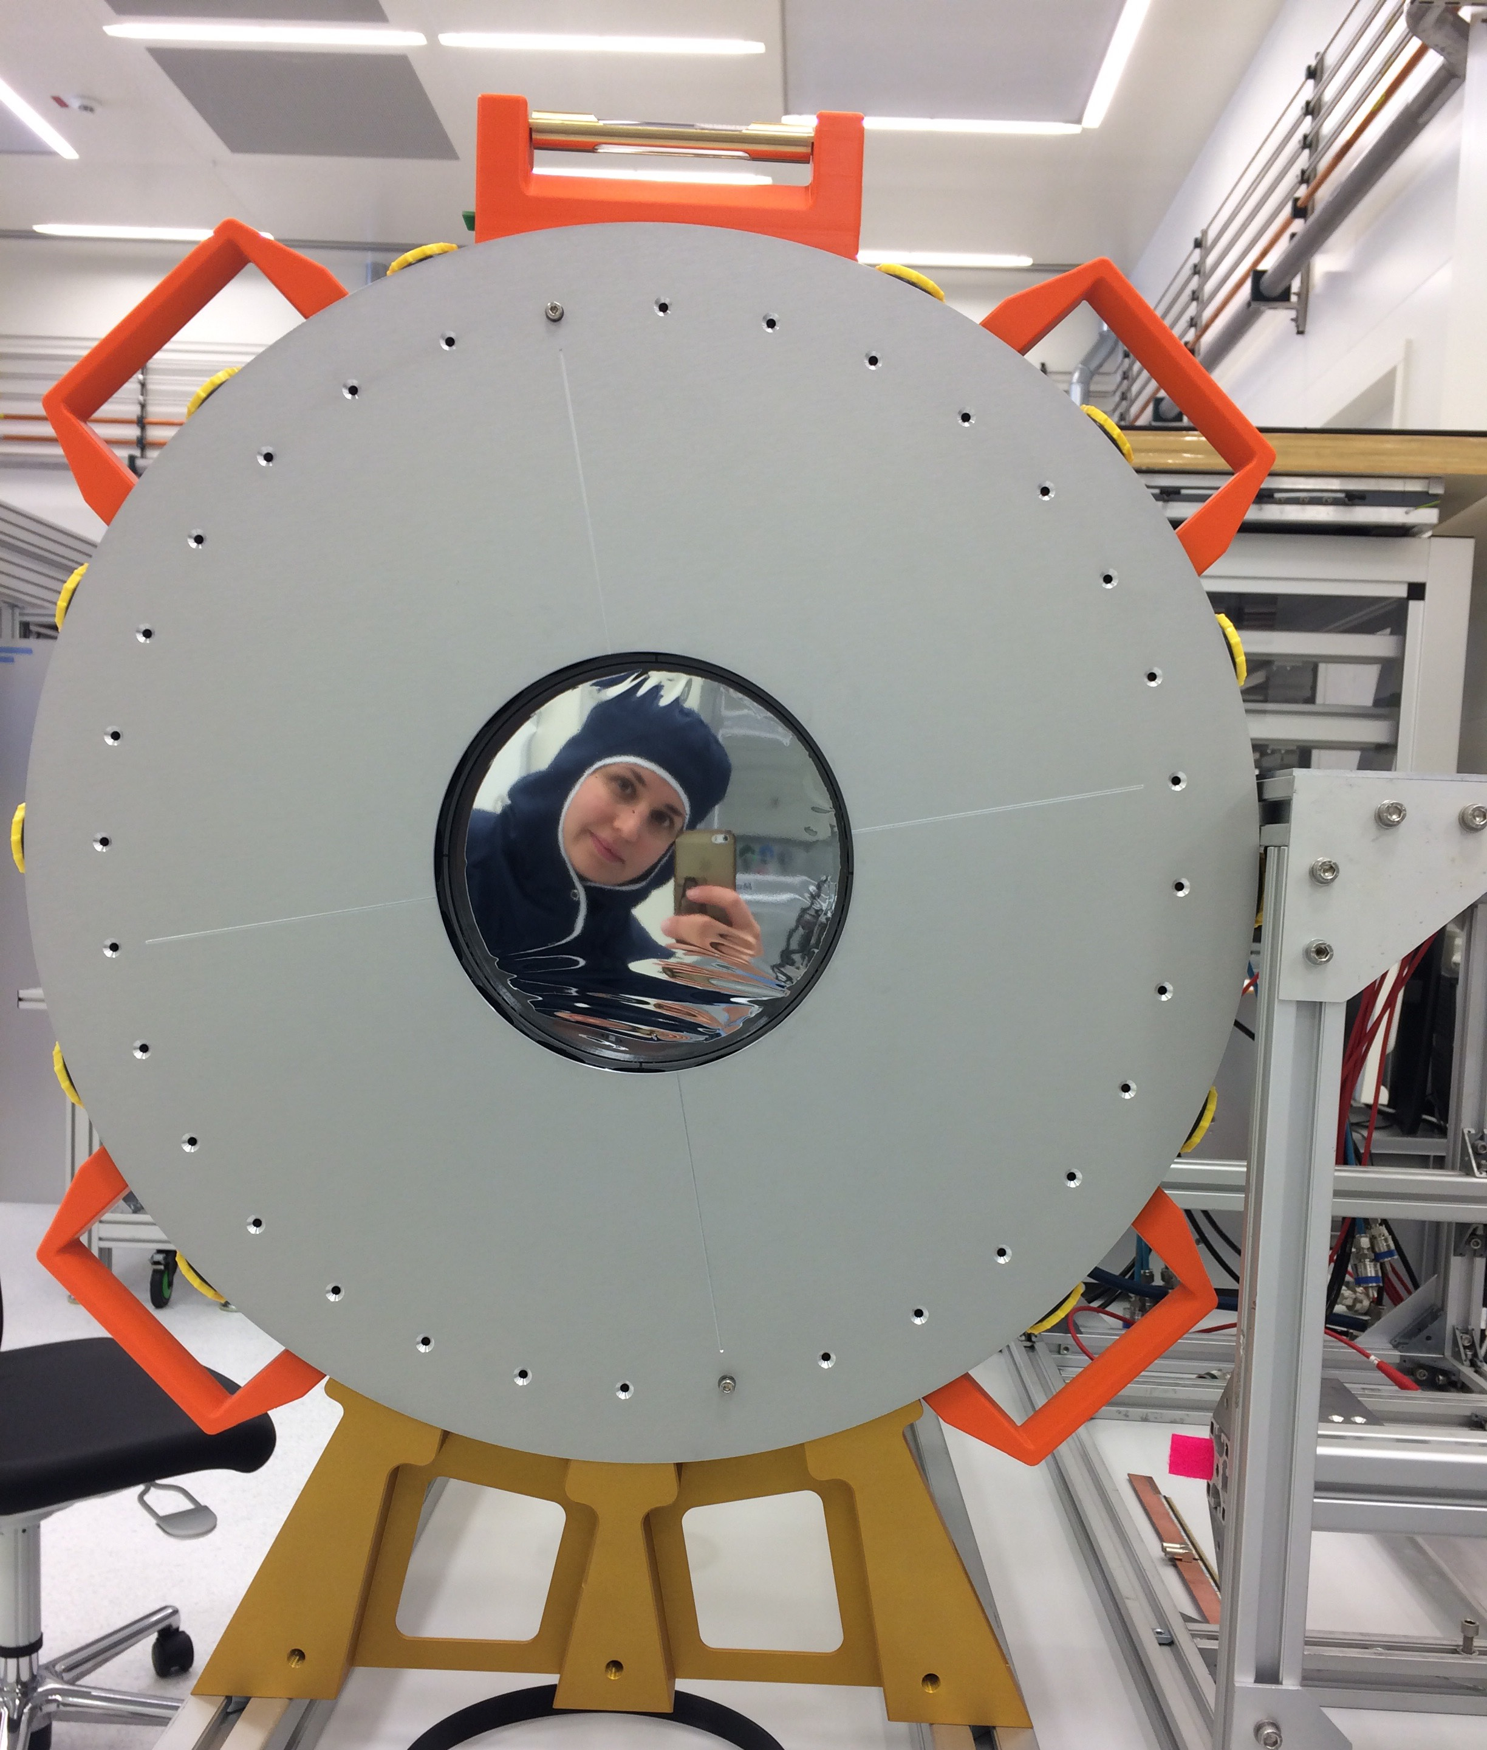
Thank you
for your attention!

Slide 13
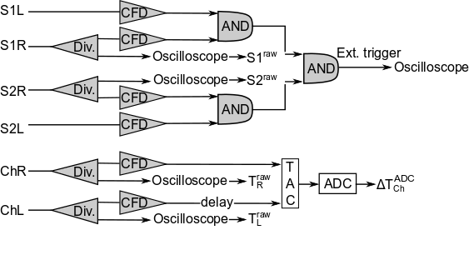
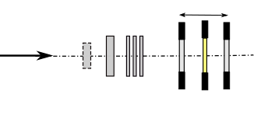
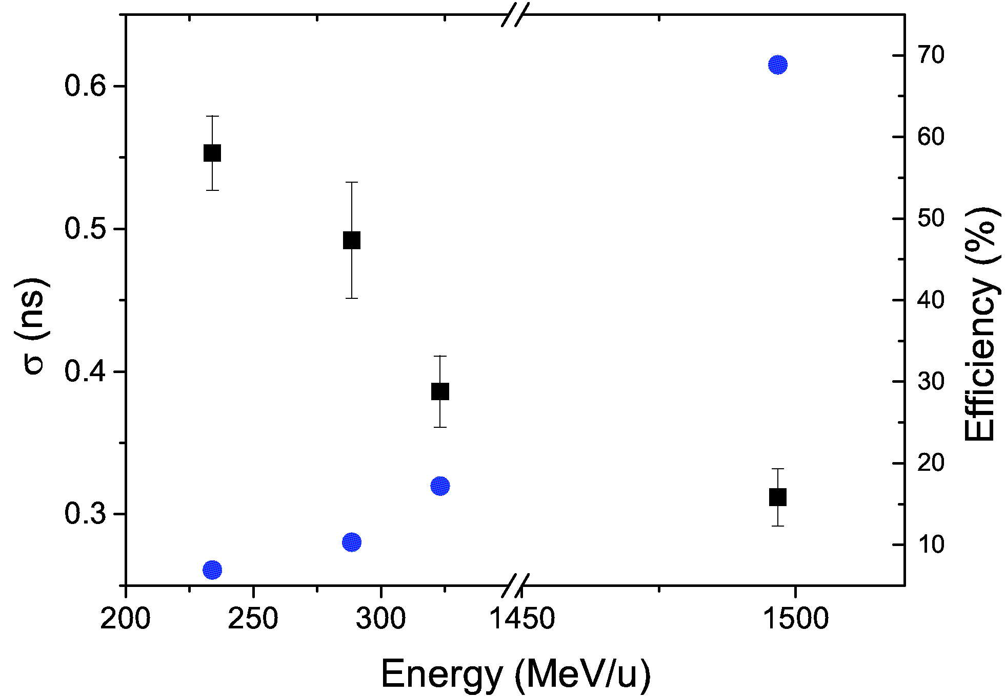
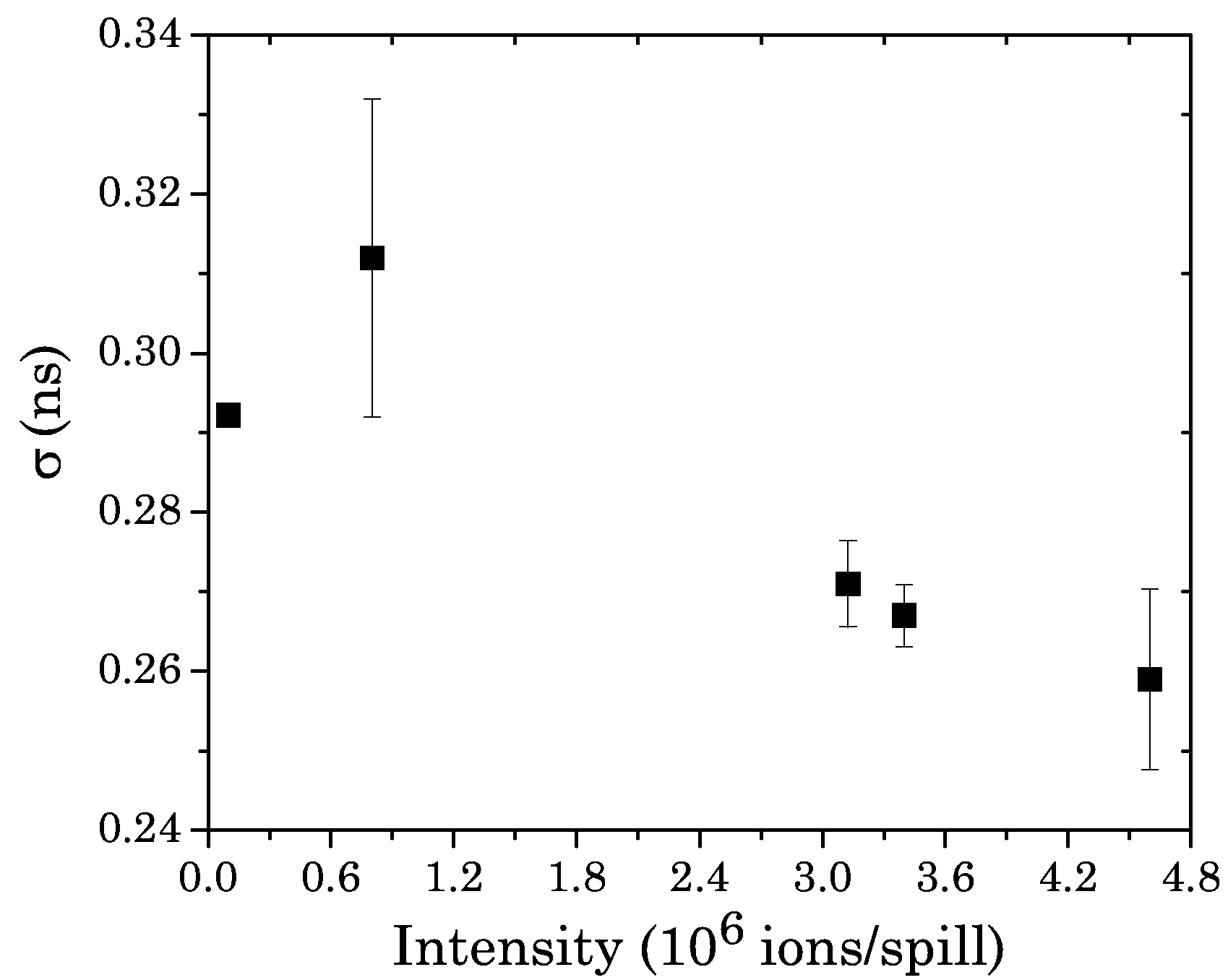

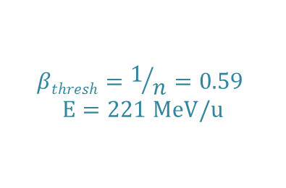

First proof of principle experiment with
⁵⁸Ni ions at CaveC
N. Kuzminchuk-Feuerstein et. al., NIM A 866 (2017) 207
Detector arrangement Scheme diagram of the electronic arrangement
Pb-targe
Particle
detectors
⁵⁸Ni
700 MeV/u
ChR ChL
S1R S1L
S2R S2L
$${∆T}_{}^{ADC}$$
_{Ch}
I~10³ ions/spill E= 1.5 GeV/u
$$βthresh=1/n=0.59$$
$$E=221 MeV/u$$
$${σ(∆T}_{}^{ADC})$$
_{Ch}
at ~0.3 MHz scintillators reached saturation level

