Slide 1
Optical Modules.
for the IceCube Upgrade and IceCube-Gen2
Timo Karg
4th Annual MT Meeting, Berlin, 13 June 2018

Slide 2
http://icecube.wisc.edu
~300 scientists, 48 institutions, 12 countries

Slide 3
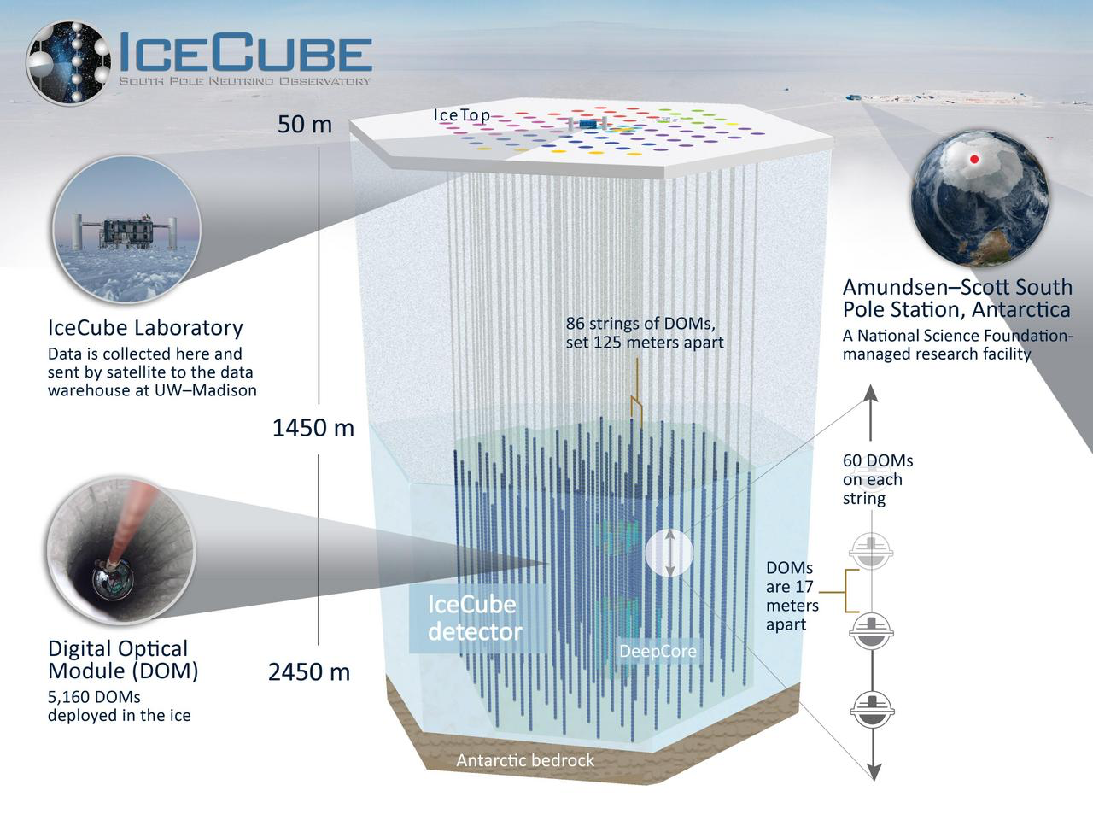
JINST 12 (2017) P03012

Slide 4
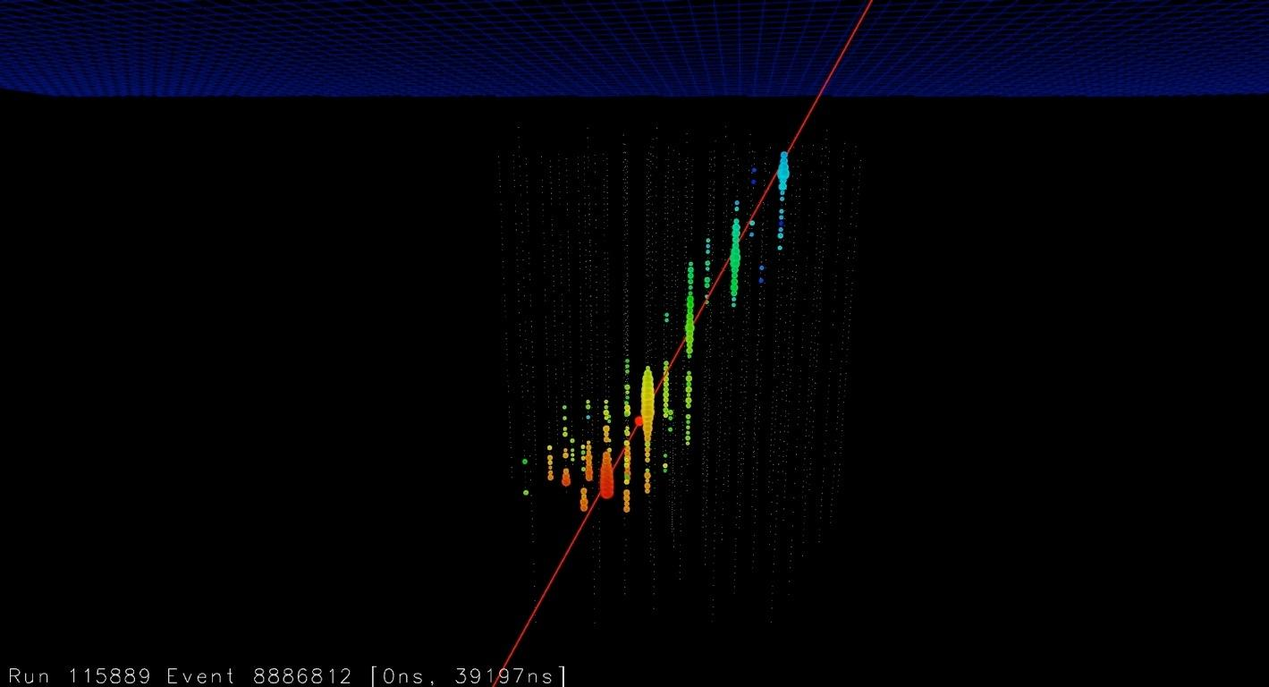
Measure Cherenkov light from charged particles in the ice
charge
time
Up-going track: Muon from muon-neutrino interaction
early
late

Slide 5
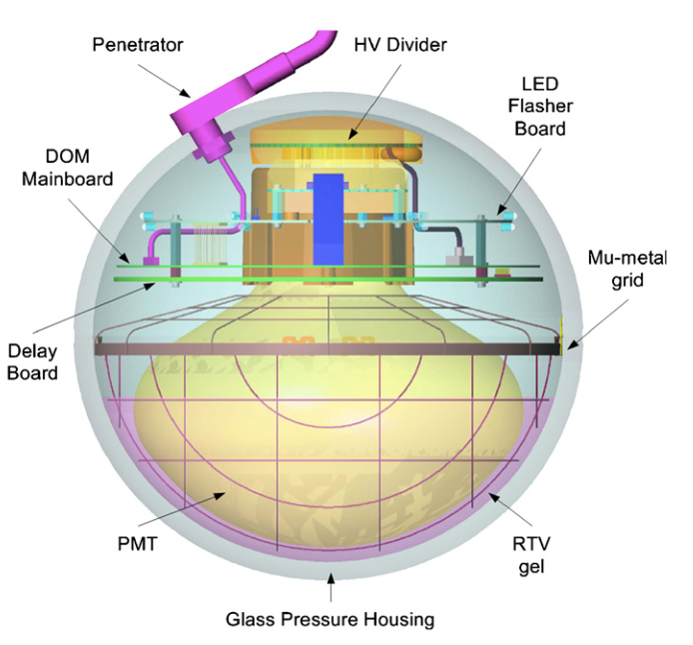
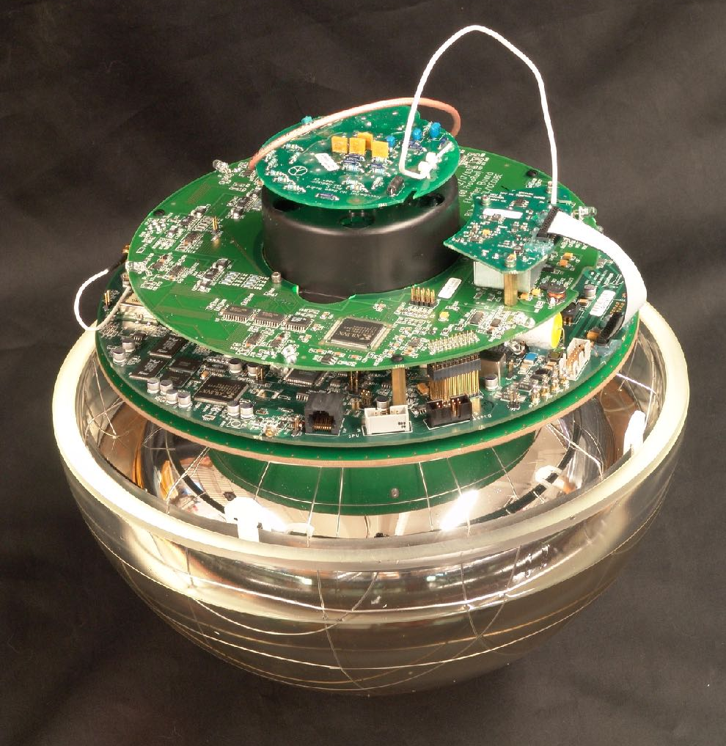
The IceCube Digital Optical Module (DOM)
Requirements
Single p.e. to few hundred photons (instantaneous)
Good Timing (all DOM clocks synchronized to < 2 ns)
Data/timing/power over 3.3 km copper pair
Low noise (MeV supernova neutrinos)
Dark noise dominated by radioactivity in glass pressure housing
Withstand > 550 bar freeze-in pressure
Survive shock vibration; ships, planes, sleds
Features
Records PMT waveform of every “hit”
300 MHz sampling switched capacitor array + 40 MHz ADC
Power consumption ~3 W
98.4% of deployed modules operational!
13 inch (33 cm)
10-inch PMT
NIM A 601 (2009) 294

Slide 6
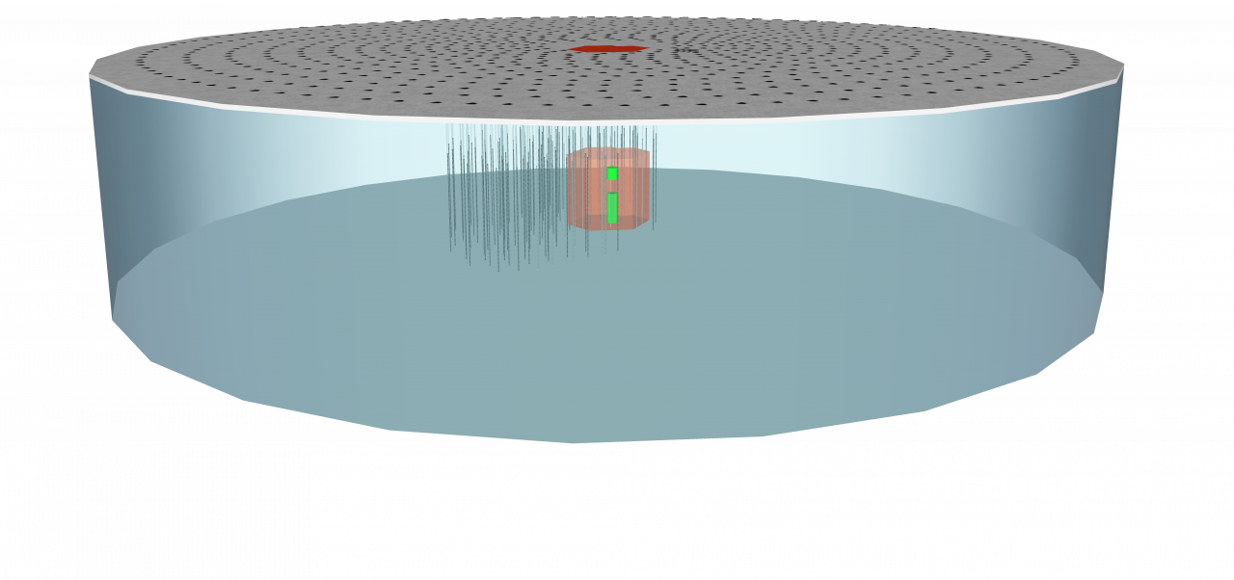
Our Vision: The IceCube-Gen2 Facility
up to 15k optical modules will be required
A wide band neutrino observatory (MeV – EeV) using several detection technologies – optical, radio, and surface veto – to maximize the science
Gen2 High-Energy Array
~120 strings
80 OMs per string
~9600 optical modules
PINGU
26 strings
up to 192 OMs per string
up to 4992 optical modules
Multi-component observatory:
Surface air shower detector
Gen2 High-Energy Array
Sub-surface radio detector
PINGU
Gen2 Surface Veto
IceCube
Gen2
High-Energy Array
DeepCore
J. Phys. G 44 (2017) 054006
PINGU
arXiv:1412.5106 [astro-ph.HE]

Slide 7
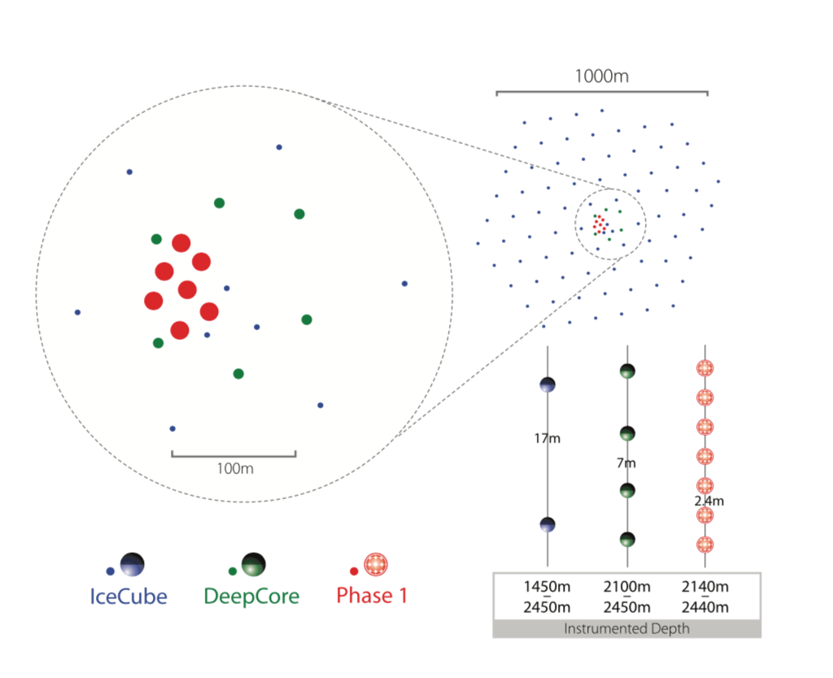
A First Step: IceCube-Upgrade
Science goals
ν_{µ} disappearance
ν_{τ} appearance
Precise calibration of IceCube optical properties and DOM response
Baseline sensor design: mDOM
Proposals pending – News expected soon!

Slide 8
Improving the In-Ice Detector With New Sensors
Event resolution, overall sensitivity and cost effectiveness can be improved with new sensors, hence a dedicated R&D effort was started
More photons per muon/cascade
Increase photocathode area per module
Increase UV sensitivity
More information per photon
Segmented instrumentation
More modules per unit construction cost
Narrower modules → narrower boreholes

Slide 9
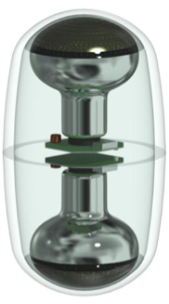
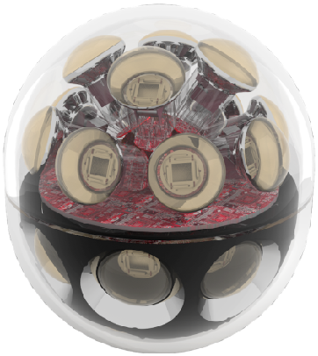
New Sensor Designs for Improved Performance
This presentation
D-Egg
mDOM
WOM
LOM
PoS(ICRC2017)1051
PoS(ICRC2017)1047
PoS(ICRC2017)1052
30 cm
36 cm
11 cm
13 cm
directional information
more sensitive area / module
smaller geometry
directional information
more sensitive area / module
more sensitive area / module
small diameter
lower noise rate
small diameter
directional info.
more sens. area / module
(Chiba)
(U Erlangen, U Münster, DESY)
(HU Berlin, U Mainz, DESY)
(UW Madison)

Slide 10
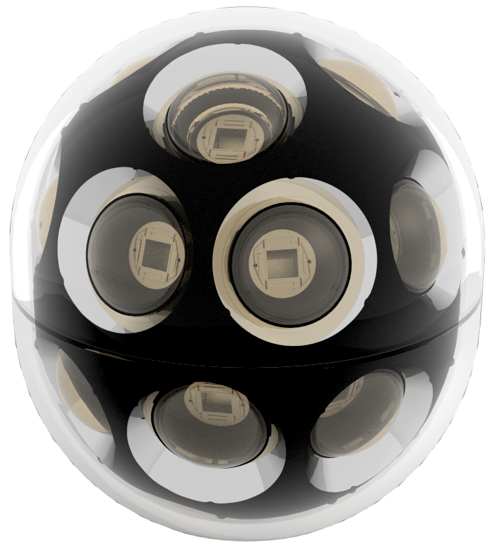
The mDOM (multi-PMT Digital Optical Module)

Slide 11
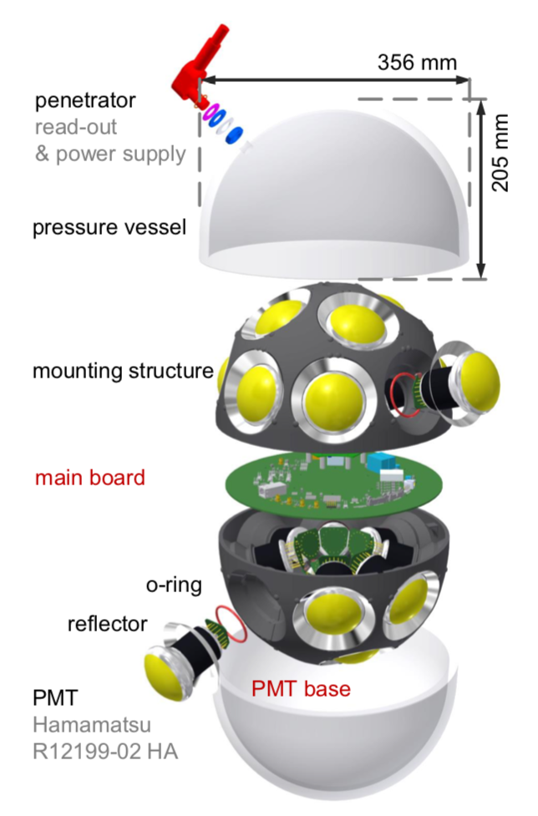
mDOM: multi-PMT DOM
Adapted from KM3NeT mDOM
24 × 3-inch PMTs
Diameter: 14 inch
Features
Doubled effective area rel. IceCube DOM
Uniform 4π sr effective area
Local coincidences (e.g. bkg. suppression)
Directional sensitivity
Improved photon counting
Challenge
Power and digitize 24 PMT channels using ≲ 3 W
PoS(ICRC2017)1047

Slide 12
mDOM Multi-ToT Readout
depends on pulse-shaping
0.9 to 1.5 W for 24 channels (w/o ADC, FPGA)
1.2 GHz sampling for lowest threshold 600 MHz for other thresholds
Cyclone 5 FPGA
PM signal
parallel processing @ 150 MHz
sampling @ 600 MHz
Other readout designs under study:
Slow (~40 MHz) ADC + TDC
DRS4-based (switched capacitor array)
ADC
SERDES 1:4
comp A
8 bit
SERDES 1:4
DAC adjustable thresholds
comp B
SERDES 1:4
4 bit
multi-ToT
comp C
SERDES 1:4
4 bit
comp D
SERDES 1:4
4 bit
channel 2
to channel 24
channel 2
to channel 24
channel 2
to channel 24
∑
ADC 250 MHz, 14 bit
channel 2
to channel 24
A. Kretzschmann (DESY)

Slide 13
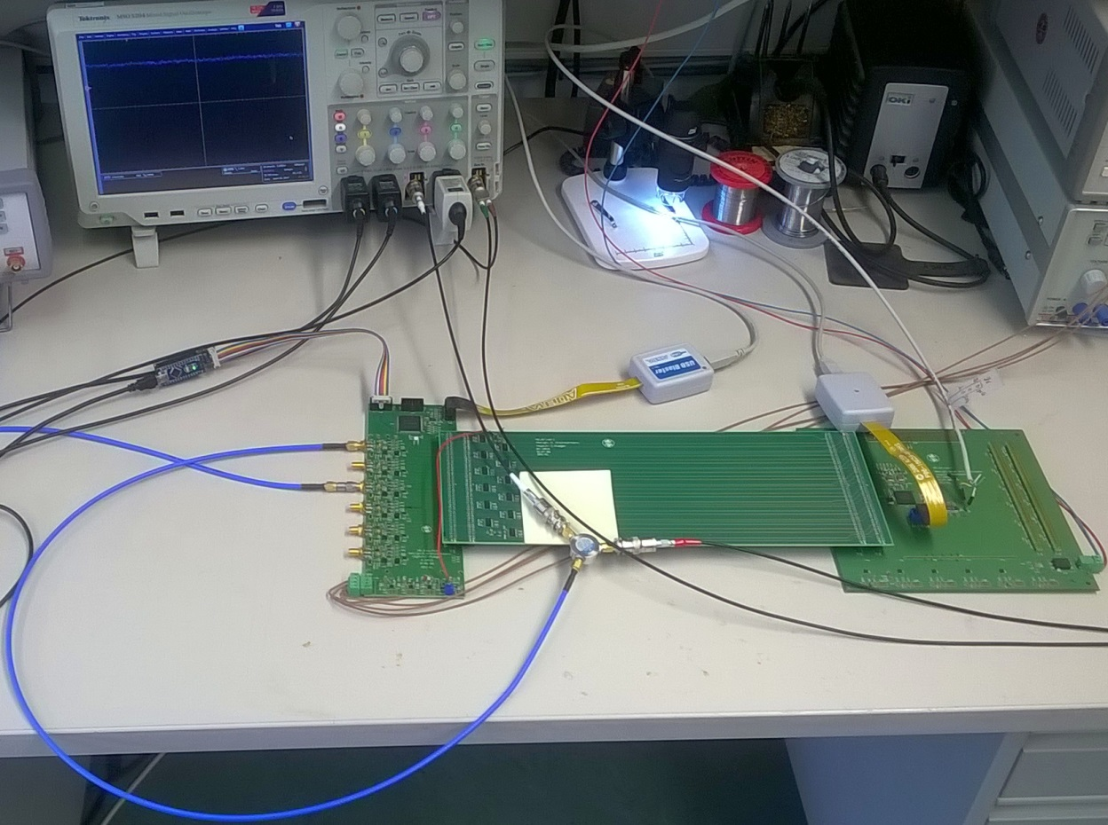
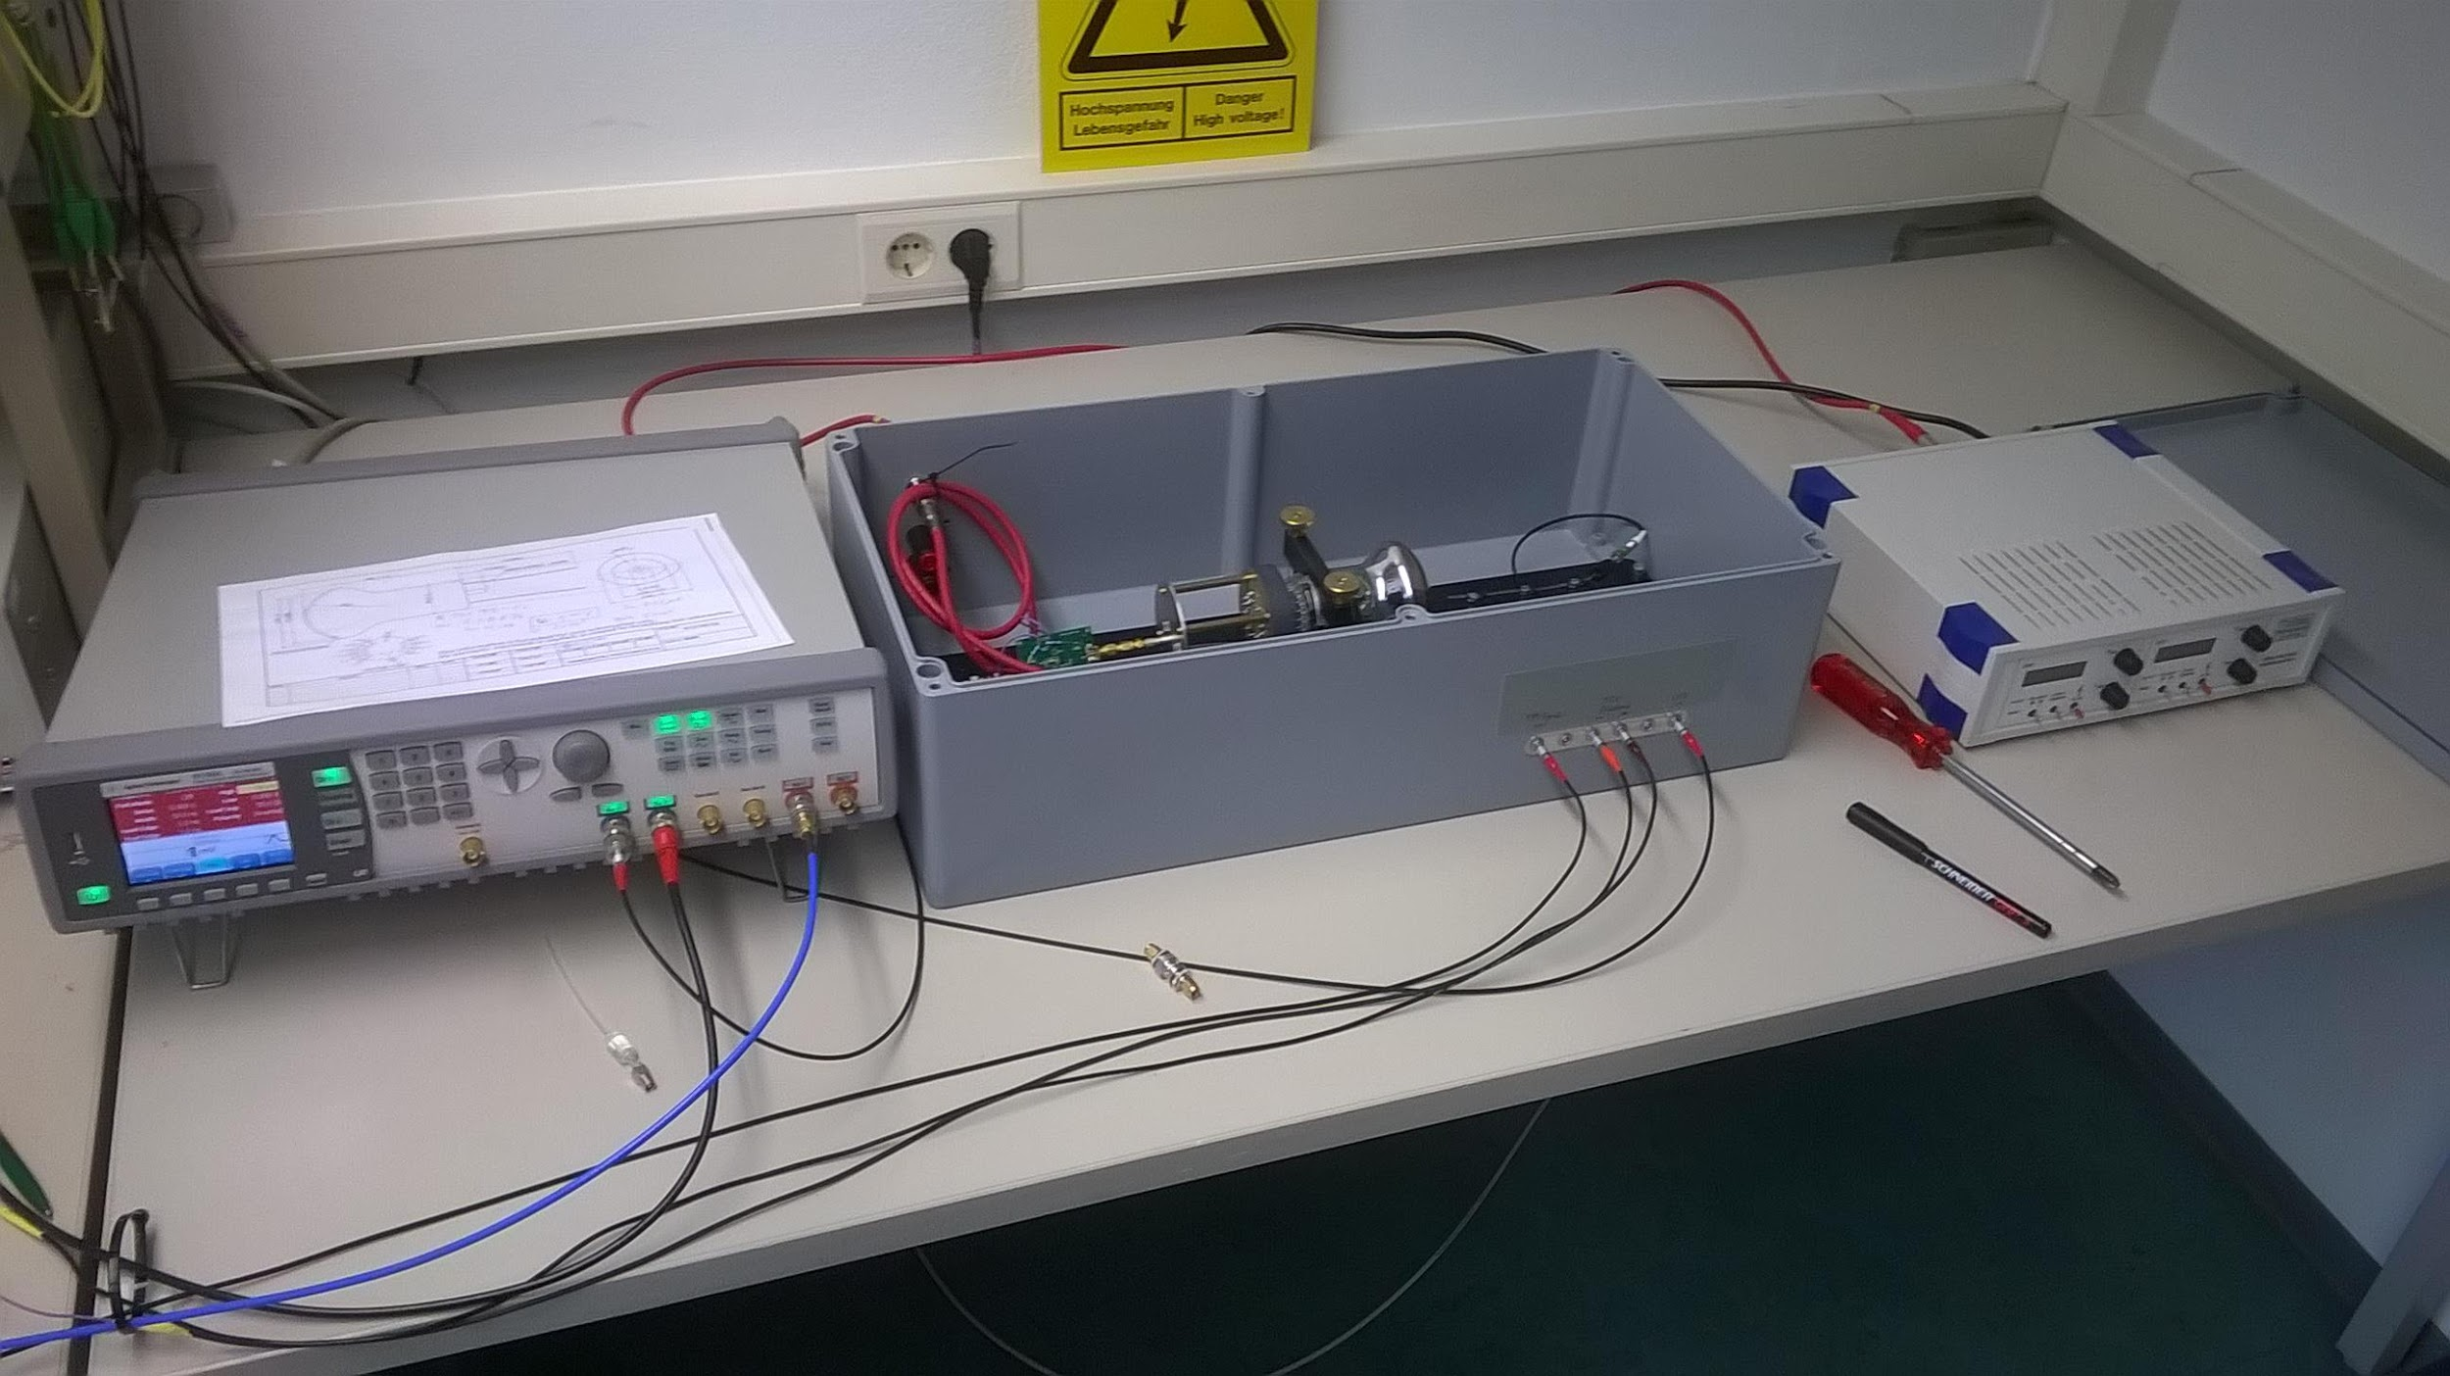
mDOM Multi-ToT Readout: Measurement Setup
power divider: splits PM-signal to D.U.T. and scope
2nd channel used for triggering only
R12199-02 PMT w/ passive base
pulsed LED
dark box with PM, LED and auxiliary preamplifier
6 ch. analog front-end
signal transmission (single-ended)
mainboard w/ FPGA
HV supply

Slide 14
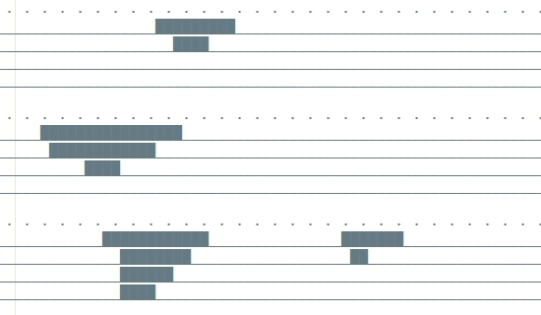
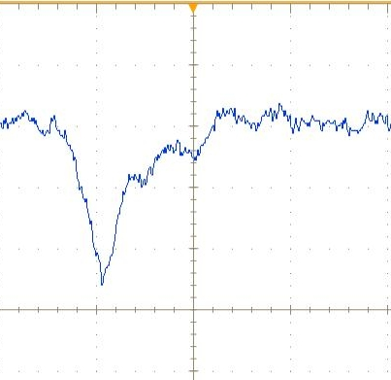
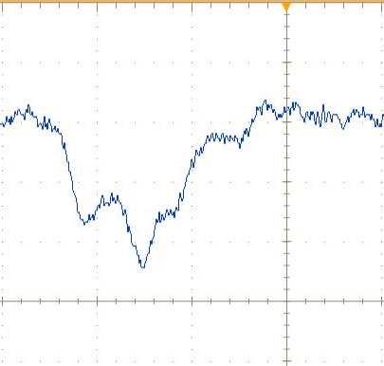
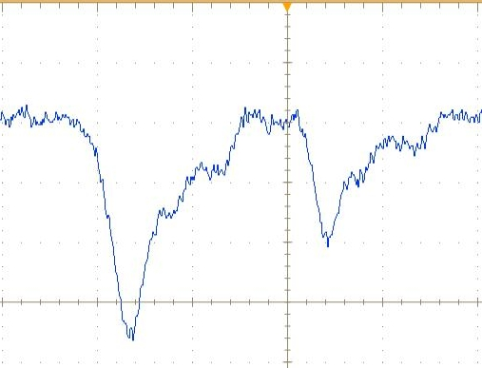
mDOM Multi-ToT Readout: Three Example Waveforms
1.67 ns
4 thresholds
time

Slide 15
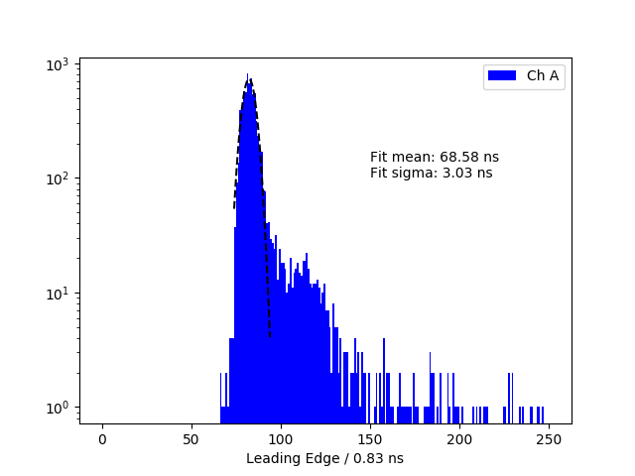
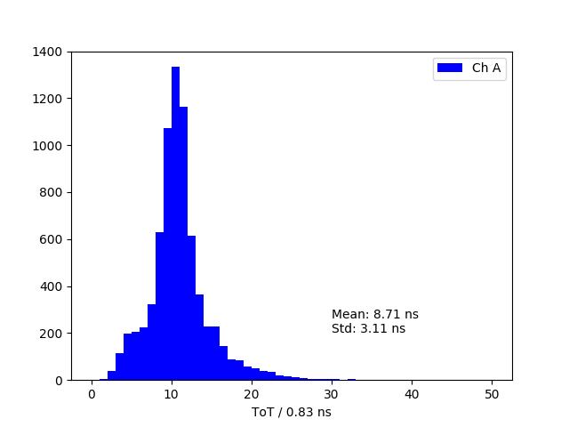
mDOM Readout: Single PE Pulses
Very first measurement! Systematic characterization will follow
Jitter: 3 ns (TTS_{σ}: 1.7 ns)
Afterpulses?
Leading Edge Time (rel. to LED trigger)
Time-over-Threshold

Slide 16
The WOM (Wavelength-shifting Optical Module)

Slide 17
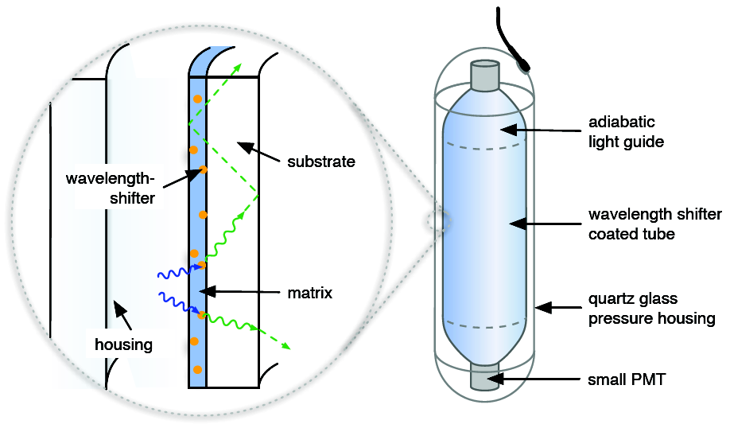
WOM: Wavelength-shifting Optical Module
Basic concept
Wavelength shifters (WLS)
Light concentration
Features
Better UV sensitivity
requires quartz housing
Large collection area
easily scalable
Low noise rate (few Hz)
due to small PMTs
Cost effective
PoS(ICRC2017)1052
Length: ~1.2 m Diameter: ~10 cm

Slide 18
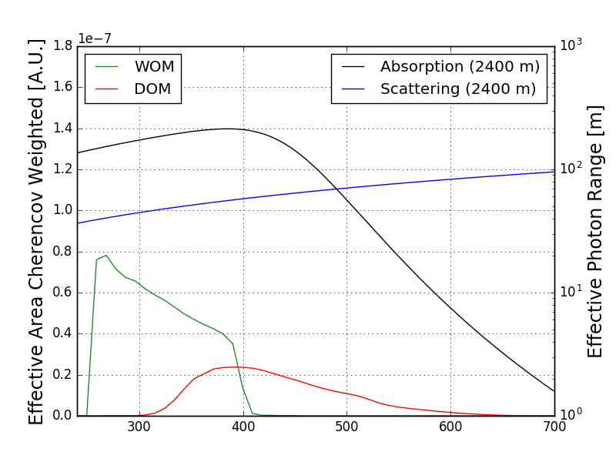
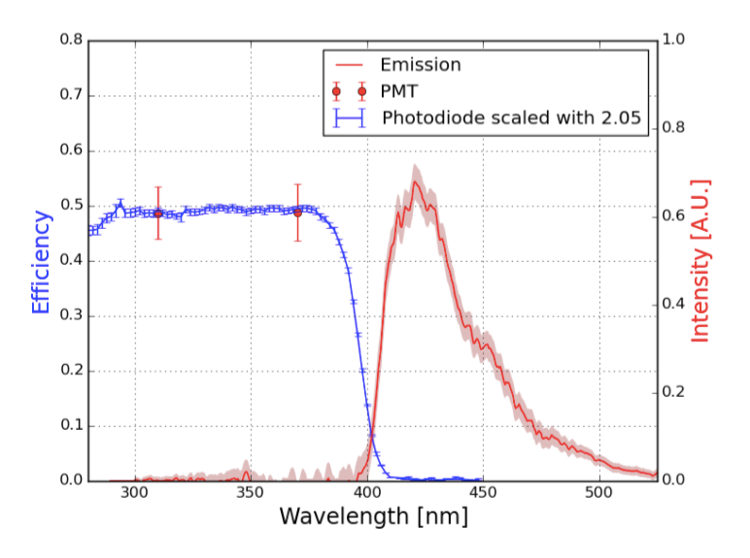
WOM: Efficiency
(convoluted with Cherenkov spectrum)
Wavelength (nm)
Efficiency to capture photons and transport them to the end of the tube
WLS paint: Bis-MSB + p-Terphenyl in Paraloid B-72

Slide 19
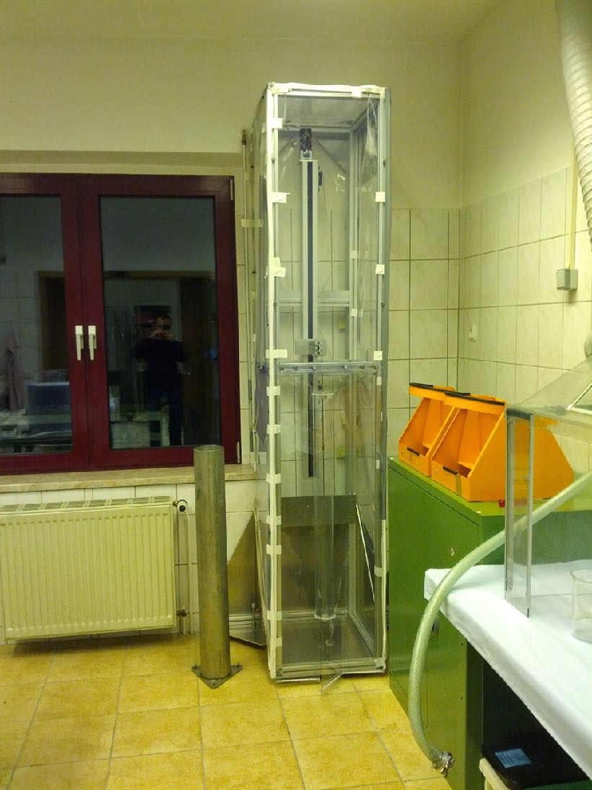
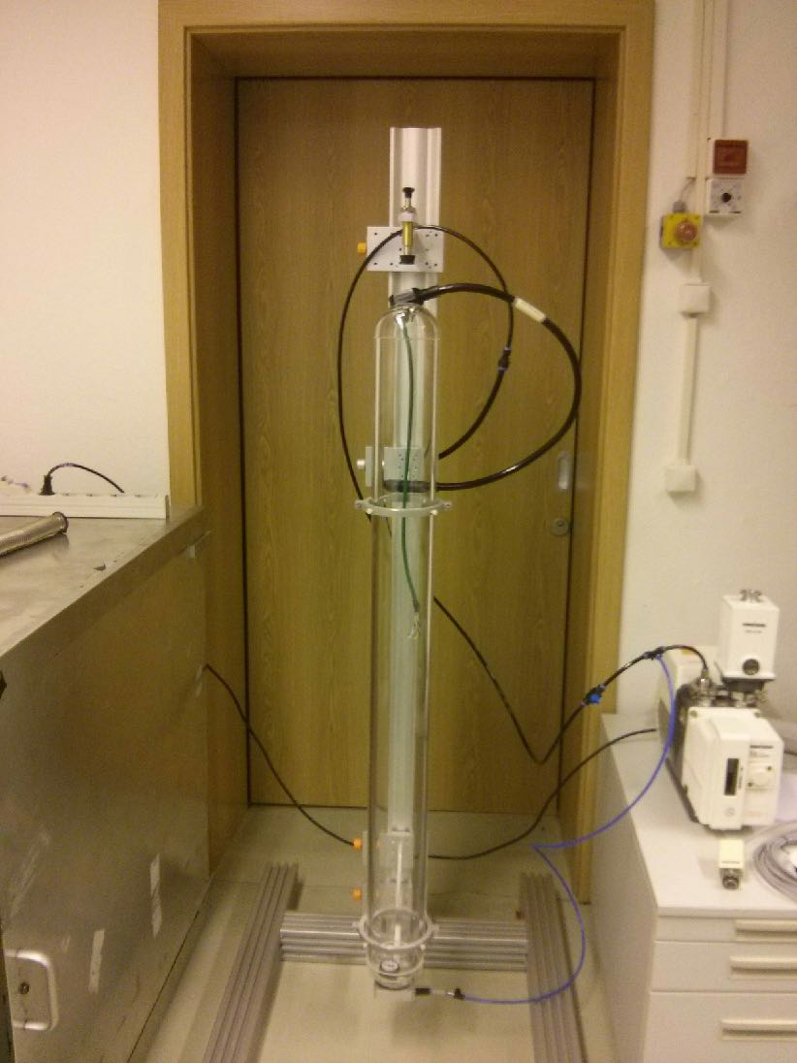
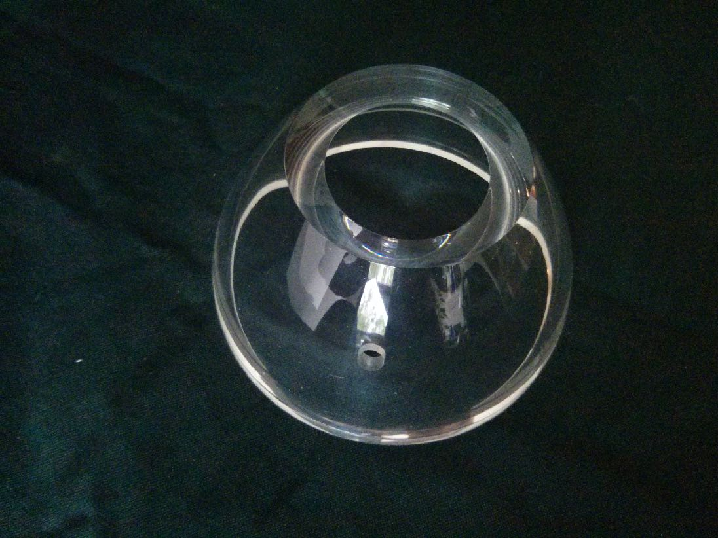
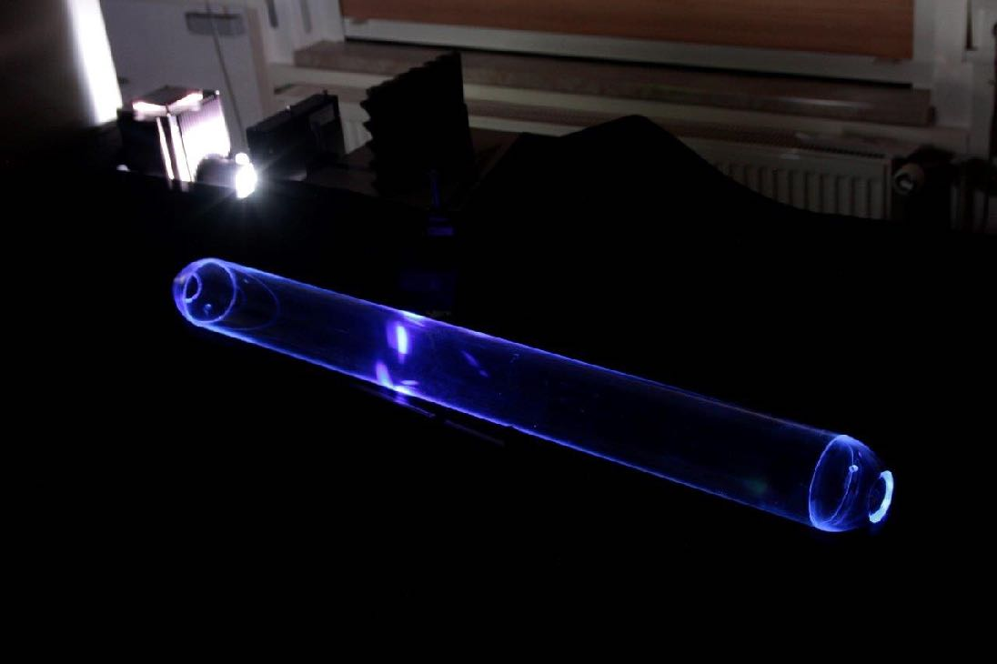
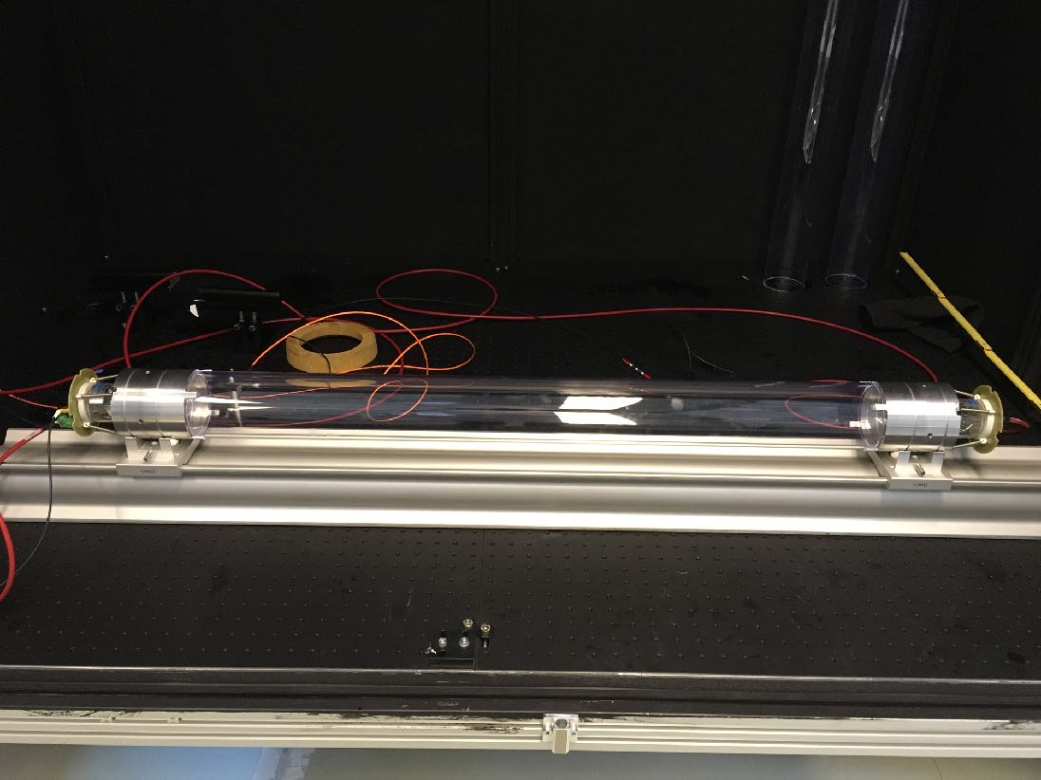
WOM Status

Slide 20
Summary
The IceCube-Gen2 facility will be nearly 10× larger than IceCube alone
The IceCube Upgrade can be used as a R&D platform for IceCube-Gen2
New sensor designs can improve the sensitivity
Physics potential only starting to be explored
Currently in R&D phase: multiple approaches being evaluated
sensors with segmented photocathode to improve directionality
wavelength-shifting sensors to increase UV sensitivity

Slide 21
Backup Slides

Slide 22
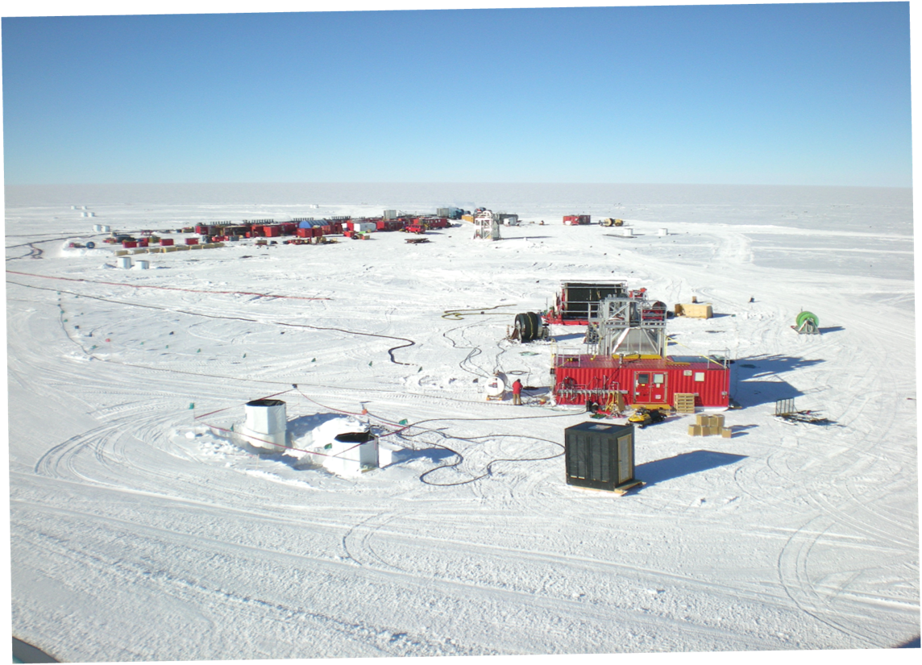
Construction: Drill Site
Drill camp (5 MW hot water heater)
Hose Reel
Hot water hoses
IceTop Tanks
(with sun shields)
Drill speed ~2 m/minute
~40 hours to drill a hole
~12 hours to deploy a string

Slide 23
The IceCube DOM: Block Diagram
NIM A 601 (2009) 294

Slide 24
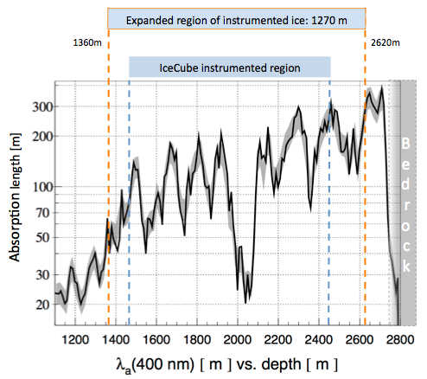
Antarctic Ice
arXiv:1412.5106 [astro-ph.HE]
IceCube construction yielded a wealth of data on the optical properties of ice
Absorption length for Cherenkov light is large
Instrumented length can be extended above and below current volume
25% gain in instrumented volume

Slide 25
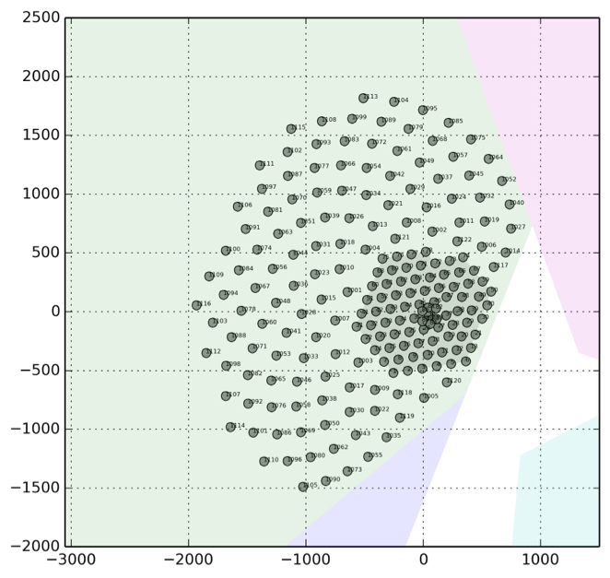
IceCube-Gen2 High Energy Array
Spacing: 240 m
Volume: 8.0 km³
Skiway
arXiv:1412.5106 [astro-ph.HE]
Current benchmark detector design:
Add 122 strings around the IceCube instrumented volume (240 m spacing)
80 standard IceCube DOMs / string
“Sunflower” geometry avoids corridors in geometry

Slide 26
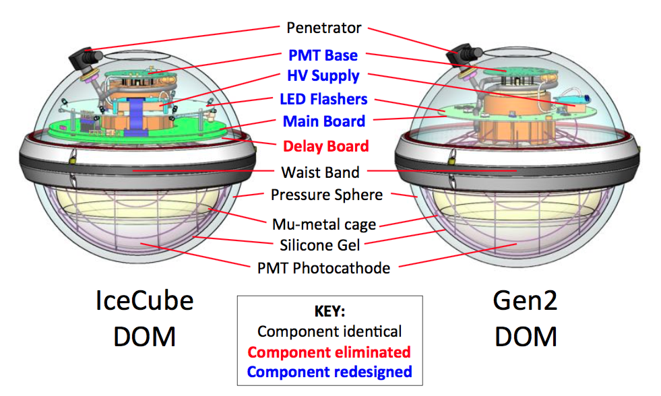
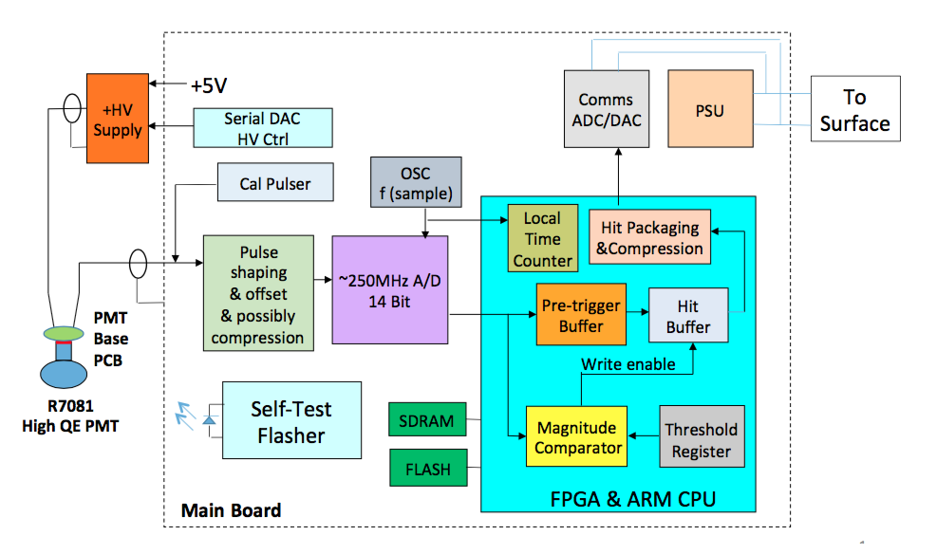
Improved IceCube DOM (PDOM)
IceCube DOM
PDOM
Keeps well-proven mechanical components of the IceCube DOM
Redesign of electronics utilizing modern technologies
10-inch HQE PMT
PDOM Prototype
PoS(ICRC2015)1148

Slide 27
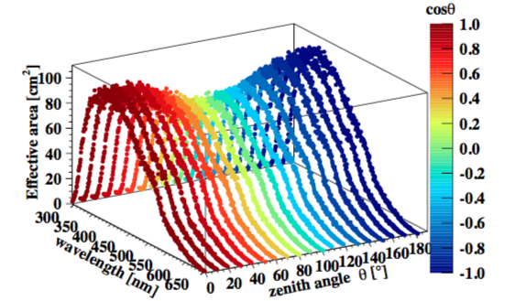
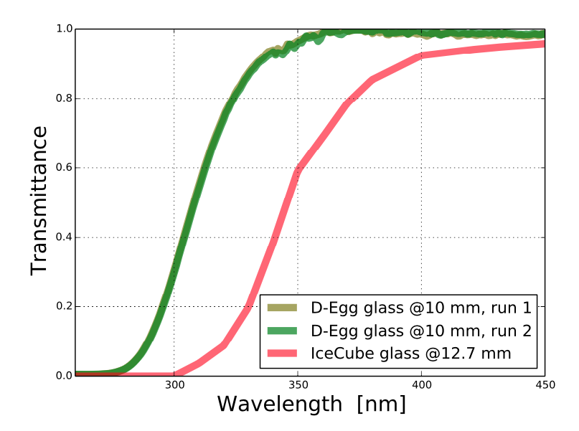
D-Egg: Dual Optical Sensor in an Ellipsoid Glass for Gen2
2 × 8-inch HQE PMTs (e.g. Hamamatsu R5912-100)
4π sensitivity
coincidence
UV-transparent glass and gel
more photons
Compact design
⌀: 300 mm
reduces drilling cost
PoS(ICRC2015)1137
PoS(ICRC2017)1051

Slide 28
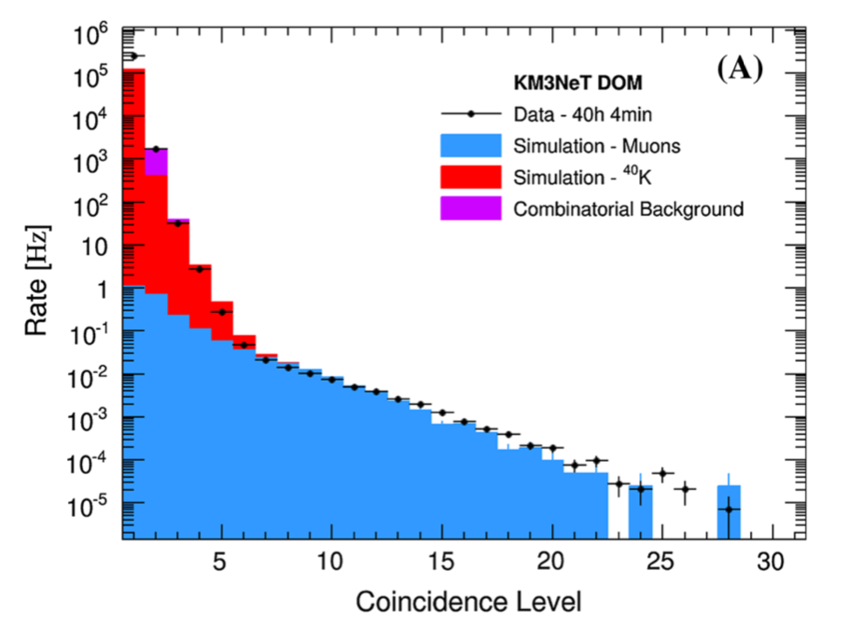
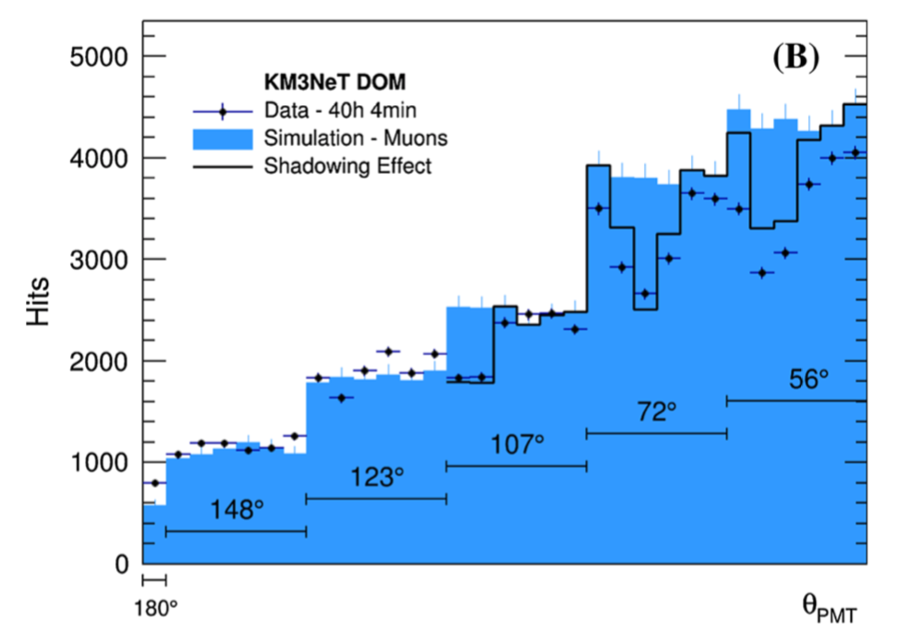
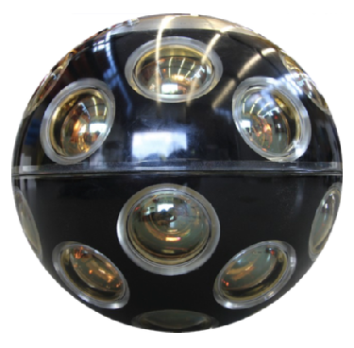
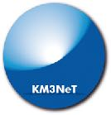
KM3NeT Multi-PMT DOM: In-Situ Measurements
Number of PMTs hit on single DOM already allows isolation of muon sample
Occupancy reasonably well described by Monte Carlo
KM3NeT Coll.,
EPJ C 74 (2014) 3056

Slide 29
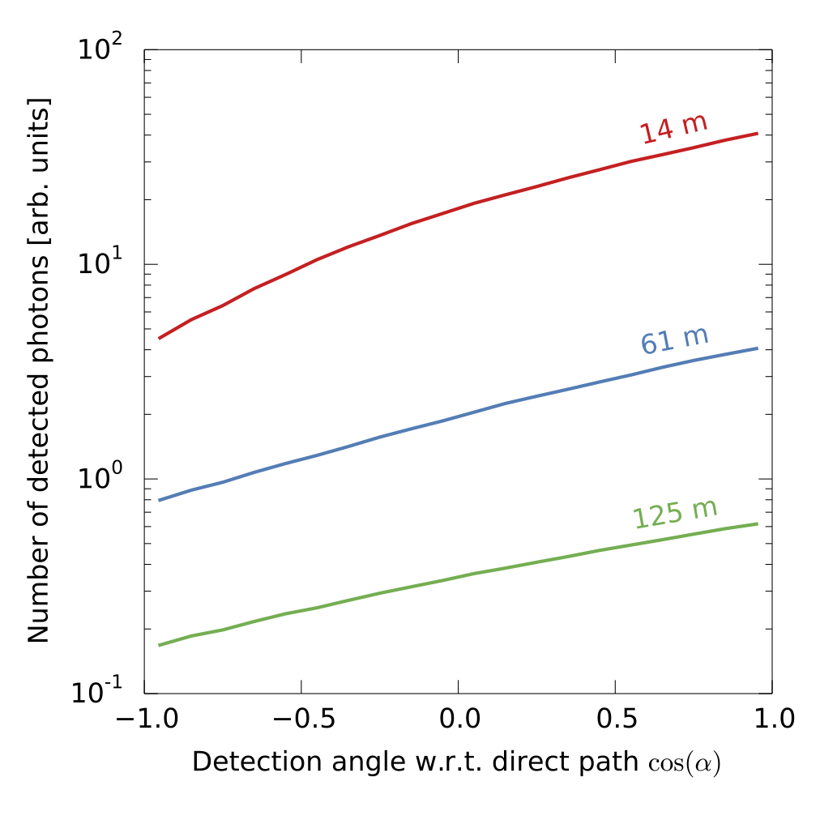
Segmented OMs and Scattering in Ice
Photons from bare muon
Direct, unscattered light
arXiv:1401.2046v2 [physics.ins-det]
Photons sneaking in from the opposite direction

Slide 30
mDOM Multi-ToT Readout: Block Diagram
PMT Base
HV supply
serial DAC HV ctrl
Amplifier
Discriminator
n×
serial DAC n thresholds
24×
Mainboard
No clock on PMT bases.
Time-stamping of leading and trailing edge time in FPGA.
FPGA
Power
(f)ADC
Comms
multi-ToT

Slide 31
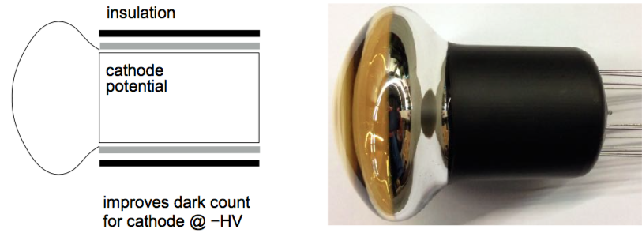
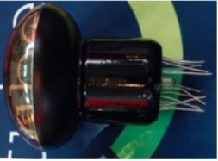
mDOM: PMT Options
Target gain: 5 × 10⁶
Hamamatsu R12199-02 HA
diameter 80 mm (cathode > 72 mm)
TTS (FWHM) ≈ 4.5 ns
max. QE: 25% @ 390 nm
also available with SBA photocathode or in a 5 mm shorter version (R12199-01)
ETEL 9320 KFL
diameter 88 mm (cathode 78 mm)
TTS (FWHM) ≈ 4.5 ns
max. QE: 30%
Potential other manufacturers: HZC, MELZ

Slide 32
mDOM: Hamamatsu R12199-02 HA SBA
SBA photocathode, otherwise identical to R12199-02
peak QE 40%
dark rate measured for bare PMT
threshold 0.3 p.e.
≈ 60 Hz @ −30℃ (R12199-02: ≈ 40 Hz @ −30℃)
AG Kappes, U Münster
AG Kappes, U Münster

Slide 33
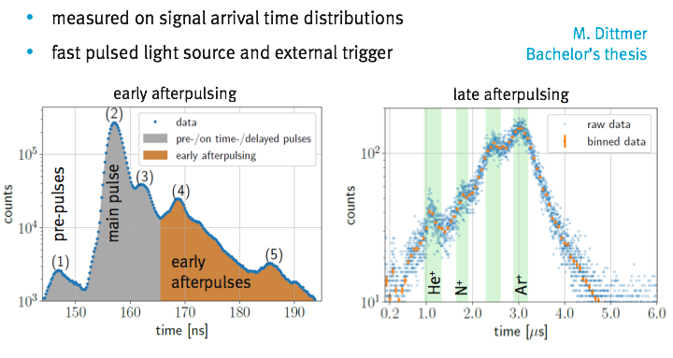
Hamamatsu R12199-02 SBA: Afterpulsing
AG Kappes, U Münster
AG Kappes, U Münster

Slide 34
Waveform Reconstruction with 63 Discriminators
Encouraging first results
Input: 10 pulses, mean amplitude 3 p.e.
ΔCharge < 1%
Δt (first pulse) ≲ 1 ns
True pulse times vs. reconstructed
A. Kappes (U Münster)

Slide 35
Optical Properties of South Pole Ice
WOM sensitive between 250 nm and 400 nm
Optical properties not very well known in the UV range
Experimental in-situ verification of models required
WOM
J. Geophys. Res. 111 (2006) D13203

