Slide 1









ST2: Hadron Accelerators
- Progress and Plans at FZ Jülich -
Andreas Lehrach, FZJ and RWTH Aachen
Subtopic coordinator ARD ST2
June 13th, 2018
4th Annual MT Meeting
HZB, Berlin

Slide 2
Outline
Introduction
Highlights
EDM measurement in storage rings
Technical developments for EDM
Laser-Plasma Acceleration
Summary & Outlook

Slide 3
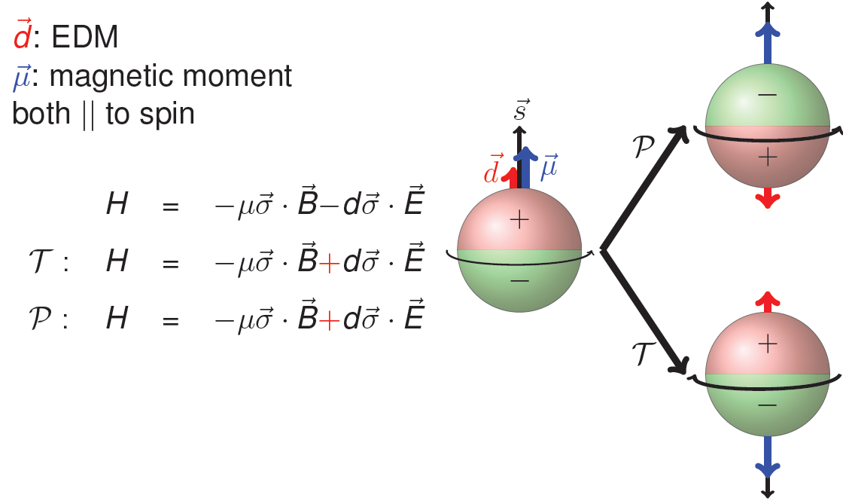
Electric Dipole Moments
It is important to measure
neutron and proton and deuteron, light nuclei EDMs in order to disentangle various sources of CP violation.
Permanent EDMs violate parity P and time reversal symmetry T
Assuming CPT to hold,
combined symmetry CP violated as well.
EDMs are candidates to solve mystery
of matter-antimatter asymmetry

Slide 4

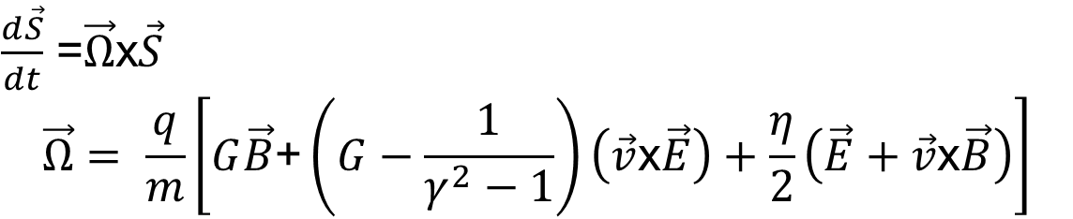
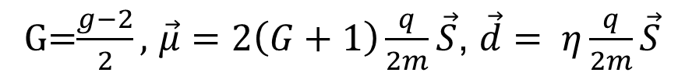
Spin Precession with EDM
Equation for spin motion of relativistic particles in storage rings
for .
The spin precession relative to the momentum direction is given by:
Magnetic Moment
Electric Dipole Moment

Slide 5
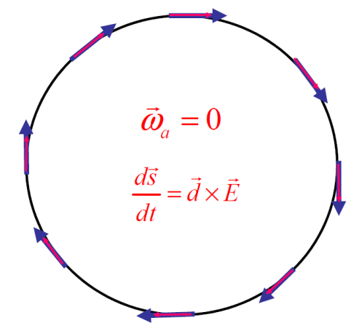
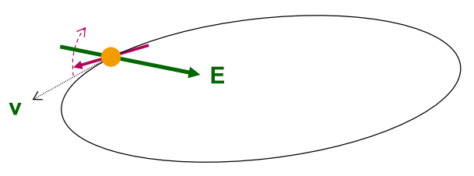
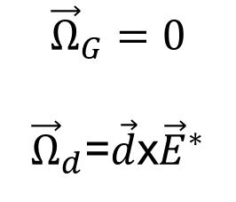
Search for Electric Dipole Moments
Approach: EDM search in time development of spin in a storage ring:
B
“Freeze“ horizontal spin precession; watch
for development of a vertical component !
A magic storage ring for protons (electrostatic), deuterons, and helium-3
particle | p (GeV/c) | E (MV/m) | B (T)
proton | 0.701 | 16.789 | 0.000
deuteron | 1.000 | -3.983 | 0.160
³He | 1.285 | 17.158 | -0.051
One machine with r ~ 30 m
Notes:
5
5

Slide 6
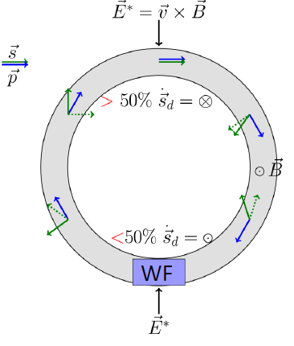
Resonance Method in Magnetic Rings
RF ExB dipole in “Wien filter” mode
→ Avoids coherent betatron oscillations
Modulation of horizontal spin precession in the RF Wien filter
EDM’s interaction with the motional electric field in the rest of the ring
continuous buildup of vertical polarization in a horizontally polarized beam.
net effect due to EDM
Investigation of sensitivity and systematic limitations
In-plane polarization

Slide 7

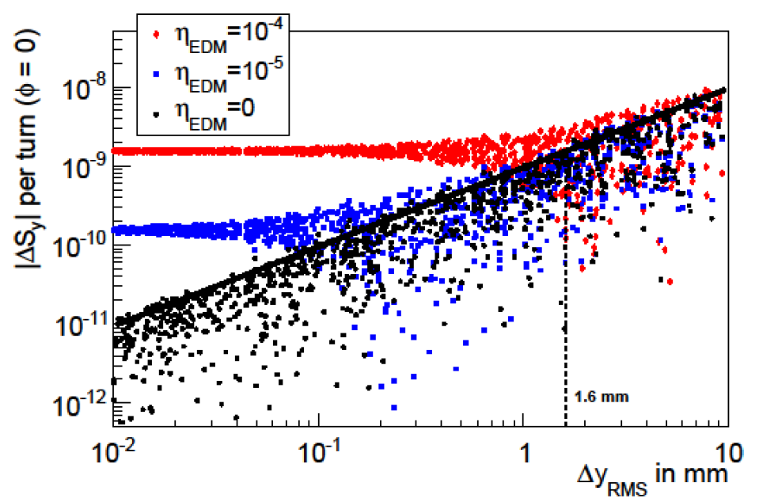
Spin Tracking
Simulation of EDM buildup with COSY Infinity
Vertical spin build up per turn vs. vertical closed-orbit
Pure magnetic ring like COSY ring requires RF method to measure EDMs utilizing the “Wien filter” mode
Systematic Limitations for a deuteron EDM measurements at COSY due to closed-orbit deviations
≈ 5∙10⁻¹⁹ e∙cm
≈ 5∙10⁻²⁰ e∙cm
Alignment of accelerator elements and improved closed-orbit correction
Improvement of systematic limit in the 5∙10⁻²⁰ e cm range
Long-term simulations are performed at JSC super computer
M. Rosenthal, A. Lehrach, IPAC’15

Slide 8


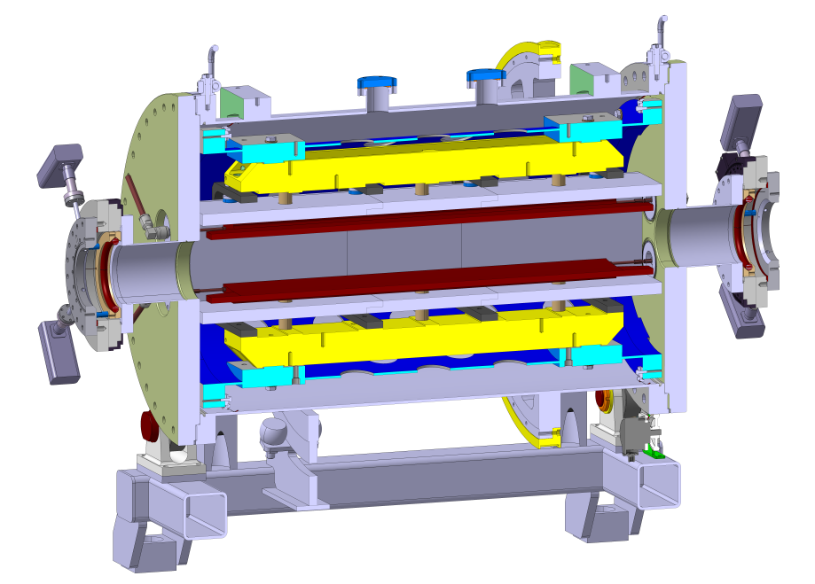
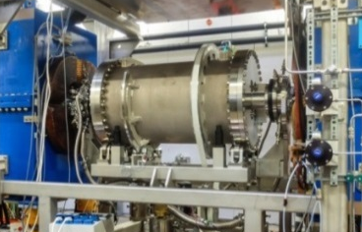
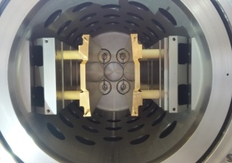
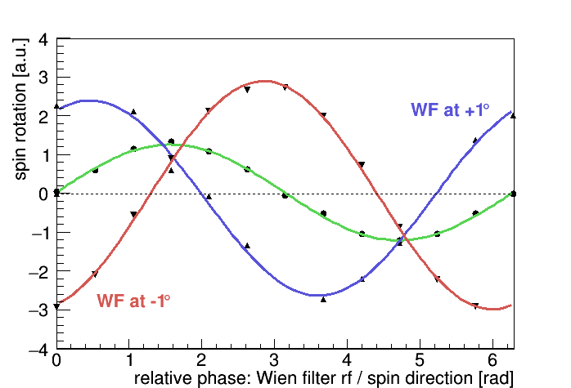
RF Wien Filter Commissioning
Waveguide RF Wien filter for EDM measurement at COSY
Wien filter mode: Lorentz force is zero
→ no beam oscillations
Installation in COSY
Glance into its inside
Beam position monitor
Copper electrodes
Commissioning from recent beam time
Ferrite cage
Vacuum vessel
Very Preliminary, December 2017
Belt drive for 90° rotation
1 m
Development together with IKP-2, RWTH Aachen (IHF)
and Central Institute (ZEA-1) in Jülich

Slide 9
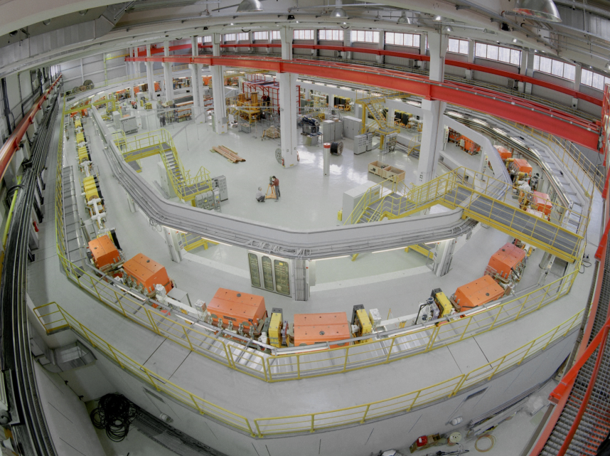
Stepwise Approach for JEDI
Measurements of charged particle EDMs
from COSY to a dedicated EDM storage ring
Cooler Synchrotron COSY
Prototype EDM Ring
Proton EDM ring
Energy 35 - 45 MeV, CW-CCW beams
Pure electric and combined E/B
Length roughly 100m
Ideal starting point for R&D work
Deliver first direct EDM measurement for deuterons
Design by R, Talman, S. Martin, A. Lehrach

Slide 10
Spin Tracking
Simulation of spin motion with EDM performed by IKP students
COSY Infinity by M. Berz and K. Makino (MSU)
Implementation of RF field kick and simulation of EDM precursor experiment at COSY (Marcel Rosenthal)
Investigation of EDM final ring (Alexander Skawran)
Fringe field description of ExB fields and investigating EDM final ring (Eremey Valetov)
Investigation of EDM final ring and EDM precursor experiment at COSY (Artem Saleev)
MODE by S. Andrianov and A. Ivanov (StPSU)
Code development (Andrei Ivanov)
Investigation of EDM final ring and EDM precursor experiment at COSY (Stas Chekmenev)
Bmad by D. Sagan (Cornell)
Implementation of RF field map and simulation of EDM precursor experiment at COSY (Vera Schmidt)
Speed Talk and Poster Vera Schmidt

Slide 11

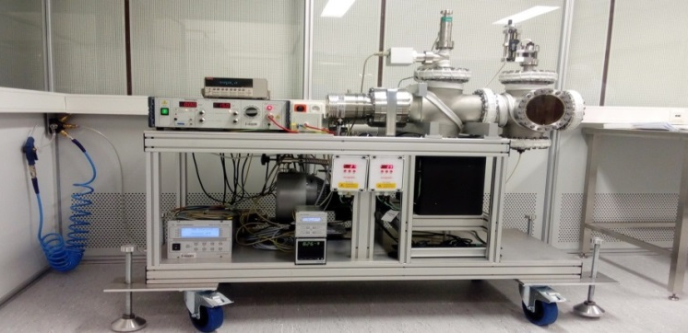
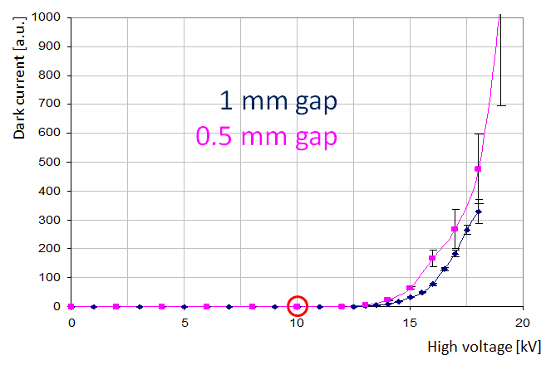
Deflector Development DEVELOPMENT
Electrostatic deflector development
Challenge: Reach electrostatic fields above 10 MV/m for final proton EDM storage ring and investigate different material and shapes of electrodes
Test electrodes
Polished stainless
steel
Aluminum
High Voltage UHV setup
in the clean room at RWTH Aachen
Results
Stainless steel
Dark current [a.u.]
Moved from Aachen to Jülich
for further development
Voltage [kV]
Poster by Kirill Grigoryev
10 MV/m for 1mm gap

Slide 12
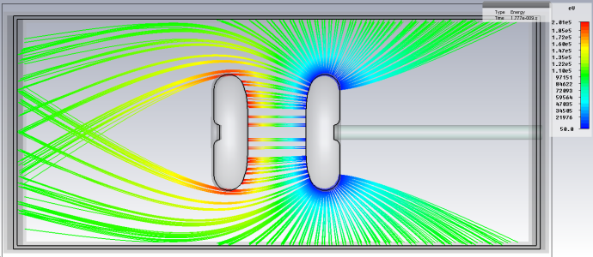
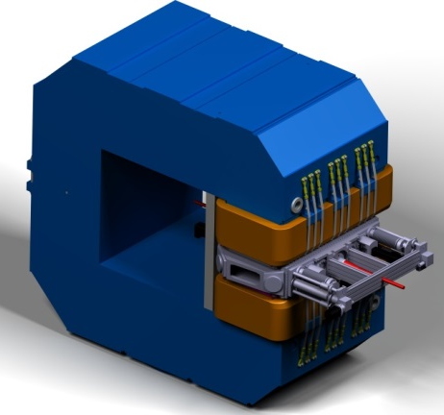
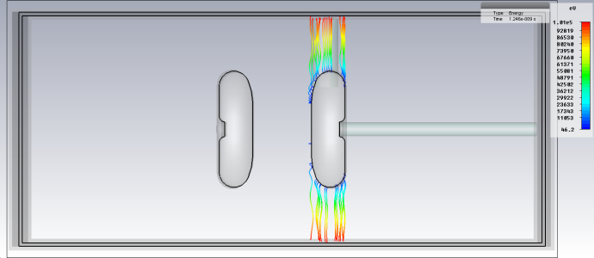

Deflector Development
Static ExB deflector
Challenge: Investigate/demonstrate the feasibility of ExB deflector for deuteron EDM storage ring with 10 MV/m and 0.3 T. Study breakdown behavior in presence of magnetic fields
Simulation of electron trajectories
Setup of electrodes using existing ANKE Magnet
Feed-Throughs
+
-
Actuators
Electrodes
with E field
B_{y}
+
-
Shield-Tighteners
with ExB field
Commissioning in summer this year
Different shapes of electrodes will be tested
B-field: 0 T B-field: 0.15 T
Poster by Kirill Grigoryev

Slide 13
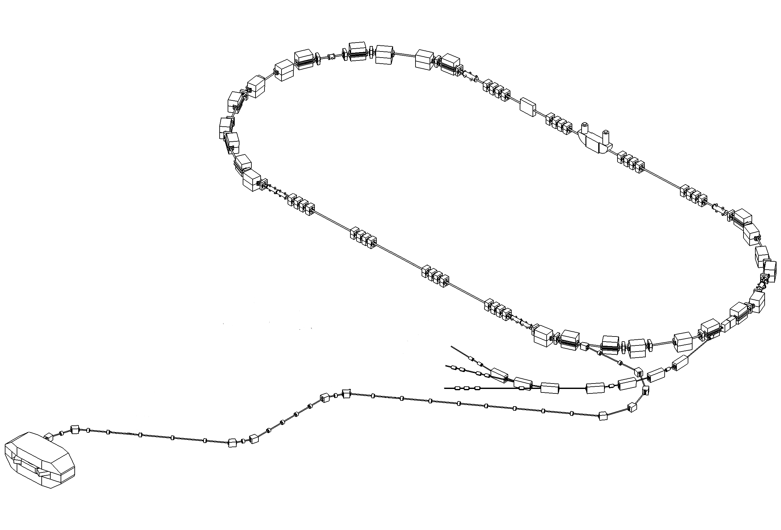
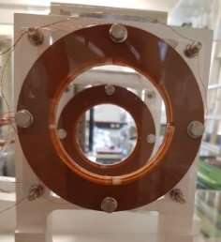


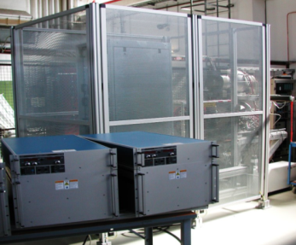
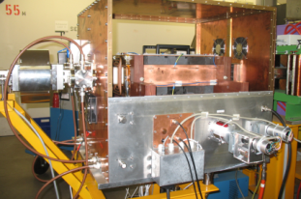

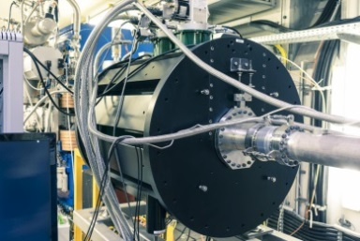
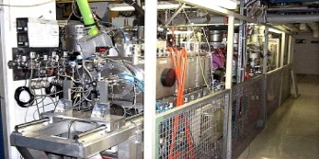
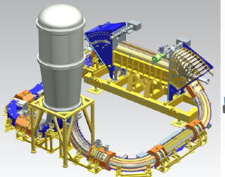
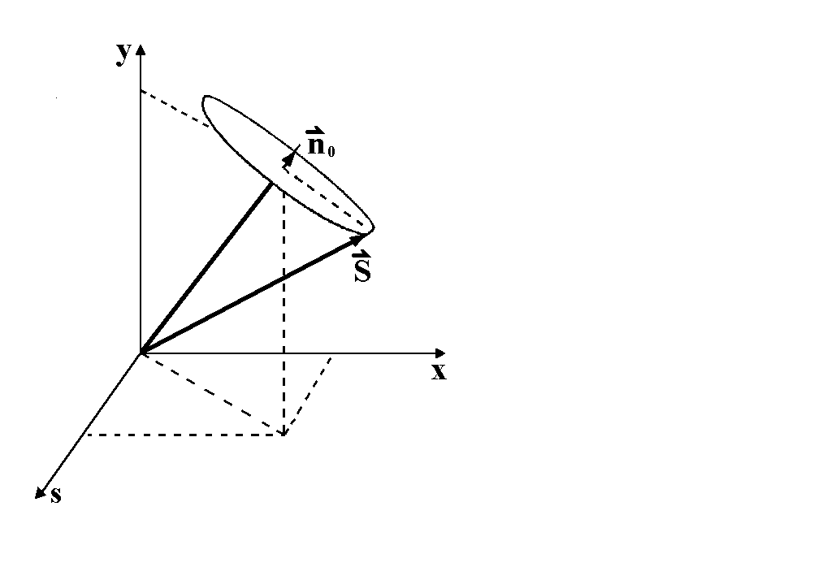
Prototyping and Spin Physics
MU
MT
MT
MT
Beam Position Monitor
Deflector Development
Prototype
RF Wien Filter
MU
MT & MU
Ion Source for ELENA at CERN
MT
MT
COSY Polarized
Ion Source
Waveguide
RF Wien Filter
Siberian Snake
2 MV Electron Cooler
Beam and Spin
Dynamics
Poster by Nikolay Shurkhno on Beam Cooling
EDM accelerator component tests and experiments with spin at COSY
Notes:
13

Slide 14
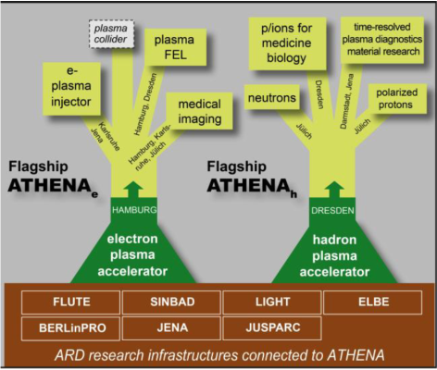

ATHENA: Contributions from Jülich
Common project by Helmholtz ARD centers
ATHENA: Infrastructure to bring compact and cost-effective laser plasma accelerators to user readiness with applications in science and medicine (30 M€ application)
Two Flagship projects:
ATHENA_{electron}
ATHENA_{hadron}
Contributions from Jülich:
Simulation of Laser-Plasma Acceleration
Polarized Targets and Polarimetry
Research work at JuSPARC
(Jülich Short-Pulsed Particle and Radiation Center)
Participating FZJ institutes: PGI-6, IKP, IAS/JSC, JCNS, IEK-5, INM-2
Simulations performed at IKP
together with PGI and JSC:
Simulation of Betatron Radiation of Accelerated Electrons in the Bubble Regime using two Subsequent Laser Pulses
EPOCH code on the Jülich supercomputer (JURECA)
2) Laser-plasma acceleration of polarized hadrons
Two interdisciplinary PhD students with PGI and JSC
FZJ cooperation partner: JSC, PGI
HHU Düsseldorf, Institut für Theoretische Physik
Talk by Anna Hützen

Slide 15
Double-Pulse Electron Acceleration
Laser & Target Parameter (JuSPARC-2):
a₀ | 3.85
Pulse energy | 2J
Pulse length | 20 fs
Focal spot | 10 µm
Target | He gas
Target density | 9.2∙10¹⁷ cm^{– 3}
2d PIC simulations with EPOCH on JURECA
Single pulse
Double pulse
Electron energy spectrum
Delay = 78 fs, E₂ = 2 E₁
X-Ray energy spectrum
Delay = 78 fs, E₂ = 2 E₁
Increased acceleration efficiency
PIC simulations by Zahra Chitgar

Slide 16
Summary & Outlook
Summary:
- Started with first direct EDM measurement at COSY
- Preliminary design of Prototype EDM Ring
- Technical developments (Deflector, RF Wien filter, BPMs, …)
- Simulation of Laser-Plasma Acceleration
Outlook:
  - Push limit for EDM measurement at COSY
  - R&D work and design study for dedicated EDM storage ring
  - Commissioning of an ExB deflector
  - Optimization of laser-induces acceleration schemes
Deliverables for EDM Storage Rings:
- Scientific input for The European Strategy for Particle Physics (ESPP)
- Executive summary to CERN Physics Beyond Colliders (PBC)
- Design report for Proton EDM Ring
Notes:
16

Slide 17
Related Talks and Posters
Student retreat (ARD session)
- Vera Schmidt (FZJ & RWTH): Search for Electric Dipole Moments at COSY in Jülich
- Anna Hützen (FZJ and HHUD): Polarized Proton Beams from Laser-induced Plasmas
MT Meeting (ARD parallel session)
- Anna Hützen (FZJ and HHUD): Polarized Proton Beams from Laser-induced Plasmas
  MT Meeting (poster session)
  - Nikolay Shurkhno (FZJ) : Latest Beam Cooling Results
  - Kirill Grigoryev (FZJ): Electrostatic Deflector Development
  - Vera Schmidt (FZJ & RWTH): Search for Electric Dipole
Notes:
17

Slide 18


Slide 19











JEDI Collaboration Members
In total 140 collaboration members
from 11 contries
and 37 institutes
BELARUS FRANCE GEORGIA GERMANY ITALIA
POLAND REPUBLIC OF KOREA RUSSIA SWEDEN UK
USA

Slide 20
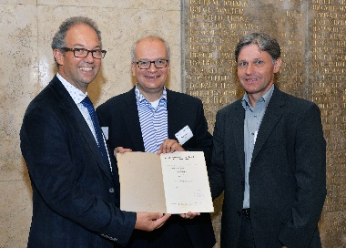
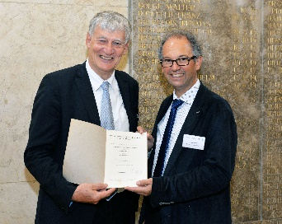
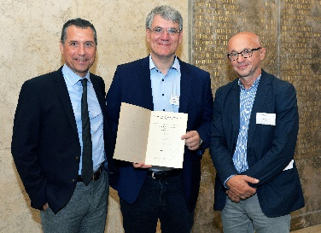
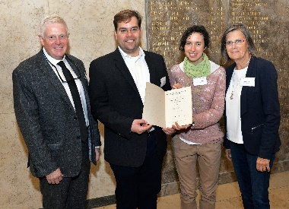
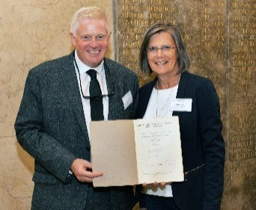
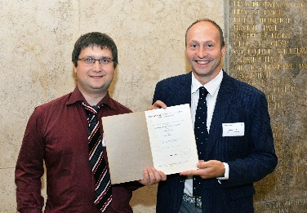
Symposium “90 Years of RF Accelerators”, Aachen
In 1927 Rolf Wideröe completed his seminal doctoral thesis in Aachen, Germany. 2017 was the 90 year anniversary of the first linear RF accelerator, constructed by Wideröe in Aachen, and of his visionary idea for a circular accelerator.
Half-day symposium on the history and modern accelerators from the LHC to the XFEL and medical applications.
Welcome addresses:
Ernst Schmachtenberg (RWTH Aachen), Arnulf Quadt (DPG) Helmut Dosch (DESY)
Plenary talks:
- Rolf Wideröe, Life and Work, N. Holtkamp (SLAC)
- From Wideröe to the LHC as a Masterpiece of Science & Technology, O. Brüning (CERN)
- From Wideröe to the EuXFEL for Cutting-Edge Exploration of Matter, H. Weise (DESY)
- Accelerators in Modern Society for Medical Treatment, H. Rohdjess (Siemens Healthcare GmbH)
- Towards a Revolutionary Generation of Compact Accelerators, W. Leemans (LBNL)

Slide 21
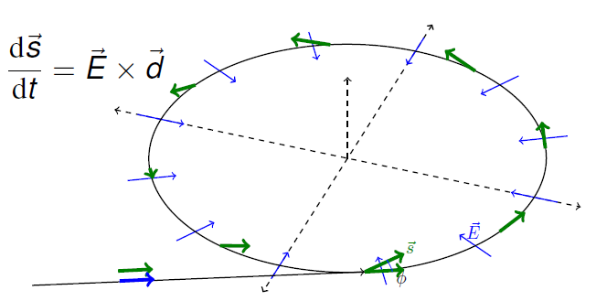

Storage Ring EDM Project
… measure for development of vertical polarization
⬄
EDM
Challenges:
Huge E-fields
Shielding B-fields
Spin coherence
Beam position
Polarimetry
(...)
Step wise:
COSY (PoF-III)
R&D and Precursor Expt.
Lower sensitivity
Dedicated SR (after PoF III)
Goal: 10⁻²⁹ e∙cm
JEDI
Jülich Electric Dipole Moment Investigations
> 100 members
(Aachen, Bonn, Dubna, Ferrara, Cornell, Grenoble, Jülich, Krakow, Michigan, St. Petersburg, Minsk, Novosibirsk, Stockholm, Tbilisi, . . . )
http://collaborations.fz-juelich.de/ikp/jedi/

Slide 22
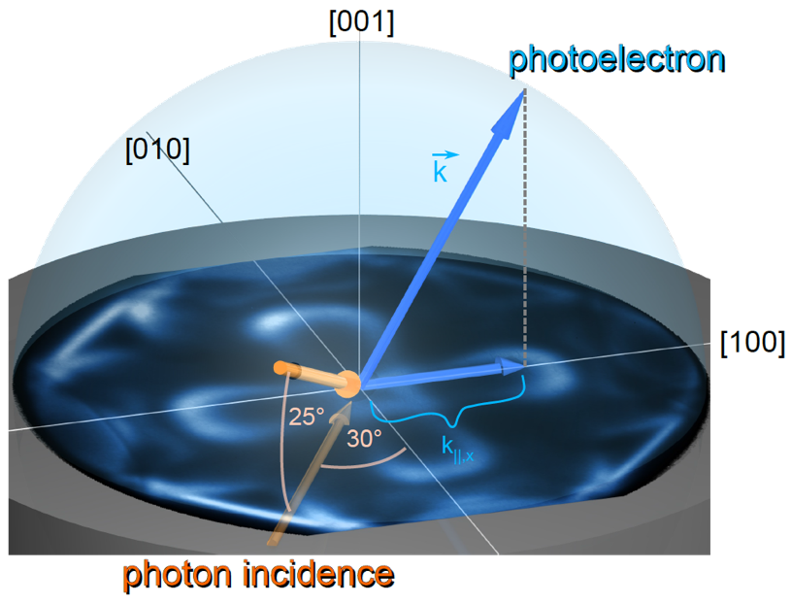
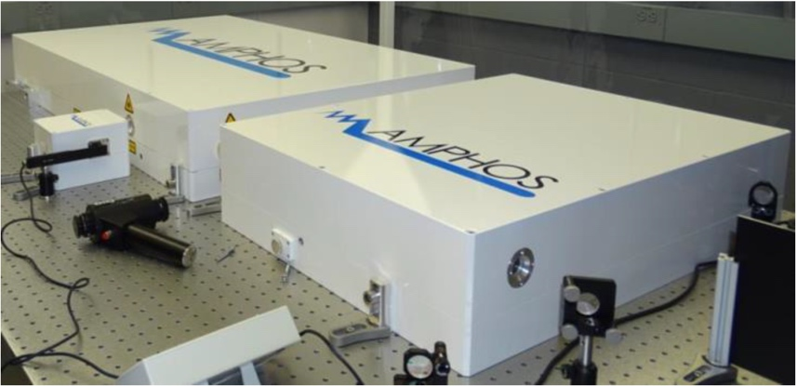
JuSPARC-1: Momentum Microscopy
Goals:
fs pump-probe studies
explicit spin-polarization analysis
highly efficient electronic structure mapping
“Photon in / Electron out”
Start of JuSPARC-1: Fall 2018
50 µJ / 100 fs / 10 MHz
07 February 2018

Slide 23
JuSPARC-2: Electron Acceleration
Optimization of acceleration process
Idea: Zahra Chitgar (and IPP Prague)
07 February 2018

Slide 24
Current EDM Limits

Slide 25
