Slide 1
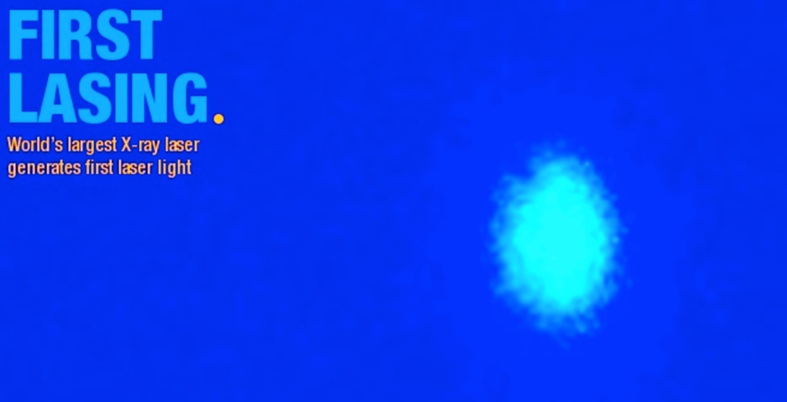

European XFEL Accelerator –
From commissioning to operation
Lessons learned
Winni Decking
for the European XFEL commissioning team

Slide 2
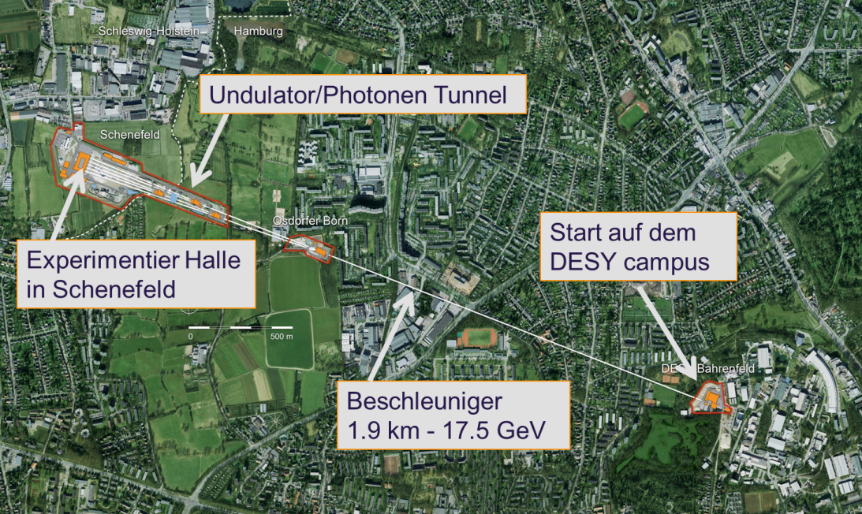
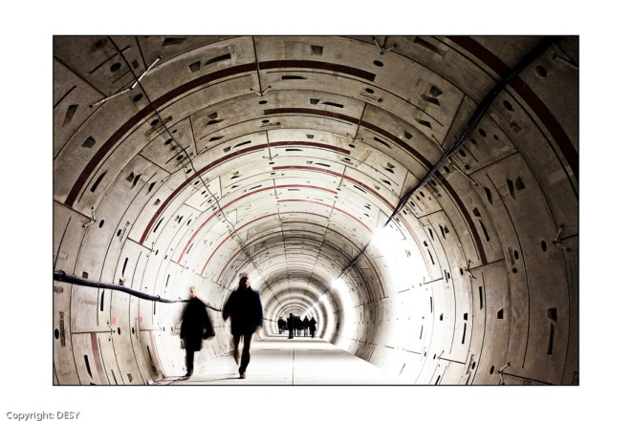

The European XFEL
Super conducting accelerator with up to 17.5 GeV electron beam energy.
Three undulator beamlines in two branches (north and south).
In total 6 experiments, 4 for hard X-rays and 2 for soft X-rays.
Undulators/Photon beamlines
Electron beam
distribution
Start on the DESY campus
Experimental hall in Schenefeld
Accelerator
1.9 km/ 17.5 GeV
Notes:
The position of the European XFEL in the Hamburg area

Slide 3
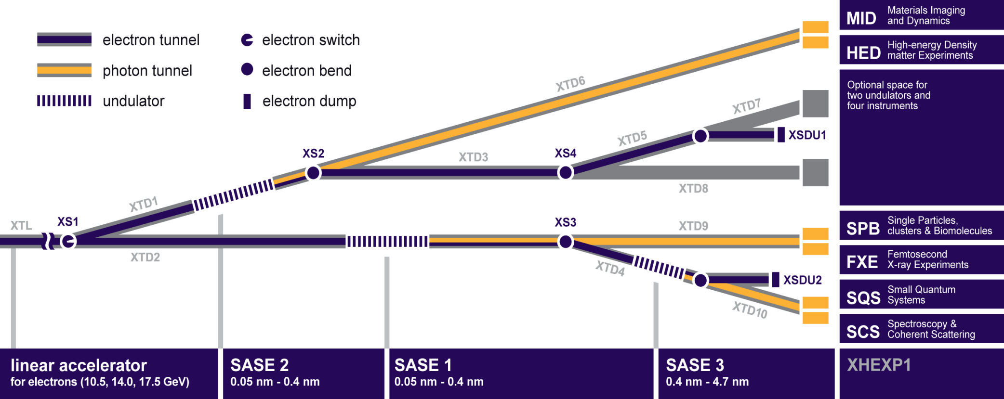
Covers photon energies from 0.25 keV to 25 keV
SASE3
Soft X-rays 0.25 – ≥ 3 keV
SASE 1& SASE 2
Hard X-rays 3.0 – ~25 keV
17.5
14.0
12.0
8.5
Electron
Energy [GeV]
0.2
1
2
10
20
Photon Energy [keV]

Slide 4


















Project History
2000: First lasing at 109 nm at the Tesla Test Facility (TTF), now FLASH
2001: TESLA Linear Collider TDR with XFEL appendix
2002: TESLA TDR supplement with stand-alone XFEL
2006: European XFEL TDR
2009: Foundation of the European XFEL GmbH
Start of underground construction
2010: Formation of the Accelerator Consortium:
16 accelerator institutes under the coordination of DESY
2012: End of tunnel construction
Start of underground installation
2016: Finish of accelerator installation
Start of commissioning

Slide 5
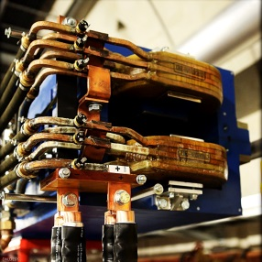
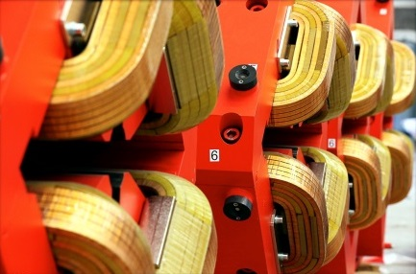
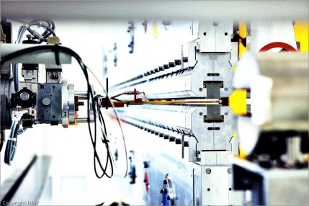
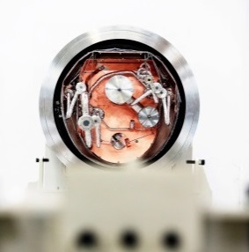
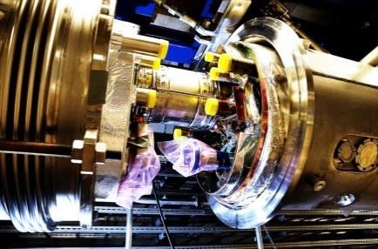
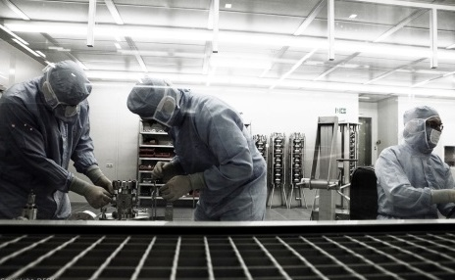
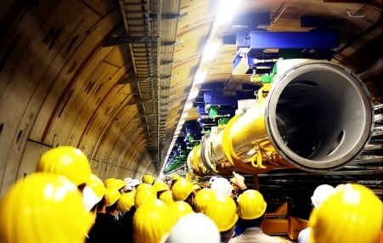
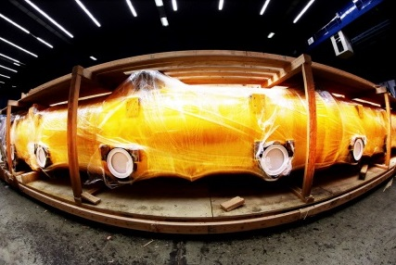
Schematic accelerator overview
L1
4 modules
(1 RF stations)
L2
12 modules
(3 RF stations)
L3
80 modules
(20 RF stations)
Injector
1.3 GHz module
3.9 GHz 3rd harm.
SASE2
300 kW
A2
A3
A4
A5
A6
A25
A1
AH1
SASE1
0.24 kW
5 kW
SASE3
9 kW
300 kW
BC2
2.4 GeV
Collimation
6 … 17.5 GeV
Gun
Dogleg, BC0
BC1
300 kW
0 m
40 m
240 m
470 m
1460 m
2130 m
2440 m
3100 m

Slide 6
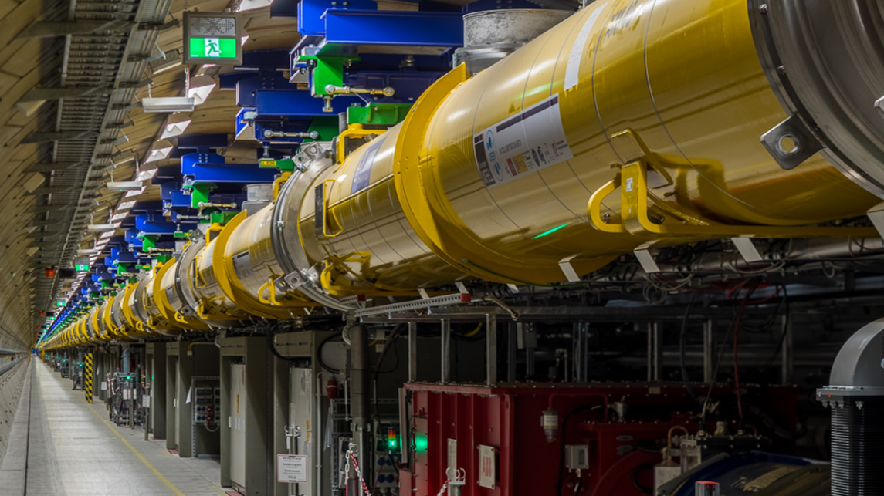
View along the linear accelerator
The longest superconducting accelerator of the world

Slide 7
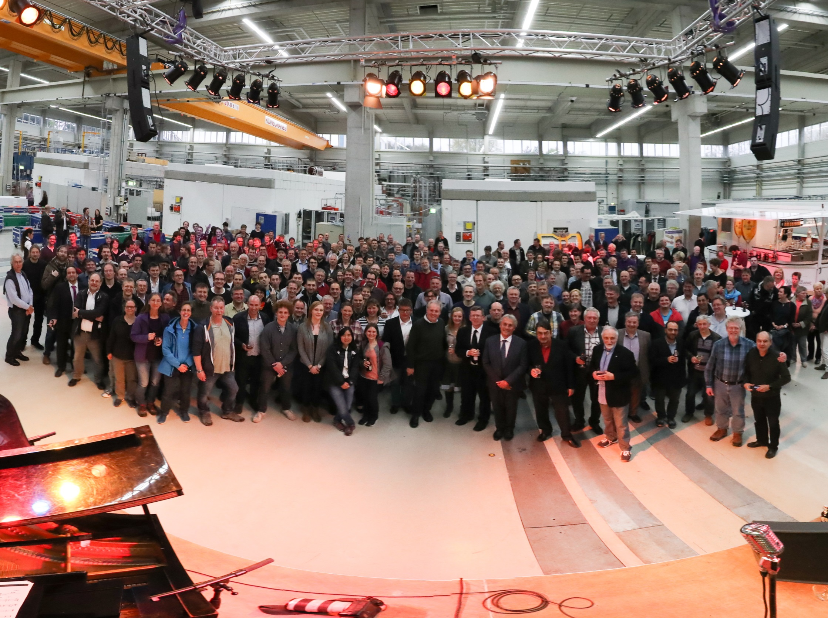














....Constructed by the European XFEL Accelerator Consortium
General Assembly of the European XFEL Accelerator Consortium
04.05.2017

Slide 8
View along the linear accelerator
Magnets | 103 Dipoles, 495 Quads, 59 Multipoles, 403 Correctors, 103 Quad-Movers, 2 Solenoids
Modules | 101 x 1.3 GHz, 1 x 3.9 GHz, 27 RF Stations
Diagnostics | 457 BPMs, 64 Imaging Stations, 36 Toroids, 9 Dark Current Monitors, 7 Beam Arrival Monitors, 4 Beam Halo Monitors, 4 Bunch Compression Monitors, 4 Elector Optical Monitors, 3 Coherent Radiation Detectors, 3 Faraday Cups
Fast Devices | 34 Kicker Magnets, 3 Transverse Deflecting Structure
Undulator | 1 Laser Heater Undulator, 91 SASE Undulator Segments
Vacuum | About 4200 m of cold & warm beam vacuum, Collimators, Beam Stops, …
And many more …………………

Slide 9
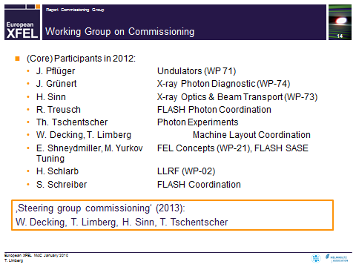
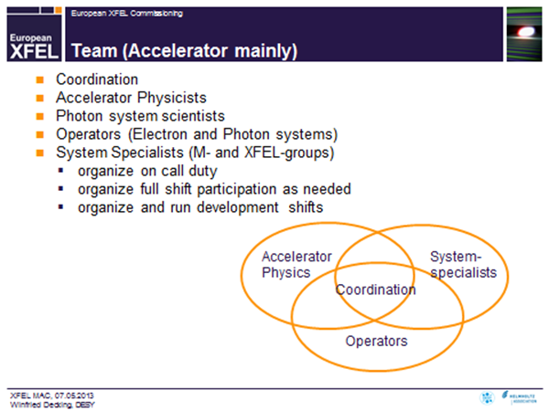
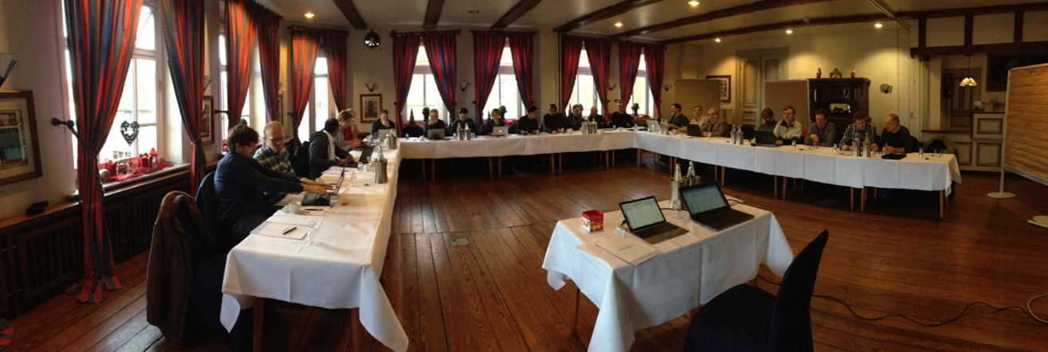


Form a team …

Slide 10
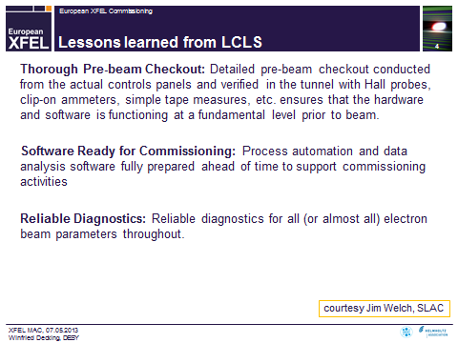
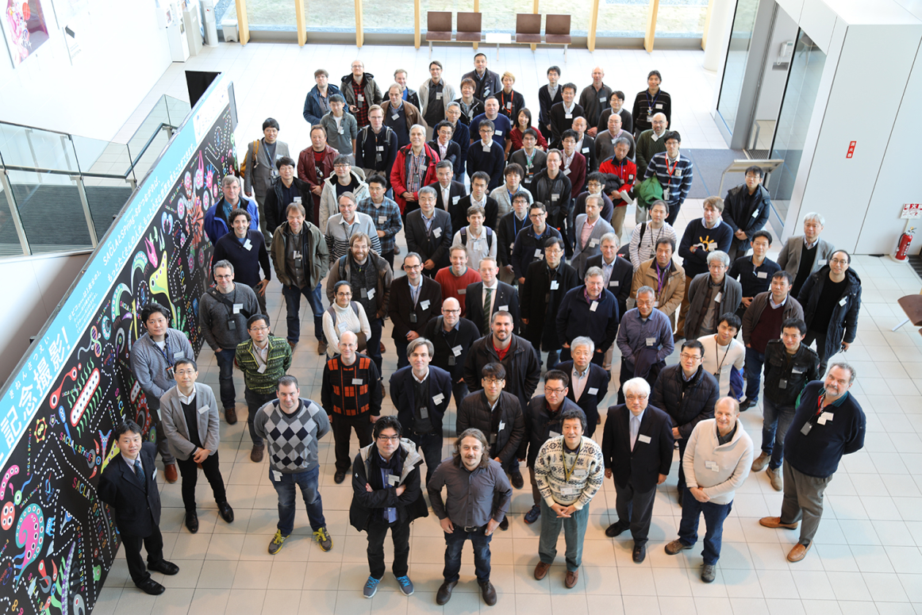




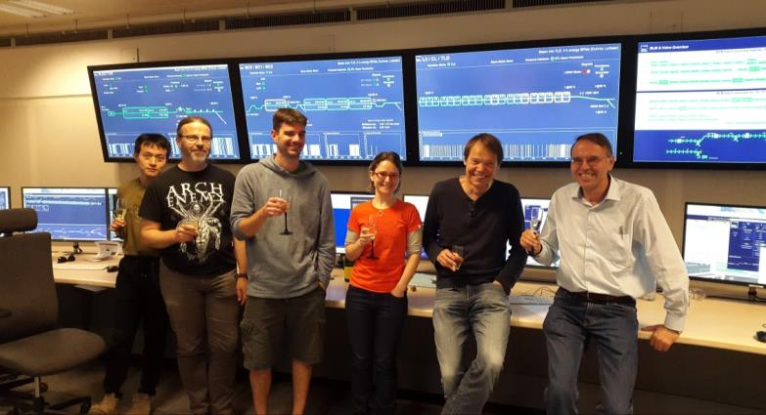
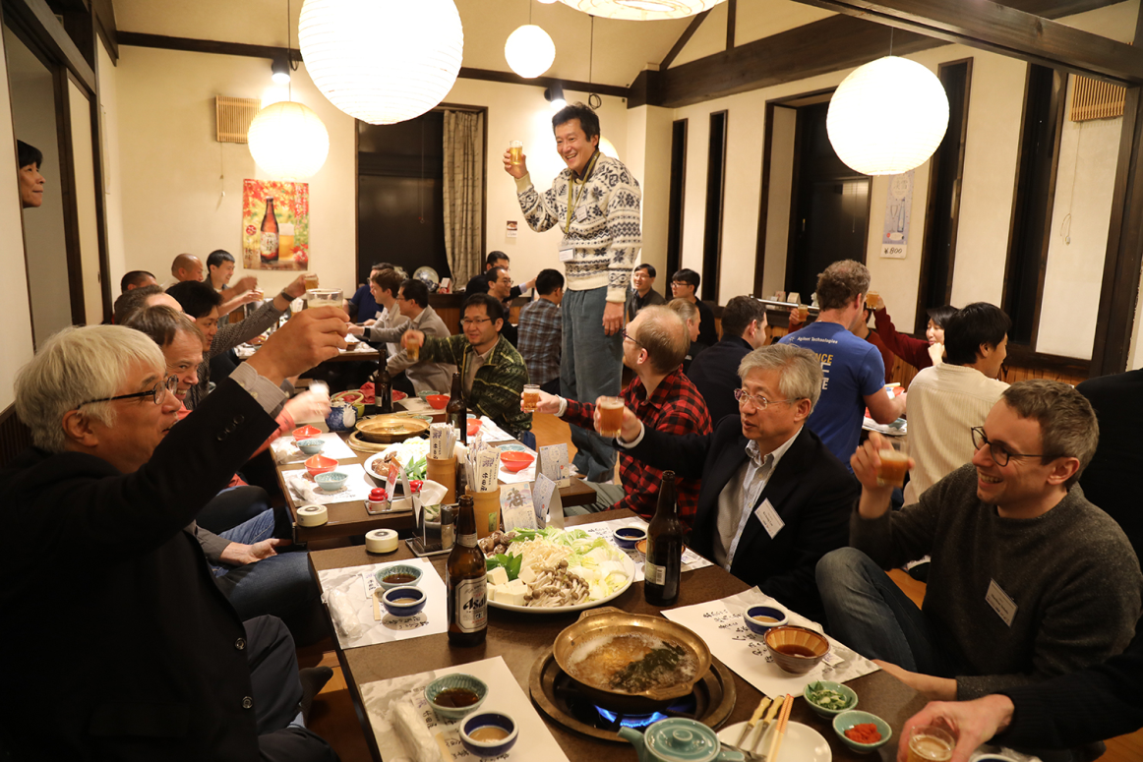
Get help …
Help with personnel during
the commissioning:

Slide 11
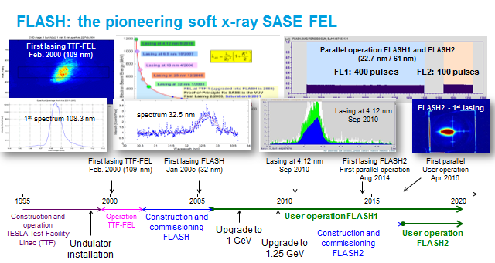
Get help …

Slide 12
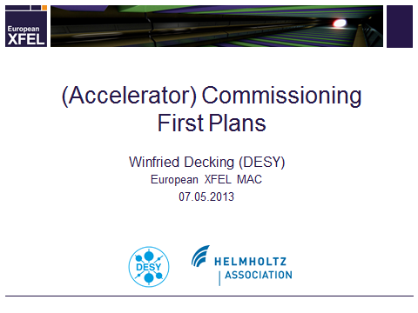
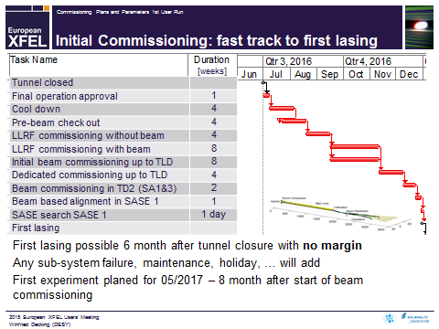
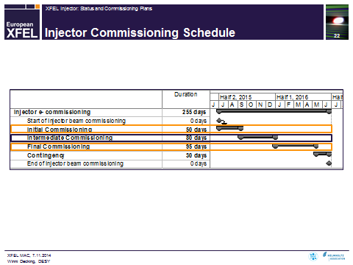
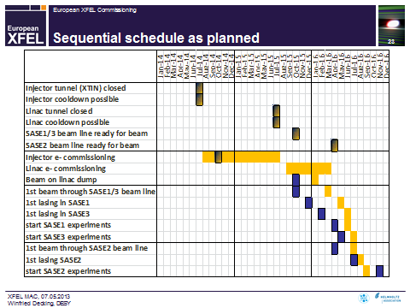
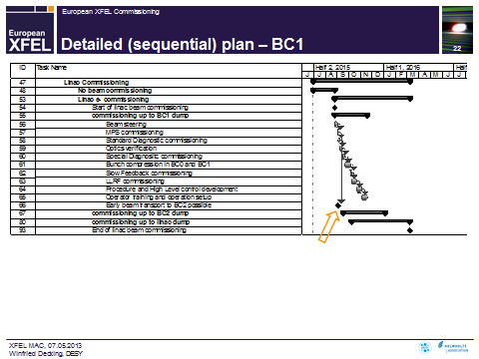
Make a plan …

Slide 13
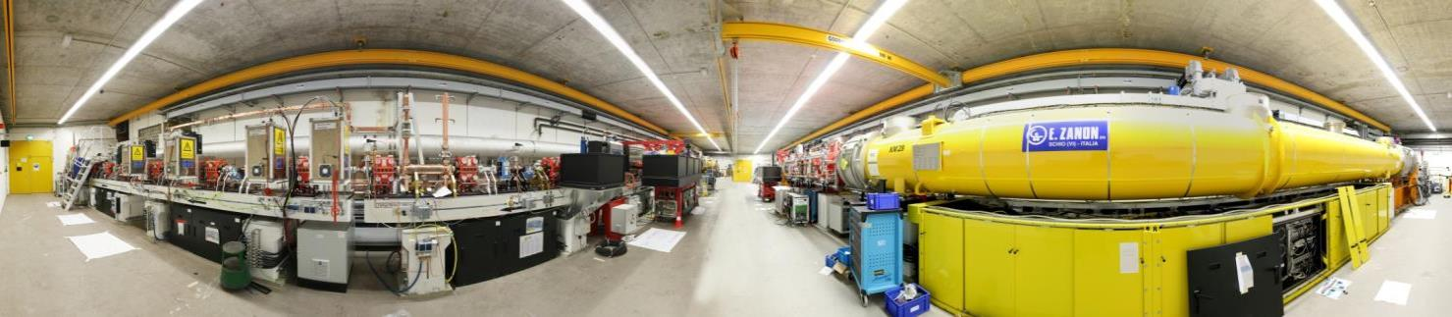
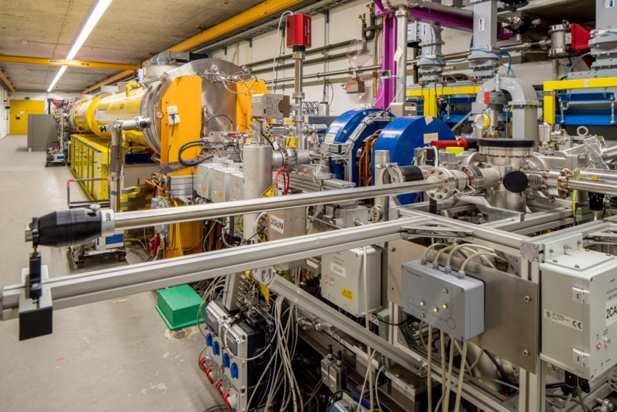
Injector commissioning
Dump Transverse Deflecting Structure
Spectrometer Diagnostic Section Laser Heater 3.9 GHz Module 1.3 GHz Module Gun
Photoinjector conditioned and characterized at PITZ, DESY-Zeuthen
Photocathode laser (Yb:YAG laser from Max-Born Institute Berlin 257 nm ≤ 4 μJ; 3 ps) with excellent up-time
Injector cool-down 12/2015, beam commissioning till Q2/2016
Full beam parameter envelope exploited

Slide 14
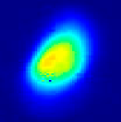
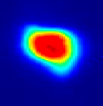
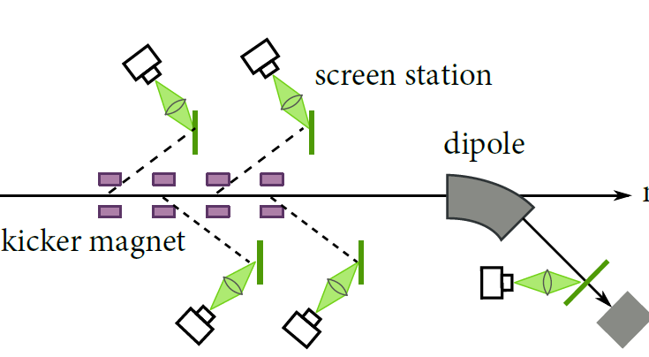
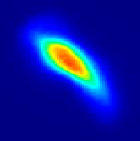
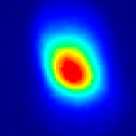
Injector Commissioning: projected emittance
Scheme of the XFEL injector diagnostic section
Emittance optimization mainly at 500 pC and reduced gun gradient (≈ 52 MV/m)
 | Design | Achieved
Normalized proj. emittance [mm mrad] | < 1.5 | 1.2
Normalized slice emittance [mm mrad] | 0.6 | 0.6
Fast kickers kick single bunches out of the trains to off-axis screens
“Semi-parasitic” diagnostics
Together with transverse deflecting system also used for slice diagnostics

Slide 15
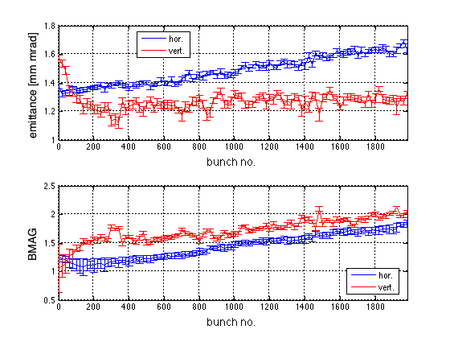
Injector Commissioning: projected emittance
Nina Golubeva, DESY
Scheme of the XFEL injector diagnostic section
Projected emittance along bunch train
Optics mismatch along bunch train
Up to a factor 2 with respect to design beta functions
Matched to design optics
Fast kickers kick single bunches out of the trains to off-axis screens
“Semi-parasitic” diagnostics
Together with transverse deflecting system also used for slice diagnostics
Variations along the train can be monitored
Corrections to provide uniform conditions along train

Slide 16
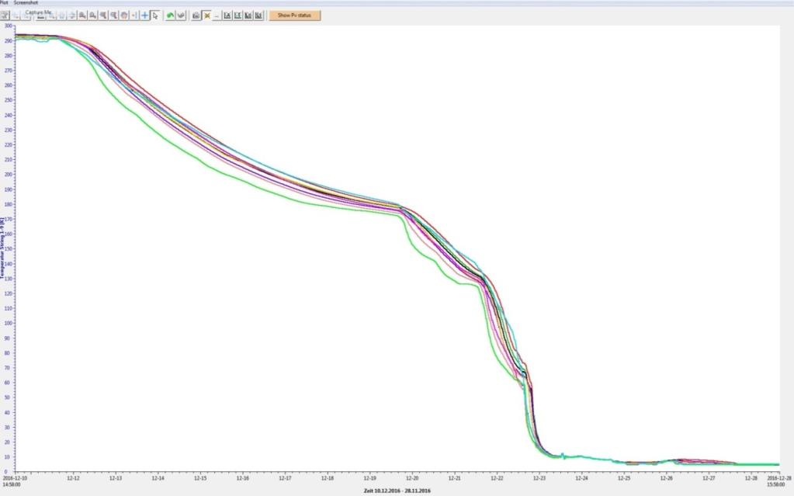
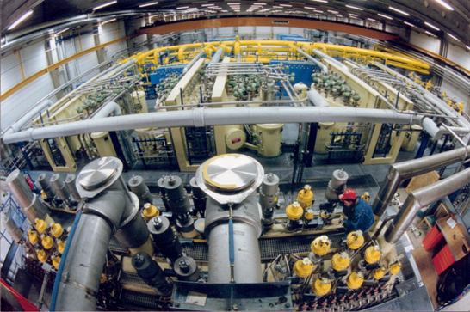
Cool-Down
T [K]
300
Temperature at 9 positions along the linac versus time
Cryo plant with cold compressors and extended distribution system
Cooling capacity:
2K : >1.9 kW
5/8K : 4 kW
40/80K : 24 kW
Cooldown with one coldbox
No cold leaks !
200
Lessons learned:
Experienced personnel for installation is a must
Excellent quality control pays off
100
Fast cooldown at temperatures below liquid nitrogen (no more thermal stress)
Reached 4K
0
10.12.2016
27.12.2016

Slide 17
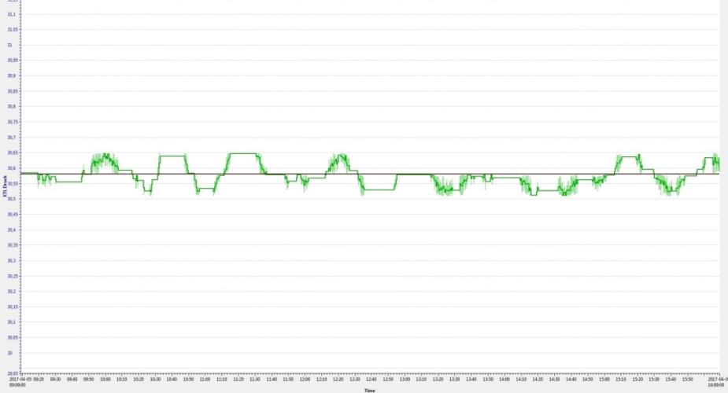
Cool-Down: cryo-system status after only 12 month of operation
2 K pressure stability < 0.3% reached (specification < 1%) after tedious adjustment of regulation loops
Stability can also be maintained during extreme dynamic load changes due to inner system heaters
  2K pressure
  [mbar]
  30.9
  30.6
± 1%
2K pressure
  30.3
Sudden shutdown of 18 RF stations
Linac pressure (2K)
7 hours

Slide 18
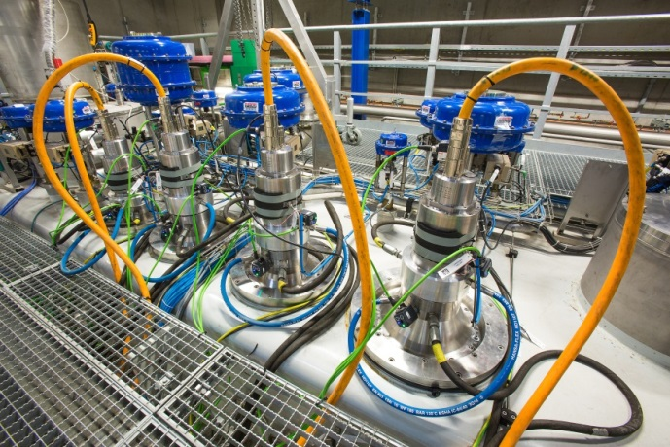
Cool-Down: cryo-system status after only 12 month of operation
2 K pressure stability < 0.3% reached (specification < 1%) after tedious adjustment of regulation loops
Stability can also be maintained during extreme dynamic load changes due to inner system heaters
But open issue with MBTF of cold compressors
    Repair & recover to SASE delivery < 36 hours
 | Bearing failures | Specified lifetime | Current run
CC-stage 1 | 0 | 16000 | 6800*
CC-stage 2 | 5 |  | 8600**
CC-stage 3 | 9 |  | 960**
CC-stage 4 | 3 |  | 5600**

Slide 19
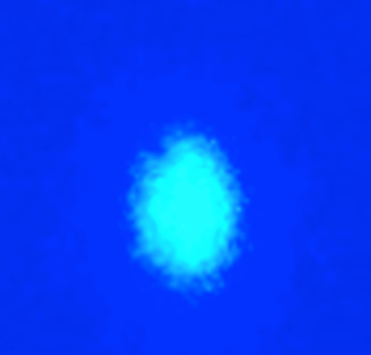
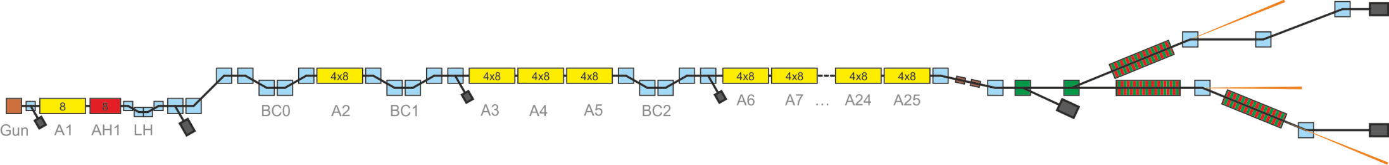

Commissioning timeline
First light from SASE1
@ 9 Å
May 2-3, 2017
April 27, 2017
Jan 13, 2017
Feb 2, 2017 @ 600 MeV
Feb 22, 2017 @ 2.5 GeV
First light from SASE3
@ 1.3 nm
Jan 15, 2017 @ 130 MeV
Jan 19, 2017 @ 600 MeV
Feb 25, 2017@ 2.5 GeV
March 19, 2017 @ 6 GeV
April 8, 2017 @ 12 GeV
Oct 23, 2017 @ 14.9 GeV

Slide 20
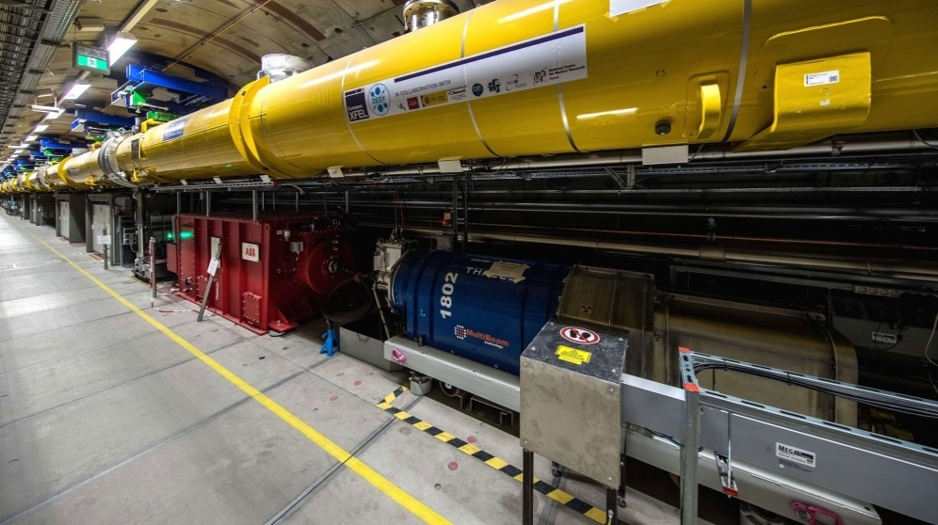
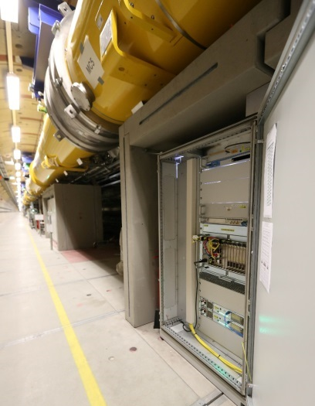
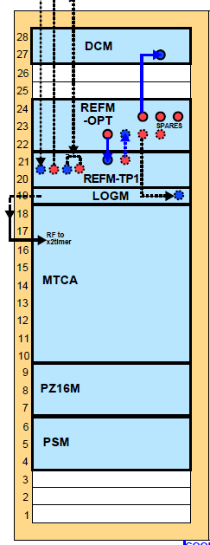
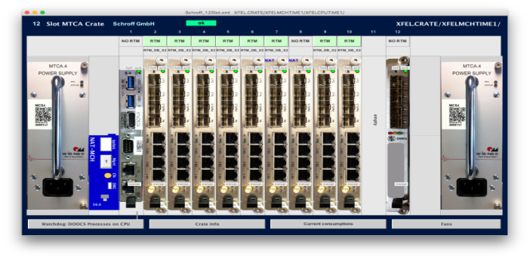
XFEL rf system (1 out of 25 stations)
CM1 (8 cav.)
CM2 (8 cav.)
CM3 (8 cav.)
CM4 (8cav.)
KLYSTRON
Drift compensation
Reference synchr. + distr.
Clocks + local oscillator
Main controller crate (MicroTCA)
Piezo*
Electronics
Klystron and modulator
Power supplies
All hardware in the tunnel ( no access during operation)
Electronics based on MTCA.4 standard, developed by DESY together with industry
  Fully automated and standardized installation procedure allows rapid deployment and recovery
  Enhanced remote management allow for simplified maintenance
  Extended monitoring and management of module ensure reliable crate operation
Lessons learned:
Concept works well
Common hardware platform pays off

Slide 21
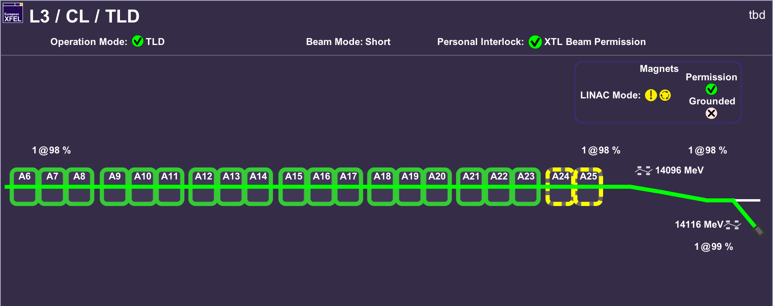
RF Commissioning: process and results
About 3.5 month initial commissioning time with up to 3 teams in parallel
Without and with electron beam in parallel to other beam commissioning
23 out of 25 RF stations initially commissioned
Operation automated; energy goal for 2017/2018 reached with 1-2 stations in reserve

Slide 22
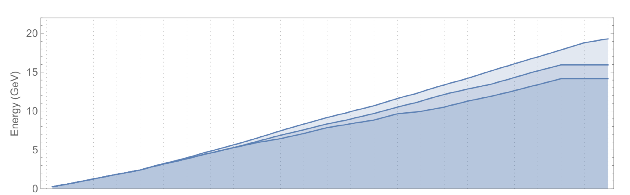
RF Commissioning: process and results
About 3.5 month initial commissioning time with up to 3 teams in parallel
Without and with electron beam in parallel to other beam commissioning
23 out of 25 RF stations initially commissioned
Operation automated; energy goal for 2017/2018 reached with 1-2 stations in reserve
Design energy 17.5 GeV
AMTF prediction (19.3 GeV)
Now (16.0 GeV)
May 2017 (14.2 GeV)
Maximum electron beam energy so far:
14.9 GeV

Slide 23
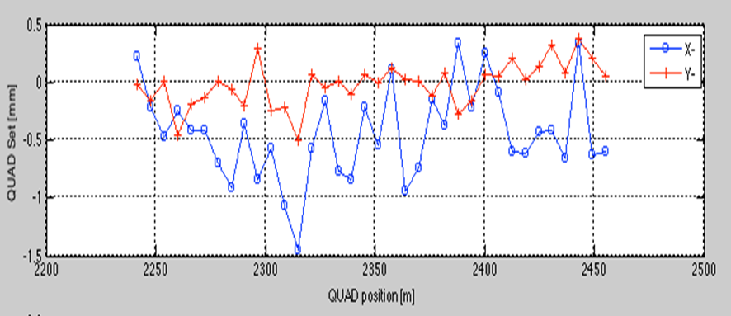
First Lasing Results
Beam based alignment results
1st lasing at about 1.6 keV (02/05)
Undulator trajectory alignment (23/05)
Quad misalignment
0.5
0
-0.5
-1
-1.5
800 µm
Needs excellent diagnostics
Lessons learned:
There might be sign errors
QUAD offset [mm]
Button BPM_{d=78mm} ≈ 5 µm
Button BPM_{d=40mm} ≈ 2 µm
30 µm

Slide 24
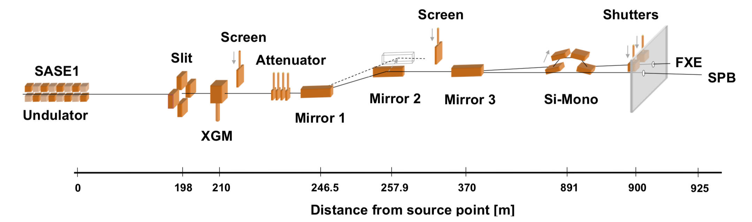
Photon beamline commissioning
hard X-ray beamline
photon beam mirrors
two experiments
screens
calibrated gas monitors
attenuators

Slide 25
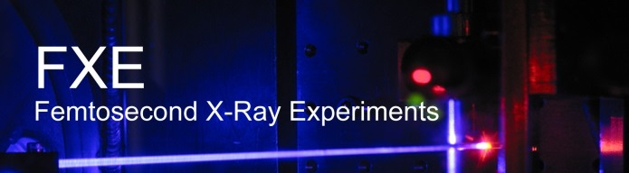

Commissioning timeline
First light from SASE1
@ 9 Å
First user runs started in September 2017
May 2-3, 2017
April 27, 2017
Jan 13, 2017
Feb 2, 2017 @ 600 MeV
Feb 22, 2017 @ 2.5 GeV
First light from SASE3
Jan 15, 2017 @ 130 MeV
Jan 19, 2017 @ 600 MeV
Feb 25, 2017@ 2.5 GeV
March 19, 2017 @ 6 GeV
April 8, 2017 @ 12 GeV
Oct 23, 2017 @ 14.9 GeV

Slide 26


First 7 user blocks 10/2017 – 11/2017
Recording of SASE level
Recording of SASE level
1000 µJ
X-ray mirror replacement
Beam based alignment
1 month shutdown & development
84% 84% 92% 10% 92% 97% 97%
Block 1 Block 2 Block 3 Block 4 Block 5 Block 6 Block 7
Availability (= SASE delivery above threshold)
Prominent error sources: operation, rf-trips (frequent but speedy recovery), magnet (rare but lengthy)
In general: the technical systems show excellent performance

Slide 27

Schedule 2018
About 6800 hours of operation

Slide 28


Commissioning timeline 2018
First bunches in
T5D
First light from SASE1
@ 9 Å
First user runs started in September 2017
March 13, 2018
May 2-3, 2017
April 27, 2017
Jan 13, 2017
Feb 2, 2017 @ 600 MeV
Feb 22, 2017 @ 2.5 GeV
First light from SASE3
@ 1.3 nm
Jan 15, 2017 @ 130 MeV
Jan 19, 2017 @ 600 MeV
Feb 25, 2017@ 2.5 GeV
March 19, 2017 @ 6 GeV
April 8, 2017 @ 12 GeV
Oct 23, 2017 @ 14.9 GeV
February 8, 2018

Slide 29

Commissioning timeline 2018
First lasing SASE2
@ 1.8 Å
First lasing SASE1
@ 9 Å
First user runs started in September 2017
May 1, 2018
May 2-3, 2017
April 27, 2017
Jan 13, 2017
Feb 2, 2017 @ 600 MeV
Feb 22, 2017 @ 2.5 GeV
First lasing SASE3
@ 1.3 nm
Jan 15, 2017 @ 130 MeV
Jan 19, 2017 @ 600 MeV
Feb 25, 2017@ 2.5 GeV
March 19, 2017 @ 6 GeV
April 8, 2017 @ 12 GeV
Oct 23, 2017 @ 14.9 GeV
February 8, 2018

Slide 30



Beam distribution
XDU2
XDU2
Dump beamline
XS1
XDU2
Both kicker and septum sections
Northern branch: SASE1 and SASE3
Southern branch: SASE2
Collimation section

Slide 31

Parallel operation of three beamlines
75 bunches per pulse
25
750 bunches per second accelerated in the linac
SASE2
Main linac
SASE1
SASE1
20
30

Slide 32



South Branch commissioning
Scheduled after final technical commissioning of SASE2 undulator
1000 m electron beam line
Initial steering and diagnostics set-up in 1 shift
Lessons learned:
Need well prepared diagnostics
Pre-beam polarity tests
A little luck

Slide 33


Serial operation of the hard and soft
X-ray beamlines SASE1 and SASE3
The undulator beamlines SASE1 and SASE3 are in series.
Bunches that lased in SASE1 do also lase in SASE3.
The level of photon pulse energy in SASE3 depends on the level in SASE1.
SASE1
SASE3

Slide 34

Serial operation of the hard and soft
X-ray beamlines SASE1 and SASE3
Correlation between SASE1 and SASE3 photon pulse energy.
The undulator beamlines SASE1 and SASE3 are in series.
Bunches that lased in SASE1 do also lase in SASE3.
The level of photon pulse energy in SASE3 depends on the level in SASE1.
Lessons learned:
Series operation of SASE FELs has its challenges
SASE1
SASE3

Slide 35


All 3 SASE in parallel May 2nd 2018

Slide 36

SASE delivery with 5000 bunches per second
Maximum number of SASE pulses generated so far in the SASE1 beamline was 5000/s
Number will be increased further step by step followed by radiation safety measurements
Homogeneous lasing thanks to IBFB operation

Slide 37



Controls and Automation
XFELs small brother: FLASH
All relevant hardware (uTCA, timing system, …) and software (DOOCS, TINE, …) already in operation
BUT: magnitude higher number of components!
Need for ‘data reduction’ is essential!
➔ Automation
x 20 at FLASH
x 200 at XFEL

Slide 38



Controls and Automation
Data throughput tested on ’virtual’ XFEL
  can safely cope with XFEL producing data rates in the 1-2 GBs range
  now we are maintaining 9 million system variables
Very high degree of automation from first hours on
  fully automated recovery of RF stations
  many feedback loops (transversal + longitudinal)
  automatic optimization procedures, …
Machine can be operated by single person
with just at ‘few tools’
Lessons learned:
Prepare high level controls for day one
Joint control/physics team is perfect for this task
Transversal Feedback Loops
Longitudinal Feedback Loops

Slide 39

Machine Protection System
Inputs:
  Hardware status
  Beam loss monitors
  Transmission interlock
  Beam position
  Photon system status
Output:
  Injector laser (Pockels cell & beam shutter)
  Beam dump kicker
  Timing system
Lessons learned:
Very complicated system
We learn every day
One incident leading to machine damage was caused by not fully installed MPS hardware

Slide 40


Challenge: Three Control Systems Used for European XFEL
Karabo
DOOCS controlled world for XFEL.EU:
  Accelerator
  Undulators
  Timing system
  Mainly used in
  Beschleuniger-Kontroll-Raum (BKR)
Karabo controlled world:
  Photon beam lines
  Experiments
  Data Acquisition
  Mainly used in experiment control hutches
Small, but important overlap: need Karabo DOOCS inter system communication
EPICS TINE TANGO DOOCS
Lessons learned:
Use one control system if possible
But also control system zoo is manageable
Interfaces will cost delay and friction

Slide 41

Diagnostics – BPM resolution
10 µm
Button & Re-entrant BPM_{d=78mm} ≈ 5 µm
Button BPM_{d=40mm} ≈ 2 µm
1 µm
Lessons learned: excellent standard diagnostics is essential from day one
Cavity BPM_{d=40mm} ≈ 1 µm
Cavity BPM_{d=10mm} < 1 µm
0 m Distance along accelerator 3100 m
250 pC
Correlations subtracted

Slide 42

Diagnostics - Screen resolution
Scintiallator material (LYSO) selected based on resolution measurements with CW beam
Images showed ‘smoke rings’ and systematical larger beam size compared to wire scans at large charge densities (small beams)
Explained by saturation effects for pulsed beams
New screen materials tested
Lessons learned:
be prepared for surprises and have alternatives at hand
Of the > 50 installed screens max. 20 are used
Single quad scan

Slide 43


Diagnostics – TDS long. resolution
15 fs resolution reached
Needs careful tuning of spurious dispersion and optics match
Lessons learned:
Special (‘complicated’) diagnostics not needed at start
Becomes essential for optimal performance

Slide 44



Beam stability & Fast feedbacks
Intra bunch train orbit feedback
Arrival time stability
Arrival time jitter
Injector
100 fs
INJ
60 fs
BC0
BC2
BC1
BC0
20 fs
BC1
We expect an arrival time jitter in the range of 10 fs with arrival time feedback
Fast arrival time feedback at FLASH
14 fs
pk2pk ~ 30 μm
pk2pk ~ 6 μm

Slide 45
Parameters
Quantity |  | Project Goal | Achieved | Routine
electron energy | GeV | 8-17.5 | 6-14.9 | 14
bunches per second |  | 27000 | 5000 | 300
bunch charge | pC | 20 – 1000 | 100-500 | 250
electron bunch length after compression | fs (FWHM) | 2 – 180 | 20, 90 | 90
beam power | kW | 500 kW | 18 kW | 1.8 kW
undulators in operation (lasing) |  | SASE1-3 | SASE1-3 | SASE1
photon energy (SASE1) | keV | 0.25 - 25 | 1,6,9-14 | 9-9.5
saturation power (SASE1 @ 14 GeV, 250 pC, 9 keV) | mJ | 1 | 1.5 | 1

Slide 46


Thanks to the wonderful XFEL operation team
The lesson learned:
Team is essential
http://tesla.desy.de/status_PNGs/

