Slide 1
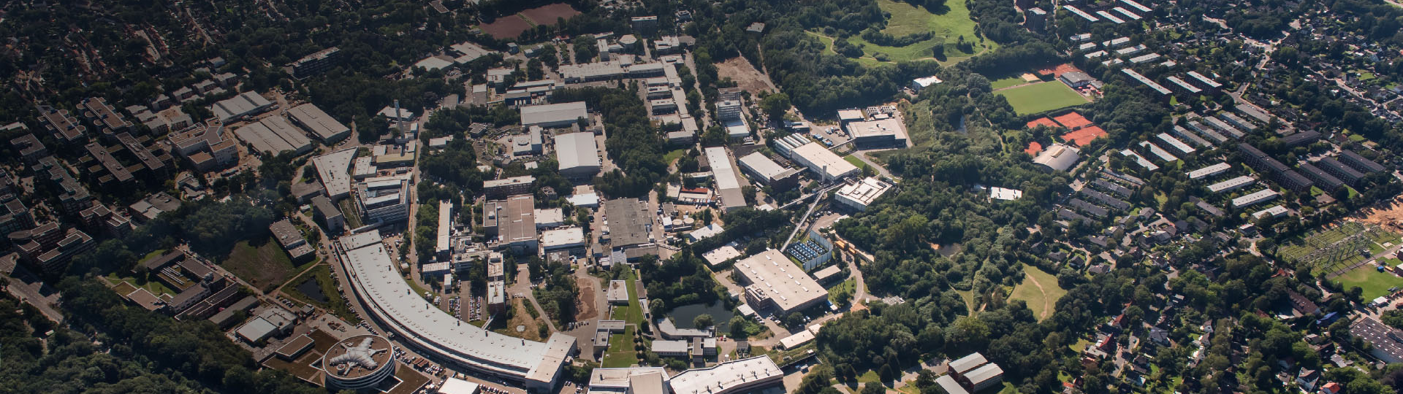
XUV Seeding and Slice-Resolved Diagnostic at sFLASH
Christoph Lechner for the sFLASH team
4th Annual MT Meeting, 13.06.2018

Slide 2

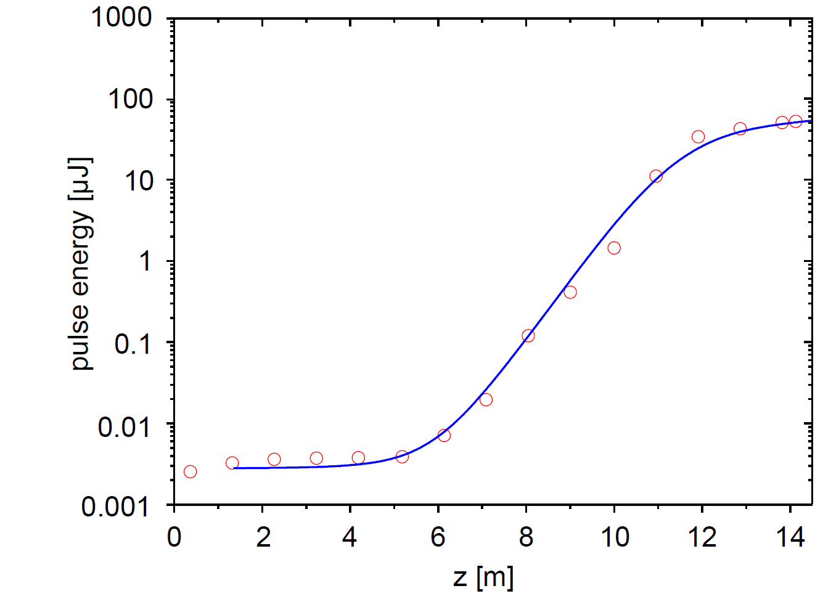

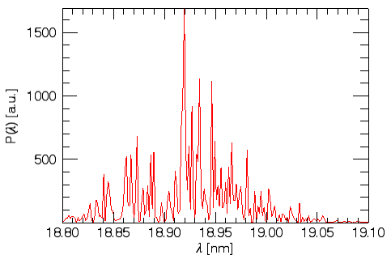
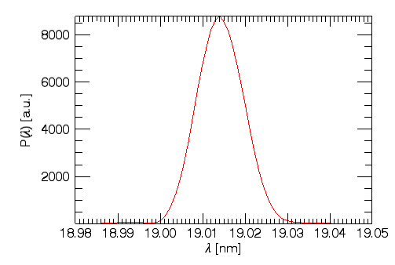



Introduction: Free-Electron Laser (FEL) & Seeding
Controlling and manipulating the FEL light pulses
=> ultra-short photon pulses with GW-peak power
Seeded operation
FEL controlled by external, coherent light pulse → from laser
3
SASE operation
Stochastic start-up
Noisy spectrum
2
simulation
simulation
1
Seeding transforms the FEL into a fully coherent light source

Slide 3
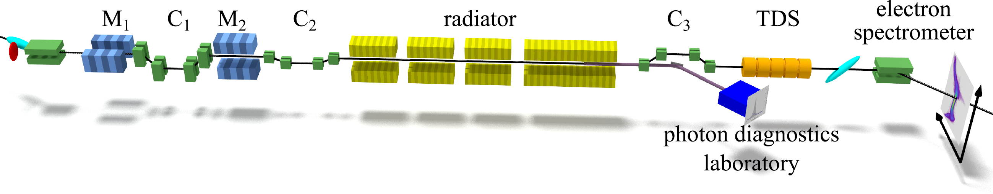
sFLASH – The Seeding Test Facility at FLASH
sFLASH as R&D experiment integrated into the FLASH user facility
RF Stations
Accelerating Structures
Fixed Gap Undulators
Photon Diagnostics
sFLASH
FLASH1
THz
RF Gun
Bunch Compressors
FLASH2
Albert Einstein
Lasers
Variable Gap
5 MeV
150 MeV
450 MeV
1250 MeV
FLASHForward
Kai Siegbahn
OUTLINE
High-gain harmonic generation (HGHG) seeding at sFLASH
Characterization of the seeded FEL pulses
Towards tailored seeded FEL pulses
FEL Experiments
315 m

Slide 4

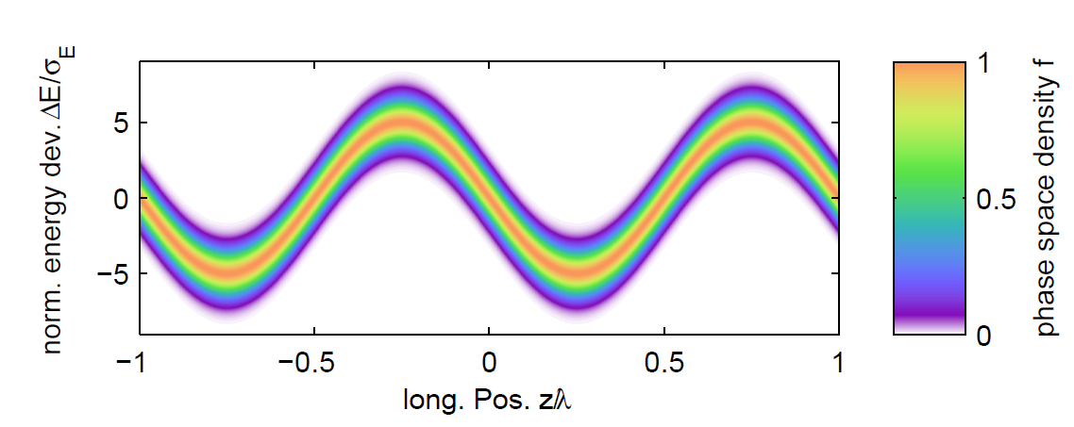
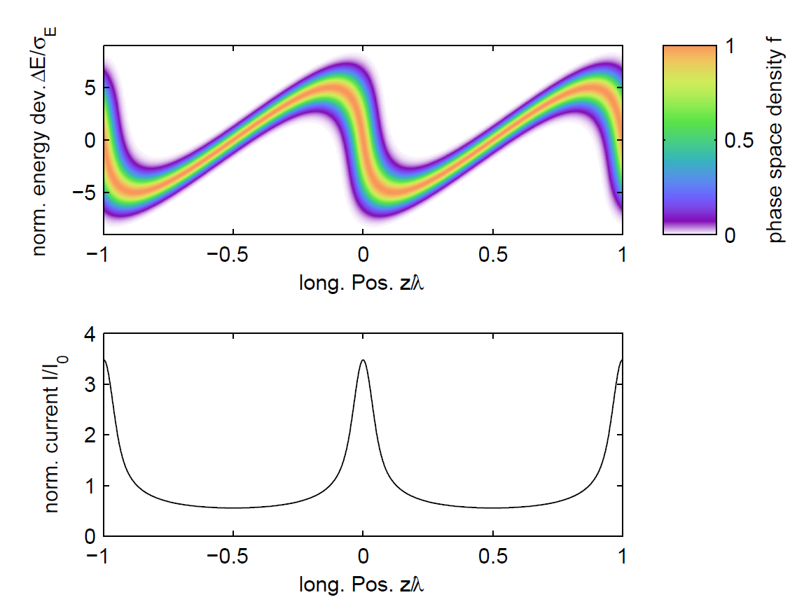

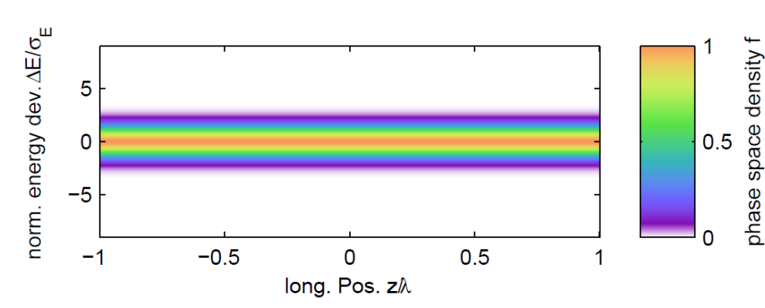
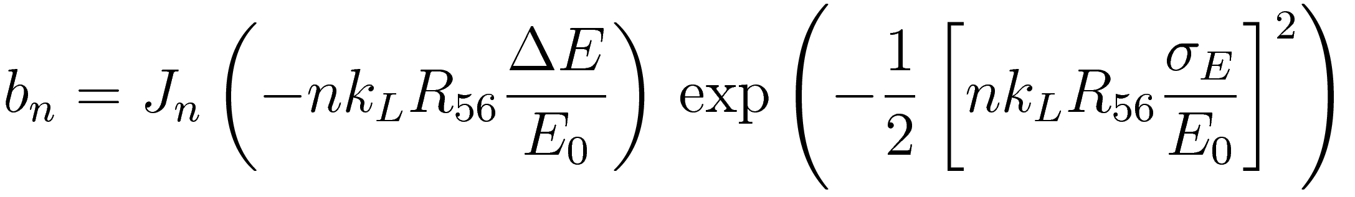
High-Gain Harmonic Generation (HGHG)
chicane
modulator
radiator
Bunching factor at harmonic n
Proposed by Yu in 1991:
L.H. Yu, Phys. Rev. A 44, 5178 (1991)

Slide 5
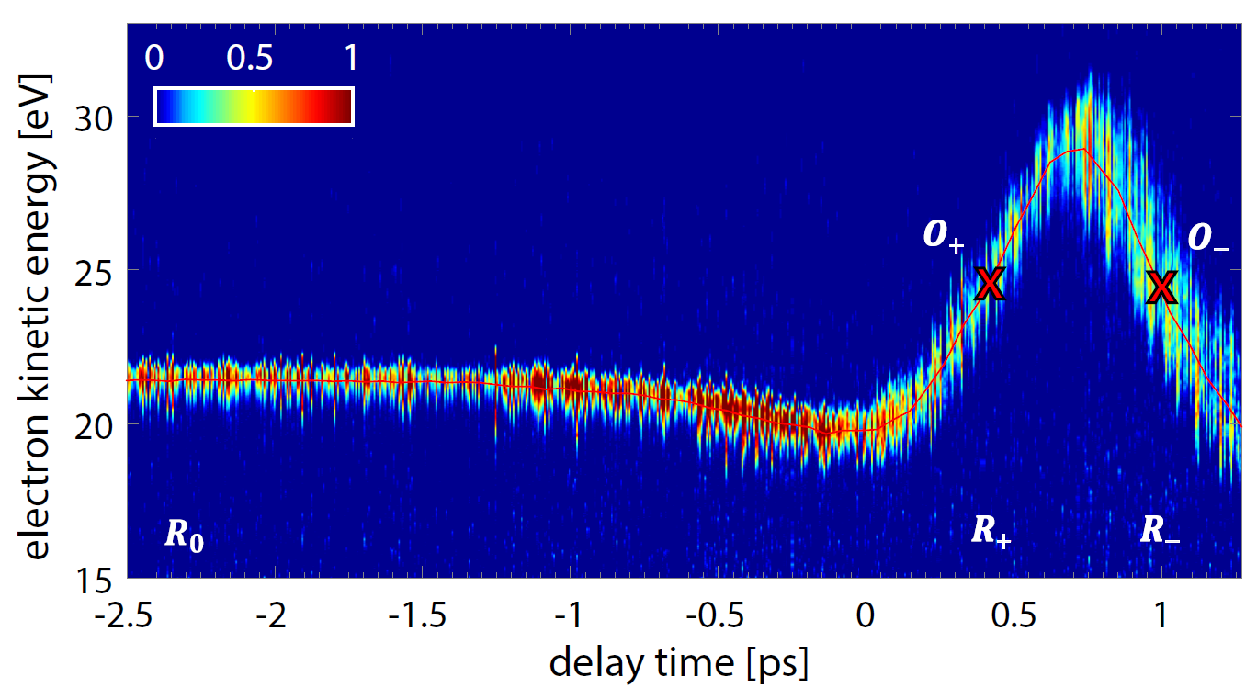
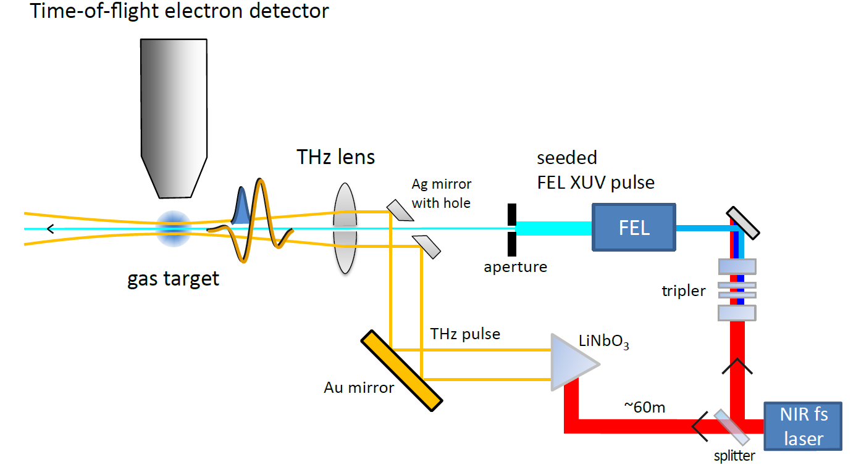
THz Streaking of Photon Pulses
Newly applied at DESY for seeded pulses
Time-of-flight electron detector
Combining measurements at both slopes gives access to
chirp
duration
of photon pulses
seed
source
THz
source
A. Azima, et al., New J. Phys. 20, 013010 (2018)

Slide 6
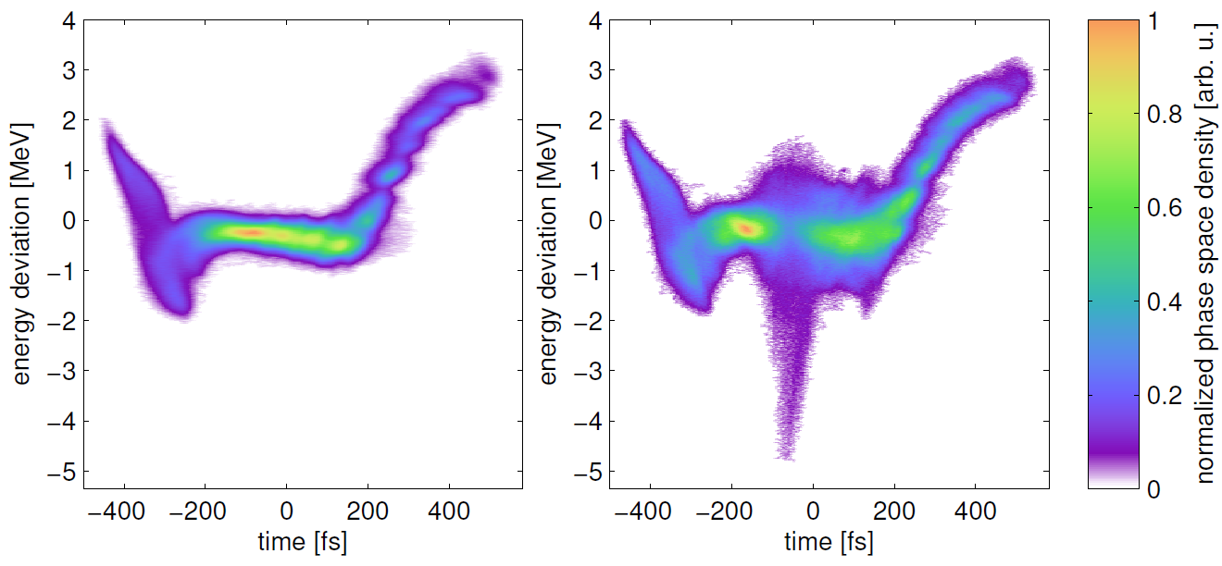
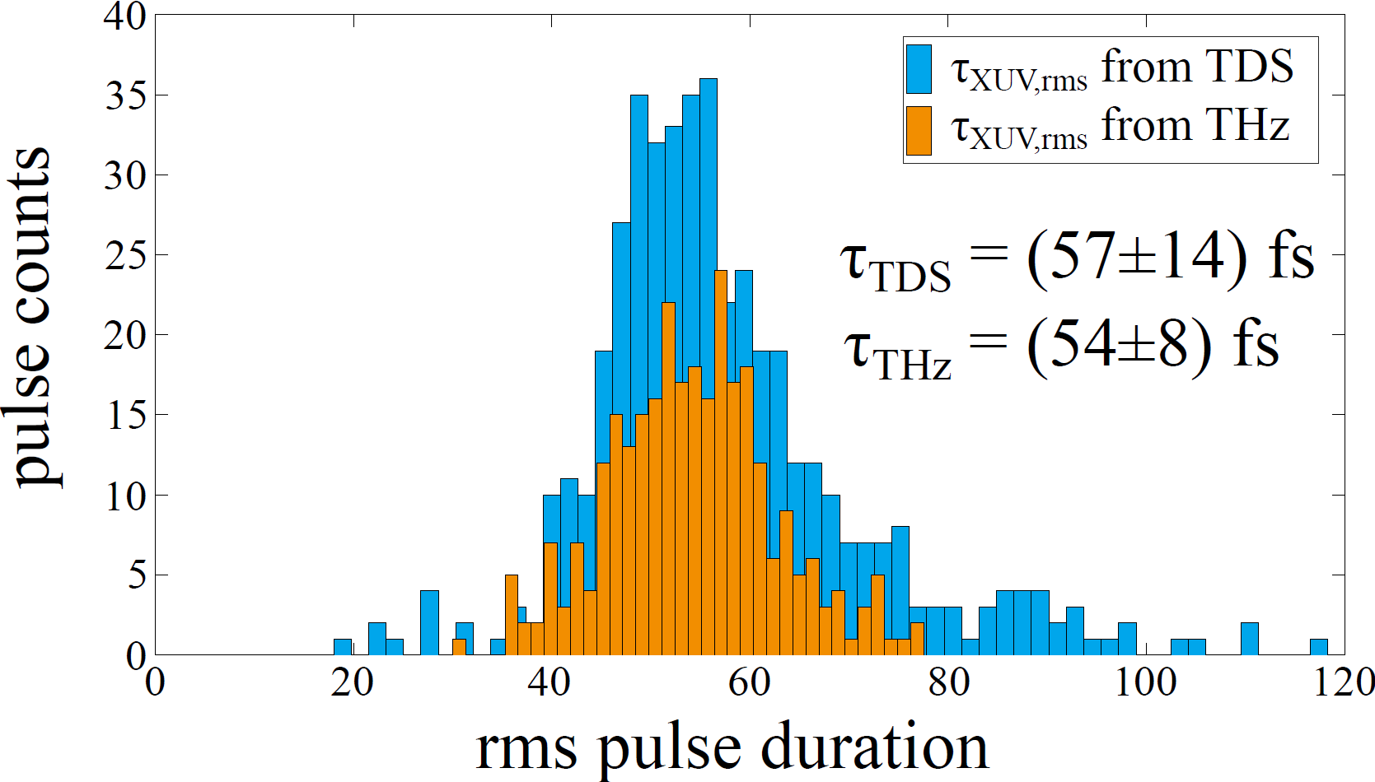
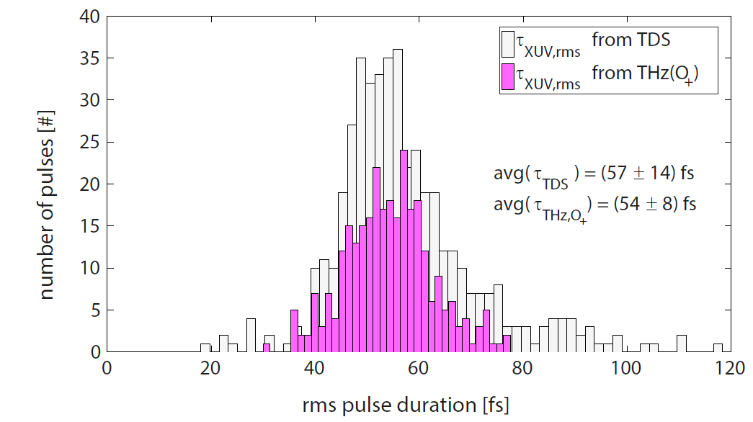
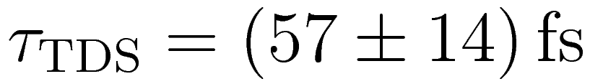
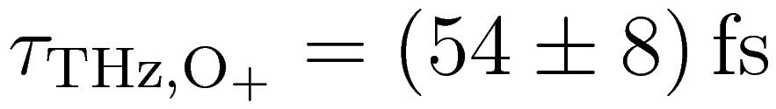
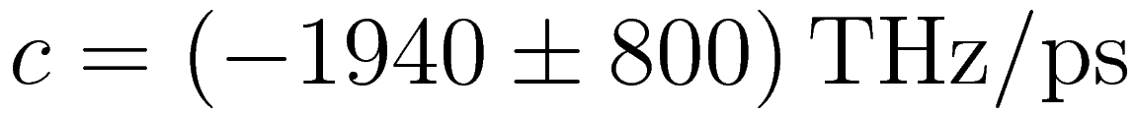
Measurement of FEL Pulse Duration
Using transverse-deflecting structure (TDS):
Extract duration of seeded FEL pulses
With THz streaking:
Access optical phase of FEL pulses
Chirp of seeded FEL pulses (only determined by THz streaking)
A. Azima, et al., New J. Phys. 20, 013010 (2018)

Slide 7
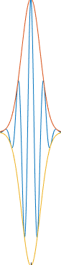
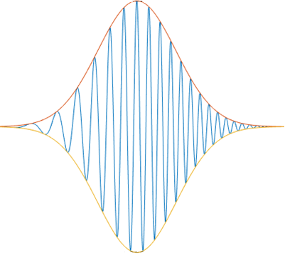


Next Step: Manipulation of UV Seed Laser Pulses
First step towards tailored seeded FEL pulses
$$E(t)$$
Dispersive medium
$$v_{g}(ω)$$
L
Longer wavelengths
(red)
Short
wavelengths
(blue)

Slide 8
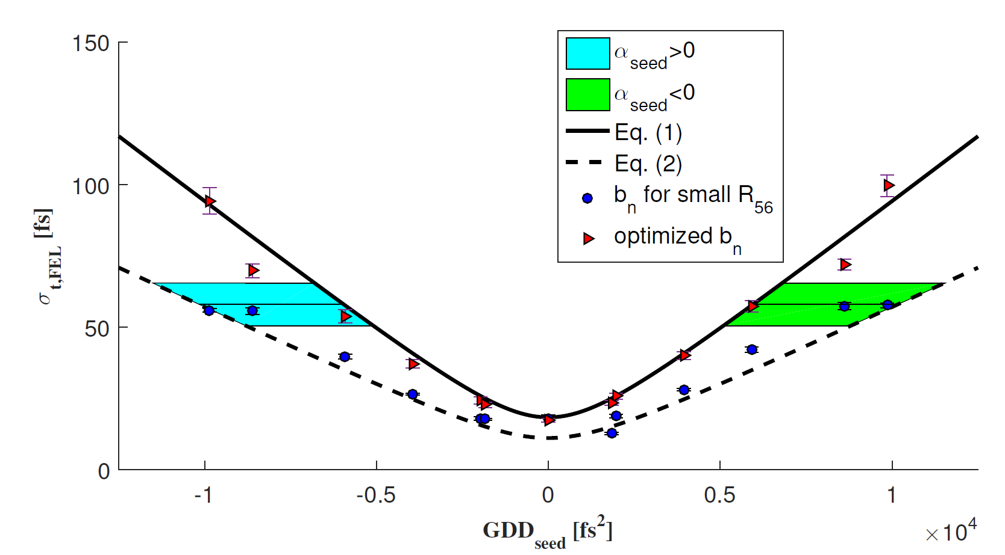
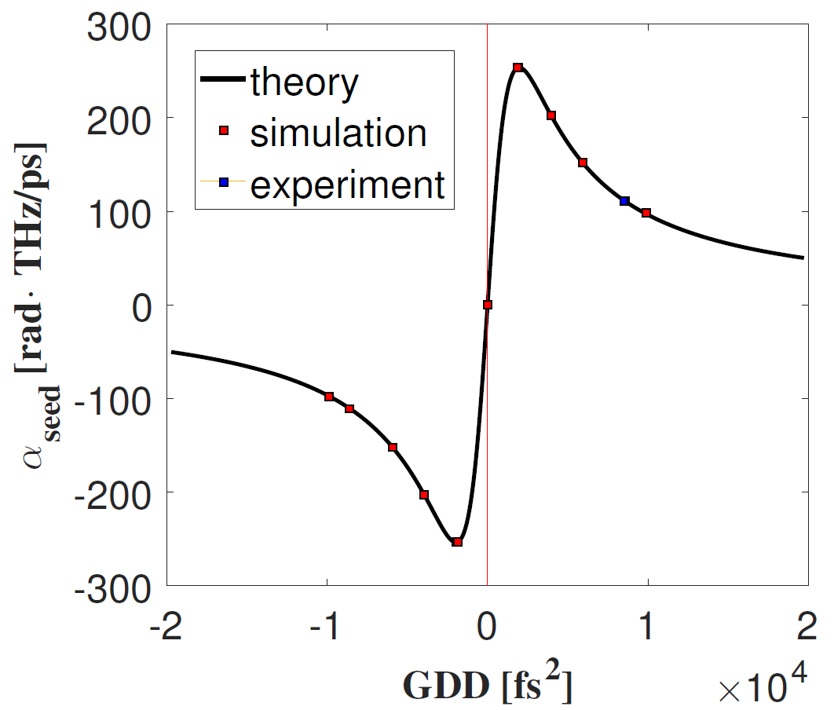
Next Step: Manipulation of UV Seed Laser Pulses
First step towards tailored seeded FEL pulses
α_{seed}<0
α_{seed}>0
optimized R₅₆
small R₅₆
group-delay dispersion GDD_{seed} [fs²]
Inserting material into seed laser beamline changes GDD
First study being prepared: put fused-silica elements into seed laser beamline
GENESIS
simulation
At 267nm, 1mm of UV fused silica adds GDD of 195fs^2.
We have already operated the FEL with 12mm fused silica.

Slide 9

Summary
Seeding providing new insights and control for sFLASH FEL light pulses
sFLASH developed important new analysis methods (with HGHG seeding)
World-wide first TDS measurements of seeded FEL process, providing insights into FEL light properties
World-wide first THz streaking of seeded photon pulses: allows determining optical phase of FEL pulses, a critical information for frontier photon science
Next steps:
HGHG with manipulated seed laser pulses
Demonstration of EEHG-seeded FEL gain at sFLASH
Study of seeding design for FLASH2020+ upgrade plans

Slide 10




Thank you for your attention
Sven Ackermann*, Armin Azima, Jörn Bödewadt*, Hauke Biss, Martin Dohlus, Nagitha Ekanayake*, Vanessa Grattoni, Kirsten Hacker*, Mehdi Kazemi, Leslie L. Lazzarino, Christoph Lechner, Bastian Manschwetus, Theophilos Maltezopoulos*, Velizar Miltchev, Tim Plath*, Andreas Przystawik, Yannik Ristau, Sergey Usenko, Mathias Vogt, Igor Zagorodnov, Johann Zemella,
Ralph Assmann, Markus Drescher, Bart Faatz, Ingmar Hartl, Wolfgang Hillert, Shaukat Khan, Tim Laarmann, Jörg Rossbach, Wilfried Wurth
* former team member

Slide 11

Echo-Enabled
Harmonic Generation

Slide 12
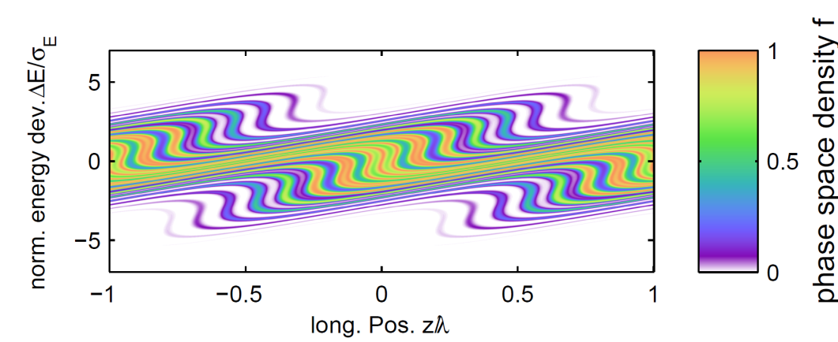
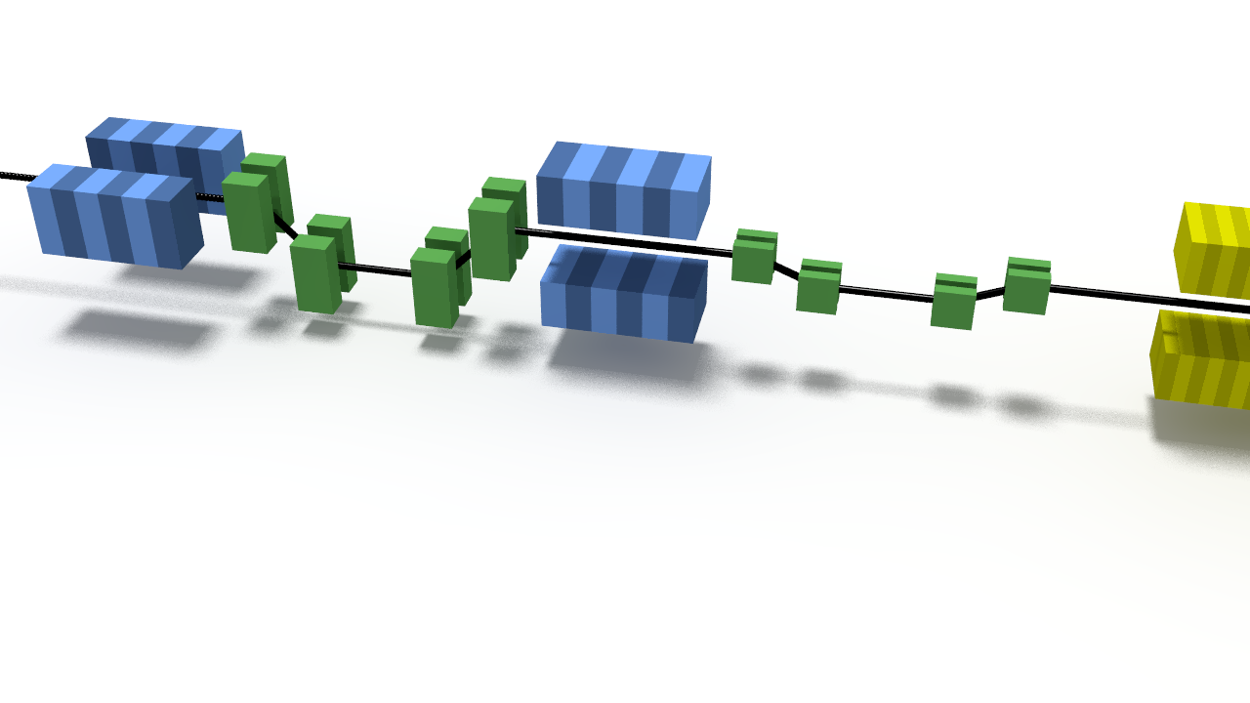
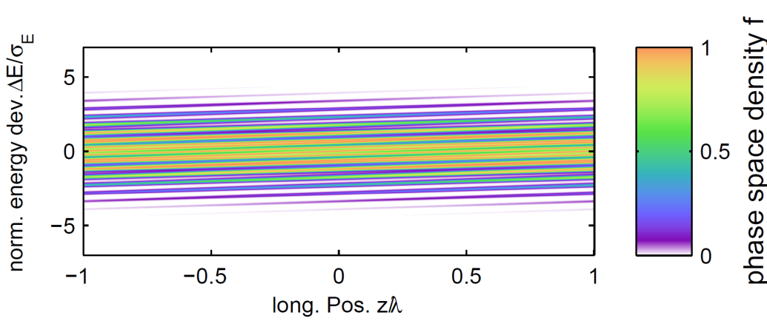
Echo-Enabled Harmonic Generation (EEHG)
Echo-enabled harmonic generation (EEHG):
Seeding adds less energy spread to electron beam
Electron beam imperfections have smaller impact on generated photons
Favorable bunching efficiency at high harmonics
EEHG is promising candidate for seeding at significantly higher harmonics
SLAC invention:
G. Stupakov, Phys. Rev. Lett. 102, 074801 (2009)

Slide 14
Additional Material

Slide 15

The FLASH Seeding Collaboration and Expertise
Bringing different fields together: from R&D to photon science
Laser Science
FS Laser
Group
Hartl
Accelerator
Science
TU
Dortmund
University Group
Khan
University Hamburg
Group
Drescher
FLASH
Groups
Wurth (FS) Schreiber (M)
University Hamburg
Group
Hillert (Rossbach)
FS Photon Science
Group
Laarmann
M ARD
Groups
Aßmann
Schlarb
Photon Science
Experiments

Slide 16
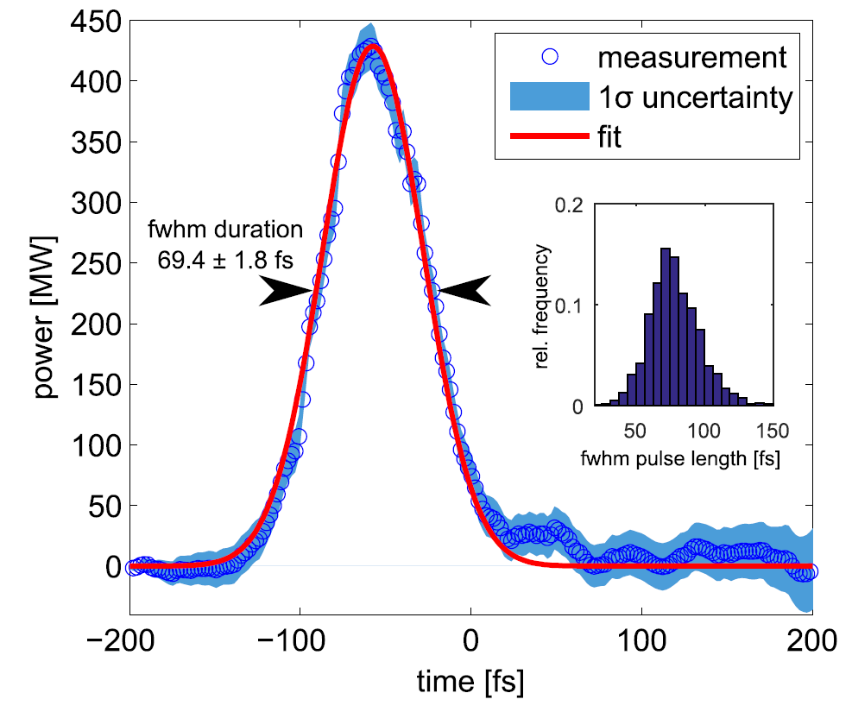
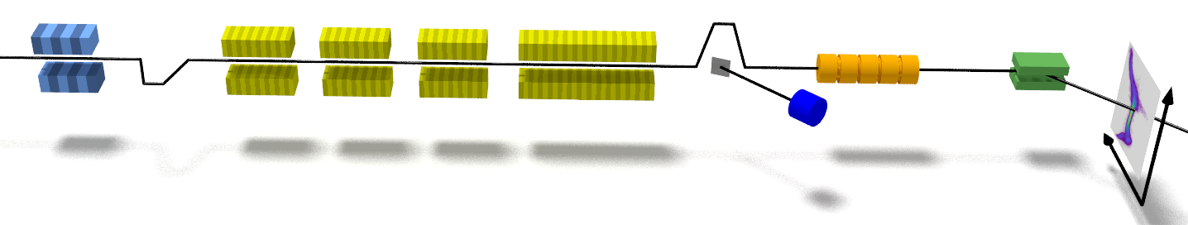
Generation and Analysis of Seeded FEL Pulses at sFLASH
Extraction from electron bunches with RF deflector
seeded area
Electron beam energy | 685 MeV
Peak current | 0.62 kA
Seed laser wavelength | 267 nm
Demonstrated for SASE FELs at LCLS
(DESY as co-author): C. Behrens, et al., Nat. Commun. 5, 4762 (2014)
modulator
radiator
TDS
sFLASH: first achieved for seeded FEL
T. Plath, et al., Sci. Rep. 7, 2431 (2017)
chicane
sFLASH

Slide 17
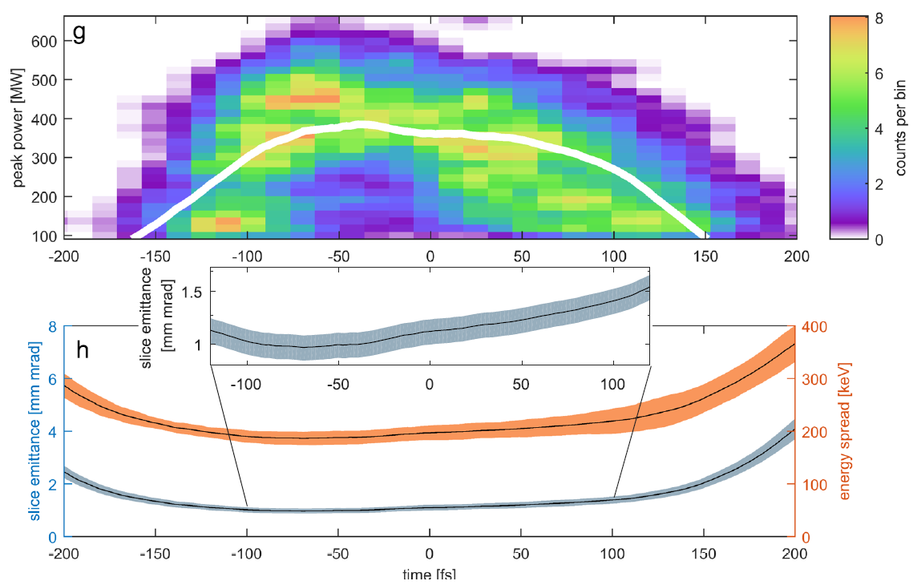
Generation and Analysis of Seeded FEL Pulses at sFLASH
Extraction from electron bunches with RF deflector
Measured emittance and current profiles and Ming Xie formalism very nicely model lasing in different regions of electron bunch
Unique hardware configuration (TDS setup at the exit of seeded FEL) enables detailed study of the seeded FEL
time [fs]
T. Plath, et al., Sci. Rep. 7, 2431 (2017)

Slide 18
Echo-Enabled
Harmonic Generation

Slide 19
Echo-Enabled Harmonic Generation (EEHG)
Echo-enabled harmonic generation (EEHG):
Seeding adds less energy spread to electron beam
Electron beam imperfections have smaller impact on generated photons
Favorable bunching efficiency at high harmonics
EEHG is promising candidate for seeding at significantly higher harmonics
SLAC invention:
G. Stupakov, Phys. Rev. Lett. 102, 074801 (2009)

Slide 20
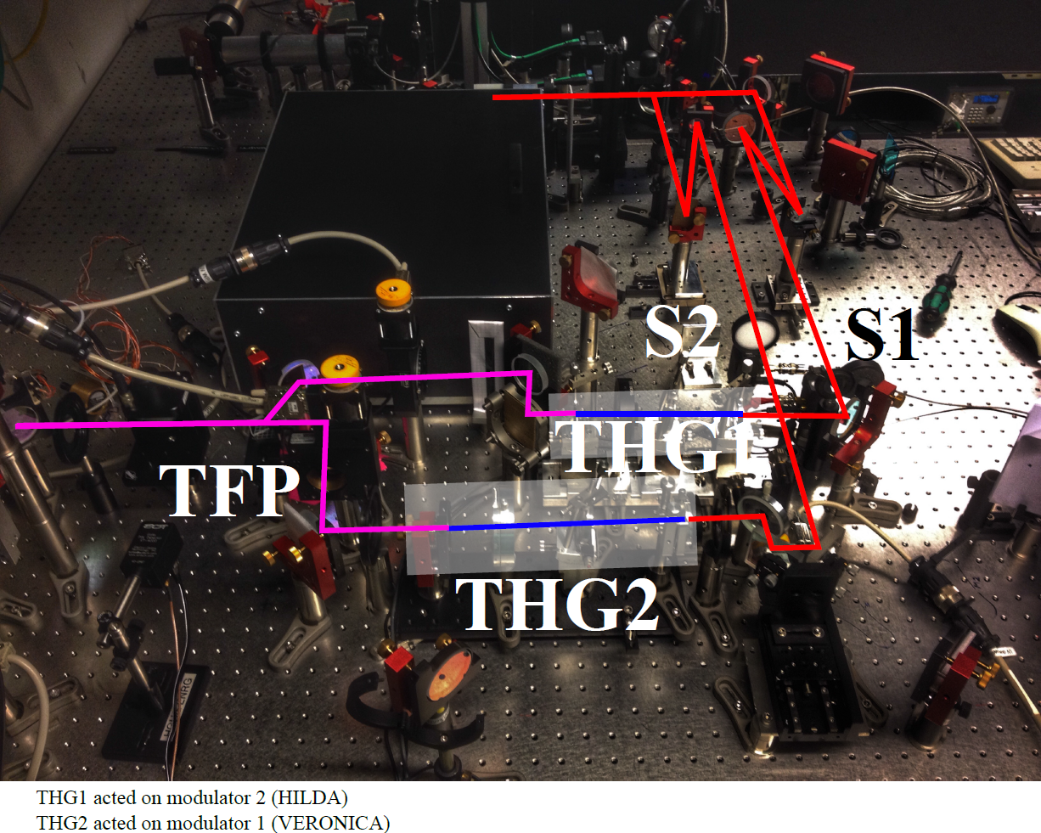
sFLASH Seed Source System (May 2017)
Two seed sources:
THG1 acts on modulator 2
THG2 acts on modulator 1
To tunnel
THG: third harmonic generation seed source
TFP=thin-film polarizer
Relative timing

Slide 21
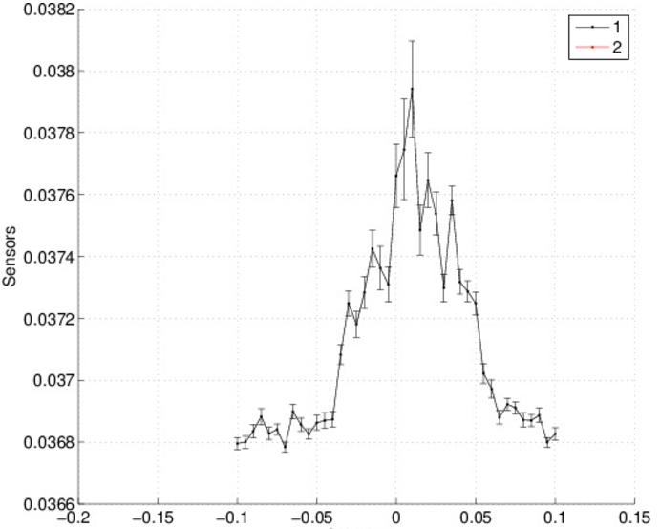
Scan of Relative Timing of Seed 1 and Seed 2 (May 2017)
Photons generated in CHG process, analyzed with photon energy detector and spectrometer
Repeated scan of relative seed pulse timing for three positions in the electron bunch:
(-0.2/0.0/+0.2) ps
Strongest signal when both seed sources are on and are overlapping on the bunch
FWHM ~ 500 fs
Spectrometer signal 12th harmonic [arb. u.]
Delay stage (mm)
-1
Relative timing seed1-seed2 (ps)
+1

Slide 22
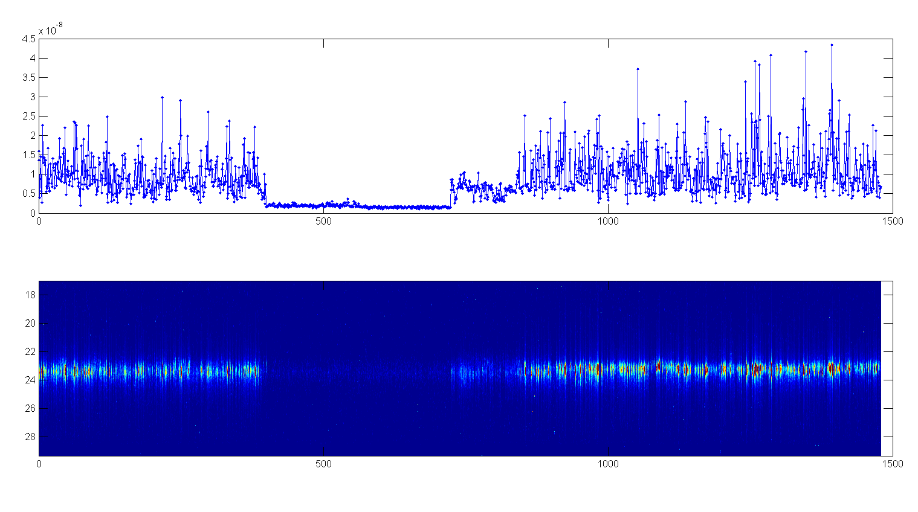
Seed On/Off Test
S1 on
S2 on
S1 on
S2 off
S1 off
S2 off
S1 off
S2 on
S1 on
S2 on

Slide 23
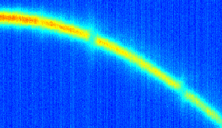
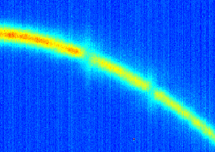
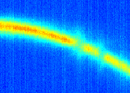
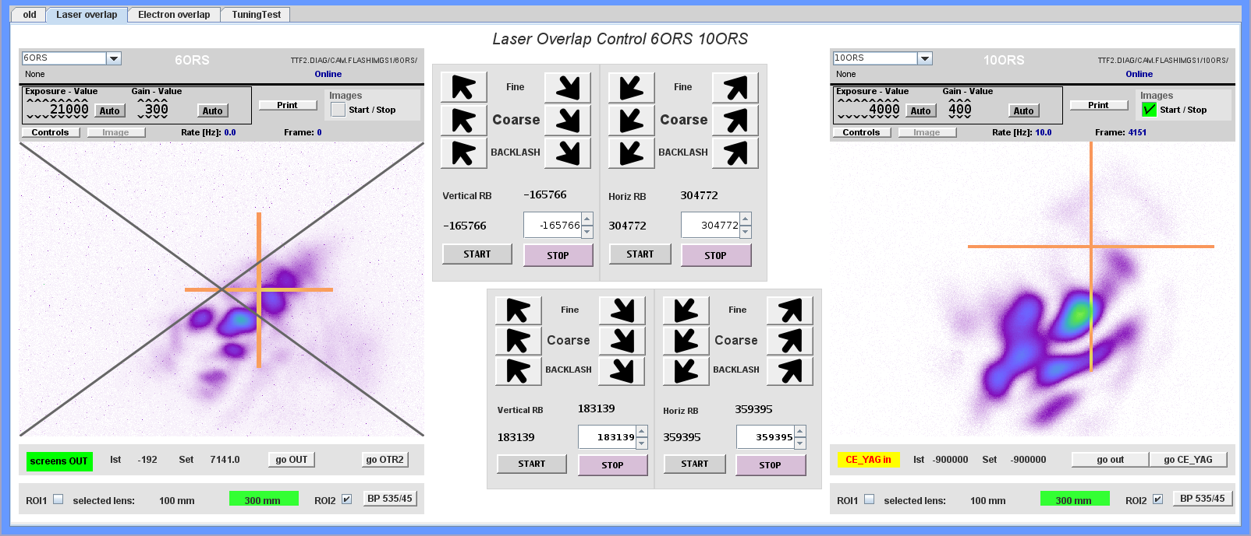
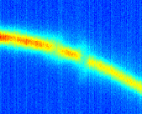
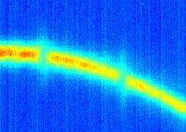
Nov 2017: Both Seed Laser Pulses on the Bunch
Seed laser pulses have orthogonal polarization
  Pulse 1 interacts with bunch in 1st modulator
  Pulse 2 interacts with bunch in 2nd modulator
Independent control in timing, modulation amplitude
  Global timing of seed laser pulses w.r.t. electron bunch controlled by vector modulator or OXC
  Delay stage controls relative timing of the two seed pulses
Data: 20171117T123144

Slide 24
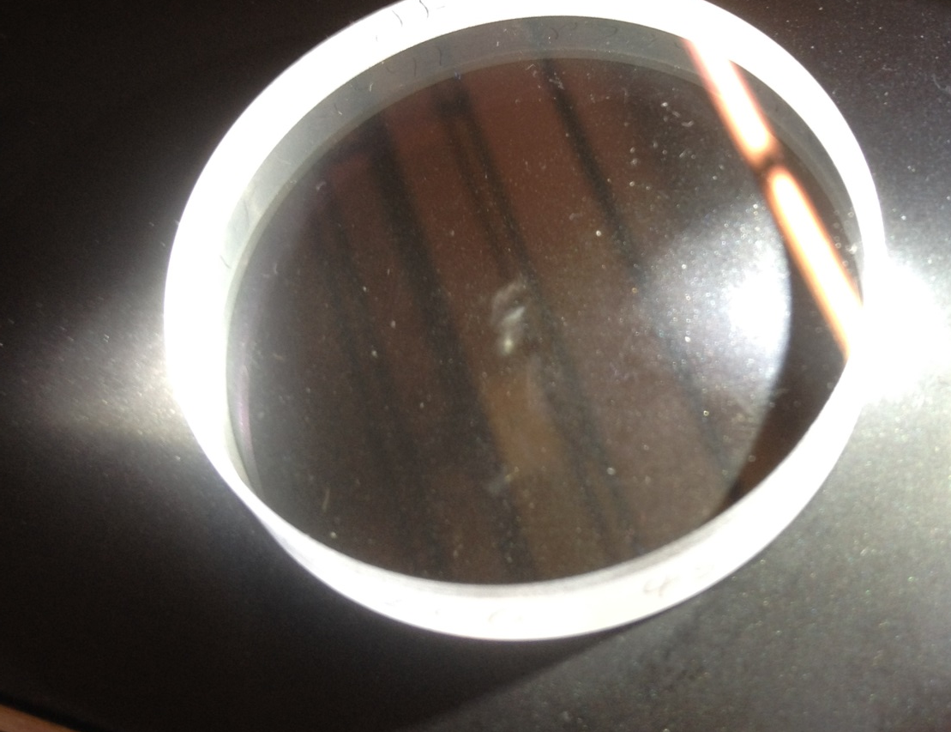
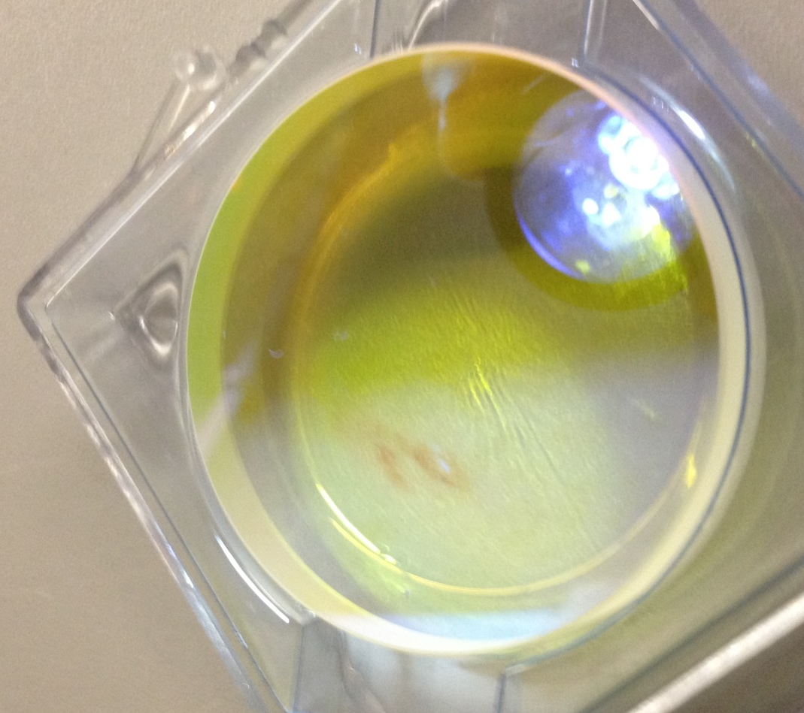
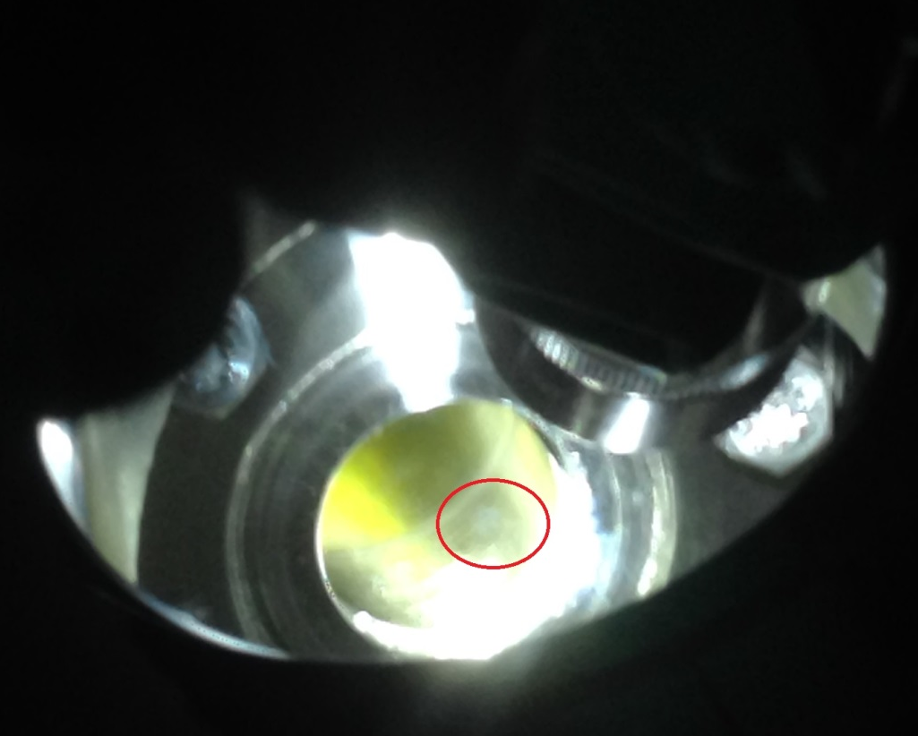
Vacuum Issue in sFLASH Laser Injection Beamline
Multi-day sFLASH run together with FLASHforward (09.11.2017, 07:00 – 14.11.2017, 07:00)
  FLASH LINAC shared between both experiments, “RF steps” enable independent control of compression
  Efficient use of machine time
Integrated UV pulse energy impinging optical components (mirrors, windows) was multiple times that of normal runs
Inspection after the experiment revealed black coating of optical components
vacuum window
p<10⁻⁵ mbar
machine vacuum

Slide 25
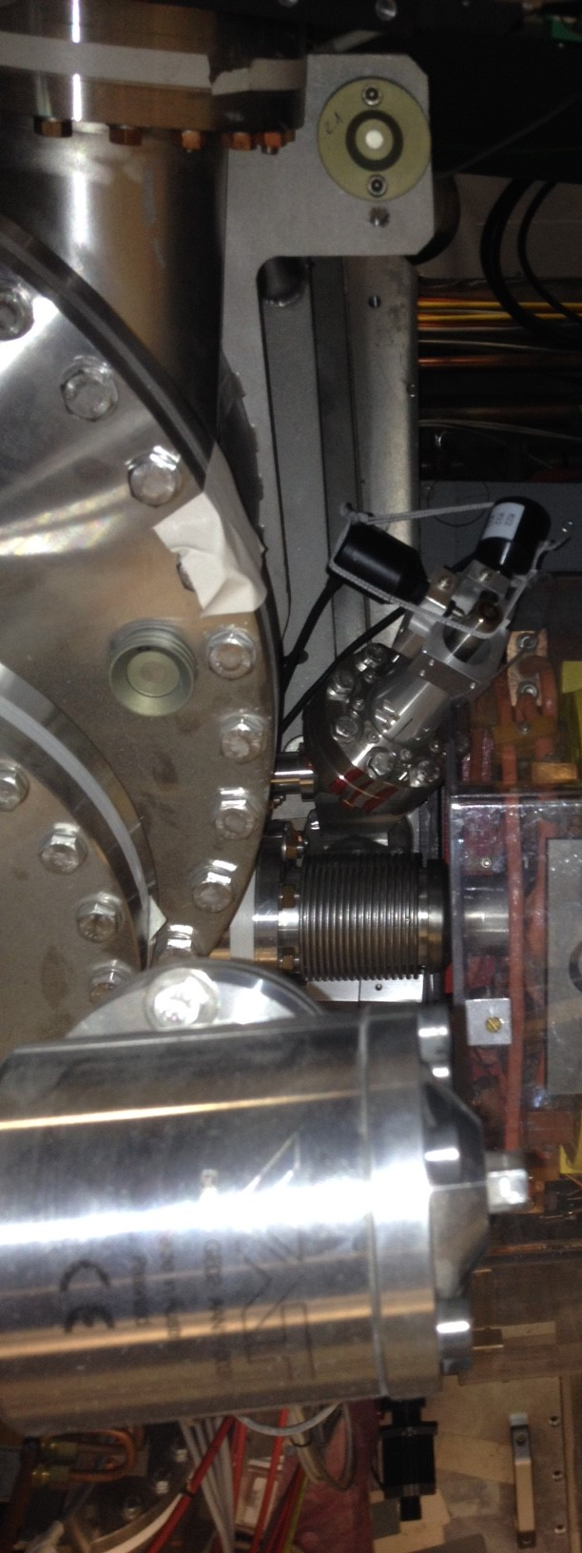
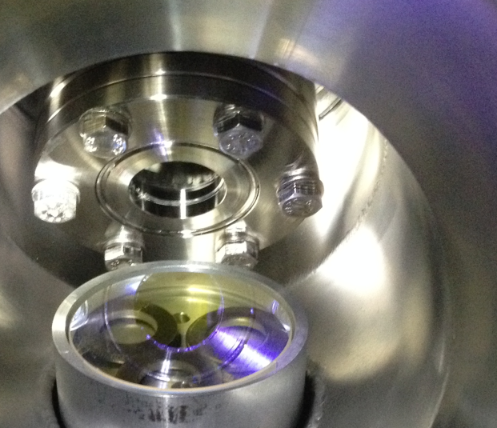
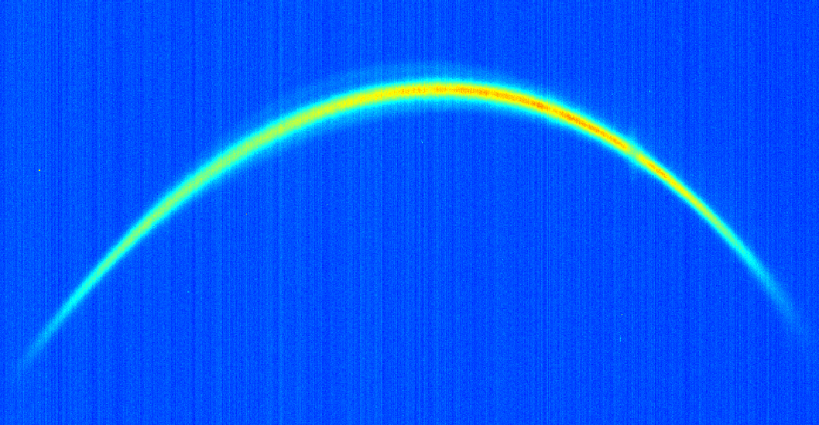
Vacuum Issue in sFLASH Laser Injection Beamline
In Winter 2017 shutdown: Disassembled, cleaned, and reassembled complete sFLASH laser vacuum system
  Only vacuum window to machine vacuum and last mirror in machine vacuum could not be replaced
  Requested exchange for upcoming Summer 2018 shutdown
Cleaning significantly reduced hydrocarbon peaks in vacuum spectrum
March 28, 2018: first laser-electron interaction after shutdown
vacuum window
p<10⁻⁵ mbar
machine vacuum

Slide 26
sFLASH Plans

Slide 27
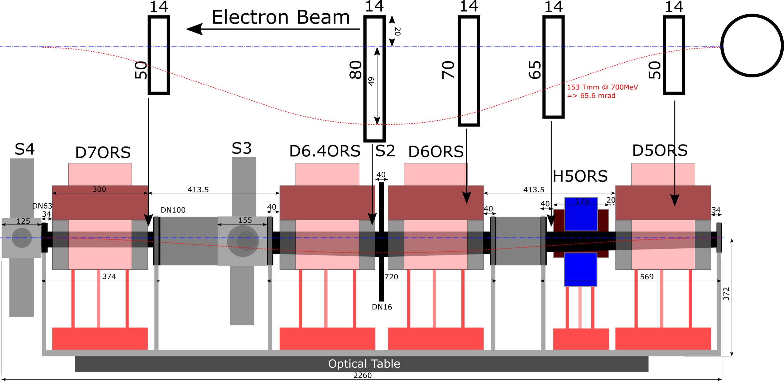
Upgrade Plans for 1st sFLASH Chicane
Current 1st sFLASH chicane is limited by vacuum chamber (R₅₆<700µm) => Upgrade is being designed (4mm at 700MeV)
Rectangular vacuum chamber
Magnets with increased 1st field integral

Slide 28
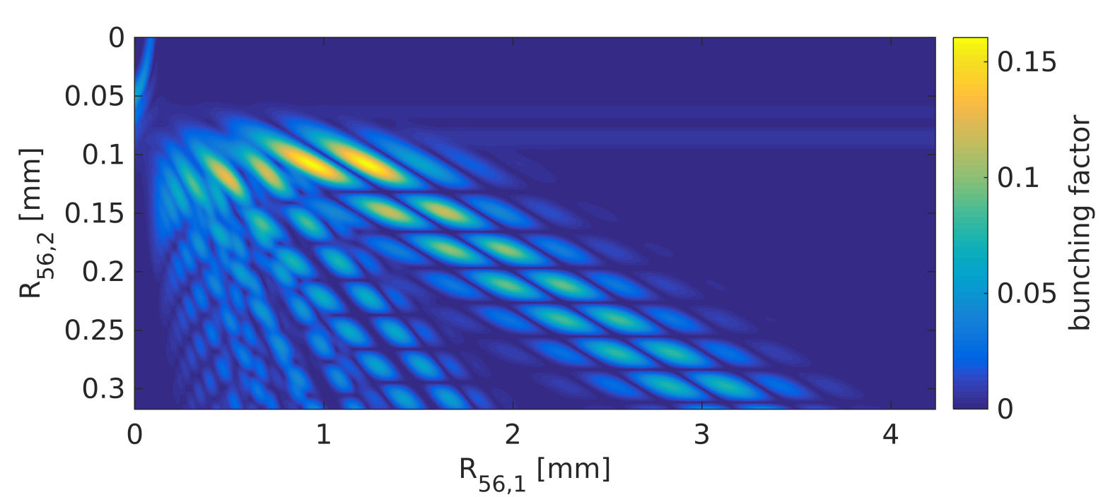

Upgrade Plans for 1st sFLASH Chicane
Current 1st sFLASH chicane is limited by vacuum chamber (R₅₆<700µm) => Upgrade is being designed (4mm at 700MeV)
Rectangular vacuum chamber
EEHG at the 10th harmonic
$$E_{0}=700 MeV$$
$$ΔE_{1}=350 keV$$
$$ΔE_{2}=350 keV$$
Magnets with increased 1st field integral

Slide 29
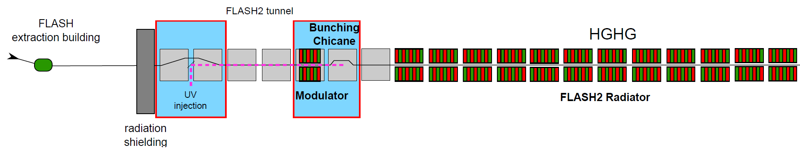
FLASH2020+ Seeding Plans
Started conceptual design process of seeded FEL beamline for FLASH1 as part of FLASH2020+ upgrade plans:
100-kHz+ seeding of 90 nm-4 nm wavelength range from 2024 on
  Wavelength of seeded FEL continuously tunable
  HGHG seeding for long-wavelength range
  Short wavelengths: EEHG seeding
Aiming at radiator design supporting SASE operation at full repetition rate of machine with var. polarization
Knowledge transfer from FLASH2 seeding conceptual design (HGHG down to 19nm) to FLASH2020+ seeding design
(from F2 Seeding CDR)

