Slide 1
THz User Operation with Short and High Charge Bunches
Driven by the ELBE SRF Gun
4th Annual MT Meeting, 12 – 14 June 2018, HZB Berlin
J. Teichert, A. Arnold, M. Bawatna,
P. Evtushenko, M. Gensch, B. Green,
S. Kovalev, U. Lehnert, P. Lu, P. Michel,
P. Murcek, H. Vennekate, I. Will, R. Xiang

Slide 2
OUTLINE
Introduction
Mg Photocathodes
Gun Parameters, Beam Transport and Short Pulses
THz Results
Summary

Slide 3
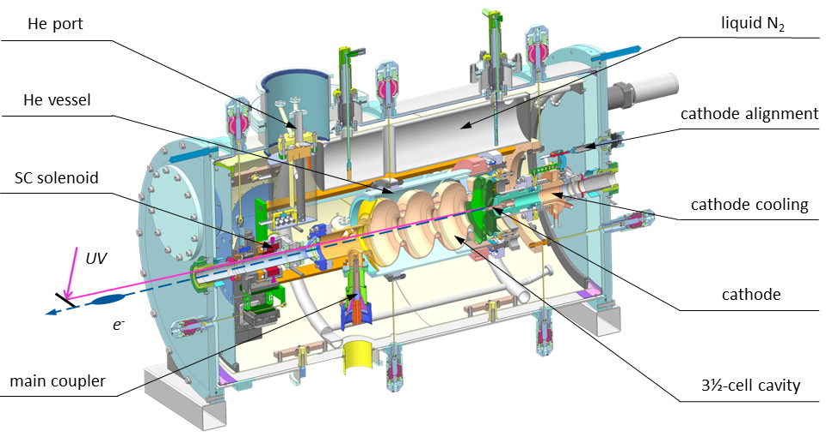
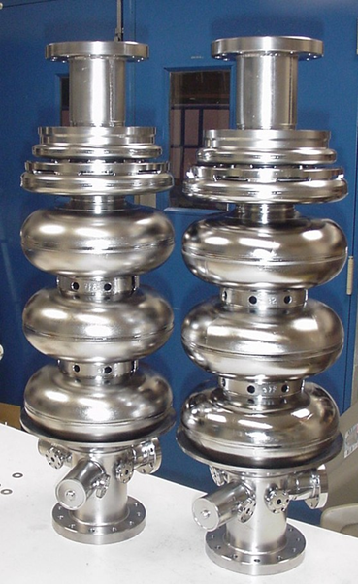
1. Introduction - ELBE SRF Gun II
RRR 300
Nb cavity
large grain
Nb cavity
New cavity - fine grain Nb,
produced, treated,
tested at JLab
Integration of a superconducting solenoid

Slide 4
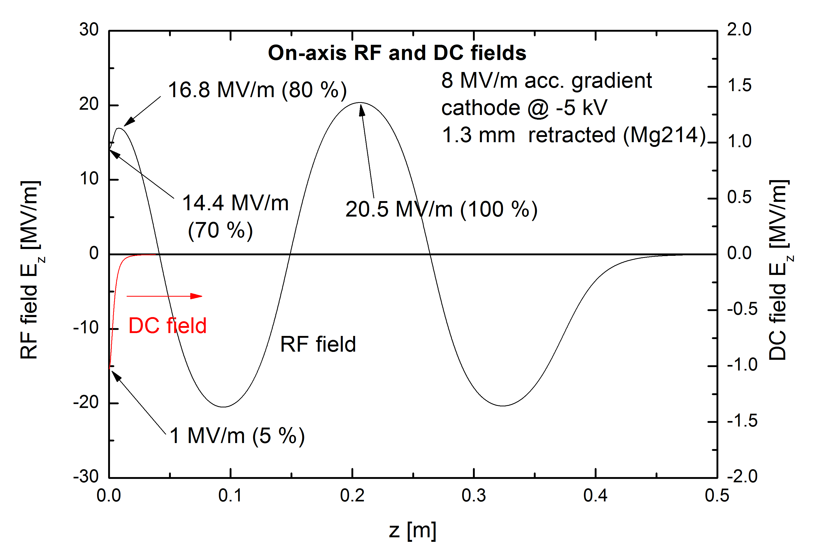
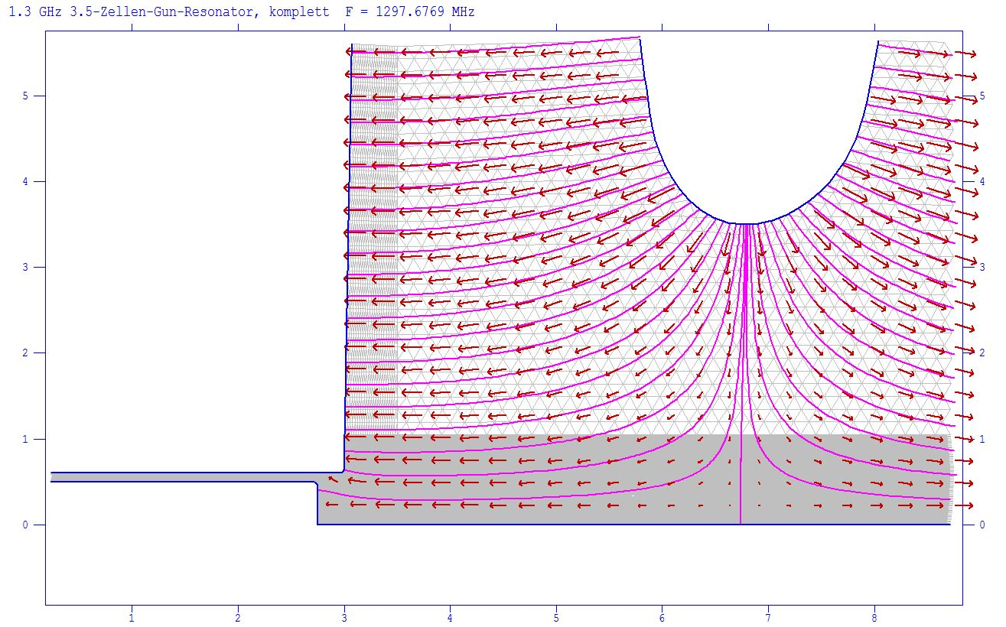
1. Introduction - Cavity status
Mg #214
70%
z
On-axis field profile (calculated with SUPERFISH)
retracted cathode for RF focusing
1.3 mm (adjustable ± 0.5 mm)
Berkeley VHF gun
186 MHz
20 MV/m cathode field
750 keV
100 kW HF power
 | CW RF measured 2014 | with CW beam at present
acceleration field | 10 MV/m | 8 MV/m
peak field on axis | 25.6 MV/m | 20.5 MV/m
cathode field | 15.4 MV/m | 14.4 MV/m
kinetic energy |  | 4 MeV

Slide 5
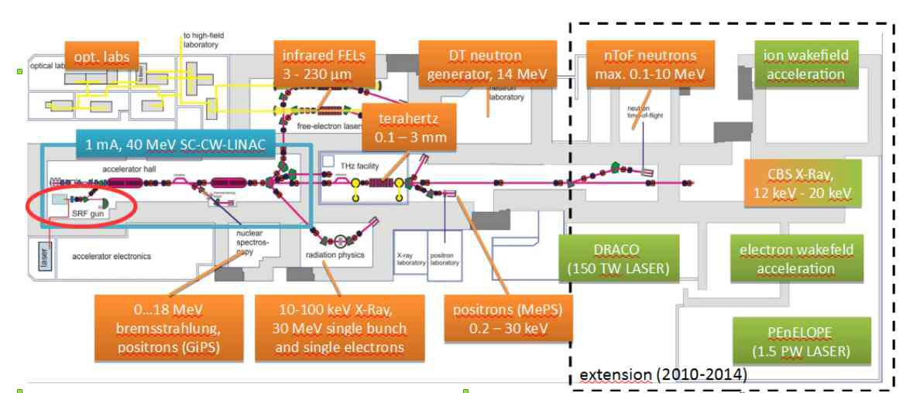
1. Introduction – ELBE User Facility
Advantages of SRF Gun II:
continuous wave operation (CW)
higher bunch charge
lower transverse emittance
short pulses
Beginning operation for users at ELBE in 2018:
with 200 pC¹⁾ and 100 kHz pulse rate:
THz production TELBE: >4 times higher THz power
neutron production nELBE: 2 times more neutrons
¹⁾ the previously used thermionic injector has a maximum of 80 pC
$$P_{THz}\sim N^{2}$$
most important !

Slide 6
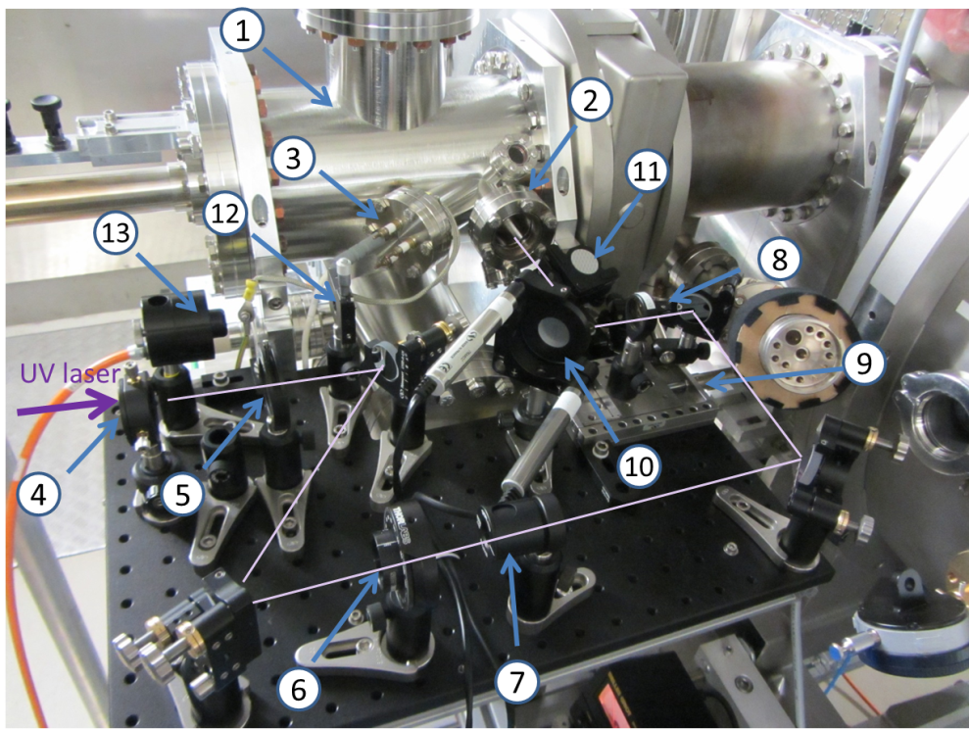
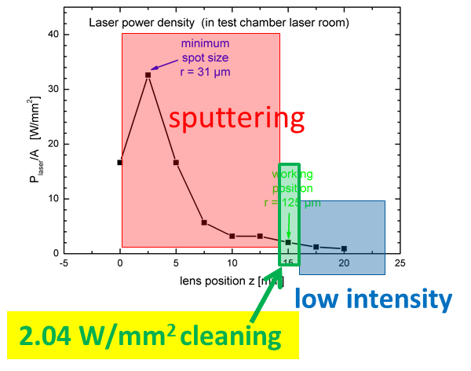
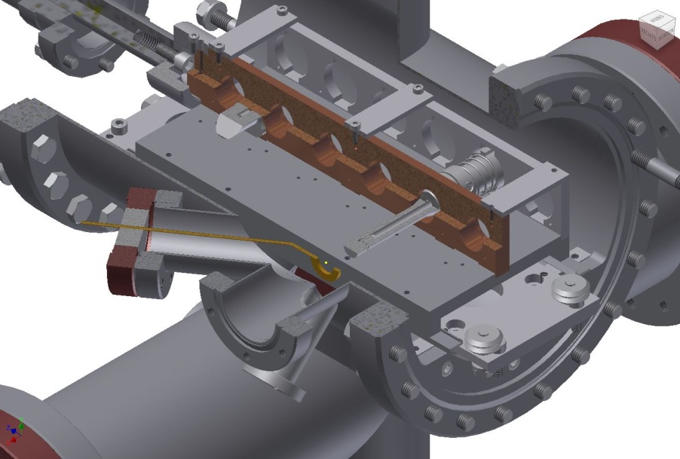
2. Mg Photocathodes
Laser cleaning set-up - PC in transport chamber
Laser cleaning set-up at transport chamber
at SRF gun
using the UV drive laser (100 mW, 100 kHz CW)
laser ablation
cathode
Anode
window
transport chamber
Notes:
- Transportkammer mit Platz für sechs Photokathoden,
- Quarzglas-Eintrittsfenster für den UV-Laserstrahl,
- HV-Durchführung zur ringförmigen Anode,
- Linse mit f = 250 mm,
- Eintrittsblende,
- Wellenplatte zur einstellbaren Drehung der Polarisationsrichtung,
- Polarisator,
- Fokussierlinse mit f = 200 mm,
- Mikrometertisch zum Positionieren der Fokussierlinse,
- Kippspiegel mit Schrittmotoren,
- Klappspiegel,
- Schneidkanten-Schlitzblende,
- Leistungsmesser

Slide 7
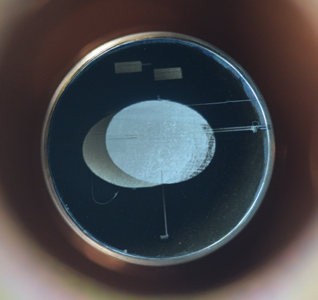
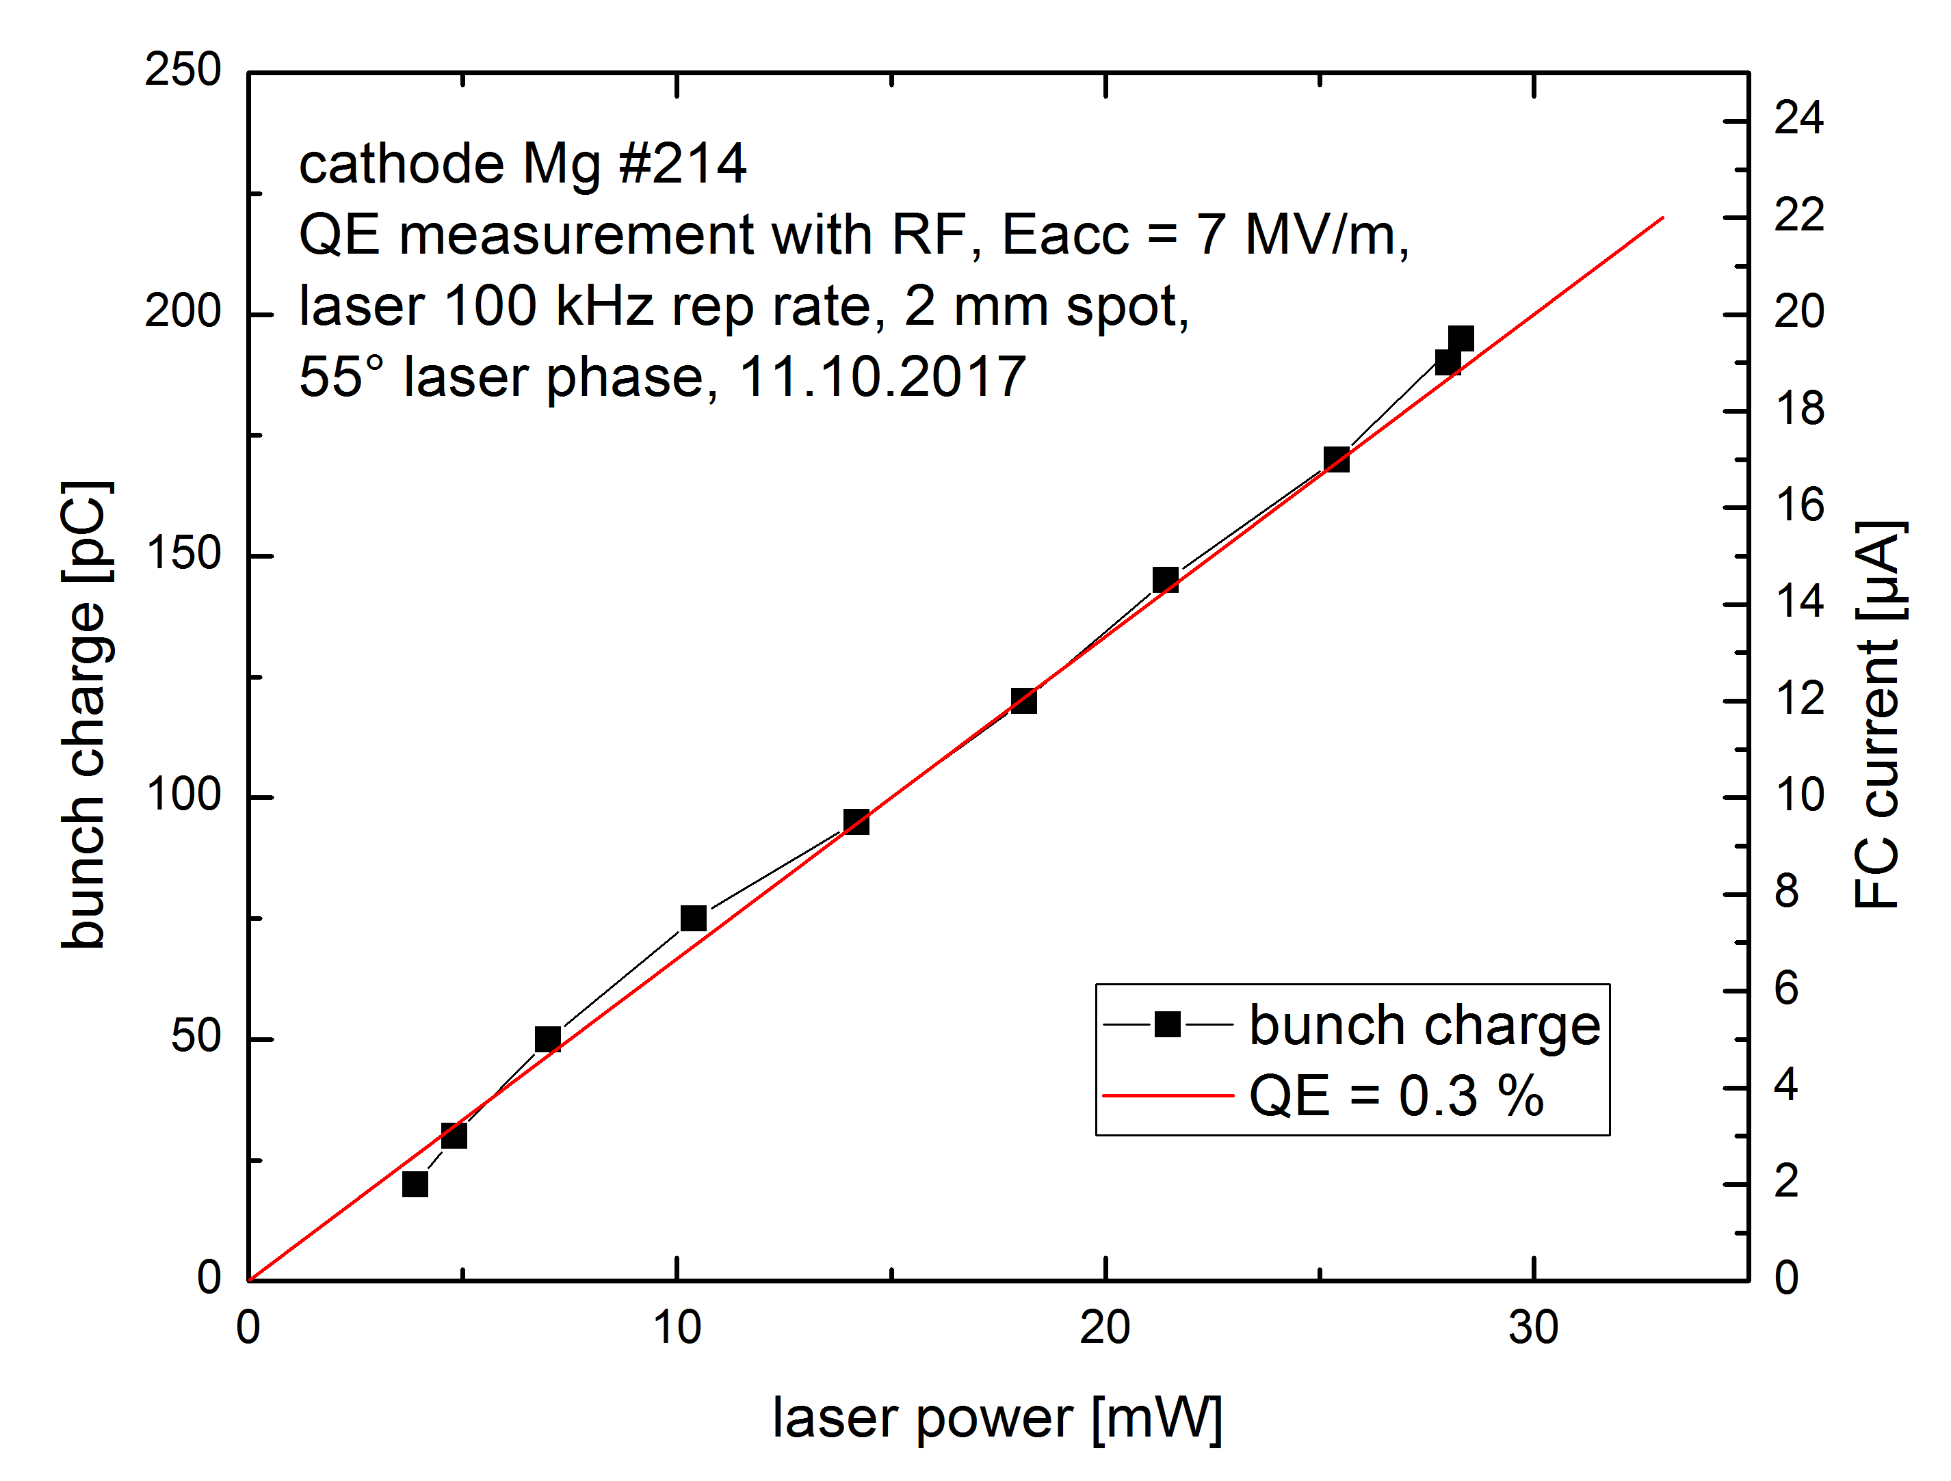
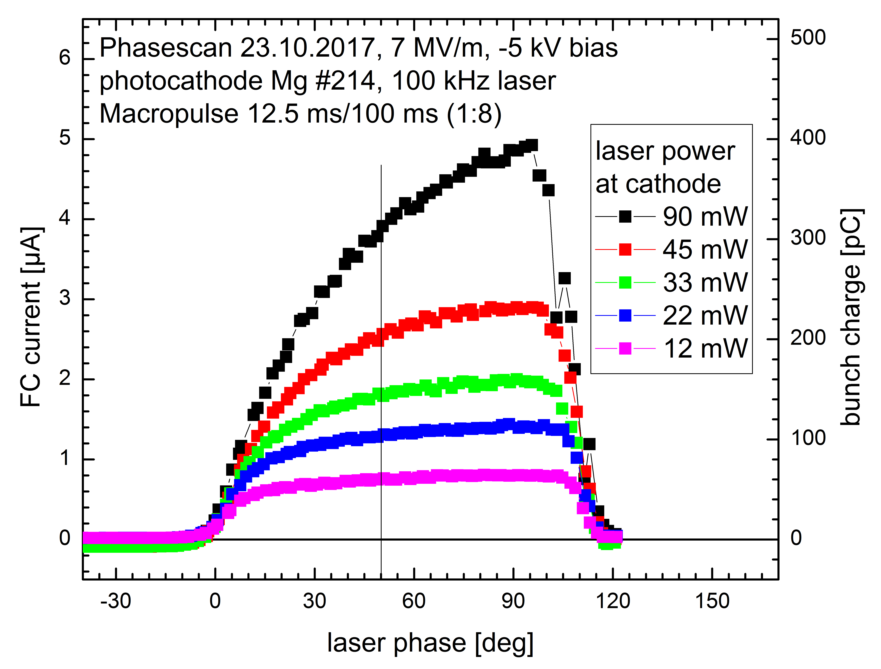
2. Mg Photocathodes
Mg #214
Mg cathodes work routinely in gun
prepared by UV laser cleaning (drive laser)
best QE 0.3 %
low risk of cavity contamination
extremely long life time in 10⁻⁹ mbar vacuum
cleaning can be several times repeated

Slide 8
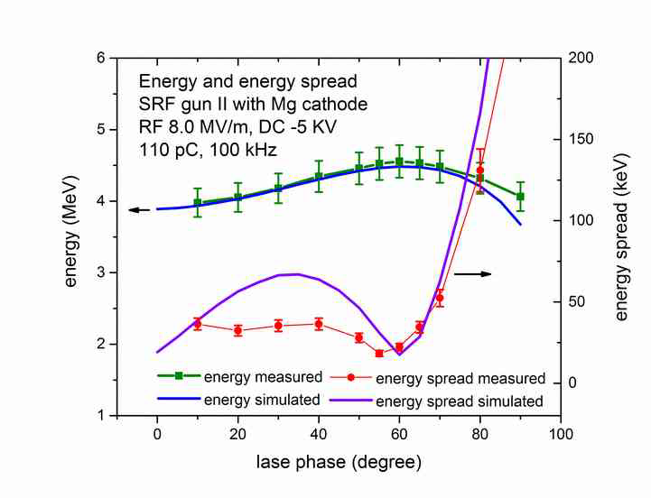
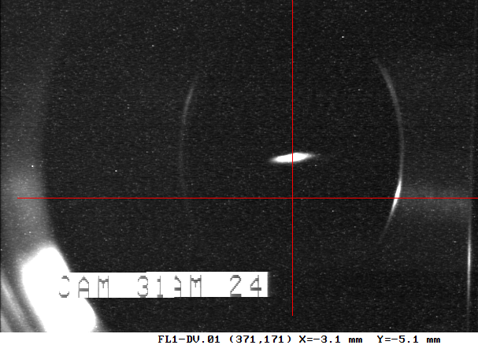
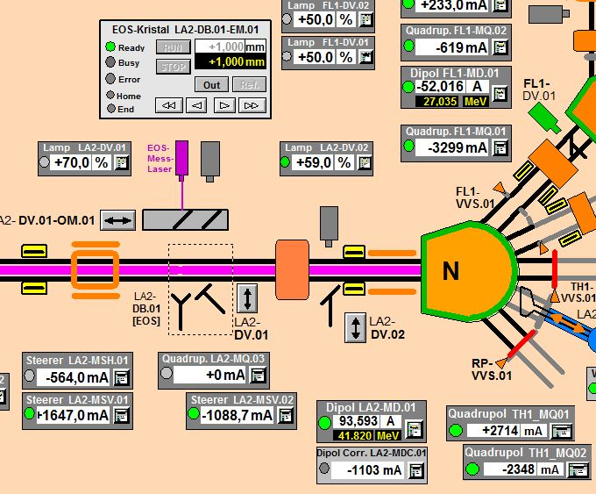
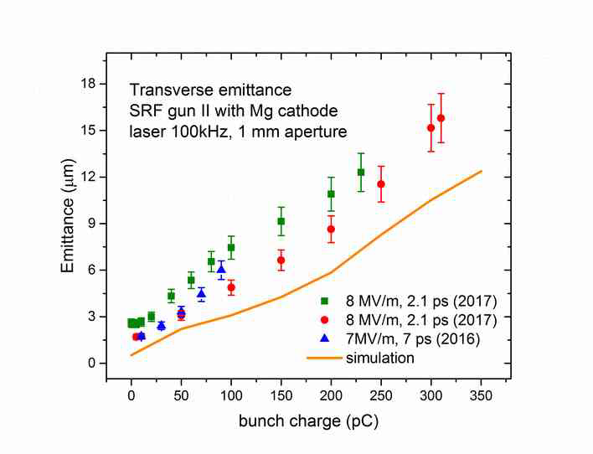
3. 1. Gun parameters
In ELBE: pc> 40 MeV
4.5 MeV plus
all cavities on crest

Slide 9
4. Gun performance
operational stability: 12 h shift, beam from cathode to dump in diagnostic beamline
200 pC CW @ 100 kHz, 7 MV/m (E_{kin}= 3.5 MeV)
I_{dump}= 20 µA
σ_{rms}= 0.2 µA
beamdump current
12 h night shift
with current stabilization – compensation of long-term drifts
Cathode current -> NI cRIO -> laser polarizer

Slide 10
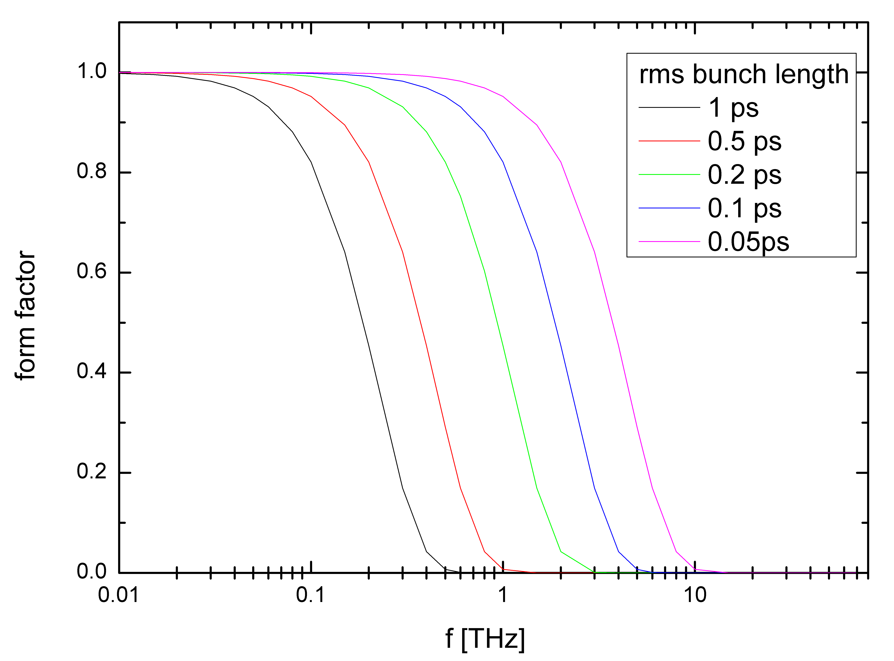
3. 3. Short pulses
Coherent diffraction and undulator radiation (superradiant)
compression
acceleration
on-crest
undulator
radiation
energy
correlation
$$E_{bunch}=F\left(ω,σ_{z}\right)N_{}^{2}E_{electron}(ω)$$
$$E_{electron}=\frac{πe^{2}}{2ε_{0}λ}\frac{K^{2}}{1+{K^{2}}/2}f(K)$$
Simulation
with long laser pulse with short laser pulse
8.3 ps rms 3.0 ps rms
σ_{t} (rms) = 0.82 ps
σ_{t} (rms) = 0.18 ps
ΔE [keV]
ΔE [keV]
form factor Gaussian pulses
t [ps]
t [ps]

Slide 11
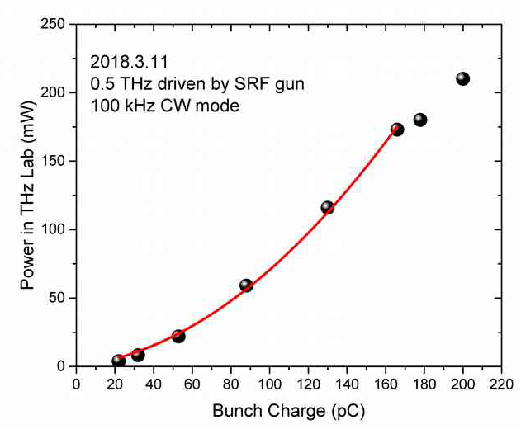
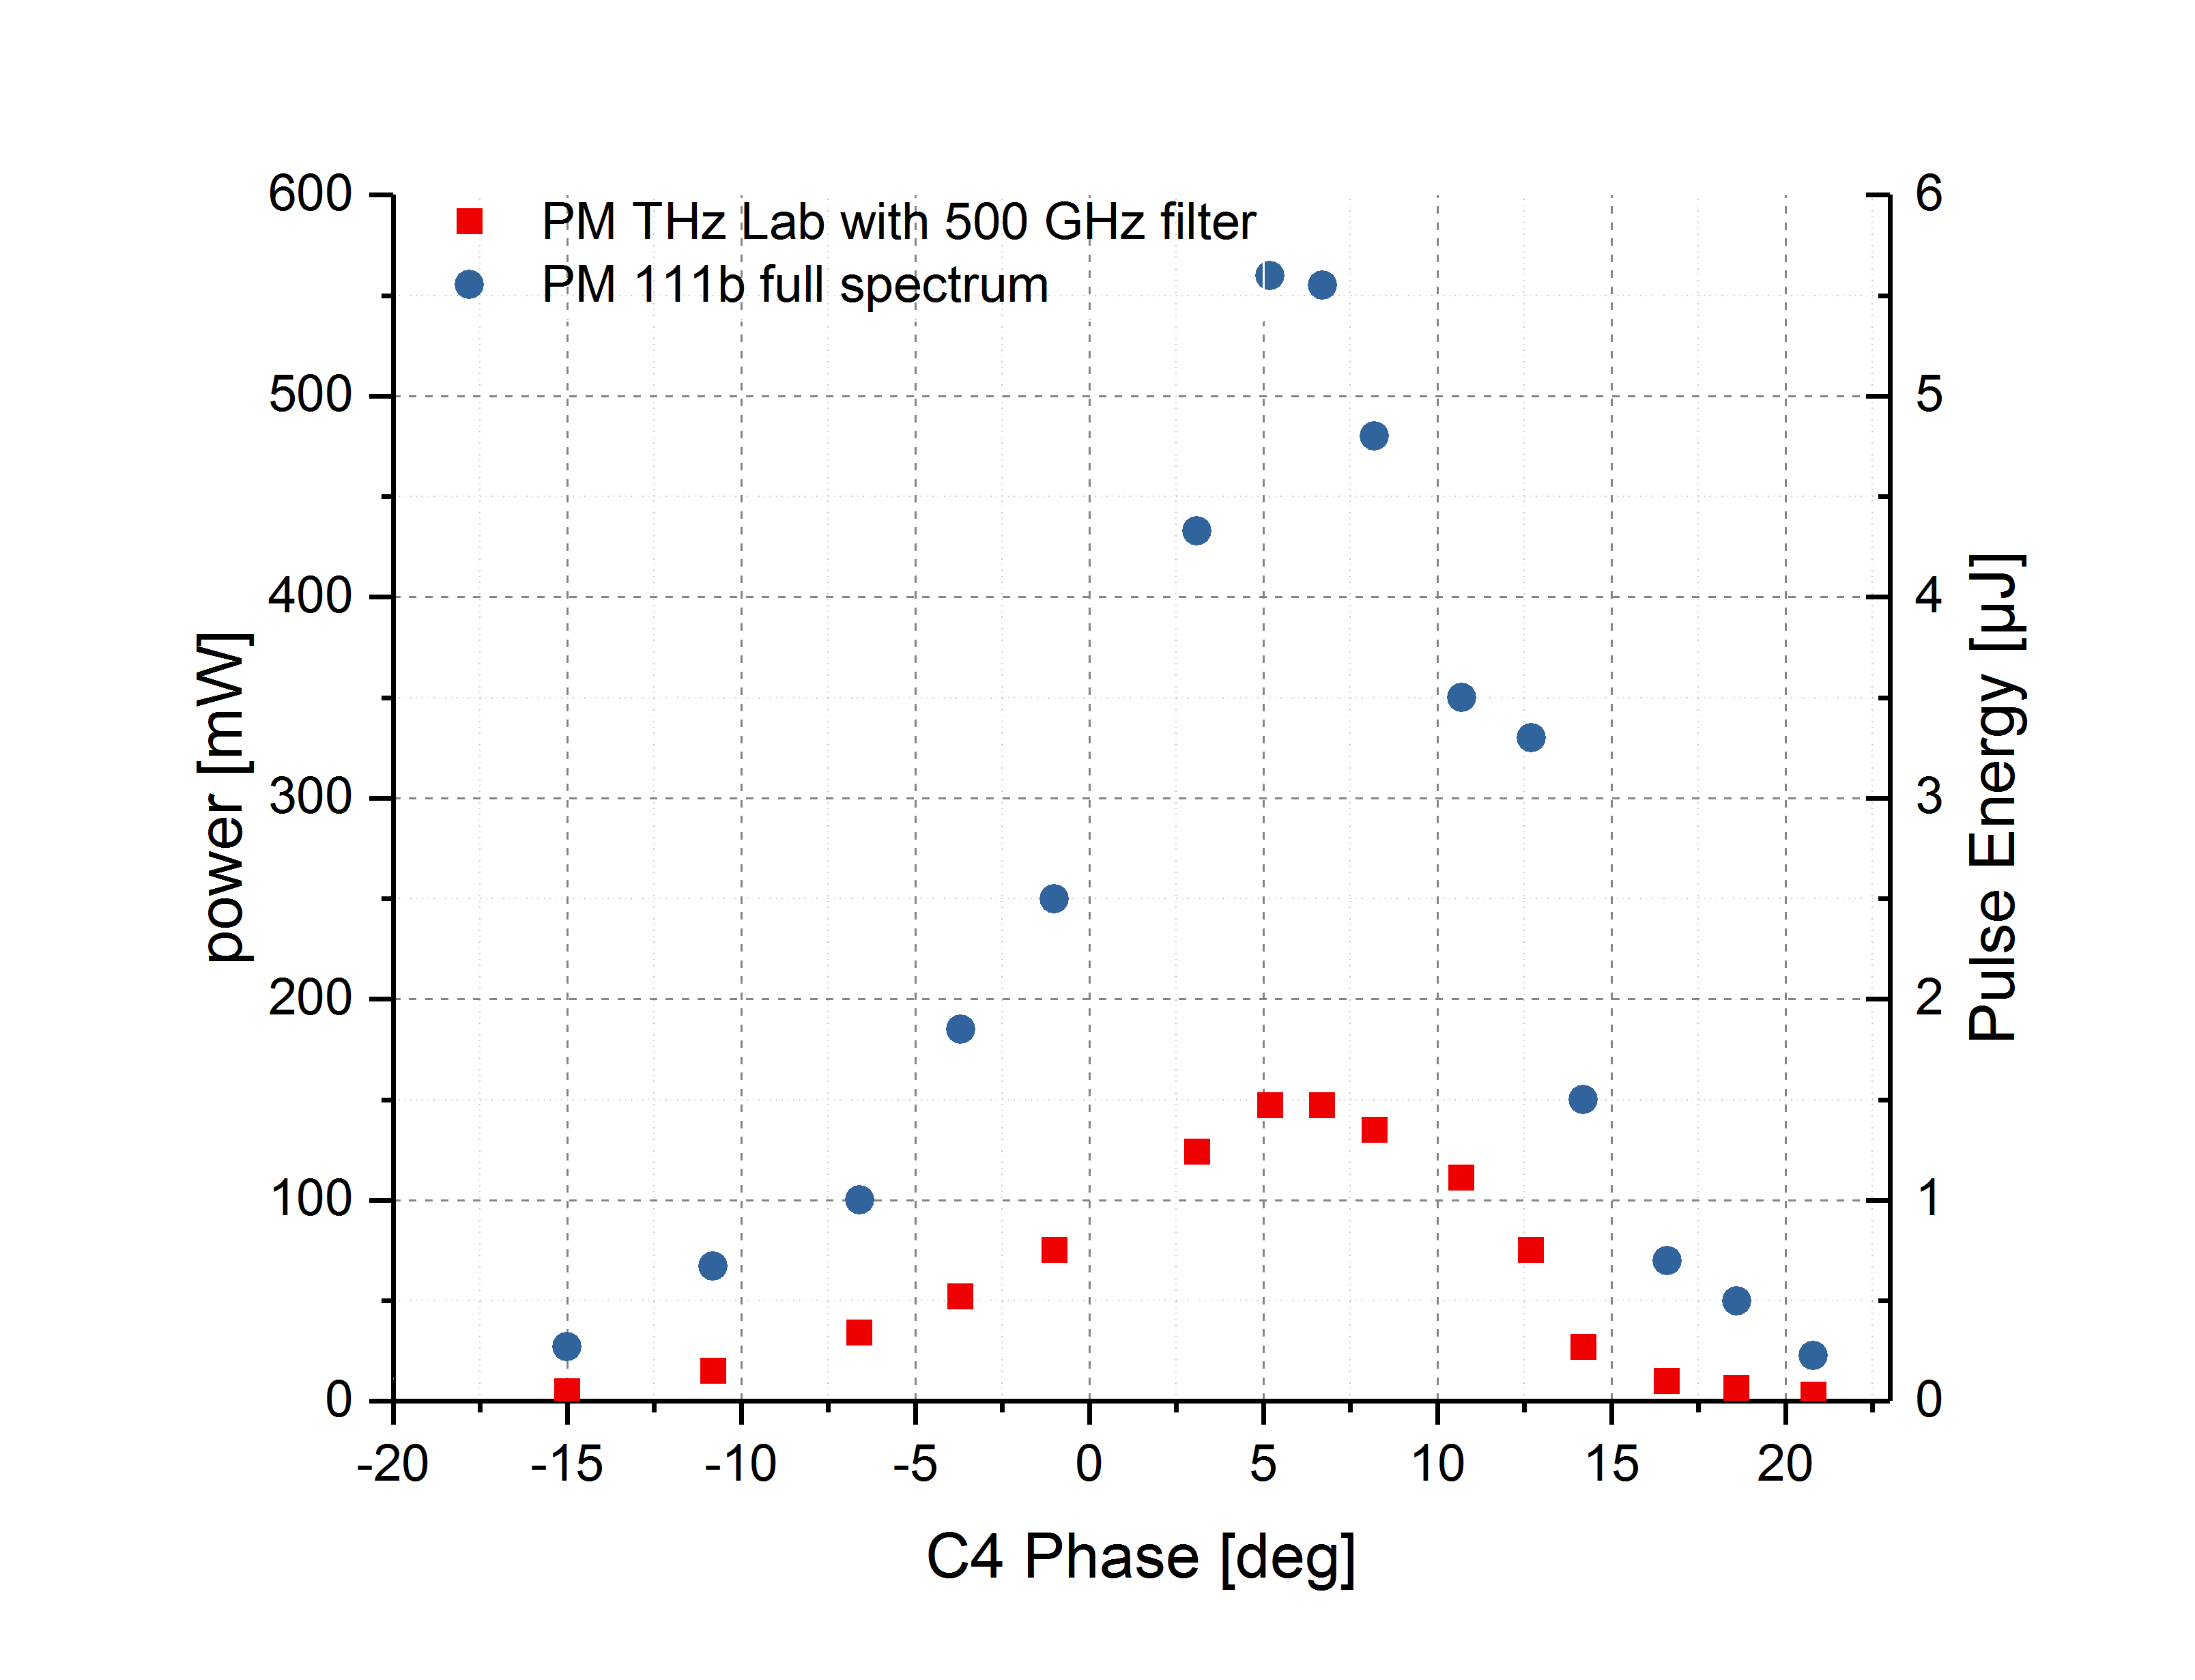
4. THz Results
Successful experimental realization of the bunch compression schema
Optimization parameters
correlated energy spread: phases of cavities C3 & C4
chicane angle (dipole currents)
Compression and longit. space charge compensation: SRF gun laser phase
bunch charge dependancy
bunch chirp dependancy

Slide 12
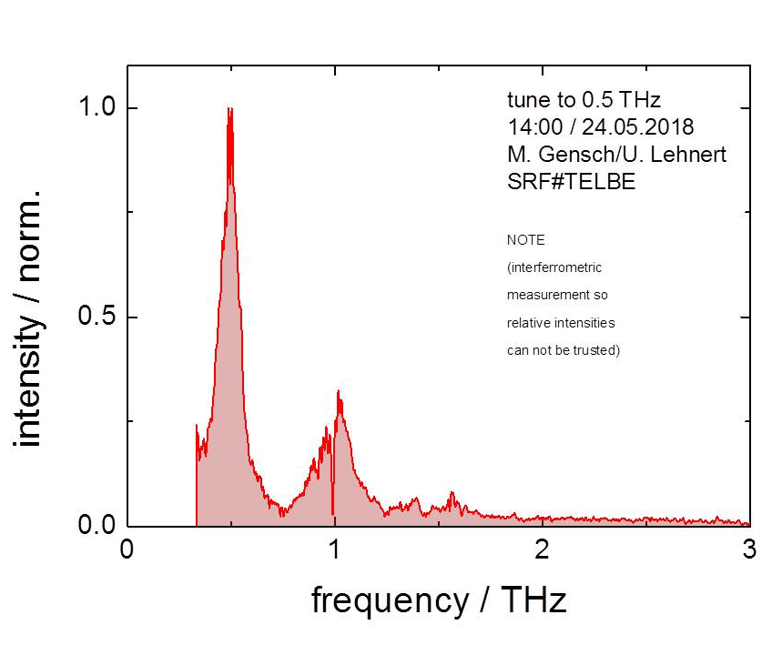
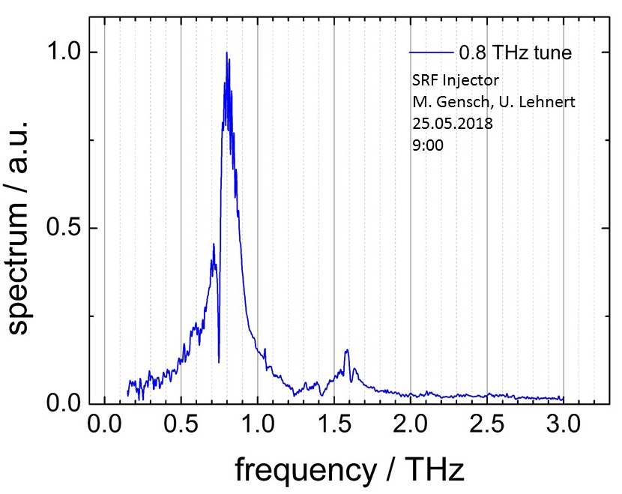
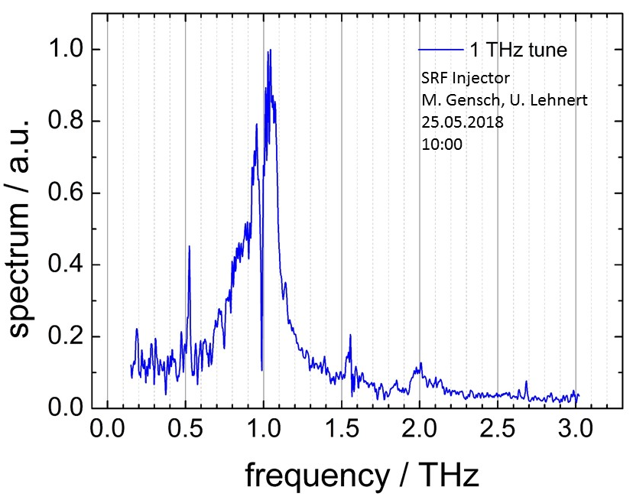
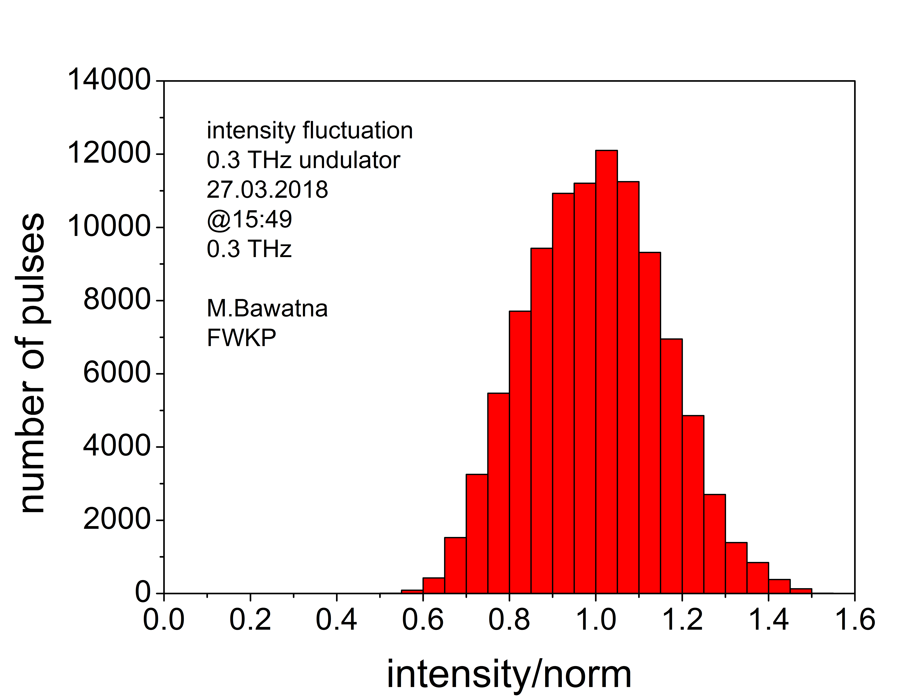
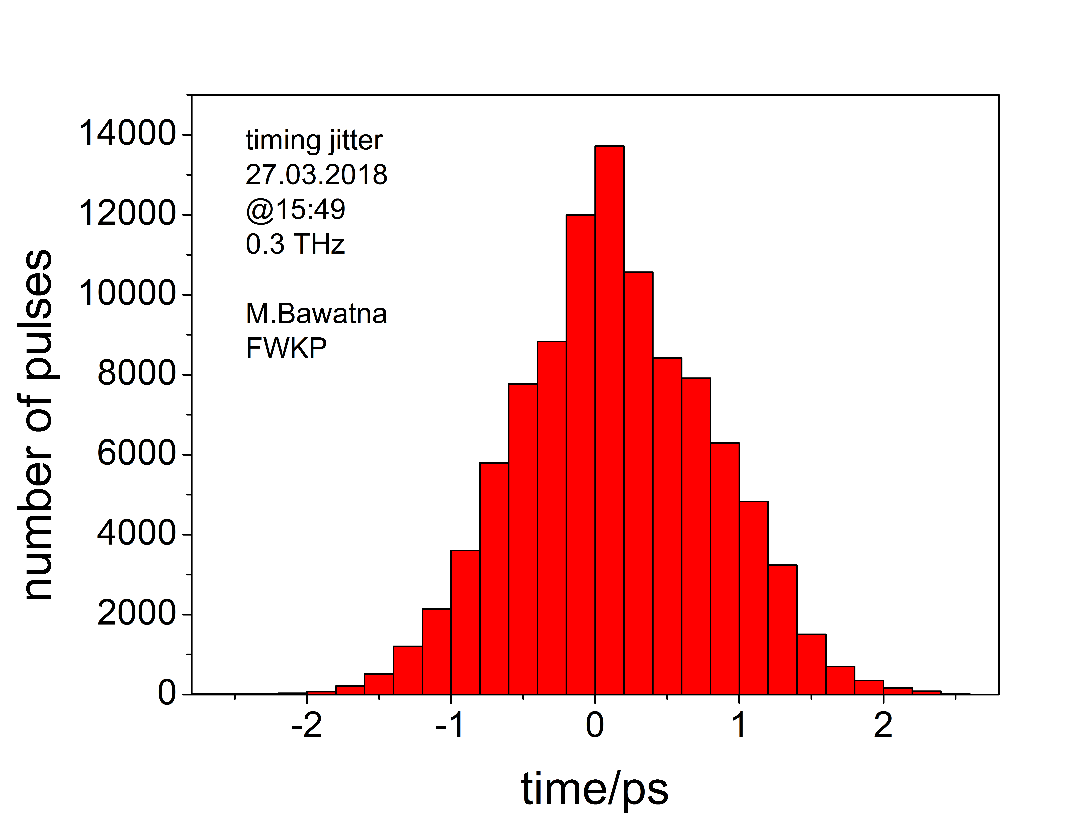
4. THz Results
THz radiation has produced and characterized for 0.3, 0.5, 0.8, 1.0 and 1.5 THz
better pulse energy stability

Slide 13
4. THz Results
Results for 16 - 20 µA CW beam (160-200 pC) with SRF Gun
THz Power | 0.3 THz tuning | 0.5 THz tuning | 0.8 THz tuning | 1.0 THz tuning | 1.5 THz tuning
20 % bandwidth | 77 mW | 215 mW | 145 mW | 150 mW- | 80 mW
total power | 480 mW | 600 mW | 480 mW | 350 mW | 320 mW
example values for thermionic injector @ 80 pC :
total power 117 mW 90 mW 140 mW 110 mW

Slide 14
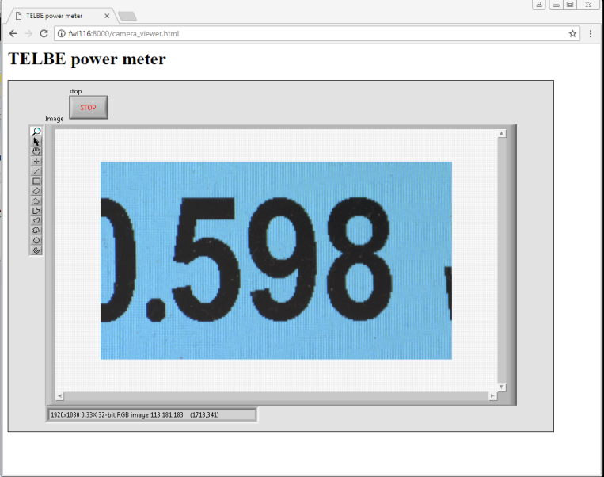
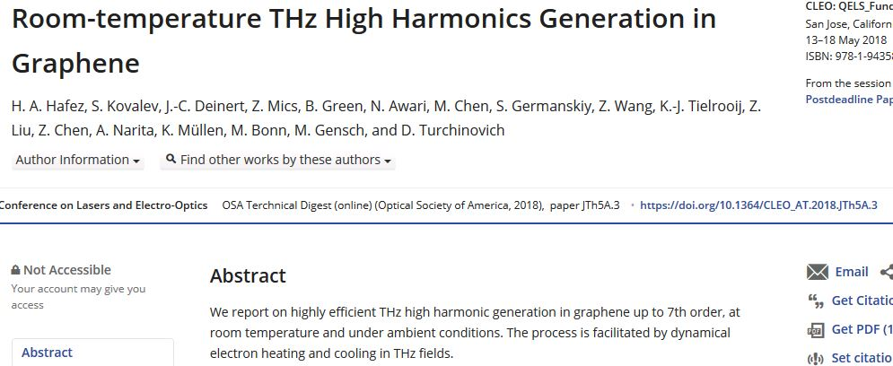
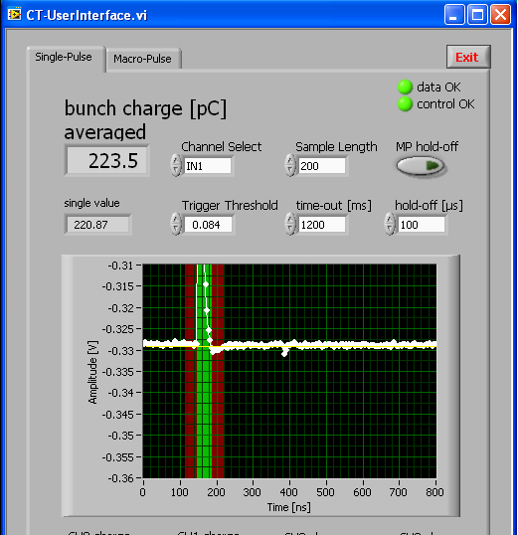
4. THz Results
In 2018
14 Shifts ARD/AP for THz production,
optimization, and measurements
3 Shifts for TELBE in March with successful
user experiment
600 mW
@ 0.5 THz

Slide 15
5. Summary
Mg PCs with 0.3 % QE are robust and safe for SRF guns.
The ELBE SRF Gun II operates with 8 MV/m (20.5 MV/m peak) and delivers 300 pC at Ekin = 4 MeV in CW.
Injector operation for ELBE has been demonstrated.
For 2018 application for user operation with 200 pC,
successful THz production with >4 times higher THz power,
and better pulse stability
Starting with full TELBE user beam time in run III + IV
Further important activities:
- SRF Gun III with higher gradient ->higher charge
- Photocathodes (Cs2Te, GaAs, GaN) & Cryomodule
within ARD SRF Gun Cluster

Slide 16
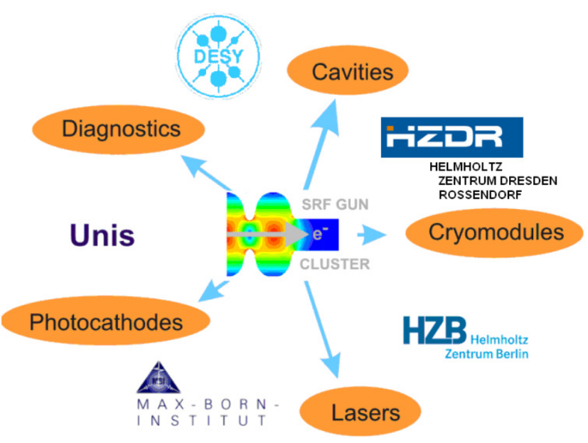
Acknowledgements
Thank you for your attention!
Thanks to the ELBE team
A. Arnold, P. Zwartek, P. Lu, P. Murcek, H. Vennekate, R. Xiang, H. Büttig, P. Evtushenko, M. Freitag, M. Justus, M. Kuntzsch, U. Lehnert, P. Michel, C. Schneider, R. Steinbrück, K. Zenker,
and our co-workers
P. Kneisel, G. Ciovati JLAB, Newport News, USA
I. Will MBI, Berlin, Germany
T. Kamps, J. Kühn, M. Schenck, M. Schmeißer, G. Klemz,
J. Voelker, E. Panofski, HZB, Berlin, Germany
J. Sekutowicz, E. Vogel, F. Stephan, DESY, Germany
K. Aulenbacher, JGU, Mainz, Germany
M. Vogel, M. Schuhmacher, X. Jiang, Uni Siegen, Germany
R. Nietubyć NCBJ, Świerk/Otwock, Poland
U. van Rienen, E. T. Tulu, Uni Rostock, Germany

