Slide 1
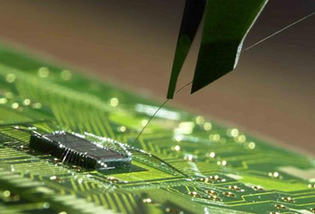
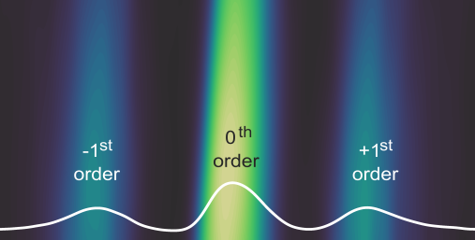
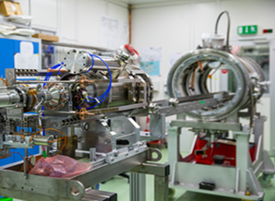



Matter and
Technologies
A program in Matter
Report to the 4th MT annual meeting
Ties Behnke (DESY)
Spokesperson of the program

Slide 2
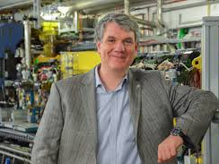
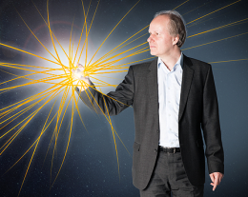
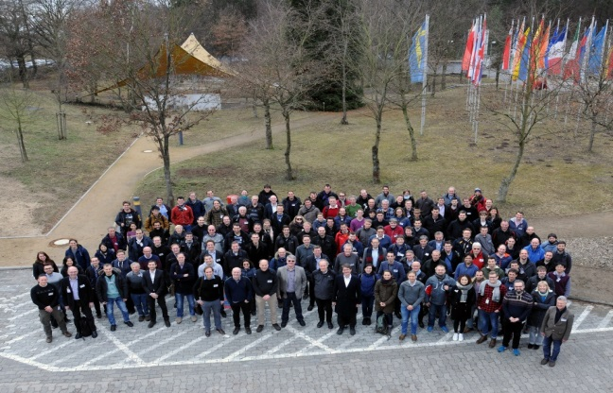




Matter and Technologies: current structure
ARD
SCRF Science and Technology
Concepts and Technologies for Hadron Accelerators
Picosecond and Femtosecond Electron and Photon Beams
Novel Acceleration Concepts
DTS
Detector Systems
Sensors, ASICs and Interconnects
Data Transmission and Processing
Andreas Jankowiak
HZB
Marc Weber
KIT
Notes:
The MT program has currently two topics, ARD and DTS. The sub-topic structure shown here is the one from the POFIII proposal.

Slide 3
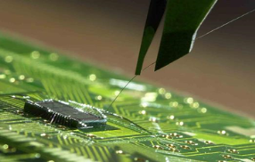
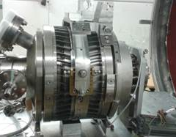
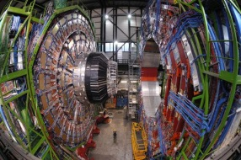
Matter and Technologies:
Our Mission
Matter and the Universe
From Matter to Materials and Life
Accelerator, Detector
Matter and Technologies
MT
Technologies, R&D
The programme Matter and Technologies:
Develops fundamental technologies
Gives the freedom to try new things
Gives the freedom to try risky things
We are science driven
Prototyping, R&D
Building
MU
MML
Operation
We develop today the technologies for tomorrow
driven by the scientific questions in our fields
Notes:
MT is driven by the scientific needs coming from MU and MML. MT develops today technologies which we need to answer tomorrows questions. MT by its nature is very closly interlinked with the other two programs in matter. Scientists in MT are an integral part of MU and/or MML in addition to their role in MT. MT is concentrating on research, it is not the place to operate or maintain detector systems.

Slide 4
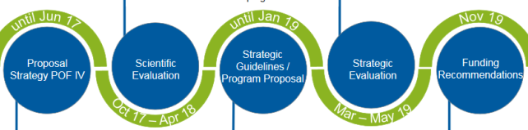
The review: global observations
Excellent to outstanding results at all centers
All comittees appreciated and supported fully MT as a separate program
We received broad support for the strategy
Overarching recommendation:
Establish a program topic “Data Management and Analysis” (DMA),
and develop a strategic plan for data handling and computing that capitalizes
on the emerging DMA for the ARD and DTS activities.
Develop a concrete plan for a “Distributed Detector Laboratory” (DDL)
for the entire program topic DTS to be realized with highest priority.

Slide 5
Continue to build-up research into novel accelerator systems, and consolidate the future program in sustainable facilities, such as ATHENA-e, Flashforward and possibly EuPRAXIA; similarly the THz effort has many potential applications and offers a wide research field for future compact accelerators, also in this area, choices need to be made.
In view of the new research topic on Data Management and Analysis (DMA) it is a priority to develop a strategic plan for data handling and computing for the ARD and DTS activities that provide input to and capitalizes on the emerging DMA topic.
Ensure completion of the HESR construction, installation and commissioning, and support R&D activities for PANDA and KOALA as well as for precision measurements at COSY searching for the EDM of charged particles.
Keep the strong collaboration among the sub-institutes of IKP for carrying out the development of cutting edge technology that underlies scientific programs of extremely high level.
Continue to develop understanding and novel techniques for reaching high brilliant ion beams throughout the GSI accelerator chain including R&D of ion sources and further upgrades of the UNILAC.
Enhance efforts to share technological information amongst the researchers at the center across the different research units.
Take advantage of the considerable capabilities of bERLinPro for generic accelerator R&D.
Increase the priority for developing the BESSY III conceptual design in light of the plans for the BESSY VSR upgrade and possible technical issues combined with that.
Strengthen the research groups in the program working on ARD and DTS projects as FLUTE and cSTART and ATHENA, but also on the tomographic 3D data processing theme with matching DAQ developments etc.
Work with other research centers of the Helmholtz Association on a concrete plan for a Distributed Detector Laboratory.

Slide 6
Review results
Accelerator Research and Development
Continue and further strenghten R&D into compact accelerators, continue to buildup the
infrastructure: ARD is building up a unique portfolio and infrastructure (in particular plasma
based accelerators)
Continue SC CW accelerator development with all required systems
Push FAIR technologies, DLSR technologies, etc.
Fully exploit available infrastructure for R&D (e.g. BerlinPro, others)
fs/ps beams/ beam diagnostic is done at several centers, with excellent results
Develop concepts for the next generation facilities: BESSYIII, PETRAIV
Strengthen the cross-center and cross-topic/ internal collaboration further

Slide 7
Review results
Detector Development
Continue developments in strong cooperation with MU and MML
Strengthen the cross-center and cross-topic/ internal collaboration further
Several areas for promising new technologies have been clearly recognised, should be
further developed, e.g.:
  Cryogenic detectors, HVCMOS/CMOS, Granular calorimeters, silicon photonics
XFEL detectors are a success story
Role in LHC upgrade is strongly recognised
Recognition of the strong system competence present for detector systems in Helmholtz
Work on a concrete plan for the distributed detector laboratory

Slide 8
The review: global results
MT results in centers:
DESY | FZJ | GSI | HZB | HZDR | KIT
5 | 4 | 5 | 4 | 4 | 5
Overall grades for ARD and DTS:
ARD | 4.5
DTS | 4.3

Slide 9
The review: global results
MT results in centers:
DESY | FZJ | GSI | HZB | HZDR | KIT
5 | 4 | 5 | 4 | 4 | 5
Overall grades for ARD and DTS:
We did exceedingly well in both topics.
Congratulations to all!
The differences are small and do not
point to particular problems.
ARD | 4.5
DTS | 4.3

Slide 10
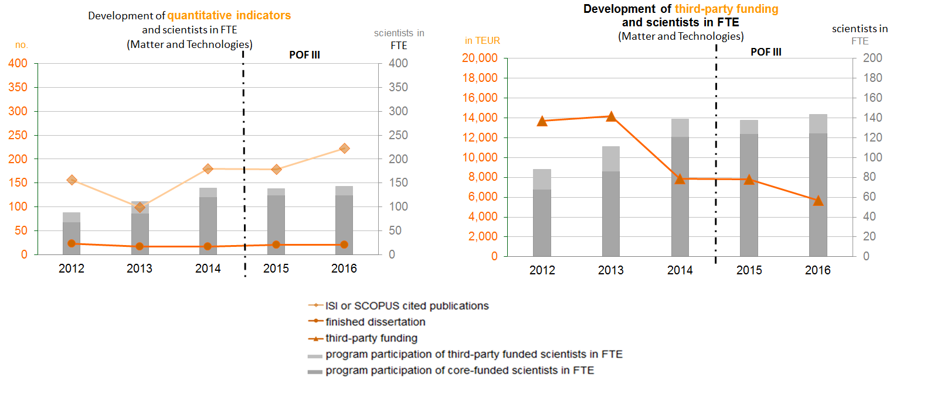
Program Indicators
Budget about 40 Mio EUR/ year
About 140 scientists in total in
6 Helmholtz centers/ 2 institutes
Publications
FTE scientists
PhD theses
ARD
DTS
Note: Fair related part from GSI and FZJ was not fully included in POFIII
Notes:
Note that the GSI was excluded from the POFIII system. Only the two Helmholtz centers Mainz and Jena are contributing formally to the POFIII progam. Nevertheless the program MT closely works together with the GSI proper. For POFIV, a full return by GSI into the POFIV framework is anticipated.

Slide 11
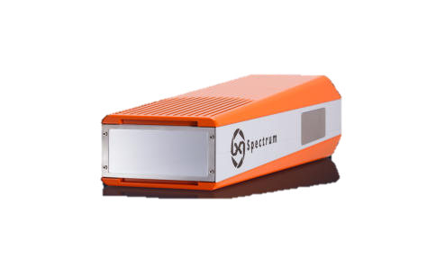

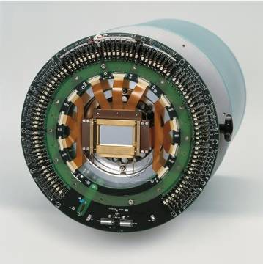


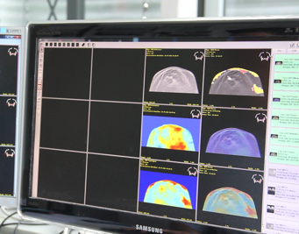
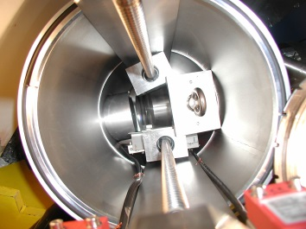
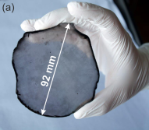
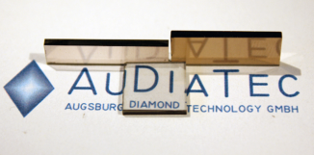

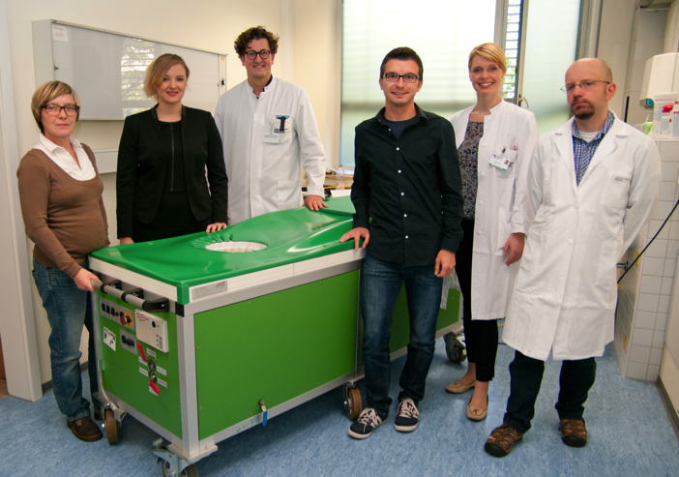


Transfer
Many of our technologies
find their ways into
applications beyond their
original scope.
SEMIKON Detector GmbH
All centers have intense
efforts to further transfer
of technology and know-how
into society.
X-spectrum: imaging detectors for
synchroton sources
Detectors and Detector systems
A spin-off company of the FZ-Jülich (IKP)
3D-Ultrasonic
Computer tomography
AUDIATEC: diamond detectors
HZDR Innovation GmbH
Accelerator components
Notes:
We show a few examples of sucessful spin-offs and transfers of technology which has been developed inside the Helmholtz Association.

Slide 12
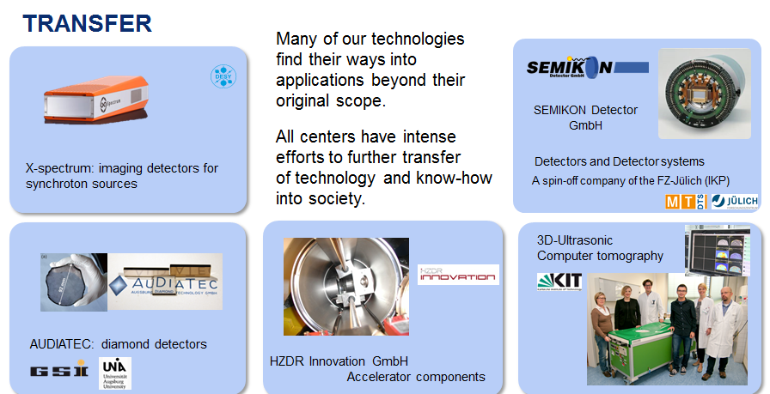
Transfer
Technology transfer is increasingly
important
We need to increase our attention to
this topic
We need to ensure that MT build up
intensified contacts to the typically
center based TT efforts.
Collect examples systematically
Make sure we know what is happening
Trigger pro-activly activities where it seems
sensible

Slide 13
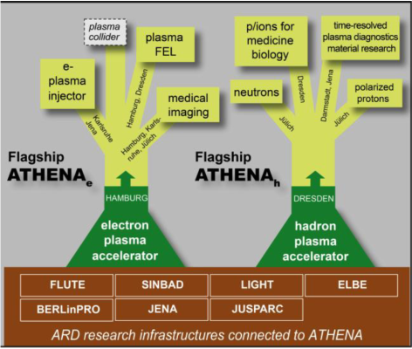



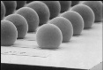


Distributed INfrastructures
Development of common infrastructures
  Share expensive infrastructure
  Concentrate know-how for optimal use
  Develop synergies
ARD: ATHENA
DTS: DDL
Competence center
Cryo Detectors
Post-processing
3D Structures
Interconnects
Novel materials
Participating FZJ institutes: PGI-6, IKP, IAS/JSC, JCNS, IEK-5, INM-2
Characterization
Positive funding decision 2017
Notes:
Both ARD and DTS want to further develop and increase the cooperation among partners. To this end ARD has developed the ATHENA proposal, a proposal for a distributed infrastructure to develop research into novel acceleration methods.
DTS is currently developing a proposal for a distributed development lab, which will have two pillars: a competence center, which should facilitate close interactions and organise cross-center activities, and a number of specific infrastructure actions, which will be developed at one lab, and then be made availabel to all members of DTS and beyond.

Slide 14
Distributed INfrastructures
Development of common infrastructures
  Share expensive infrastructure
  Concentrate know-how for optimal use
  Develop synergies
ARD: ATHENA
DTS: DDL
FUNDED
Competence center
Cryo Detectors
Post-processing
3D Structures
Interconnects
Novel materials
Participating FZJ institutes: PGI-6, IKP, IAS/JSC, JCNS, IEK-5, INM-2
Characterization
Positive funding decision 2017
Notes:
Both ARD and DTS want to further develop and increase the cooperation among partners. To this end ARD has developed the ATHENA proposal, a proposal for a distributed infrastructure to develop research into novel acceleration methods.
DTS is currently developing a proposal for a distributed development lab, which will have two pillars: a competence center, which should facilitate close interactions and organise cross-center activities, and a number of specific infrastructure actions, which will be developed at one lab, and then be made availabel to all members of DTS and beyond.

Slide 15
Distributed INfrastructures
Development of common infrastructures
  Share expensive infrastructure
  Concentrate know-how for optimal use
  Develop synergies
ARD: ATHENA
DTS: DDL
Competence center
Cryo Detectors
PROPOSAL TO BE SUBMIITTED 2018
Post-processing
3D Structures
Interconnects
Novel materials
Participating FZJ institutes: PGI-6, IKP, IAS/JSC, JCNS, IEK-5, INM-2
Characterization
Positive funding decision 2017
Notes:
Both ARD and DTS want to further develop and increase the cooperation among partners. To this end ARD has developed the ATHENA proposal, a proposal for a distributed infrastructure to develop research into novel acceleration methods.
DTS is currently developing a proposal for a distributed development lab, which will have two pillars: a competence center, which should facilitate close interactions and organise cross-center activities, and a number of specific infrastructure actions, which will be developed at one lab, and then be made availabel to all members of DTS and beyond.

Slide 16

Program Development
Development of programatic structure
Future new facilities require new technologies
ARD: Focus even stronger on strengths (e.g. CW SRF, Plasma Acceleration remain
central priority)
DTS: Ramp-up cryogenic detectors, install semi-conductor
post-processing capabilities
Extend program by topic on data management and analysis
Data play an ever more important role: the detector / the accelerator do not end
after the preamp.
Have initiated the new program topic “Data Management and Analysis” (DMA)
for POFIV (designated speaker M. Bussmann, HZDR)
Notes:
MT is still a relativly new program, with real activities starting in 2015. Since then the program has developed a wide range of activities. In preparation for POFIV a dynmaic development of scope and content of the different topics and subtopics is visible, though a major re-organisation it not deemed necessary.
A new program topic, DMA, will be installed for POFIV. Here activitire on data management and analysis will be concentrated.

Slide 17
Matter and Technologies in POF IV
Matter and Technologies
Accelerator Research and Development
DESY, GSI, HZB, HZDR, KIT, (FZJ)
LK I activities
New topic: address the
challenges of data and
data handling
Detector Technologies and Systems
DESY, GSI, KIT
Data Management and Analysis
DESY, FZJ, GSI, HZB, HZDR
LK II: move the Tier-2 from
MU to MT and expand
Interdisciplinary Data Analysis Facility (IDAF)
DESY

Slide 18

ARD StruCtuRE in POF IV
Accelerator Research and development
POF III
POF IV
SCRF Science and Technology
CW SCRF Science
and Technology
Linacs, SR, ERLs
Bright sources
From development to maturity
Concepts and Technologies for Hadron Accelerators
Concepts and Prototypes for the Advancement of Conventional Acc.
Broadening scope
FAIR et al
PETRA IV
Picosecond and Femtosecond Electron and Photon Beams
Advanced beam controls, beam diagnostics, beam dynamics
Ultra short pulse challenge
unprecedented beams
spectral flux
Novel Acceleration Concepts
Novel Accelerators and their Applications
Novel accelerators and their challenges
Future topic plasma acceleration

Slide 19
DTS StruCture in POF IV
Detector technologies and systems
POF III
POF IV
Detection and Measurement
Sensors - 3D, post
ASICS processing
- Cryogenics Sensor
Sensors, ASICs and Interconnects
Data Transmission and Processing
System Technologies
- Data transmission - advanced
- on-detector materials
processing - Interconnect
- Detector controls
Detector Systems
Particle and
nuclear physics
Photon science - Test beams
Astroparticle physics
Beam diagnostics
Science Systems
DDL

Slide 20
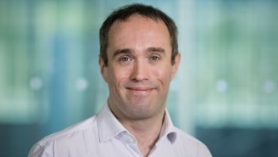
NeW in POF IV: DMA in MT
Data Management and analysis
POF IV
The Matter Information Fabric
High Throughput Computing
IT Infrastructure
Automization of data handling
State of the art Service Tools
The Digital Scientific Method
Forefront Methods for Data Analysis
Simulations, machine learning
High Power Computing
DMA
DATA MANAGEMENT AND ANALYSIS
Cutting edge Tools and Frameworks
Simulation tools
Controls for experiment and machine
The Digital Experiment and Machine

Slide 21
New structures: The matter forum
Matter Management Board
All permanent members
Forschungs-
bereichs
Plattform:
Supervision
Approval
Has veto right
List of projects
Proposes selected projects
1% of Matter LKI budget
BMBF adds another 1%
Project driven:
Startup projects
Strategic projects
Matter Forum Management
3 program mspeakers
1 representative from each center
3 junior researchers
Project proposals
The Matter Forum
MU-MT-MML
Final decision
Report
MF Project 1
MF Project 2
BMBF goal: start this
very soon, still in POFIII
1% LKI contribution
DESY
FZJ
GSI
HZB
HZDR
HZG
KIT

Slide 22
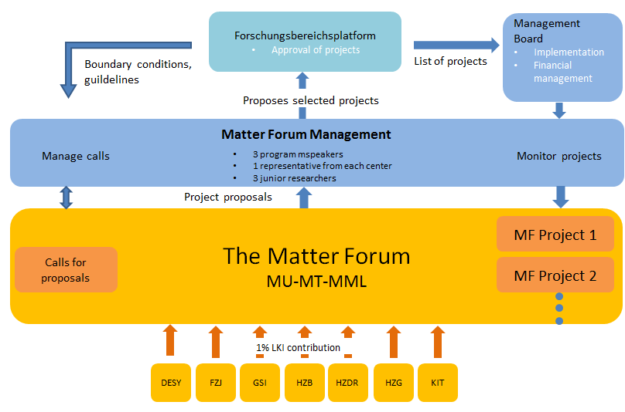
New structures: Matter Forum
1% of Matter LKI budget
BMBF adds another 1%
Project driven:
Startup projects
Strategic projects
BMBF goal: start this
very soon, still in POFIII

Slide 23
Matter Forum
Some numbers:
Funding for the matter forum:
1% LKI money (1% from 200 Mio) 2 Mio/ year
1% BMBF additional funds 2 Mio/ year
                4 Mio/ year total MF budget
MT is about 25% of matter: can expect around 1 Mio/ year for MT projects.
(around 10 FTE in total, around 3-4 projects)
Impact is limited, but we should make sure we (MT) use this new tool to our
advantage! Please discuss ideas within the topics/ subtopics.

Slide 24
The 4th MT meeting
Tuesday: Plenary Session, Poster speed talk session, Reception
Wednesday: Parallel Sessions
Thursday: Plenary Session
204 registrants

Slide 25
Conclusion
Program Matter and Technologies has started very well.
Significant progress has been achieved already at this early stage.
Visibility of technological developments has been improved.
An active and very dynamic community has formed strongly pushing
the program forward.
I am looking forward to 3 interesting and useful days here in Berlin
DMA
DATA MANAGEMENT AND ANALYSIS

