Slide 1


Timing layers, 4D- and 5D-tracking
Besides a few indirect signals of new physics, particle physics today faces a discovery desert.
We need to cross an energy- cross section desert to reach the El-dorado of new physics.
Very little help in the direction of this path is coming from nature, the burden is on the accelerator and experimental physicists to provide the means for this crossing.
Timing is one of the enabling technologies to cross the desert
The R&D programs on “timing” are very intense, it is a very challenging technological development
People of Silicon
The journey to new physics across the LHC desert

Slide 2
Overview
This talk uses examples from high-energy physics, however the application of precision “ photons and charge particles” timing are much wider.
The basic question is: can we design a single detector that can concurrently measure position and time with
~ 10 micron and 10 ps precision
This is an extraordinary challenge in sensor design and ASICs

Slide 3
Outline
The effects of timing
Different “timing” schemes
A specific example: CMS MIP Timing Detector
Timing with Silicon detectors
  Electronics and signal formation
  Gain
  Simulation
  Performances
  Radiation resistance
Future directions

Slide 4
The effect of timing information
The inclusion of track-timing in the event information has the capability of changing radically how we design experiments.
Timing can be available at different levels of the event reconstruction, in increasing order of complexity:
Timing in the event reconstruction ➔ Timing layers
  this is the easiest implementation, a layer ONLY for timing
Timing at each point along the track ➔ 4D tracking
  tracking-timing
Timing at each point along the track at high rate ➔ 5D tracking
  Very high rate represents an additional step in complication, very different read-out chip and data output organization

Slide 5
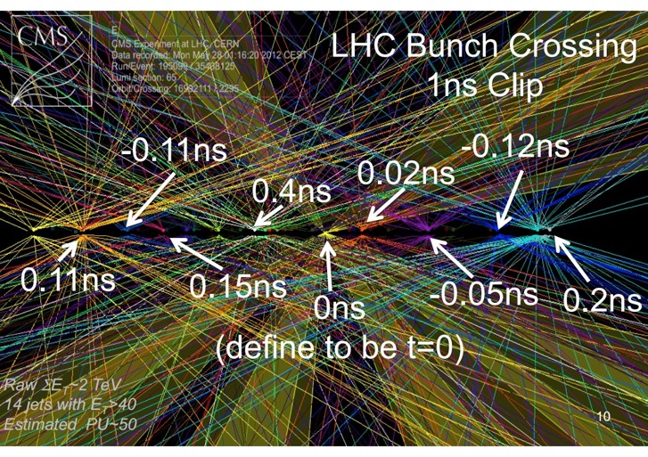
CMS@LHC: pp collisions in space and time
Current situation: ~ 50 vertexes per bunch crossing
Vertexes do not overlap in space ➔ tracking resolves the vertexes
protons
protons

Slide 6
Vertexes in space and time
HL-LHC situation: ~ 150 – 200 vertexes per bunch crossing
Vertexes overlap in space ➔ tracking does not resolves all vertexes
p
p
There are between 15-20% of tracking vertexes (longitudinal resolution ~ 200 micron) that are actually composed by 2 or more interactions.
➔ Loss of events ➔ loss of luminosity ➔ loss of physics ➔ loss of money

Slide 7
Pileup and event density
Pile-up: number of concurrent scattering processes (140 – 200).
Density of events: number of events 1 mm (0.2 – 2 event/mm)
Why are they different?
Pile-up is a global quantity, and it can be fought with very high granularity. It influences, for example, the total amount of tracks and neutral clusters
Density of events: it can be fought with longitudinal resolution and timing.
➔ Charge particles

Slide 8
Position – time of each vertex
Tracker Longitudinal resolution ~ 300 micron
Timing resolution ~ 30 ps
At pileup levels of 140–200, a fraction as high as 15-20% of independent vertices merges, in the absence of time information.

Slide 9
Timing at each point along the track
  ➔Massive simplification of patter recognition, new tracking algorithms will be faster even in very dense environments
  Use only “time compatible points”
Timing
protons
Z- Vertex distribution
protons

Slide 10
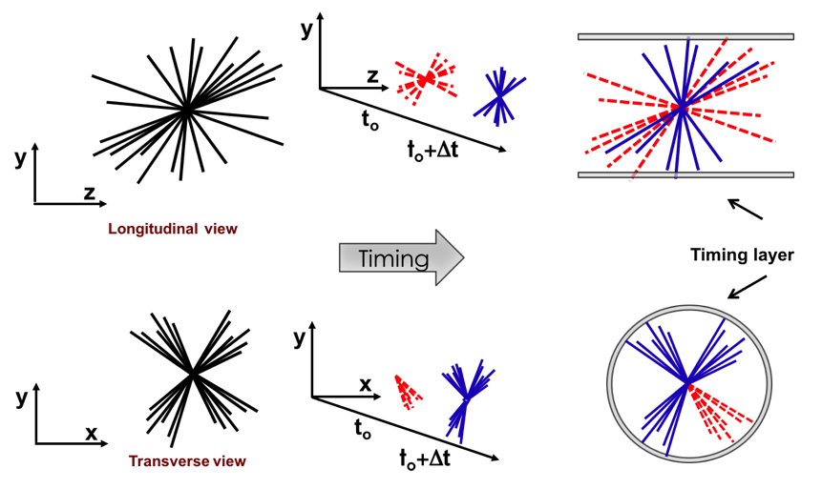
Timing in the event reconstruction
Timing allows distinguishing overlapping events by means of an extra dimension.

Slide 11
Example of Timing @ CMS
Missing Et: consider overlapping vertexes, one with missing Et: Timing allows obtaining at HL-LHC the same resolution on missing Et that we have now
Timing
H ➔ γ γ : The timing of the γγ allows to select an area 1 cm) where the vertex
is located. The vertex timing allows to select the correct vertex within this area
Timing
Displaced vertexes: The timing of the displaced track and that of each vertex allow identifying the correct vertex
Timing

Slide 12
Where do we stand in CMS?
The tracking community thinks it is a wonderful idea, clearly to be implemented outside the tracker volume, in front of the calorimeter
The calorimeter community thinks it is a wonderful idea, clearly to be implemented far from the calorimeter, in the tracker volume
Lesson learnt: sociology can be harder than science…….

Slide 13
CMS Timing layer position
Between tracker and ECAL
Crystals + SiPM
1600
1400
Silicon detector
High rapidity option:
Inside Forward pixel
Most likely position
In front HGCAL
~ 10 m²

Slide 14
Radiation levels
Barrel is a much easier environment
Endcap will be driving the radiation aspects of the project

Slide 15
Why do we want a timing layer?
HL-LHC limit: 2 × 10³⁵ cm⁻²s⁻¹ at the beginning of each fill.
Limited by luminosity leveling at 5.2 or 7.2×10³⁴ cm⁻²s⁻¹.
➔ Possibly LHC will be able to deliver luminosity in excess of what the experiments can take: we need to be able to take data efficiently at very high instantaneous luminosity
The purpose of a timing upgrade of the CMS detector is to consolidate the particle-flow performance at a multiplicity of 140 pileup events and to extend it up to 200 pileup events, exploiting the additional information provided by the precision timing of both tracks and energy deposits in the calorimeters.

Slide 16
Silicon time-tagging detector
(a simplified view)
Time is set when the signal crosses the comparator threshold
The timing capabilities are determined by the characteristics of the signal at the output of the pre-Amplifier and by the TDC binning.
Strong interplay between sensor and electronics

Slide 17
Time resolution
Usual “Jitter” term
Here enters everything that is “Noise” and the steepness of the signal
Time walk: Amplitude variation, corrected in electronics
Shape variations: non homogeneous energy deposition
total current
electron current
hole current
total current
electron current
Need large dV/dt
hole current

Slide 18
Not all geometries are possible
Signal shape is determined by Ramo’s Theorem:
Weighting field
Drift velocity
The key to good timing is the uniformity of signals:
Drift velocity and Weighting field need to be as uniform as possible
Basic rule: parallel plate geometry: strip implant ~ strip pitch >> thickness
Everything else does not work
YES
NO

Slide 19
dV/dt in Thin and Thick silicon detectors
(Simplified model for pad detectors)
Thin detector
d
+
-
+
-
i(t)
+
-
S
Thick detector
D
+
-
+
-
+
-
+
-
tr
Thick detectors have longer signals, not higher signals
Best result : NA62, 150 ps on a 300 x 300 micron pixels
How can we do better?
➔ Add internal gain

Slide 20
Gain need E ~ 300kV/cm. How can we do it?
1) Use external bias: assuming a 50 micron silicon detector, we need V_{bias} = ~ 600 - 800 V
Difficult to achieve
2) Use Gauss Theorem:
E = 300 kV/cm ➔ q ~ 10¹⁶ /cm³
Need to have 10¹⁶/cm³ charges !!

Slide 21
LGAD - Ultra-Fast Silicon Detector
Adding a highly doped, thin layer of of p-implant near the p-n junction creates a high electric field that accelerates the electrons enough to start multiplication. Same principle of APD, but with much lower gain.
Gain changes very smoothly with bias voltage.
Easy to set the value of gain requested.

Slide 22
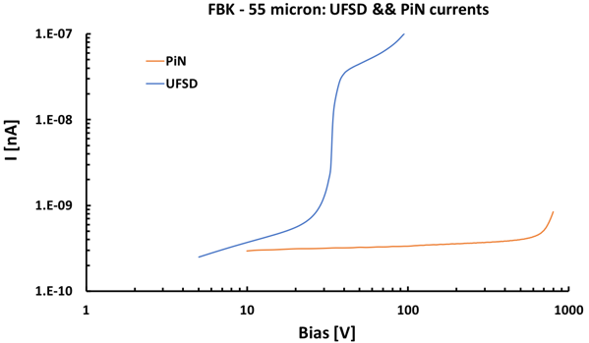
Leakage currents in LGAD and PiN
onset of gain in UFSD - LGAD happens at low voltage
The onset of gain in pad happens only at very high bias and it is very steep

Slide 23
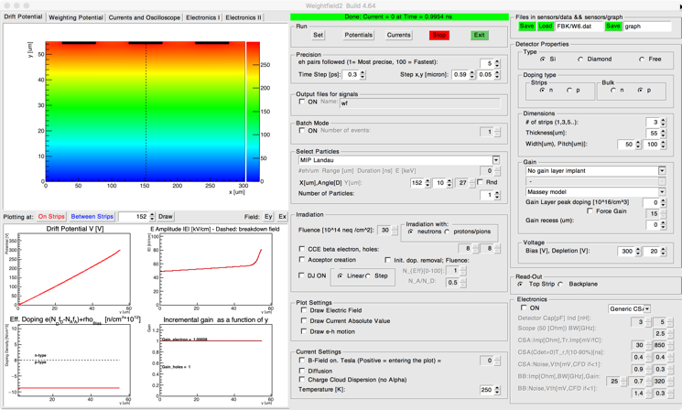
Weightfield2
Available at:
http://personalpages.to.infn.it/~cartigli/Weightfield2/Main.html
It requires Root build from source, it is for Linux and Mac.
It will not replace TCAD, but it helps in understanding the sensors response

Slide 24
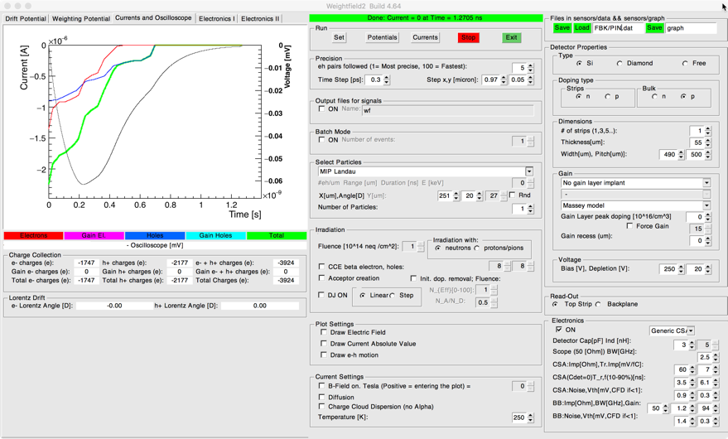
WF2: Currents
Current tabs

Slide 25
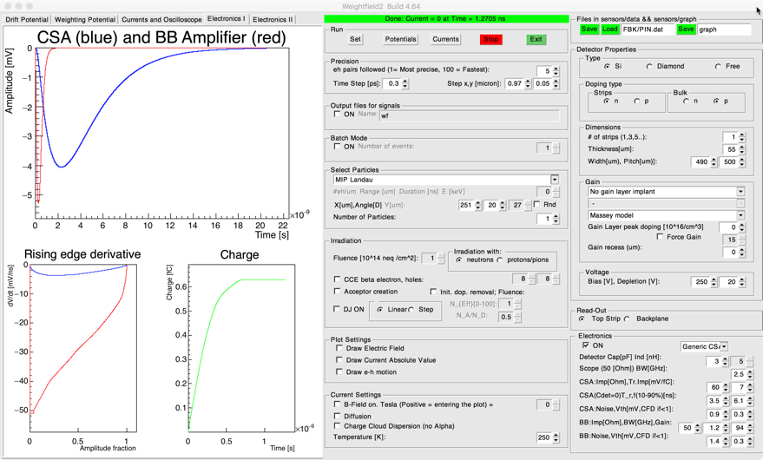
WF2: Electronics
Electronics tabs

Slide 26
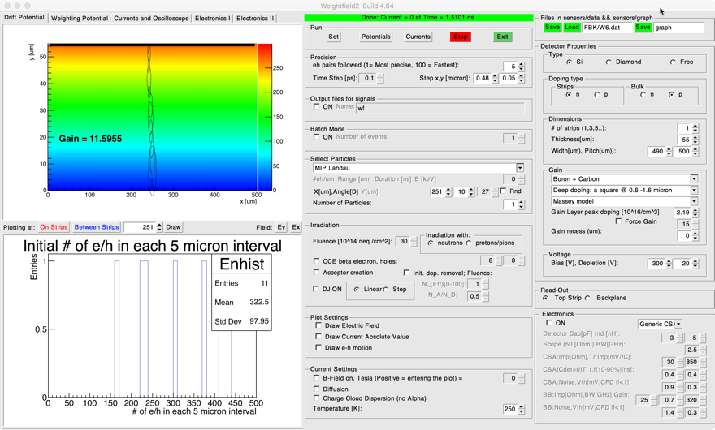
WF2: Radiation damage

Slide 27
How gain shapes the signal
Gain electron: absorbed immediately
Gain holes:
long drift home
-
+
Initial electron, holes
-
+
+
-
Electrons multiply and produce additional electrons and holes.
Gain electrons have almost no effect
Gain holes dominate the signal
➔ No holes multiplications

Slide 28
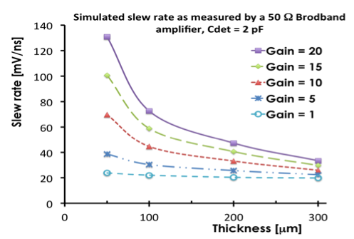
Gain and slew rate vs thickness
For a fixed gain:
amplitude = constant
rise time ~ 1/thickness
The slew rate:
Increases with gain
Increases ~ 1/thickness
➔ Go thin!!
Significant improvements in time resolution require thin detectors

Slide 29
WF2 simulation of silicon signals
WF2 can generate current signals to be used as input in the design of the electronics

Slide 30
Ultra Fast Silicon Detectors
UFSD are LGAD detectors optimized to achieve the best possible time resolution
Specifically:
Thin to maximize the slew rate (dV/dt)
Parallel plate – like geometries (pixels..) for most uniform weighting field
High electric field to maximize the drift velocity
Highest possible resistivity to have uniform E field
Small size to keep the capacitance low
Small volumes to keep the leakage current low (shot noise)

Slide 31
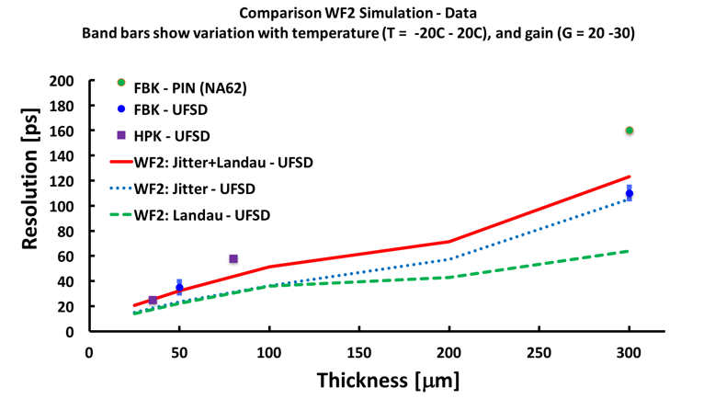
UFSD time resolution summary
UFSD2 achieved 30 ps time resolution, in line with our target.
Resolution without gain
UFSD1
UFSD2

Slide 32
What is the best pre-amp choice?
Energy deposition in a 50 mm sensor
Current Amplifier
Fast slew rate
Higher noise
Sensitive to Landau bumps
More power
Current signal in a 50 mm sensor
Integrating Amplifier
Slower slew rate
Lower noise
Signal smoothing
Less power

Slide 33
The players: signal, noise and slope
Signal dV/dt
Landau Noise
Shot Noise
Electronic Noise
50 micron sensor gain = 15
t_{Cur}
t_{Cur}
t_{RC}
R
t_{Amp}
C
The current rise time (t_{Cur})
The RC circuit (t_{RC})
Amplifier rise time (t_{Amp})
There are 3 quantities determining the output rise time after the amplifier:
  The signal rise time (t_{Cur} )
  The RC circuit formed by the detector capacitance and the amplifier input impedance (t_{RC} )
  The amplifier rise time (t_{Amp})

Slide 34
Integrator or current amplifier?
integrators work best with signals that are of the same length of their integration time
Current amplifiers work best with very fast signals

Slide 35
Irradiation effects
Irradiation causes 3 main effects:
Decrease of charge collection efficiency due to trapping
    Very small in thin sensor
Increased leakage current, shot noise ➔ back up slides
Gain layer disappearance ➔ following slides

Slide 36
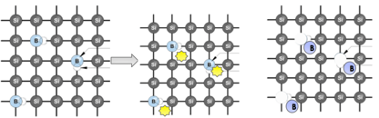
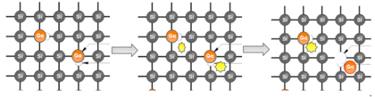
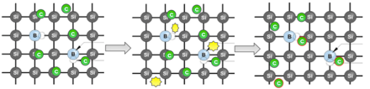
Radiation Damage
Unfortunate fact: irradiation de-activate p-doping removing Boron from the reticle
$$N\left(∅\right)=N\left(0\right)∗e^{−c∅}$$
Boron
Radiation creates interstitial defects that inactivate the Boron: Si_i + B_s ➔ Si_s + B_i
Two possible solutions: 1) use Gallium, 2) Add Carbon
Gallium
From literature, Gallium has a lower possibility to become interstitial
Carbon
Interstitial defects filled with Carbon instead of with Boron and Gallium

Slide 37
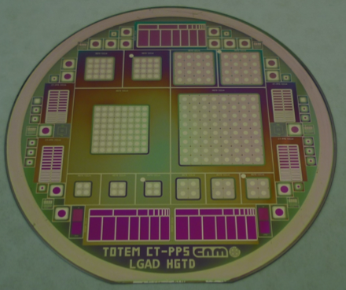
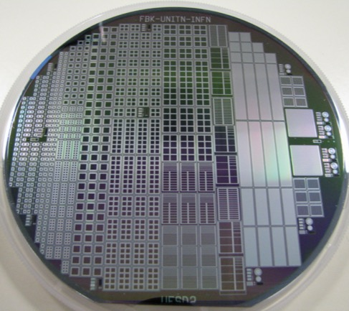
Sensors: FBK, CNM and HPK
FBK 50-micron production
Very successful, good gain and overall behavior
Gain layer: Boron, Gallium, Boron+Carbon, Gallium+Carbon
CNM 75-micron
CNM 50-micron production
x4 CT-PPS
x3 TOTEM
ATLAS High Granularity Timing Det.

Slide 38
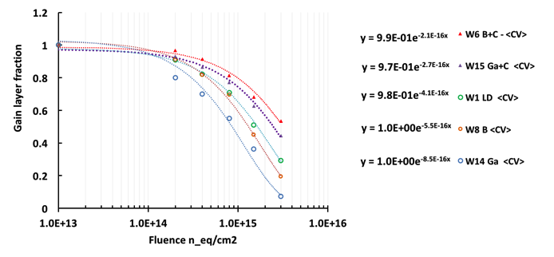
Results on radiation hardness: go Carbon!
more radiation resistance: B+C
less radiation resistance
Gallium is actually less rad-hard than Boron
Carbon addition works really well, increasing by a factor of 2 the radiation hardness

Slide 39
UFSD: HPK time resolution
UFSD from Hamamatsu confirm our simulation: 30 ps time resolution,
Value of gain ~ 20

Slide 40
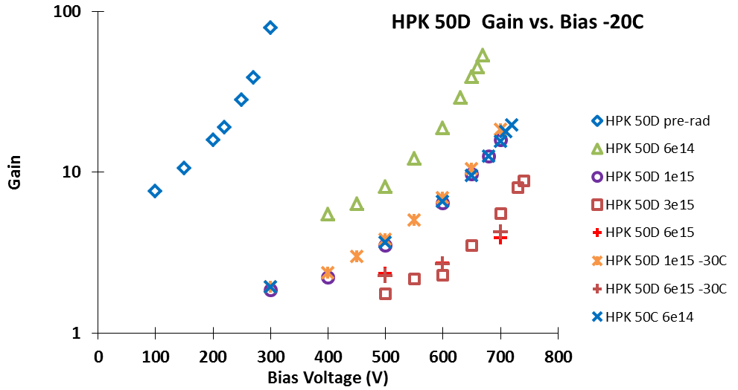
Gain in irradiated sensors
No unexpected features: the gain layer disappearance is compensated by external bias

Slide 41
How to use UFSD up to 5~10¹⁵ n_{eq}/cm²
As the gain layer density decreases, we need to increase the external voltages to create the Efield needed for multiplications.
In so doing, the gain moves from the gain layer to the bulk

Slide 42
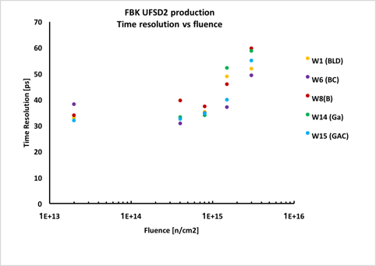
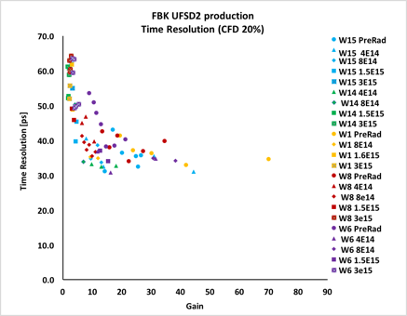
UFSD: Time resolution after irradiation
FBK production of UFSD sensors: time resolution for different fluence
Very complex irradiation campaign, lot’s of samples and fluences
Achieved:
Unchanged time resolution of ~ 35 ps, up to ~ 2E15 n/cm2
Time resolution of 50 ps up to 3E15 n/cm2

Slide 43
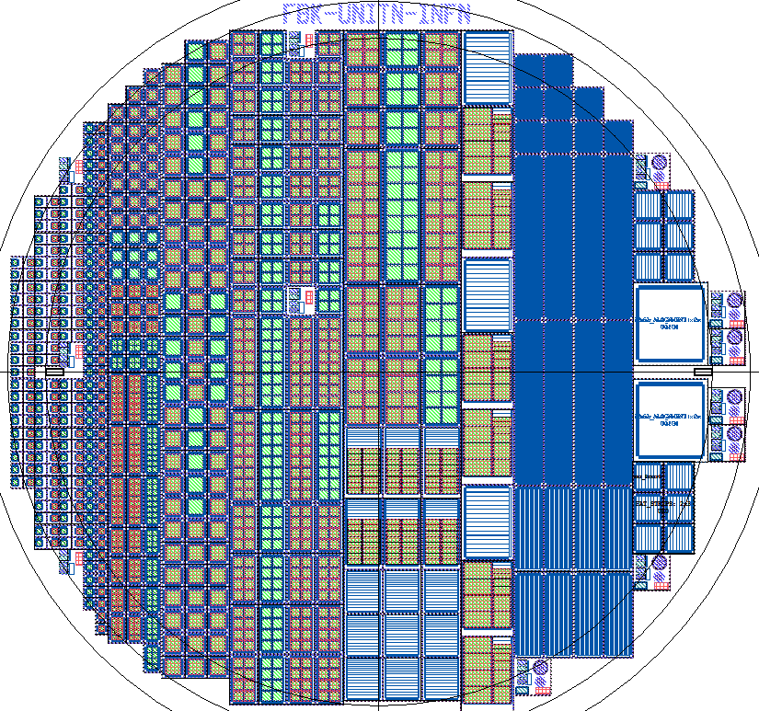
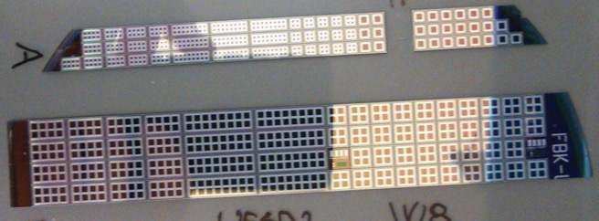
From one pad to a tracker
We have produced thousands of UFSDs, with many shapes, thicknesses, gains etc..
We know very well how a single pads and small array work, however….
Are we able to produce a full large tracker? ?
Uniformity
Fill factor

Slide 44
Multi-pad sensors: TDCpix & FBK-UFSD
Bump-bonded NA62 TDCpix ROC to FBK-UFSD sensor
NA62 ROC: 40x45 pads, each 300x300 μm² (1800 pads)
More than 99% of pads working
Same voltage behavior as single pad: breakdown above 280 V
First example of 4D tracking!
PiN
UFSD2
UFSD1

Slide 45
Fill factor
The fill factor is mainly determined by the inactive gap between sensors.
No gain area
Current measured gap size:
  ~ 70 micron for CNM
  ~ 100 micron for HPK
  ~ 70 micron for FBK
No gain area
gain layer
JTE: Gain termination
This gap affects directly the detector acceptance as we have only one layer: a 70 micron gap corresponds to a 91% fill factor
Goal: 30 micron gap = 96% fill factor
Currently under study, looks possible…
2)

Slide 46
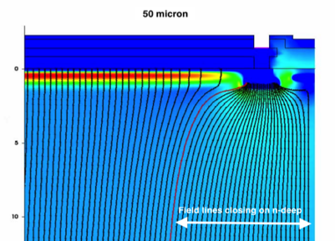
Fill factor: optimization of current design
The gap is due to two components:
1) Adjacent gain layers need to be isolated (JTE & p-stop)
2) Bending of the E field lines in the region around the JTE area
Both under optimization Different junction termination/p-stop design
CMS Goal: 30 micron gap = 96% fill factor
Gain JTE
@20 micron: 99% of full gain
JTE+p-stop
@15 micron: 90% total signal
JTE
Different gain doping
p-stop
pad
isolation
Very aggressive design: <10 micron per side

Slide 47
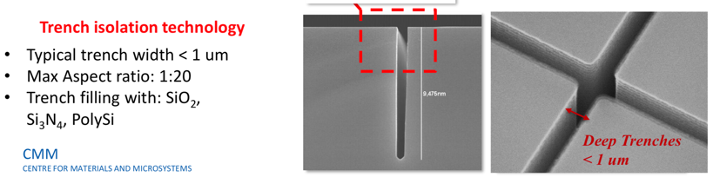
Fill factor solution 1: trenches
Trenches (the same technique used in SiPM):
No pstop,
No JTE ➔ no extra electrode bending the field lines
Current version
R&D goal
No gain area
JTE + p-stop design Trench design

Slide 48
Fill factor solution 2: Resistive electrode
The signal is frozen on the resistive sheet, and it’s AC coupled to the electronics
➔ 100% fill factor
➔Segmentation is achieved via AC coupling
AC coupling
n++ electrode
gain layer
p++ electrode
The AC read-out sees only a small part of the sensor:
small capacitance and small leakage current.

Slide 49
And now we need to build the detector..
CMS and ATLAS have now in their upgrade proposal the combined construction of ~ 20 m2 of UFSD sensors.
Main challenges:
Sensor: moving from one pad to large area
Electronics: need to design an appropriate chip
3x3 mm² pads
1x3 mm² pads
And: backend electronics, mechanics, cooling, HV & LV distribution, High precision clock, data transmission

Slide 50
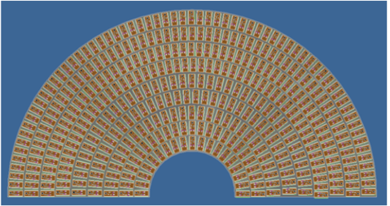
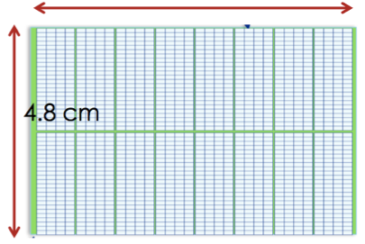
ETL: Endcap Timing Layer
The chosen sensors for ETL are UFSD
one layer
per side,
each made of
two disks
sum of two half disk
9.6 cm
~ 1800 sensors:
4.8 x 9.6 cm² --- Large Sensors
Thickness of active area: 40-50 microns
Pad size: 1 x 3 mm² (1536 pads)

Slide 51
SENSORS: state of the art
UFSD: 35 ps resolution for fluences up to 5 - 6e14 neq/cm²
State-of-the-art sensors guarantee 80% of the ETL coverage
Low radiation : radius 55 – 110 cm ~2.8 m2 , ~80%
High radiation: radius 25 – 55 cm ~0.7 m2, ~20%
There are several options to cover the additional 20%
• R&D will demonstrate new solutions → next 18 months
• Allow degradation of resolution (~ 60 ps after 3000 fb-1)
• Have two layers

Slide 52
R&D: Can we use Monolithic technology?

Slide 53
R&D in 5 years: space-time tracking at high rate
Imagine tracking with ~ 1000-2000 tracks @ 40 MHz crossing
This situation is the pinnacle of complications..
Very good time resolution
Small pixels
100 x100 μm
Small area for electronics
➔ 28 nm
4D tracking at high rate
High power requirements
Radiation damage
Very high data transfer
High event rates

Slide 54
One “side” topic: detection of low energy X-rays
Gain is great for timing, however, it is also very good for enhancing low energy depositions in silicon detectors.
We started an R&D plan with PSI for enhanced 1-5 keV soft x-ray detections.
2-3 keV photons have been seen very clearly.
Take home message:
even if you don’t do timing, gain might be good for you

Slide 55
Another “side” topic: very low material budget
There are applications that need very low material budget.
If you imagine a gain of 6, a 50-micron thick sensor provides the same signal of a 300-micron thick sensor.
If you imagine a tracker with 5 layers, you save more than 1 mm of silicon
PiN sensor
LGAD Sensor

Slide 56
Summary
4Dimensional timing can be achieved using special silicon sensors with internal gain, the so called UFSD based on the LGAD technology
Sensor R&D is very active, funded by a variety of sources.
Very strong collaboration ATLAS-CMS.
In the next 2 years several new options will be explored, hopefully increasing radiation resistance and fill factors.
Lowest time resolution is ~ 30 ps ( gain ~ 20 with CFD ~ 20%) when new, and ~ 50 ps (gain ~ 7-10 with CFD ~ 50%) at 1e15neq/cm2
Timing should be “custom made” for each application, there is no a “one solution fits all”
Think about gain as a swiss-army knife: it can be useful in many situation

Slide 57
Acknowledgement
This research was carried out with the contribution of the Ministero degli Affari Esteri, “Direzione Generale per la Promozione del Sistema Paese” of Italy.
This work is currently supported by INFN Gruppo V, UFSD project (Torino, Trento Univ.,FBK).
This work was developed in the framework of the CERN RD50
The work is supported by HORIZON2020 Grants and UFSD ERC grant UFSD669529
Notes:
57

Slide 58
References
H. Sadrozinski et al. “4D tracking with UFSD sensors”, ROPP
R. Mulargia et al, “Temperature dependence of the response of Ultra Fast Silicon Detectors” Pixel 2016, to be published in JINST 11 (2016) C12016
N. Cartiglia et al, “The 4D pixel challenge”, JINST 11 (2016) C12016
N. Cartiglia et al, “Beam test results of a 16 ps timing system based on ultra-fast silicon detectors”, NIMA 850 (2017) 83 – 88
B. Baldassarri et al, Signal formation in irradiated silicon detectors, NIMA 845 (2017) 20 – 23
N. Cartiglia et al, Tracking in 4 Dimensions, NIMA 845 (2017) 47 – 51
N. Cartiglia et al, Design Optimization of Ultra-Fast Silicon Detector, NIMA 796 (2015) 141-148, doi:10.1016/j. nima.2015.04.025i
F. Cenna et al, Weightfield2: A fast simulator for silicon and diamond solid state detector, NIMA 796 (2015) 149-153, doi:10.1016/j.nima.2015.04.015
G-F Dalla Betta et al, Design and TCAD simulation of double-sided pixelated low gain avalanche detectors, NIMA 796 (2015) 54-157, doi:10.1016/j.nima.2015.03.039
N. Cartiglia et al., Timing Capabilities of Ultra-Fast Silicon Detectors, doi:10.5506/APhysPolBSupp.7.657
N. Cartiglia, et al., Performance of Ultra-Fast Silicon Detectors, JINST 9 (2014) C02001
H.-W. Sadrozinski et al., Sensors for ultra-fast silicon detectors, NIMA 765 (2014) 7
H.-W. Sadrozinski, et al., Ultra-fast silicon detectors, NIMA 730 (2013) 226-231

Slide 59
Bonus Material

Slide 60
R&D in the next 1-2 years
Reduce material budget:
Current version
R&D goal
Thin LGAD on a thick support wafer
Thin LGAD on ribs
Reduce dead area between pads:
Current version
R&D goal
dead area
dead area
JTE + p-stop design Trench design

Slide 61
CMS Timing Module for the endcap
Use the geometry 5x10 cm2 as baseline
Connectors
9.6 cm
ASIC
24 mm
Read-out chip size: ~ 8 x 24 mm
64 channels per FE chip
Pad: 1x3 mm2
8 mm
ASIC
From physics: what is the granularity? 1x1 mm2, 1x2 mm2, 1x3 mm2.
Shall we use hexagon to minimize the perimeter?
30 μm dead area
2
mm2
3
mm2
1x1
1x2
1x3 mm2
Dead area: 12% 9% 8% 9% 6%

Slide 62
Endcap disks

Slide 63
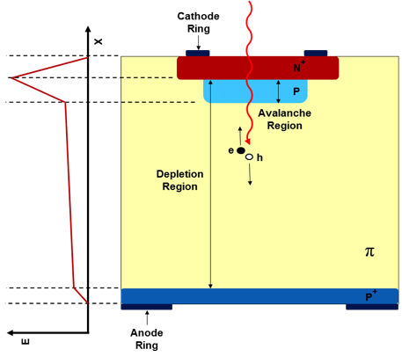
Low Gain Avalanche Detectors (LGADs)
The LGAD sensors, as proposed and manufactured by CNM
(National Center for Micro-electronics, Barcelona):
High field obtained by adding an extra doping layer
E ~ 300 kV/cm, closed to breakdown voltage
High field
Gain layer

Slide 64
Gain layer design

Slide 65
WeightField2: a program to simulate silicon detectors

Slide 66
Thin vs Thick detectors
(Simplified model for pad detectors)
Thin detector
d
+
-
+
-
i(t)
+
-
S
Thick detector
D
+
-
+
-
+
-
+
-
tr
Thick detectors have longer signals, not higher signals
Best result : NA62, 150 ps on a 300 x 300 micron pixels
How can we do better?

Slide 67
2 important effects: Time walk and Time jitter
Time walk: the voltage value V_{th} is reached at different times by signals of different amplitude
Jitter: the noise is summed to the signal, causing amplitude variations
Due to the physics of signal formation
Mostly due to electronic noise
Time walk and jitter ~ N/(S/t_{r}) ₌ N/(dV/dt)

Slide 68
Barrel Timing layer: on the Tracker Support Tube

Slide 69
Barrel design: crystals read-out by SiPM
Crystal: 1.2 x 1.2 cm²
SiPM = 0.5x0.5 cm²
Crystal: 0. 3 cm² thick
Single photon efficiency as a function of position
Based on LYSO:Ce crystals read-out with silicon photomultipliers (SiPMs)
1.2x1.2 cm² crystal, 3 mm thick, read-out by a 0.5x0.5 cm² SiPM
time resolution in the order of 10-20 ps.
➔ A MIP traversing 3mm of LYSO produces 90,000 photons and with a 5mm x 5mm SiPM per cm^2 tile yields a S/N of above 100 throughout the entire HL-HLC program.
Use the design of the present Tracker Support Tube (TST) and rails to instrument the region outer tracker ring and the ECAL front-end cooling plates with a thin standalone detector
Both the crystals and the SiPM are proven to be radiation tolerant up to neutron equivalent fluence 3 × 10¹⁴ cm⁻², when cooled to −30ºC.
We do not foresee to use time information in the level-1 trigger decision.

Slide 70
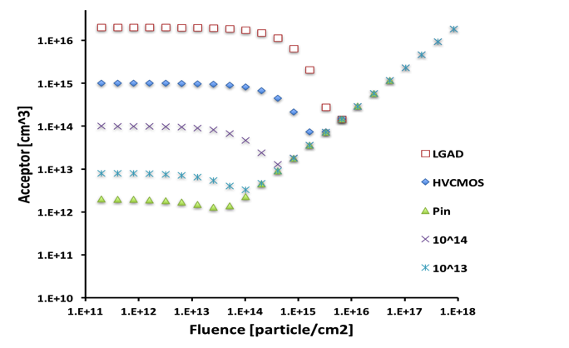
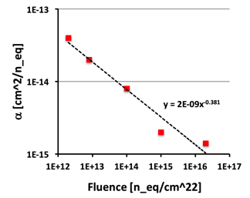
Irradiation main problem: gain layer disappearance
Density of the doping vs irradiation:
Initial acceptor removal
Deep level creation
p-doping lookalike
α is a function of initial doping conditions

Slide 71
Shot noise in LGAD - APD
n++ electrode
I_{ds}
I_{dg}
+
-
+
-
gain layer p+
Bulk Leakage current
+
-
Surface current
+
-
p++ electrode
Current density, nA/sqrt(f)
Correction factor to the standard Shot noise,
due to the noise of the multiplication mechanism
k = e/h ionization rate
x = excess noise index
M = gain

Slide 72
Noise in LGAD & APD – Aide Memoire
Noise increases faster than then signal ➔
the ratio S/N becomes worse at higher gain.
There is an Optimum Gain value: 10-20?
Signal:
Total noise
Output
Shot noise:
Best S/N ratio
Noise floor, gain independent
10 100 1000
Gain
M _{opt}

Slide 73
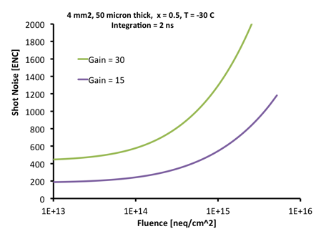
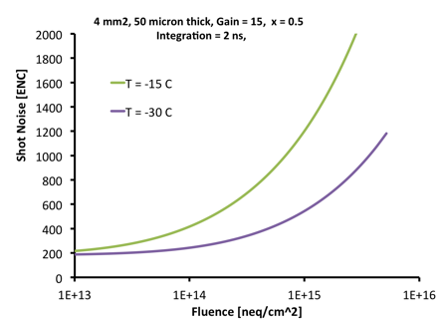
Shot noise
Let’s assume a 4 mm² pad, 50 micron thick, and a electronic noise of 500 ENC
What is the effect of shot noise as a function of radiation?
I = α ∗ Φ * Volume α = 3 10⁻¹⁷ /cm
Shot noise:
Steep dependence on gain
Gain increase
T increase
Electronic noise
To minimize Shot noise:
Low gain!! Keep the gain below ~ 20
Cool the detectors
Use small pads to have less leakage current

Slide 74
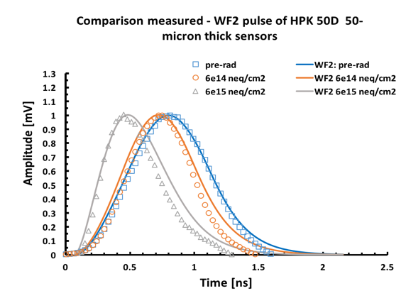
Pulse shape in irradiated UFSD
Normalized amplitude
With irradiation the signal changes: it becomes shorter and steeper

