Slide 1
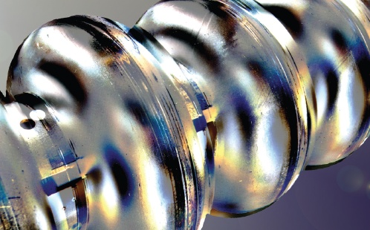
superconducting cavity R&D @ DESY
towards continuous wave operation of the European XFEL
Lea Steder on behalf of the SRF team at DESY
4th Annual MT Meeting, HZB
12 – 14 June 2018

Slide 2
superconducting radiofrequency technology
European XFEL defining the standard
superconducting radiofrequency (SRF) cavities are figurehead of DESY’s engagement for accelerator science
other projects like LCLS-II, ESS, new SRF based FELs e.g. @ SINAP are profiting from successful technology transfer to industry
European XFEL is longest SRF linear accelerator worldwide ~ 800 cavities
average accelerating gradient 30 MV/m (design: 23.6 MV/m)
average quality factor 1.4 x 10¹⁰ (design 1.0 x 10¹⁰)
[D. Reschke et al., PhysRevAccelBeams.20.042004 (2017)]

Slide 3
superconducting radiofrequency technology
European XFEL defining the standard
superconducting radiofrequency (SRF) cavities are figurehead of DESY’s engagement for accelerator science
other projects like LCLS-II, ESS, new SRF based FELs e.g. @ SINAP are profiting from successful technology transfer to industry
European XFEL is longest SRF linear accelerator worldwide ~ 800 cavities
average accelerating gradient 30 MV/m (design: 23.6 MV/m)
average quality factor 1.4 x 10¹⁰ (design 1.0 x 10¹⁰)
[D. Reschke et al., PhysRevAccelBeams.20.042004 (2017)]
future goal for European XFEL: flexible beam patterns for experiments
short pulses with high energy of 17.5 GeV
long pulses (duty factor 10-50 %) with medium energy of 10 GeV
continuous wave (cw) mode at 8 GeV

Slide 4
challenges for European XFEL upgrade
high-performance cavities for continuous wave mode operation needed
second injector for continuous wave operation
first 17 cryo-modules to be exchanged: 136 new cavities
L3 remains untouched but old modules can lengthen L3
cw-mode capable RF sources (1 IOT per station, + 4 stations in L3)
cryo plant needs twice the power: 2.5 ➔ 5 kW
talk E. Vogel
poster A. Bellandi

Slide 5
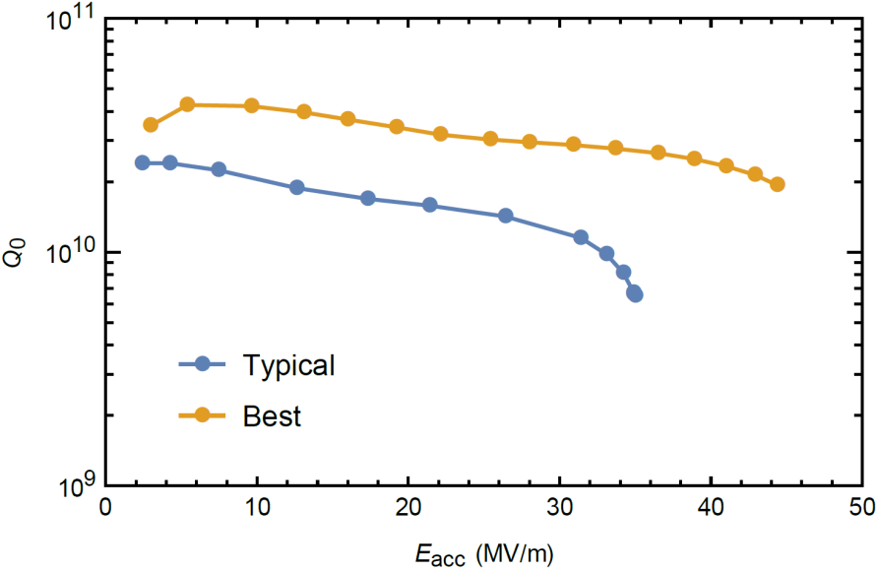
challenges for European XFEL upgrade
high-performance cavities for continuous wave mode operation needed
second injector for continuous wave operation
first 17 cryo-modules to be exchanged: 136 new cavities
L3 remains untouched but old modules can lengthen L3
cw-mode capable RF sources (1 IOT per station, + 4 stations in L3)
cryo plant needs twice the power: 2.5 ➔ 5 kW
requirements for new cavities
high Q₀ since 1/Q ~ P_{RF,loss} ~ P_{cryo,dyn}
high gradient for short pulse operation
talk E. Vogel
European XFEL series cavities
poster A. Bellandi

Slide 6
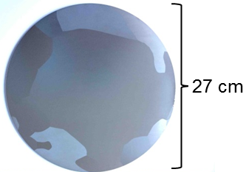
cavity R&D topics within ARD ST1
improved niobium material and new surface treatments
two SRF R&D topics identified
large grain niobium
disks for cavity production based on the existing world-leading experience at DESY
nitrogen infusion
a novel surface treatment applying a partial pressure of nitrogen during heat treatment developed at Fermilab

Slide 7
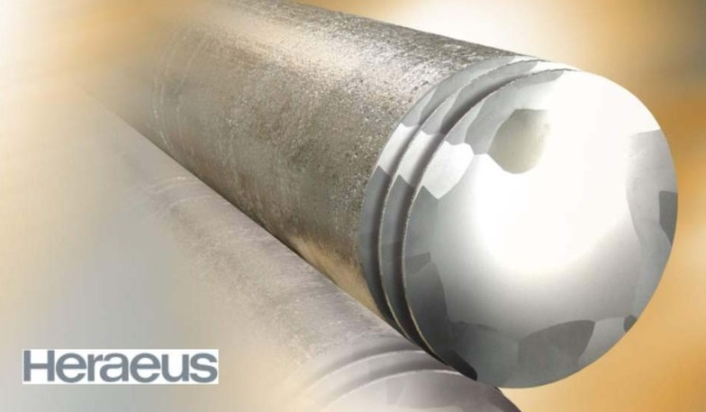
large grain cavity R&D
engineering and surface physics towards high-performance cavities
fine grain (FG) niobium: typical grain size of ~ 50 µm
well-known mechanical & physical properties, commercially available, used for all recent SRF accelerator projects (XFEL, LCLS-2, ESS, MESA)
large grain (LG) niobium: typical grain size of ~ cm
first R&D during preparation phase for European XFEL
[W. Singer et al., PhysRevSTAB.16.012003 (2013)] [A. Ermakov et al., 2008 J. Phys.: Conf. Ser. 97 012014]

Slide 8
large grain cavity R&D
engineering and surface physics towards high-performance cavities
fine grain (FG) niobium: typical grain size of ~ 50 µm
well-known mechanical & physical properties, commercially available, used for all recent SRF accelerator projects (XFEL, LCLS-2, ESS, MESA)
large grain (LG) niobium: typical grain size of ~ cm
first R&D during preparation phase for European XFEL
specification for material, mechanical forming and welding process to be defined
compatibility with pressure equipment directive (PED) → investigation of mechanical properties LG disks from different vendors
➔ stable industrial high-performance cavity production
[W. Singer et al., PhysRevSTAB.16.012003 (2013)] [A. Ermakov et al., 2008 J. Phys.: Conf. Ser. 97 012014]

Slide 9
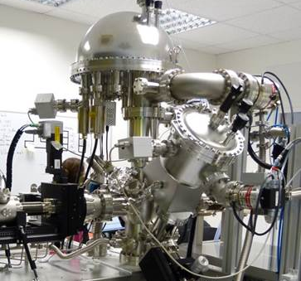
large grain cavity R&D
engineering and surface physics towards high-performance cavities
fine grain (FG) niobium: typical grain size of ~ 50 µm
well-known mechanical & physical properties, commercially available, used for all recent SRF accelerator projects (XFEL, LCLS-2, ESS, MESA)
large grain (LG) niobium: typical grain size of ~ cm
first R&D during preparation phase for European XFEL
specification for material, mechanical forming and welding process to be defined
compatibility with pressure equipment directive (PED) → investigation of mechanical properties LG disks from different vendors
➔ stable industrial high-performance cavity production
surface-sensitive characterization techniques and analysis of existing cavity test data
investigation of grain boundaries (less than in FG) - responsible for RF losses?
systematic studies of correlations between cavity treatment and performance
identification of surface properties correlating with cavity performance
[W. Singer et al., PhysRevSTAB.16.012003 (2013)] [A. Ermakov et al., 2008 J. Phys.: Conf. Ser. 97 012014]

Slide 10
performance of large grain niobium cavities
promising Q₀ values in vertical and module tests
11 nine-cell, several three- and single-cell large grain cavities fabricated
➔ world class performance
vertical test comparison to fine grain cavities
for standard EP surface treatment about 25 % higher Q₀
same reach for high accelerating gradients

Slide 11
performance of large grain niobium cavities
promising Q₀ values in vertical and module tests
11 nine-cell, several three- and single-cell large grain cavities fabricated
➔ world class performance
vertical test comparison to fine grain cavities
for standard EP surface treatment about 25 % higher Q₀
same reach for high accelerating gradients
European XFEL pre-series cryo-module XM-3 with 7 LG + 1 FG cavities
➔ cw operation with excellent results and stability
module test in continuous wave and long pulse mode
stable operation at 17 MV/m and Q₀ of 2.3 x 10¹⁰ at 2K
long pulse operation with duty factors (DF) from 22-43 %
long term (>7y) operation of two further LG cavities in FLASH modules

Slide 12
heat treatments in a partial pressure of nitrogen
nitrogen infusion as promising approach
nitrogen infusion yields significant development of quality factors
baseline recipe: 3 hours heat treatment at 800°C, then 48 hours 120°C in UHV with nitrogen – partial pressure of 25 mTorr
no additional final EP treatment (as in standard surface treatment) necessary
high Q₀ and high gradients reported, [A. Grasselino et al. 2017 Supercond. Sci. Technol. 30 094004] but process still not reproducible in every attempt
➔ goal: definition of stable recipe for high-performance cavities

Slide 13
heat treatments in a partial pressure of nitrogen
nitrogen infusion as promising approach
nitrogen infusion yields significant development of quality factors
baseline recipe: 3 hours heat treatment at 800°C, then 48 hours 120°C in UHV with nitrogen – partial pressure of 25 mTorr
no additional final EP treatment (as in standard surface treatment) necessary
high Q₀ and high gradients reported, [A. Grasselino et al. 2017 Supercond. Sci. Technol. 30 094004] but process still not reproducible in every attempt
➔ goal: definition of stable recipe for high-performance cavities
two R&D approaches at DESY
in-situ infusion of samples followed by surface characterization techniques
➔ understanding from surface physics point of view
heat treatment of cavities and samples
vertical tests of cavities
surface analysis of samples
➔ correlation of surface and RF properties

Slide 14
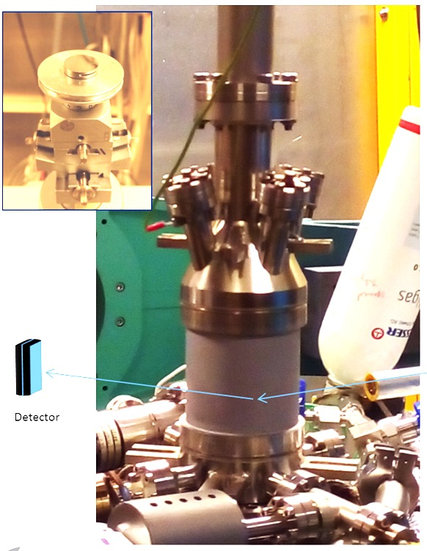
nitrogen infusion at Nanolab
poster G. Dalla Lana Semione
surface characterization shows no nitrides
to understand role of nitrogen in infusion process
sample treatment in UHV chamber on high-purity, UHV-annealed single crystal Nb (100) – as a model system
surface analysis wrt. oxides, nitrides, hydrides and interstitials
in-situ XRR and GIXRD experiments, XPS, SEM, AFM
[Dangwal Pandey, A., Dalla Lana Semione, G., Prudnikava, A. et al. J Mater Sci (2018) 53: 10411]

Slide 15
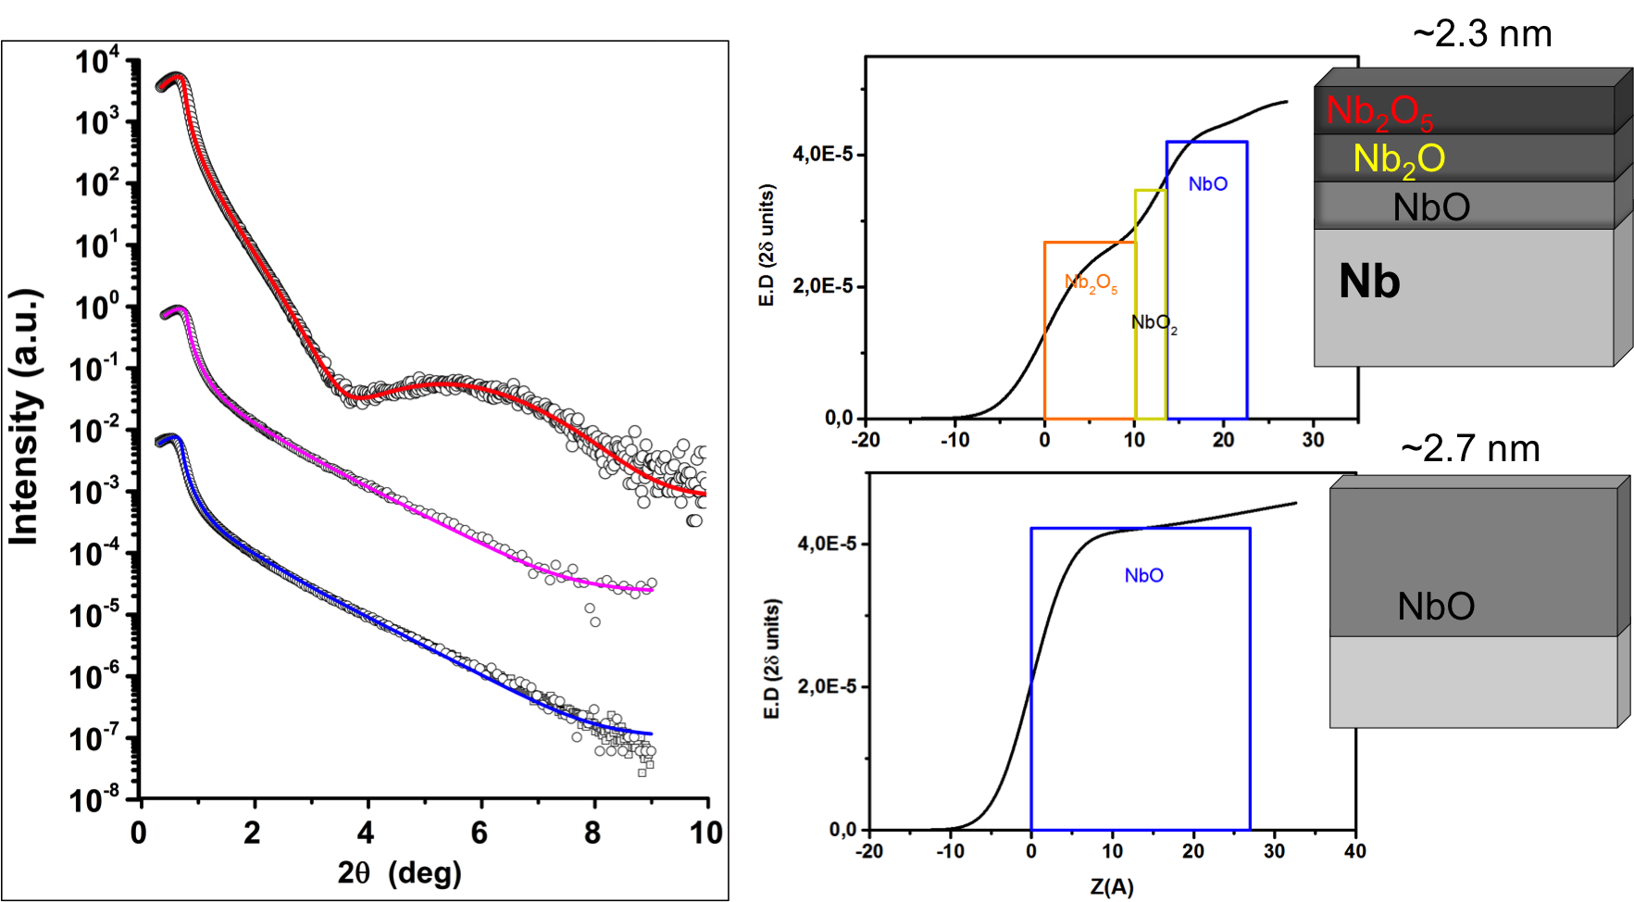
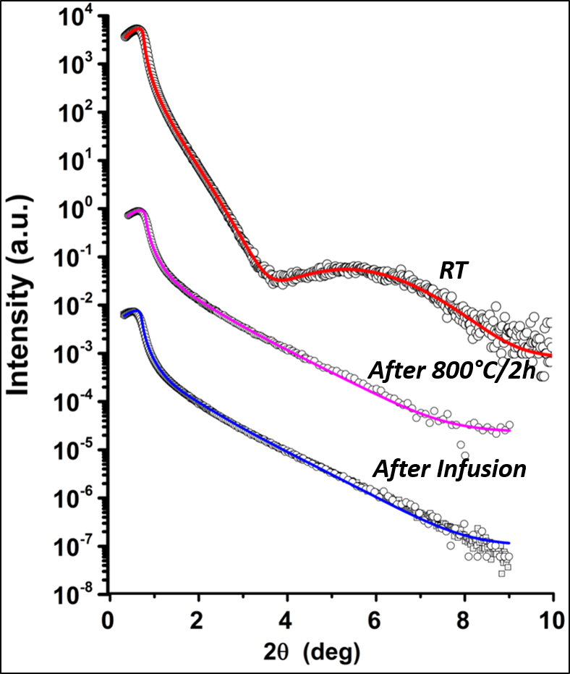
nitrogen infusion at Nanolab
poster G. Dalla Lana Semione
surface characterization shows no nitrides
to understand role of nitrogen in infusion process
sample treatment in UHV chamber on high-purity, UHV-annealed single crystal Nb (100) – as a model system
surface analysis wrt. oxides, nitrides, hydrides and interstitials
in-situ XRR and GIXRD experiments, XPS, SEM, AFM
results of in-situ XRR & XPS:
NbO phase present
but no nitride phase identified after nitrogen infusion process
no other unexpected layers
natural oxides re-grow after venting
[Dangwal Pandey, A., Dalla Lana Semione, G., Prudnikava, A. et al. J Mater Sci (2018) 53: 10411]

Slide 16
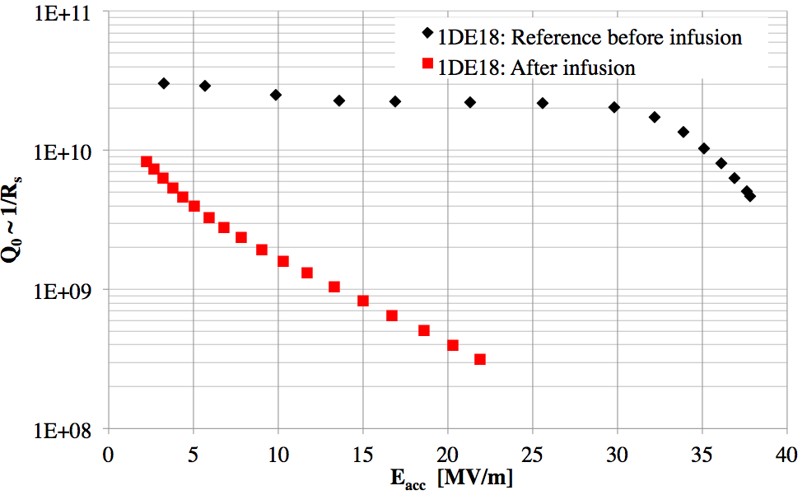
evolution of infusion process at DESY
poster C. Bate
large parameter space to be controlled
first tests couldn’t reproduce Fermilab results

Slide 17
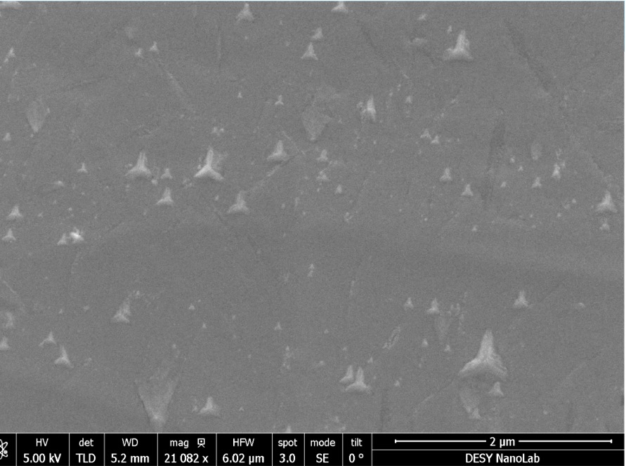
evolution of infusion process at DESY
poster C. Bate
large parameter space to be controlled
first tests couldn’t reproduce Fermilab results
star-like structures found on samples
possible hydro-carbon contamination of furnace
process parameters compared to setups at other labs
close collaboration with Fermilab
SEM after heat treatment
2 μm
‘star-like’ precipitates identified as carbon using advanced surface analysis techniques
TEM on FIB Cuts
TEM-EDS: Carbon

Slide 18
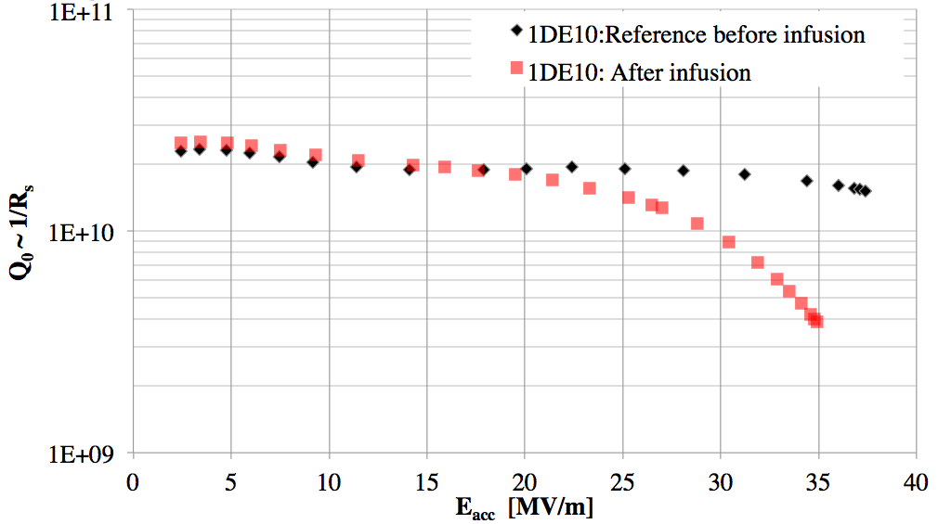
evolution of infusion process at DESY
poster C. Bate
large parameter space to be controlled
first tests couldn’t reproduce Fermilab results
star-like structures found on samples
possible hydro-carbon contamination of furnace
process parameters compared to setups at other labs
close collaboration with Fermilab
SEM after heat treatment
2 μm
furnace environment improved, studies for further optimization ongoing
precipitates depending on grain orientation observable
hexagonal β-Nb₂C phase?
correlation to cavity performance?
‘star-like’ precipitates identified as carbon using advanced surface analysis techniques
TEM on FIB Cuts
TEM-EDS: Carbon

Slide 19
summary and outlook
answers raise more questions
large grain cavities very promising
vertical / module test
preparation serial cavity production: specification for material, mechanical forming and welding process started
vertical and module tests ongoing
systematic re-analyzing of older test
➔ production process for high-performance cavities

Slide 20
summary and outlook
answers raise more questions
large grain cavities very promising
vertical / module test
preparation serial cavity production: specification for material, mechanical forming and welding process started
vertical and module tests ongoing
systematic re-analyzing of older test
➔ production process for high-performance cavities
no nitride phase on surface found
effects on grain boundaries and due to grain orientation under study
impact of infusion temperature will be analyzed
correlation of sample surface to cavity performance
cutting of cavity for direct surface investigation
analysis of other interstitial gases planned
➔ stable and reproducible recipe for nitrogen infusion

Slide 21
SRF R&D at DESY in full swing
closing remarks
two aspects of SRF R&D towards and continuous wave upgrade of E-XFEL
large grain R&D shall provide cavities with naturally high Q₀ and large accelerating gradients
nitrogen infusion R&D shall allow for a surface treatment improving standard cavities to high-performance cavities with high Q₀ at large gradients
➔ goal of SRF R&D @ DESY: 136 high-performance cavities for low energy section of European XFEL

Slide 22
SRF R&D at DESY in full swing
closing remarks
two aspects of SRF R&D towards and continuous wave upgrade of E-XFEL
large grain R&D shall provide cavities with naturally high Q₀ and large accelerating gradients
nitrogen infusion R&D shall allow for a surface treatment improving standard cavities to high-performance cavities with high Q₀ at large gradients
➔ goal of SRF R&D @ DESY: 136 high-performance cavities for low energy section of European XFEL
thanks to the complete DESY and Nanolab SRF team, I gave this talk on their behalf
special thanks to Detlef Reschke, Julien Branlard, Christopher Bate and Guilherme Dalla Lana Semione for providing material from their talks and posters
only collaboration with many partners allows for complex R&D work

