Slide 1


Draco PW experiments
Preparation of radiobiological studies
4th annual Matter and Technology Meeting 2018 Berlin
K. Zeil, L. Obst, M. Rehwald, H.-P. Schlenvoigt, F. Brack, F. Kroll, J. Metzkes-Ng, C. Bernert, L. Gaus, I. Prencipe, T. Ziegler, T. Kluge, M. Garten, A. Hübl, S. Kraft, U. Schramm
E. Beyreuther, L. Karsch, J. Pawelke, L. Kunz-Schughart
P. Poole, G. Cochran, D. Schumacher

Slide 2
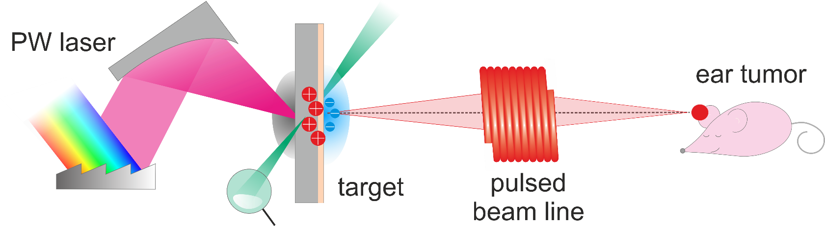
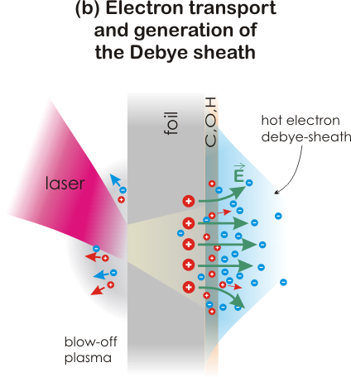
Laser-Proton Acceleration at HZDR
Motivation: applicability of laser-driven proton beams
compact proton acceleration in laser-driven plasmas: TV/m field strength → broadband MeV ion source with large divergence
20°
p
C^{n+}
O^{n+}
E = TV/m
high particle energy and yields 3D beam shaping
Requirement: high proton beam quality
stability
Notes:
Inertial fusion with proton beams: (Roth, Fernandez) → E_ig of entire particle beam ~ 10 kJ, E_particle ~ 13 MeV (for protons), meaning that particle number in beam needs to be ~ 10^16

Slide 3
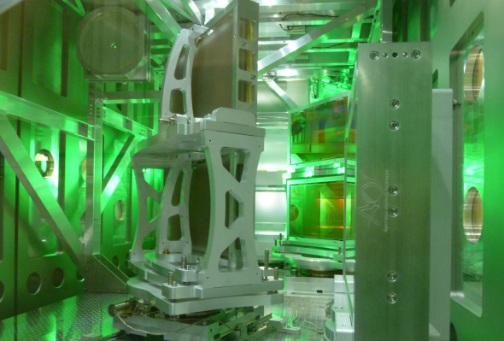
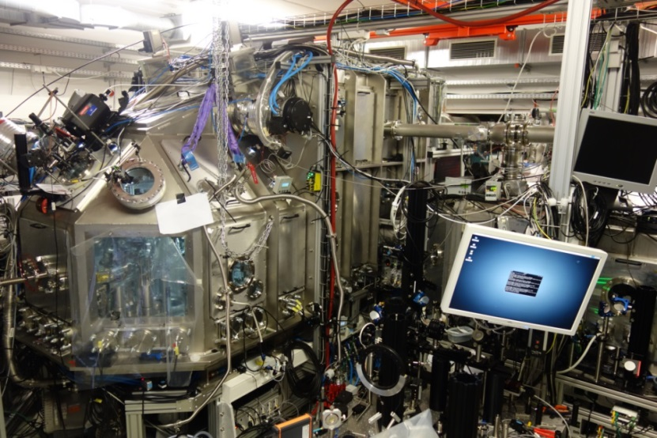
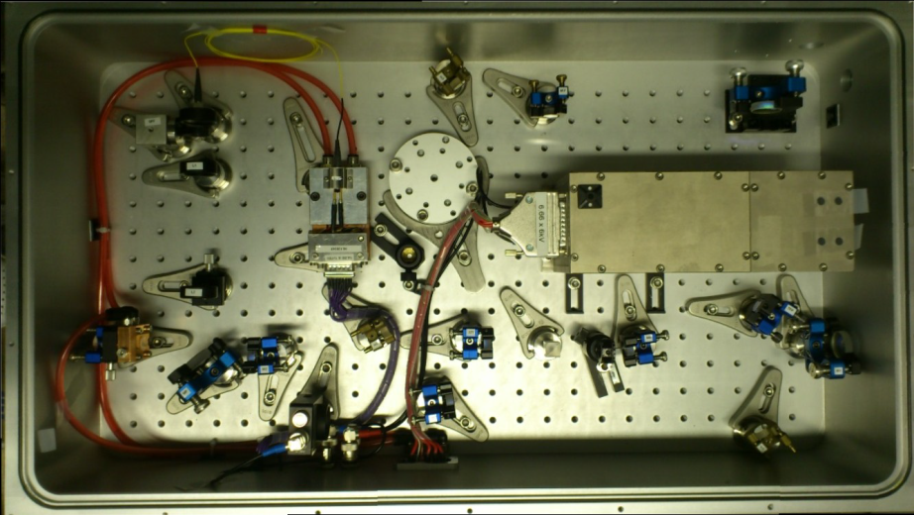

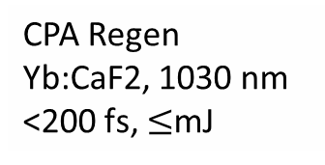
Draco PW and target area
  Draco Ti:Sa Laser System for ion acceleration
laser upgrade - dual beamline:
  150 TW (4J pulses with 30fs)
  PW (30J pulses with 30fs)
Ion target area with 3 beamlines
  150 TW: F2.5 → I ≈ 10²¹ W/cm²
  150 TW: F10 → I ≈ 5·10¹⁹ W/cm²
  PW: F2.5 → I ≈ 10²² W/cm²
plasma mirror devices
synchronized stand-alone probe laser system for multicolor femto-scale probing within Helmholtz future-topic funding
CPA Regen
Yb:CaF2, 1030 nm
<200 fs, $≤$mJ
Notes:
but I have to thank most people from FWKT
dazu natürlich Zusammenarbeit aller Gruppenteile Draco, Penelope, Elektronen, Ionen enorm wichtig gewesen
auch jetzt noch in meinen Augen eine wichtige Stärke unseres Standorts, gerade wenn man mit anderen Labs vergleicht, wo oft stark zwischen Laser- und Experimentteams getrennt wird, womit das für tieferes Verständnis notwendiges Feedback verloren geht → der Laser selbst ist Hauptbestandteil der Experimente selbst

Slide 4
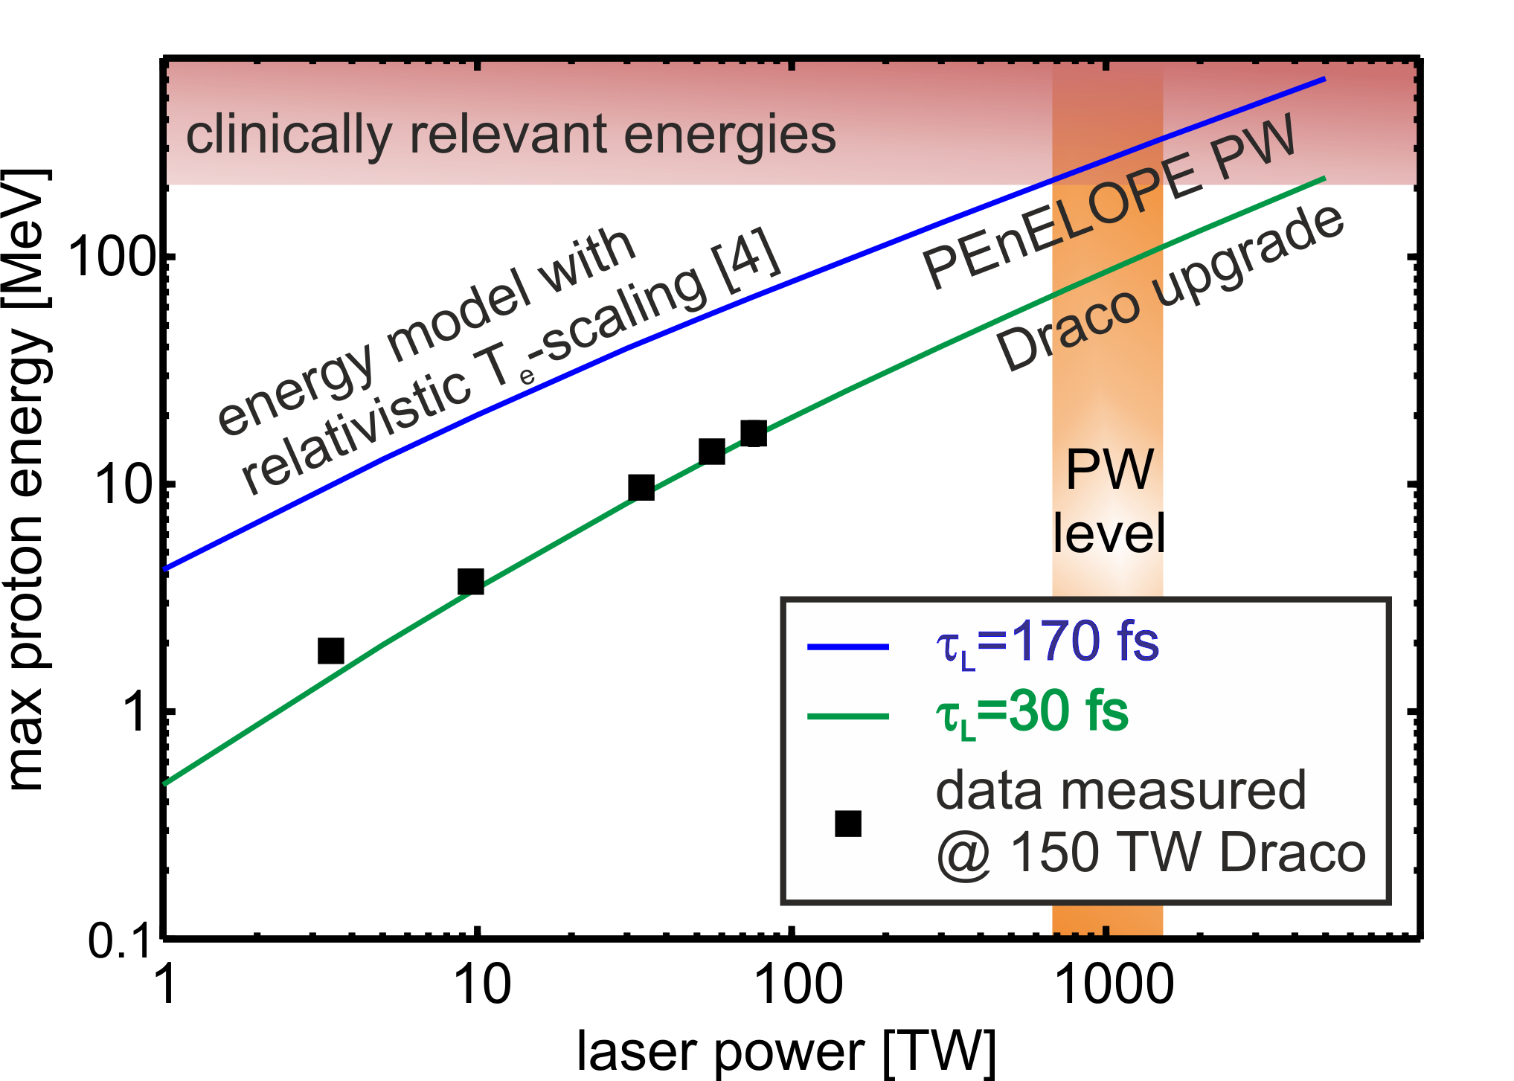
Main challenge: proton energy scaling for application
with PM @ 12 J up to 50 Mev
[1]
first series in 2016
ca. 40 MeV p from
1 µm Ti-foil
with PM @ 2.5 J around 25 MeV
[2,3,4]
Laser could deliver up to 25 J on target → 80 MeV for conservative square-root-scaling – Limits !?!?
[1] Kluge et al. PRL 107, 205003 (2011), [2] Ogura et al., OPT. LETT. , 37 (2012),
[3] Jong Kim et al., PRL 111, 165003 (2013), [4] Wagner et al., PRL 116, 205002 (2016)
Notes:
auch wenn therapy with Draco nicht drin ist, 80 MeV sind save für in-vivo, prep PENELOPE and support HiBef
efor cancer therapy and radiobiology
nergy scaling
preparation for PENELOPE
Support Hibef

Slide 5

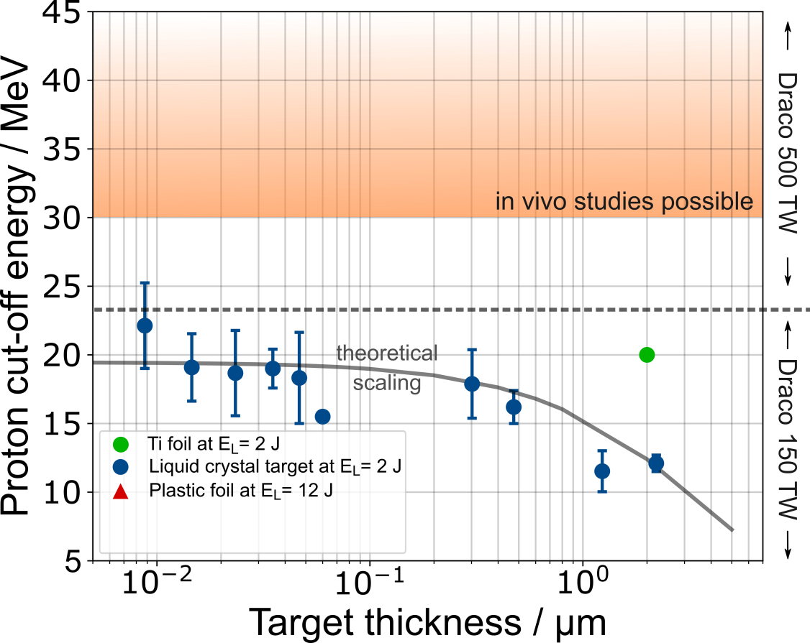
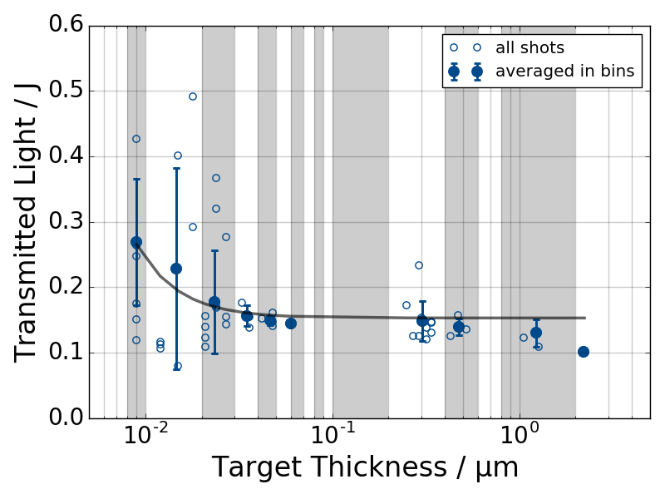
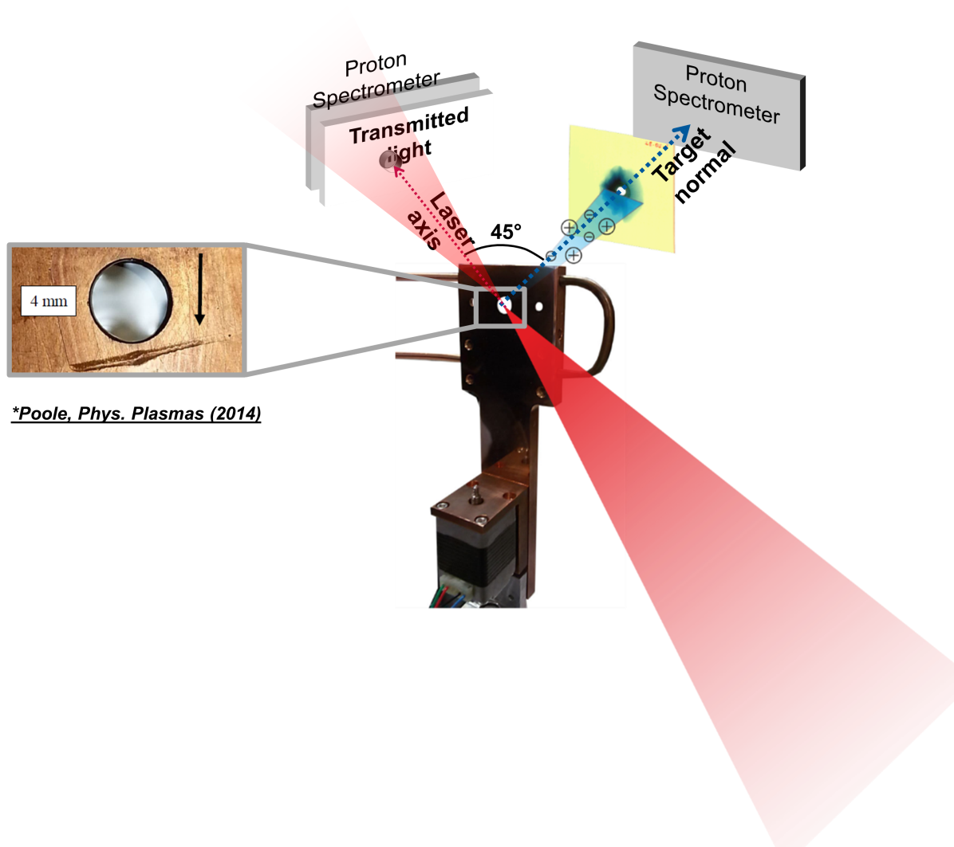
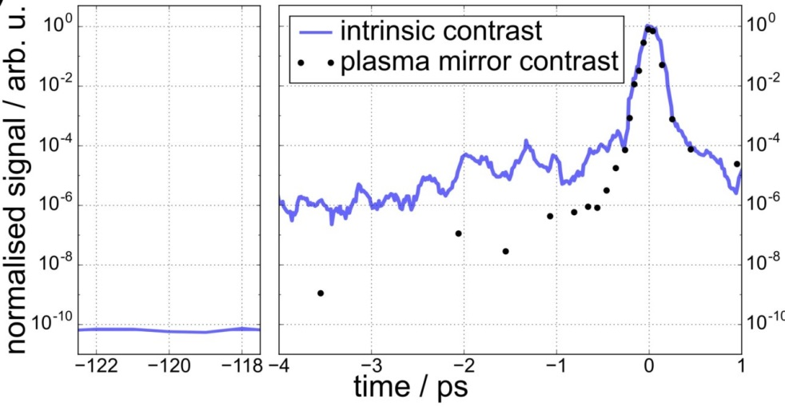
Proton acceleration – enhanced TNSA regime
onset of (relativistic) transparency
Liquid Crystal Target
2.5J / 30fs
Draco contrast
P.L. Poole NJP (2018)
Notes:
P.L. Poole, et al., Laser-driven ion acceleration via TNSA in the relativistic transparency regime, New Journal of Physics 20, 013019 (2018)

Slide 6

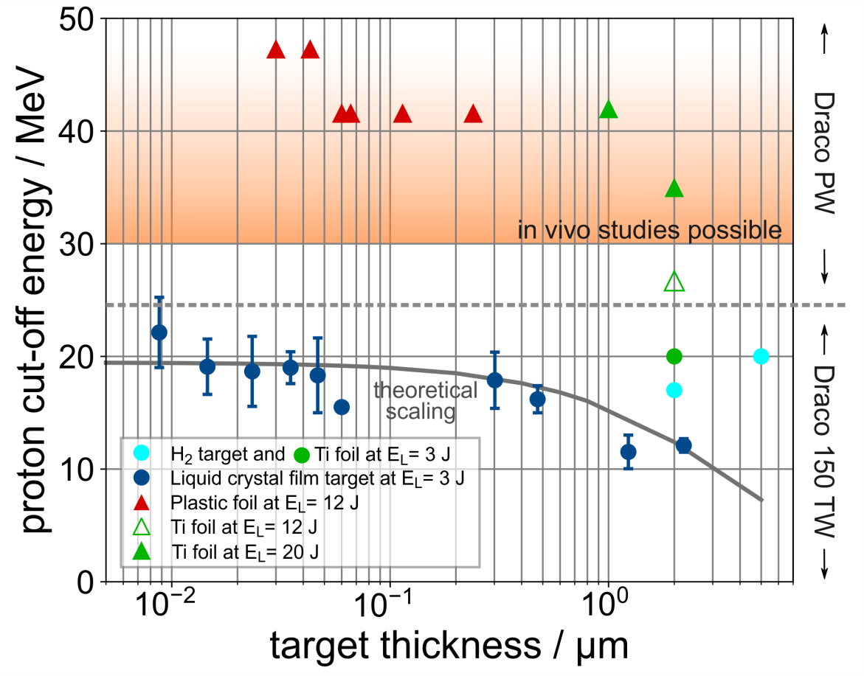
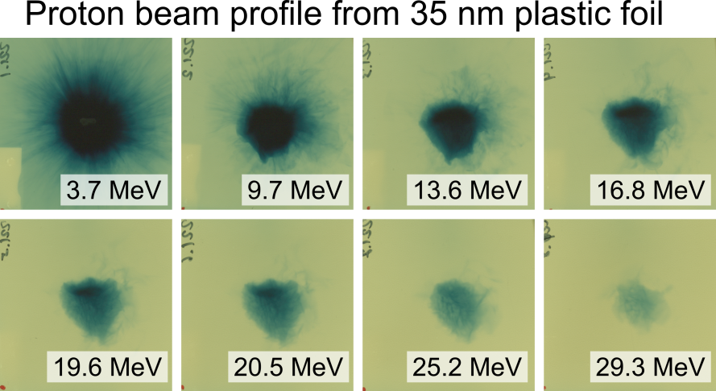
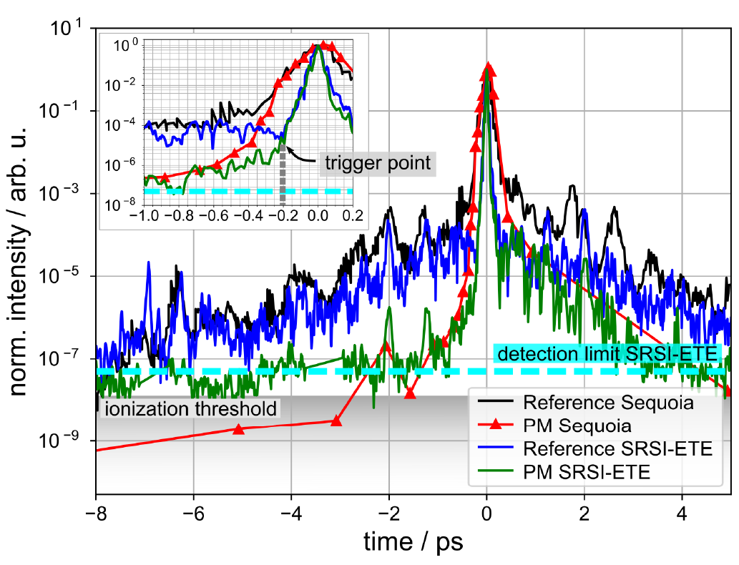
Proton acceleration – enhanced TNSA regime
usual
best performance ≠ usual
key could be temporal pulse shape of the last picosecond
spatio-temporal laser pulse distribution in the focus not sufficiently known: laser ↔ experiment ↔ simulation
L. Obst PPCF (2018), T. Oksenhendler Opt. Exp. (2017)
Notes:
P.L. Poole, et al., Laser-driven ion acceleration via TNSA in the relativistic transparency regime, New Journal of Physics 20, 013019 (2018)
L. Obst, et al., Single Plasma Mirror Temporal Contrast Improvement with On-Shot Characterization, Plasma Physics and Controlled Fusion 60, 054007 (2018)
T. Oksenhendler Opt. Exp. (2017)
this is were we are now
explored thin foils with enhanced contrast
so far less than expected → still optimizing
nice profiles and energy sufficient

Slide 7
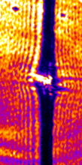
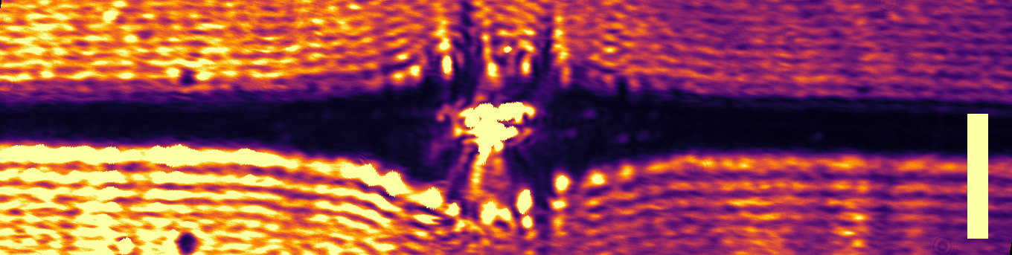
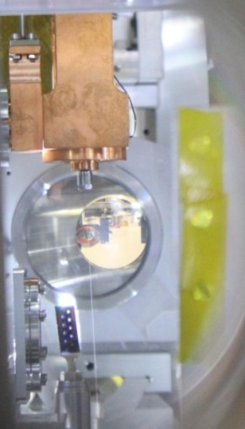
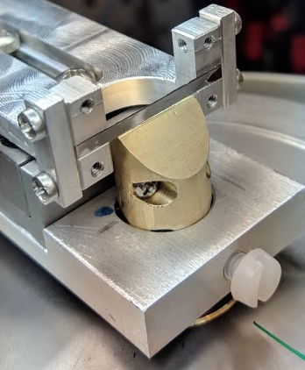
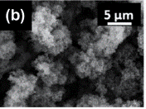
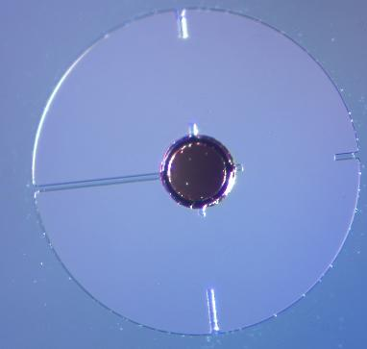
Proton acceleration – targetry
cryogenic hydrogen target
usual
+5ps
+10 ps
+20 ps
+35 ps
L. Obst Sc. Rep. (2017), M. Gauthier APL (2017),T. Ziegler PPCF (2018)
→ next talk by L. Obst
Targetry
mass limited, foams, cryogenics, liquid crystals, gas
P. Sommer PPCF (2018), S.D. Kraft PPCF (2018), P.L. Poole NJP (2018), S. Göde PRL (2017)
Notes:
P.L. Poole, et al., Laser-driven ion acceleration via TNSA in the relativistic transparency regime, New Journal of Physics 20, 013019 (2018)
L. Obst, et al., Single Plasma Mirror Temporal Contrast Improvement with On-Shot Characterization, Plasma Physics and Controlled Fusion 60, 054007 (2018)
this is were we are now
explored thin foils with enhanced contrast
so far less than expected → still optimizing
nice profiles and energy sufficient

Slide 8
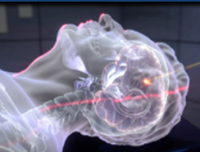
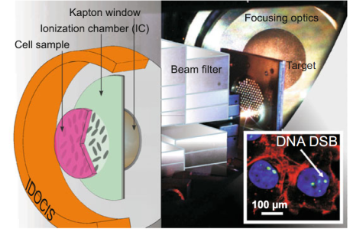
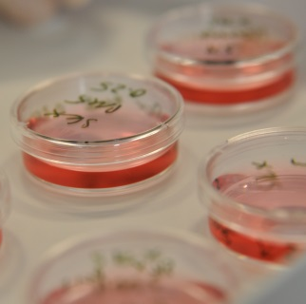
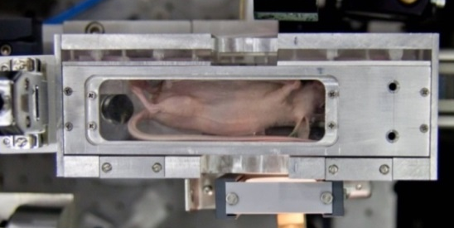
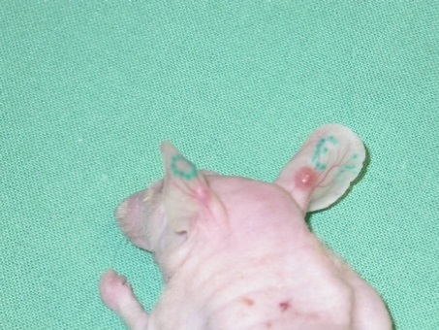
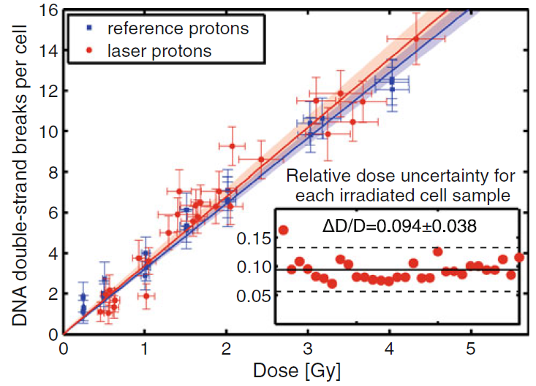
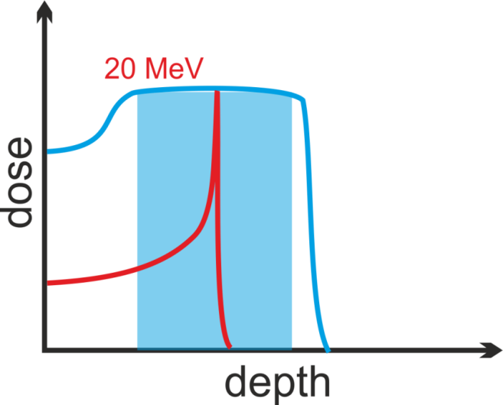
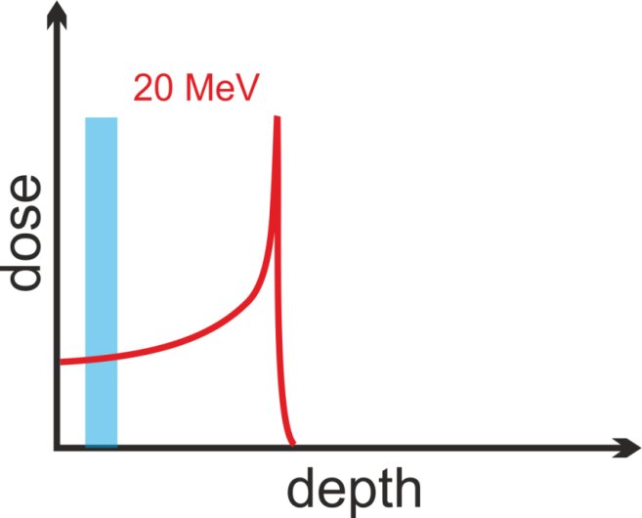
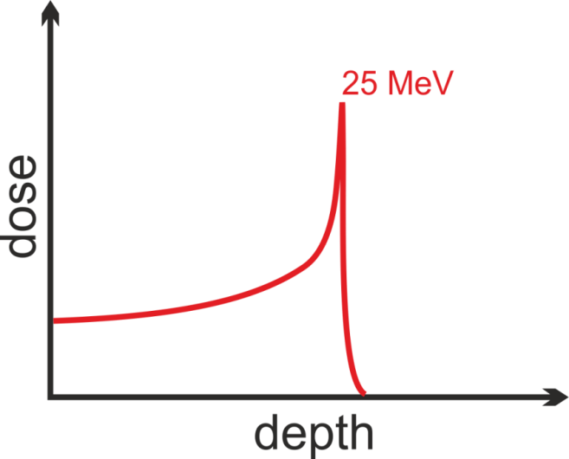
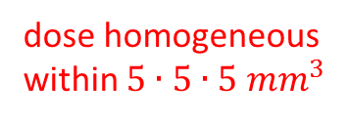
Motivation: Compact ion accelerator for cancer research
Feasibility of laser-driven proton & ion dose delivery for radio-biology studies at lower proton energies
In vitro cell irradiation
In vivo cell irradiation
dose homogeneous within $5∙5∙5 {mm}^{3}$
15 MeV
SOBP
3D
2D
Notes:
we are the only ones / last who are seriously working on that

Slide 9
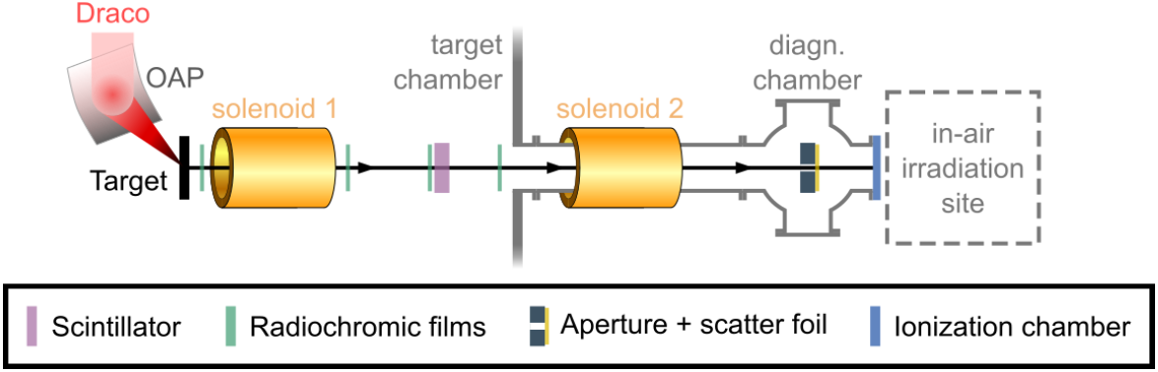
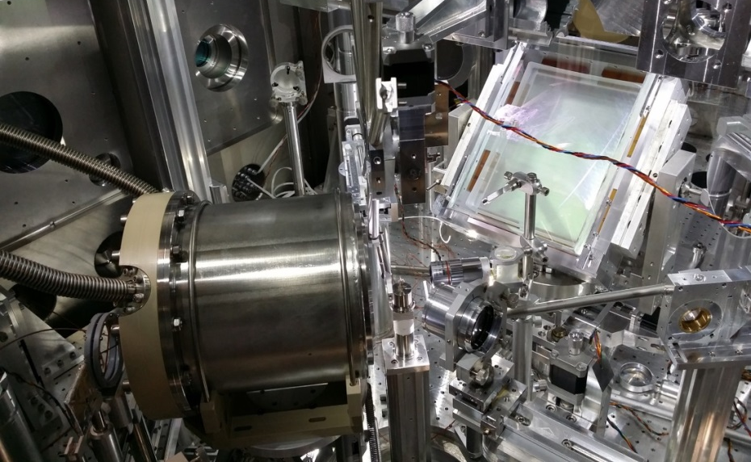
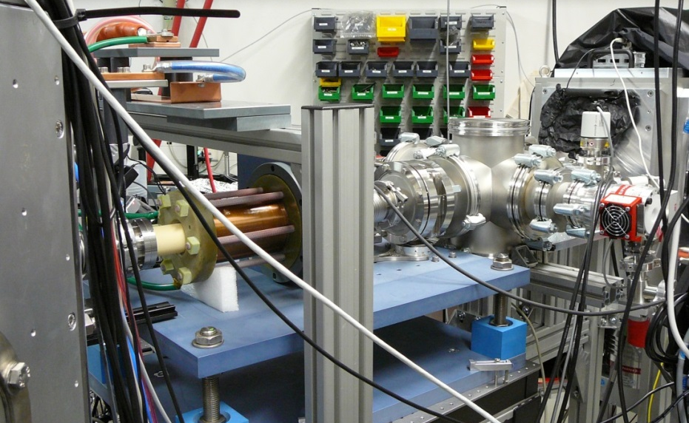
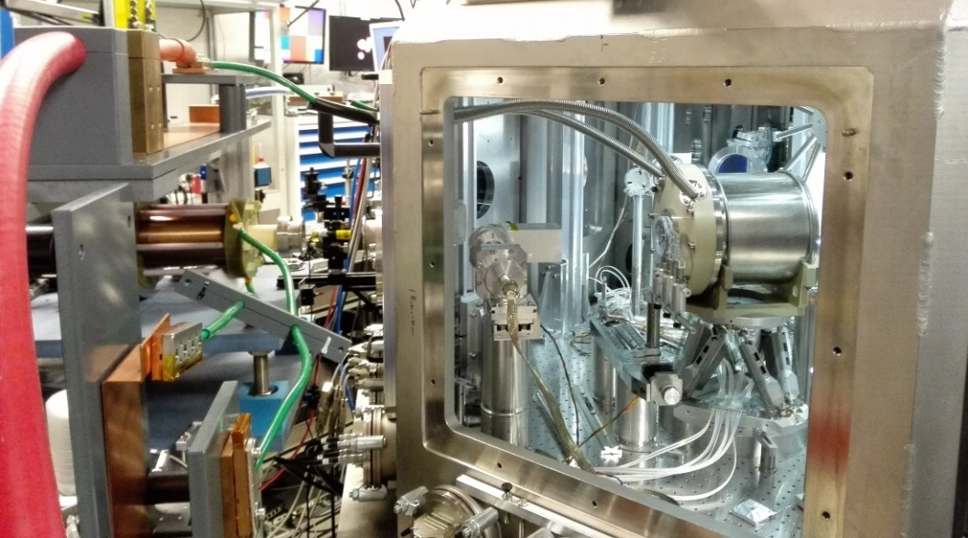

Pulsed beam line for in-vivo irradiation with SOPB
Off-Axis Parabola
Irradiation site
Solenoid 2
Solenoid 1
Target
Solenoid 2
Solenoid 1

Slide 10
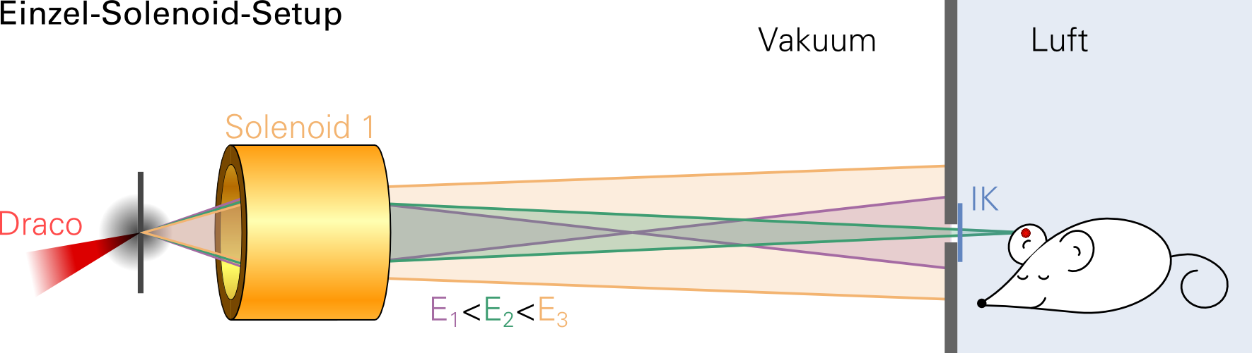
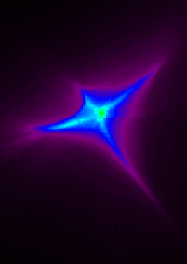
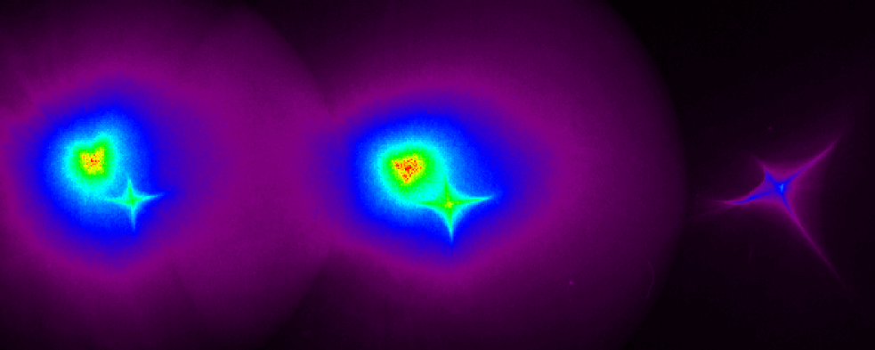

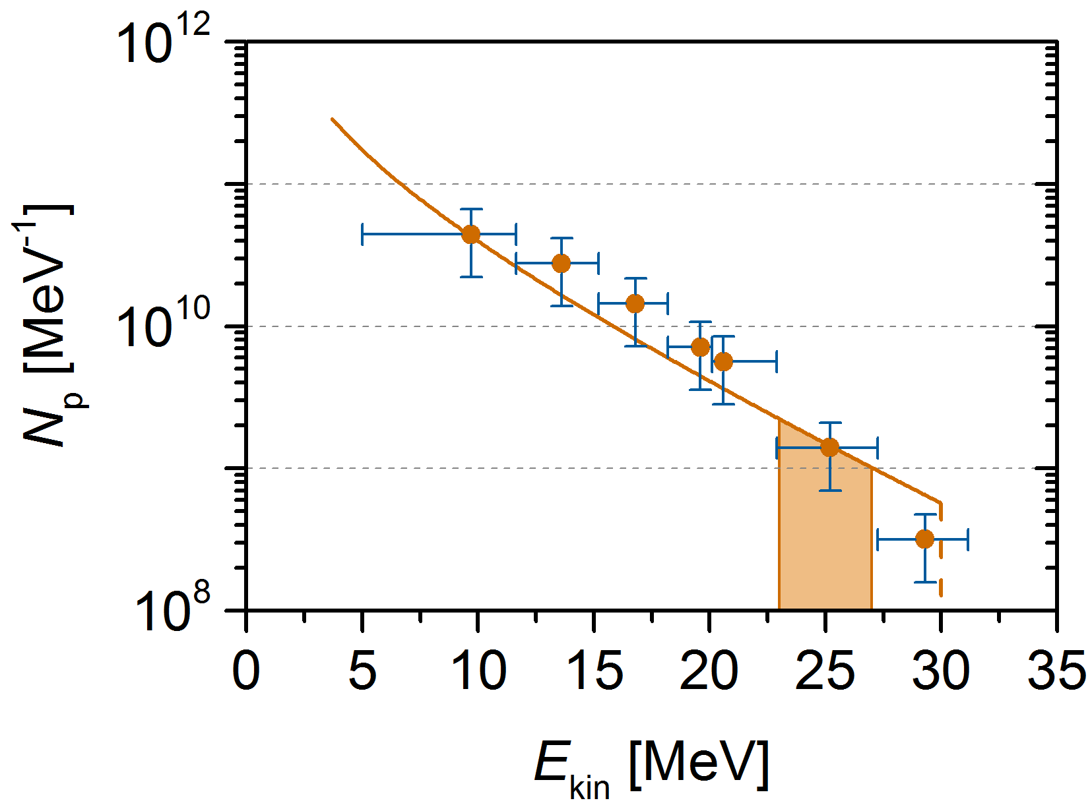
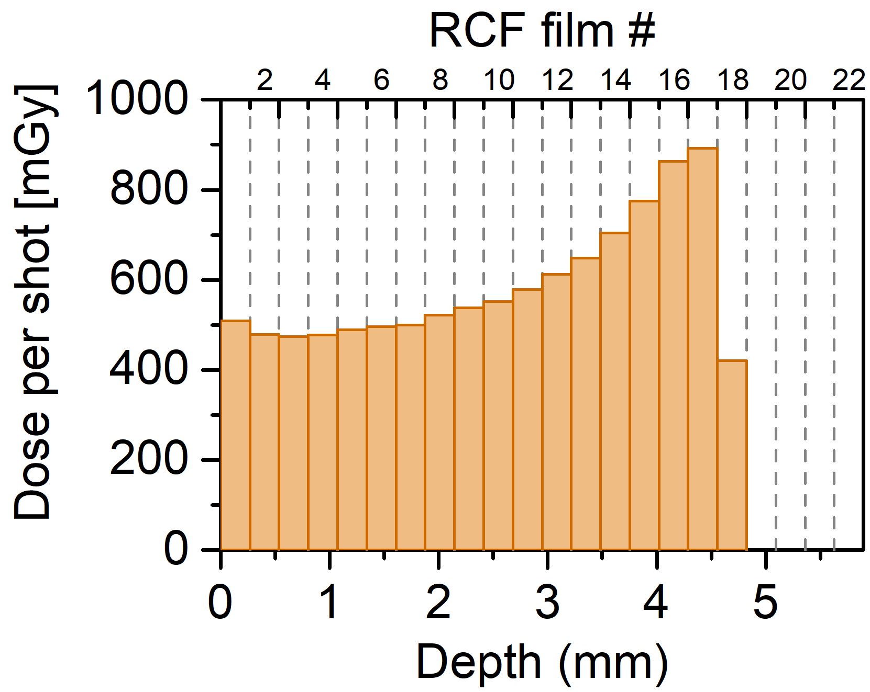


Tunable proton beamline – single solenoid
D [Gy]
1-solenoid Setup
30
vacuum
air
15
1 cm
0
18,6 MeV
RCF #
D_{shot} [mGy]
d [mm]

Slide 11
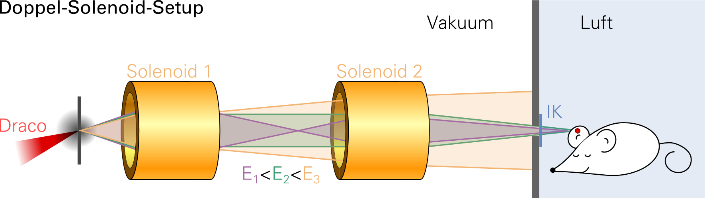
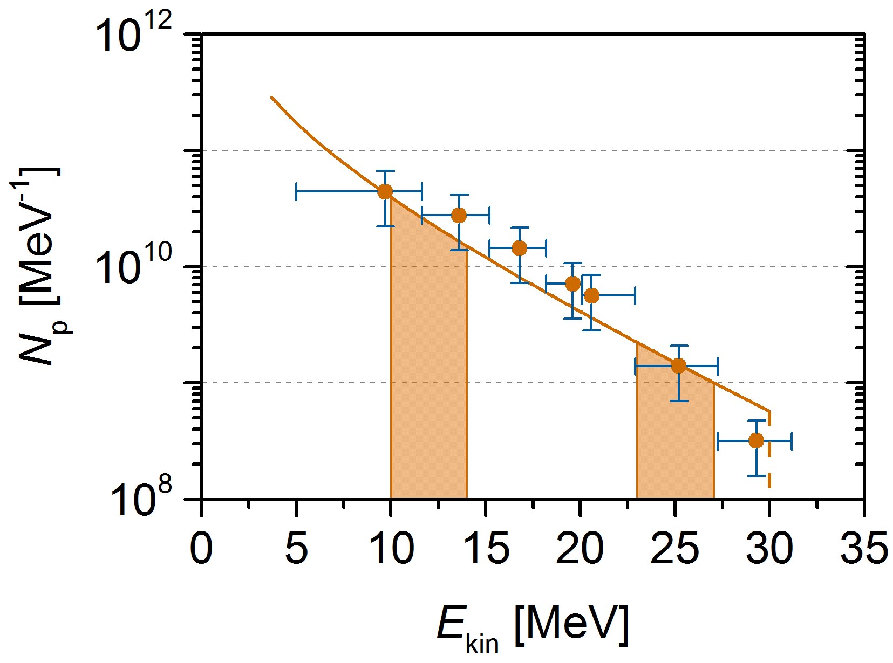
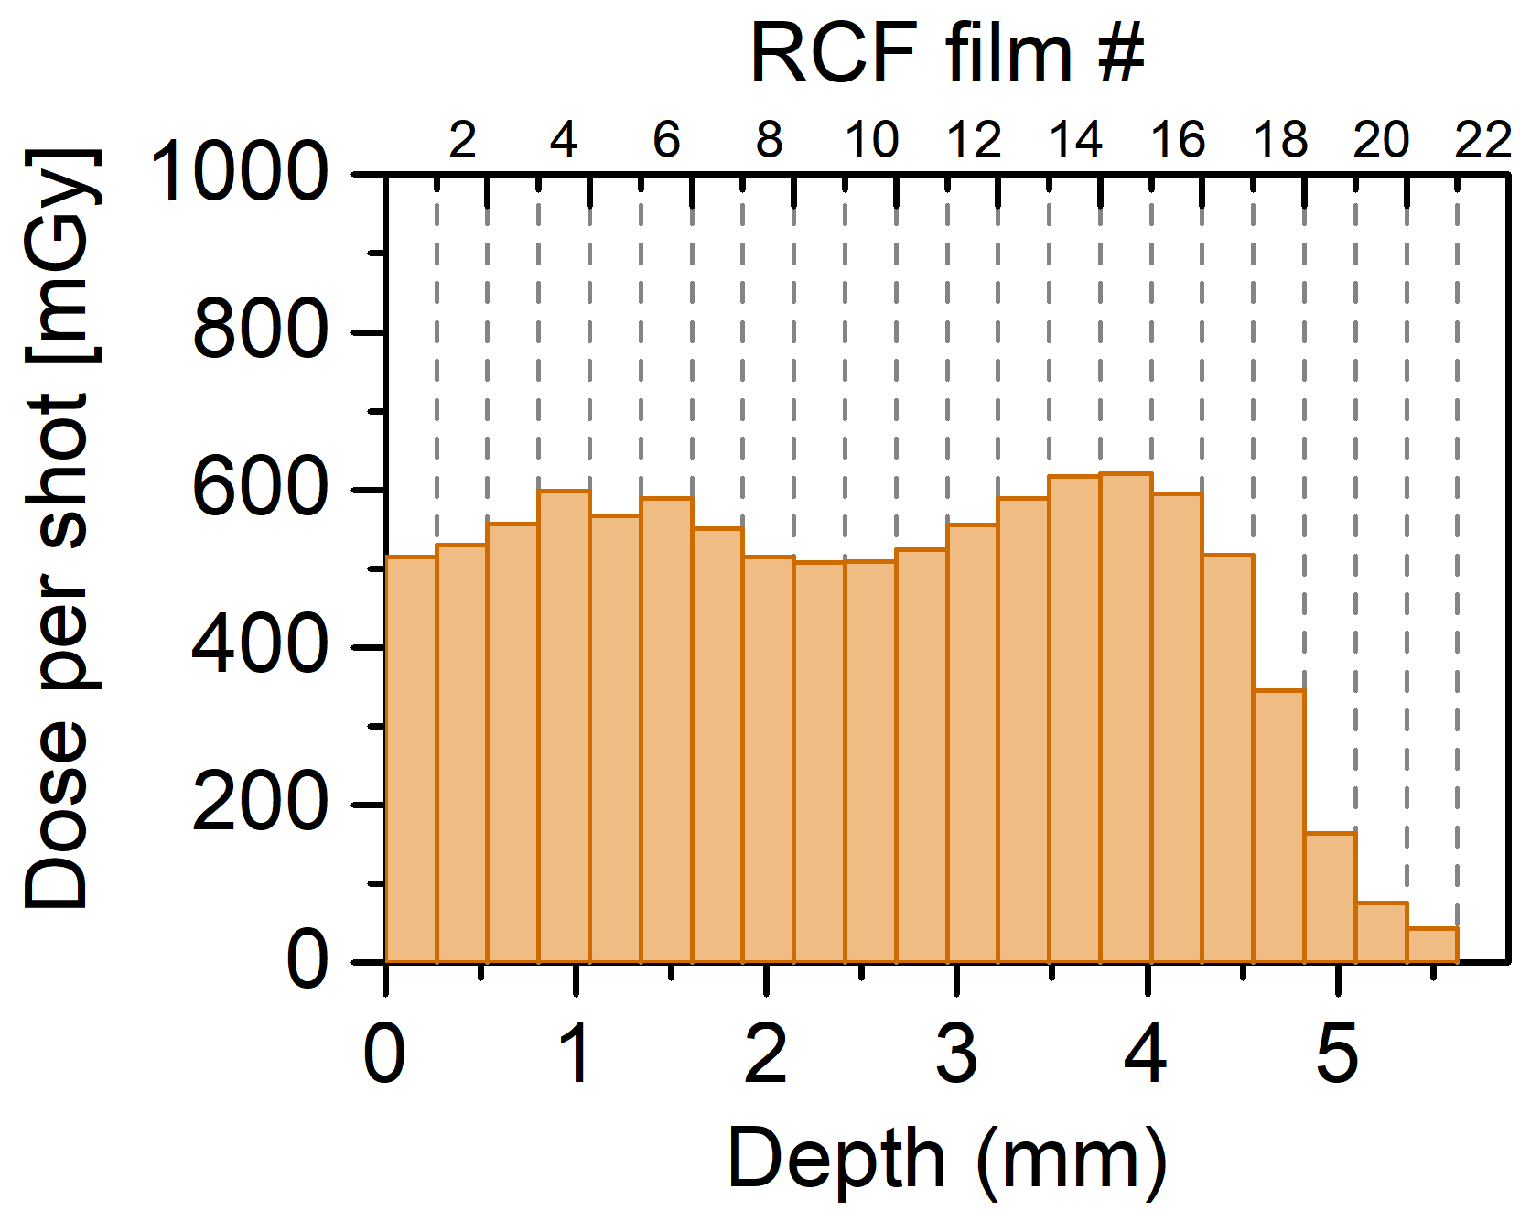
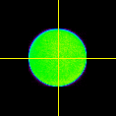
Tunable proton beamline – double solenoid
D [Gy]
30
2-solenoid Setup
vacuum
air
15
1 cm
0
18,6 MeV
12,3 MeV
RCF #
D_{Schuss} [mGy]
0
800
D [mGy]
Modulation
(peak-to-peak) < 17 %
d [mm]

Slide 12








Acknowledgement - Collaboration partners
S. Glenzer, C. Curry, M. Gauthier, J. Kim, F. Fiuza
S. Goede et al.
D. W. Schumacher, P. L. Poole, G. E. Cochran
V. Malka, D. Levy, E. Kroupp (Whelmi)
M. Nichiuchi, H. Kyriama, N. Dover
C. Roedel, M. Kaluza, G. Becker
J. Schreiber, D. Haffa, F. Englbrecht
M. Passoni et al.
Notes:
a list of some, although there are many more activities not necessarily pushed from the group

Slide 13
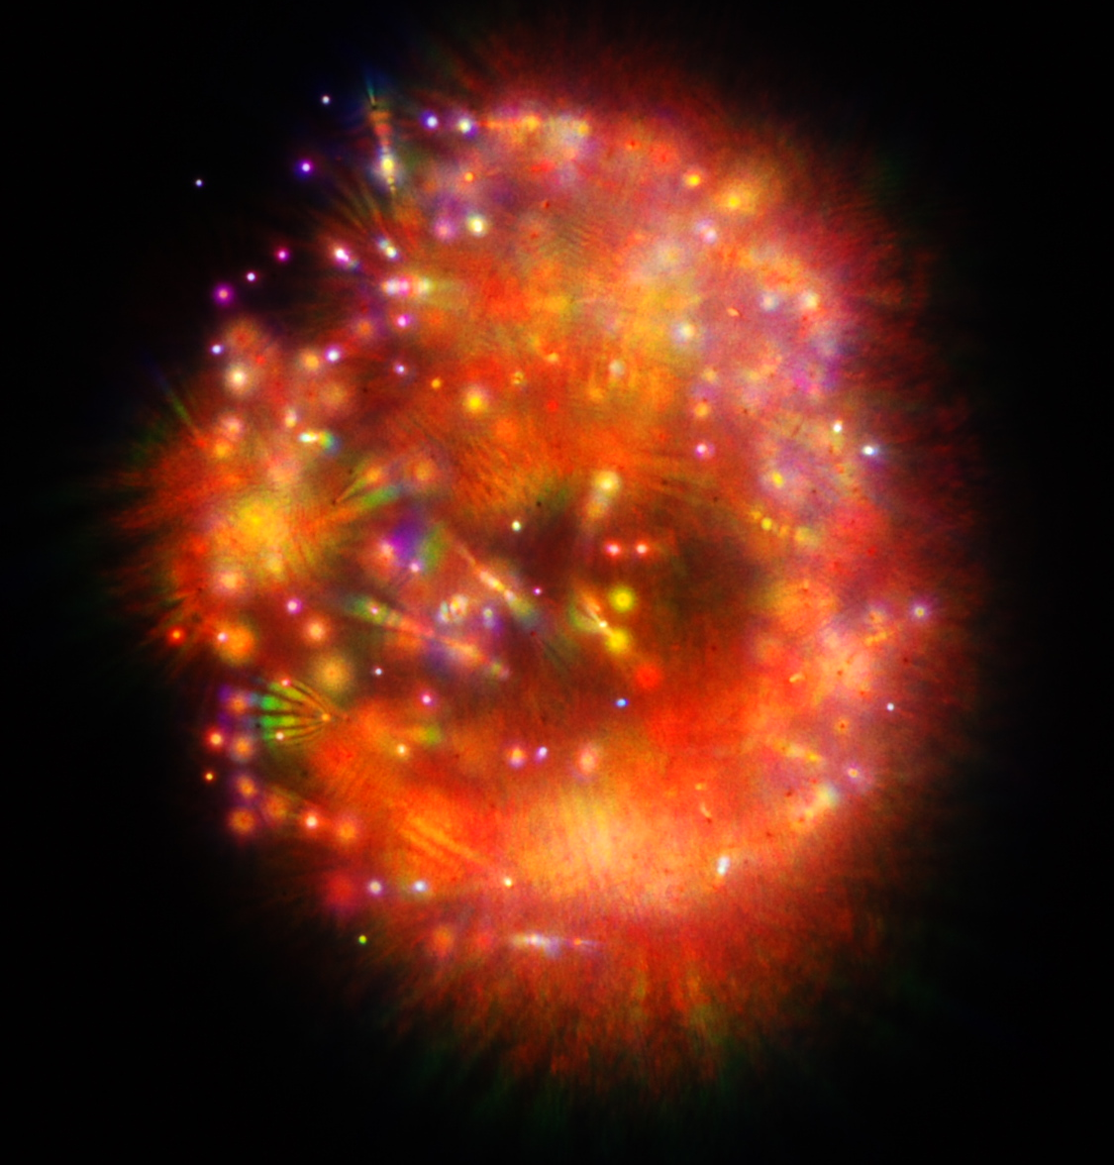
Thank you for your attention
multiple filamentation of freely
propagating 100 TW beam in air

