Slide 1
LEAPS - Technology Roadmaps for Detectors, Accelerators, Information Technology
Hans Braun, PSI Spokesperson LEAPS working group “Photon Sources”
4th annual meeting of the Helmholtz program "Matter and Technologies” HZB, 14.6.2018

Slide 2
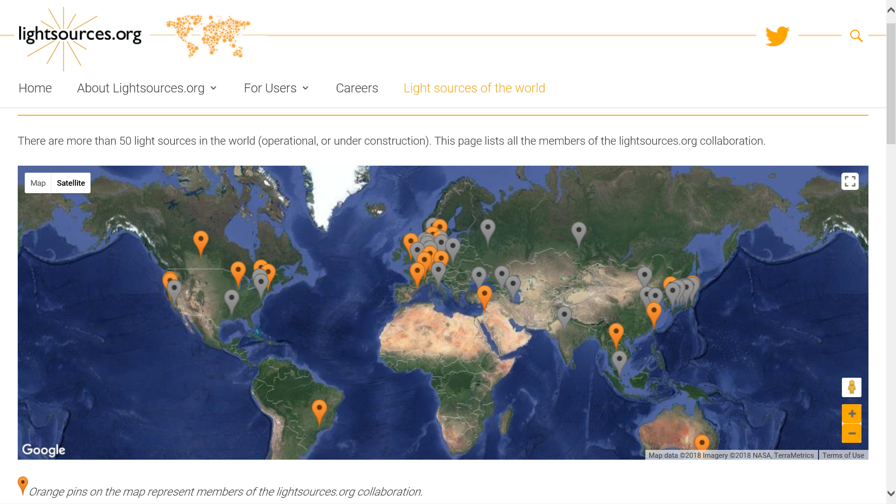

Slide 3
World w/o Europe investment 2017 – 2022: ≈ 3.500 M€ → 700 M€/y
World ≈ 900M€/y
European investment 2010 – 2025: ≈ 3.000 M€ → 200 M€/y

Slide 4
A new consortium of excellence in Europe
13 European Synchrotron Radiation User facilities
and 6 FEL User Facilities are
joining forces to master the challenges of the next decades

Slide 5
LEAPS - League of European Accelerator-Based Photon Sources
Launched: 2015
Members: 16 Laboratories with total 19 Photon User Facilities + European Synchrotron User Organization

Slide 6
LEAPS - League of European Accelerator-Based Photon Sources
Goals:
Secure EU leadership for decades
Coherent Roadmap of all SR and FEL facilities in EU
Strong & diverse user community
Best practice
Push & disseminate technology
Integration & sustainability
Enable excellent science
Next generation light sources
Open science
LEAPS Charter
LEAPS Strategy Document &
LEAPS Kickoff Event in Brussels, 13.11.2017
Input to European Commission
Framework Program FP9 2021-2027

Slide 7
LEAPS webpage

Slide 8
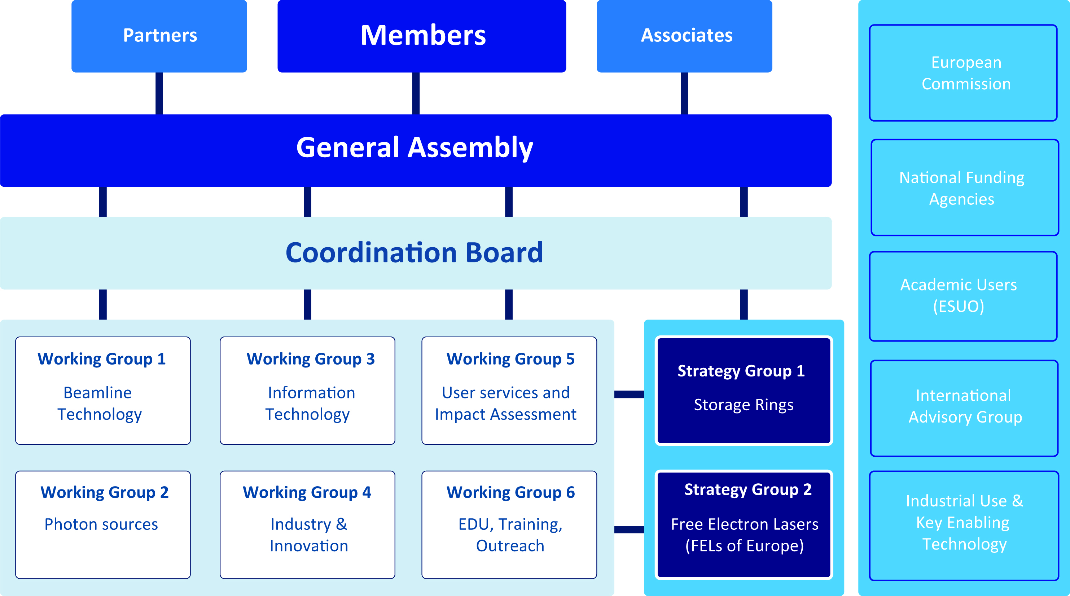
Organisation
GA Chair: Helmut Dosch
GA Vice chair: Catarina Biscari
WGs
SG 1&2

Slide 9
Organisation
GA Chair: Helmut Dosch
GA Vice chair: Catarina Biscari
WGs
SG 1&2

Slide 10
LEAPS Working Groups Leaders
WG 1 Beam Technology Edgar Weckert/DESY & Jean Daillant/SOLEIL
WG 1.1 Detectors Heinz Graafsma/DESY
WG 1.2 Optics Ray Barett/ESRF
WG 1.3 Sample Environment Luc Patthey/PSI
WG 2 Photon Sources Hans Braun/PSI
WG 1.1 Synchrotrons Andreas Jankowiak/HZB
WG 1.2 FELs Th. Tschentscher/Eu-XFEL & S. DiMitri/ELETTRA
WG 1.3 Compact sources Ralph Assmann/DESY
WG 3 Data Management Mark Heron/DIAMOND
WG 4 Industry & Innovation Ed Mitchell/ESRF
WG 5 User Services & Impact Cecilia Blasetti/ELETTRA
WG 6 Education & Training Marjolein Thunnissen/MAX IV

Slide 12
Synchrotron based photon sources
e⁻ synchrotrons are established as dedicated user X-ray photon sources for several decades.
Europe is playing with ESRF and 12 top quality national facilities a leading role worldwide.
What is required to maintain this role?

Slide 13
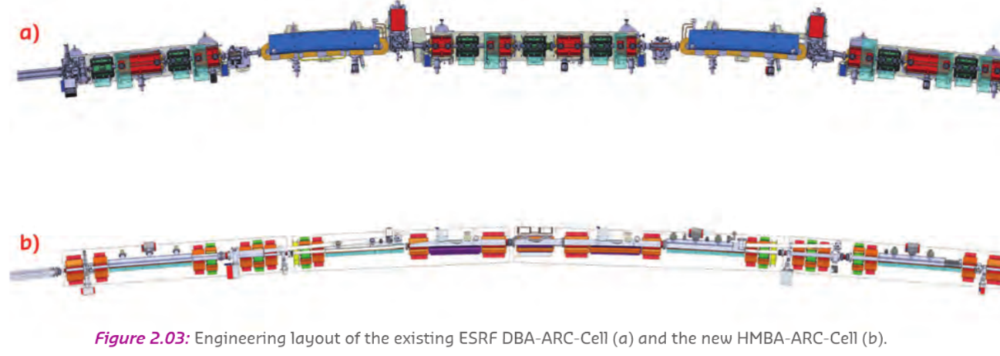
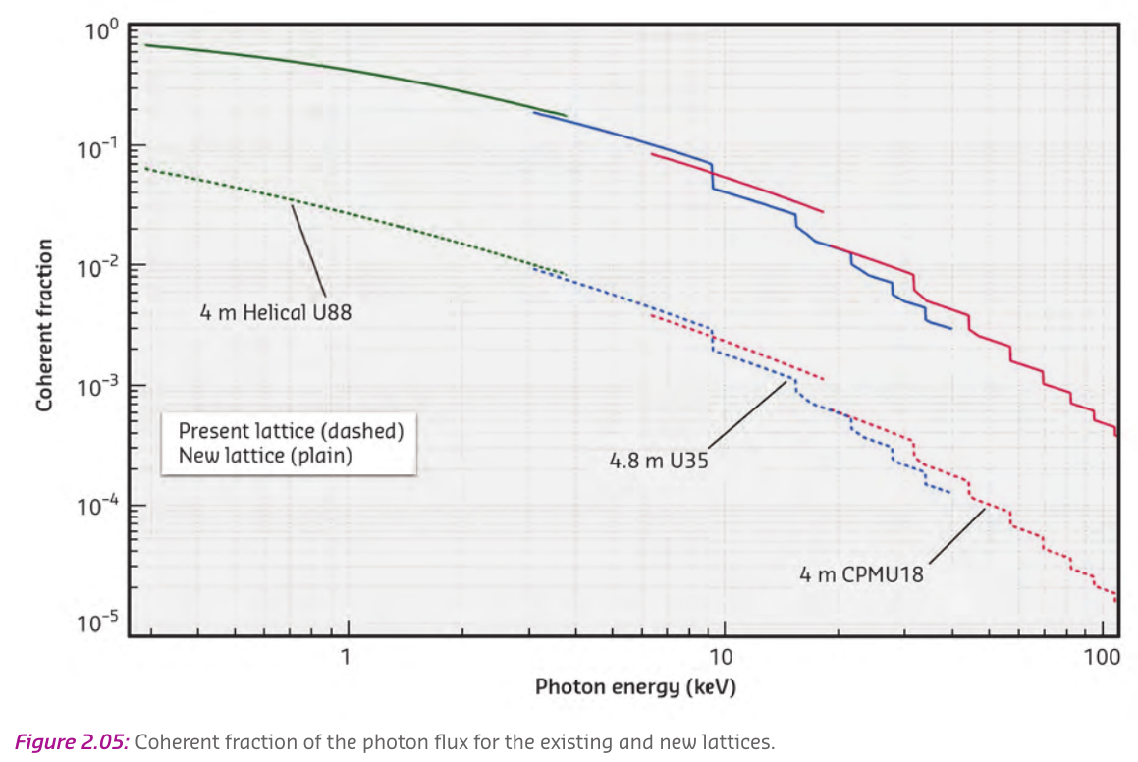
Recent development of MultiBend Achromats (MBA) with ultra low emittance allows a dramatic increase of photon beam brilliance and coherence
Present ESRF magnet lattice
Example EBS,
the upgrade of the
ESRF Synchrotron
Future EBS magnet lattice
Images from:
ESRF Upgrade Programme Phase II (2015-2022) - Technical Design Study

Slide 14
The majority of synchrotron based user facilities has been in operation for 10-20 years and is planning for major upgrades in the next decade to remain
Scientifically competitive.
Experiments need higher brightness, better coherence, better time resolution
→ R&D for improved storage rings concepts and related technologies, in particular magnet, vacuum and RF systems
Better photon beam quality put tighter constraints on X-ray optics to conserve the beam quality from source to sample
→ R&D on X-ray mirrors and X-ray focusing optics
Brighter beams, smaller focus sizes allow for more sophisticated samples
→ R&D on sample environment
Improved coherence, brightness and shorter pulses ask for photon detectors with improved spatial, spectral and timing resolution, increased spectral range and largely improved dynamic range
→ R&D on photon detectors for improved spatial, spectral and timing resolution, increased spectral range and dynamic range
This leads inevitably to massive increase of data rate, transport, storage,
and related soft- and hardware for data handling and analysis
→ R&D on data handling

Slide 15
The next generation of synchrotron based photon sources needs
improvement of all elements from photon source through sample environment to detectors and data processing
for success!
→ Coordinated European effort for the required R&D in all relevant areas

Slide 16
Free Electron Laser photon sources
FELs covering the VUV to hard X-ray wavelengths are a recent development.
2005 first VUV FEL FLASH/DESY started user operation
2009 First X-ray FEL LCLS/SLAC started operation
2011 X-ray FEL SACLA / Japan started operation
2016 X-ray FEL PAL-XFEL / South-Korea started operation
2017 First X-ray FELs in Europe, Eu-XFEL and SwissFEL, started experiments
FELs complement storage rings with the capability to provide
extremely intense, coherent photon pulses of femtosecond duration.
Key R&D challenges
Better control of spectral and temporal properties for better energy and time resolution.
Full longitudinal coherence at X-ray wavelength
C.W. operation
Experiment environment and methods
Many common R&D issues with next generation synchrotrons → Synergies from coordination across areas

Slide 17
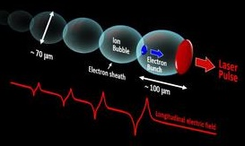
Future Compact Sources
Longer-term goal:
Development of compact sources based on plasma wakefield acceleration Make capabilities of FELs available for industrial applications, hospitals and smaller laboratory environments.
→ Many common R&D issues with next generation synchrotrons and FELs
Synergies from coordination across areas

Slide 18
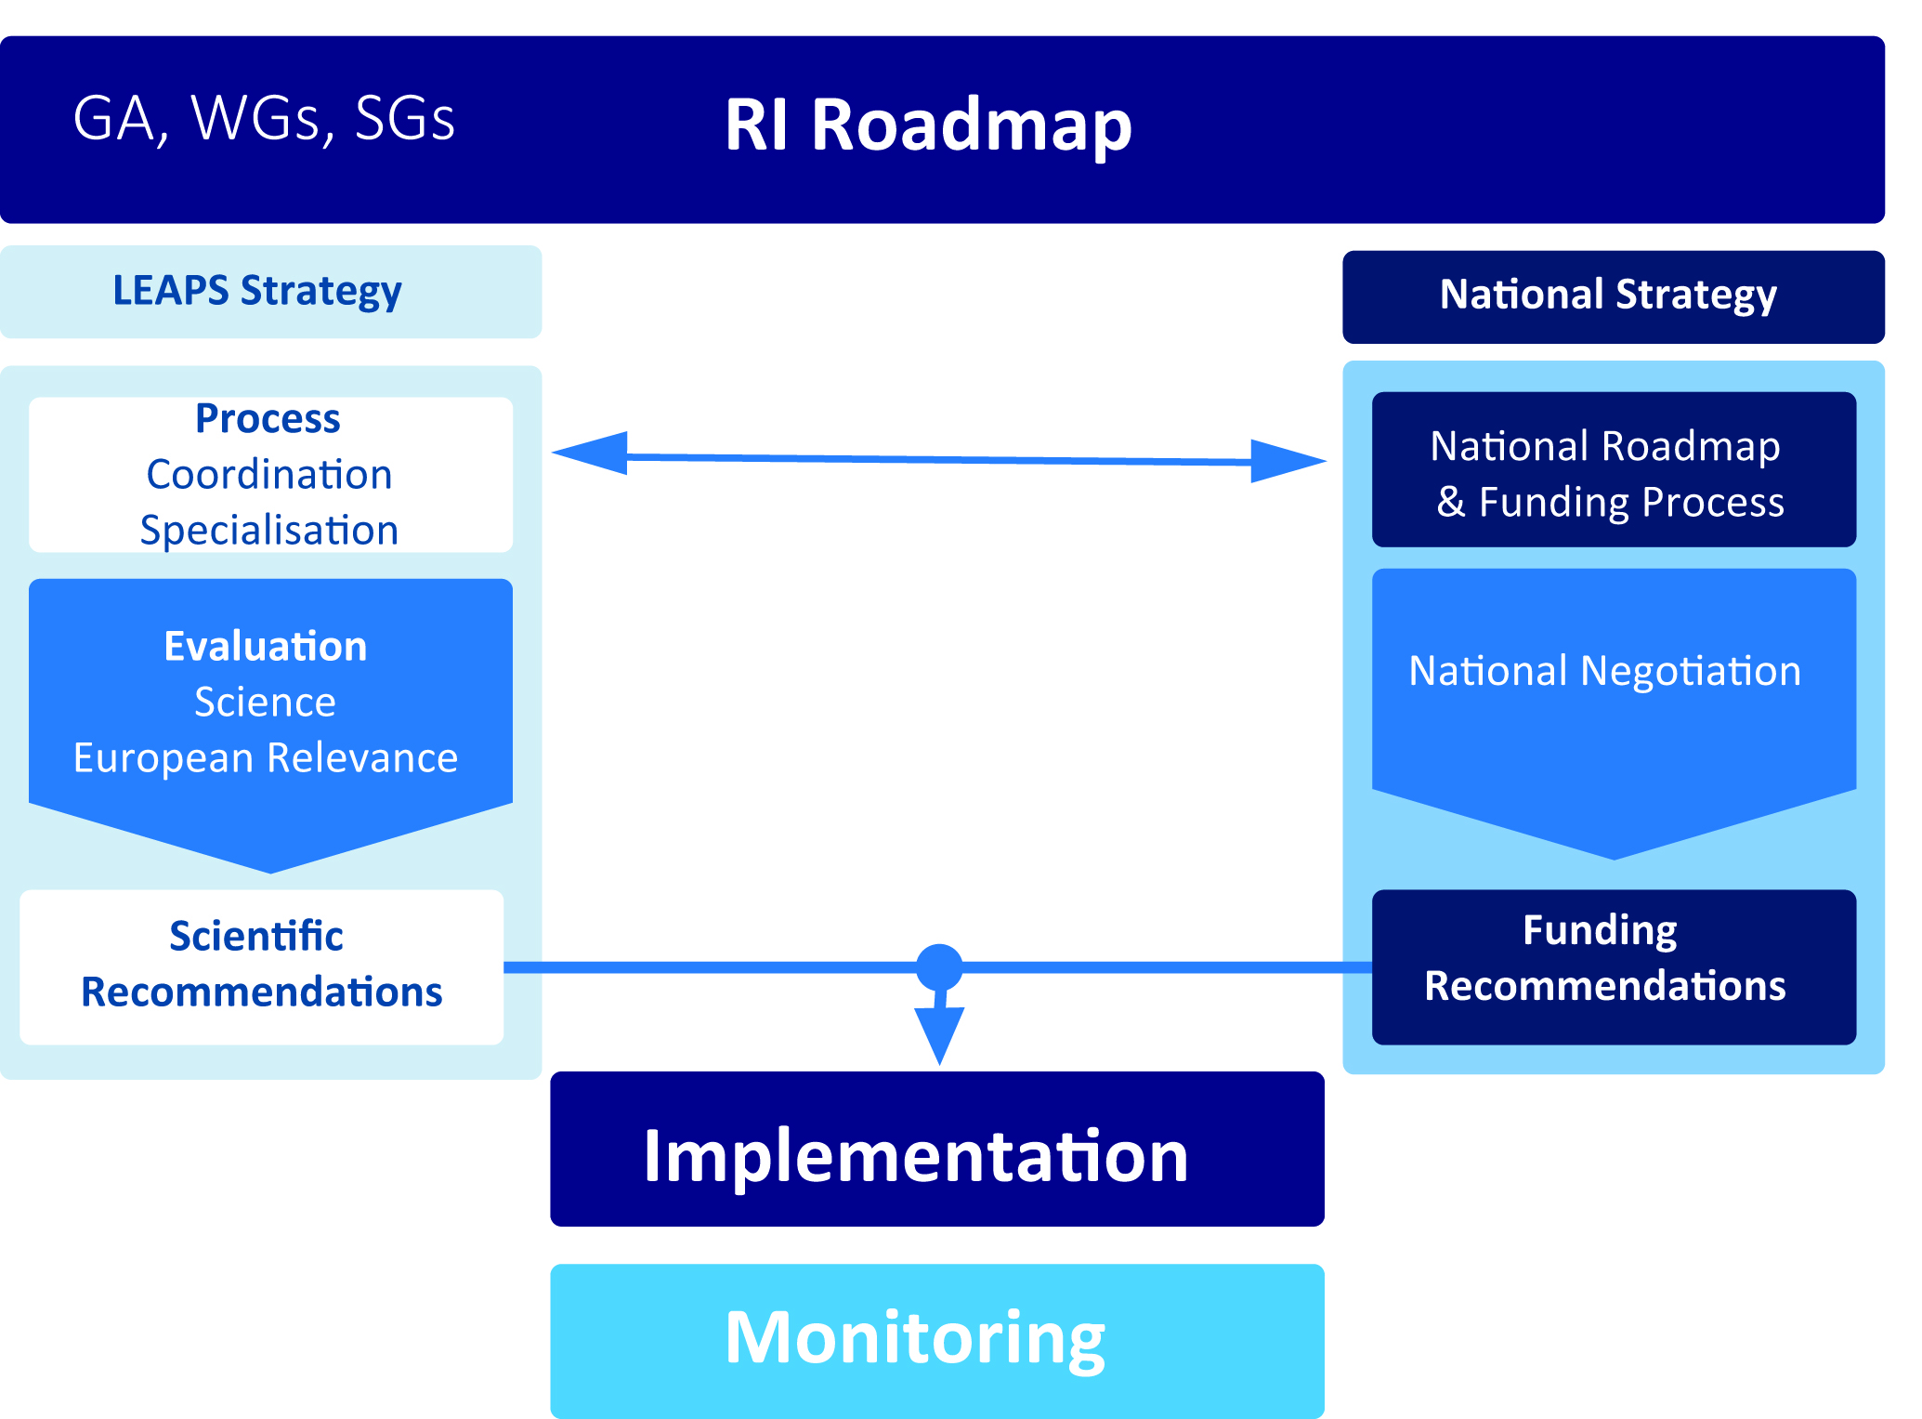
LEAPS Research Infrastructure (RI) Roadmap

Slide 19
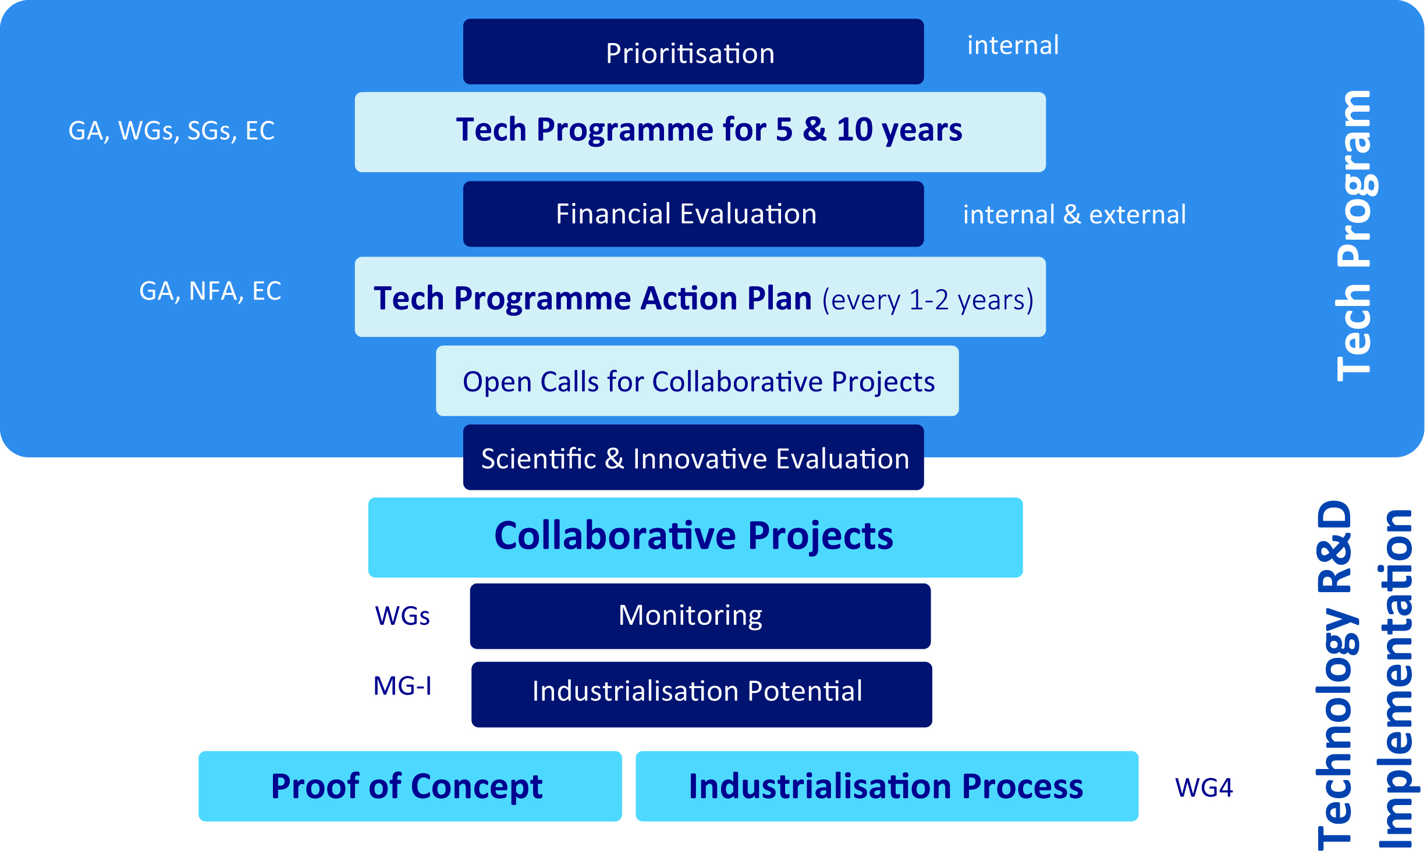
LEAPS Technology Roadmap Process

Slide 20
Technology Roadmap: first list of projects I
WG 1 Beam Technology

Slide 21
Technology Roadmap: first list of projects II
WG 2 & WG 3

Slide 22
Technology Roadmaps
Technology 2018-2028 |  | requires / Mio €
Beamline technology | Detectors, optics, sample environment | 200
Photon Sources | (novel accelerators) | 198
Information technology / Data |  | 137
~ 650 Mio €
Integration 2018-2028 | requires / Mio €
Innovation & industry | 85
User Services and Impact Assessment | 5
Education, training & outreach | 25
Governance | 0
LEAPS is aiming for support by the E.C. in FP 9 and beyond

Slide 23
Next
LEAPS plenary meeting 12-14 Nov 2018 @ DESY
Preparation of an EC proposal for submission beginning 2020
with 2-4 technology projects
Pilot for LEAPS Tech Progam under FP9

Slide 24
Facility Roadmaps – 2020-2035
LEAPS roadmap process has been started
Consultation of national authorities
Integration of user needs ➔ ESUO questionnaire 2016/17
2018 LEAPS focus activities
Upgrade of European Synchrotron Radiation Facilities with 4th generation technology
▪
▪
▪
Novel high brilliance storage rings Strong international competition
MAX IV and ESRF: international trend-setters and technology drivers

Slide 25
Summary
Pushing X-Ray Science in Europe to the next level building a new RI consortium for FP 9 and beyond
New Cooperation between European Facilities in close interaction with
national authorities and the European Commission
Coordinated transformation of Europe´s facilities towards the nextGen facilities
Smart specialisation strategy among LEAPS facilities
LEAPS roadmaps for facility developments and new technologies
Most advanced technologies to academia and industry
New European training platform for nextGen scientists, industry and future managers
Development of LEAPS as a contact point of the future EOSC
Integration of emerging communities and strategic partners of Europe

Slide 26
Acknowledgment
Many thanks to
Andreas Jankowiak, HZB/Germany
Jean Daillant, SOLEIL/France
Mark Heron, DIAMOND/United Kingdom
Mirjam van Daalen, PSI/Switzerland
For providing slides & informations for this presentation

