Slide 1
Welcome
Matter and Technology
Meeting No. 4
Organisational Issues
Roswitha Schabardin
Matter and Technology Meeting No. 04
12.-14.06.2018

Slide 2
Necessary paperwork: 1. For the tour we need your birth date. Please enter your birth date in the list. 2. For the group photo we need your agreement. Please sign in the photo list.

Slide 3
As usual for the Matter and Technology meeting, we have 2 topical groups. In addition to this, this time we have 3 locations, so we will need to hike around a little in the coming days.

Slide 4
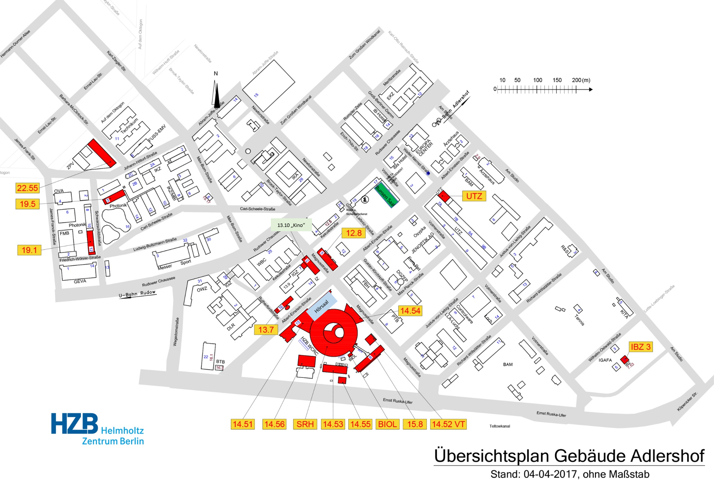
Location MaT Tuesday 12.06.2018, today we are at “WISTA”
Bunsen Saal

Slide 5
Please remove your posters
from the poster boards tonight before leaving,
and take them with you.
We are not at this place here tomorrow.

Slide 6
Wednesday 13.06.2018, MaT moves to HZB
DTS Kino
ARD Hörsaal / lecture hall

Slide 7
All coffee breaks on Wednesday and the buffet dinner
will be
joint events
in the foyer in front of lecture hall

Slide 8
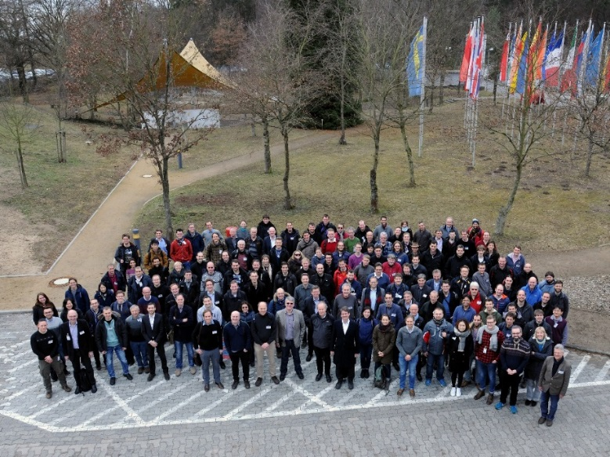
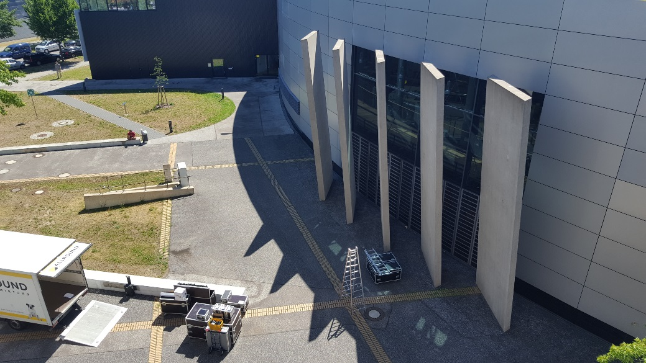
Important!
Wednesday 10:30
(before 1st coffee break)
we want to take the MaT group photo
in front of the BESSY ring

Slide 9
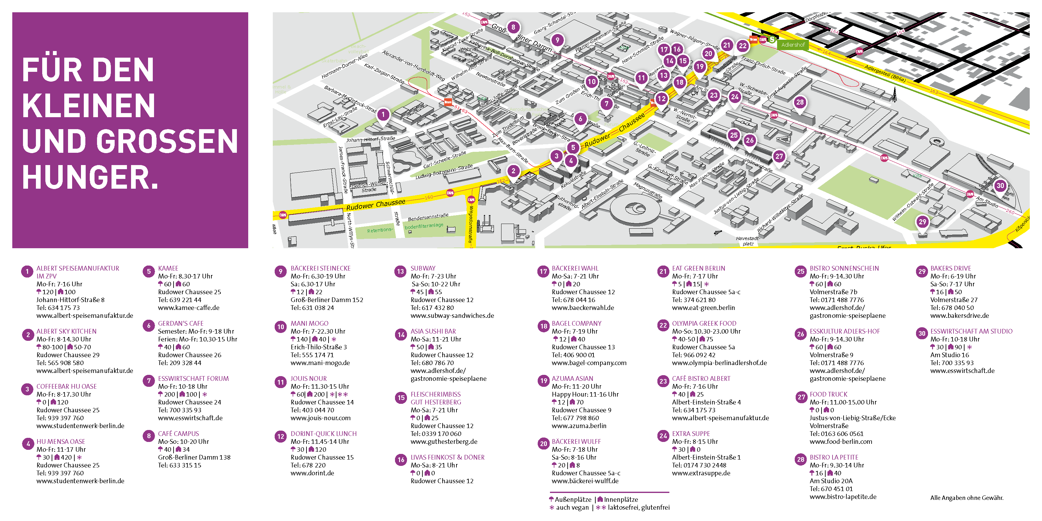
Wednesday 13.06.2018. Looking for lunch?

Slide 10
Thursday 14.06.2018, MaT shifts back to WISTA
Bunsen Saal

Slide 11
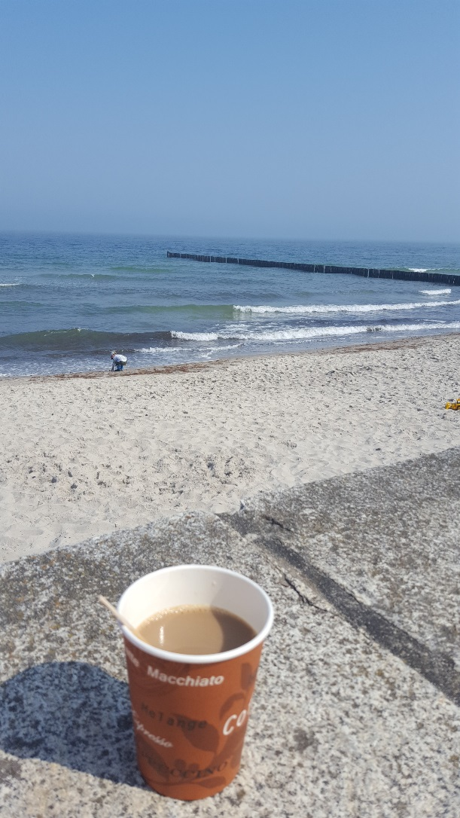
Thank you for your attention
and enjoy the coffee break!

