Slide 1
Ultimate tools for beam diagnostics
L. Rota – lorenzo.rota@kit.edu, M. Caselle – michele.caselle@kit.edu,
T. Atkinson, G. Brenner, E. Bründermann, S. Düsterer, S. Funkner,
C. Gerth, M. Gensch, B. Green, B. Kehrer, C. Mai, A. Mozzanica,
D. Makowski, A. Mielczarek, M.J. Nasse, G. Niehues, M. Patil,
P. Schönfeldt, B. Steffen, B. Schmitt, A.-S. Müller, M. Weber

Slide 2

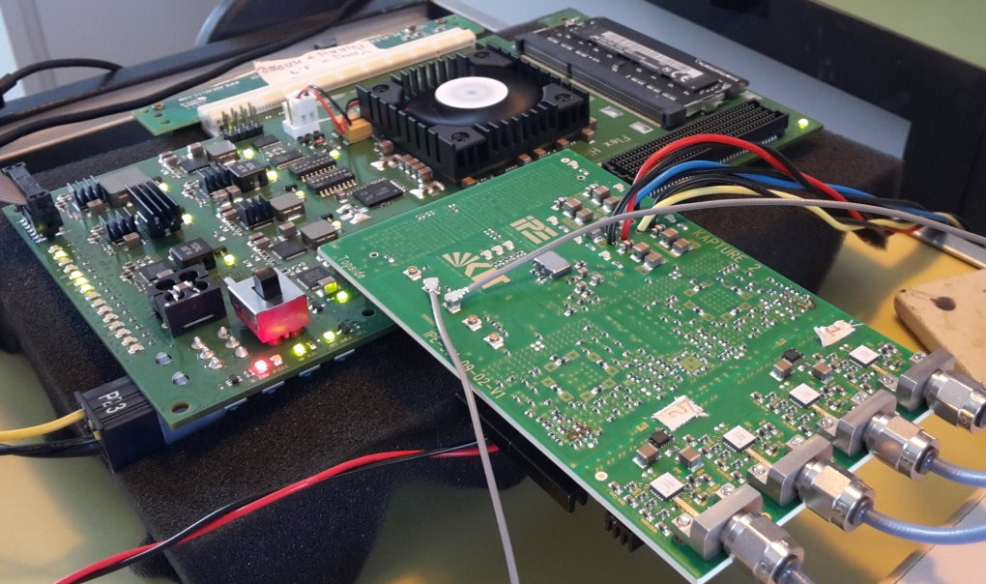
KAPTURE II
Readout electronics for THz detectors
Local sampling frequency > 300 GS/s
Up to 1 GHz trigger rate
Pulse amplitude (mV) and arrival time (ps) accuracy
4 channels per board
8 channels with 2 boards in master/slave configuration
System is operational @ KARA
FPGA Readout
Card
THz detector
inputs
KAPTURE-2

Slide 3
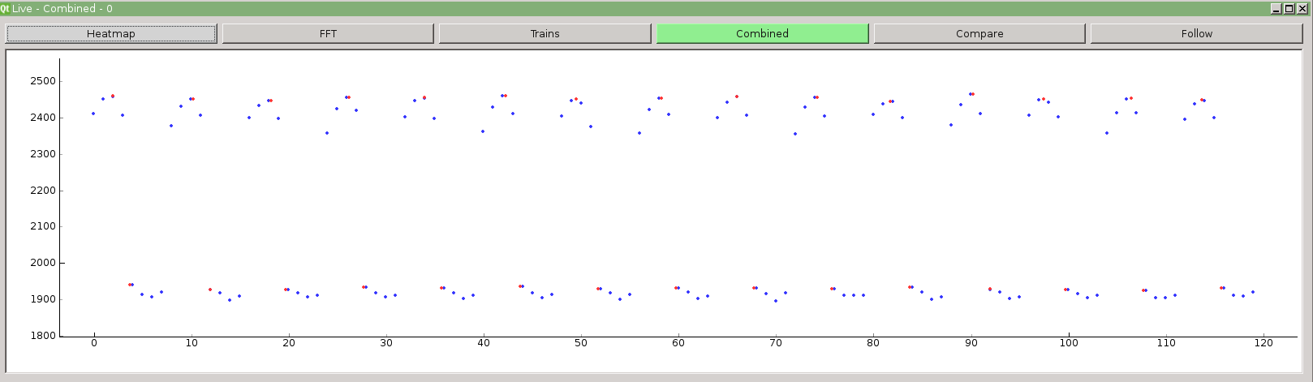
KAPTURE II
Readout electronics for THz detectors
Real time pulse sampling @ 1 GHz rep. rate
Baseline
90 ps
pulse width
Pulses
1 ns
Sampling rate = 1 GHz
2 ns
Pulse rate = 500 MHz
Baseline
Sampling points

Slide 4


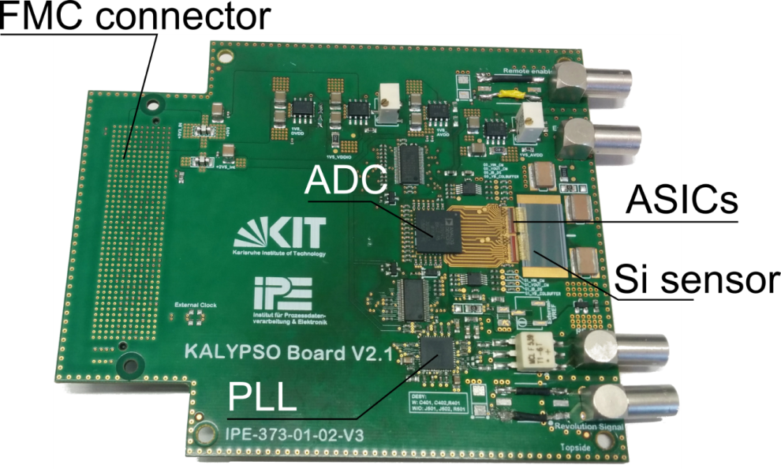
KALYPSO II
Ultra-fast 1D detector
KArlsruhe Linear arraY detector for MHz-rePetition rate SpectrOscopy
Frame rate up to 2.7 MHz
Continuous acquisition
InGaAs/Si sensors for near-IR/visible light
Pixel size up to 256 pixels, pitch of 50 µm
Front-end chip: GOTTHARD 1.6
Installed @ KARA, Eu-XFEL, DELTA
90 mm

Slide 5
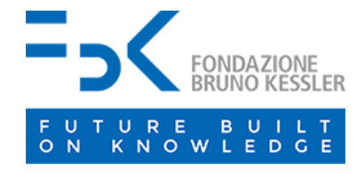
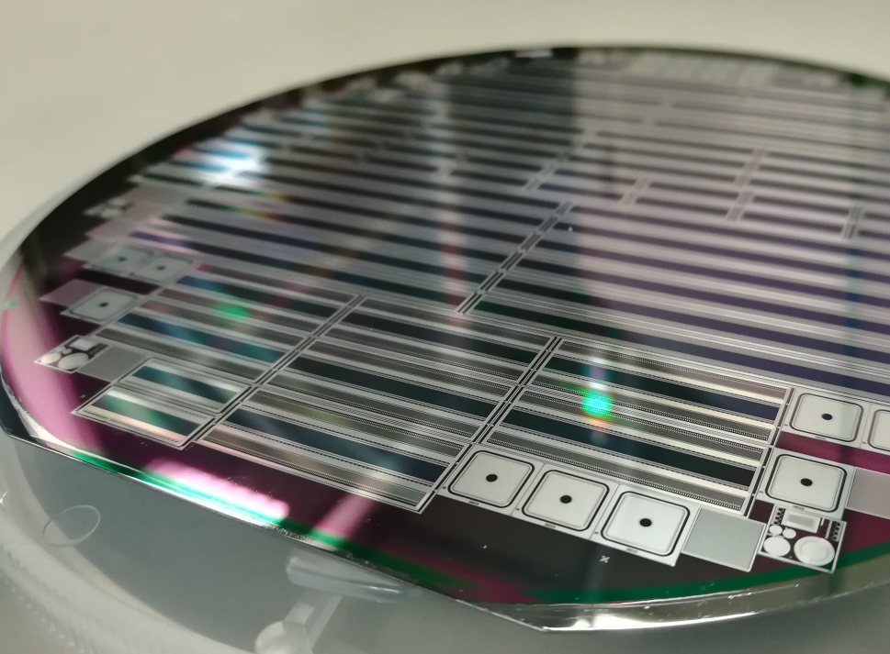
KALYPSO II
New Si microstrip sensors
Designed @ KIT, produced @ FBK
Channel number: 512 / 1024 / 2048
Pixel pitch: 25 / 45 µm
Different Anti-Reflective Coatings (ARCs):
  nearUV (350 nm)
  visible light (400 – 800 nm)
  nearIR (1050 nm)
Dedicated PCB for FLASH / SOLEIL / SLS is under production

Slide 6
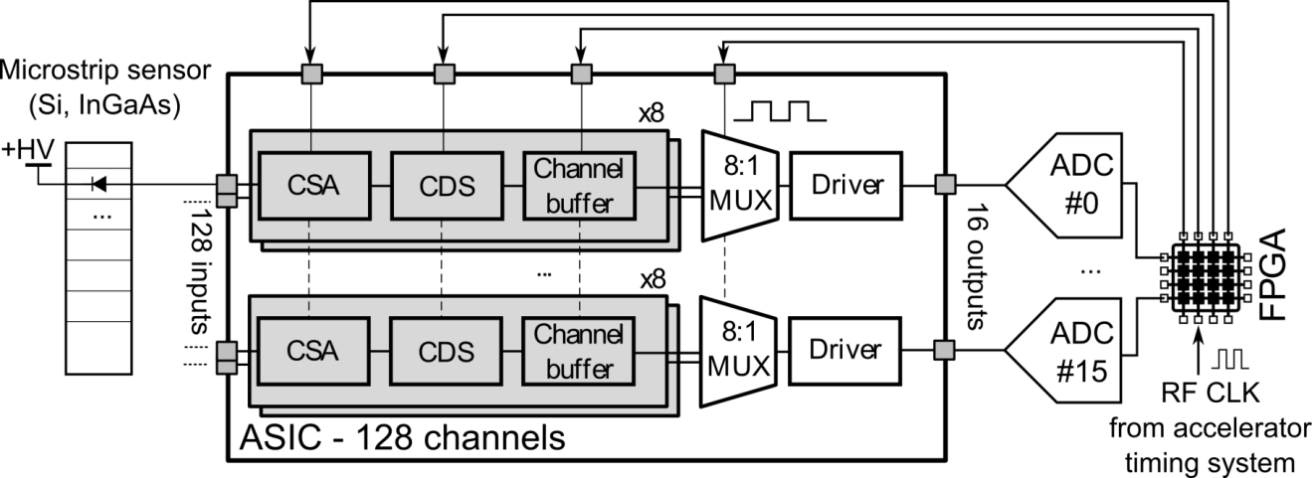
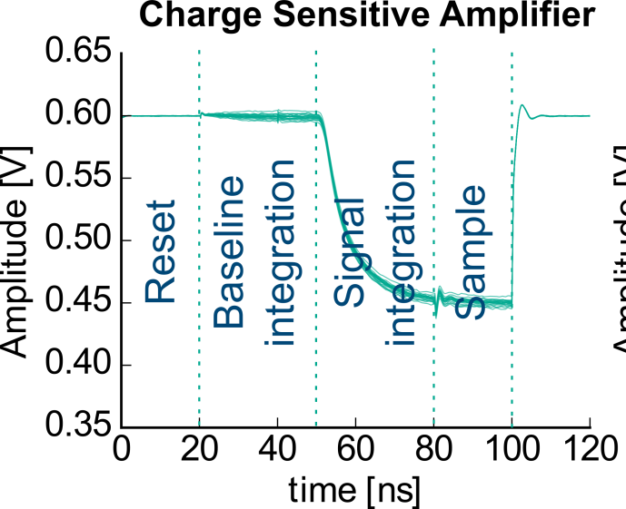
KALYPSO III
Readout ASIC: architecture
Dedicated readout Application Specific Integrated Circuit (ASIC)
Technology: UMC CMOS 110 nm
Goal: increase frame-rate to 10 MHz and improve noise performance

Slide 7
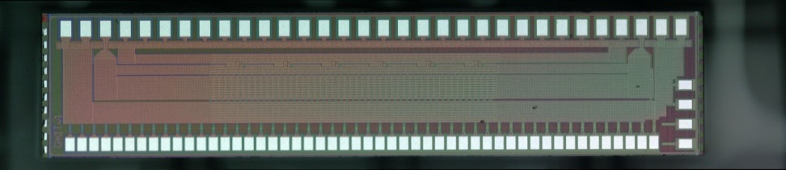
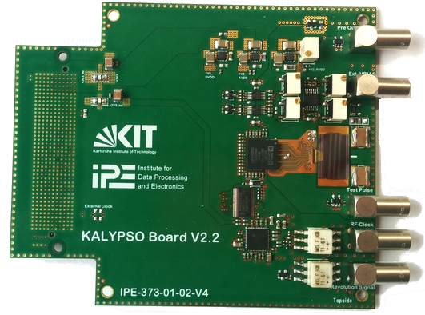
KALYPSO III
Readout ASIC: first results
Submitted prototype with 48 channels
Final design will be submitted in August 2018
1 mm
Specification | Value
Frame rate | 12 MHz
C_{D} | 0.5 – 6 pF
Signal polarity | +/-
Cross-talk (no sensor) | 0.2 %
ENC @ 1.3 pF | 417 e⁻
INL error | 0.5 %
Power consumption | 1.3 mW/ch.
5 mm

Slide 8
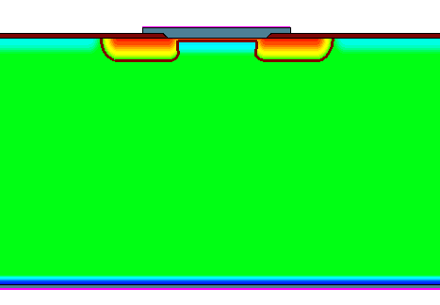
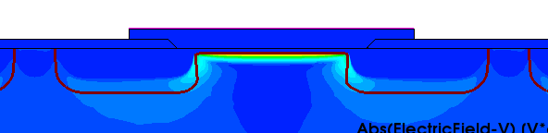
KALYPSO III
Beyond 100 MHz
New Si sensor based on Low Gain Avalanche Detectors (LGAD)
Enable shutter-less measurements @ 500 MHz
Design goals:
  Charge collection time < 2 ns
  Pixel pitch < 50 µm
  Built-in gain ~10-30
p-spray
n+ (JTE)
p+
(multiplication region)
P-Bulk
p++
-HV
Courtesy: M. Patil

Slide 9
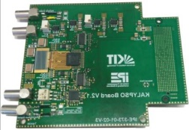
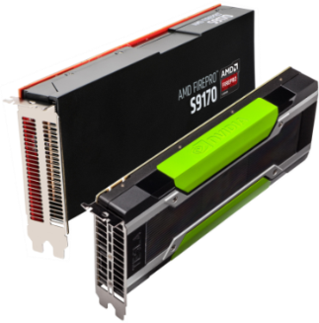
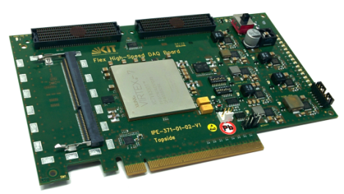

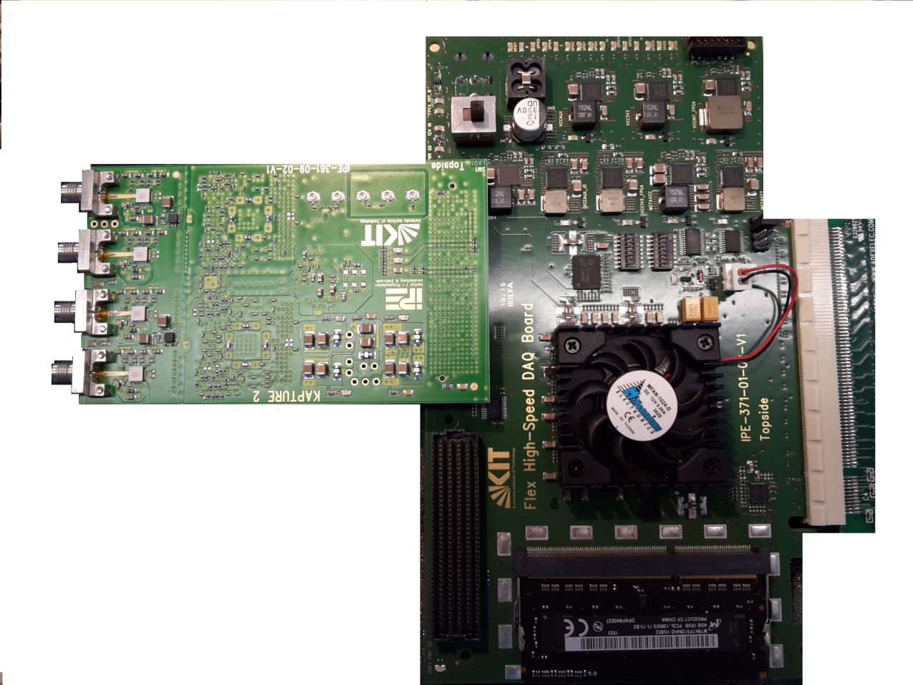
Detector system architecture
Heterogeneous DAQ system
Accelerator
feedback
Front-end board with FEE: sensors, ASICs, ADCs, etc.
“High-Flex” custom FPGA readout card for pre-processing and fast data-link [1]
Real-time data processing with GPUs → see M. Vogelgesang talk
[1] M. Caselle et al., TWEPP 2016, JINST 12 C03015 2017

Slide 10

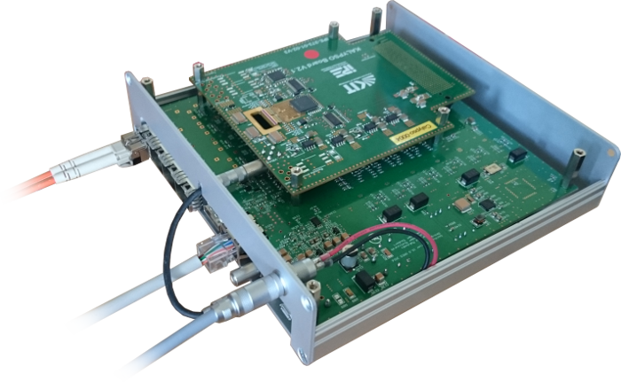
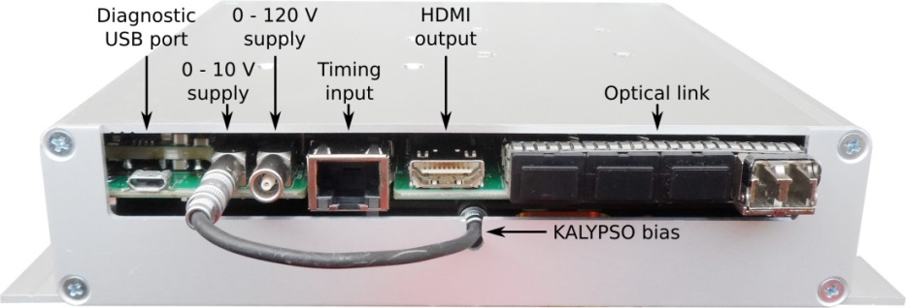
Detector system architecture
The HOLD detector @ DESY
High-speed Optical Line Detector
KALYPSO front-end board
+ Gotthard carrier (FPGA readout card)
+ optical readout
Courtesy: A. Mielczarek, D. Makowski

Slide 11

Applications and
(preliminary) experimental results
*see also poster

Slide 12
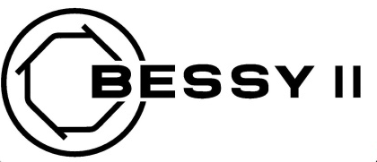
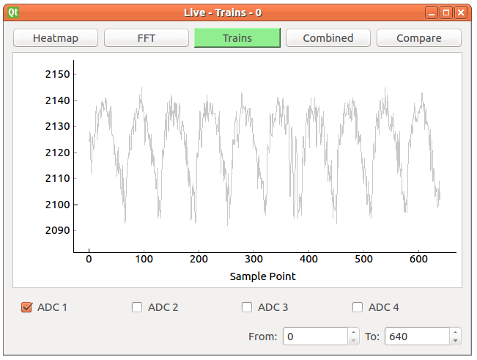
KAPTURE
Application at BESSY II
First bunch profile measurements
Courtesy: T. Atkinson (HZB)

Slide 13

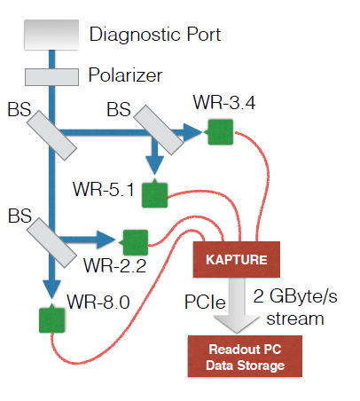
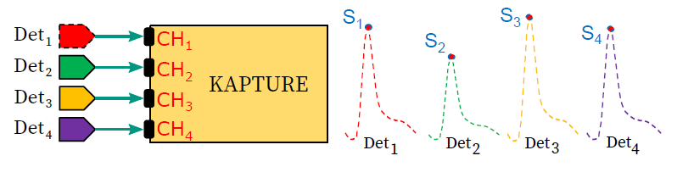
KAPTURE
Applications at KARA
Single-shot 4-channels spectrometer
Different detectors connected to KAPTURE
J. L. Steinmann et. al., IPAC17,
DOI: 10.18429/JACoW-IPAC2017-MOPAB056
Courtesy: J. Steinmann (KIT)

Slide 14
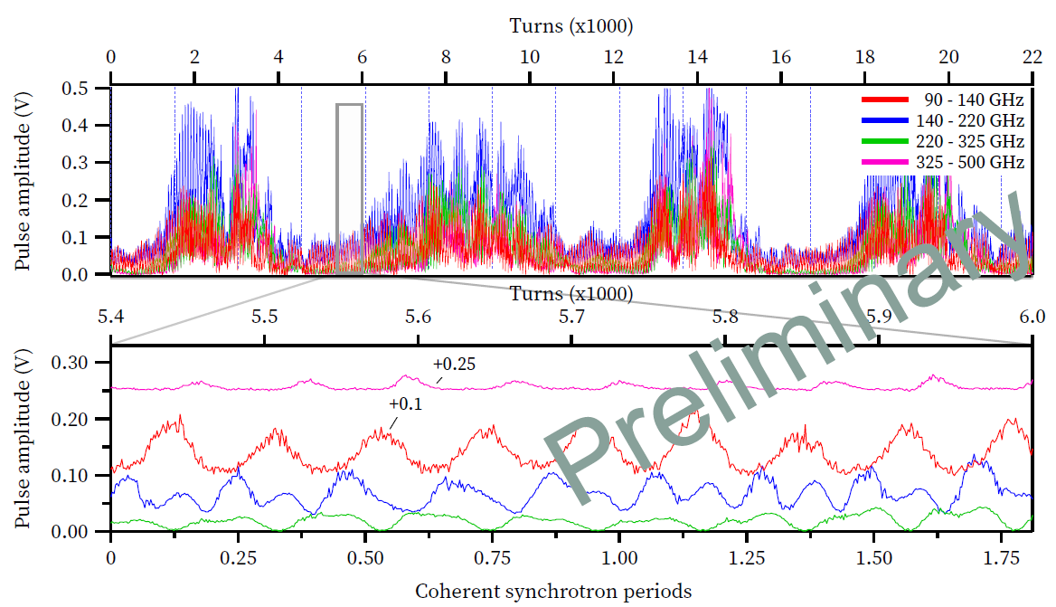
KAPTURE
Applications at KARA
Courtesy: J. Steinmann (KIT)

Slide 15

KALYPSO
Applications at Eu-XFEL
Single-shot Electro Optical Spectral Decoding (EOD) traces from one train
EOD traces of all 30 bunches of a bunch train @ 1.13 MHz
Courtesy:
B. Steffen, Ch. Gerth (DESY)

Slide 16
KALYPSO
Applications at Eu-XFEL
Arrival time and bunch length from fitted Gaussians for 10 bunches.
Courtesy:
B. Steffen, Ch. Gerth (DESY)

Slide 17

KALYPSO
Applications at FLASH
On-line measurement of FEL radiation spectrum with VLS spectrometer at FLASH1
Tool for tuning of the FLASH accelerator
Electronics designed for MTCA based readout
Courtesy: S. Düsterer, G Brenner, Ch. Gerth,
D. Haack and B. Steffen (DESY)

Slide 18
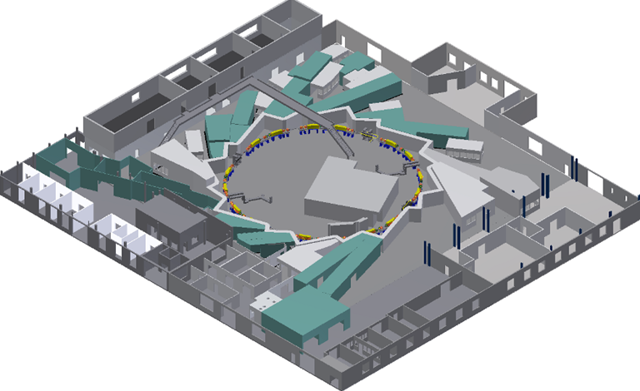



Putting it all together
KARA distributed sensor network
KALYPSO + near-field EOSD:
  Longitudinal bunch profile @ 2.7 MHz
KALYPSO + Visible Light Diagnostics port:
  Horizontal bunch profile @ 2.7 MHz
KAPTURE + THz detectors:
Intensity of CSR @ 500 MHz
EOSD
VLD
THz
Courtesy: KARA THz group

Slide 19
Putting it all together
KARA distributed sensor network
KALYPSO
EOSD
KALYPSO
VLD
KAPTURE
THz
Courtesy: KARA THz group

Slide 20




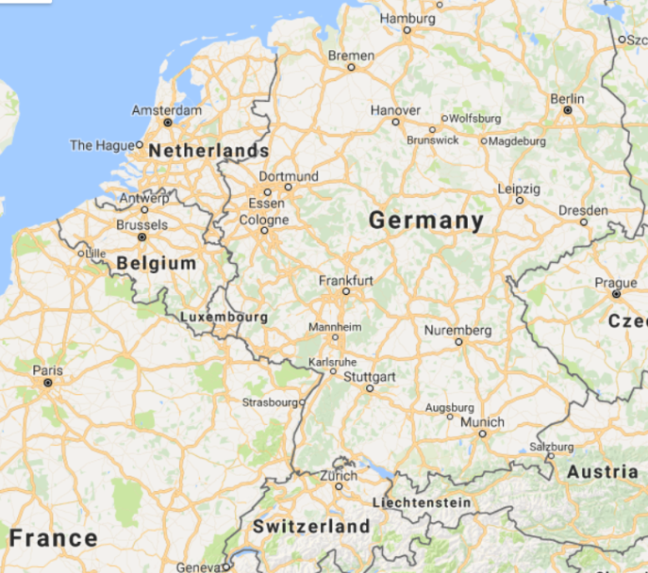





KAPTURE & KALYPSO users
List of facilities
In operation:
KIT / KARA
DESY / Eu-XFEL, FLASH
HZB / BESSY II
Installed:
TU Dortmund / DELTA
HZDR Dresden / ELBE
Coming soon:
SOLEIL
PSI / Swiss Light Source
SLS

Slide 21
Thank you for your attention

Slide 22


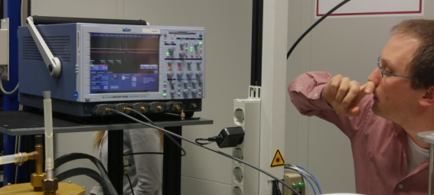
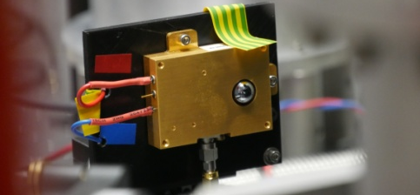
KAPTURE
Applications at DELTA
Diagnostics of laser-induced THz & VUV radiation
readout of fast THz detectors (YBCO from KIT, Schottky)
readout of 8 channel single-shot THz spectrometer (developed by TU Dresden)
KAPTURE & KALYPSO
installed, first beam
time in July 2018
Courtesy: C. Mai (DELTA)

Slide 23

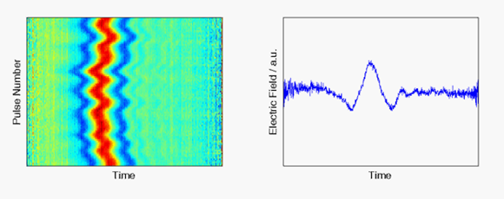
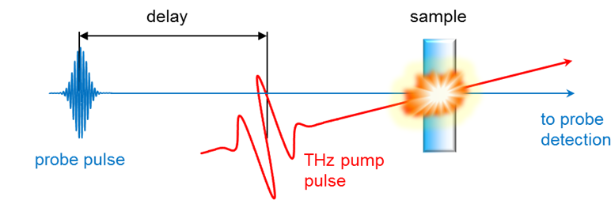
KALYPSO
Applications at ELBE: pulse-resolved DAQ
Ultra-fast experiments at high reprate
Requirements:
few 10 fs time resolution
excellent dynamic range
THz Instabilities: Arrival time and Intensity
1 ps
slow motion movie @ 100 kHz
What can be done?
Courtesy: M. Gensch, B. Green (HZDR)

Slide 24
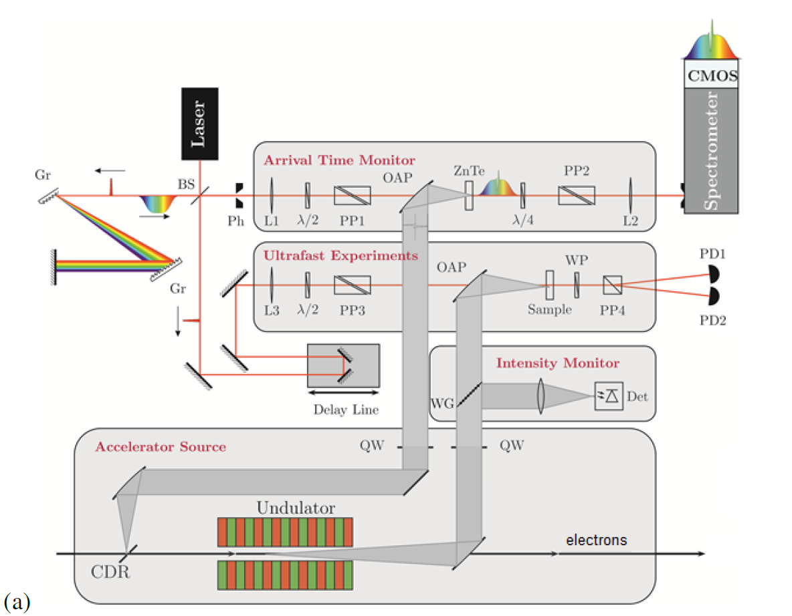
KALYPSO
Applications at ELBE: pulse-resolved DAQ
Pulse-resolved diagnostics with ONLINE analysis:
time resolution: 12 fs (rms)
maximum reprate: 200 kHz → limited by CMOS camera
Next steps:
2 MHz KALYPSO II
4.5 or 13 MHz KALYPSO III
[1] S. Kovalev et al, Probing ultra-fast processes with high dynamic range at 4th generation light sources: arrivaltime and intensity binning at unprecedented repetition rates, Struct. Dyn. 4 2017, 10159.
[2] B. Green, Superradiant Terahertz Sources and their Applications, PhD thesis, KIT 2017.

Slide 25
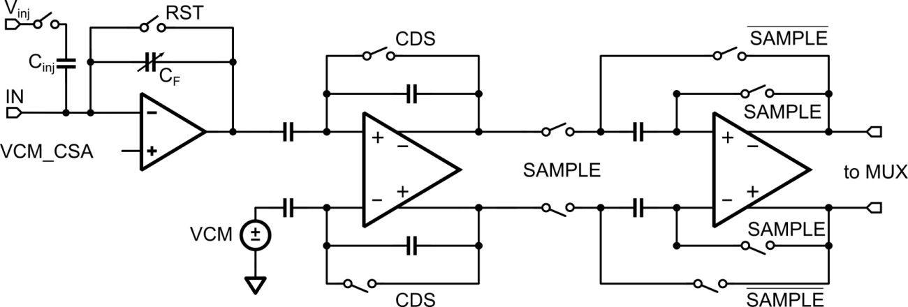
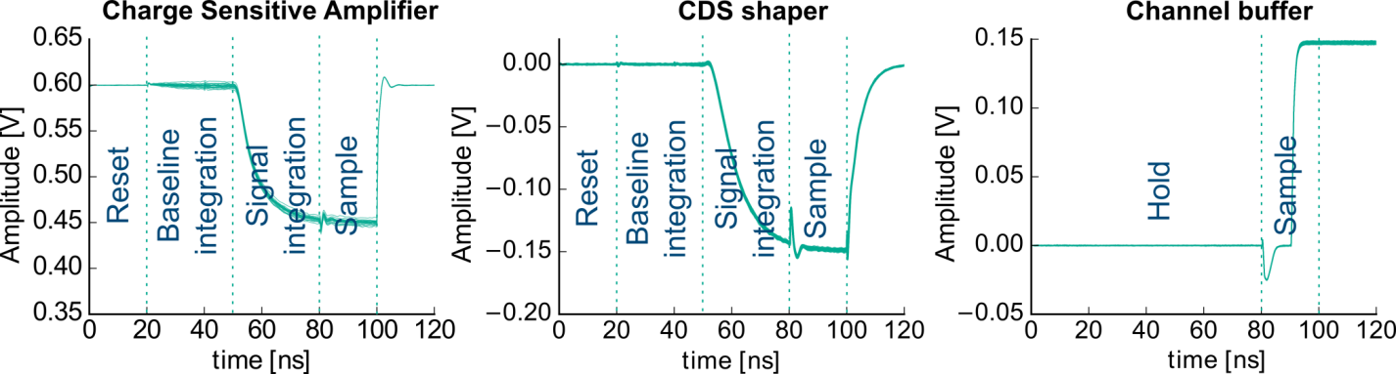
KALYPSO

Slide 26
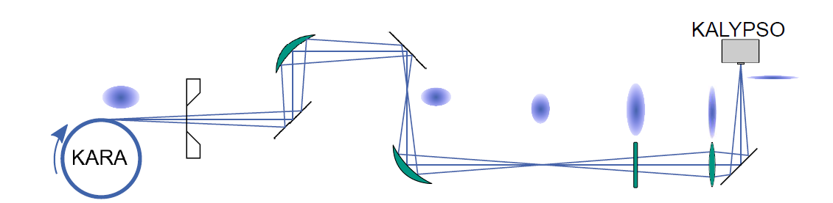
KALYPSO
Horizontal bunch profile @ VLD
Installed at visible light diagnostics (VLD) port [1]
Horizontal bunch profile → energy spread
Synchrotron radiation in dispersive section
Single-shot, turn-by-turn @ 2.7 MHz

Slide 27
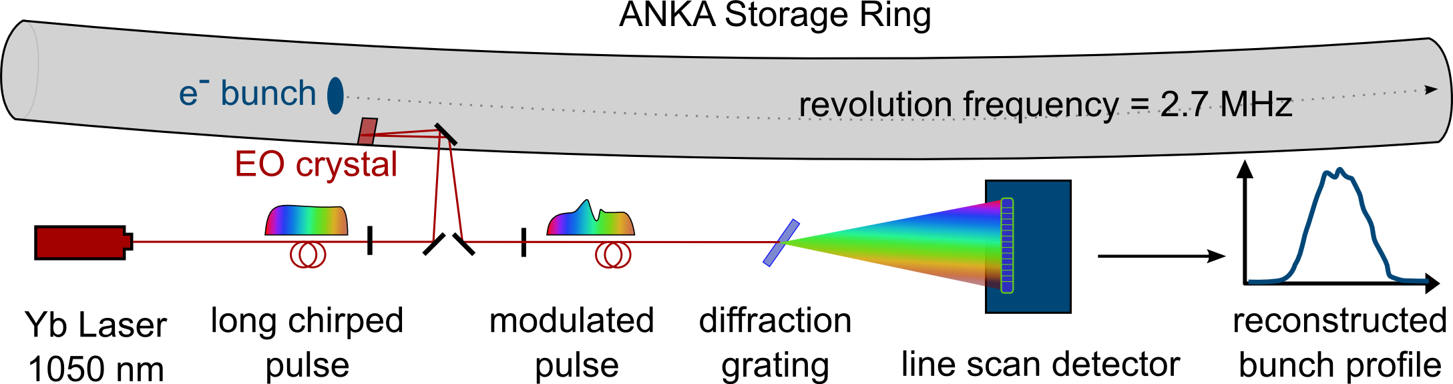
KALYPSO
Longitudinal bunch profile @ near-field EOSD
KALYPSO
High frame rate 2.7 Mfps
Long observation times continuous data taking
High resolution > 256 pixels, low-noise
Compatible with different setups visible light / near-IR / near-UV

