Slide 1
Integrated Sensors for Particle Physics
Ivan Peric

Slide 2


KIT ASIC and Detector Laboratory (KIT-ADL)
Application specific integrated circuits (ASICs) and sensors
Instrumentation of experiments
New sensor technologies for science, medicine and industry
adl.ipe.kit.edu

Slide 3
KIT ASIC and Detector Laboratory (KIT-ADL)
Group members:
  Ivan Peric (Professor at the Faculty for Electrical Engineering and Information Technology - ETIT)
  Doctoral students:
  Roberto Blanco
  Felix Ehrler
  Horacio Mateos
  Mridula Prathapan
  Rudolf Schimassek
  Alena Weber
  Hui Zhang

Slide 4

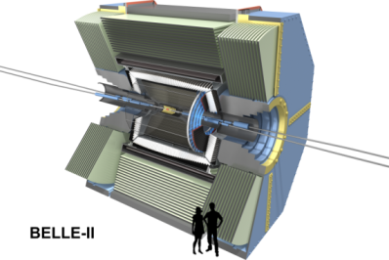
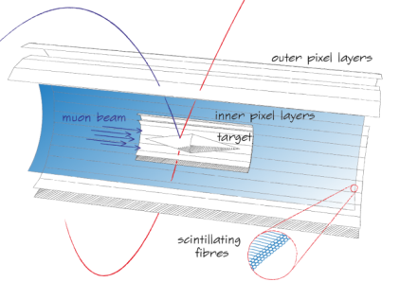
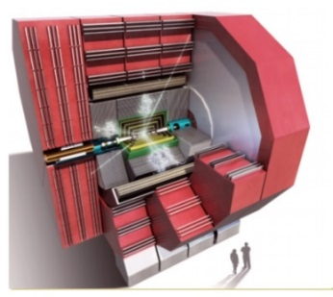
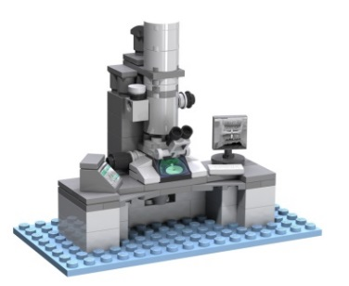
KIT ASIC and Detector Laboratory (KIT-ADL)
Experiments: ATLAS, Belle II, CLIC, Mu3e, Tristan
Projects with industry: STREAM, USCT
ATLAS - new technology for the largest particle detector
Belle II – Our ASICs contribute to understanding of matter-antimatter asymmetry
Mu3e – Search for physics beyond standard model requires thin monolithic high-voltage CMOS sensors
CLIC – innovative capacitively coupled sensors for the compact linear collider
Sensors for medical and industry applications

Slide 5
KIT ASIC and Detector Laboratory (KIT-ADL)
Projects: Belle II Pixel Detector and Physics (BMBF), HVMAPS Pixel Sensors for HL-LHC (BMBF), STREAM (EU: CMOS Sensors for Electron Microscopy), AIDA 2020 (EU: Novel HV/HRCMOS Sensors)
ATLAS - new technology for the largest particle detector
Belle II – Our ASICs contribute to understanding of matter-antimatter asymmetry
Mu3e – Search for physics beyond standard model requires thin monolithic high-voltage CMOS sensors
CLIC – innovative capacitively coupled sensors for the compact linear collider
Sensors for medical and industry applications

Slide 6
Time line of chip submissions

Slide 7
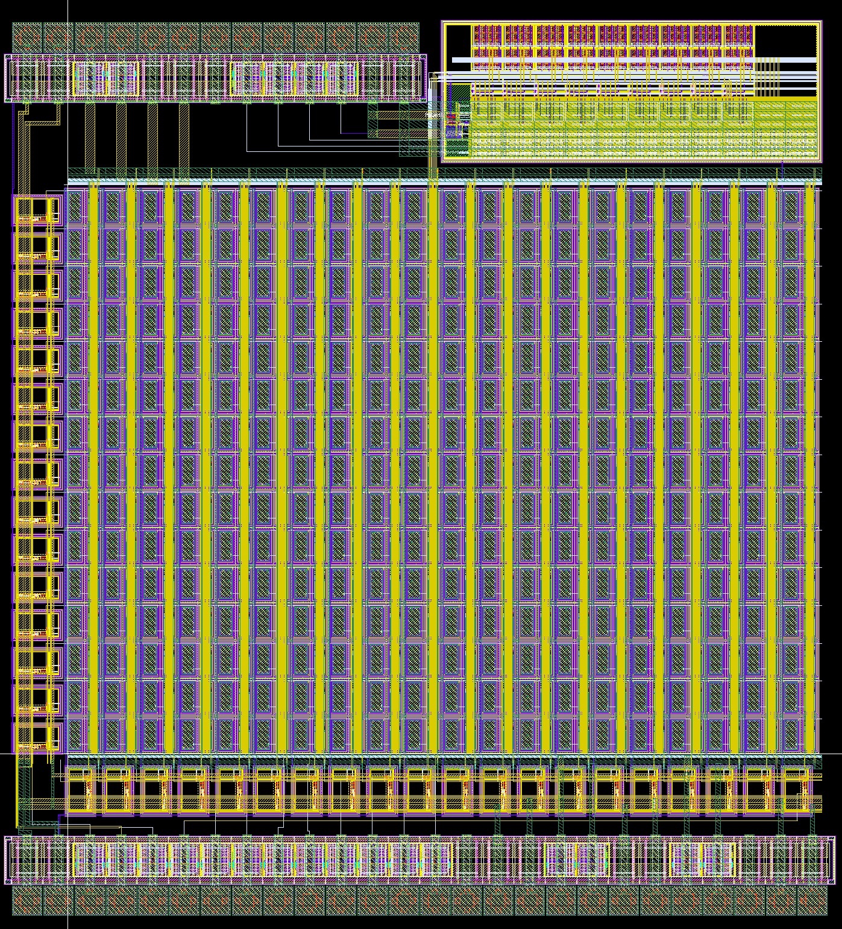
Single photon detectors in CMOS technologies
Applications: e.g. readout of scintillating detectors

Slide 8
Single photon detectors in CMOS technologies
Applications: e.g. readout of scintillating detectors

Slide 9
Single photon detectors in CMOS technologies
Prototype chip
Pixel matrix ~ 3mm x 3mm
Active quenching
Self triggering, time stamp and hit bit per pixel

Slide 10
Single photon detectors in CMOS technologies
Test system developed (PCB, software, FPGA firmware, laser setup)

Slide 11
Single photon detectors in CMOS technologies
Measurements

Slide 12
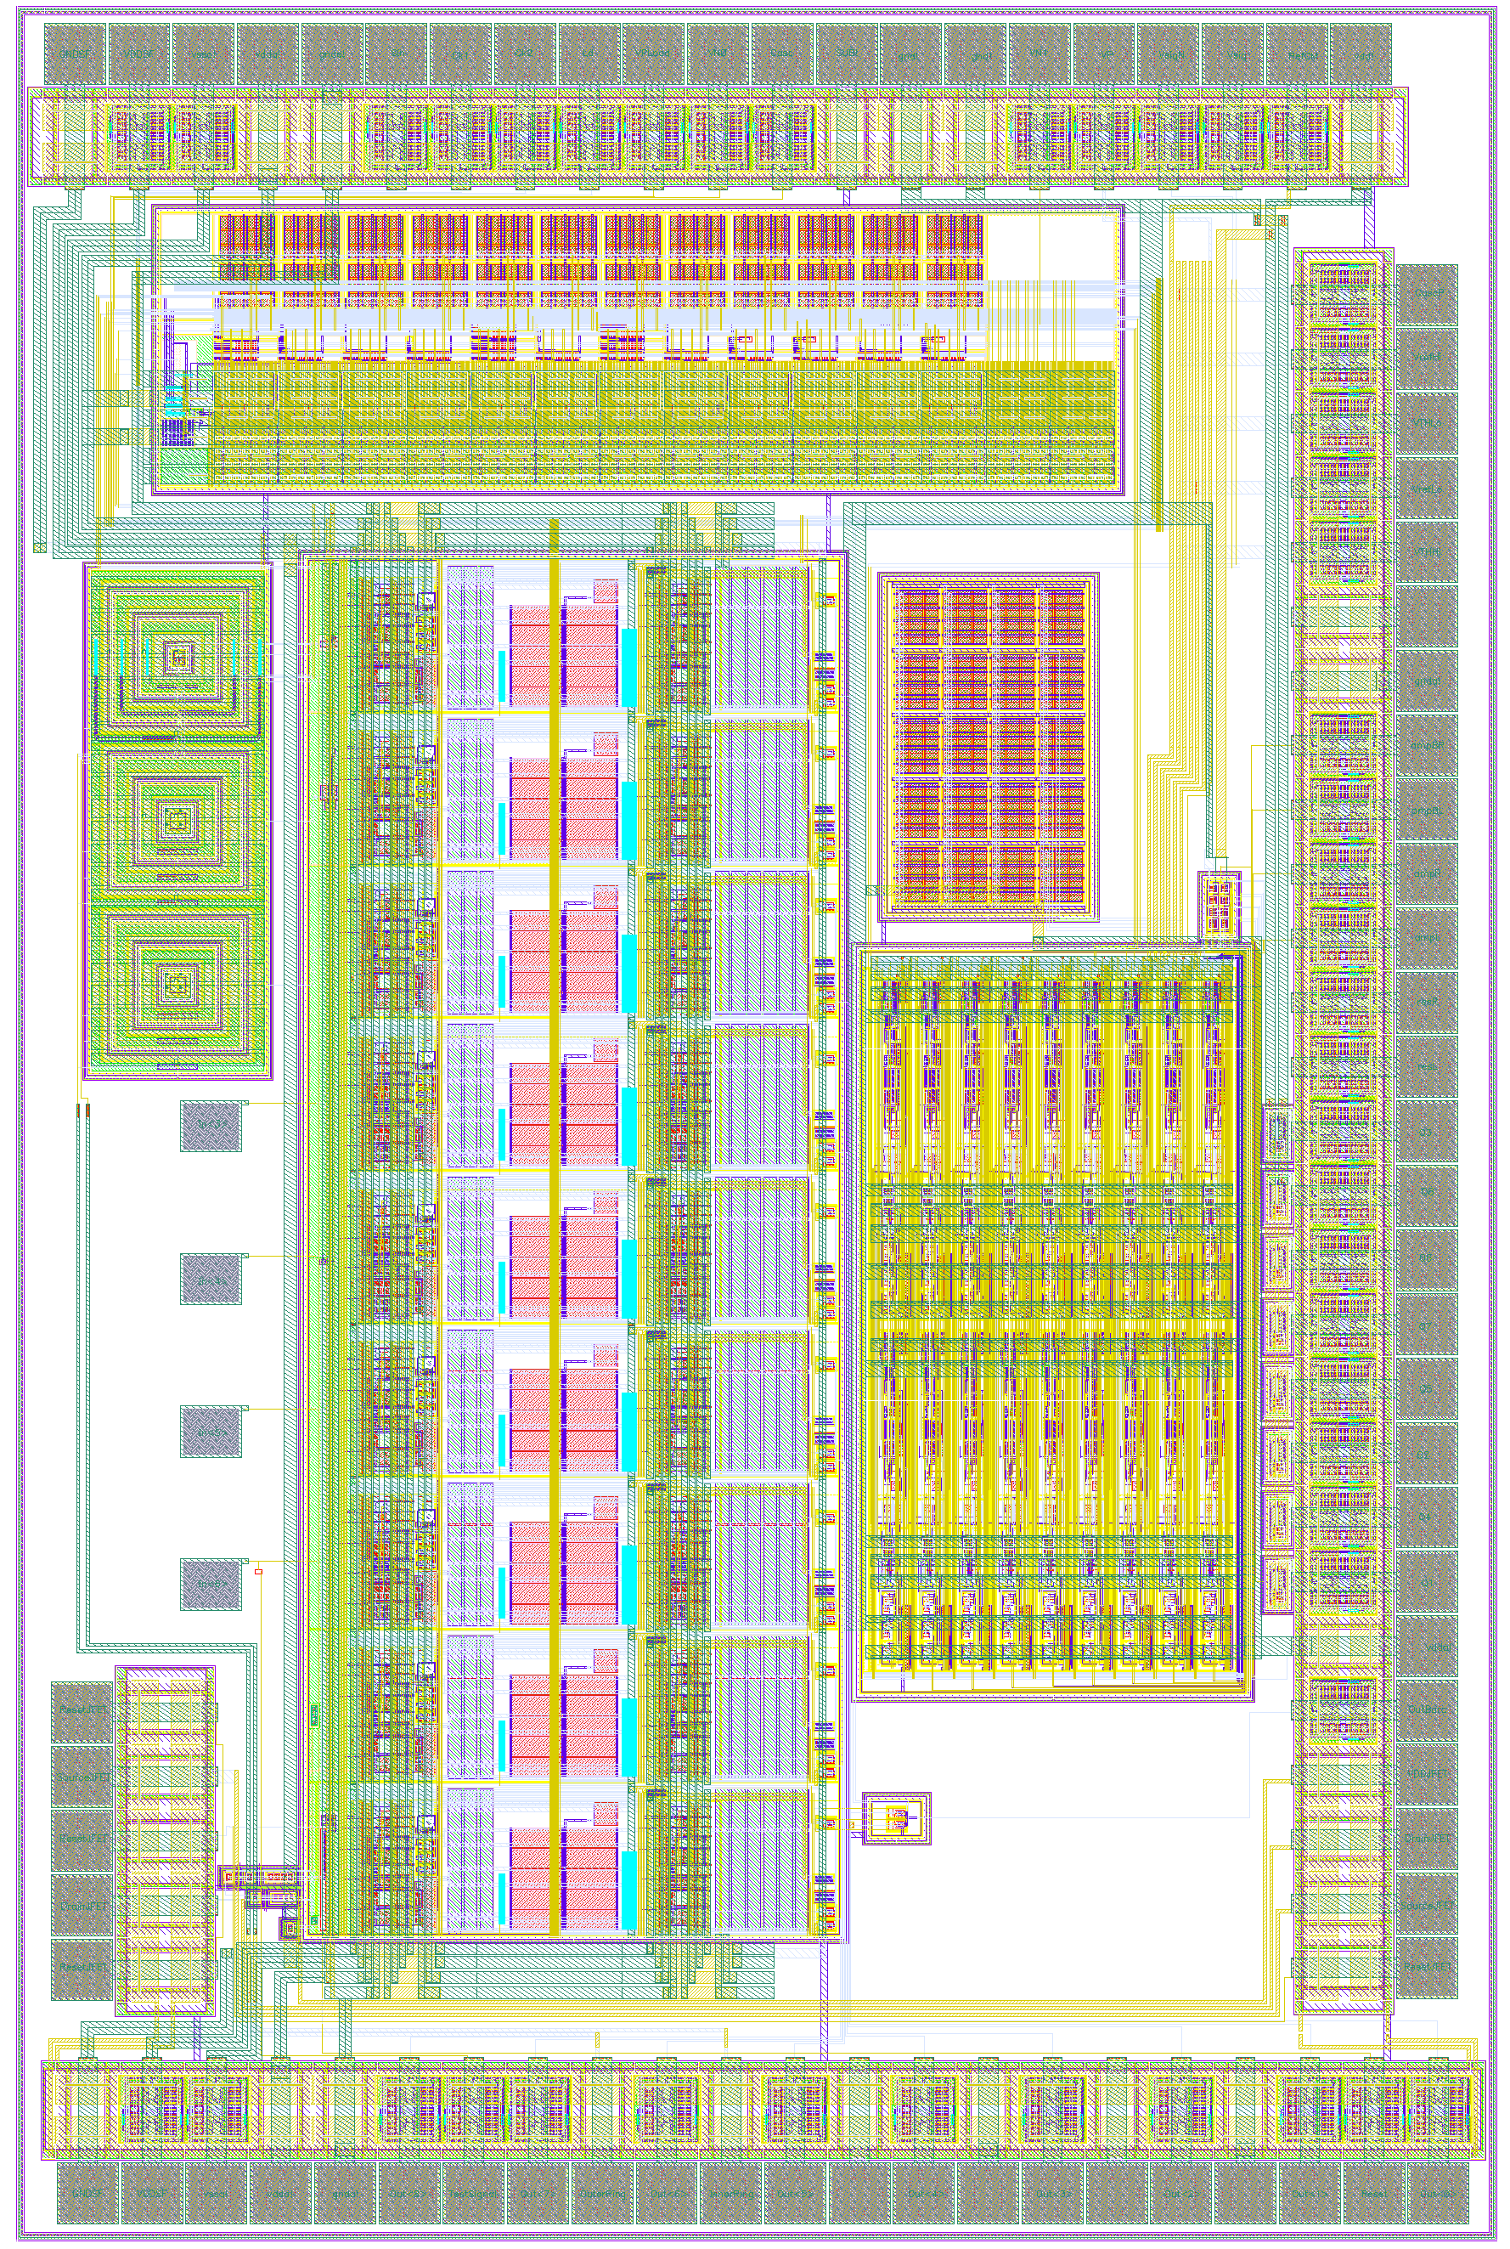
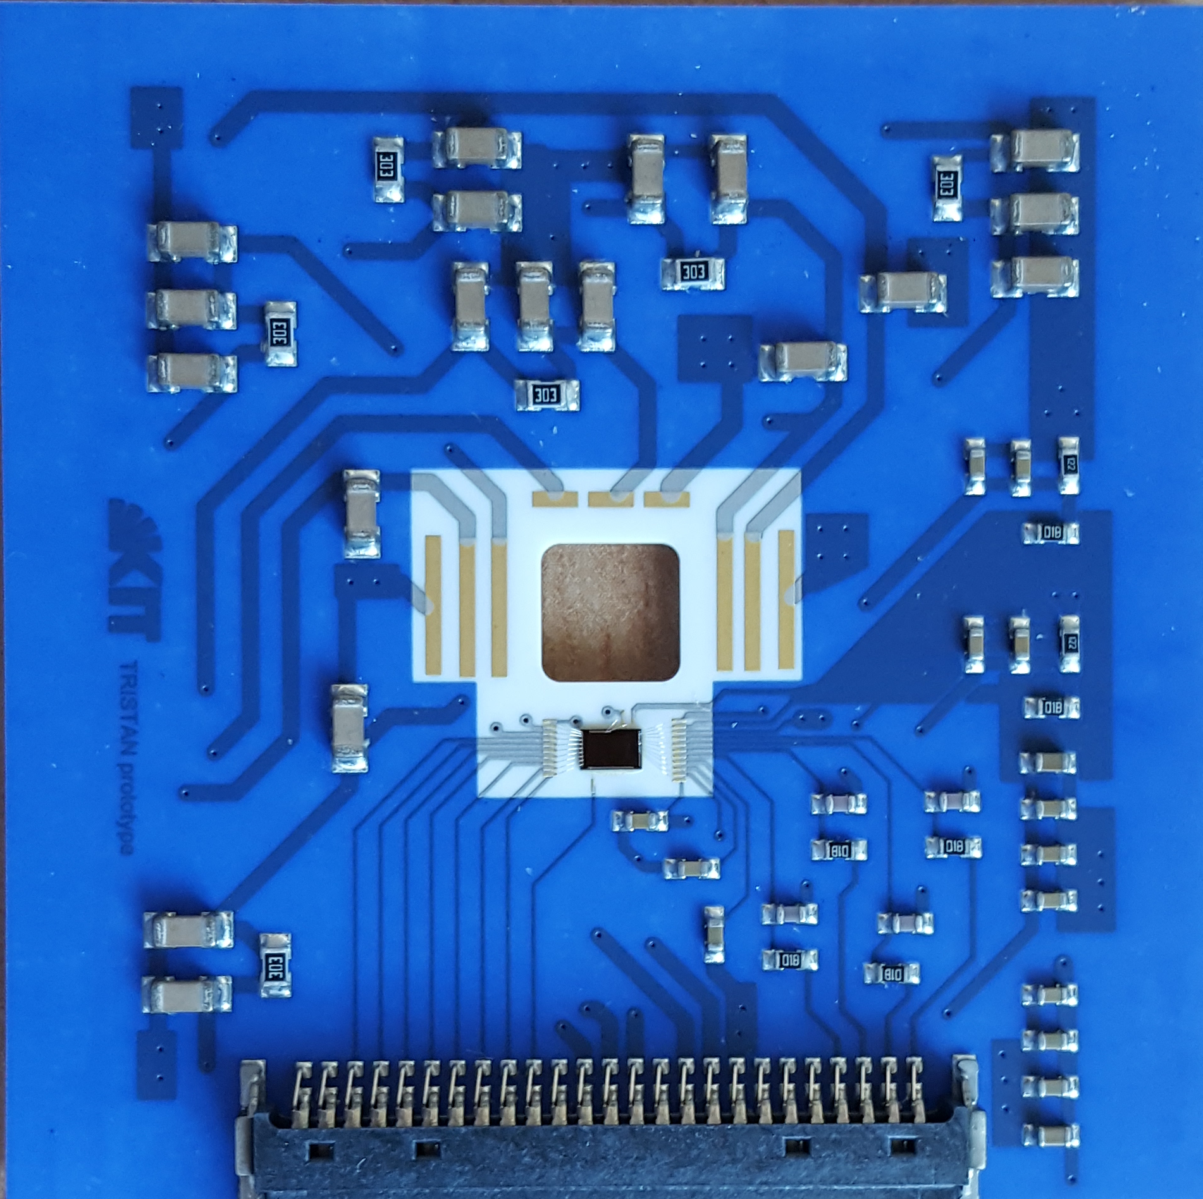
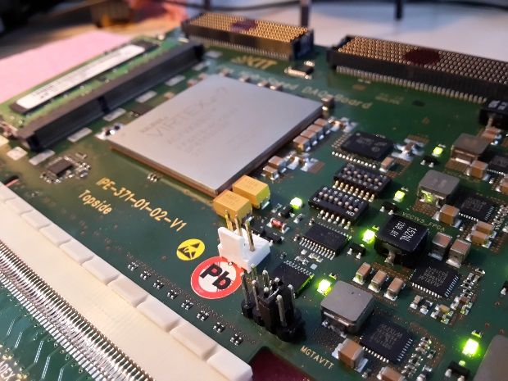
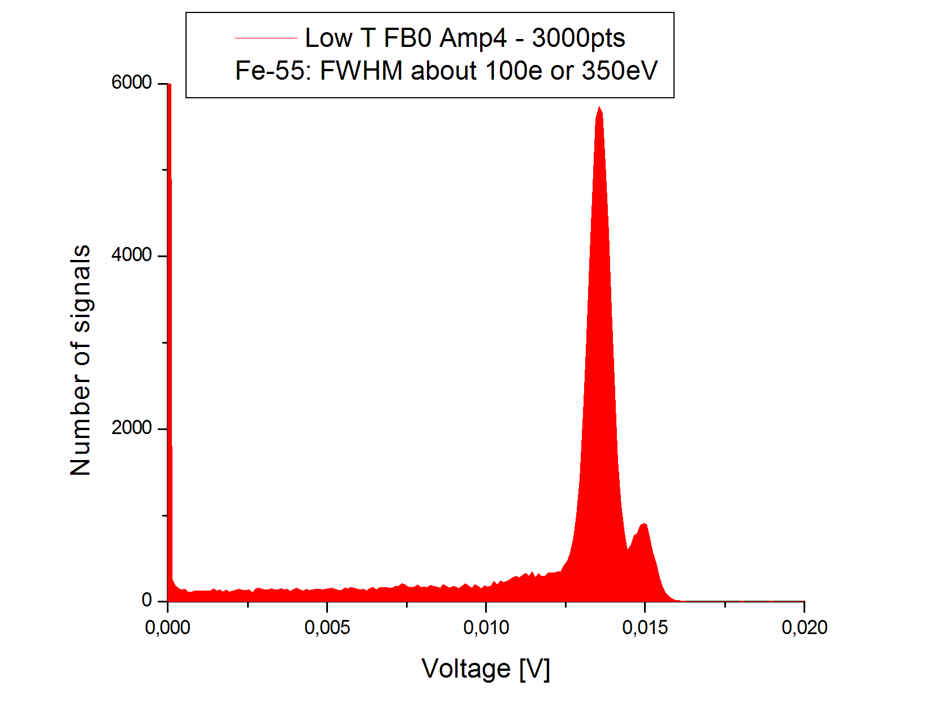
Sterile neutrino search at KATRIN
Detector development (ASIC, Sensor, System, DAQ)
New measurement concept for TRISTAN experiment can improve sensitivity and reduce costs
Amplifier/
Sensor/ADC IC
Detector system
High-flex board
Measurement

Slide 13
Sterile neutrino search at KATRIN
TRISTAN is a planned experiment at KATRIN facility (KIT, Karlsruhe, Germany)
The aim of experiment is to search for heavy (“sterile”) neutrinos by measuring of the electron energy spectrum in tritium b-decays
These neutrinos are candidates for dark matter particles, their mass is in the range of a few keV
The signal would manifest itself as a kink-like signature and spectral distortion at E = E0 - ms, where E0 is the endpoint energy (18.575 keV)

Slide 14
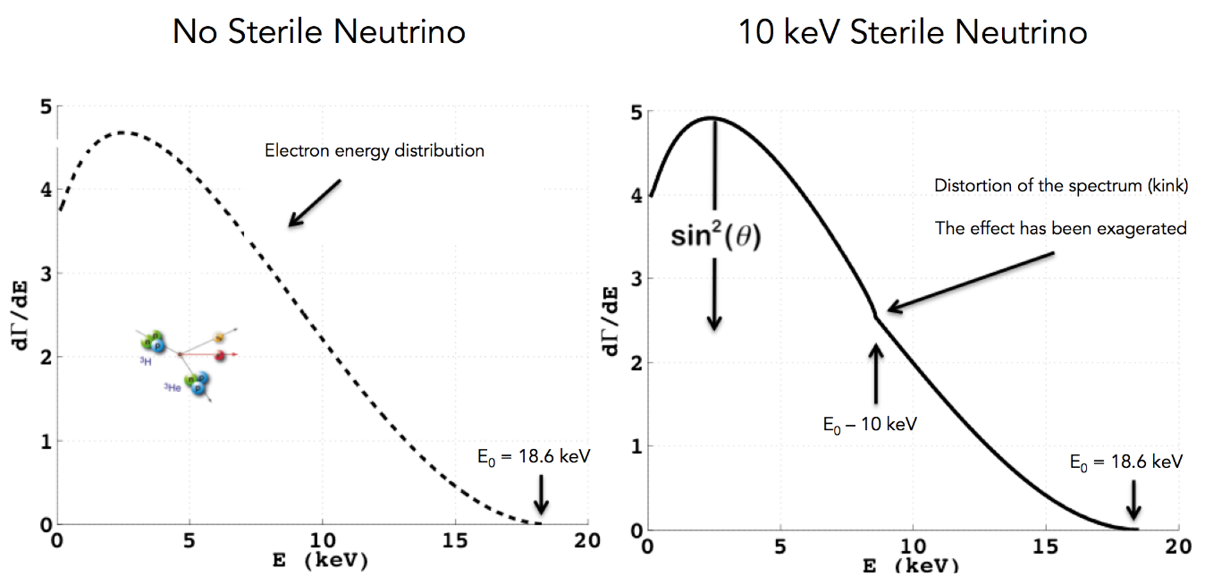
Sterile neutrino search at KATRIN

Slide 15
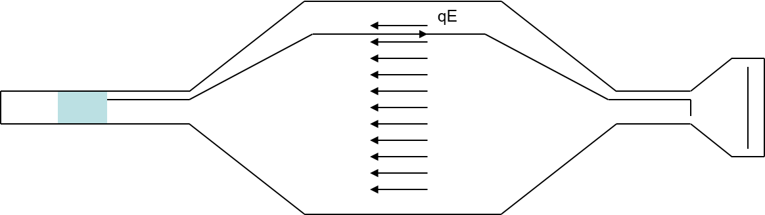
Sterile neutrino search at KATRIN
The principle of KATRIN
The electrons generated from beta decay of tritium are all directed in one direction
Electric field (voltage) is applied to filter all the electrons with higher energy than set by the voltage
A detector counts the number of electrons that pass this filter

Slide 16
Sterile neutrino search at KATRIN
In order to investigate the energy range of keV sterile neutrinos, much larger part of the initial electron spectrum (more) particles should be passed through filter. This would lead to the rate that the present KATRIN detector cannot measure.
Therefore a new detector should be designed.
The new detector have the capability for high rate and the energy resolution

Slide 17
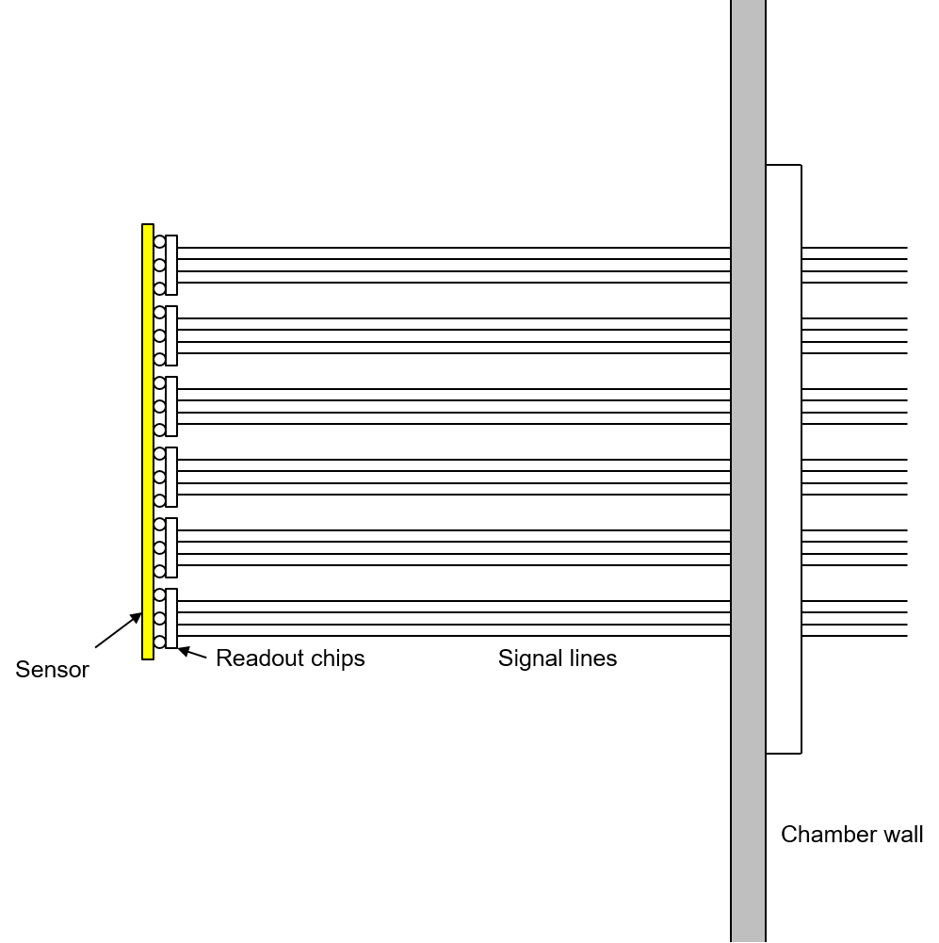
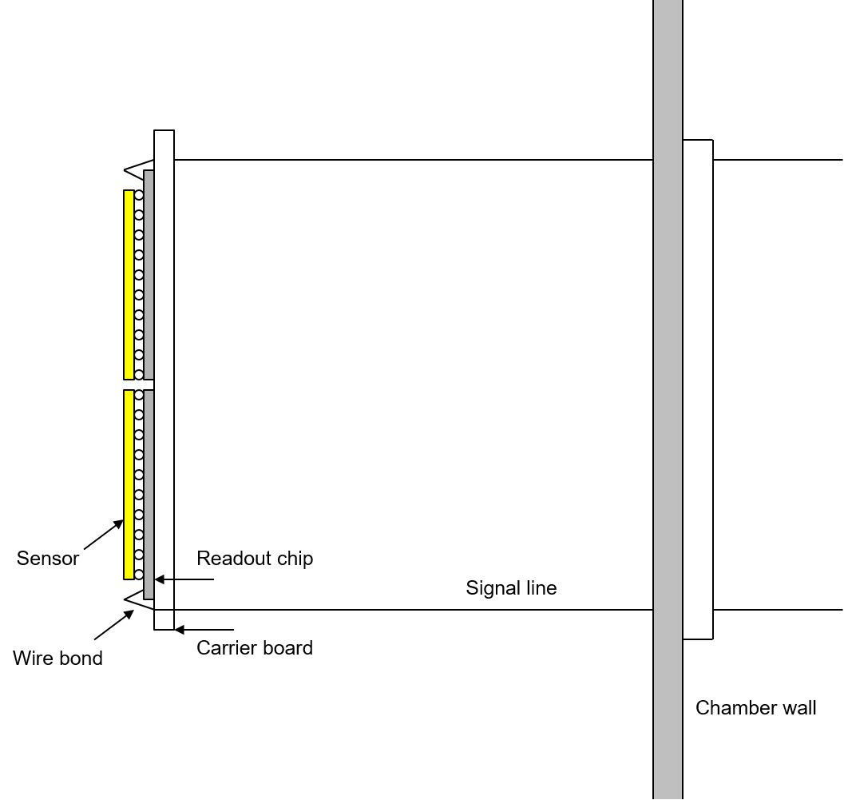
Sterile neutrino search at KATRIN
Two detector concepts:
Detector with single pixel readout
Detector with a pixel readout chip – hybrid detector

Slide 18
Sterile neutrino search at KATRIN
Two signal processing concepts:
Detector energy resolution
Counting detector

Slide 19
3 prototypes
8/9 channels (amplifier and shaper)
Pipeline ADC (9-bit, 50MHz)

Slide 20
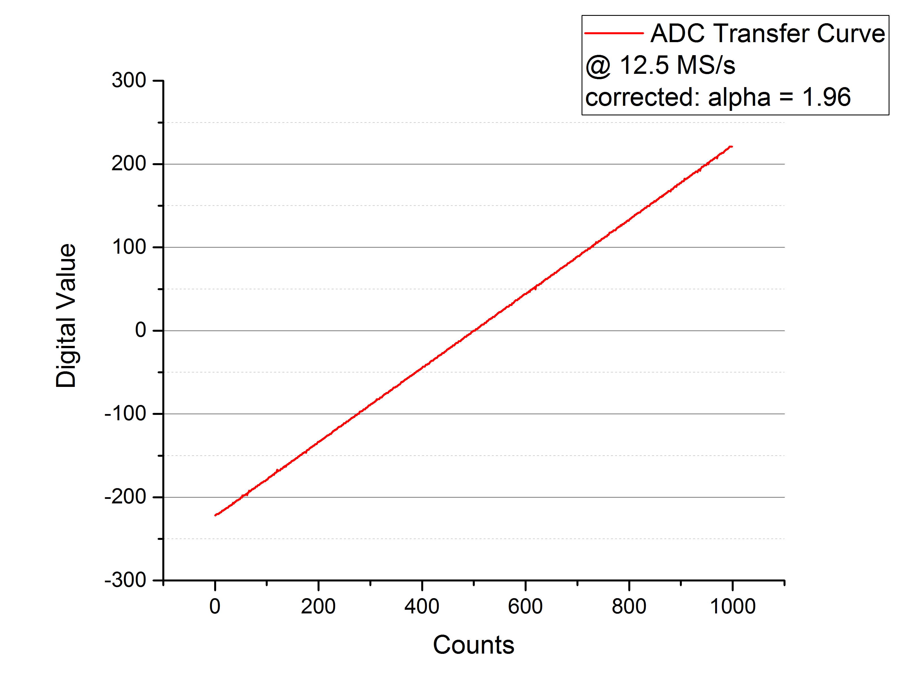
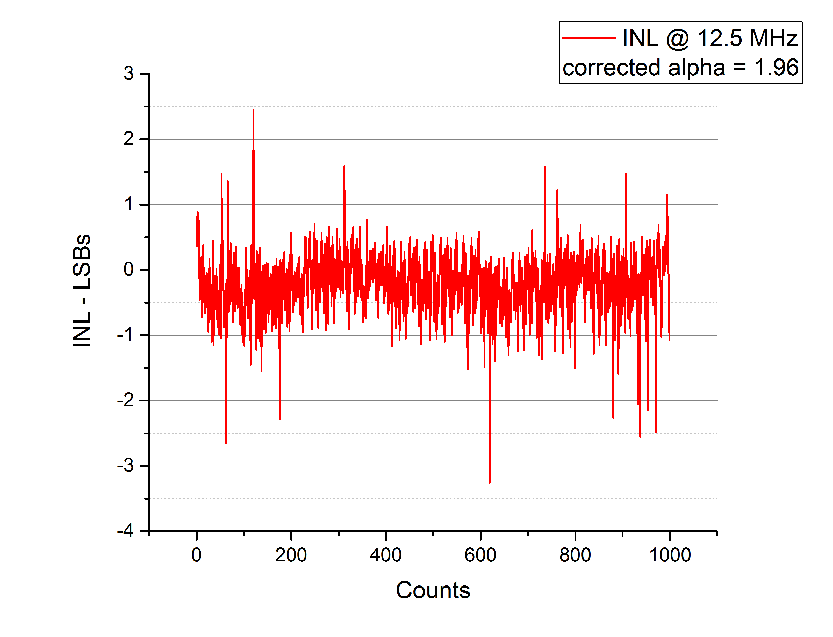
Measurement results (first prototype)
ADC works as expected

Slide 21
Measurement results (first prototype)
7+1 channels, ceramic PCB, HLL drift diode with thin entrance window
Readout system based on Atlys FPGA board, DAQ software in Scala, oscilloscope measurement (without external amplifier), waveform recording (as csv files) and offline (software-based) filtering
Simple filtering used - average of the waveform calculated before trigger and subtracted from the average after trigger. This corresponds to a trapezoidal filter with a shaping time of about 6µs

Slide 22
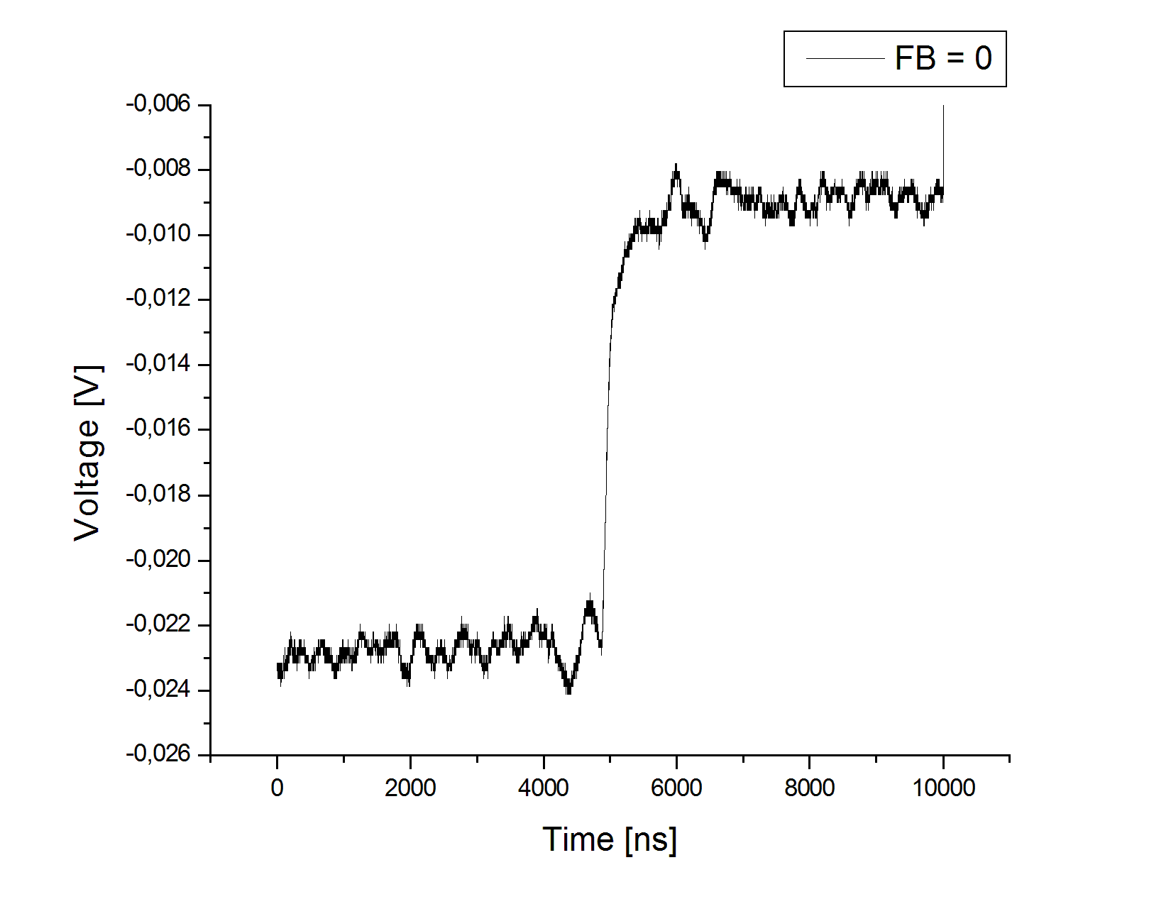
Fe-55 measurement, cooled in an normal refrigerator
100k waveforms recorded
Digital filter applied
Noise about 350eV FWHM
Noise highly temperature dependent

Slide 23
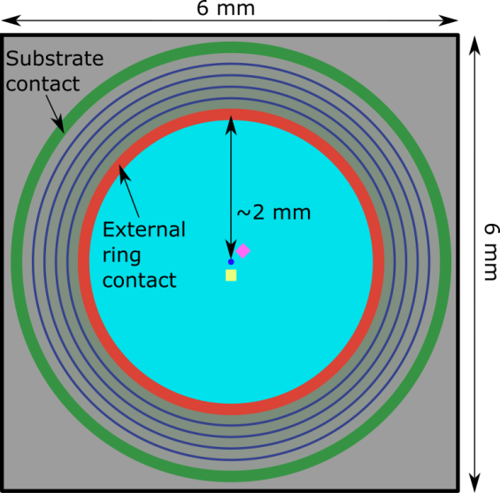
Readout ASIC, third version
8+1 channels, normal PCB, FBK diode with thin entrance window
Readout system based on Nexys FPGA board, DAQ software in C++(Qt), oscilloscope measurement (without external amplifier)
On chip shaper used, maximum of the signal is histogrammed
Thin entrance window

Slide 24
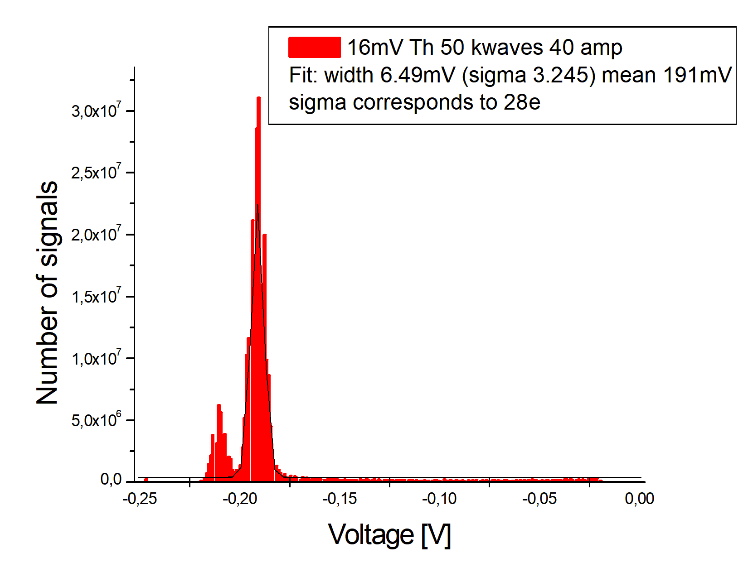
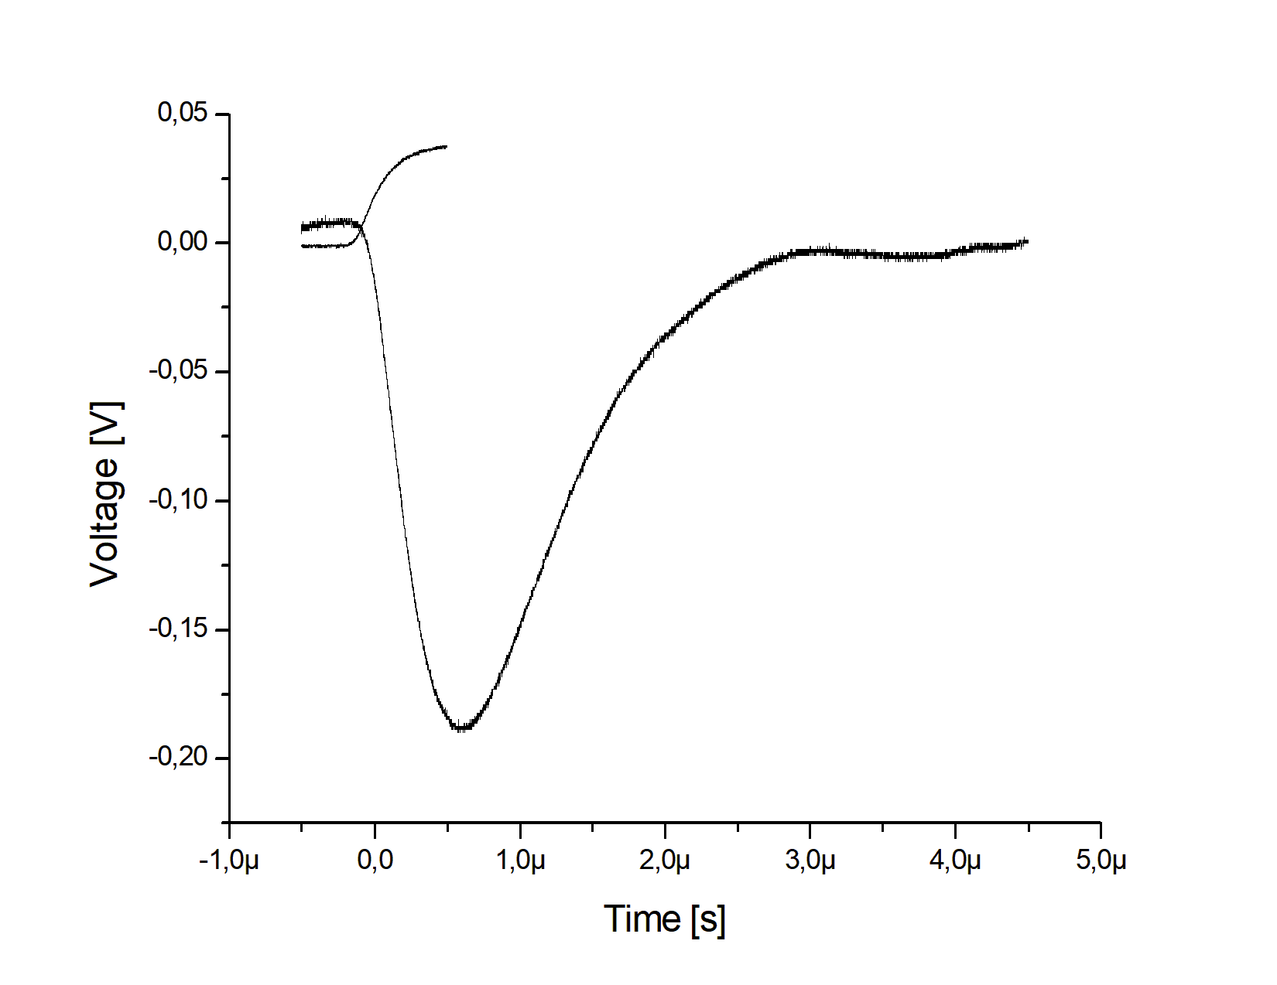
Fe-55 measurement, room temperature
50k waveforms recorded
Only waveform minimum recorded
Noise about 240eV FWHM (28e)
From noise peak 152eV FWHM (18e)
Threshold 500eV

Slide 25
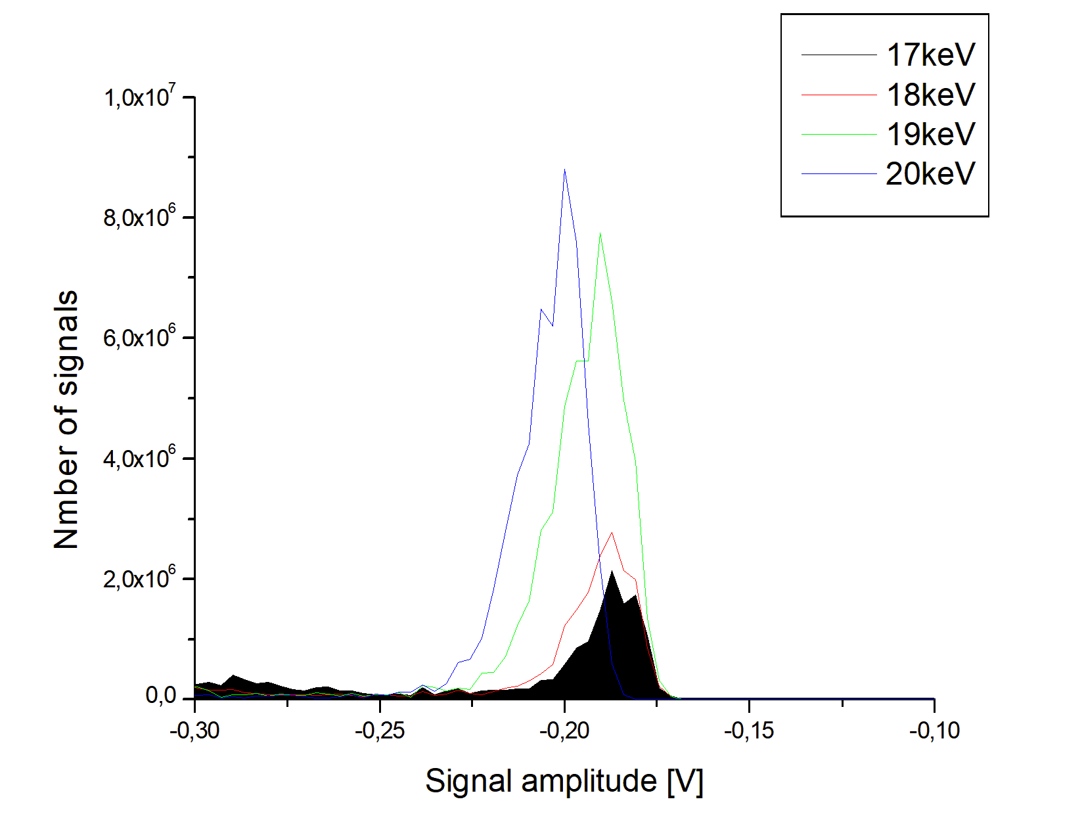
Using the E-gun and a single pixel SDD from FBK first electron energy spectra were taken
Reducing the incident electron energy by adjusting the acceleration potential

Slide 26
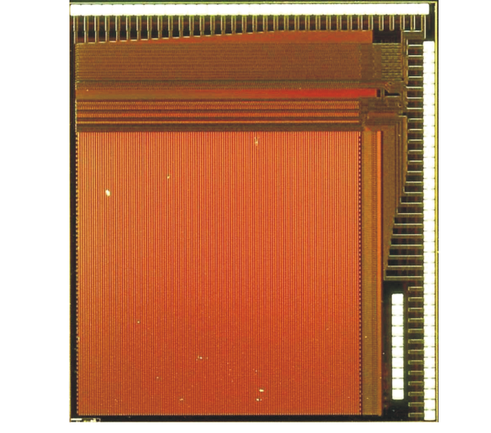
High-voltage CMOS sensors
HVCMOS: Radiation detector on a chip in a standard technology
Excellent particle detection efficiency, radiation tolerance, low cost
5 mm

Slide 27
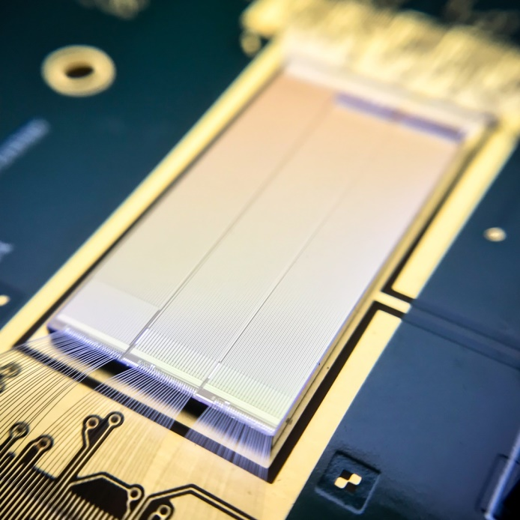
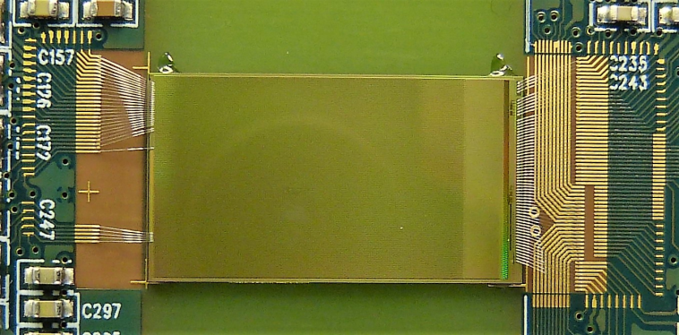
HVCMOS sensors
Pre-production sensors for ATLAS and Mu3e designed at KIT-ADL
20 mm

Slide 28
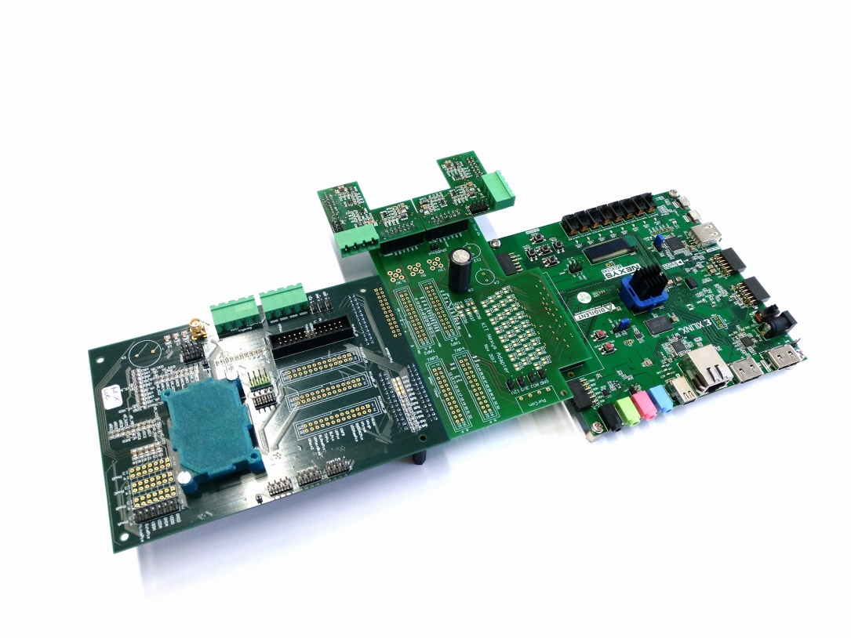
HVCMOS sensors
Measurement system developed at KIT-ADL
Readout simulation and modelling environment “ROME” developed at KIT-ADL

Slide 29
HVCMOS sensors
MuPix

Slide 30
HVCMOS sensors
MuPix

Slide 31
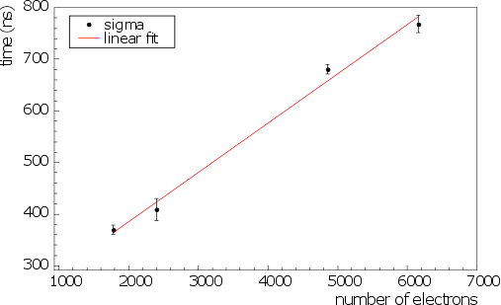
HVCMOS sensors
ramp-ADC
MuPix – measurements
Works as expeted
Efficiency
Fe, Zn, Mo, Ag targets
X-ray energy measurement with the ramp-ADC
Efficiency measured at DESY test beam (Lennart Huth, Uni Heidelberg)

Slide 32
HVCMOS sensors
Monolithic Detectors in LFoundry process: Measurements

Slide 33
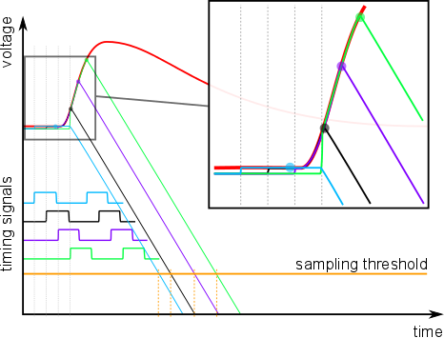
HVCMOS sensors
In pixel waveform sampling circuit works
Principle of operation
Measurement

Slide 34

HVCMOS sensors
ATLASPix Measurements

Slide 35
HVCMOS sensors
ATLASPix Architecture

Slide 36
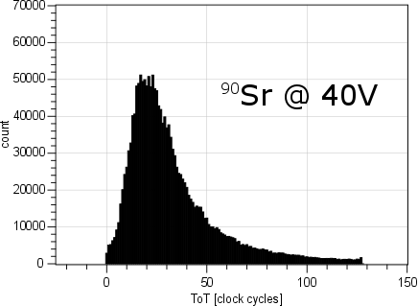
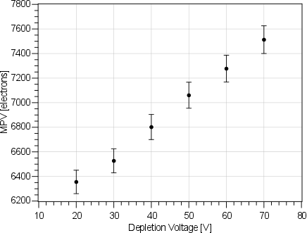
HVCMOS sensors
ATLASPix Measurements
Sr-90 spectrum measured by time over threshold method – fast readout
Sr-90 spectrum MPW for different bias voltages

Slide 37
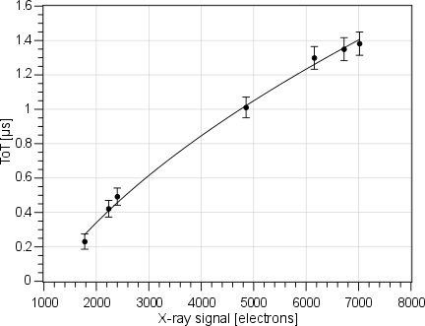
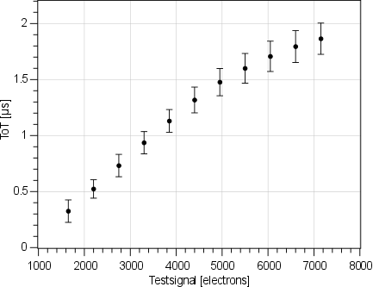
HVCMOS sensors
Good energy resolution by time over threshold
X-ray energies measured by time over threshold method – fast readout
Calibration of time over threshold

Slide 38
HVCMOS sensors
ATLASPix efficiency measured at CERN SpS – CLIC telescope
Efficiency
Dominik Dannheim, Andreas Nürnberg
Threshold voltage

Slide 39
HVCMOS sensors
ATLASPix Design
Triggered readout for ATLAS - measurement

Slide 40
HVCMOS sensors
ATLASPix Design

Slide 41
HVCMOS sensors
HVCMOS can improve performances of large experiments and lead to a significant cost reduction
Applications: Radiation detection in science (particle physics, x-ray detection at synchrotrons), medicine (hadron therapy) and industry (x-ray detection, electron microscopy)

Slide 42
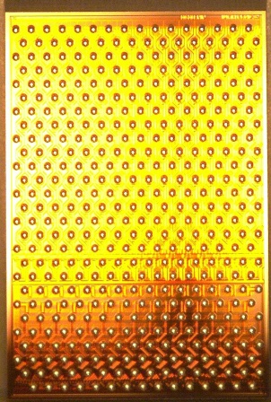

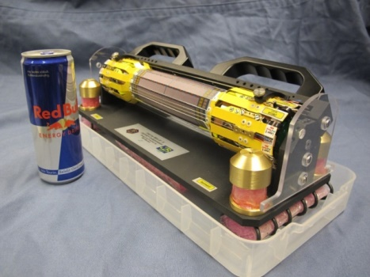
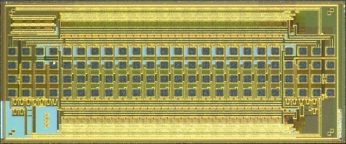
ASICs for Belle II
Belle II – a large particle physics experiment in Tsukuba/Japan
Readout ICs for Belle II pixel detector module are developed by KIT-ADL
Novel circuits, ~500 ASICs produced, tested and delivered
Detector assembly ongoing
5 mm
Control ASIC:
fast high-voltage drivers
Readout ASIC:
256 radiation-hard ADCs

Slide 43
Summary
KIT-ADL: Integrated circuits for various applications
SIPM Avalanche Diode Arrays in standard CMOS technologies
TRISTAN (search for sterile neutrinos – possible dark matter particles): New experiment concept and electronics developed
HVCMOS: New sensor technology for various applications developed from idea to large devices
Belle II (understanding of matter-antimatter asymmetry): Design and production of the readout- and control chips for a large particle physics experiment

