Slide 1
Data Management & analysis (DMA)
A new, cross-programme topic in MATTER
Michael Bussmann (HZDR)
Volker Guelzow (DESY)
with contributions from
DESY, FZJ, GSI with HI Jena & HI Mainz,
HZB, HZDR

Slide 2

The data challenge in matter: Volume
Volume (per scientist): We are now facing a situation where a single scientist can be confronted with Pbyte of data to analyze.
International Research Facilities
(XFEL, HL-LHC, FAIR, ESS, ...)
DMA
MATTER is pioneering in dealing with with massive amounts of data from large-scale facilities

Slide 3
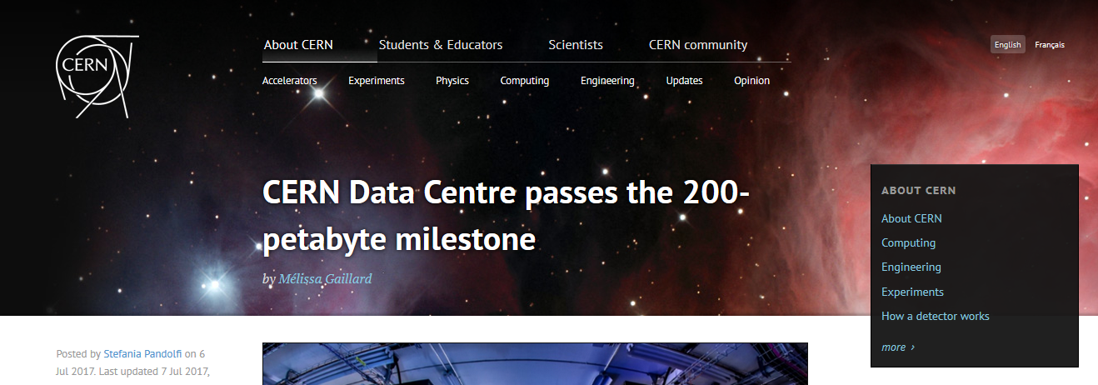
200 pbyte of useful data!
Volume (per scientist): We are now facing a situation where a single scientist can be confronted with Pbyte of data to analyze.
(on TAPE!)

Slide 4
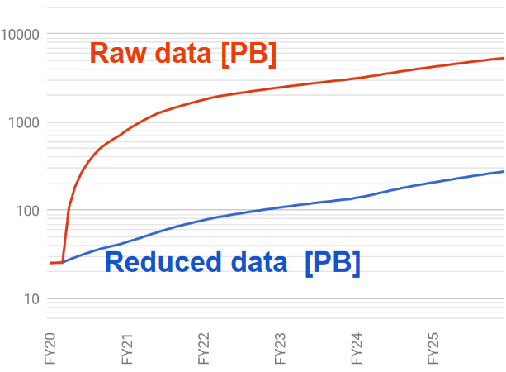
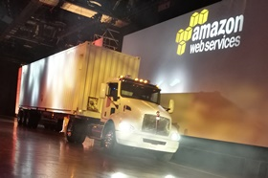
Reduction is necessary, but won‘t save us
Volume (per scientist): We are now facing a situation where a single scientist can be confronted with Pbyte of data to analyze.
LCLS-II prognosis
PB
X
100 PB / truck
Jana Thayer, LCLS Data Systems, PSI-Workshop „New concepts in ultrafast data acquisition“

Slide 5
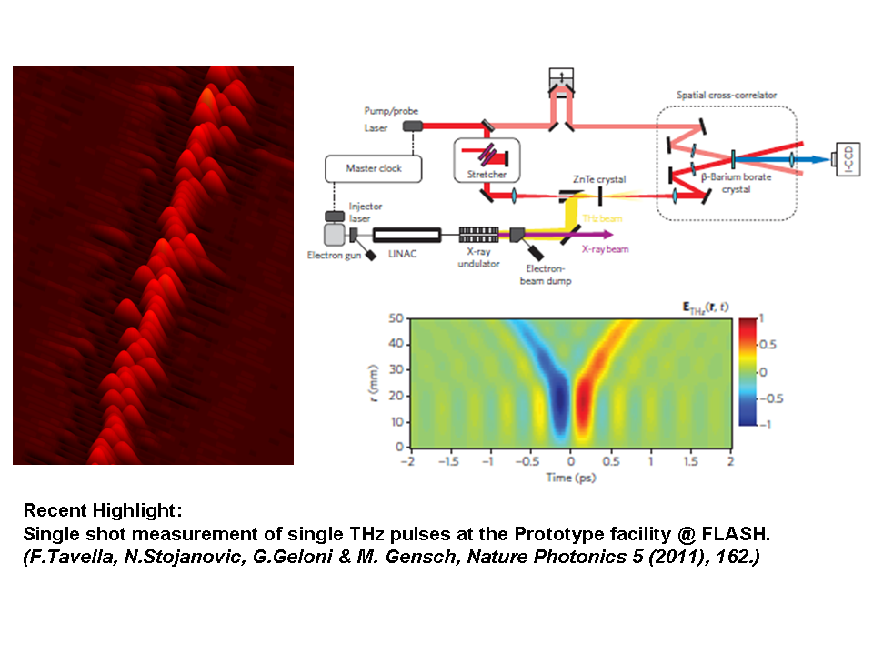
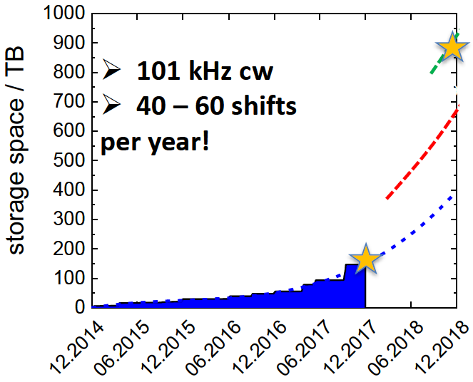
LK-II facilities all over matter are affected
Volume (per scientist): We are now facing a situation where a single scientist can be confronted with Pbyte of data to analyze.
Realtime
high rate
THz Science
with TELBE
Detector
improvement
© M. Gensch,
HZDR

Slide 6
LK-II facilities all over matter are affected
Volume (per scientist): We are now facing a situation where a single scientist can be confronted with Pbyte of data to analyze.
International Research Facilities
(XFEL, HL-LHC, FAIR, ESS, ...)
DMA
LK II – Facilities
in MATTER

Slide 7
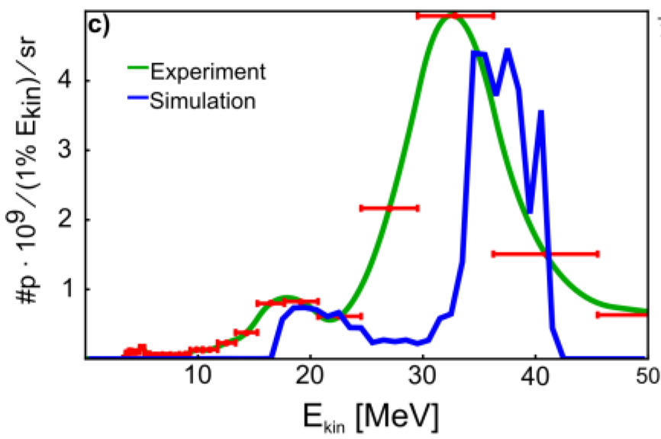
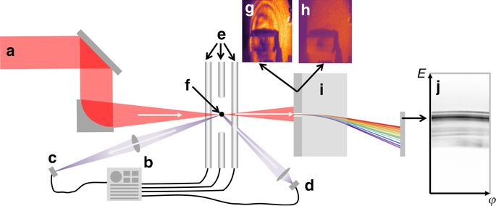
Even single phd students face challenges
Volume (per scientist): We are now facing a situation where a single scientist can be confronted with Pbyte of data to analyze.
Example: M&T ARD (LMU + HZDR) Laser-driven ion acceleration
4 Pb
sim
P.Hilz et al., Nature Communications 9(1), 423 (2018)

Slide 8

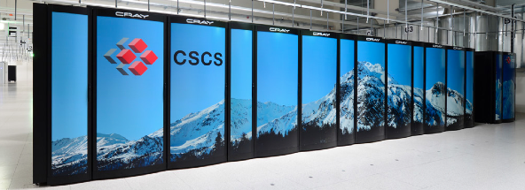
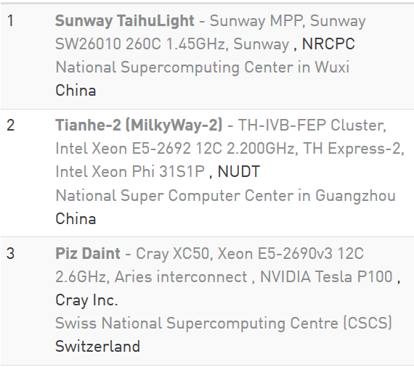
These challenges are real!
Volume (per scientist): We are now facing a situation where a single scientist can be confronted with Pbyte of data to analyze.
“Overall , this is an outstanding proposal. […]
The PIs should try to reduce the data requirements
and try to find a solution that is technically possible for CSCS.”
2 Pb total requested!
1 Pb produced in less
than a week

Slide 9
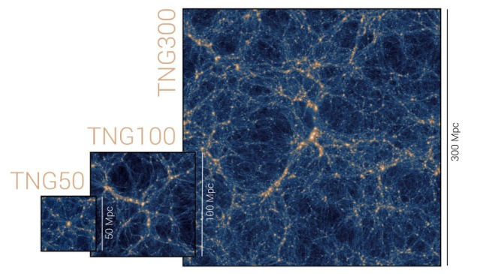
Understanding needs time
Volume (per scientist): We are now facing a situation where a single scientist can be confronted with Pbyte of data to analyze.
“The TNG simulations produced more than 500 Terabyte […] The full analysis will keep the participating scientists busy for many years to come”
International Research Facilities
(XFEL, HL-LHC, FAIR, ESS, ...)
DMA
LK II – Facilities
in
MATTER
Simulations

Slide 10
The data challenge in matter: Volume
Volume (per scientist): We are now facing a situation where a single scientist can be confronted with Pbyte of data to analyze.
Large volumes of meaningful data (data that cannot be reduced by orders of magnitude and do contain complex experimental measurements of value) require massively parallel, high throughput computing to analyze
Assumptions on how this data is produced and how it is analyzed determine the solutions one needs, in both hard- and software.
Lifetime of data and access workflows become important, as analysis needs bandwidth and bandwidth is more expensive than simple storage

Slide 11
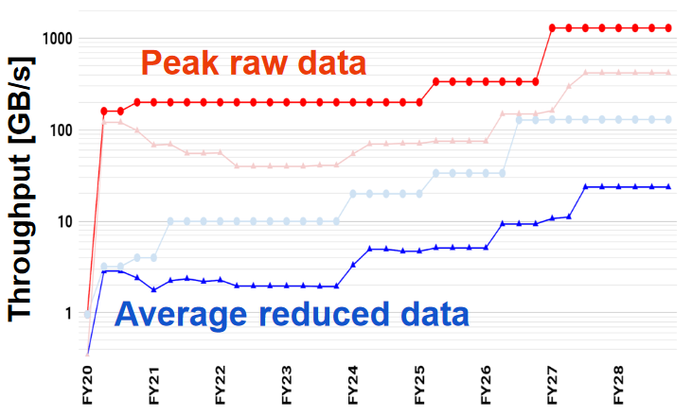
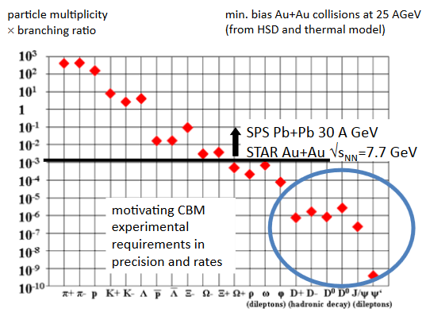
The data challenge in matter: rate
Rate (per detector): Machines allow for high production rates, detectors and data transport go towards TB/s throughput, data channels grow in number
Jana Thayer, LCLS Data Systems, PSI-Workshop „New concepts in ultrafast data acquisition“
CBM rare processes
2 orders of
magnitude
LCLS-II prognosis
12 orders of magnitude

Slide 12
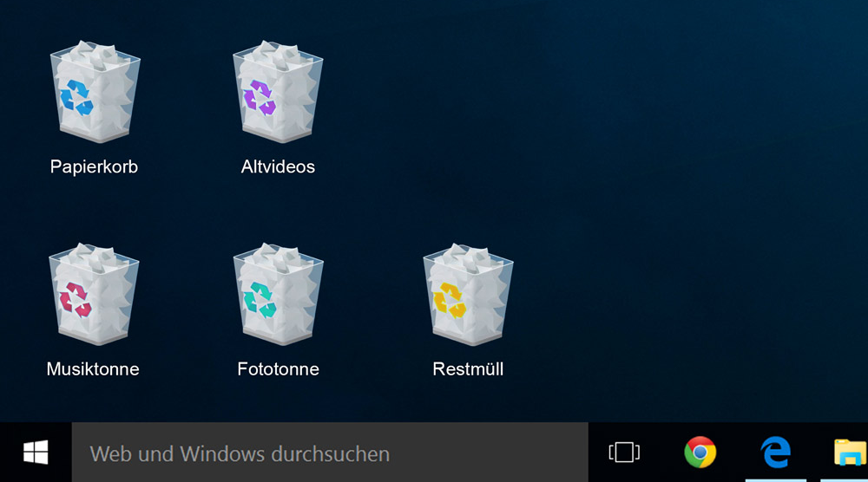
The data challenge in matter: rate
Rate (per detector): Machines allow for high production rates, detectors and data transport go towards TB/s throughput, data channels grow in number
Data reduction is essential! (discarding, compressing. transforming)
Data reduction should happen as
early as possible
Complexity of data matters when
reducing data (see later in the talk)
Maintaining throughput is a problem
What if one only has
useful, high quality data?
What if not?
What if one doesn‘t know?

Slide 13
From rate to throughput
Rate (per detector): Machines allow for high production rates, detectors and data transport go towards TB/s throughput, data channels grow in number
Production and acquisition rate determine throughput requirements
Peak throughput determines the DAQ and network bandwidth needed
Average throughput to storage & data lifetime determine storage needs

Slide 14
Bandwidth hierarchies
Rate (per detector): Machines allow for high production rates, detectors and data transport go towards TB/s throughput, data channels grow in number
Bandwidth depends critically on usage workflow
The larger the available memory, the smaller the available bandwidth
Staging + parallelism as mechanisms to deal with this

Slide 15
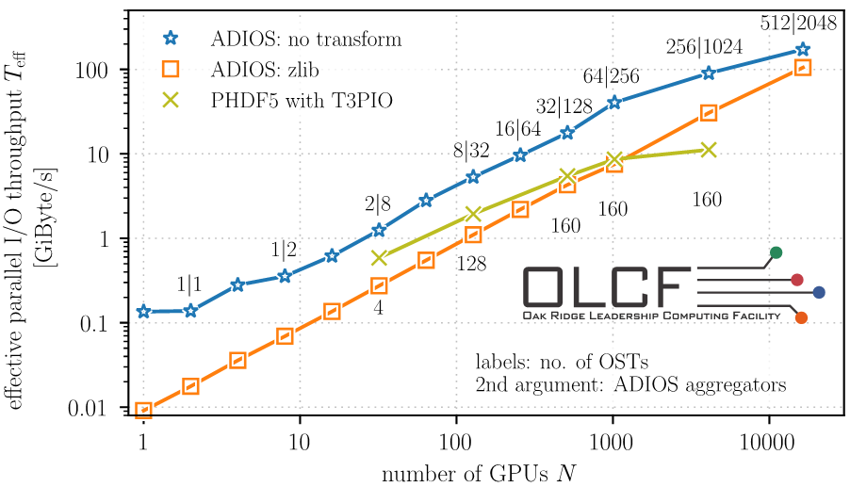
Throughput depends critically on usage
Rate (per detector): Machines allow for high production rates, detectors and data transport go towards TB/s throughput, data channels grow in number
1 TB/s theoretical throughput
250 GB/s reached
14 MB/s per node
Exclusive access
How is it accesed?
How long may it live?
1 Pb I/O in 1 hour

Slide 16
Compression may reduce throughput!
Rate (per detector): Machines allow for high production rates, detectors and data transport go towards TB/s throughput, data channels grow in number

Slide 17
Extreme Throughput requires online analysis
Rate (per detector): Machines allow for high production rates, detectors and data transport go towards TB/s throughput, data channels grow in number
Past
Present
Detector
Initial Reduction
Lifetime
Online Analysis
Log scales
Initial Knowledge
Extraction
Time
Offline Analysis
of stored data
Volume

Slide 18

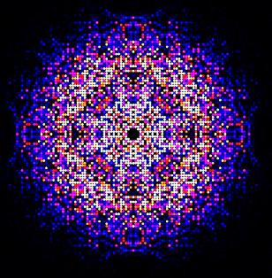
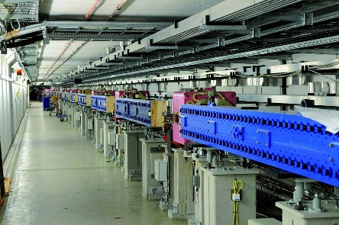
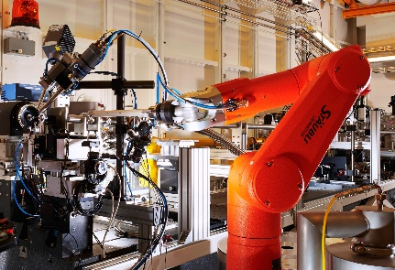
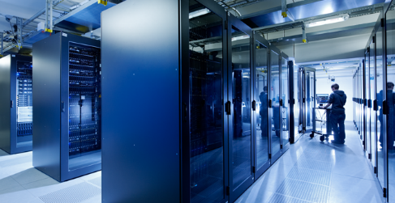
Throughput = online analysis & control
Rate (per detector): Machines allow for high production rates, detectors and data transport go towards TB/s throughput, data channels grow in number
Online analysis requires data from and feedback to machine,
DAQ & user, including meta data. Throughput must be maintained!
USER
MACHINE
EXPERIMENT,
DETECTORS
& DAQ
DATA CENTER
All of these are Big Data
Challenges!

Slide 19
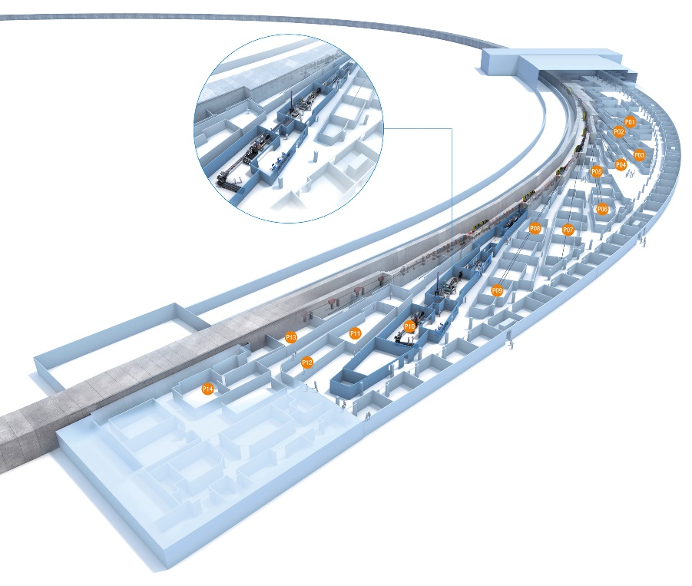
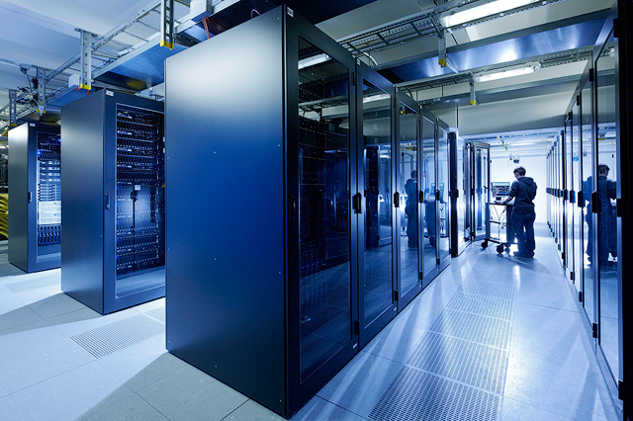
Resiliance & throughput
Rate (per detector): Machines allow for high production rates, detectors and data transport go towards TB/s throughput, data channels grow in number
Should work all the time & flawlessly

Slide 20
The data challenge in matter: RATE
Rate (per detector): Machines allow for high production rates, detectors and data transport go towards TB/s throughput, data channels grow in number
Reduction should be made as early as possible, parallelism is essential!
If one stores data, its analysis will essentially be limited by the bandwidth of the file system, which is orders of magnitude lower than throughput of the DAQ
One has to discard data and decide fast which data has to be kept
One has to integrate the whole chain from machine to offline analysis
Online analysis is essential, including meta data/DAQ/control data + feedback

Slide 21
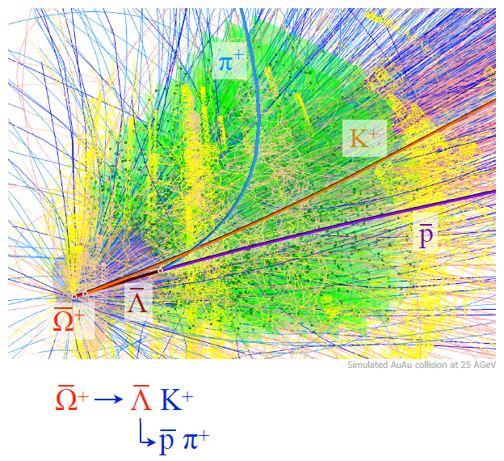
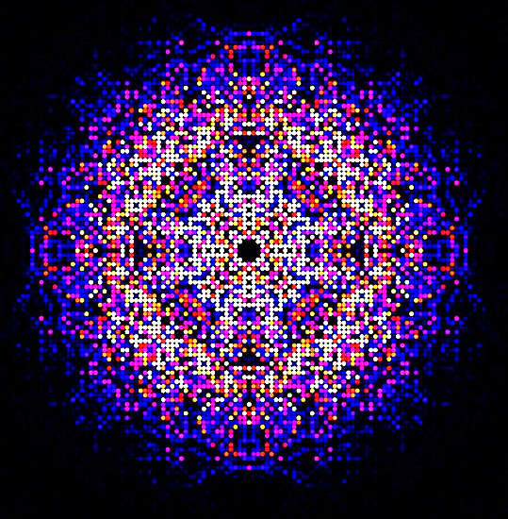
The data challenge in matter: complexity
Complexity (per event/data set/image and community): Machines + detectors produce more and more complex data, more and more scientific communities are involved in analyzing this data
Trypanosoma brucei cathepsin B
scattering pattern
CBM Au Au collision

Slide 22
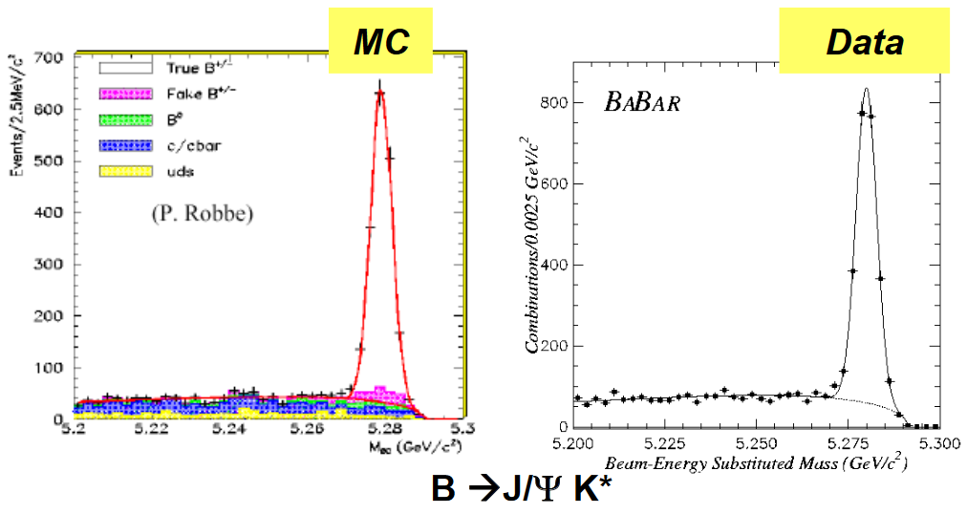
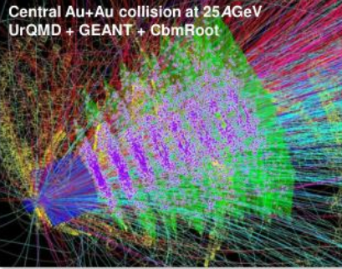
Complexity makes inversion harder
Complexity (per event/data set/image and community): Machines + detectors produce more and more complex data, more and more scientific communities are involved in analyzing this data
If one cannot invert the data, one must (potentially) simulate all possible experiments in a realistic manner and see which set of parameters fits best
CBM

Slide 23
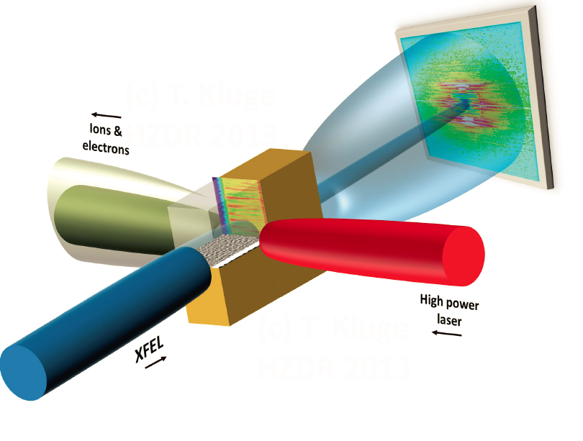
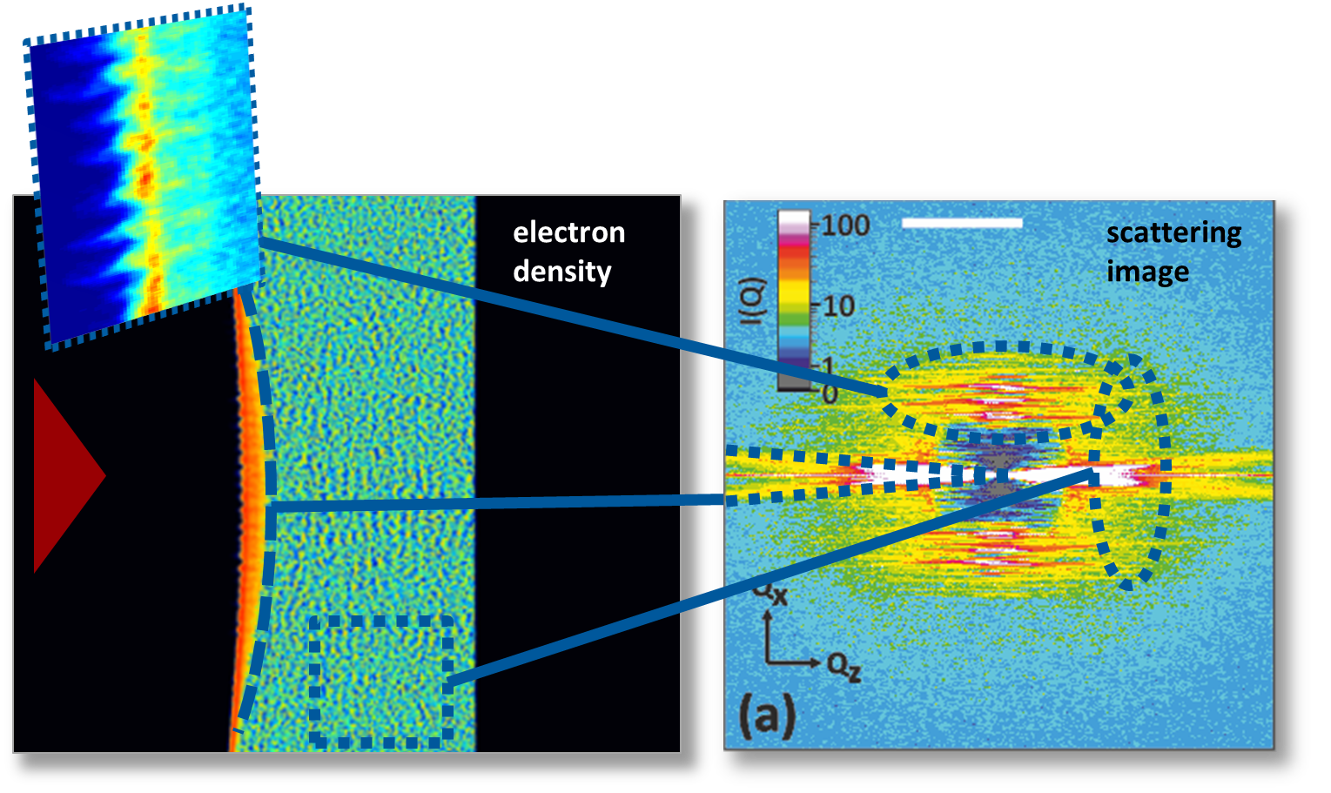
Example: hibef @ European xfel
Complexity (per event/data set/image and community): Machines + detectors produce more and more complex data, more and more scientific communities are involved in analyzing this data
Small-Angle X-ray Scattering from
free electron plasma density (sim!)

Slide 24
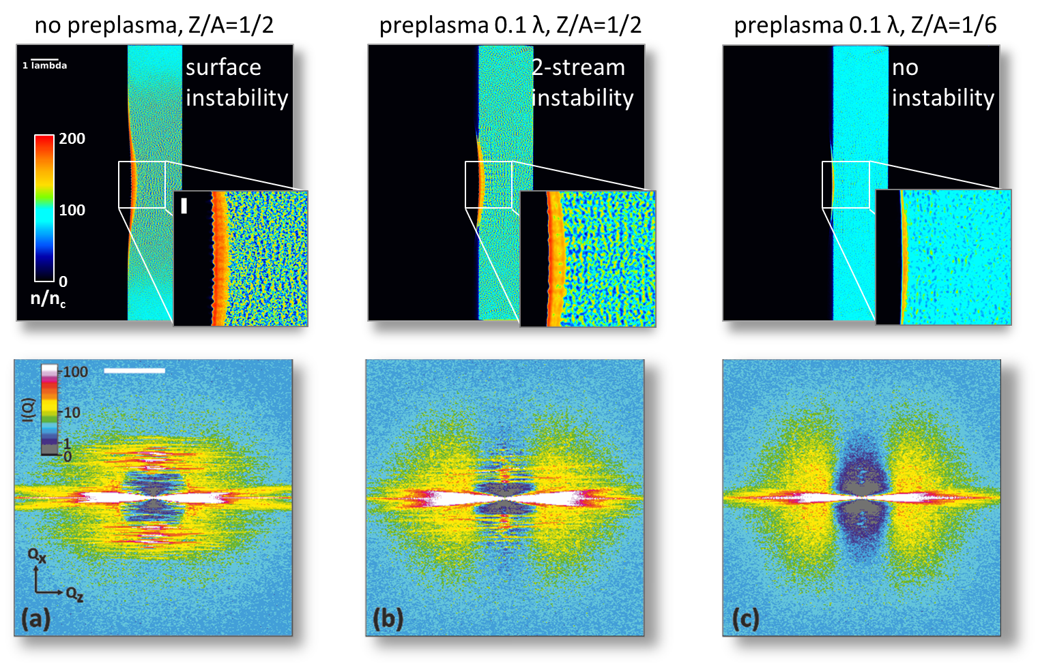
what if inversion becomes hard?
Complexity (per event/data set/image and community): Machines + detectors produce more and more complex data, more and more scientific communities are involved in analyzing this data
Variability between shots high
Underdetermined as a single modality
Multi-modal sensing needs a proper model

Slide 25
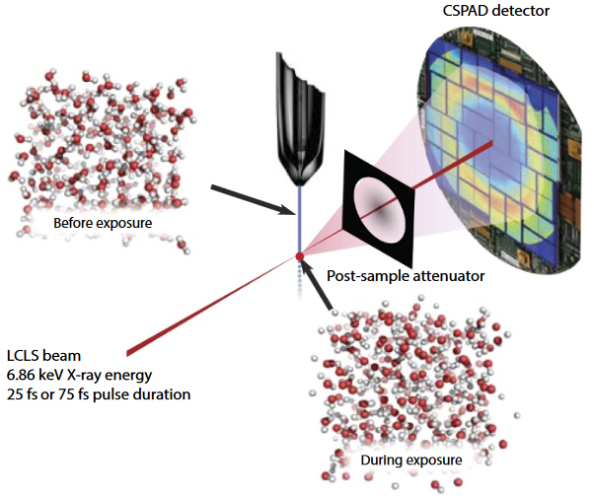
Observation can alter the probe
Complexity (per event/data set/image and community): Machines + detectors produce more and more complex data, more and more scientific communities are involved in analyzing this data
Ultrashort X-rays can interact with matter e.g. via ionization
This in turn can alter the sample under investigation significantly
One has to include these effects into the data analysis, making inversion even harder (= interdisciplinary)
K.R. Beyerlein et al., PNAS May 14, 2018. 201711220

Slide 26
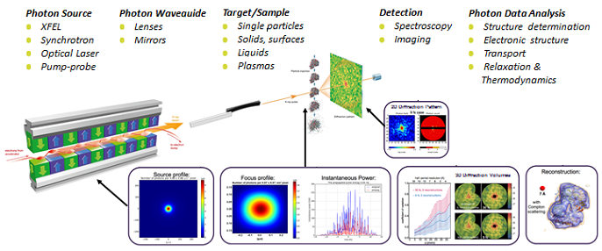

Start-to-end simulations (digital twins)
Complexity (per event/data set/image and community): Machines + detectors produce more and more complex data, more and more scientific communities are involved in analyzing this data
Peta-scale
Simulation

Slide 27
Reducing complex data requires computing
Complexity (per event/data set/image and community): Machines + detectors produce more and more complex data, more and more scientific communities are involved in analyzing this data
Detector
Initial Reduction
Complex data becomes harder to reduce quickly
Storage of data requires initial knowledge extraction
Online analysis becomes essential
Online Analysis
Initial Knowledge
Extraction
Compute effort
per data chunk
Offline Analysis
of stored data

Slide 28
The data challenge in matter: complexity
Complexity (per event/data set/image and community): Machines + detectors produce more and more complex data, more and more scientific communities are involved in analyzing this data
Complexity can come both with high quality and poor quality data.
Loosely said, complexity becomes critical at high data rates and large volumes if it complicates or even prohibits unmaintained data inversion.
In these cases, multi-modal sensing and modeling can help providing the missing information needed to extract the relevant information
This needs expert knowledge on the system studied, experiment & machine

Slide 29
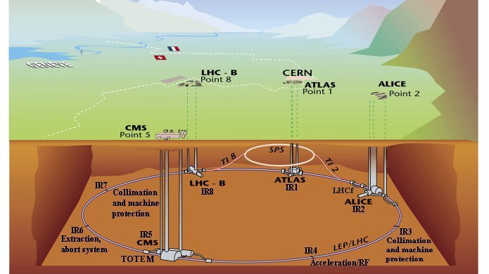
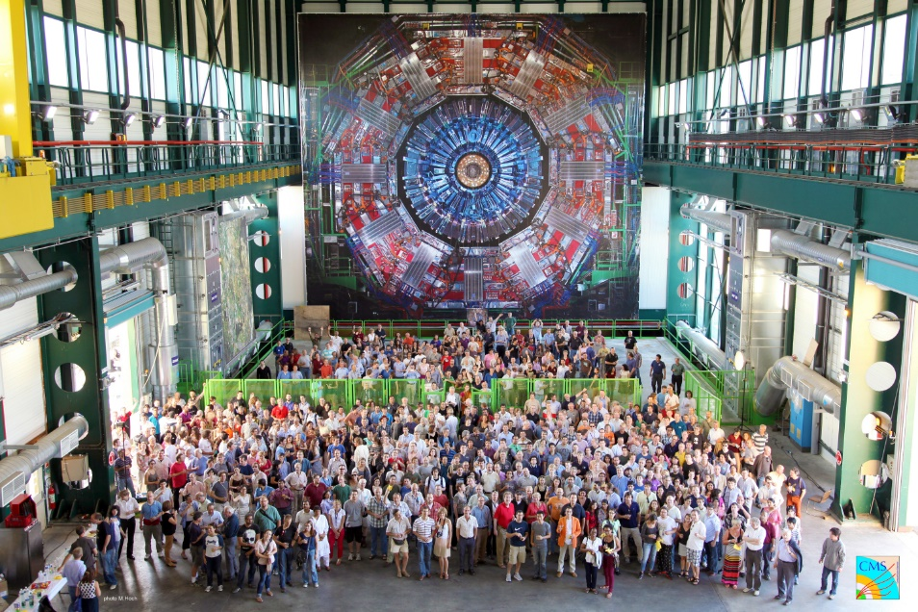
Domain expertise needed for data analysis
Complexity (per event/data set/image and community): Machines + detectors produce more and more complex data, more and more scientific communities are involved in analyzing this data

Slide 30
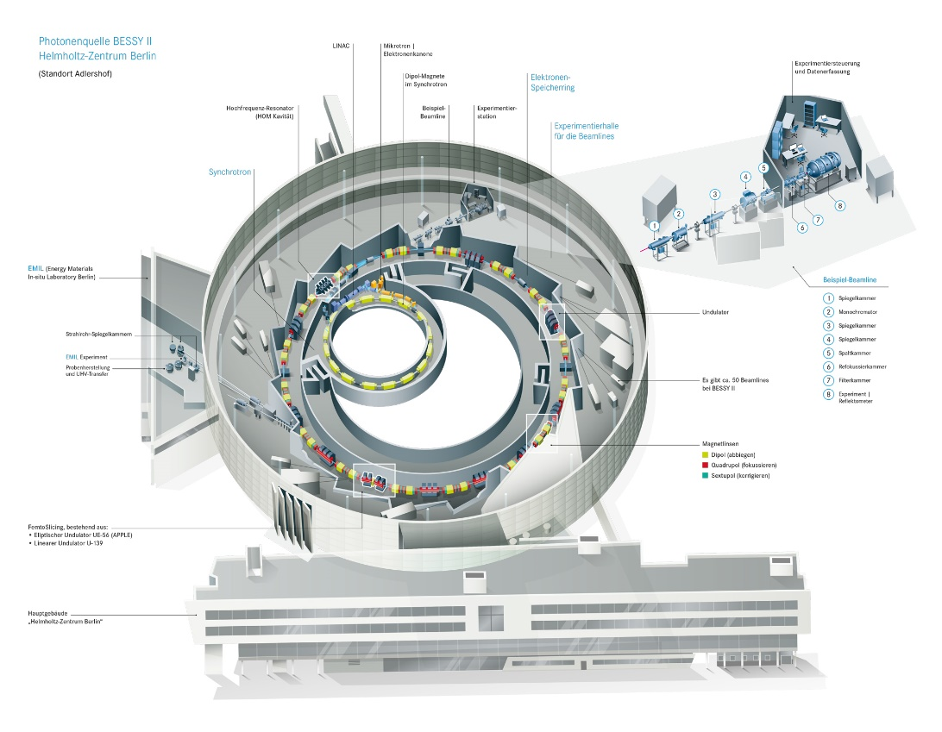
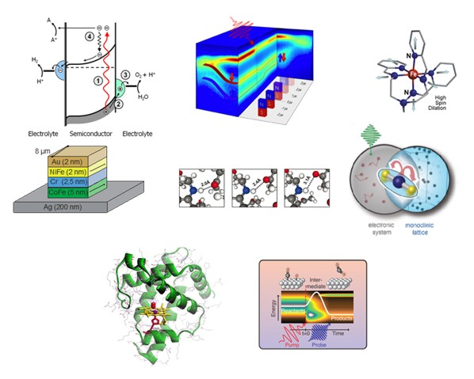
smaller communities, more applications
Complexity (per event/data set/image and community): Machines + detectors produce more and more complex data, more and more scientific communities are involved in analyzing this data

Slide 31


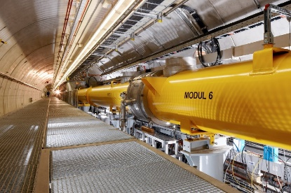





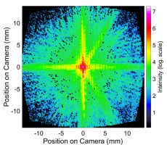
The data challenge in matter: complexity
Complexity (per event/data set/image and community): Machines + detectors produce more and more complex data, more and more scientific communities are involved in analyzing this data
The diversity of communities and users facing
The analysis of large sets of complex data at high
rates grows at all LK-II facilities and even in LK-I
research
Enabling all these scientists to make the best out of their
experiments and data is a challenge that is not only
solved by scientific and engineering innovation

Slide 32
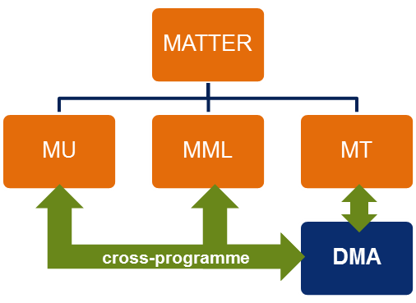
Introducing Data management & analysis

Slide 33
Scientific & data-intensive computing in dma
In the media, „Data Mining“ is used synonymously with „knowledge extraction
Hypothesis
Model
Prediction
Experiment
Analysis

Slide 34

Scientific & data-intensive computing in dma
DMA integrates methods, research tasks and applications from scientific & data-intensive computing relevant for research in Matter
DMA focuses und joins the various efforts in Matter to develop advanced digital methods for applications in Matter. This will happens for all parts of the scientific workflow, from model building to simulation, from experiment and machine to analysis
Hypothesis
Model
Prediction
Experiment
Analysis

Slide 35
Scientific & data-intensive computing in dma
DMA integrates methods, research tasks and applications from scientific & data-intensive computing relevant for research in Matter
DMA focuses und joins the various efforts in Matter to develop advanced digital methods for applications in Matter. This will happens for all parts of the scientific workflow, from model building to simulation, from experiment and machine to analysis
DMA sees the efficient and complete extraction of knowledge from data as a digital process that involves domain scientists, IT, data scientists and mathematicians, software engineers, machine and detector experts.
Hypothesis
Model
Prediction
Experiment
Analysis
Data Mining,
Cloud services,
Skaling
Data und
Model exploration,
Machine Learning
HTC, Staging,
Realtime feedback,
Online analysis
HPC,
Effective models,
Uncertainty quantification
Start-to-End Simulations,
Virtual Twins,
Machine & Experiment

Slide 36
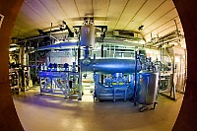
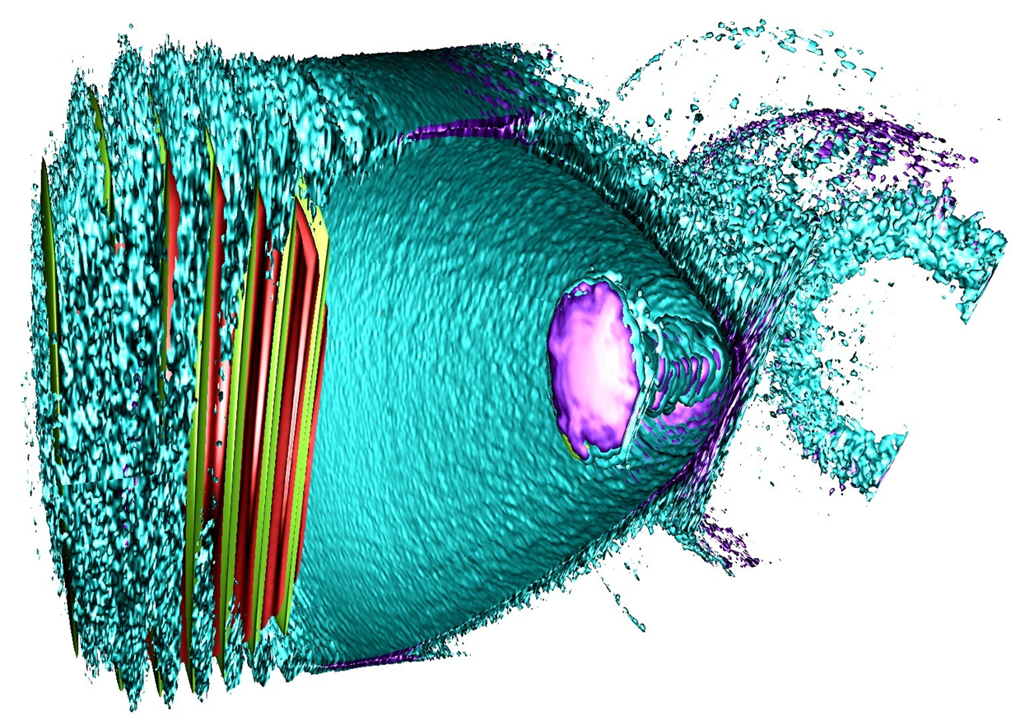
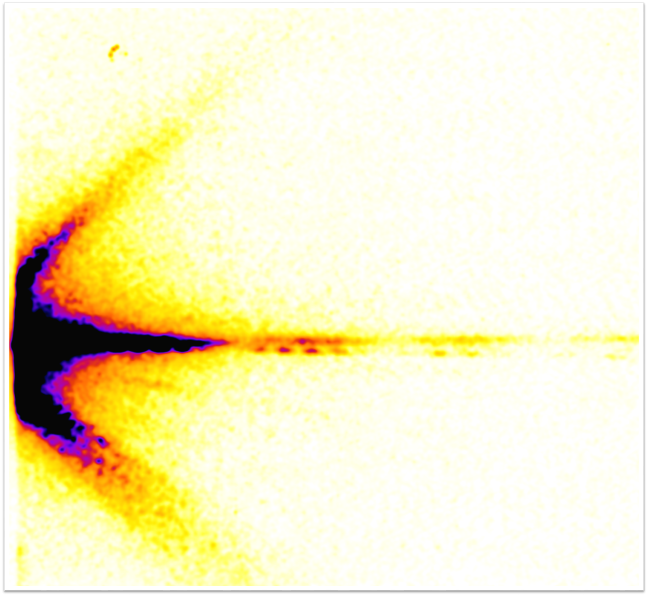
The three DMA subtopics
ST1: The Matter Information Fabric
  IT infrastructure (Hard- & Software) for facilities
  Automization of Data Lifecycle Management (LK II)
  Solutions für Communities
Two ST leaders
(IT & domain science)
ST2: The Digital Scientific Method
  Matter-specific research in Data Analysis & Simulation methods
  e.g. Machine Learning, Simulation, Visual Analytics, Scientific Workflow
  Developing methods für heterogeneous HPC, HTC, I/O for Matter applications
ST3: The Digital Experiment and Machine
  Start-to-End Simulations (Machine/Interaction/Detectors)
  Fast feedback & machine control („Human in the Loop“)
  Quantifying data quality, meta data acquisition & analysis

Slide 37
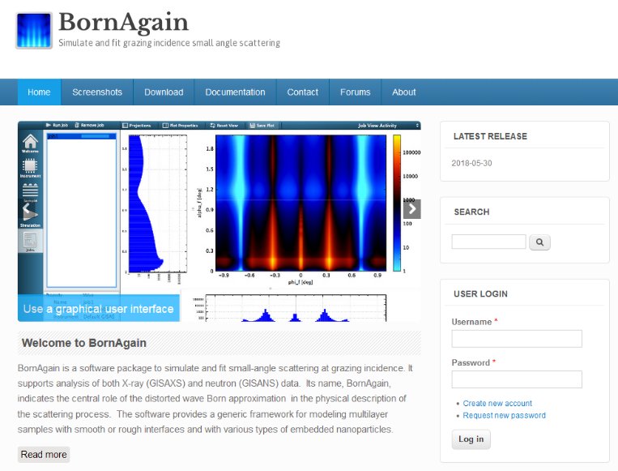
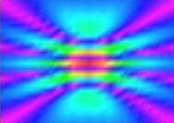
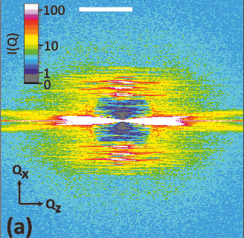

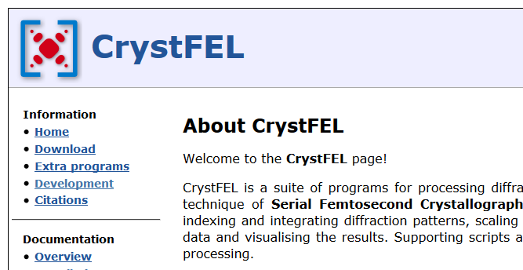
Example: high-rate x-ray/neutron scattering
X-ray and neutron scattering problems can often be treated in similar manners, e.g. when reconstructing images from scattering pictures
At high rates, the methods available will require more automation, adaption to facility data flows and detectors
DMA can utilize synergies and common needs to develop modular building blocks
HIJ XUV
EUXFEL
GISAX/NS
Neutrons
HIBEF

Slide 38
Modular, reusable, shareable solutions …
Data Lifecyle
High-rate Scattering Suite / Plattform (aaS)
Services
Processing Tools
Reconstruction Tools
Analysis Tools
Domain Specific Languages / Libraries für Scattering Primitives
Scalable Pipelining
I/O Stack & Staging
Portable, high throughput communication stack
Portable high performance computing stack
Adaption to Hardware & Optimization

Slide 39
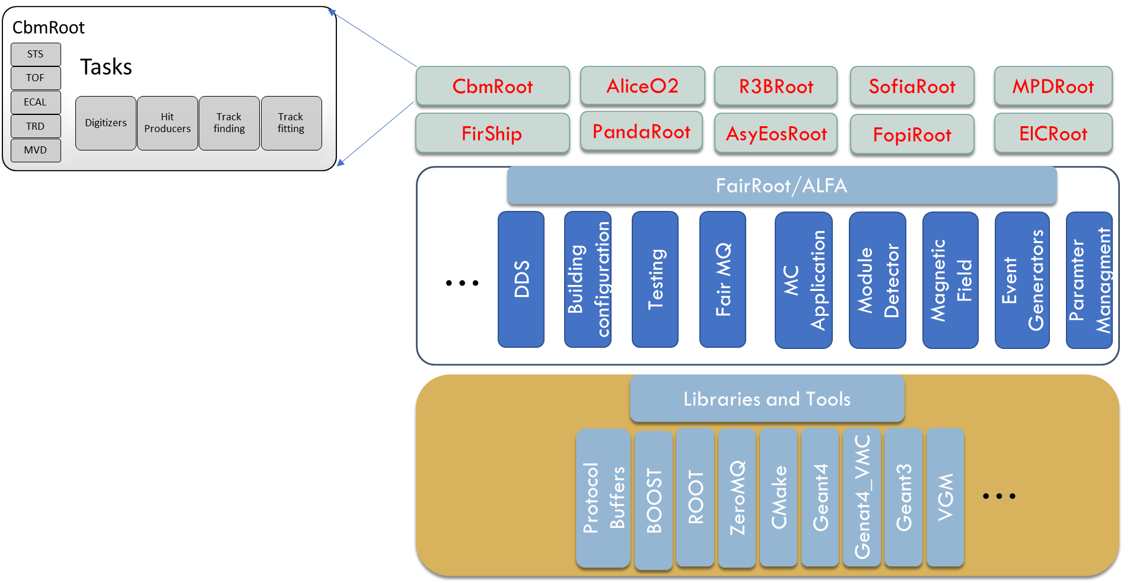
… are a successful model

Slide 40
New interfaces, new career paths
Users and Domain Scientists
DMA brings together experts from center IT, the facility, users and domain scientists, method scientists and developers
New career paths and the education of experts at the interfaces between these groups are necessary („Data Scientists“, „HIDA“, graduate schools)
DMA will develop modular, reusable solutions to be applied to applications in Matter and shared with others.
DMA will work as an open & dynamic topic to adapt to the fast pace of digitalization and to be open for new partners from Matter (IPP).
Center IT, Facilities
Method Scientists, Developers

Slide 41







Challenges in pof iv
Establishing digitalization of the scientific process over all Matter, including all levels from whole facilities to single researchers
Development, adaption & support for modular, shareable solutions for all scientific communities within Matter
Strengthening the expertise & diversity of advanced digital methods all over Matter (Machine Learning, Uncertainty Quantification, High Throughput Computing, Heterogeneous Computing, etc.)
Increasing the number of experts at strategically relevant interface positions („Data Scientists“, Joint professorships with local universities)
Openness to new partners that acknowledges the fast development within this field of research and fosters working with DMA easily.

Slide 42

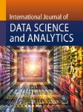
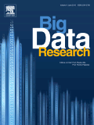

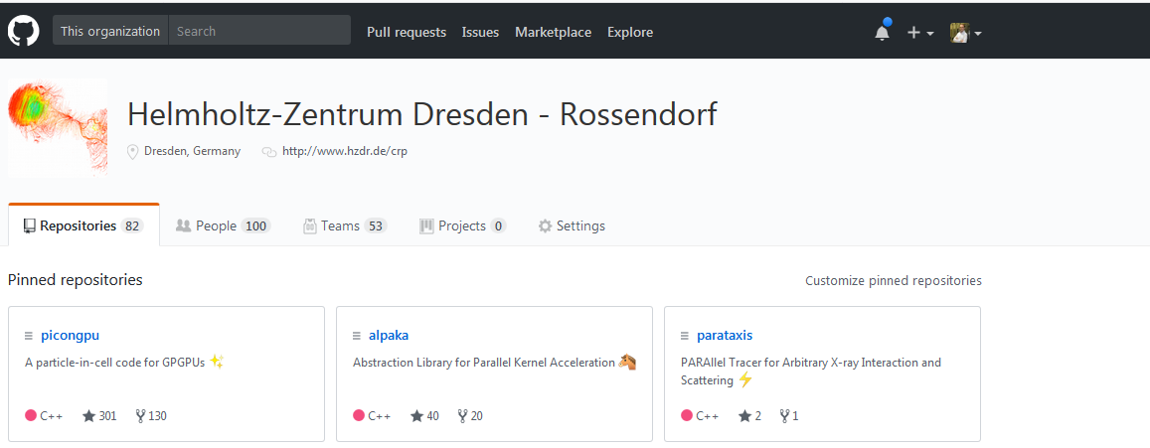

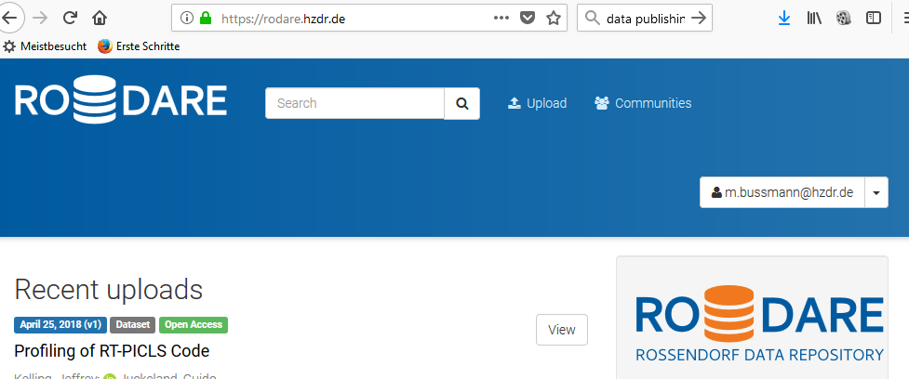
Beyond bibliographic indices
„The best methods for the best science“
Common Publications together with scientists from all fields of Matter
Publikations in dedicated journals & conferences
Software & data publication (Open Science, ~ LK-II usage)

Slide 43
DMA in matter & helmholtz
MATTER
MU
MML
MT
DMA
INFORMATION
P1: Von Daten zu Wissen & Handeln
DMA communicates scientific results & solutions that are of interest beyond Matter
cross-programme
DMA supports the adaption of solutions to specific applications in Matter
HELMHOLTZ
INCUBATOR
Joins resource & competence in „Scientific & Data-intensive Computing“ in Matter
Fosters networking inside Matter to research, develop, maintain and support common, modular, reusable solutions for applications in Matter
Increases international visibility, impact and variety of supported solutions
DMA as the single point of contact for applications in Matter

Slide 44
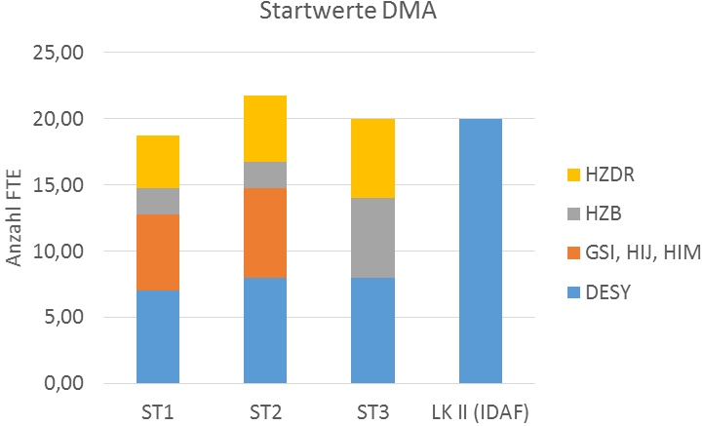
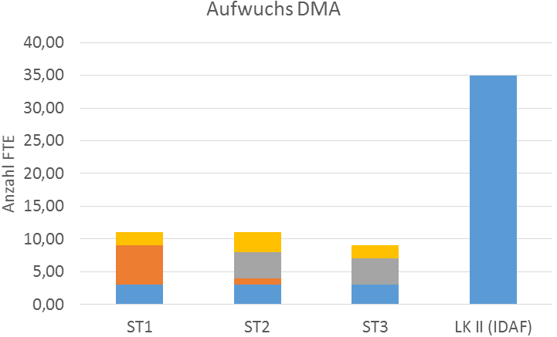


Dma Startwerte und aufwuchs
Interdisciplinary Data Analysis Facility
IDAF @ DESY
60,5
91,5

