Slide 1
The Silicon Tracking System of the
CBM experiment at FAIR
Johann M. Heuser,
GSI Helmholtzzentrum für Schwerionenforschung GmbH
− for the CBM Collaboration −
4th Helmholtz Matter and Technologies Meeting,
Berlin, 12-14 June 2018

Slide 2
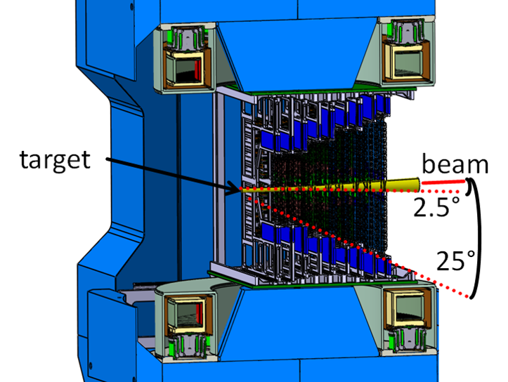
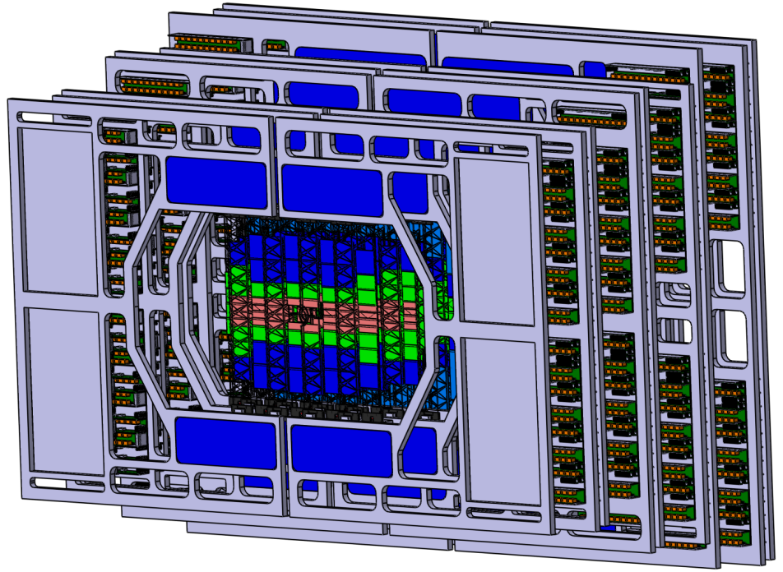
CBM: world-record high-rate heavy-ion physics experiment
  Compressed Baryonic Matter; up to 10⁷ beam-target interactions/s
  in preparation by the international CBM Collaboration at FAIR-SIS100
Silicon Tracking System STS: core CBM detector
  identification of hundreds of charged particles per interaction
  determination of their momenta in a dipole magnetic field

Slide 3
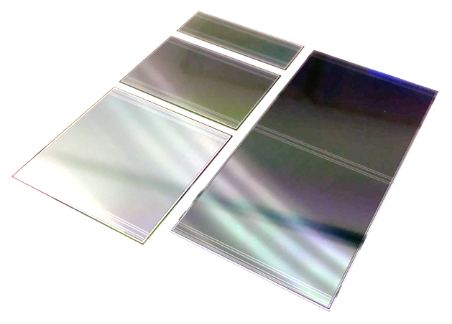
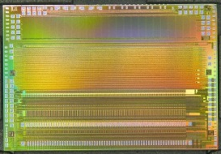
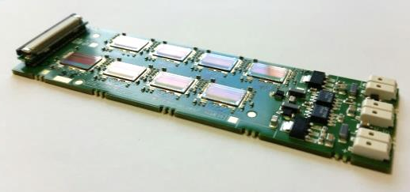
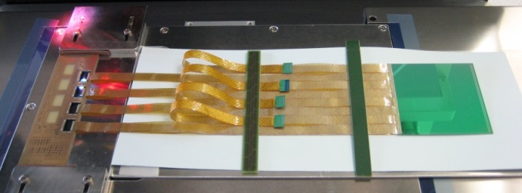
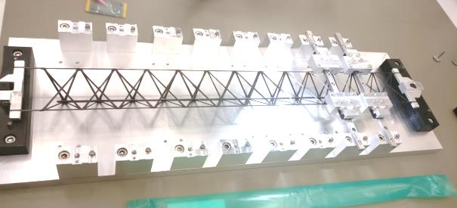
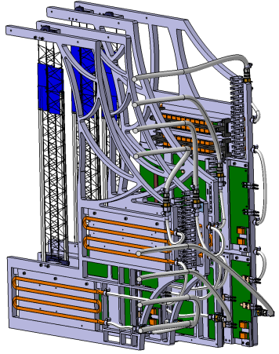
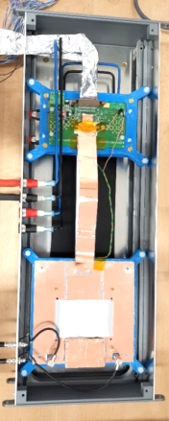
STS technical developments are advanced,
construction starting in 2019
  double-sided silicon
  microstrip sensors
  (high spatial segmentation,
  radiation tolerance)
  self-triggering read-out
  electronics
  (high time resolution, charge
  measurement, high data throughput)
  module + ladder assembly
  (low mass, handling, yield)
  system integration,
  system demonstrators
  (performance tests:
  S/N, resolution, rate capability)

Slide 4
Germany, Russia, Poland are key STS contributors
  distributed production of components
Helmholtz Centers play an important role:
  GSI: * Project leadership, technical coordination
  * STS system integration
  * Detector Laboratory expertise + infrastructure
  * demonstrator experiment miniCBM at SIS18
  Jülich: in-beam component tests with extracted
  proton beam at COSY
  KIT: module assembly center
  DESY: coordination of EU-H2020 Project CREMLIN:
  WP3: Joint development of STS by GSI and JINR

Slide 5
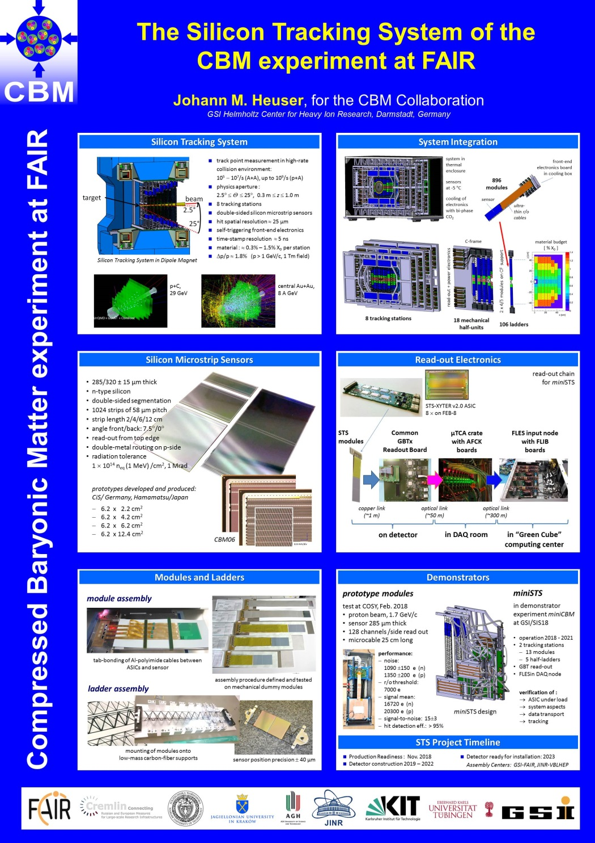
More at the posters:
+
P. Pfistner, KIT
Module assembly technologies for the Silicon Tracking System of the CBM experiment at FAIR
+
A. Rodriguez Rodriguez, Univ. Frankfurt
The front-end electronics of the CBM Silicon Tracking System
+
M. Dogan, GSI and Istanbul University
STS-XYTERv2 and prototype FEB-B tests for the CBM Silicon Tracking System

