Slide 1

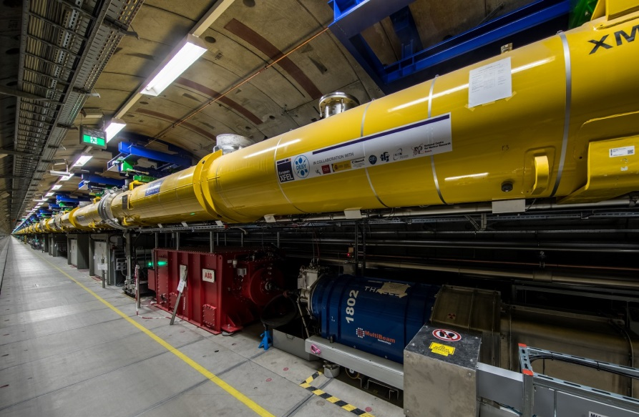
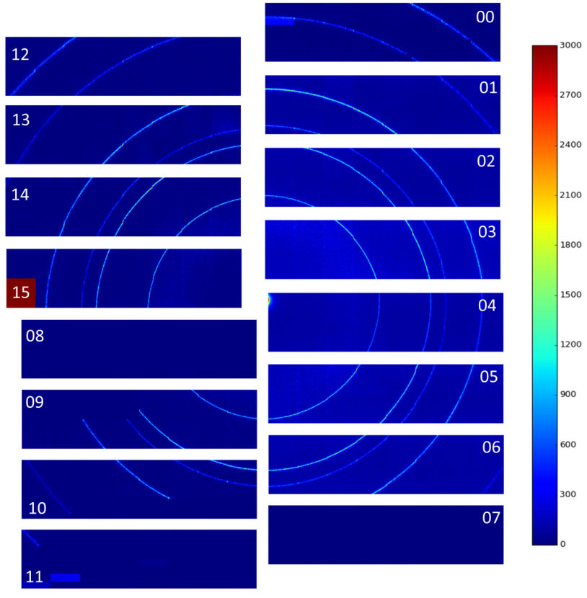

High Frame Rate X-ray Imager for Photon Science
D. Pennicard, U. Trunk, C. Wunderer, S. Smoljanin and H. Graafsma – DESY
European XFEL CW upgrade
Multi-megapixel, 100,000 fps+
X-ray camera
X-ray “flash photography” at atomic scales
Notes:
In photon science we need to build much faster X-ray cameras.

Slide 2
Detector head proposal
Notes:
Currently, working on conceptual design

Slide 3
High-speed DAQ
400 Gbit/s per module would allow:
  100 µm pixels and 300 kHz frame rate
  60 µm pixels and 100 kHz frame rate

