Slide 1
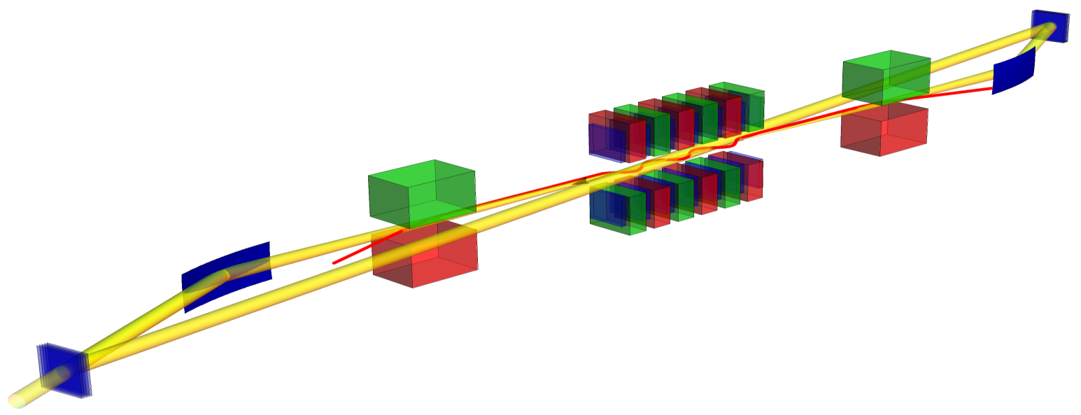




Diamond Crystals
Bending Magnets
Grazing Incidence Optics
Patrick Thiessen
Investigation of an XFELO for integration at the European XFEL
*Supported by BMBF
FKZ 05K13GU4 + FKZ 05K16GU4
*Supported by BMBF
FKZ 05K13GU4 + FKZ 05K16GU4
*Supported by BMBF
FKZ 05K13GU4 + FKZ 05K16GU4
*Supported by BMBF
FKZ 05K13GU4 + FKZ 05K16GU4
*Supported by BMBF
FKZ 05K13GU4 + FKZ 05K16GU4

Slide 2
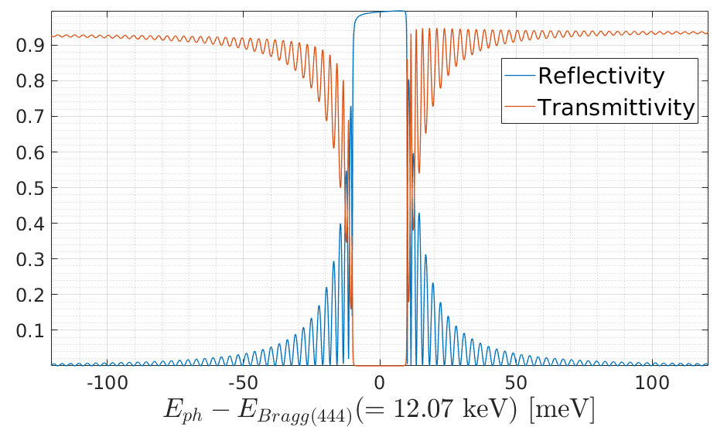
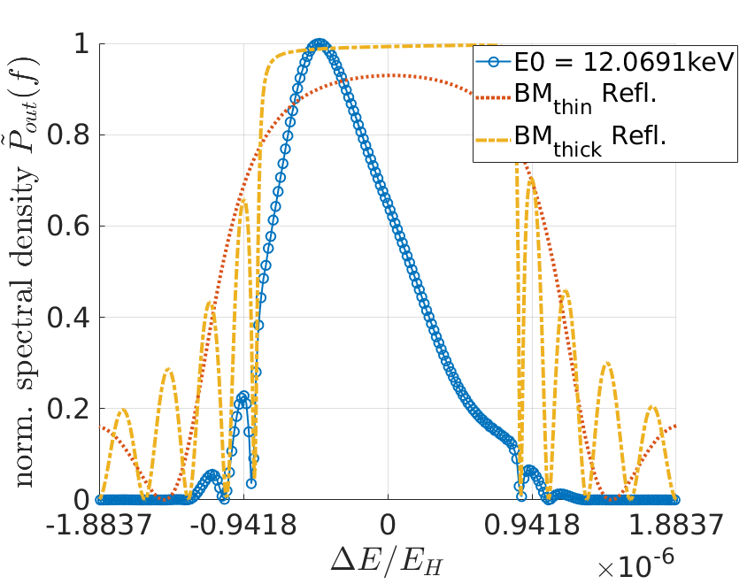
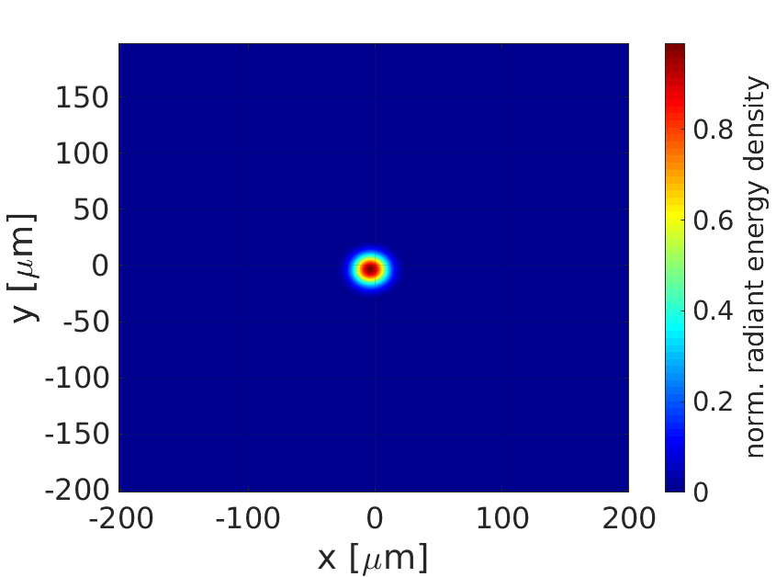
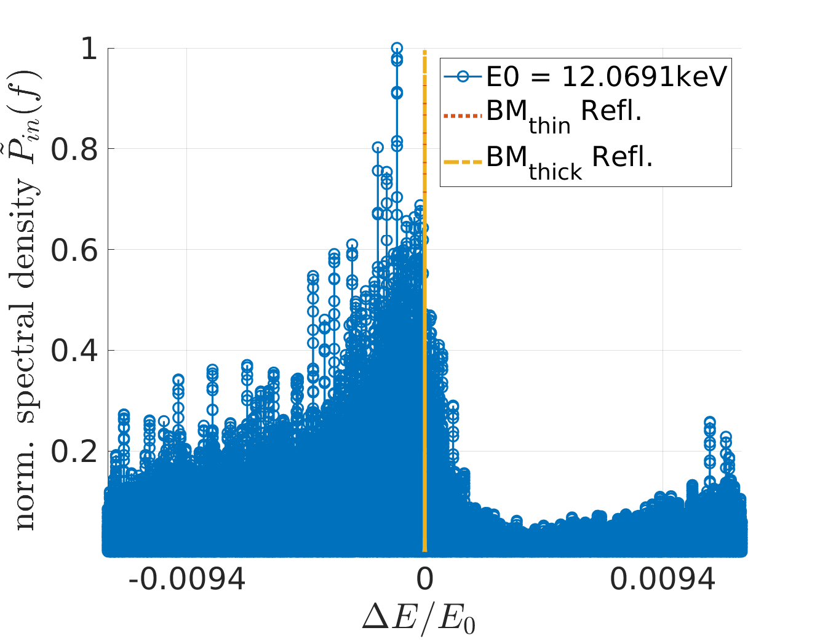
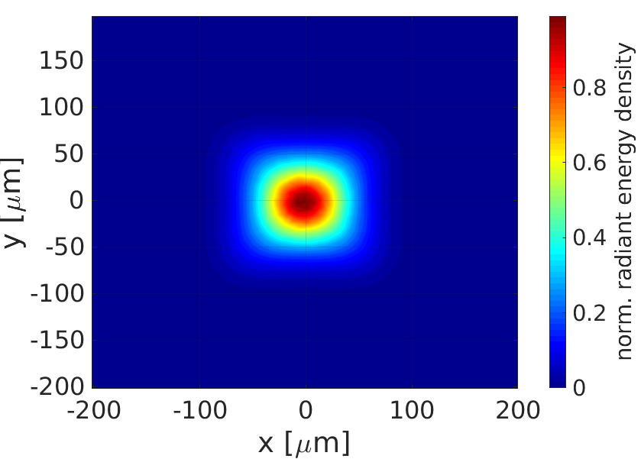
What is an XFELO:
extension of classical FEL oscillators to the hard X-ray:
  Mirrors based on principle
  of Bragg reflection
  Producing longitudinally
  coherent, stable, highly
  brilliant x-ray pulses
Pass 1
Pass 17
12.06.2018
Matter &Technology
1

Slide 3
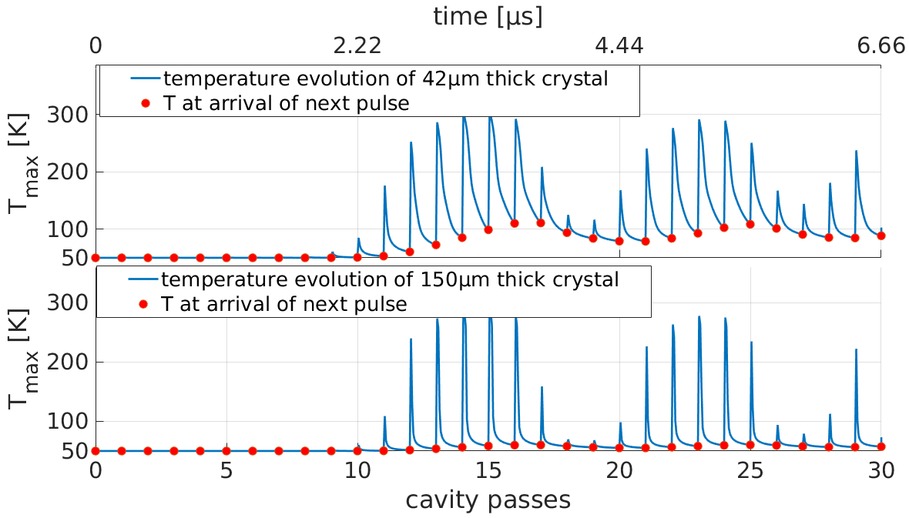
Challenges of an XFELO:
High brilliance, high repetition rate electron-bunches ← European XFEL
High demands on optical stability (optical resonator length > 60m)
Thermal load on crystals
→ Want to know more:
Come to my and I. Bahns poster !
12.06.2018
Matter &Technology
2

Slide 4
12.06.2018
Matter & Technology
4

