Slide 1
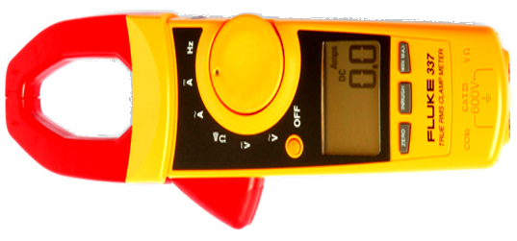
Low-Intensity Beam Measurement Based on Low-Temperature Superconductors
Cryogenic
Current
Comparator
Price:3 orders up
i_{beam}(t)
Current: 9 orders down
Nano- amperes
DC - MHz
B(t)
Current clamp
4. MT Meeting 12-June-2018 Berlin V. Tympel (Helmholtz Institute Jena)

Slide 2
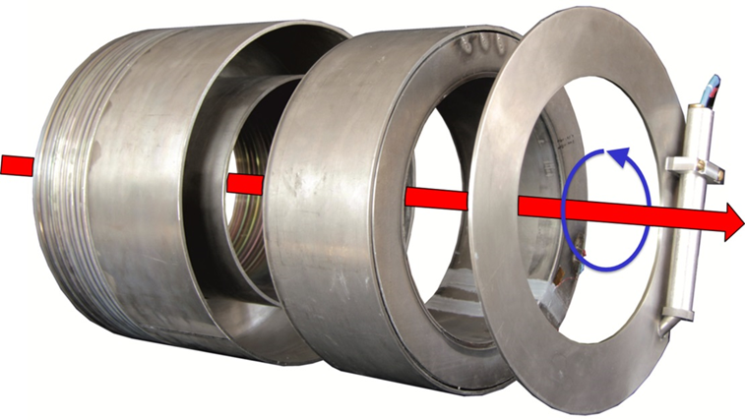
Low-Intensity Beam Measurement Based on Low-Temperature Superconductors
Cryogenic
Current
Comparator
Nb-CCC before
final closing
u_{SQUID}(t)
B(t)
i_{beam}(t)
superconducting
Shielding
Nb-meander
superconducting
DC-transformer
Nb-pickup coil
LT-SQUID
Superconducting quantum
interference device
4. MT Meeting 12-June-2018 Berlin V. Tympel (Helmholtz Institute Jena)

Slide 3
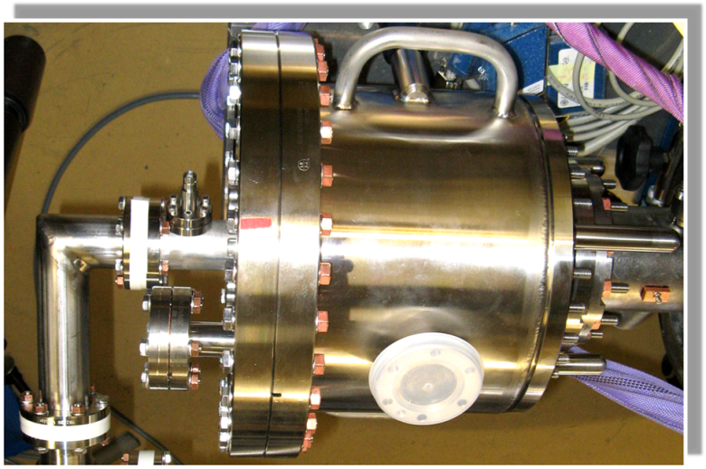
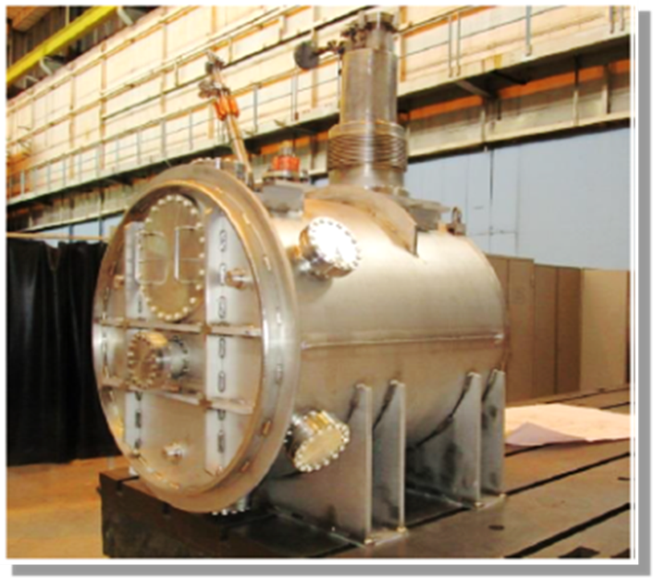
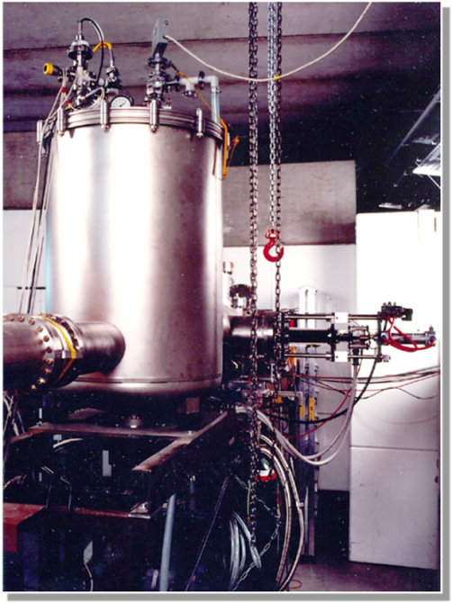
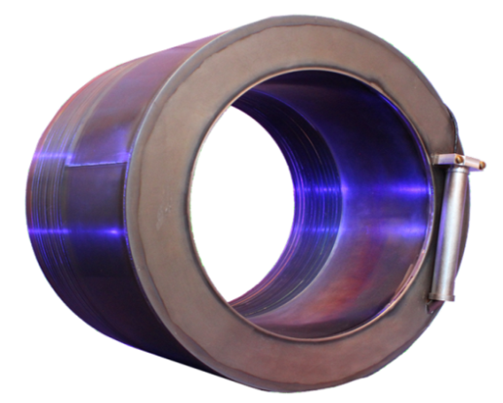
Low-Intensity Beam Measurement Based on Low-Temperature Superconductors
CCC-
Evolution
CCC @ Bessy 2010
CCC @ CERN AD 2015
CCC-XD
for
FAIR
2017
250 mm
CCC-Prototype @ GSI 1996
4. MT Meeting 12-June-2018 Berlin V. Tympel (Helmholtz Institute Jena)

Slide 4
Thank you for your attention.
Low-Intensity Beam Measurement Based on Low-Temperature Superconductors
Squid it !
CCC Meeting 06.06.2018 Darmstadt V. Tympel (Helmholtz Institute Jena)

