Slide 1
Commissioning results of
the HZB SRF Gun for bERLinPro
with a Cu cathode
Matter and Technologies 4. annual meeting
13.06.2018
Georgios Kourkafas, Thorsten Kamps, Guido Klemz, Julius Kühn, Axel Neumann, Martin Schmeißer, Jens Völker and the
bERLinPro team

Slide 2
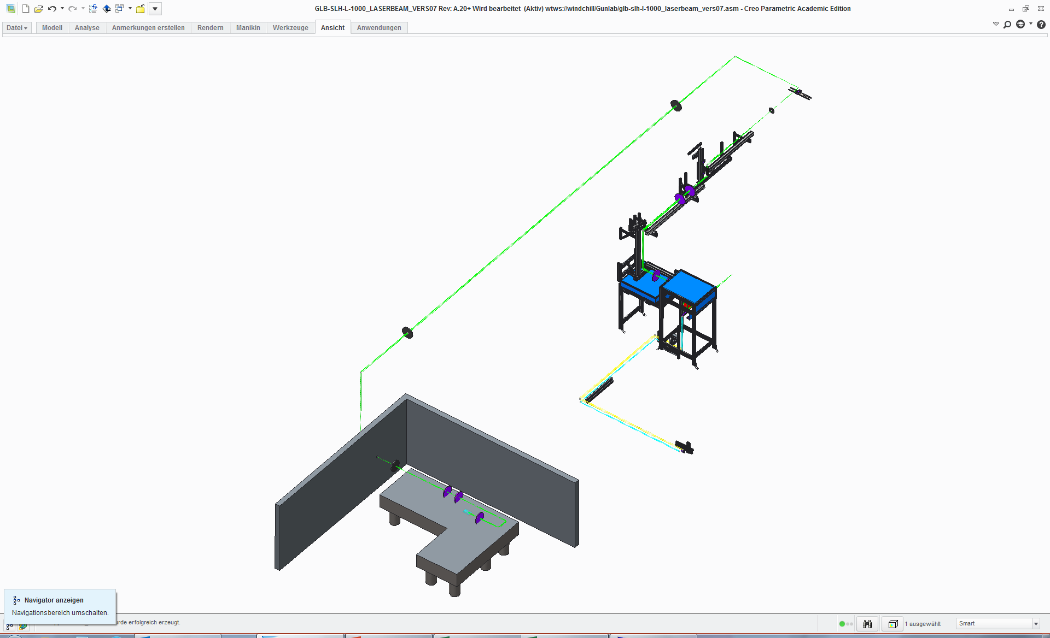
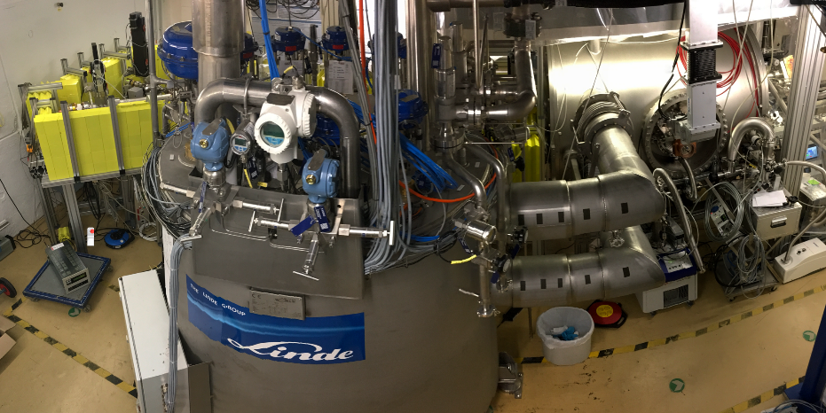
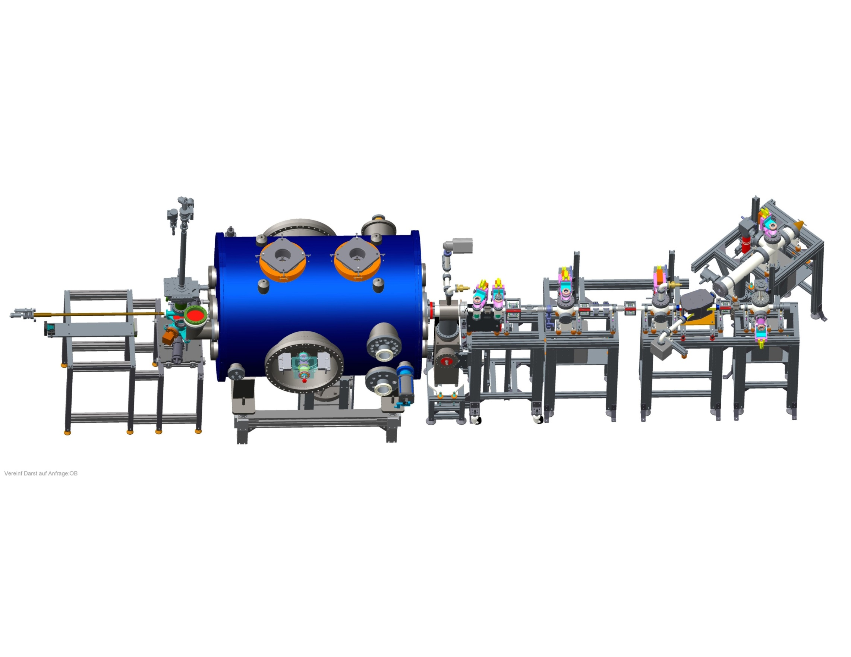
Overview of components & measurements
Laser
Cathode
Gun
e⁻ diagnostics
  power, spot size
  & pulse duration
  cathode position
  QE scan & map
  Shottky scan
  dark current
  DC-bias scan
  RF gradient
  phase scan for momentum (spread)
  + beam size

Slide 3

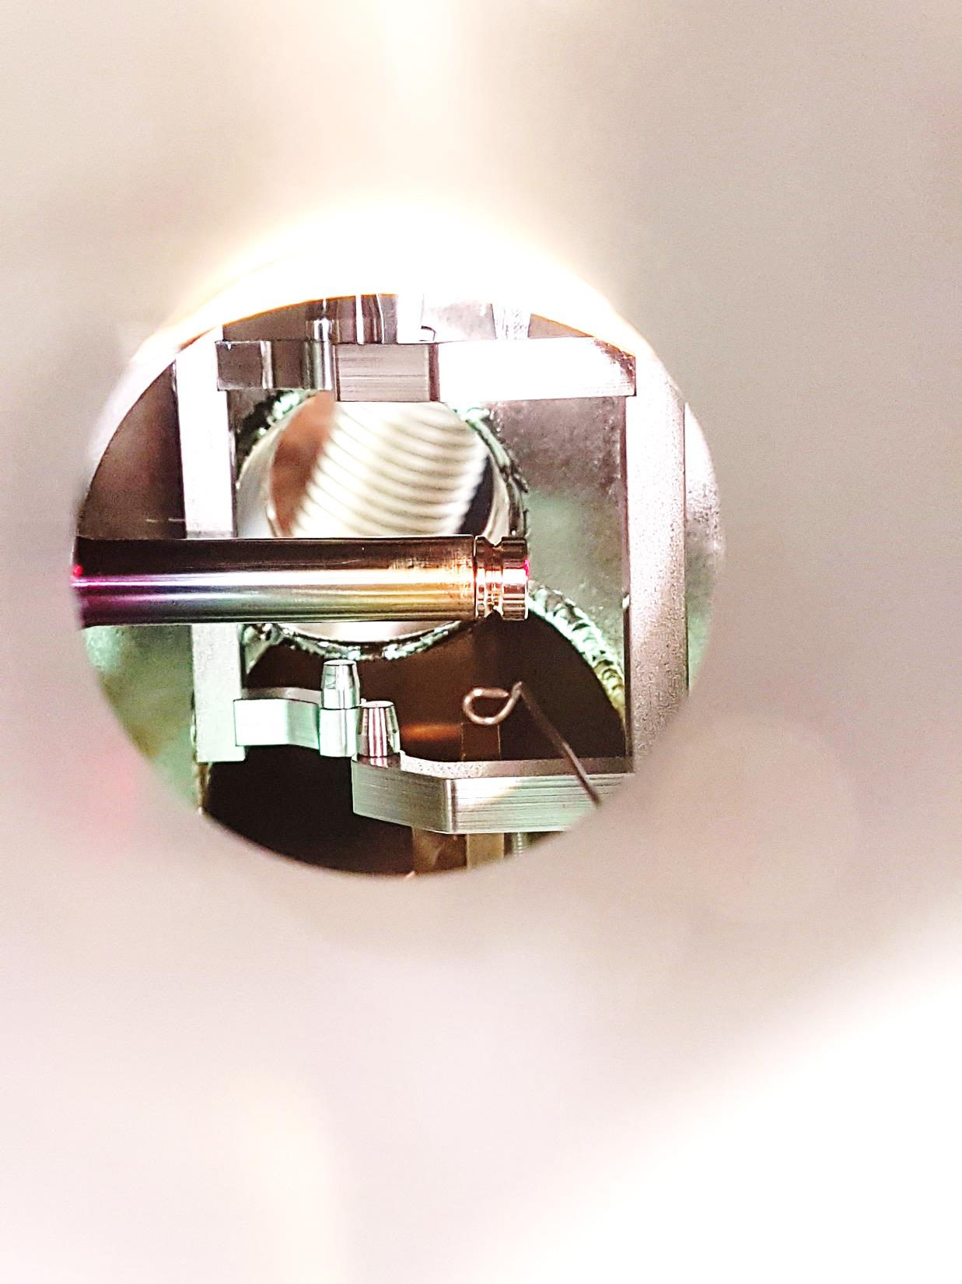
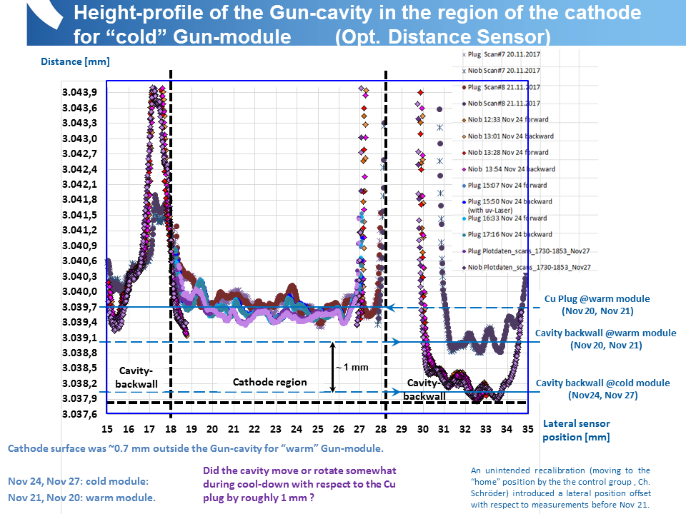
Timeline & incidents
- solenoid short-circuit observed,
- beam-profile monitor broke,
- cavity accidentally vented
Measurements timeline:
  First RF without cathode: 18–24.08.17
  1st cathode insertion (inner cathode position): 13.09.17
  Cathode removal,
  helium processing: 14–15.12.17
  2nd cathode insertion (outer cathode position): 19.12.17
  laser on: 22.12.17 – 15.01.18
Uncertain: RF calibration, solenoid strength,
cathode position and cooling…
cathode warming
frequency change
dark current measured
test of
coldbox
DC-bias on
e⁻ beam measurements
Courtesy:
G. Klemz et. al
~ 0.7 mm
~ 0.7 mm

Slide 4
Dark current summary
  First RF without cathode
  1st cathode insertion (inner cathode position + equipment failures)
  Cathode out & helium processing
  2nd cathode insertion (outer cathode position)
  e⁻ beam operation (PLL + LLRF)
deviation
above 8 MV/m
due to DC bias
/ cathode?
measuring different
emitters which overlap
above 7 MV/m ?

Slide 5
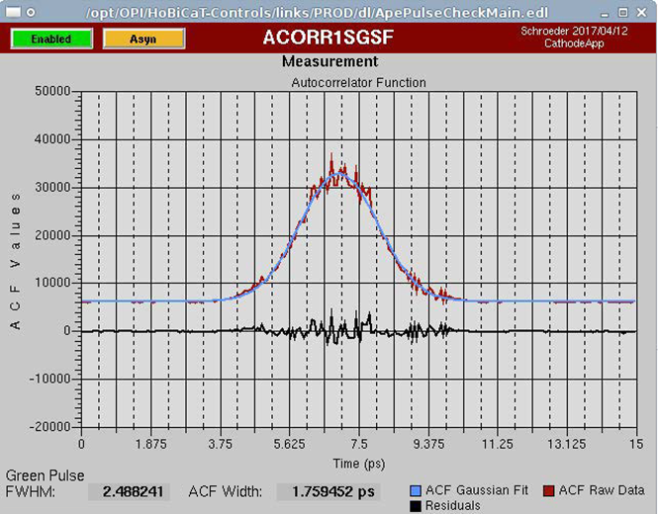
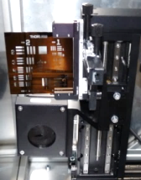
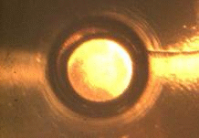
Laser parameters
Power meter:
  After a cold-start ~10 minutes for stabilization
  Short-term fluctuation: +/- 0.3 % rms, +/- 1.5 % max
  Long-term drift: +/- 1.2 % rms, +/- 2.8 % max
Pulse duration (optical auto-correlator):
  long-term drift: ~ 4 h to stabilize to
  0.6 ps rms (UV)
Transverse parameters:
“virtual cathode” + front camera

Slide 6
Quantum Efficiency maps
Laser: 1.75 mm diameter, 12.1 kHz rep rate
Date | Peak on-axis field (MV/m) | Relative RF phase (deg) | Momentum (MeV/c) | DC bias (kV) | Solenoid (A)
09.01 | 6.2 | +25 | 0.94 | -2 | -0.36
12.01 | 6.0 | +60 | n/a | -2 | -0.40
Date | Peak on-axis field (MV/m) | Relative RF phase (deg) | Momentum (MeV/c) | DC bias (kV) | Solenoid (A)
09.01 | 6.2 | +25 | 0.94 | -2 | -0.36
12.01 | 6.0 | +60 | n/a | -2 | -0.40
15.01 | 7.0 | +50 | n/a | -2 | -0.36
Date | Peak on-axis field (MV/m) | Relative RF phase (deg) | Momentum (MeV/c) | DC bias (kV) | Solenoid (A)
09.01 | 6.2 | +25 | 0.94 | -2 | -0.36

Slide 7
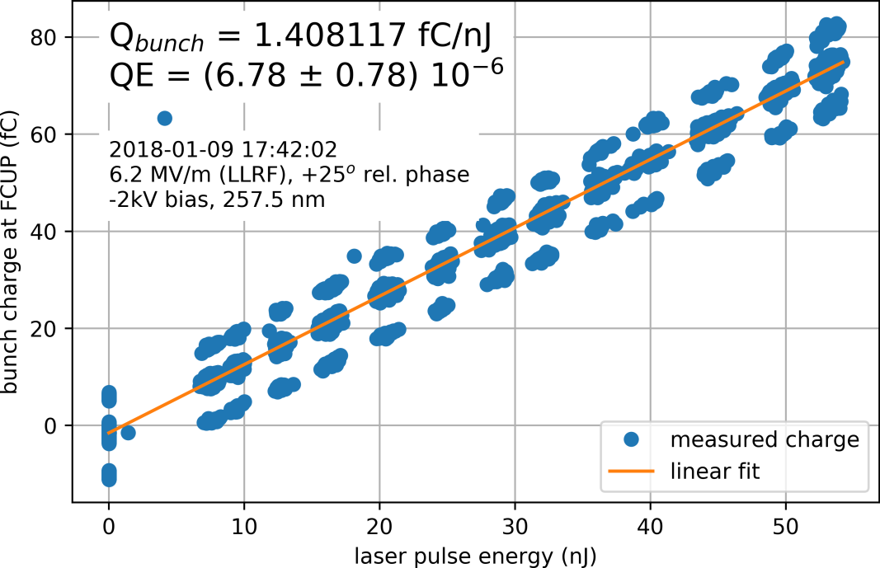
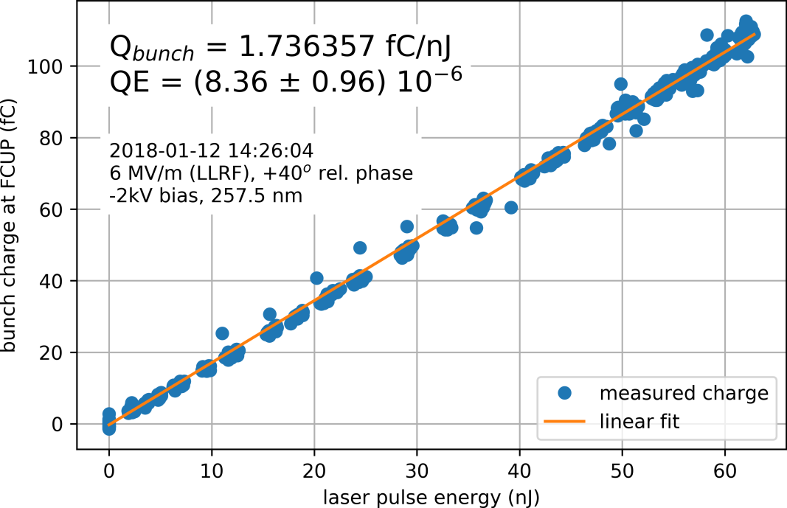
Quantum Efficiency scans
In agreement with Cu measurements from other photo-injectors
Date | Peak on-axis field (MV/m) | Relative RF phase (deg) | Momentum (MeV/c) | DC bias (kV) | Solenoid (A)
09.01 | 6.2 | +25 | 0.94 | -2 | -0.36
12.01 | 6.0 | +40 | n/a | -2 | -0.40

Slide 8
Photoemission scans
Date | Peak field (MV/m) | Laser power (mW) | DC bias (kV)
09.01 | 6.2 | 0.63 | -5
Date | Peak field (MV/m) | Laser power (mW) | DC bias (kV)
09.01 | 6.2 | 0.63 | -5
10.01 | 5.4 - 6.2 | 0.47 - 0.51 | -2
Date | Peak field (MV/m) | Laser power (mW) | DC bias (kV)
09.01 | 6.2 | 0.63 | -5
10.01 | 5.4 - 6.2 | 0.47 - 0.51 | -2
12.01 | 6.0 | 0.72 | -2

Slide 9
Momentum scans

Slide 10
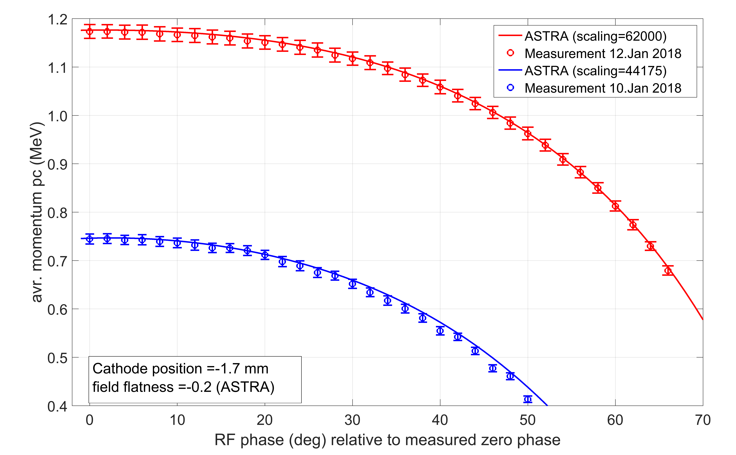
Simulating the measured momentum
ASTRA indicates +35% peak RF field
ASTRA 10.2 MV/m
Measurement 7.5 MV/m
ASTRA 7.3 MV/m
Measurement 5.4 MV/m
Courtesy:
J. Voelker

Slide 11
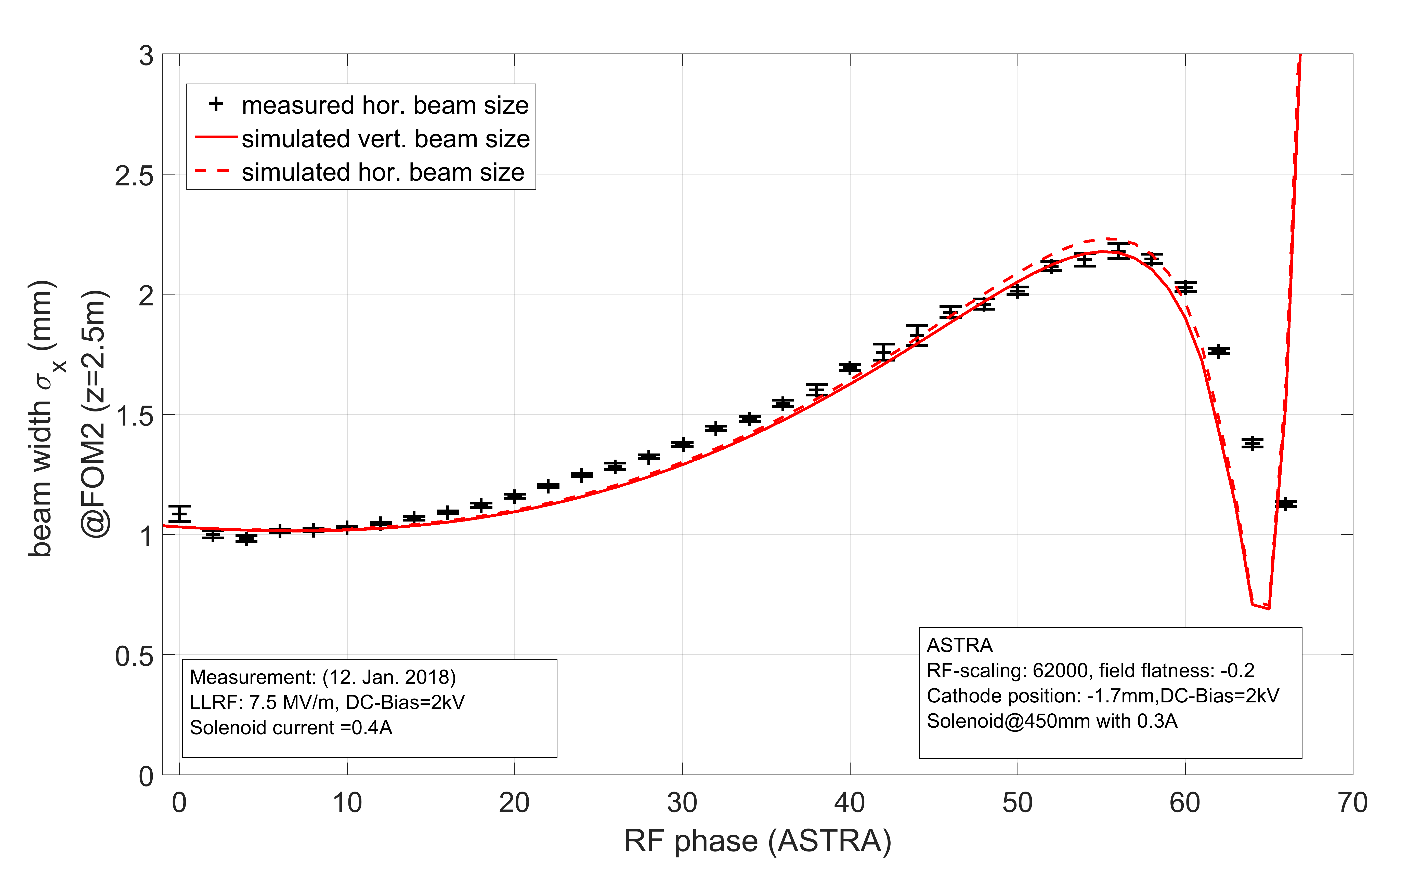
Simulating the measured beam size
ASTRA indicates -25% solenoid strength
Courtesy:
J. Voelker

Slide 12
Summary & Outlook
Valuable experience and data from the commissioning of the SRF injector for bERLinPro with a Cu cathode:
  Laser performance
  Cathode position and DC-bias
  Gun performance & RF parameters
  Measurement procedures, diagnostics, controls, …
Consistent beam dynamics simulations –
further analysis for (field) emission with DC-bias
Ongoing tests and improvements regarding:
  Cryo distribution system
  Cathode cooling
  Solenoid
Next goal: operation with CsK₂Sb cathode at bERLinPro
with an online simulation tool for live feedback

Slide 13
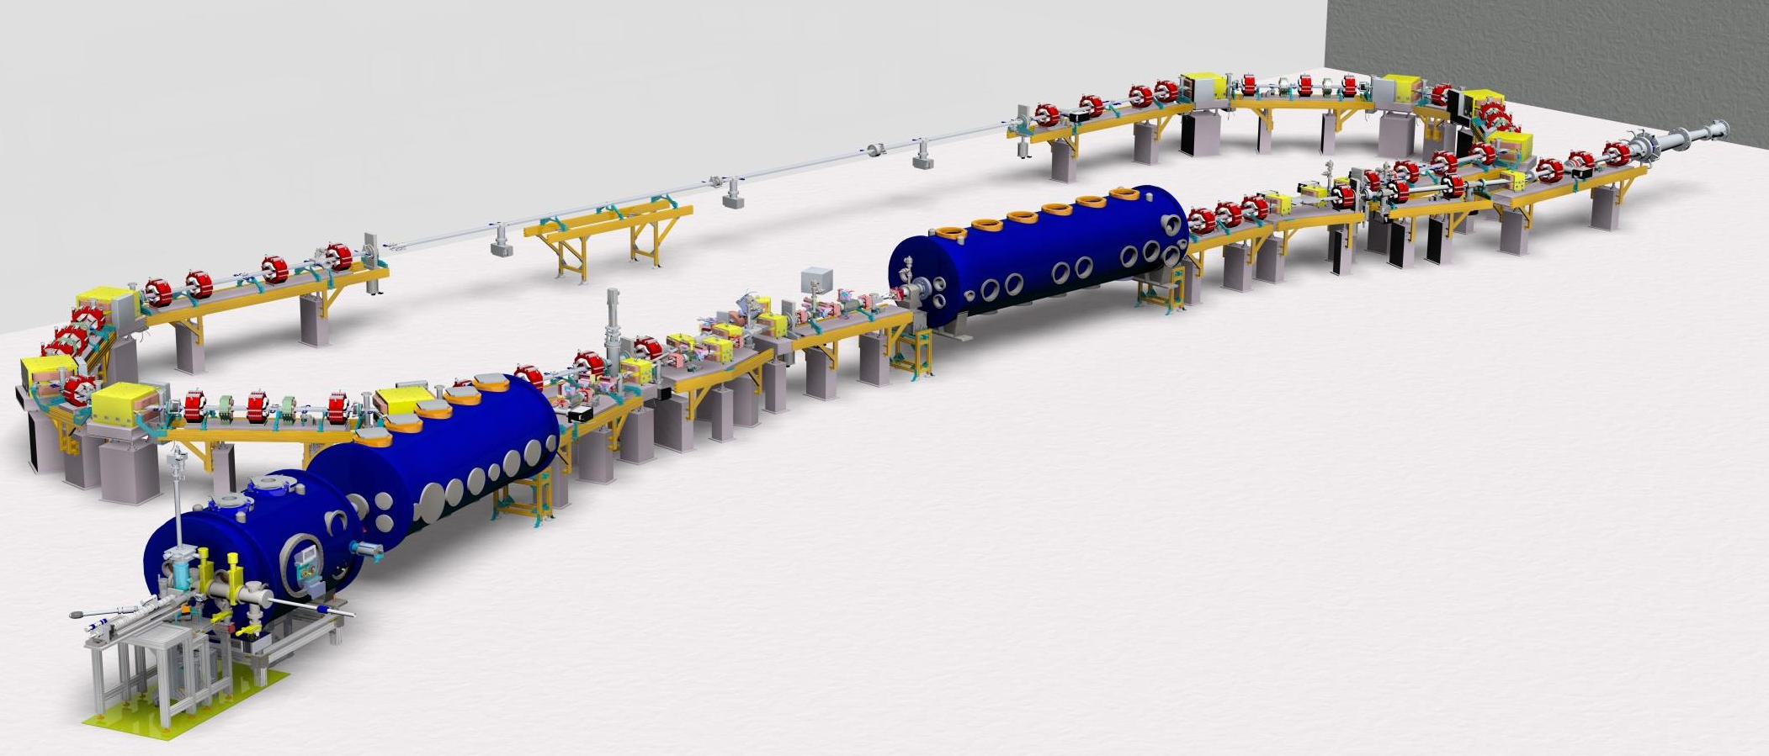
THANK YOU FOR YOUR ATTENTION

Slide 14
Variable Gun Parameter in ASTRA simulations:
-> Cathode position inside the cavity
-> DC Bias voltage for the cathode insert
-> RF gradient in the the cavity
-> field flatness between the gun cells
-> solenoid postion
-> solenoid strength
field calculation:
-> calculating RF and DC fields of the gun as function of the cathode position
-> field flatness (FF) is calculated by ASTRA
Start with energy calibration:
-> find cathode positions and FF values to describe both
measurements simultaneously , RF gradient free parameter
check transverse beam optics:
-> variate solenoid position and strength to achieve the same
beam sizes (as function of the phase) at FOM2 like the measurements

Slide 15
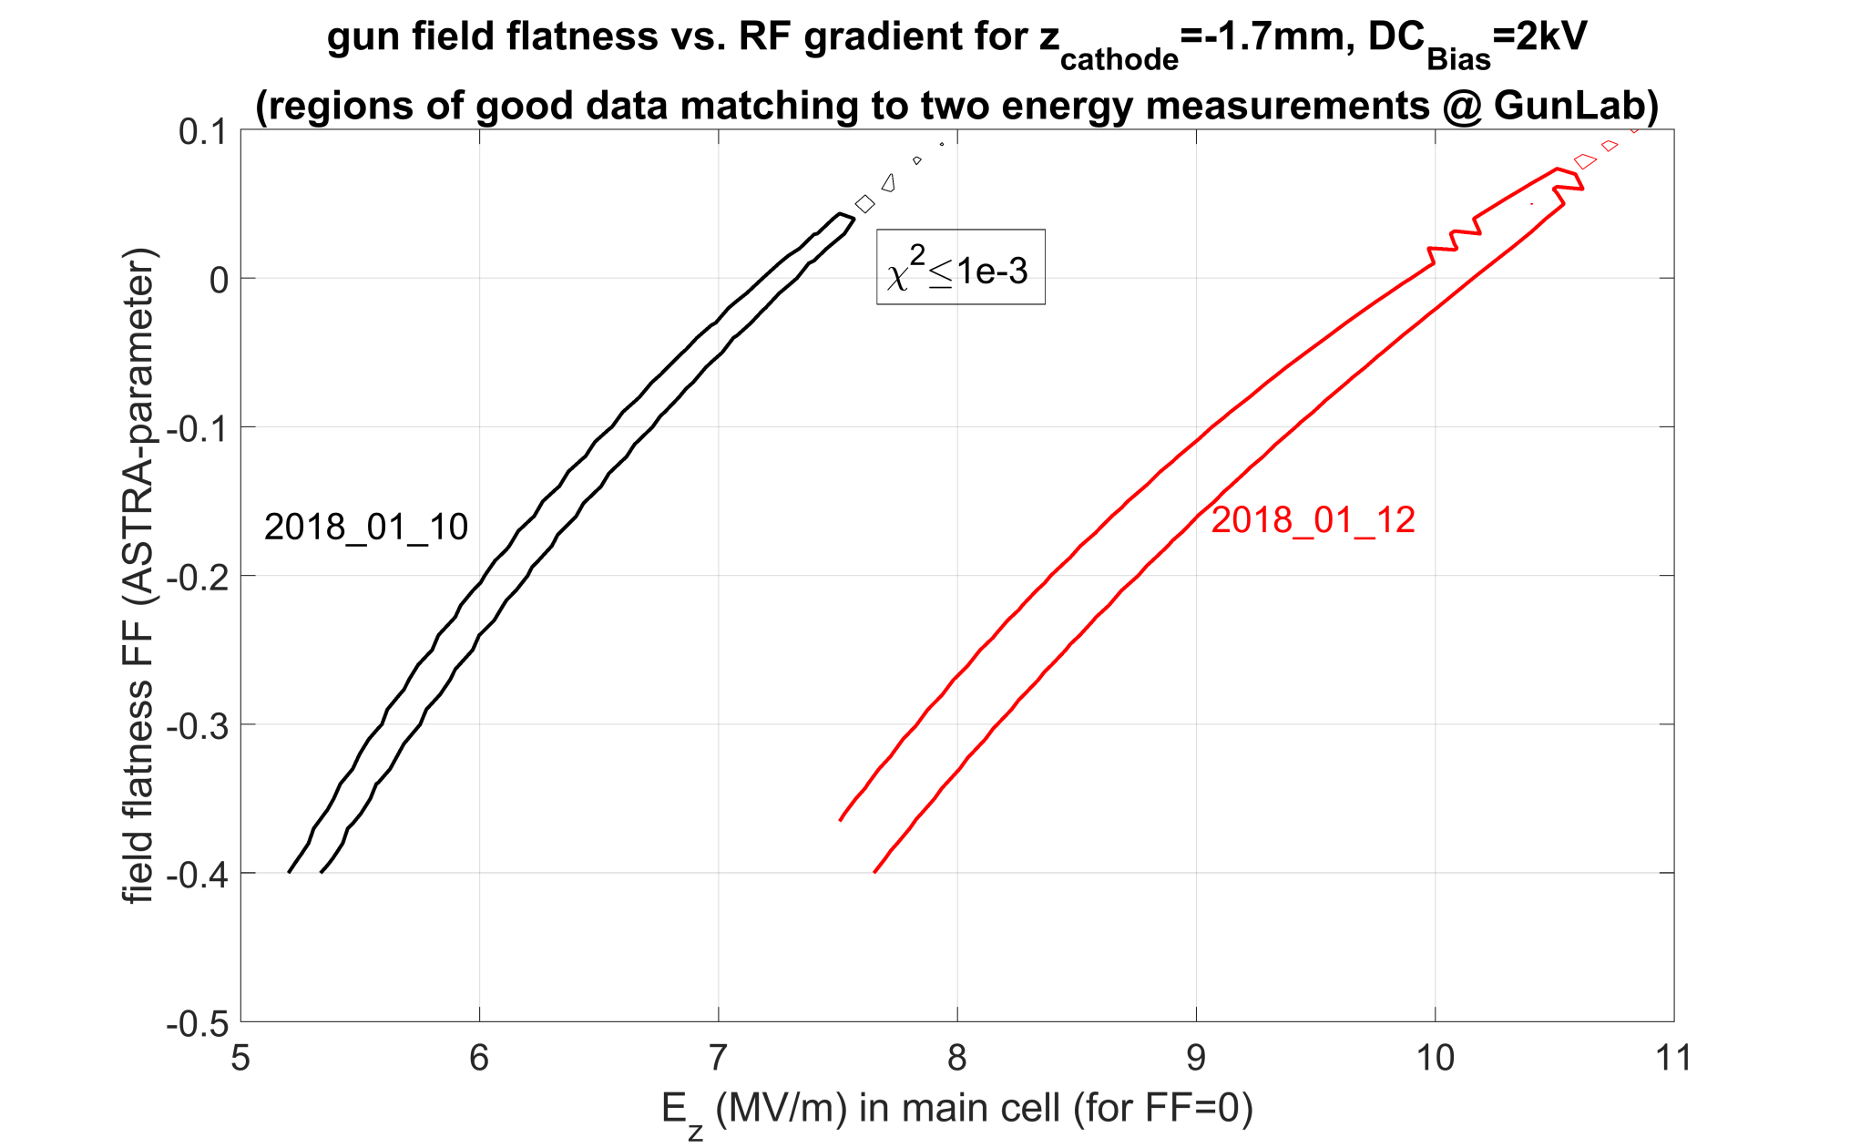
energy calibration -> only for cathode positions of -1.7mm for both measurements
the same FF (FF$≈$-0.2) can be found to describe both distributions

Slide 16
find the minimal parameter setting with the smallest $χ^{2}$for both measurements:

Slide 17
LLRF (measurements) | final ASTRA field (main cell) | final ASTRA field (half cell) | final ASTRA field (cathode)
7.5MV/m | 9.433 MV/m | 10.177MV/m | 7.29MV/m
5.4MV/m | 6.721 MV/m | 7.251MV/m | 5.195MV/m
DC Bias voltage of 2kV results in an additional electric field on the
cathode surface of 0.413 MV/m

Slide 18
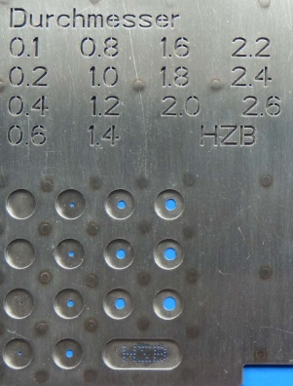
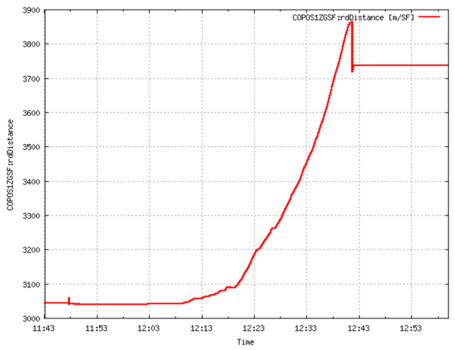
Laser
UV & green wavelengths delivered
Controlled & measured beam parameters
  Spot size, location & shape (motorized
  position & aperture, “virtual cathode”)
  Pulse energy (λ/2-plate, power meter)
  Pulse duration (pulse stretcher,
  optical auto-correlator)
Cathode position monitoring
  x3 capacitive sensors (relative measurement,
  4 mm range, µm precision)
  → useful during cathode transfer,
  cool-down, RF-induced heating
  optical system (visual inspection +
  absolute position measurement
  wrt cavity wall, ~ 0.5 mm precision)
  → useful during cathode transfer,
  with system-related difficulties…
Courtesy: G. Klemz et. al
Insert retracted
692 mm
Distance [mm]
Insert in Gun
Time [hh:mm]

Slide 19
Dark current
Data not always measured with same machine settings:
  Solenoid
  DC bias
  Statistics
  Steerers (emitters)
  RF feed (PLL / Cornell LLRF)

Slide 20
Momentum scans
Date | Peak on-axis field (MV/m) | Max momentum [MeV/c] | DC bias (kV) | Solenoid (A)
27.12 | 7.1 | 1.01 | -2 | -0.35
09.01 | 6.2 | 0.96 | -2 | -0.36
10.01 | 5.4 | 0.74 | -2 | -0.40
12.01 | 7.5 | 1.17 | -2 | -0.40

Slide 21
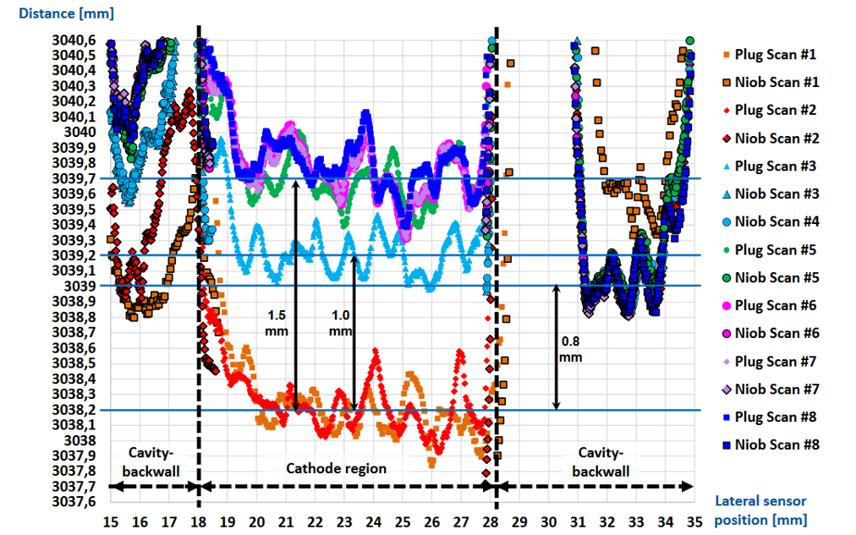
Cathode: -0.7 mm from warm cavity backwall
Cathode was retracted to -0.7 mm behind the cavity backwall
at the warm state
Courtesy: G. Klemz et. al

Slide 22
Cathode: -1.7 mm from cold cavity backwall
Cavity shrinks by ~1 mm away from the cathode holder
after cool-down
Courtesy: G. Klemz et. al

Slide 23
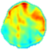
Quantum Efficiency maps
In agreement with Cu measurements from other photo-injectors
Laser: 1.75 mm diameter, 12.1 kHz rep rate
Date | Peak on-axis field (MV/m) | Relative RF phase (deg) | Momentum (MeV/c) | DC bias (kV) | Solenoid (A)
09.01 | 6.2 | +25 | 0.94 | -2 | -0.36
12.01 | 6.0 | +60 | n/a | -2 | -0.40
Date | Peak on-axis field (MV/m) | Relative RF phase (deg) | Momentum (MeV/c) | DC bias (kV) | Solenoid (A)
09.01 | 6.2 | +25 | 0.94 | -2 | -0.36
12.01 | 6.0 | +60 | n/a | -2 | -0.40
15.01 | 7.0 | +50 | n/a | -2 | -0.36
Date | Peak on-axis field (MV/m) | Relative RF phase (deg) | Momentum (MeV/c) | DC bias (kV) | Solenoid (A)
09.01 | 6.2 | +25 | 0.94 | -2 | -0.36

Slide 24
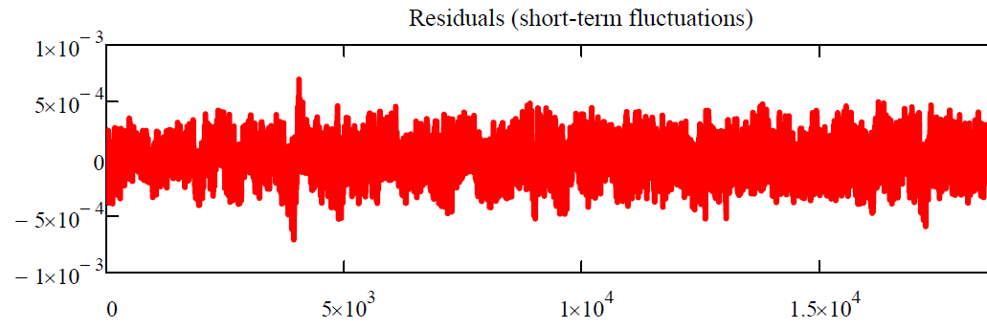
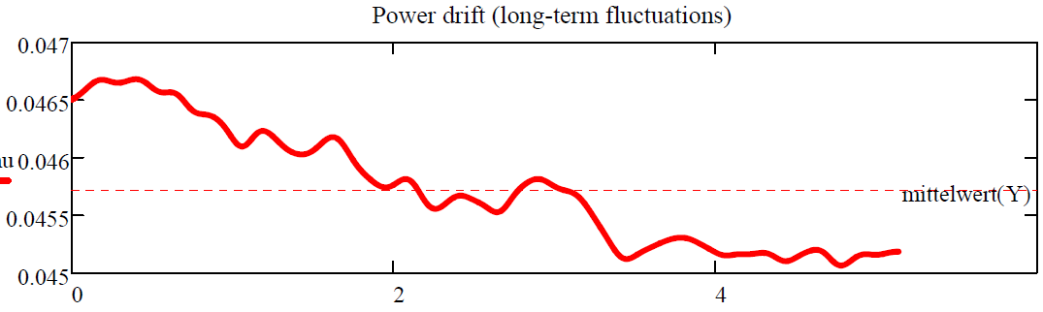
Laser power
After a cold-start ~10 minutes required for stabilization
Short-term fluctuation (noise around 10 min. average):
+/- 0.3 % rms
+/- 1.5 % max
Long-term drift:
+/- 1.2 % rms
+/- 2.8 % max
Noise (mW)
Courtesy:
G. Klemz et. al
Power (mW)
Time (h)

Slide 25
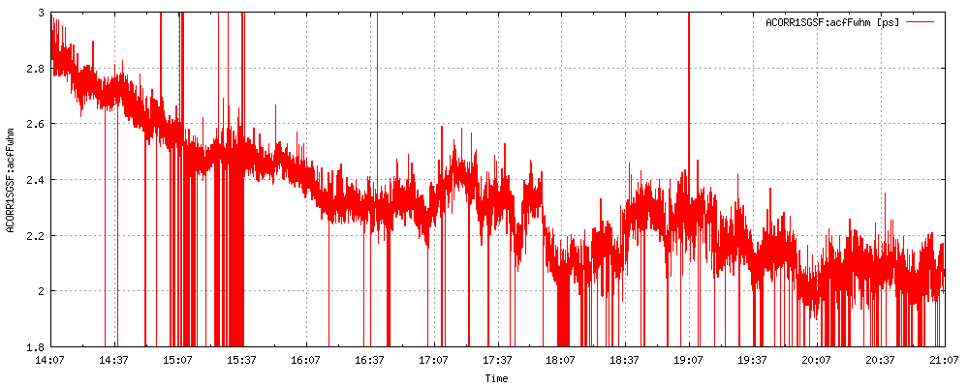
Laser
Long-term drift: takes 4 h to stabilize to
to ~2.1 ps FWHM (green light)
=> 1.5 ps FWHM (UV)
=> 0.6 ps RMS (UV)
Not archived during measurements

Slide 26
transverse beam optics:
-> no simulation results were found with solenoid currents of
0.4Amp (as used in the measurements)
-> variable solenoid position and current to find the best values:
-> estimated solenoid position: 0.458 m from cathode (0.45m in simulation)
-> defined solenoid current in measurement: 0.4A, (0.3A in simulation)

