Slide 1
Applications of the Interferometric Beam Size Monitor at the BESSY II Storage Ring
Marten Koopmans
4th MT student retreat Berlin, 11th – 12th June 2018

Slide 2
Content
Introduction
Interferometric Beam Size Monitor
Theory
Setup
Measurements
Summary
Notes:
2

Slide 3
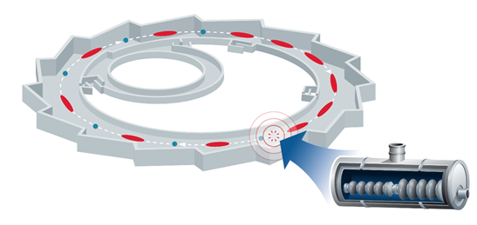
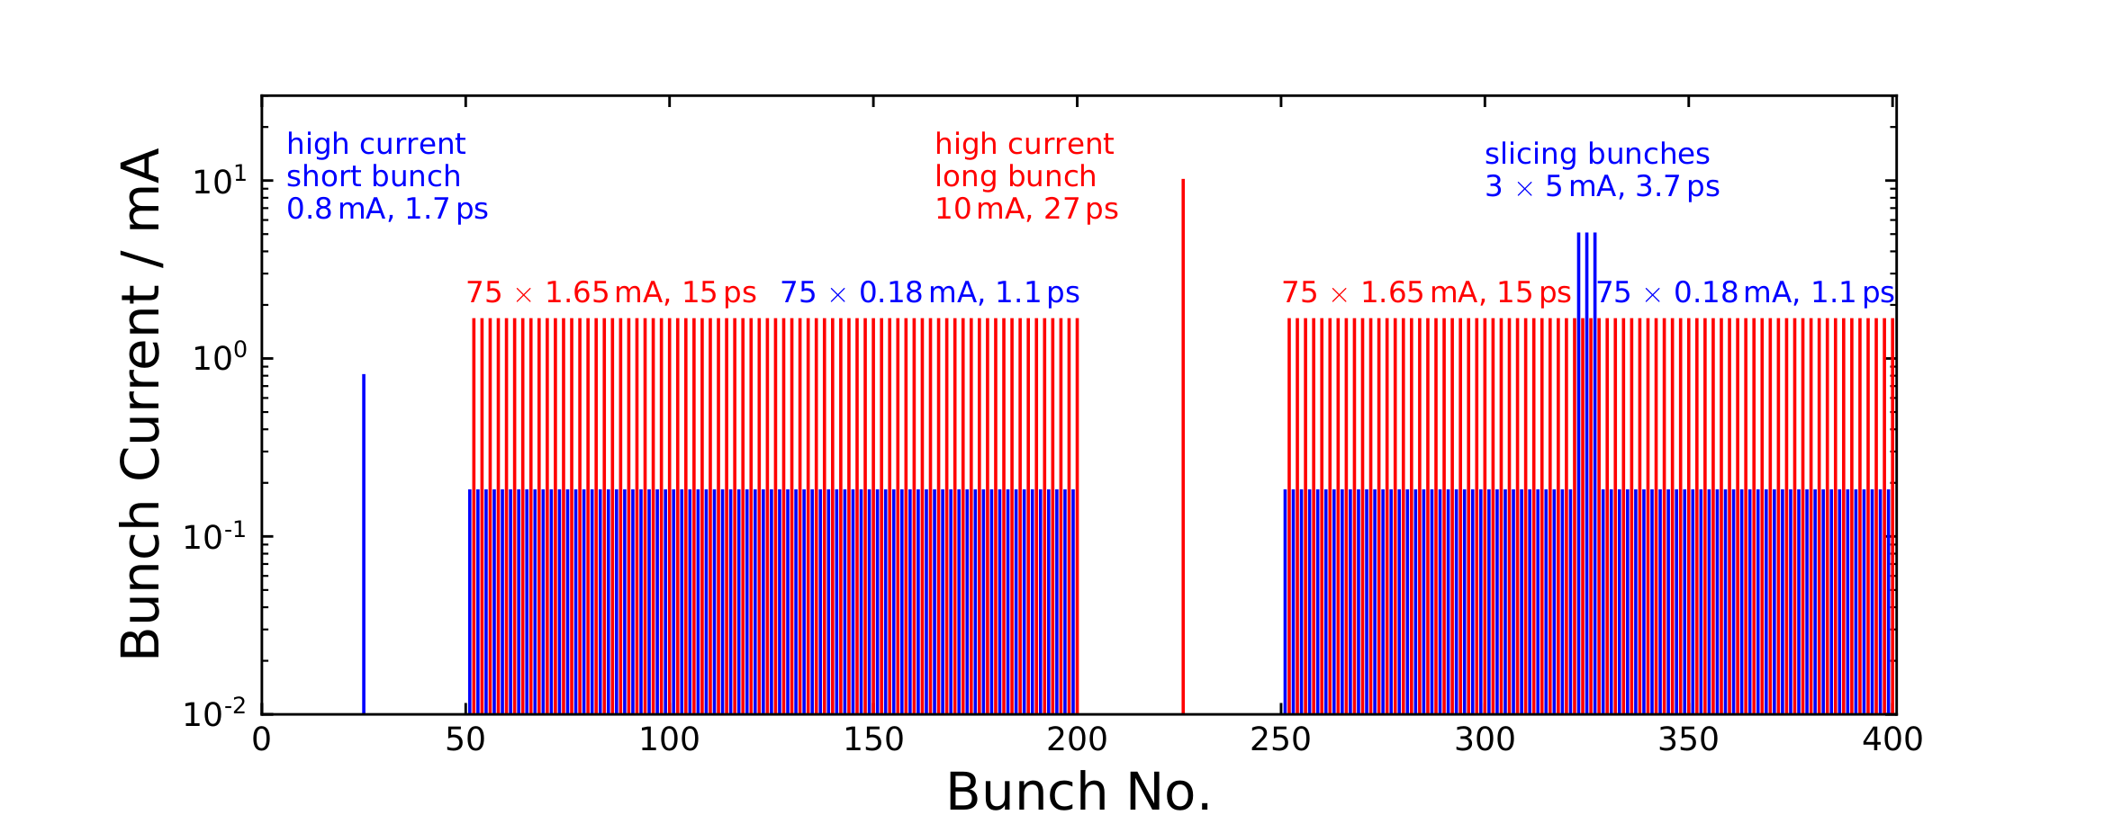
Introduction: BESSY VSR Upgrade
VSR upgrade of the BESSY II storage ring
Variable pulse length Storage Ring
VSR Fill Pattern of different bunch types, in length, current, transverse beam size
Single and coupled bunch instabilities
Bunch resolved diagnostics needed
BESSY II Parameters
Energy | 1.7 GeV
Circumference | 240 m
Bending Radius | 4.35 m
Horizontal emittance | 5 nm rad
Max. Beam current | 300 mA
RF frequency | 500 MHz
max. RF voltage | 2 MV
Bunch length low-$α$ | 15 ps 2 ps
Mom. Comp. factor low-$α$ | 7.5 $×$ 10⁻⁴ 3.5 $×$ 10⁻⁵
A. Jankowiak et al., eds., “BESSY VSR - Technical Design Study”, Helmholtz-Zentrum Berlin für Materialien und Energie GmbH, Germany, June 2015. DOI: 10.5442/R0001
Notes:
3

Slide 4
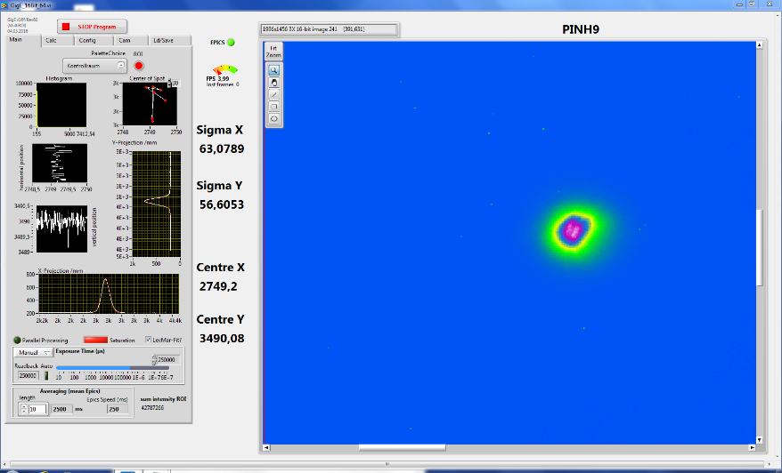
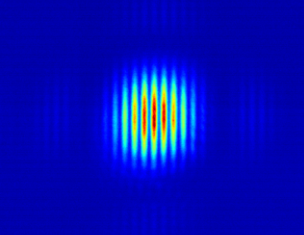
Bunch Resolved Measurements
Present BESSY II Pinhole System
Direct imaging only with X-rays
Not very flexible system, long averaging
Bunch resolved measurements difficult
System using visible light
Problem: higher resolution limit (few 100 µm) $⇒$ interferometry
Interferometric beam size monitor
Well understood, efficient technique
Flexible
Uses visible light $⇒$ Gateable
Upgrade to bunch resolved system possible
Notes:
4

Slide 5
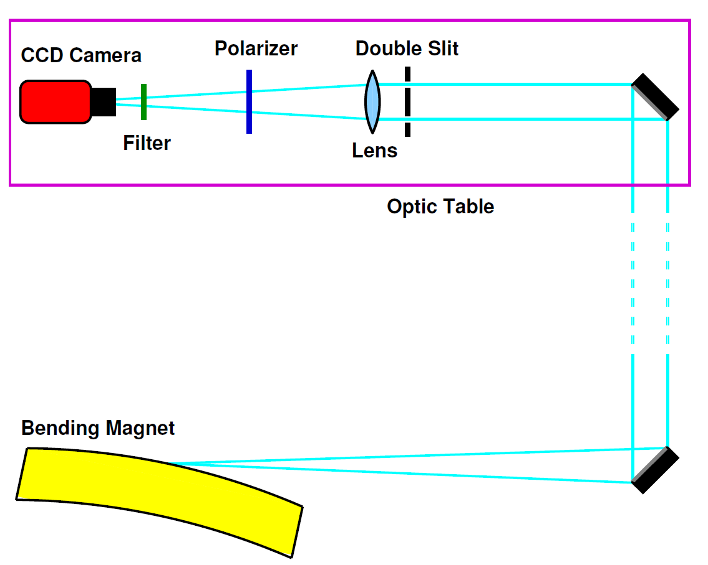
Interferometric Beam Size Monitor

Slide 6
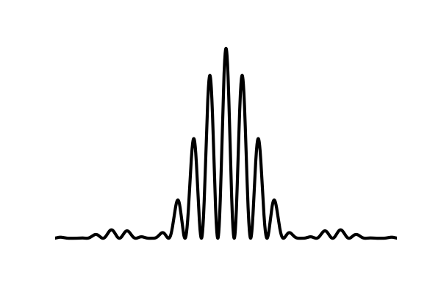
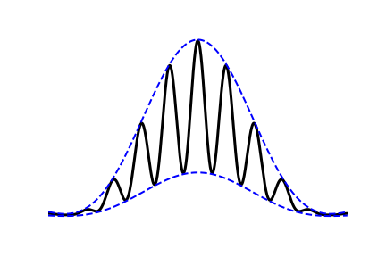
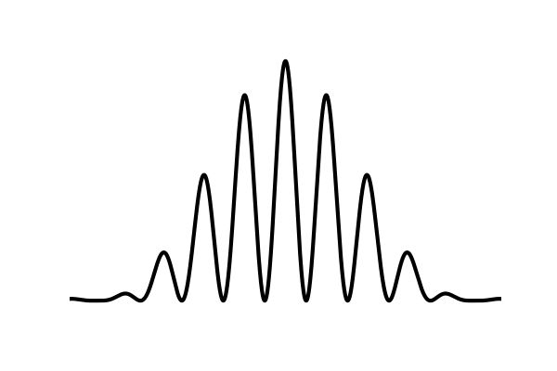
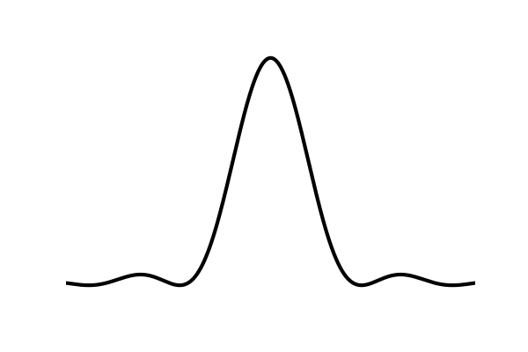
Theory: Interference and Visibility
Interference pattern of double slit interferometer:
$$I\left(x\right)=\left(I_{1}+I_{2}\right) {sinc}^{2}\left(\frac{πa}{λf}\left(x−x_{0}\right)\right)\left[1+V_{x}\cos\left(\frac{2πd}{λf}\left(x−x_{0}\right)+φ\right)\right]$$
Interference pattern of double slit interferometer:
$$I\left(x\right)=\left(I_{1}+I_{2}\right) {sinc}^{2}\left(\frac{πa}{λf}\left(x−x_{0}\right)\right)\left[1+V_{x}\cos\left(\frac{2πd}{λf}\left(x−x_{0}\right)+φ\right)\right]$$
Visibility from coherence theory:
$$V_{x}=\frac{I_{max}−I_{min}}{I_{max}+I_{min}}=\frac{2\sqrt{I_{1}I_{2}}}{I_{1}+I_{2}}\left|γ_{x}\right|$$
Where $|γ_{x}|$ is the spatial coherence
Point source
Broad source
$V=$ 1
$V=$ 0.6
T. Mitsuhashi, ''Beam Profile and Size Measurement by SR Interferometer'‘, in: Beam measurement, Ed. by S. Kurokawa et al., pp. 399 – 427, World Scientific 1999.

Slide 7
Theory: Beam Size from Interference
Interference pattern of double slit interferometer:
$$I\left(x\right)=\left(I_{1}+I_{2}\right) {sinc}^{2}\left(\frac{πa}{λf}\left(x−x_{0}\right)\right)\left[1+V_{x}\cos\left(\frac{2πd}{λf}\left(x−x_{0}\right)+φ\right)\right]$$
Visibility from coherence theory:
$$V_{x}=\frac{I_{max}−I_{min}}{I_{max}+I_{min}}=\frac{2\sqrt{I_{1}I_{2}}}{I_{1}+I_{2}}\left|γ_{x}\right|$$
$|γ_{x}|$ is given by Fourier Transform of the source $f\left(x\right)$ (van Cittert-Zernike)
$$γ_{x}=\int{dx f\left(x\right)exp}\left(−i\frac{2πd}{λL}x\right)$$
Gaussian beam, uniform slit illumination:
$$V_{x}=\left|γ_{x}\right|=exp\left[−2{\left(\frac{πσ_{x}d}{λL}\right)}^{2}\right]$$
Beam size (rms) can then be calculated:
$$σ_{x}=\frac{λL}{πd}\sqrt{\frac{1}{2}\ln\left(\frac{1}{V_{x}}\right)}$$
Method works in both transversal dimensions ($x↔y$)
$a$ – slit width
$d$ – slit separation
$f$ – distance camera to slit
$L$ – distance slit to source
$I_{i}$ – intensity at slit $i$
$x$ – position on screen
$x_{0}$ – offset from $x$
$λ$ – wavelength
$φ$ – phase
$sinc\left(x\right)={\sin\left(x\right)}/x$
Notes:
7

Slide 8
Setup at Diagnostics Beamline
Notes:
8

Slide 9
Measurement Range
Parameter Ranges
Double slit separation 7.5 mm to 25 mm
Wavelength 400 nm to 800 nm
Distance to source 16.1 m (fixed)
Visibility Range 0.3 to 0.9
Statistical Errors (assuming $∆V=$ 0.005):
$→σ_{min}=$ (18.8 $±$ 1.1) µm
$→σ_{max}=$ (424 $±$ 23) µm
Parameter | Range | Uncertainty | Relative beam size error
$L$ / m | 16.09 | 0.84 | 5.2 %
$d$ / mm | 7.5 – 25 | 0.1 | 1.3 – 0.4 %
$λ$ / nm | 400 – 800 | 1.6 | 0.4 – 0.2 %
$$V\left(σ_{min}\right)$$ | 0.9 | 0.005 | 0.7 %
$$V\left(σ_{max}\right)$$ | 0.3 | 0.005 | 2.6 %

Slide 10
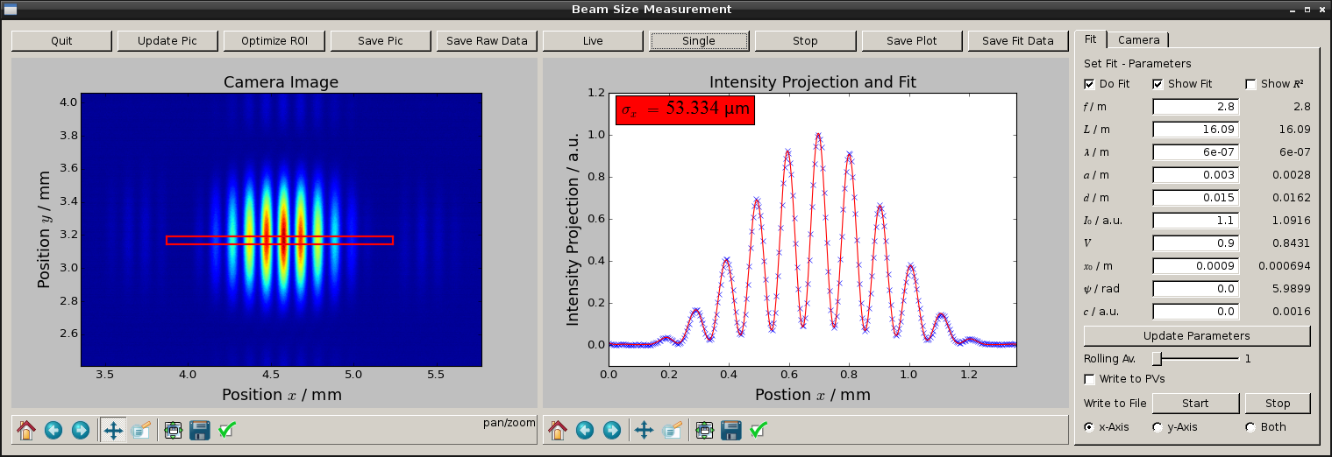
Live Beam Size Measurement
Python tool for online analysis
Using EPICS environment from BESSY II
Data archiving possible
Fitting:
$$I\left(x\right)=a_{0} {sinc}^{2}\left(a_{1}\left(x−a_{2}\right)\right)\left[1+a_{3}\cos\left(a_{4}\left(x−a_{2}\right)+a_{5}\right)\right]+a_{6}$$
Notes:
10

Slide 11
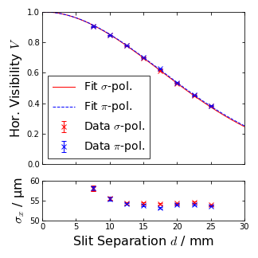
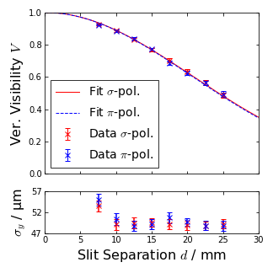
Beam Size Measurement with Slit Separation Scan
Standard user operation, 250 mA
Interferometer: $λ=$ 400 nm
$$V(d)=exp\left[−2{\left(\frac{πσd}{λL}\right)}^{2}\right]$$
 | Horizontal / µm | Vertical / µm
$σ$-Polarisation | 54.3$±$2.9 | 49.5$±$2.6
$π$-Polarisation | 53.8$±$2.8 | 49.8$±$2.7

Slide 12
Compare Std. User Measurements
Compare results from slit separation scans with pinhole systems and results from model (emittance std. user ~5 nm rad)
$σ_{x,y}=\sqrt{β_{x,y}ε_{x,y}+{{η_{x,y}}^{2}δ}^{2}}$
Similar beam sizes expected
Measured values higher than model (all systems)
Std. User | PINH3 / µm | Interferometer / µm | PINH9/ µm
Ver. | 84.4 | 49.5$±$2.6 | 51.3
Hor. | 75.0 | 54.3$±$2.9 | 65.9
Hor. Model | 44.5 | 44.2 | 48.1

Slide 13
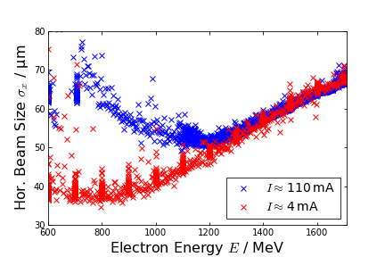
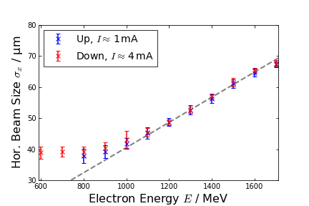
Measurements: Energy Ramp
Measuring horizontal beam size while ramping storage ring energy
Pinhole systems not designed for lower energy (16 keV)
Ramp down to 600 MeV
Measurement parameter: $d=$ 25 mm, $λ=$ 550 nm
Current dependent beam instability for lower energies
Linear behavior $σ∝γ$ (~0.0405 µm/MeV)
Notes:
13

Slide 14
Beam Profile Measurements
Rotation of camera and double slit
Theory:
Rotary mounts for camera and double slit
$$V\left(θ\right)=exp\left[−2{\left(πσ_{x}\frac{d}{λL}\cos{θ}\right)}^{2}−2{\left(πσ_{y}\frac{d}{λL}\sin{θ}\right)}^{2}\right]$$

Slide 15
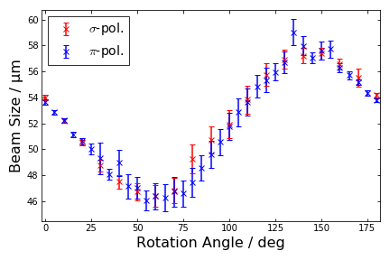
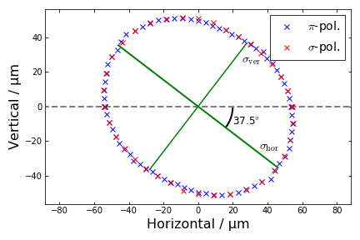
Beam Profile Measurements
Rotation of camera and double slit
Theory:
Rotary mounts for camera and double slit
$$V\left(θ\right)=exp\left[−2{\left(πσ_{x}\frac{d}{λL}\cos{θ}\right)}^{2}−2{\left(πσ_{y}\frac{d}{λL}\sin{θ}\right)}^{2}\right]$$
Standard user mode

Slide 16
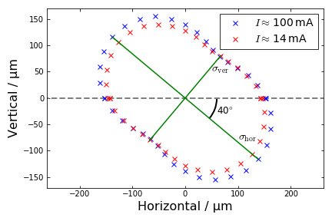
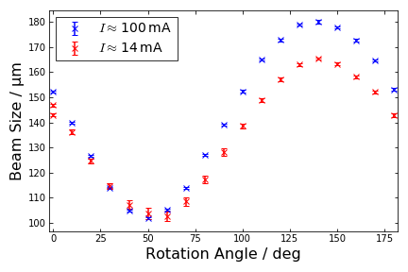
Beam Profile Measurements
Rotation of camera and double slit
Theory:
Rotary mounts for camera and double slit
$$V\left(θ\right)=exp\left[−2{\left(πσ_{x}\frac{d}{λL}\cos{θ}\right)}^{2}−2{\left(πσ_{y}\frac{d}{λL}\sin{θ}\right)}^{2}\right]$$
Low-$α$ mode

Slide 17
Summary and Outlook
Successfully designed, installed interferometric beam size monitor
Beam sizes measured from 30 to 250 µm with ~5% uncertainty
Various applications for diagnostics and commissioning
Problem with extraction mirror, polarisation effects and vibrations $→$limited resolution of system
Move to new beamline, upgrade setup (e.g. proper covering, …)
Future upgrade of system with fast ICCD camera or photodiode array for bunch resolved measurements
Notes:
17

Slide 18
Thank you for your attention!

