Slide 1
Prototype for a Highly Granular Analogue Hadron CALorimeter
Future detector at ILC
Olin Lloyd Pinto, Katja Krüger, DESY
Matter and Technology, Berlin, 11 June 2018

Slide 2
Outline
International Linear Collider
Brief description of the AHCAL detector design
AHCAL technological prototype commissioning and CERN beam tests
Conclusion

Slide 3
What next ?
The recent discovery of Higgs Boson in 125 GeV range at LHC has completed the Standard model.
Further to explore at high energies and with high precision:
properties of the Higgs boson.
search of new particles beyond standard model.
top mass measurements (at higher energies).
can be better studied at International Linear Collider.

Slide 4
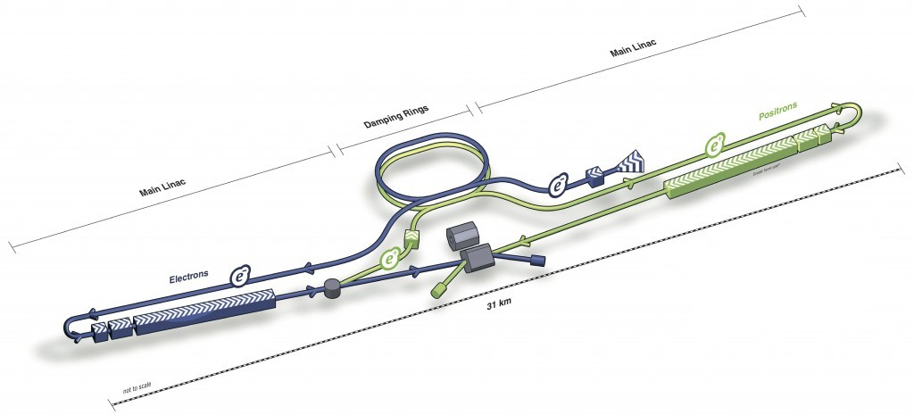
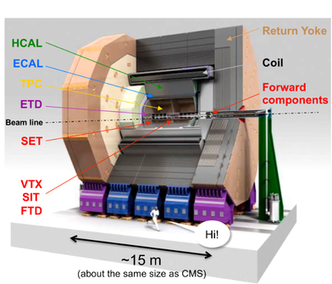
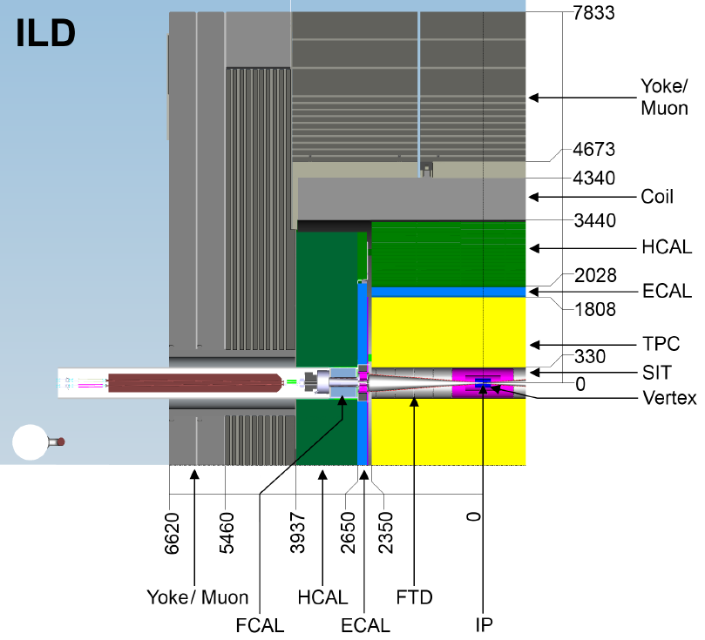
International Linear Collider
e⁺ e- collider: complementary to the LHC
√s = 250 GeV (staging scenarios to 500GeV and 1TeV).

Slide 5
Need for good Jet Energy Resolution
Objective of ILC: aim for a jet energy resolution of 3-4%.
In a typical jet: 60% charged hadrons, 30% photons, 10% neutral hadrons
Classical calorimeter: rather limited resolution
Measure all the components of jets in the calorimeters
~70% of the energy is measured in HCAL
The poor HCAL resolution limits jet energy resolution

Slide 6
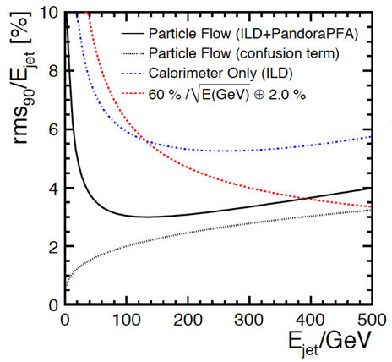
Particle Flow Approach
Promising solution to achieve the best resolution.
Trace individually all the particles in an event.
Reduce the dependence on poor HCAL resolution.
Measuring charged particles in tracker.
Photons measured in ECAL.
Neutral hadrons in HCAL.
Realistic ILC calorimeter(ILD)
Traditional calorimeter
PFA
Confusion
At high jet energy: correct association between tracks and clusters – high granularity needed.
At low energy: hadronic calorimeter with good energy resolution.

Slide 7
CALICE Collaboration
Such highly granular calorimeters optimized for PFA are being developed and tested by the CALICE collaboration.

Slide 8
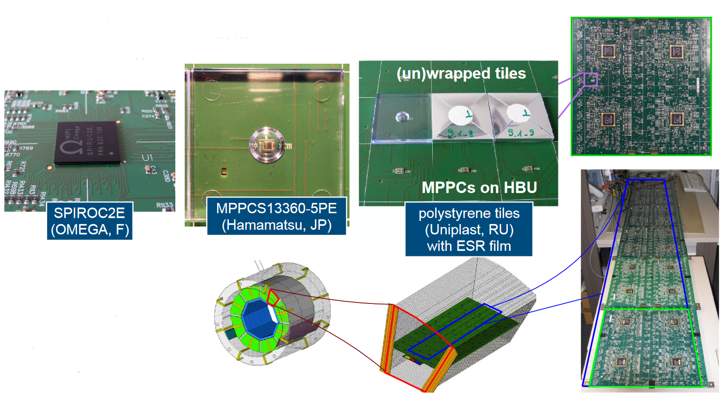
Analog Hadron Calorimeter
36cm
Sandwich calorimeter
based on scintillator
tiles (3 × 3 cm²)
read out
using Silicon
Photomultipliers (SiPMs).
HCAL Base Unit (HBU): 36 x 36 cm², 144 channels (4 ASICs).
HBU
216 cm
With electronics embedded in the active layers.
In total 8M channels for the large detector.
Notes:
8

Slide 9
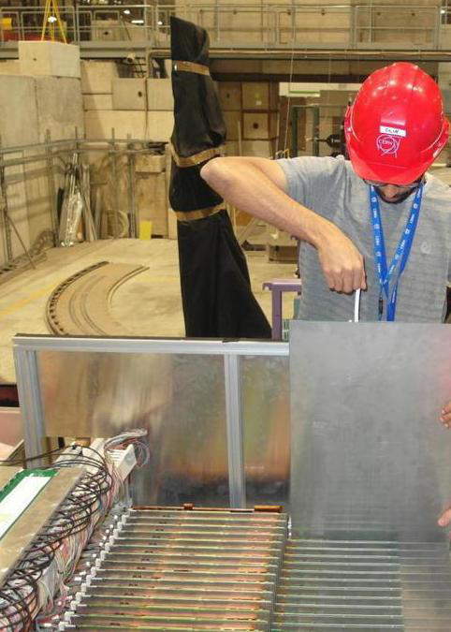
Test Beam Campaign at CERN / SPS 2018 May
CERN / SPS H2 beam line
(9.5.18 - 23.5.18).
Installation of 38 layers (nearly 22,000 channels).
Goals:
To demonstrate the SiPM-on tile calorimeter concept with scalable detector design.
Energy linearity and resolution for electrons and pions.
Cross check of calibration with muons.
Measure shower profile and hit time correlation for pions.

Slide 10
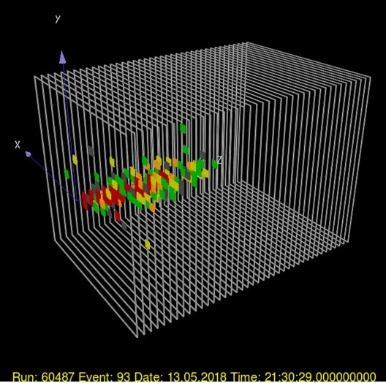
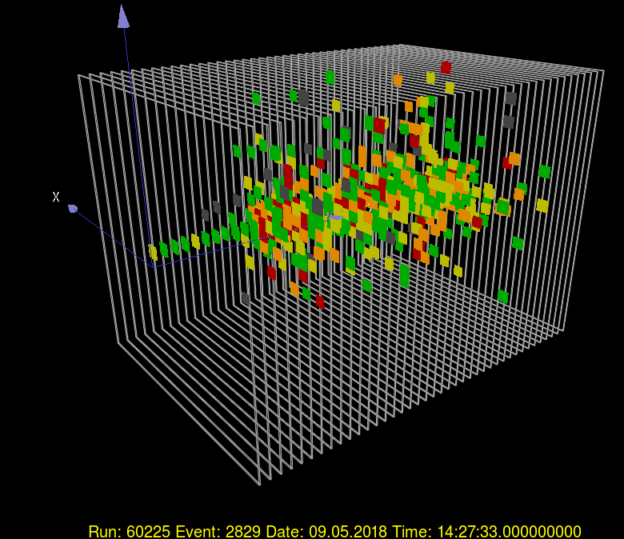
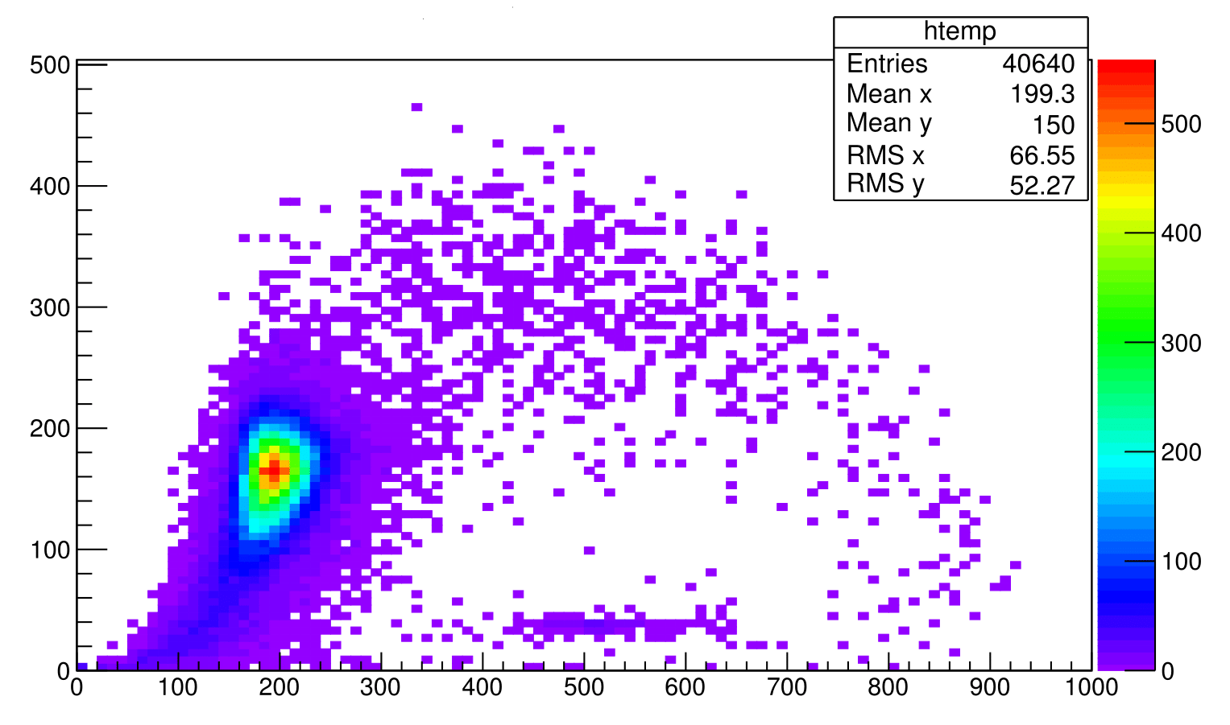
First glance into data
Hadrons
Electrons
Number of hits
Muons
Center of Gravity Z[mm]

Slide 11
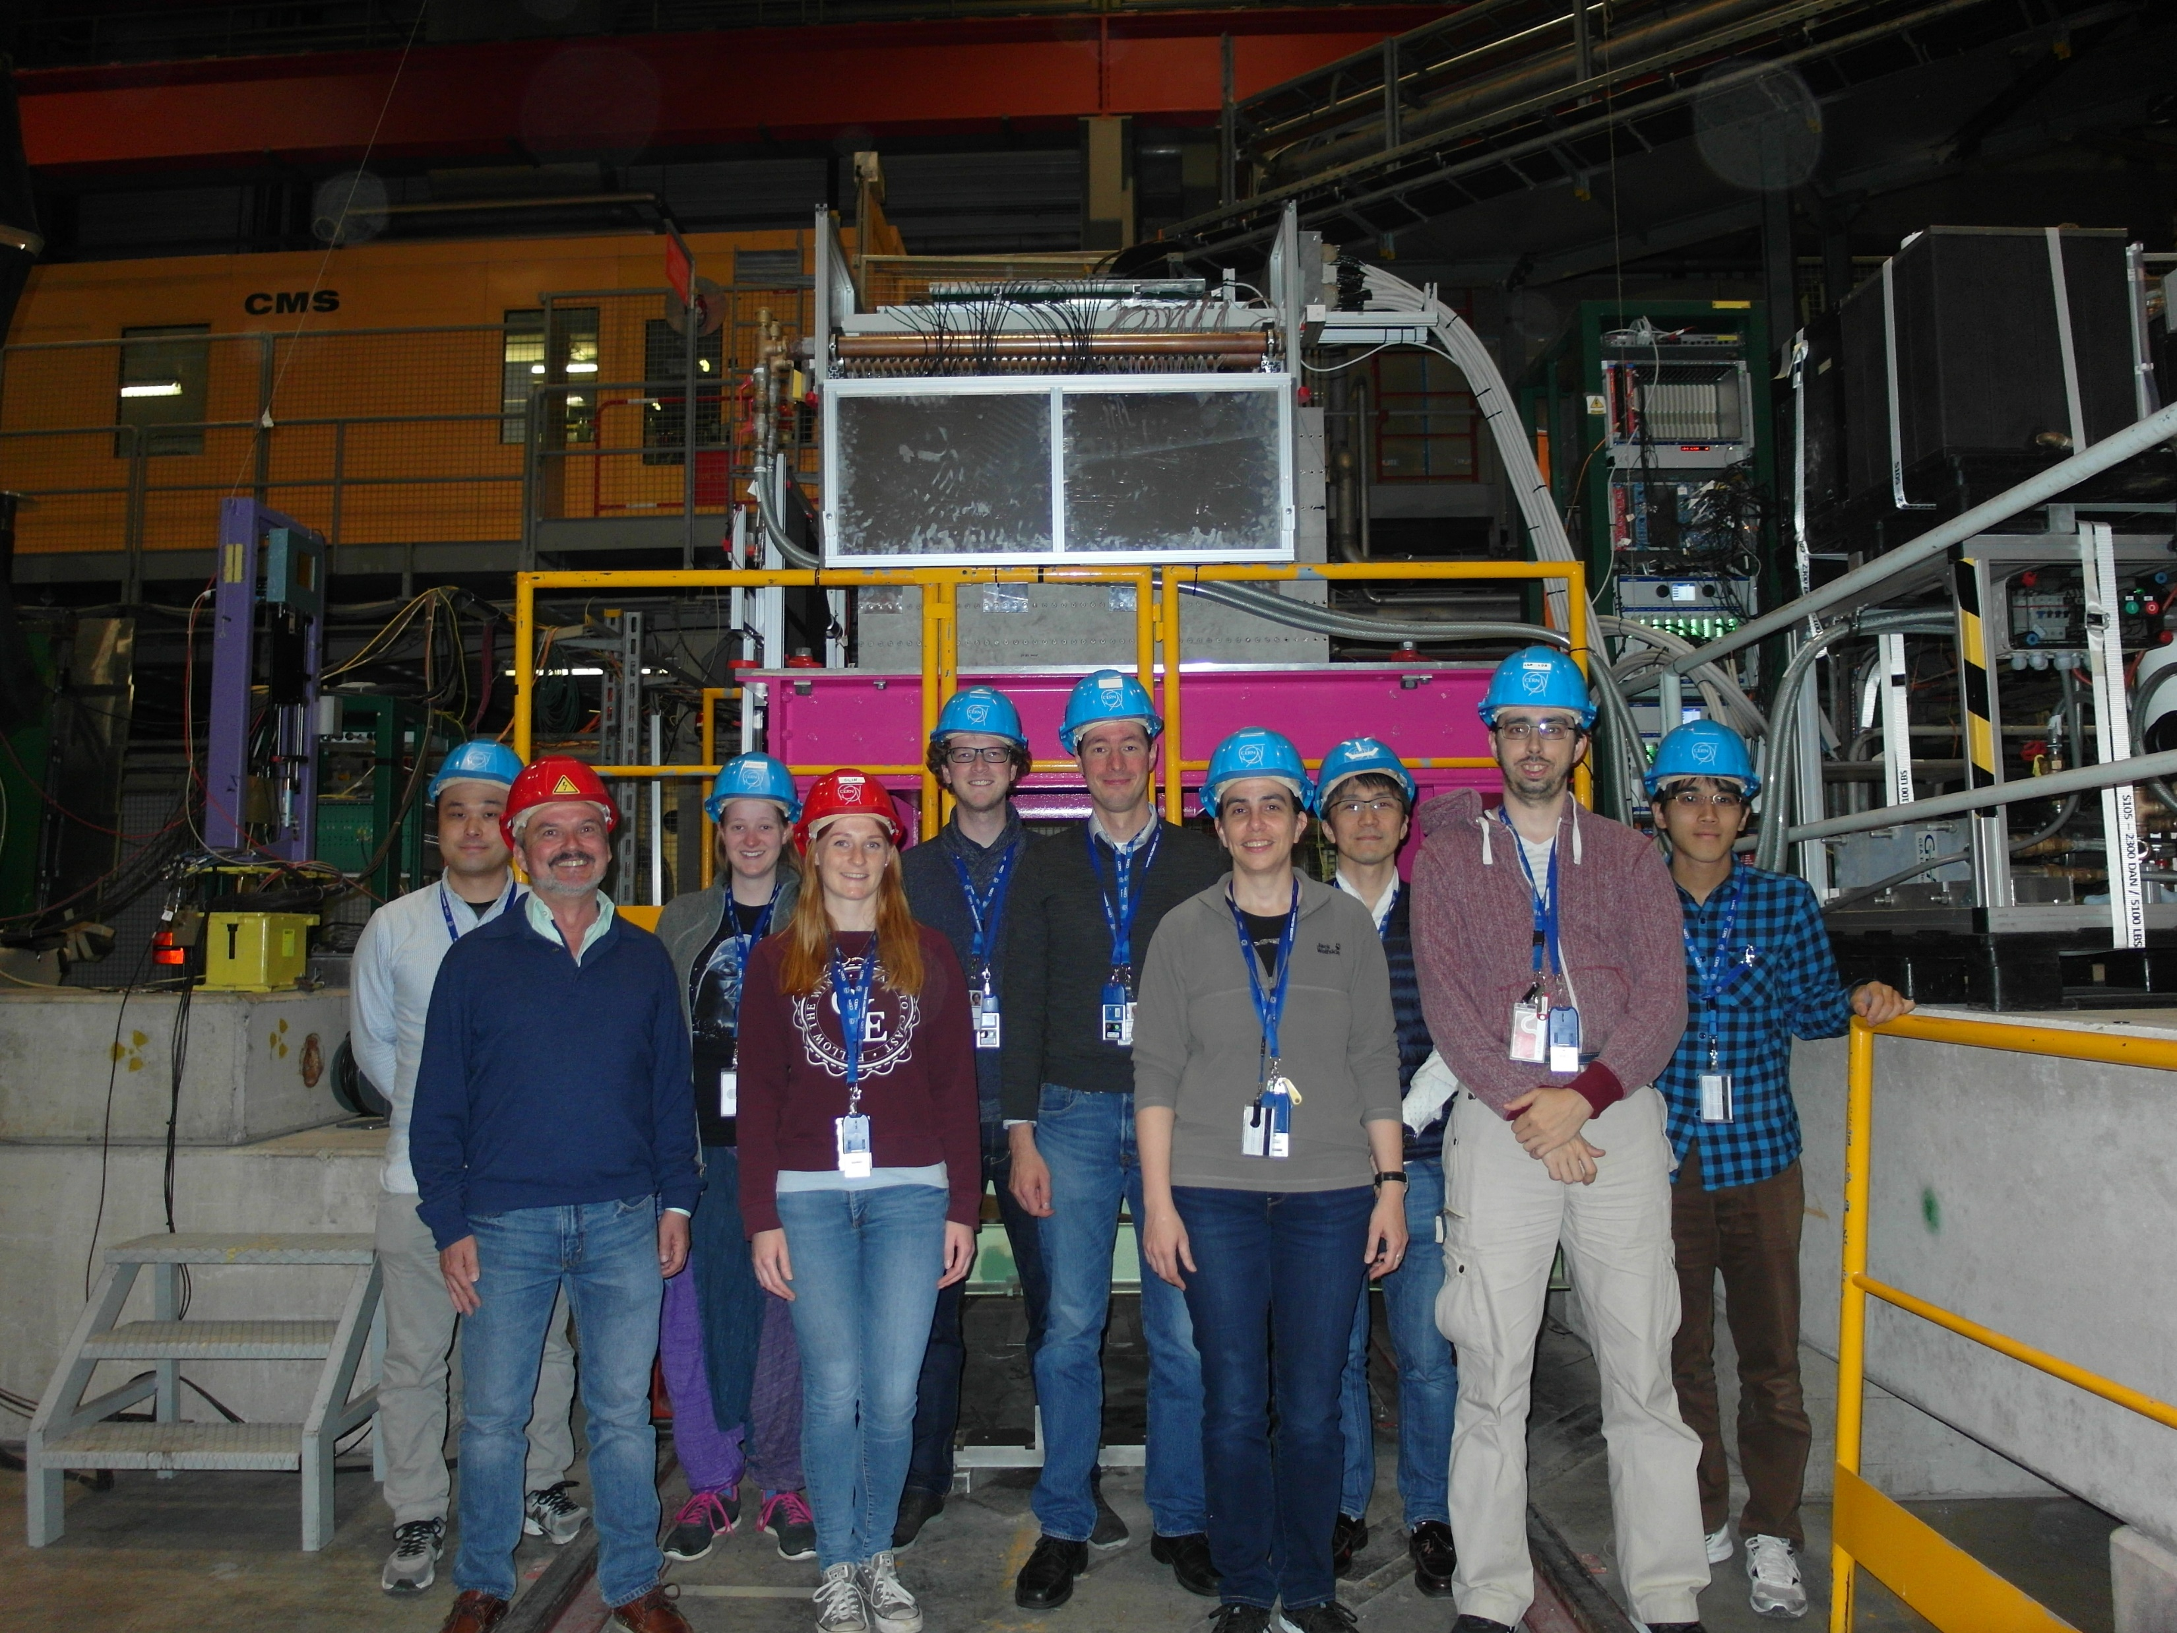
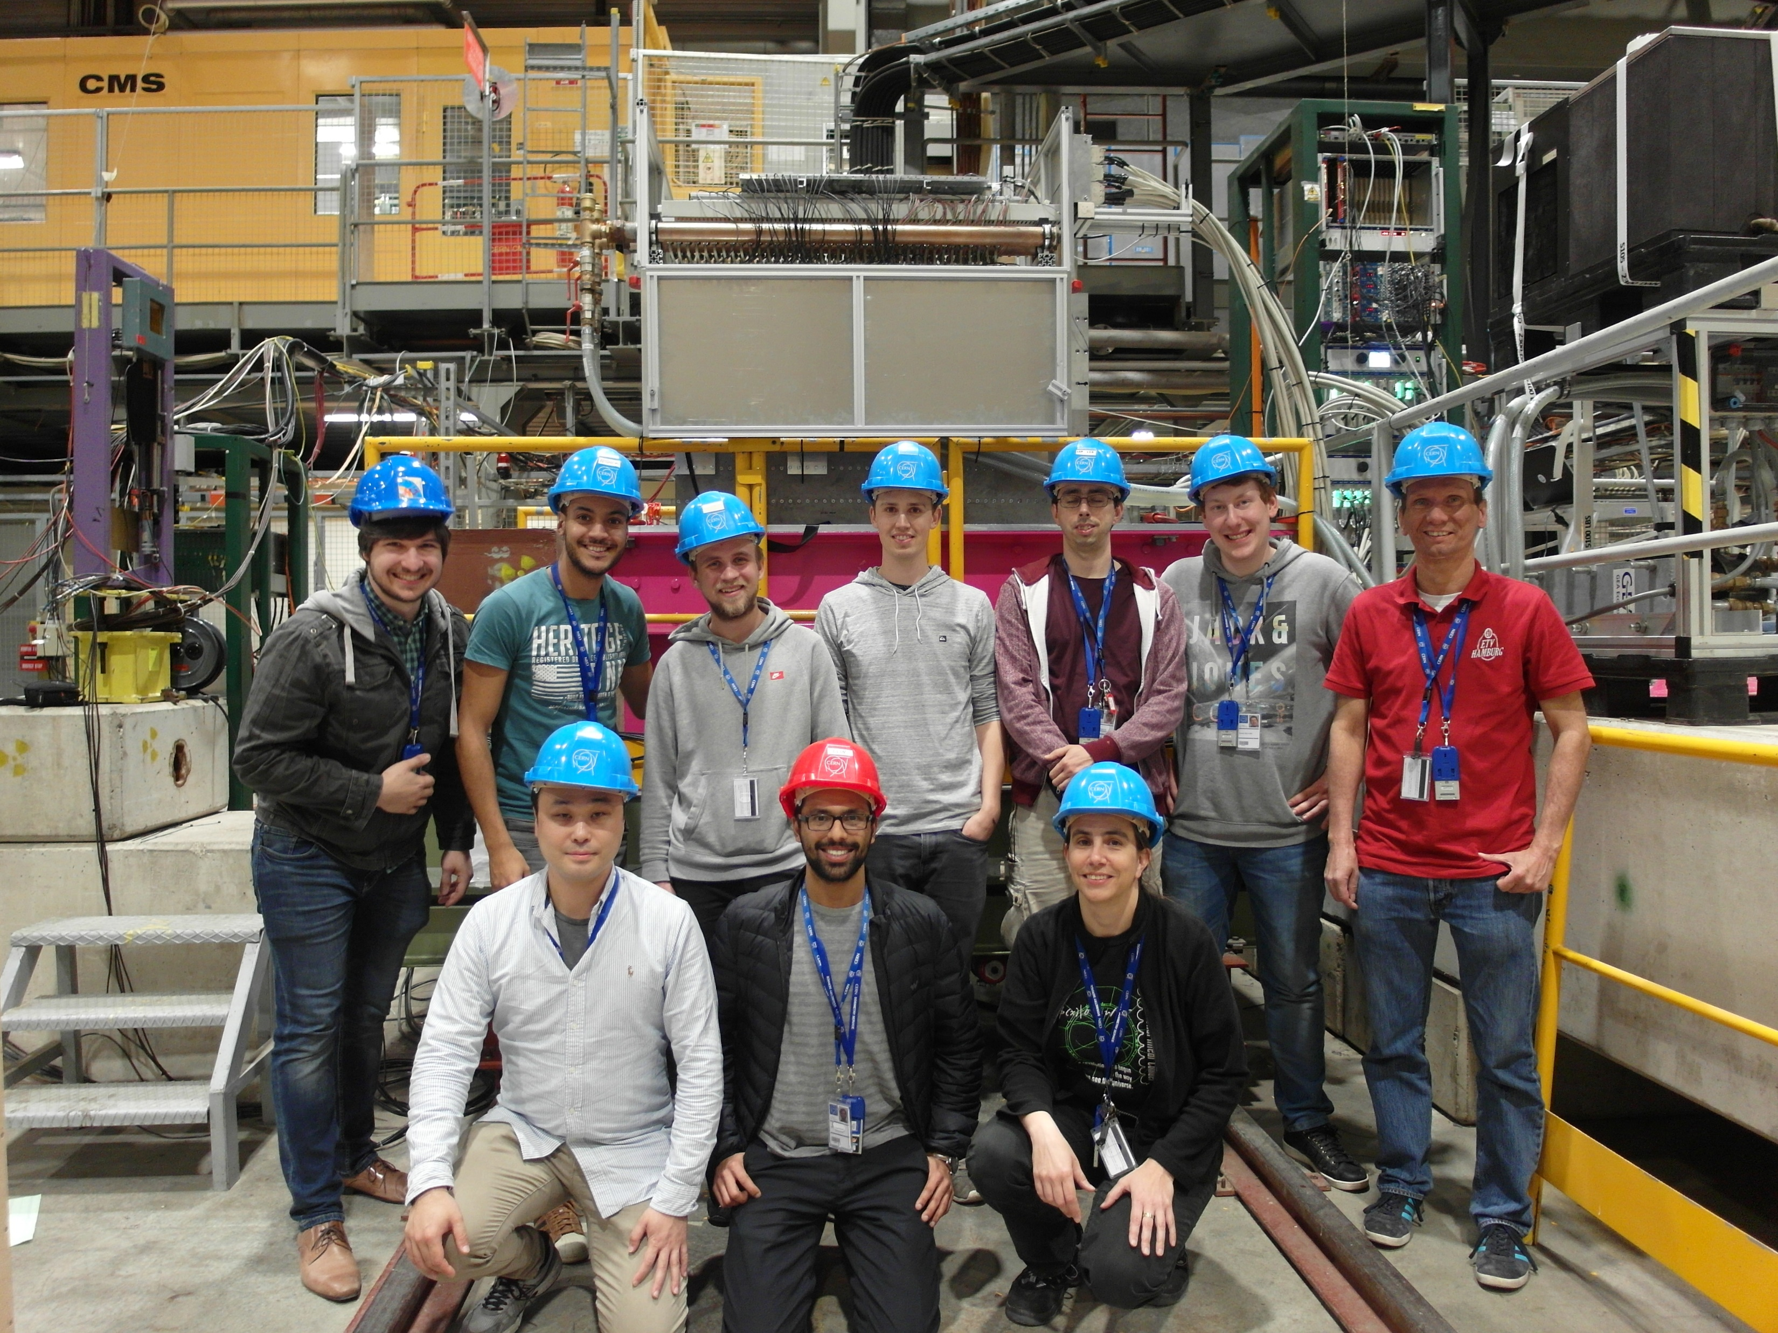
Summary
Design and procedures for construction of AHCAL are scalable to a full collider detector.
Successful commissioning and first beam test of CALICE AHCAL prototype with 38 layers in total.
Upcoming testbeam in June, including a layer with larger (6 x 6 cm²) tiles.
THANK YOU

Slide 12
BACKUP

Slide 13
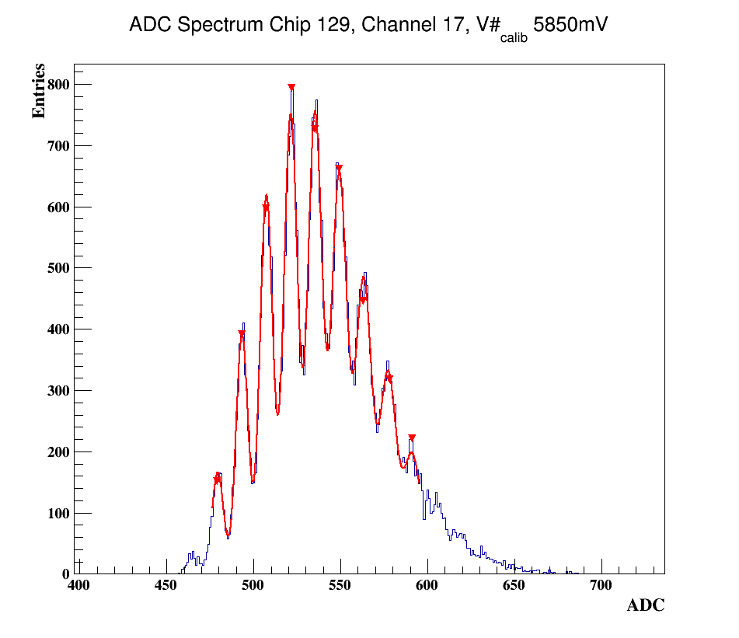
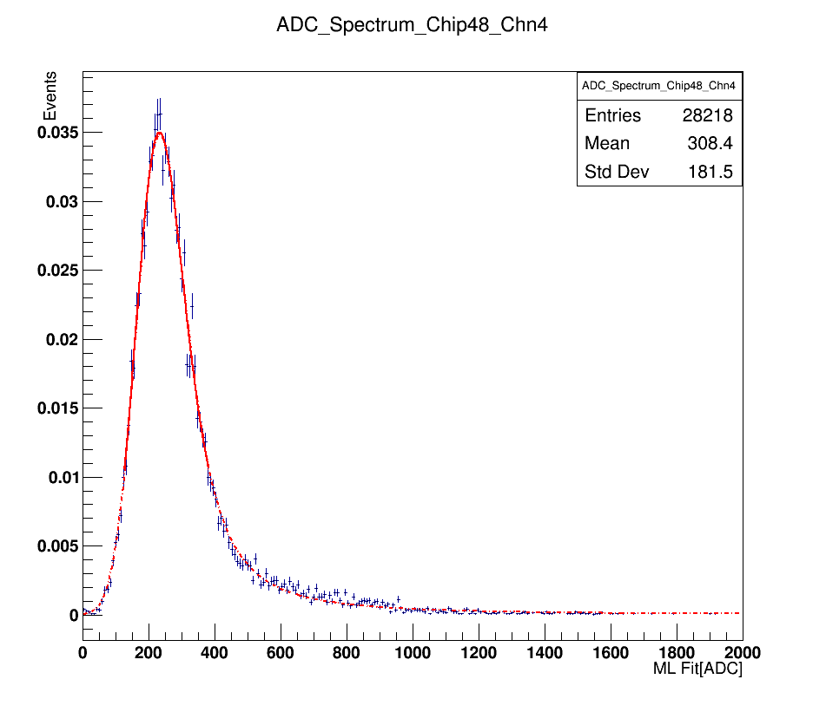
Gain and MIP calibration
The gain constant is extracted for each channel individually from the average distance between two peaks.
The MIP constant is extracted for each channel individually from the MPV of the
langaus fit function.
3 p.e
DESY Electron beam of 3 GeV
1 MIP = 250 ADC
2 p.e
pedestal

Slide 14
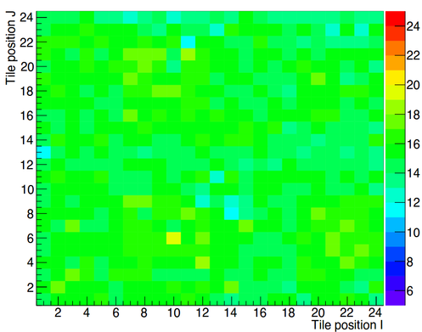
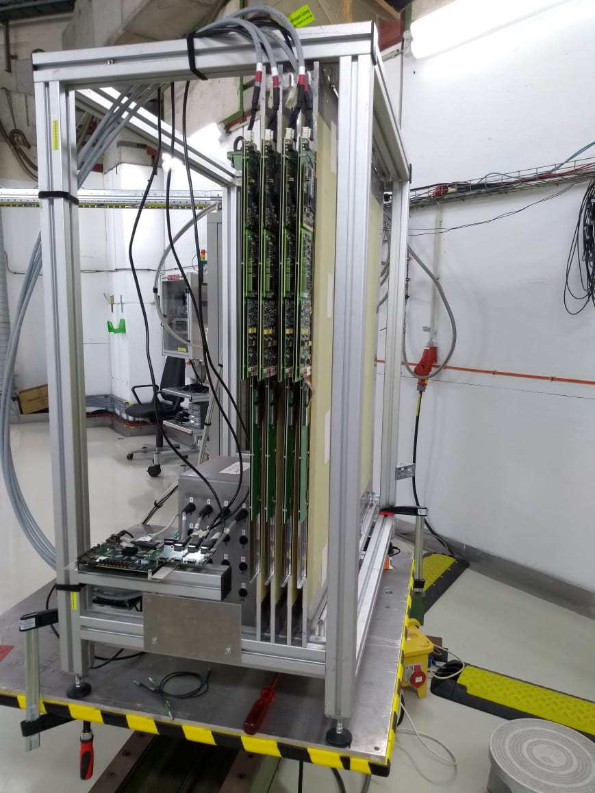
AHCAL technological prototype commissioning @ DESY
Aim: To perform gain calibration using low amplitude LED light and MIP calibration using 3 GeV electron beam at DESY
4 layers at a time in “air stack"
automatic scan for all channels

