Slide 1
Photon Run Coordinators
Harald Sinn
9.2.2018

Slide 2
Photon Run Coordinators
Every (important) week 1(2) senior physicists will take the role of Photon Run Coordinator.
The basic tasks are:
  Interface DESY-EXFEL
  PRC team plans commissioning & development activities, weekly meetings and strategic discussions
  Not a new group, but matrix team
  Leading of PSO meeting, participation on DESY RC meeting, (co)-chairing of Wednesday Operation Coordination meeting.
  Present in BKR & Experiment Hall at startup times. Point of information for EXFEL experiments & DESY.
  PRC of a current week supervises commissioning activities
  24/7 on call
Remuneration according to 24/7 on call activity
Further ideas for : Company car + resting room available for PRC
Who:
  ‘Science Support’ GLs or senior scientist of those groups
  Other experienced senior scientists (needs to be able to work with Karabo, training possible).

Slide 3
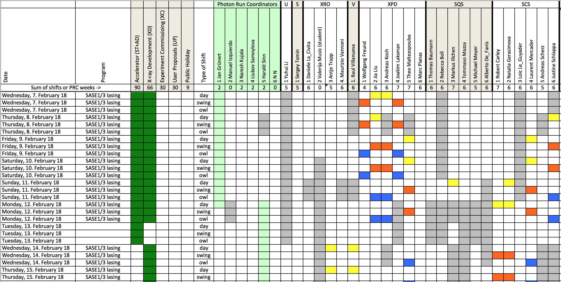
Shift Plans including PRs

Slide 4
Photon Run Coordiantors
General PRC number: 9-4800 (not yet working)
Jan Grünert (9-5777)
Harald Sinn (9-1744)
Liubov Samoylova (9-5471)
Naresh Kujala (9-6840)
Manuel Izquierdo (9-6437)

Slide 5
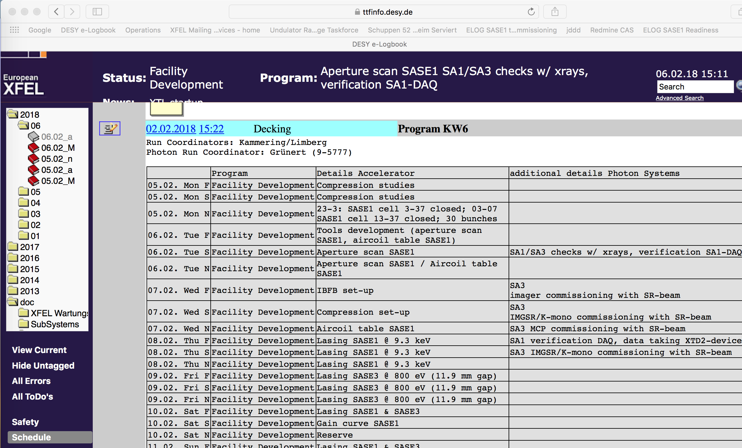

Slide 6
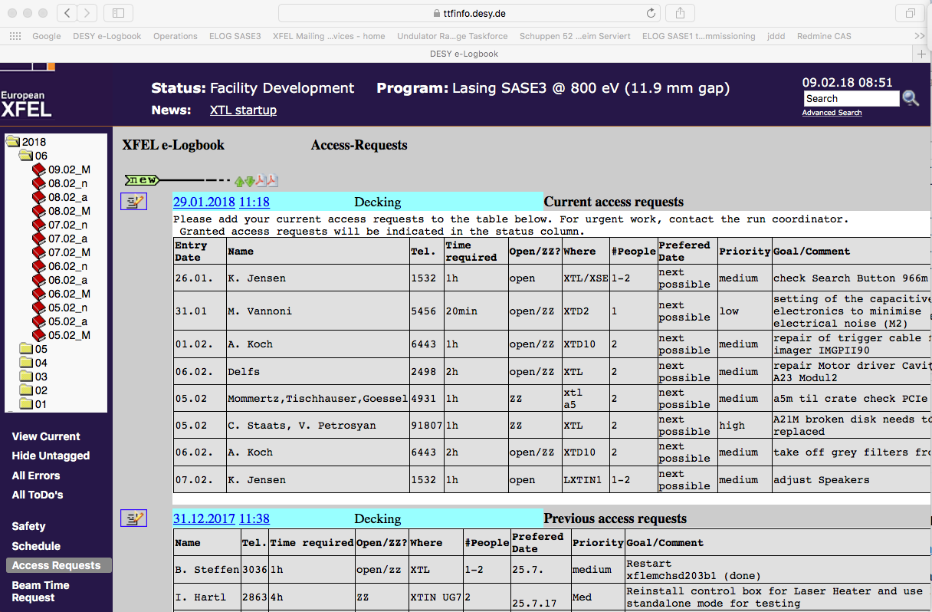
Comments on ZZ Access

Slide 7
Requirement for ZZ
Without it operation will stop
At least 2 people (max 7)
At least one experienced person
Should be short duration (< 30 min)
Alternative for XTD9/10: Talk to Martin Dommach and let them break the interlock!

Slide 8
Thank you!
Questions?

