Slide 1

RESUMMATION
Anna Kulesza
MC School, DESY Hamburg, 13.04.2018

Slide 2
Introduction
What is “resummation”?
Why do we want to resum?
How can we do it?
How well can we do it?
Examples, applications, directions
Theoretical uncertainties

Slide 3

Disclaimer
The road to resummation is long (-> Sudakov’56, a lot of research) and winding (many approaches, limited literature at the entry level)..

Slide 4

Disclaimer
The road to resummation is long (-> Sudakov’56, a lot of research) and winding (many approaches, limited literature at the entry level)..
Too little time, too much material -> subject can be introduced / discussed in many different ways, here only very few aspects can be covered without going too deep into details -> apologies for all the omissions
Today’s goal: a broad overview of the underlying ideas

Slide 5
Why?
Precise theoretical predictions needed for the LHC
Hadron collider physics notorious for presence of many scales Q_{i}
Multi-scale problems characterized by perturbative logarithmic corrections α_{s}^{n} log^{m} (Q_{i}² /Q_{j}²)
Large logs may spoil convergence of perturbation theory
Short-distance
power corrections,
Long-distance physics: parton distribution functions, fragmentation functions

Slide 6
What is Resummation?
Various types of logarithms:
  Renormalization and factorization logs: α_{s}^{n} log^{n} (Q²/μ²) -> running of α_{s,} pdfs
  High energy, small-x logs: α_{s}^{n} log^{n-1} (s/t) -> BFKL equation
  Sudakov logs: α_{s}^{n} log^{2n-1} (ζ)
    threshold logs ζ=1-z, z=M²/s, z=Q²/s, …
    recoil logs ζ=p_{T}²/Q²
    ...
Loosely speaking, resummation means reorganization of the perturbative series in such a way that the subsets of dominant terms (“logs”) are systematically grouped together to all orders. The expansion of the resulting expression returns then the dominant terms in the fixed-order perturbation theory. The form of this expression is specific to a given problem.

Slide 7
Soft Gluon Resummation
Systematic reorganization of perturbative series
NLO
NNLO
α_{s}^{n} log ^{2n}(β²)
α_{s}^{n} log ^{2n-1}(β²)
log(β²)↔log(N)≡L

Slide 8
The Goal
Systematic reorganization of perturbative series
NLO
NNLO
α_{s}^{n} log ^{2n}(β²)
α_{s}^{n} log ^{2n-1}(β²)
log(β²)↔log(N)≡L
Factorization: often in a conjugated space, e.g. a space of Melin moments N, taken wrt. 1-β²
sums up LL: α_{s}^{n} log ^{n+1} (N) NLL: α_{s}^{n} log ^{n} (N) …

Slide 9
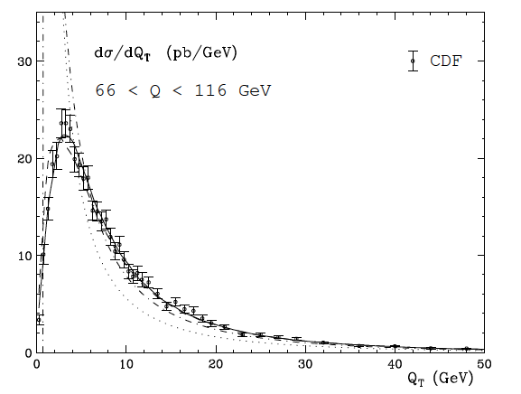
Benefits
Resummation extends accuracy of the perturbative prediction beyond fixed-order by adding a systematic treatment of the logarithmic contributions to all orders
  restores predictive power
  better describes physical phenomena
  probes the all-order structure of the perturbation theory
NLO
resummation (+power corr.)
Z boson p_{T} @Tevatron from [AK, Sterman, Vogelsang’03]
from [Moch, Vermaseren, Vogt’05]

Slide 10
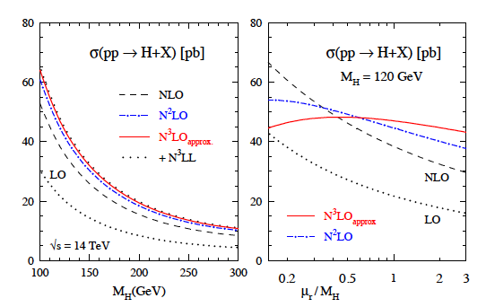
Benefits
Resummation extends accuracy of the perturbative prediction beyond fixed-order by adding a systematic treatment of the logarithmic contributions to all orders
  restores predictive power
  better describes physical phenomena
  probes the all-order structure of the perturbation theory
  by-product: approximation of the fixed-order result from expansion of the all-order resummation
NLO
resummation (+power corr.)
Z boson p_{T} @Tevatron from [AK, Sterman, Vogelsang’03]
from [Moch, Vermaseren, Vogt’05]

Slide 11
Benefits
Resummation extends accuracy of the perturbative prediction beyond fixed-order by adding a systematic treatment of the logarithmic contributions to all orders
  restores predictive power
  better describes physical phenomena
  probes the all-order structure of the perturbation theory
  by-product: approximation of the fixed-order result from expansion of the all-order resummation
NLO
resummation (+power corr.)
Z boson p_{T} @Tevatron from [AK, Sterman, Vogelsang’03]
but how to get there?
from [Moch, Vermaseren, Vogt’05]

Slide 12
Take Your Pick
Analytical methods
  Accuracy up to NNLL or N³LL
  Full control over theoretical accuracy
  Separate calculations for each process and observable
DQCD
(direct QCD)
SCET
Numerical
  Universal w.r.t. observable
  Automatized
  Accuracy (N)LL
  Limited control over accuracy, requires separate studies
MC Parton Showers

Slide 13
Methods
Historically, various approaches (or “schools”) have been formed:
  based on collinear branching formalism [Catani et al.] “bottom-top”
  based on renormalization group [Sterman et al.] “top-bottom”
  based on the effective field theory approach -> Soft Collinear Effective Theory (SCET) dominant mode selection at the Lagrangian level
Different at technical level, but equally valid
Independent methods to arrive at the same formal accuracy -> validation of theoretical predictions obtained with various methods
After all, physics is the same!

Slide 14
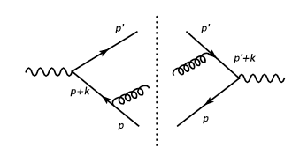
Origin of double Logs
QCD: Sudakov logarithms from soft and collinear gluon emission -> cancellations between real and virtual corrections leave out finite logarithmic remnants
  IRC singularities cancel between real and virtual corrections (KLN theorem)
  (Logarithmic) remnants of this cancellation can get large in some cases, spoiling predictive power of the theory
  Universal: same effect, appearing in many disguises, depending on the process, observable etc.
soft k₀->0
collinear θ->0

Slide 15
Example
Loop corrections vs phase-space integration
If restrictions on phase-space ➔ cancellation unbalanced ➔ finite logarithmic remnants

Slide 16
Example
Loop corrections vs phase-space integration
If restrictions on phase-space ➔ cancellation unbalanced ➔ finite logarithmic remnants
Real emission inhibited: soft gluon emission
1-z = fraction of energy carried by radiated gluon

Slide 17
Example
Loop corrections vs phase-space integration
If restrictions on phase-space ➔ cancellation unbalanced ➔ finite logarithmic remnants
Real emission inhibited: soft gluon emission
1-z = fraction of energy carried by radiated gluon

Slide 18
Example
Loop corrections vs phase-space integration
If restrictions on phase-space ➔ cancellation unbalanced ➔ finite logarithmic remnants
Real emission inhibited: soft gluon emission
1-z = fraction of energy carried by radiated gluon
Suppressed emission x→1 large logarithmic terms

Slide 19
Factorization
Factorization of soft and collinear emission is the underlying principle allowing resummation
Intuitive: short distance incoherent with long distance dynamics, long-wavelength soft gluons “insensitive” to short wavelength physics
Diagrams with collinear kinematics – factorization at each branching (coherent branching formalism) -> “bottom-top”
All-order factorization separating dynamics at various energy scales (RG approach, SCET) “top-bottom”

Slide 20
Eikonal Approximation in QED
One photon emission in the soft k^{μ} ➞ 0 limit
Eikonal approximation
k^{μ} << p^{μ}
emitting particle keeps its 4-momenta ➞ “straight line”
p+k
p
k,μ

Slide 21
Eikonal Approximation in QED
One photon emission in the soft k^{μ} ➞ 0 limit
Emission of two soft photons
Eikonal approximation
k^{μ} << p^{μ}
emitting particle keeps its 4-momenta ➞ “straight line”
p+k
p
k,μ
p+k₁+k₂
p+k₁
p
k₂,ν
k₁,μ
eikonal identity

Slide 22
Eikonal Approximation in QED
One photon emission in the soft k^{μ} ➞ 0 limit from an ougoing electron
Emission of two soft photons
Multiple soft photon emission
Eikonal approximation
k^{μ} << p^{μ}
emitting particle keeps its 4-momenta ➞ “straight line”
p+k
p
k,μ
p+k₁+k₂
p+k₁
p
k₂,ν
k₁,μ
eikonal identity
p+…+k_{n}
p+k₁
Independent, uncorrelated emissions
Poisson process
Exponentiation at the cross section level
k₁,μ₁
k_{n},μ_{n}

Slide 23
IR Limit
  One-photon soft emission amplitude
  M_{eik} does not depend on spin, energy or short-distance structure. Only dependence on charge and direction
  Eikonal factorization in QCD amplitudes works just as in QED
  but beware of colour!! -> see later
  Angular ordering contraint -> soft emission factorizes if ordered in the emission angle
  Virtual corrections also factorize
eikonal current

Slide 24
Wilson Lines
Wilson line is a functional of a gauge field with specific properties under gauge transformation. In an Abelian theory
Integrating over the path of a charged final-state particle p^{μ} , n^{μ}=p^{μ}/E,
Matrix element for one photon emission from expansion
reproduces eikonal interaction for an outgoing particle of charge Q_{n.} For m gluon emission from n external lines expand
Interactions of soft gluon with energetic charged particles can be completely described through Wilson lines➔particle just moves along a classical trajectory, emitting photons

Slide 25
Wilson Lines
Wilson line a functional of a gauge field with specific properties under gauge transformation. In an Abelian theory
Integrating over the path of a charged final-state particle p^{μ} , n^{μ}=p^{μ}/E,
Matrix element for one photon emission from expansion
reproduces eikonal interaction for an outgoing particle of charge Q_{n.} For m gluon emission from n external lines expand
Interactions of soft gluon with energetic charged particles can be completely described through Wilson lines➔particle just moves along a classical trajectory, emitting photons
in non-Abelian theory, path-ordered exponentials

Slide 26
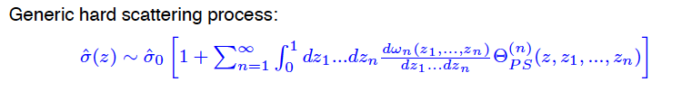
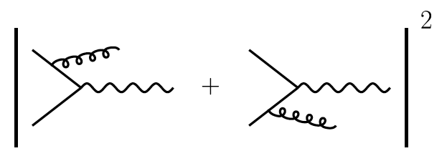
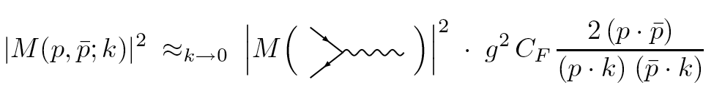


Conceptual Basis Of Resummation (I.1)
Exponentiation of one-gluon emission corrections
  matrix-element factorization in soft approximation for one-gluon emission
  multiple gluon emission factorization (colour coherence)
  phase-space factorization depends on the process: Θ_{PS} contains kinematical constraints defining the cross section
  factorized corrections exponentiate
p
k
p

Slide 27
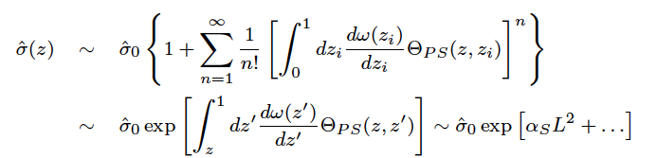


Conceptual Basis Of Resummation (I.2)
If the amplitude squared and the phase-space factorize
In practice, phase-space factorization often occurs in the space conjugate to the space of kinematic variables
  Threshold resummation, Mellin transform
  Transverse momentum p_{T} resummation, Fourier transform
ln (Q² / p_{T}² ) <-> ln (Q² b² )

Slide 28


“top -bottom” Factorization
In dimensional regularization:
Soft and collinear singularities intertwined with logs ➔ study the structure of singularities to learn about the logs
Same techniques as used in the “standard” collinear factorization proofs [Collins, Soper, Sterman’87-’89, Bodwin’85]. Particular variants of the factorized expression from which a corresponding resummed formula is derived are obtained by keeping the appropriate variable (e.g. transverse momentum, energy fraction) fixed

Slide 29
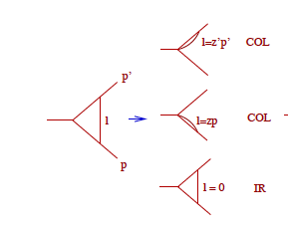
Roadmap
Methodology:
  For a general Feynman diagram, soft and collinear divergences are found by solving Landau equations
  It can be done graphically, with solutions represented as reduced diagrams [Coleman, Norton’65]. Use power-counting [Sterman] to establish the degree of divergence

Slide 30
Roadmap
Methodology:
  For a general Feynman diagram, soft and collinear divergences are found by solving Landau equations
  It can be done graphically, with solutions represented as reduced diagrams [Coleman, Norton’65]. Use power-counting [Sterman] to establish the degree of divergence
Landau equations from conditions:
- denominators have to vanish
- singularities are trapped, i.e. no deformation of the integration contour in the complex plane
Due to general nature of Landau equations, reduced diagrams can be used at any order in pert. theory. They represent leading regions where internal momenta go on-shell and denominators diverge
Landau eqs. are only necessary conditions for singularities, numerators can outweigh denominators -> power counting

Slide 31
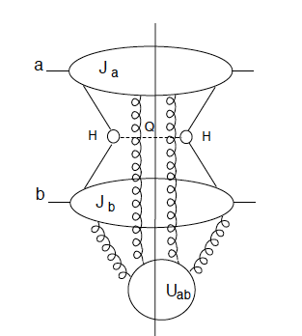
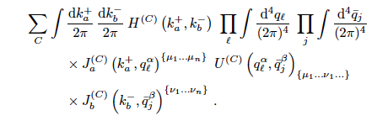
Roadmap
Methodology:
  For a general Feynman diagram, soft and collinear divergences are found by solving Landau equations
  It can be done graphically, with solutions represented as reduced diagrams [Coleman, Norton’65]. Use power-counting [Sterman] to establish the degree of divergence
  Leading regions at any order in perturbation theory
  Followed by factorization of jets from the hard off-shell part and soft gluons from jets – highly sophisticated diagrammatical analysis [Collins, Soper, Sterman]
Drell-Yan

Slide 32
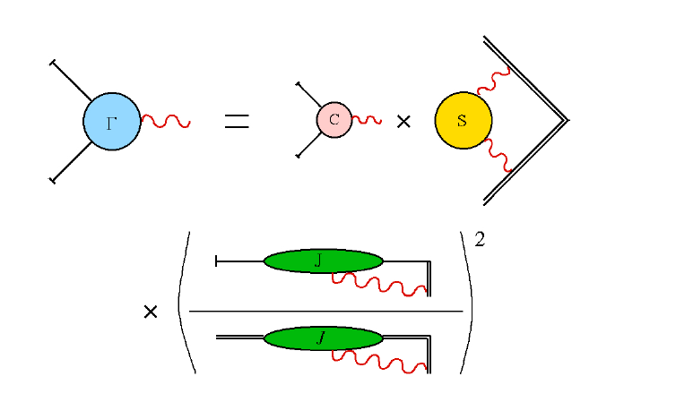
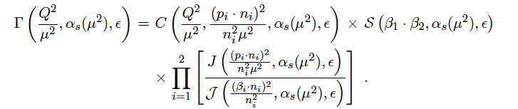
Upshot: “Top-bottom” DQCD
Form factor
from arXiv: 0805.3515

Slide 33





Resummation from Factorization
see E. Laenen, in Pramana 65(2004)1225
Single log resummation example: moments of the deep inelastic proton structure function factorize as
C_{q} are IR safe coefficient functions and is the quark distribution function. Since
then
and
Resummation of double logarithms requires additional considerations of dependence on the second variable (gauge vector ) via log(p_{i} . n)
anomalous dimension
=
Resummation of single logarithms!

Slide 34
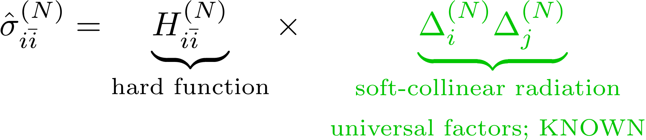
Threshold Resummed Cross Sections
Schematically, for colour singlet production
[Catani, Trentadue’89][Sterman’87]
exponential functions
A_{i} – perturbative function, A⁽¹⁾_{q/g}=α_{s}/π C_{F/A}

Slide 35
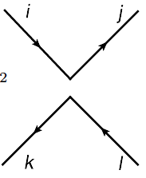
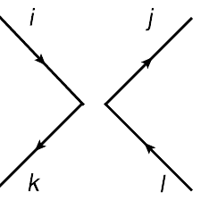
Colour Flow
Two external coloured legs
Result for three coloured legs also involves only simple Casimir factors, but starting from >= four legs objects in colour space
  gluon emission off quark lines ~ T_{i}ª T_{j}ª
  in general, decompose amplitudes in a chosen colour basis (colour tensors with indices of external partons)
e.g.
colour basis
(possible choice)
Consequence: soft emission function turns into a matrix in the colour space

Slide 36
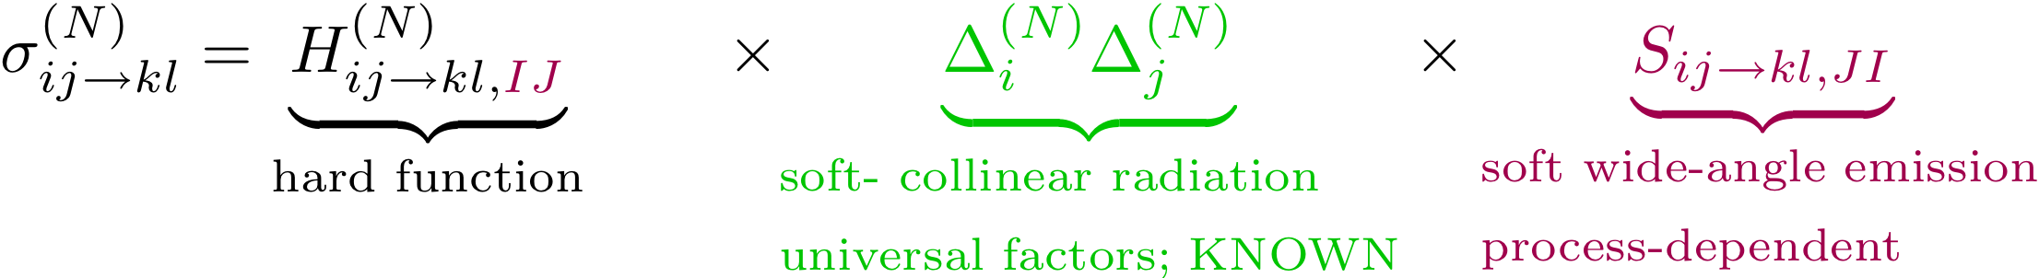

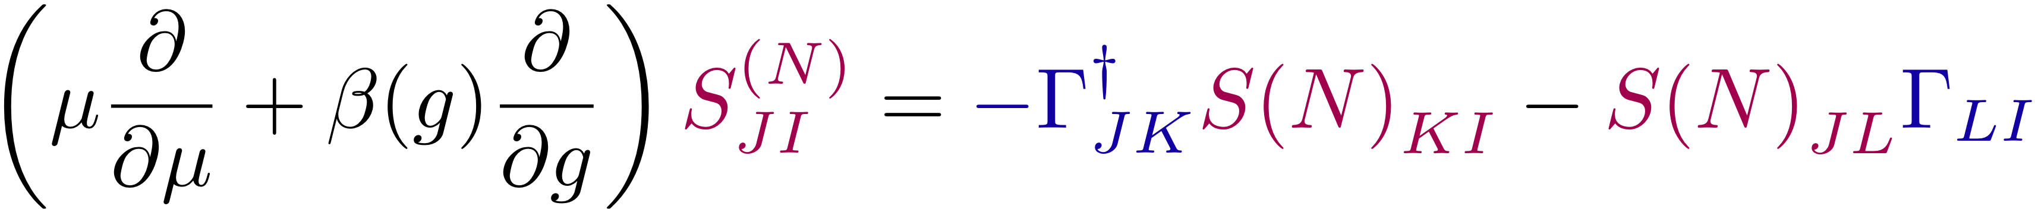
Threshold Resummation for 2→2 Processes with colour & mass in the final state
2→2 process with nontrivial colour flow
matrices in colour space
from solving the renormalization group equation

Slide 37
Threshold Resummation for 2→2 Processes with colour & mass in the final state
2→2 process with nontrivial colour flow
  NLL accuracy requires knowing the soft anomalous dimension at 1-loop, NNLL accuracy at 2-loop etc.
  Soft anomalous dimensions known at 2-loops for any number of massless/massive legs [Mert-Aybat, Dixon, Sterman’06] [Becher, Neubert’09] [Mitov, Sterman, Sung’09-’10] [Ferroglia, Neubert, Pecjak, Yang’09] [Beneke, Falgari, Schwinn’09], [Czakon, Mitov, Sterman’09] [Kidonakis’10][Chiu et al.’09]
  Recently also the 3-loop massless case calculated [Almelid, Duhr, Gardi’16]
matrices in colour space
from solving the renormalization group equation

Slide 38
NLL Resummation for 2→2 Processes with colour and mass in the final state
Some simplifications possible in the threshold limit @ NLL accuracy: resummed partonic cross section [Kidonakis, Sterman'96-97][Bonciani, Catani, Mangano, Nason'98]
Condition: choice of orthogonal basis in colour space for which Γ_{IJ} is diagonal in the threshold limit, here s-channel basis [AK, Motyka’ 09] . In general possible to construct such basis in which Γ_{IJ} diagonal to all orders [Beneke, Falgari, Schwinn’09]
Soft, wide-angle emission, process dependent
N-moments of LO
Soft-collinear radiation from incoming partons, universal, known
Soft anomalous dimension matrix

Slide 39
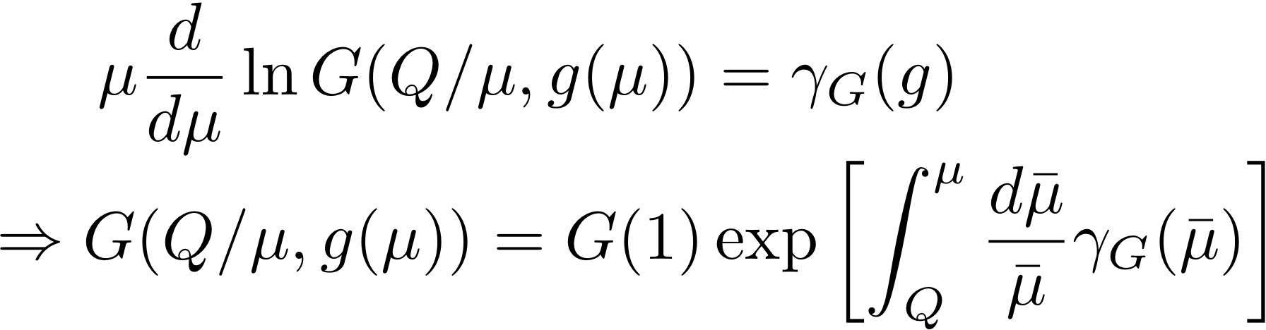
Conceptual Basis Of Resummation (II)
[Sterman et al.]
All-order factorization of soft and collinear emission
Exponentiation from solving Renormalization Group Equations, e.g
Schematically, in space where factorization takes place

Slide 40
SCET
Soft - Collinear Effective Theory (SCET) of QCD [Bauer, Becher, Beneke, Chapovsky, Diehl, Feldmann, Fleming, Hill, Lee, Luke, Manohar, Neubert, Pirjol, Rothstein, Stewart, …’early 00s]
  → dynamics of energetic particles moving close to the light-cone and interacting with soft quanta
EFTs provide useful framework for studying multi-scale problems: scale separation → factorization
Resummation from solving RG equations of SCET in momentum space [Becher,Neubert’06] [Becher,Neubert,Pecjak’07] [Becher,Neubert,Xu’08]
Relation to direct QCD studied extensively a few years ago [Bonvini, Forte, Ghezzi, Ridolfi’12][Sterman, Zheng’13], [Almeida et al.’14]
Energy
QCD
hard
SCET
collinear
soft

Slide 41
Soft Gluon Resummation
Systematic reorganization of perturbative series
NLO
NNLO
α_{s}^{n} log ^{2n}(β²)
α_{s}^{n} log ^{2n-1}(β²)
log(β²)↔log(N)≡L
Factorization: often in a conjugated space, e.g. a space of Melin moments N, taken wrt. 1-β²
sums up LL: α_{s}^{n} log ^{n+1} (N) NLL: α_{s}^{n} log ^{n} (N) …

Slide 42
Threshold Resummation-Matching with Fixed-order
Resummed expression has to be matched with the known fixed-order (f.o.) result
Inverse Mellin transform evaluated using a contour in the complex N space according to 'Minimal Prescription’ [Catani, Mangano, Nason Trentadue'96]
f.o
f.o

Slide 43

Further Systematic Improvements
Analytical resummation techniques lend themselves to further systematic improvements w.r.t. logarithmic accuracy
  calculations of anomalous dimensions at higher orders increase accuracy of resummation exponents
  apart from exponents also hard function needed: fixed-order loop calculations keeping info on the colour structure
  consistent matching with fixed order, resulting in N^{x}LO+N^{y}LL predictions
Next-to-eikonal approximation [Laenen, Magnea, Stavenga’08], [Laenen, Magnea, Stavenga,White’11][Bonocore, Laenen, Magnea, Vernazza,White’14’16][Larkoski, Neill,Stewart’14][Kolodrubetz, Moult, Stewart’16][Bonocore, Laenen, Magnea,Melville, Vernazza,White’15] [del Duca, Laenen, Magnea, Vernazza,White’17]
next-to-leading power logarithms,
factorization, exponentiation?
treated in standard resummation
loops + real
phase-space

Slide 44
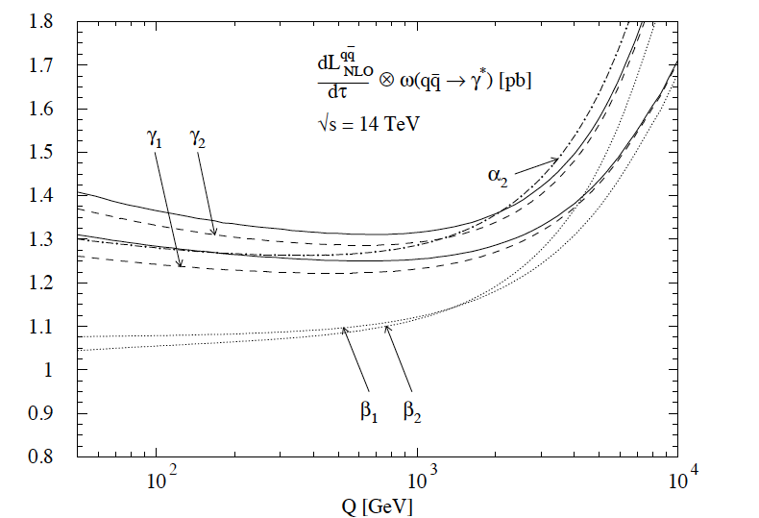

NLP threshold effects
from [Krämer, Laenen, Spira’96]
Subleading terms of collinear origin (splitting functions), subset of NLPs
can be numerically important

Slide 45
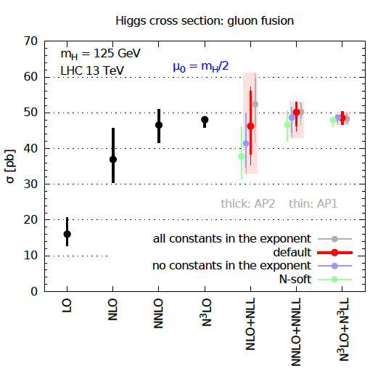
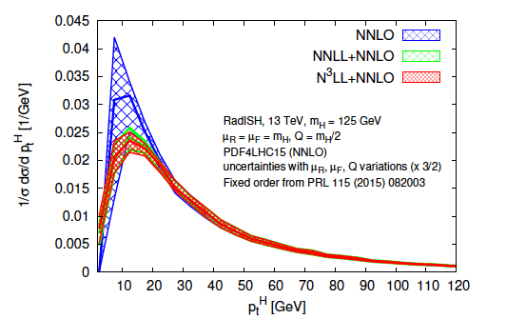
Some Recent Results: Higgs
Threshold resummation at N³LO+N³LL, inclusive [Bonvini, Marzani, Muselli,Rottoli’16]
  -> 4-loop cusp anomalous dim. A₄ not yet fully known
Transverse momentum resummation at
NNLO+N³LL [Bizon et al.’18]
  -> 3-loop anomalous dim. B₃ new [Li,Zhu’16][Vladimirov’16’17]
see also [Schmidt, Spira’16]

Slide 46
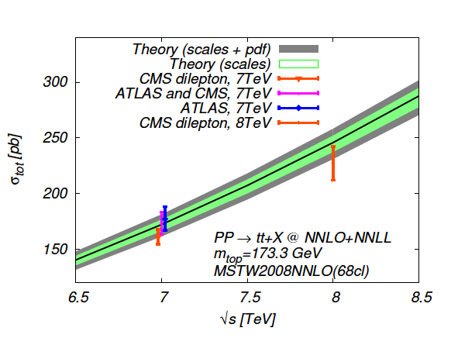
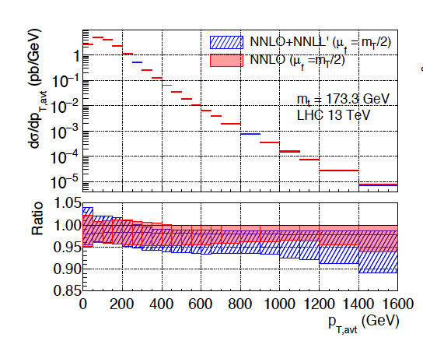
Some Recent Results: Top-Pair
Total cross section @NNLO+NNLL, threshold resummation [Cacciari et al.’11][Czakon, Mitov’13]
Differential (in p_{T,} M_{tt}) distributions @NNLO+NNLL’ [Czakon et al.’18], joint threshold and small-mass (logs of m_{t} /M_{tt}) resummation [Ferroglia, Pecjak, Yang’12]
NNLL results from SCET [Ahrens et al.’10,’11],combined with Coulomb resummation [Beneke, Falgari, Klein, Schwinn’10], incomplete N³LL resummation [Schwinn, Wever’18]

Slide 47
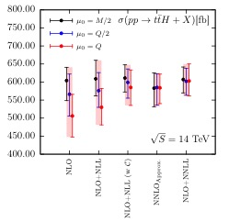
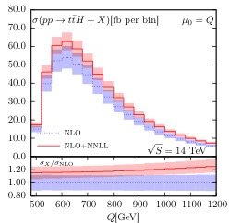
Some recent Results: TTH
Total cross sections and Q=M_{ttH} distributions NLO+NNLL, threshold resummation in the ttH invariant mass threshold limit, z=Q²/s , direct QCD [AK, Motyka, Stebel, Theeuwes’17]
NLO+NLL threshold resummation in the absolute threshold limit, z=(2m_{t} +m_{H})²/s [AK, Motyka, Stebel, Theeuwes’15]
NLO+NNLL invariant mass threshold limit also from SCET [Broggio, Ferroglia, Pecjak, Yang’16]

Slide 48
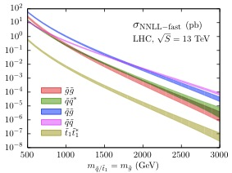
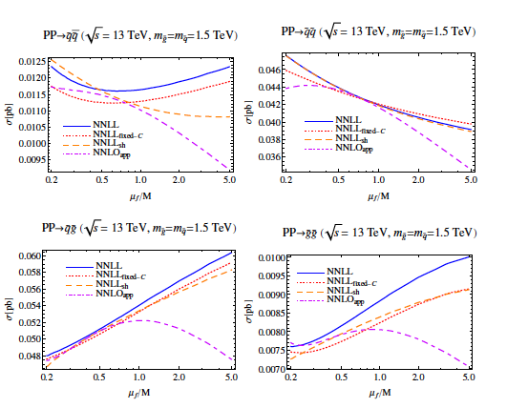
Some Recent Results: SUSY
Total cross section for squark- and gluino pair production @NNLO_{approx} +NNLL, threshold resummation (+Coulomb resummation and bound state effects) , direct QCD [Beenakker, Borschensky, Heger, Krämer, AK, Laenen, Theeuwes, Thewes’14-’16]
Total cross section for squark- and gluino pair production @NNLO_{approx} +NNLL, threshold resummation (+Coulomb resummation and bound state effects), SCET [Beneke, Piclum, Schwinn, Wever’16]

Slide 49
Some Recent Results: SUSY
Total cross section for squark- and gluino pair production @NNLO_{approx} +NNLL, threshold resummation (+Coulomb resummation and bound state effects) , direct QCD [Beenakker, Borschensky, Heger, Krämer, AK, Laenen, Theeuwes, Thewes’14-’16]
Total cross section for squark- and gluino pair production @NNLO_{approx} +NNLL, threshold resummation (+Coulomb resummation and bound state effects), SCET [Beneke, Piclum, Schwinn, Wever’16]
[Beneke, Borschensky, Krämer, AK, Piclum, Schwinn, Wever, in prep.]
Work in progress: comparison of the results with the predictions obtained in the SCET framework
  scale choices
  pdfs
  different treatment of bound state effects, P-wave channels..

Slide 50
Theory Uncertainties
Origin in direct QCD:
  Scale dependence: renormalization, factorization and resummation scale, if considered
  Subleading log^{k} (N)/N terms: include or not?
  PDF + α_{s} error – same as in the fixed-order calculations (though better determination of PDFs using resummed predictions can be achieved)
  matching accuracy (NLO, NNLO_{approx}, etc.)
  framework used (e.g. in conjugate or direct space)
  …
Most of the sources of uncertainties are similar in SCET, set of scales driven by the framework

Slide 51
Renormalization and Factorization Scale Dependence
Direct QCD: similar to fixed-order results, resummed expression also depend on μ_{R} and μ_{F.} To compare errors with those from fixed-order predictions, use standard convention
or equivalent method for estimation of scale variation applied in fixed-order predictions, e.g. 7-point method
Naively, as resummation should take care of dominant terms up to all orders, expect decrease in the scale variation error
Reduction of factorization scale dependence well understood

Slide 52

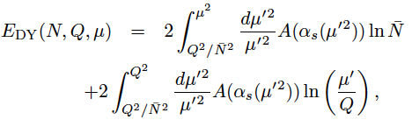
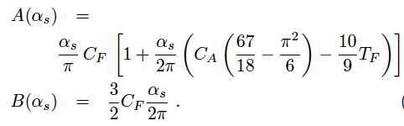





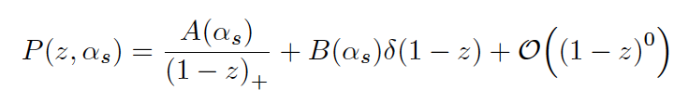
Factorization Scale Dependence
[Sterman, Vogelsang’00]
For simplicity, consider the Drell-Yan process
Rewrite
since A(α_{S}) equals the residue of 1/(1-z) term in the splitting function P_{qq}

Slide 53

Resummation Scale
Originally proposed for estimates of uncertainty in transverse momentum resummation of the Higgs boson through gg fusion [Bozzi, Catani, de Florian, Grazzini’03]
Resummation scale Q is an auxiliary scale corresponding to (re)factorization between jets and hard functions
Introduced by replacing logs of (M_{H}²b²) from Fourier conjugate of logs of (M_{H}² / p_{T}²) by
The dependence on Q only for higher logarithmic terms beyond the accuracy of the fixed-order
Hard function
Incoming jets

Slide 54
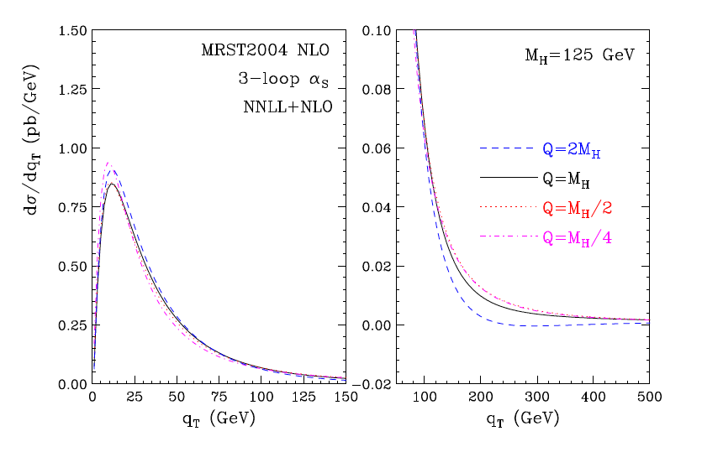
Resummation Scale
Originally proposed for estimates of uncertainty in transverse momentum resummation of the Higgs boson through gg fusion [Bozzi, Catani, de Florian, Grazzini’03]
Resummation scale Q is an auxiliary scale corresponding to (re)factorization between jets and hard functions
Introduced by replacing logs of (M_{H}²b²) from Fourier conjugate of logs of (M_{H}² / p_{T}²) by
The dependence on Q only for higher logarithmic terms beyond the accuracy of the fixed-order
Hard function
Incoming jets

Slide 55


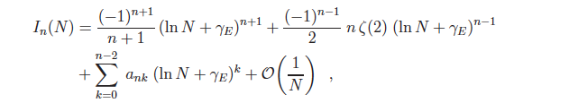
Subleading Terms in the Exponential
Logs in the conjugated space correspond to the logs in the original space modulo subleading terms. Threshold resummation:
  -> Logs of N, constants and terms of O(1/N^{p} )
“Standard” form of the exponential factors used in many applications takes into account only powers of log(N)+γ_{E} -> mismatch of O(1/N) (below formal accuracy of resummation), these subleading terms can be reinstated [Ball et al.’13], [Bonvini, Marzani’14]
Similarly, can enrich the exponentials by 1/N information from the splitting functions [Krämer, Laenen, Spira’96][Catani, de Florian, Grazzini’01][Laenen, Magnea, Stavenga][Ball et al.’13][Bonvini, Marzani’14]
[Catani, Grazzini, de Florian, Nason’03]

Slide 56
Matching Procedures
Threshold resummation
  f.o.= full N^{x} LO or approximated N^{x+1} LO , obtained by expanding the resummed cross section, truncating it at N^{x+1} LO accuracy, inverting back, and adding thus obtained N^{x+1}LO correction to the full N^{x}LO prediction.
  At N^{x+1} LO only the logarithmic terms predicted unambiguously
  Difference with matching to N^{x} LO: terms of O(1/N^{p} ) at N^{x+1} LO
Distributions where the action of logs is “visible” (p_{T}, thrust, .. ): more complicated since “smooth” transition in the spectrum between the resummation and the fixed–order region required -> additive matching (as above) or multiplicative matching
f.o.
f.o.

Slide 57

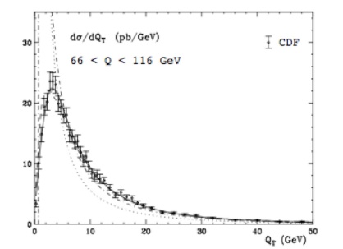
Matching Procedures
Threshold resummation
  f.o.= full N^{x} LO or approximated N^{x+1} LO , obtained by expanding the resummed cross section, truncating it at N^{x+1} LO accuracy, inverting back, and adding thus obtained N^{x+1}LO correction to the full N^{x}LO prediction.
  At N^{x+1} LO only the logarithmic terms predicted unambiguously
  Difference with matching to N^{x} LO: terms of O(1/N^{p} ) at N^{x+1} LO
Distributions where the action of logs is “visible” (p_{T}, thrust, .. ): more complicated since “smooth” transition in the spectrum between the resummation and the fixed–order region required -> additive matching (as above) or multiplicative matching
Resummation
Matching region
f.o.
f.o.
Fixed order

Slide 58
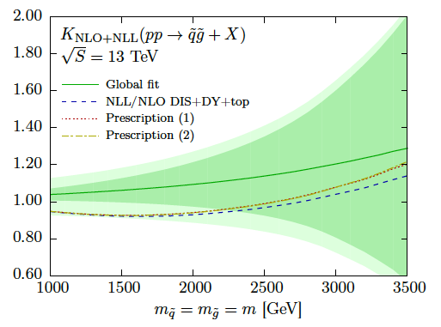
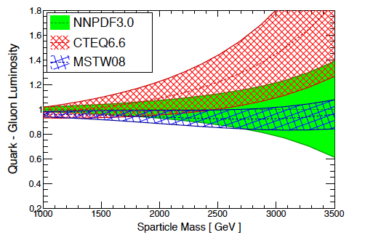
Theoretical Uncertainties
Importance of various types of uncertainties clearly depends on the process and the observable
Example: total cross sections for production of a heavy-mass system:
So pick your errors carefully!
[Beenakker, Borschensky, Krämer, AK, Laenen, Marzani Rojo’16]

Slide 59
Summary
Resummation crucial for proper description of multiple classes of observables probing the IR dynamics
Well established techniques: direct QCD and SCET
As the ability and accuracy of higher-order calculation grows, so does the accuracy of resummation
NNLL pretty much standard now, some quantities already known at N³LL
Higher logarithmic accuracy than those offered by parton showers, systematically improvable
Very dynamical field, many new developments
Need to invest effort in analytical comparisons with parton showers!

Slide 60
