Slide 1
MC Tuning
Judith Katzy (DESY)
MC Tuning of phenomenological models: the methods
MC comparisons to data (Unfolding)
Tuning of specific parameters with sensitive observables
Tuning of matched generators

Slide 2
Motivation for MC tuning
MC generators important tools to
  Derive resolution and accepetance corrections
  Estimate backgrounds
  Design detectors
  Provide theoretical interpretation of the results
Need good description of ALL aspects of high energy interaction
  differential distributions of final state objects like jets and leptons produced in either the hard process or additional physics processes
Check and tune models with available data
“The experience gained with the model, in failures as well as successes, could be used as a guideline in the evolution of yet more detailed models.” [T.Sjoestrand, 1987]

Slide 3
Observables and the partonic picture
Radiation effects
Hard interactions
Inner jet structure
Small angle lepton distributions
Jets
Leptons
Soft QCD
Soft charged particles
Energy flow
Short distance physics
Small α_{s}
Perturbative calculations
Factorisation
Large distance physics
Large α_{s}
Phenomenological models
Universality

Slide 4
Universality of phenomenological models
Underlying assumption: non-perturbative dynamics independent of the hard scattering process
use of the same parameters for the predictions of different observables
Simultaneous Tunes to different observables
Validation of models and tunes in direct comparison with different data sets

Slide 5
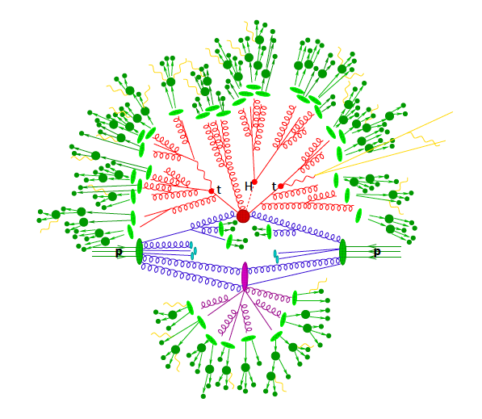
QCD models in MC
Hard interaction
Hadronisation of
Final state partons
Parton decay (t, H)
Hadron decay
Hard QCD FS radiation
Photon radiation
IS QCD radiation
Secondary interaction (MPI)
Hadronisation of
proton remnant
Up to ~30 tuneable parameters in MC codes

Slide 6
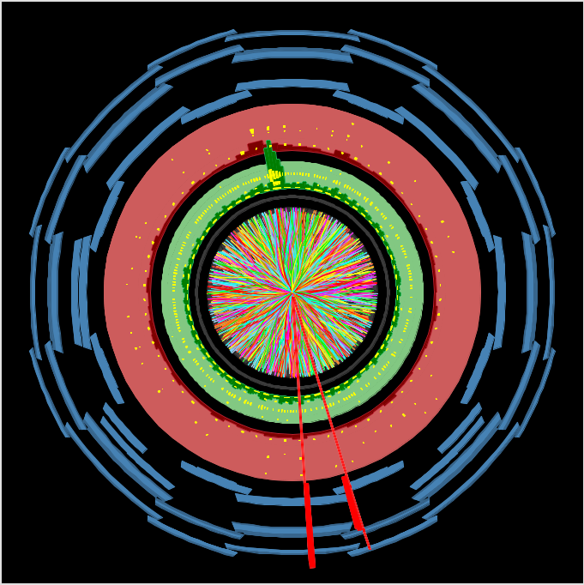
MC comparison to data
MC generator particles and jets
Particles and jets reconstructed from detector signals
Data-MC comparison

Slide 7
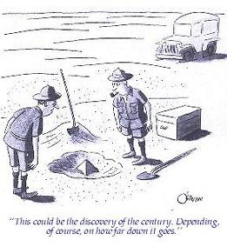
Details of MC-data comparisons (1)
Fiducial volume

Slide 8
Details of data-mc comparisons (1)
“Visible” or Fiducial volume
Idea: limit model dependent correction by minimizing extrapolation in unmeasured regions

Slide 9
Details of data-mc comparisons (1)
“Visible” or Fiducial volume
Idea: limit model dependent correction by minimizing extrapolation in unmeasured regions
Kinematics:
Same kinematic phase space
MC particles as used in data analysis e.g.
|η|< 2.5, p_{T}> 25 GeV, ….
Particles/jets in MC corresponding to detectable particles/jets in data
- Use only stable MC particles in the final state
Jets of stable particles reconstructed with anti-kt jet algorithm (R=0.4 ATLAS, R=0.6 CMS)
b-quark initiated jets reconstructed as stable particle jets containing B-hadron with non-prompt electro-weak decays
  Leptons “dressed” with photons from QED radiation if they cannot be resolved due to limited detector resolution
ETmiss/Neutrinos missing transverse energy is calculated as the 4-vector sum of neutrinos from W/Z-­boson decays.
  See standard defined by LPCC working group

Slide 10
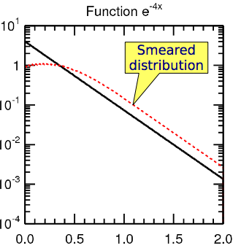
Side remark:
Detector Resolution Effects
Example: Steeply falling distribution
Function e^{-4x}
smeared by Gaussian with width of 0.3
true and smeared (measured) distribution differ by large amount
Measurement: unsmear ('unfold') measured distribution
to retrieve true distribution

Slide 11
Details of data-mc comparisons
Unfolding
MC generator particles
?
Unfold data to stable particles
Simulate hits in the detector
Hits in the detector
GEANT4
Reconstruction
Corrections for resolution and efficiencies

Slide 12
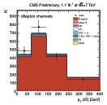
Simplest case: Bin-by-bin unfolding
correct measured
Distribution back to
Parton level distribution
(unfolding)
  apply efficiency correction separately in each bin
Features
  simple, fast, robust, statistical errors are well defined sqrt(N), biases included in systematics
  need good description of data, result does not include correlations

Slide 13
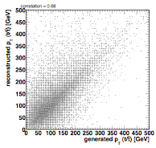
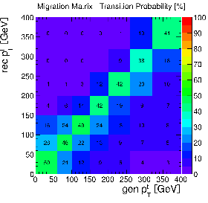


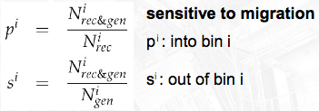
Full unfolding with response matrix
MC
reconstructed
generated
Choose bins such that purity and stability are larger than 40-50%
Full unfolding using full response matrix
  yields full covariance matrix
  slow and complex

Slide 14
Result of full unfolding
Example: highest p_{T} b-jet in top pair production
Reconstruction Level
Particle Level
MC-Data Comparisons

Slide 15
Data-MC comparisons
Tools
MC Generator
Measurments
HepMC events:
Stable particles
HepData tables:
Central value, binning, error
Rivet (HZTools)
Event selection, object + observable reconstruction

Slide 16
MC Tuning Methods
Assumption: each parameter controls only a relatively small & exclusive detail of the event generation
  Allows tuning of small amount of parameters for a particular component to suitable observables
  However, observables are usually also weakly dependent on other parameters & components
  Iterative tuning
Typical tuning sequence:
  Fragmentation and parts of parton shower tuned to LEP data
  Soft QCD models tuned to hadron collider data
Probe scaling of models by tuning / comparing to different cms energies (Tevatron, LHC 900 GeV, 7 TeV,
8 TeV, 13 TeV)

Slide 17
Tuning methods (1)
Manual tunes
Generate predictions for a parameter set within the validity range of the model & optimise according to human judgement
Strength: comprehensible & stable results
Limitations: correlated and many parameters -> very time consuming
Examples: Pythia6 and Pythia8 author (Skands, Sjoestrand) tunes (Perugia Tunes, Monash Tunes, C4, C4x…), tune A, Z1, Z2, (Rick Field)
Notes:
Problem manual tunes:

Slide 18
Tuning method (2)
Analytical approximations
Approximate the parameter dependence of the physical observable on the model parameters by an analytical function, typically a 2nd or 3rd order polynomial
Optimise tuning of a large number of parameters simultaneously
Originally method developed at LEP, reimplemented in Professor Tool
Personal judgement enters via weights of observables
Examples: ATLAS tunes (pythia AMBT1, AZ, AUET, fHerwig), CUET tunes, recent Herwig++ and Sherpa tunes
Notes:
Method invented at LEP to tune hadronisation

Slide 19
Tuning chain
MC Generator
Parameter setting 1
MC Generator
Parameter setting 2
MC Generator
Parameter setting 1000
…..
Rivet
Rivet
Rivet
Professor
Optimised Parameters

Slide 20
Uncertainties on models & optimised parameters
Tuning to different but redundant observables or different ranges of observable spectra (AZ tunes)
Allow limited deviations from the measurements (see Perugia tunes)
Perform “eigentunes” of the analytical approximation: calculate chi2 variations of the diagonalised covariance matrix used in the minimisation (see ATLAS tunes)

Slide 21
Tuning parton shower and fragmentation
Hadronisation of
Final state partons
QCD FS radiation
Lund string model or
Cluster fragmentation
IS QCD radiation
Tuned to LEP data:
particle multiplicity
Event shape variables
Momentum spectra
Shower parameters:
Low Q₀ cut-off for FSR and ISR
α_{s} (λ_{QCD}) for FSR
Mean intrinsic k_{T}
PYTHIA:
α_{s} for ISR
α_{s} for FSR off ISR
Max. allowed parton virtuality in ISR

Slide 22
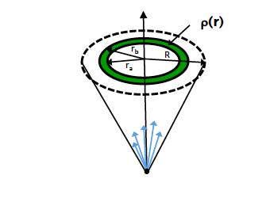

Observables sensitive to Final State Radiation and Fragmentation: Jet shapes
Jet axis
MC parameter:
α_{S} in FSR
α_{s}(Q₂)
q_{i}
In ,many bins of jet pT
+ b-jet shapes, jet shapes from Tevatron

Slide 23
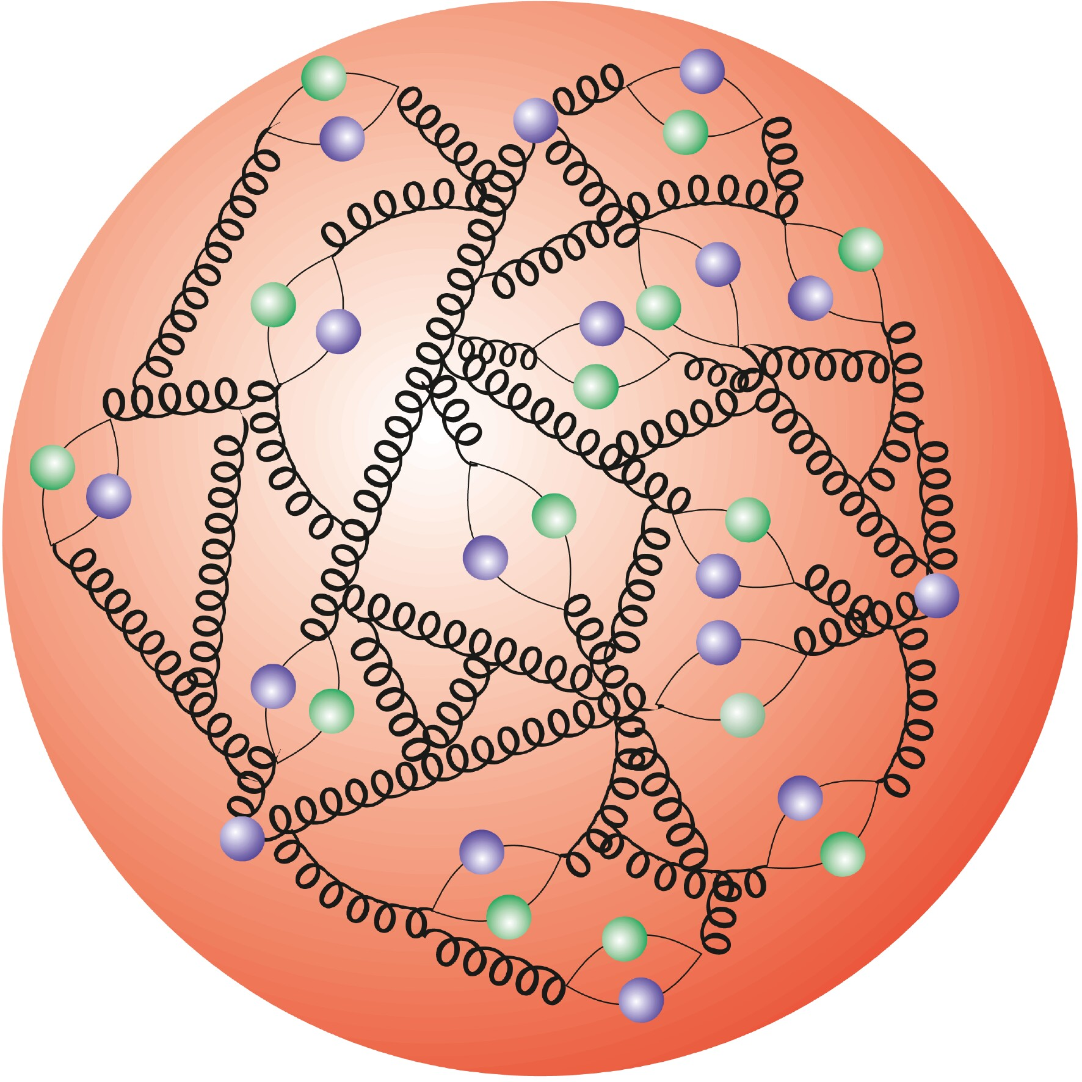
Initial State Radiation Observables:
Drell Yan
Observables: p^{Z}_{T} and phi*
Intrinsc k_{T}:
k_{T} of partons inside incoming protons
Fermi motion ~200 MeV
“sum of unresovled effect below shower cut-off”
ISR cut-off: Q₀
α_{S}(ISR)
α_{s}(Q₂)
q_{i}
e
Z
e
q_{j}
Pythia has separate α_{S} for ISR and FSR to effectively incorporate various soft effects
Herwig has only one α_{S} for parton shower to keep Lorentz Invariance

Slide 24
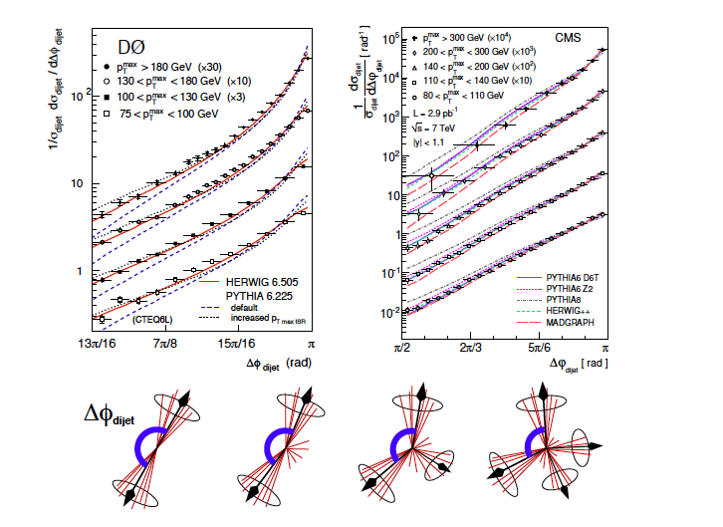
Parton Shower Tuning in dijet decorrelation
Probe hard and soft emission without explicit separation
Sensitive to max. allowed parton virtuality in ISR

Slide 25
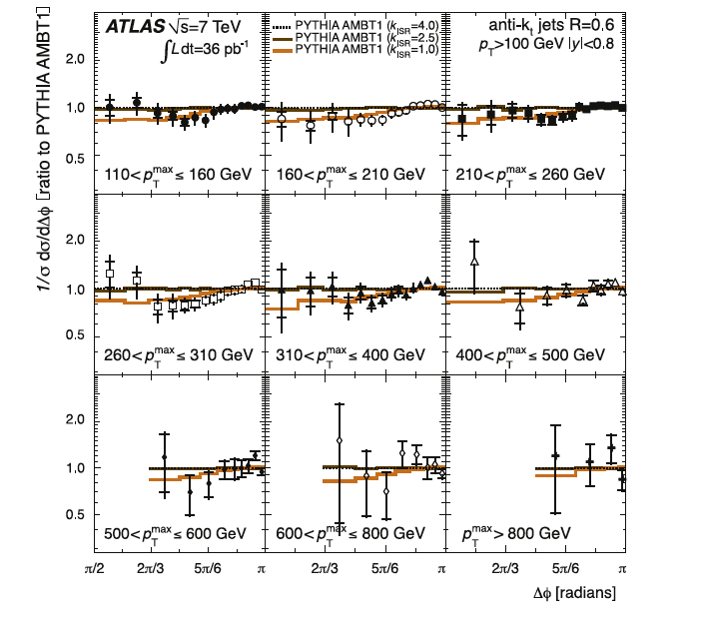
Pythia6 Shower Tuning in dijet decorrelation

Slide 26
MPI and Colour Reconnection
Secondary interaction (MPI)
Hadronisation of
proton remnant

Slide 27
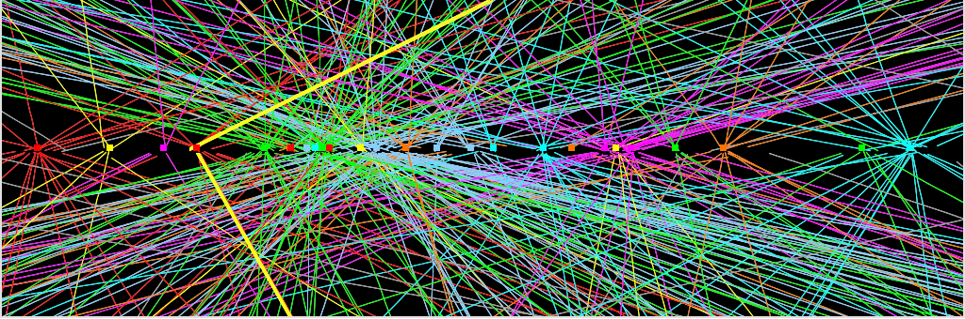
Reminder:
Minimum bias abundantly
Pile-up at LHC
2012 data (8 TeV): <mu> ~ 21
Run 2 (13-14 TeV): <mu> ~ 40
High Lumi LHC: <mu> ~ 400

Slide 28
Multi-parton interactions
Secondary interaction between remnant partons
Modeled by perturbative parton-parton scattering framework
-> rising towards low p_T
-> dominated by t-channel gluon exchange
-> parton shower and hadronise
Hard MPI observed gamma+2jet (Tevatron),
W+di-jet and 4 jet production (LHC)
Soft MPI: major source of soft particle production in min.bias events and underlying event in hard scatter processes
q_{i}
q_{i}
q_{j}
g
q_{k}

Slide 29

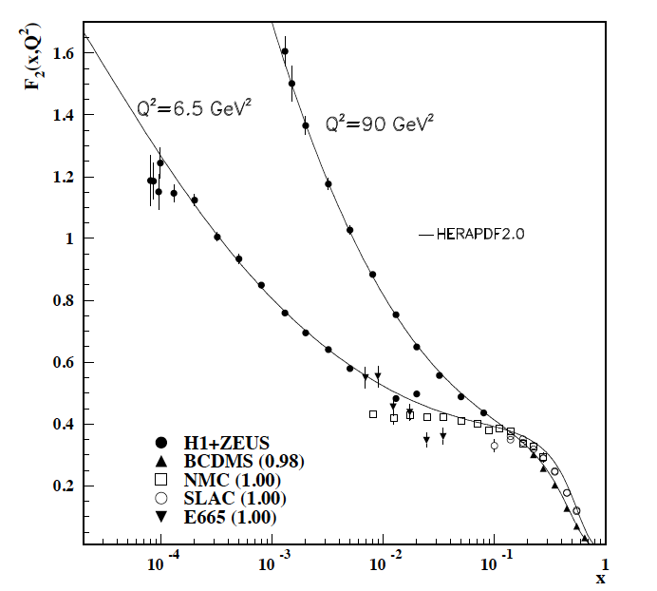
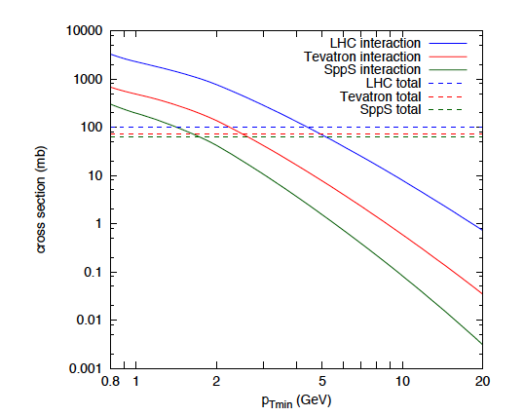
MPI model & parameters
Further reading: arXiv:1706.02166v1
q_{i}
q_{j}
g
Exceed total cross section at 1-2 GeV due to high parton densities
http://pdg.lbl.gov/
MPI parameters dependent on Parton Densities (PDF)!

Slide 30

MPI model & parameters
Further reading: arXiv:1706.02166v1
q_{i}
q_{j}
g
Exceed total cross section at 1-2 GeV due to high parton densities
  Limit rise of partonic cross section via
  N(parton-parton) = sigma(hard)/sigma(non-diff) -> matter overlap
Divergent for pT->0 : introduce cut-off pTmin
MPI parameters dependent on
Parton Densities (PDF)!
Tuneable paramters

Slide 31
Observables and model parameters for MPI
Mean nr of charged particles (Ncharged) : ptmin,0
Charged particles at different sqrt(s) measured at LHC, Tevatron, SPS
Probability distribution of charged particle multiplicity: matter distribution

Slide 32
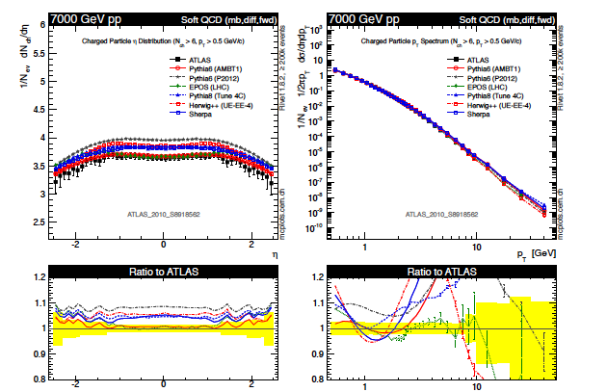
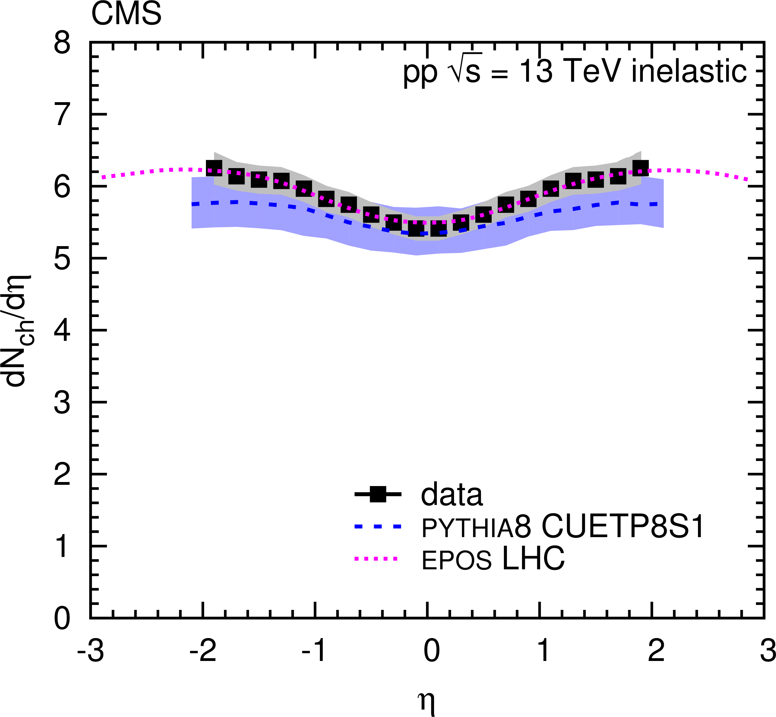
Minimum Bias Measurements (1) charged particle distributions
Check theory extrapolation and re-tune if needed for each new center of mass energy!
EPOS LHC: tuned to 7 TeV data

Slide 33
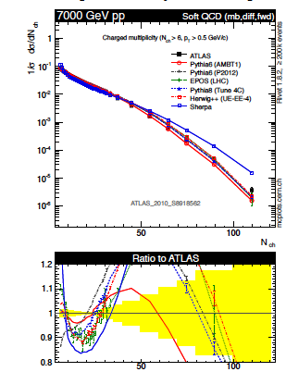
Minimum Bias Measurements (2) momentum spectra
Difficult to get momentum spectra, particle multiplicity and hadron composition right!

Slide 34
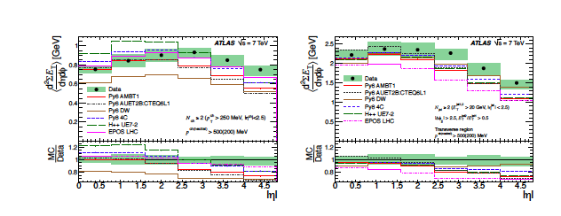
Minimum bias observables (3)
Neutral particles: energy flow
Hard to get right!
Would be nice to have for Etmiss and Cosmic rays……

Slide 35
Color reconnection
Rearrangement of the final state parton connections due to the colour structure of the scattering
Includes modeling of MPI scatters and colour flow in beam-beam remnant
Various models exist, e.g. reorder hadrons to minimise string length or cluster mass
Modifies the relation between <pT> and number of charged particles in hadron collisions
May also affect top mass (one of the dominant uncertainties!)

Slide 36
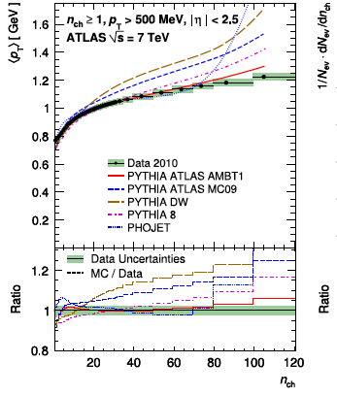
Color reconnection
Observables and model parameters
Parameter examples:
Pythia6: string length
Herwig6: Cluster size

Slide 37
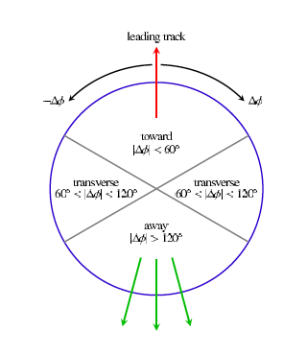
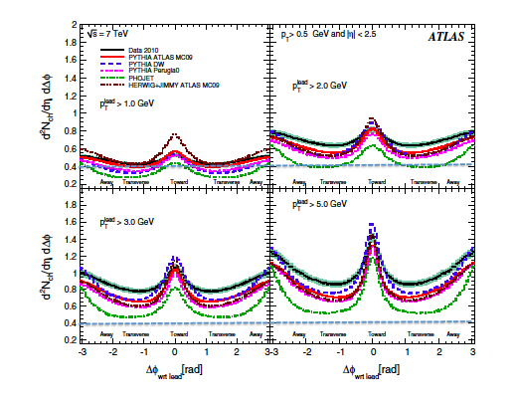
Pedestal effect
Pedestal below
jet
Minimum bias
Charged particle production with respect to the leading track

Slide 38
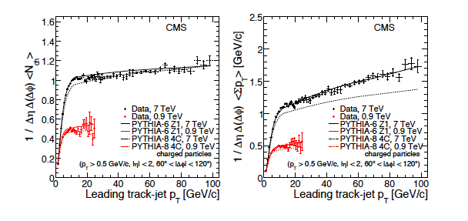
Underlying event observables
Measure charged particle density and energy density
Good description achievable with LHC data at different CMS energies
Tension with Tevatron data

Slide 39
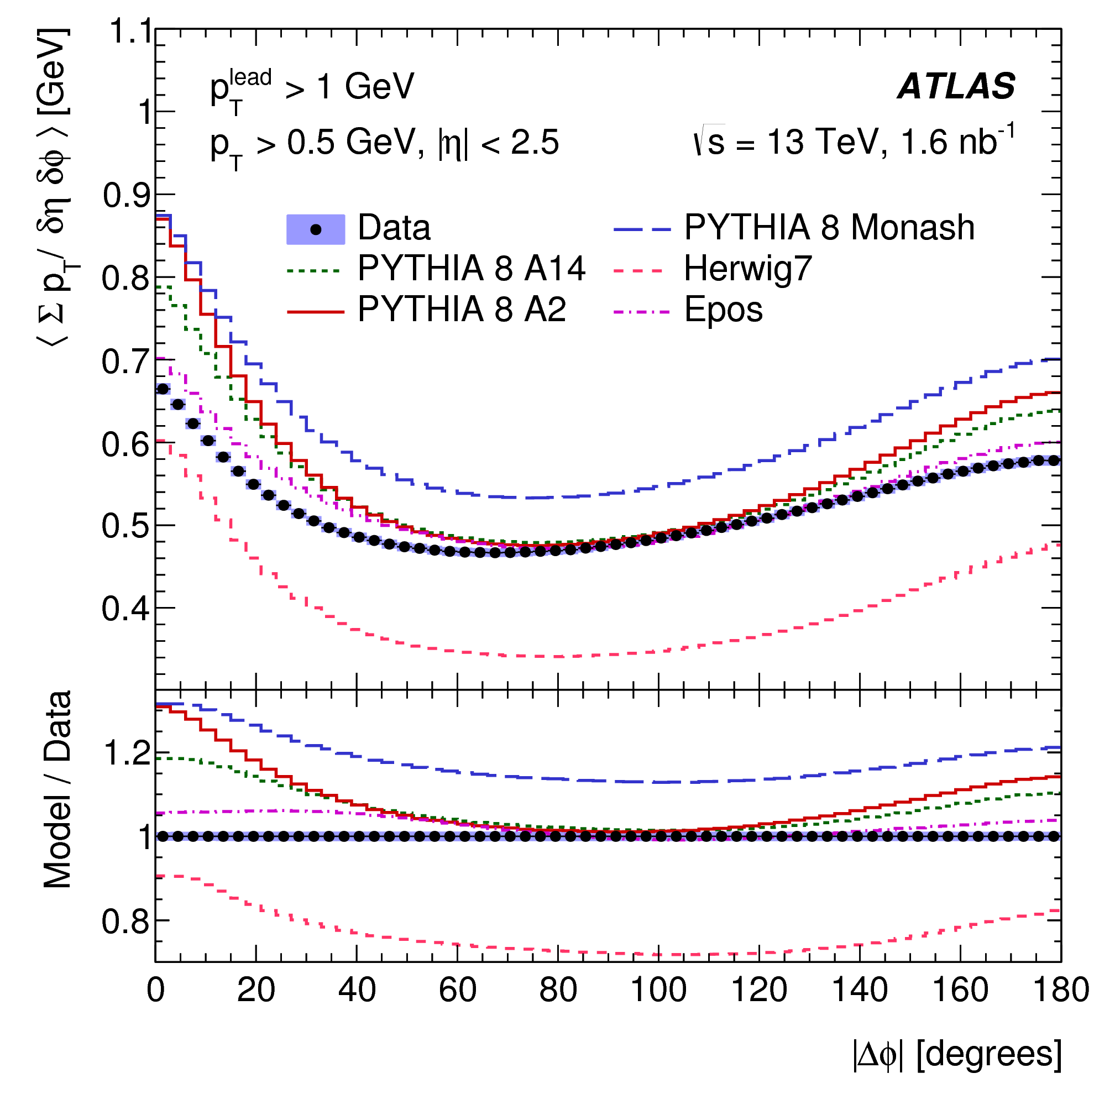
Pedestal effect @ 13 TeV
Minimum bias
0.6
1.2
Data / MC
Pedestal below
jet
Modern generators and tunes still have difficulties to describe this completely

Slide 40
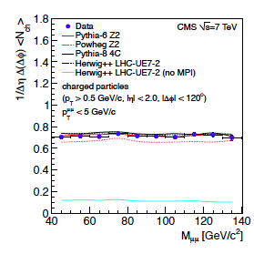
Disentangle ISR and MPI?
Underlying Event in DY
Measure particle production by removing
the 2 muons
No QCD radiation from the (LO) hard process
Ideal case to study MPI!
with MPI
No MPI*
Large amount of particles produced by MPI
*Note: MPI interleaved with Parton Shower in PYTHIA -> kinematics change if MPI is switched off

Slide 41
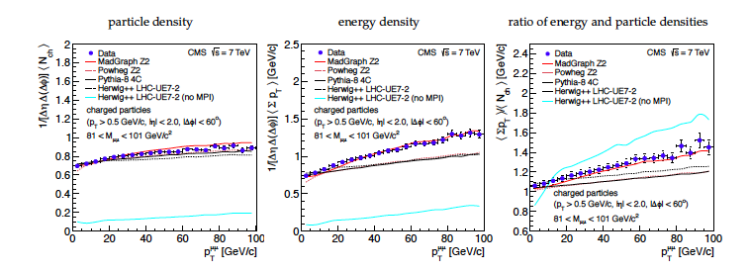
Disentangle ISR and MPI?
UE in DY
~stable particle production
Rise in energy flow
Significant contribution from ISR to UE

Slide 42
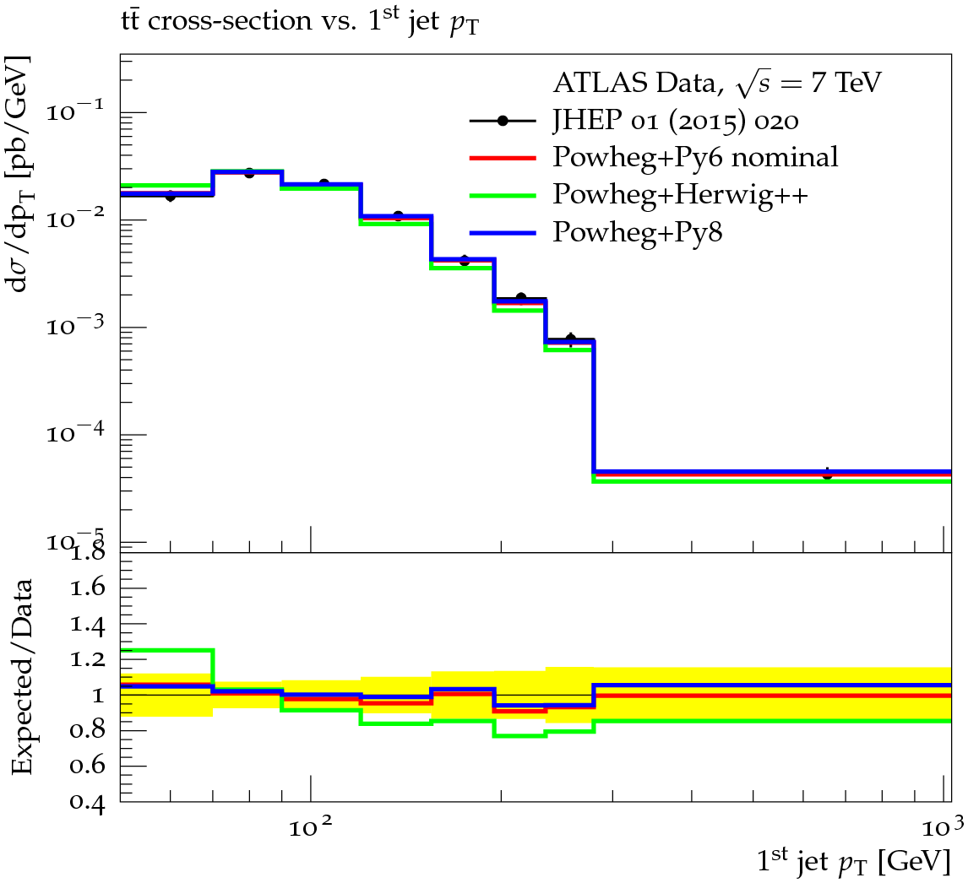
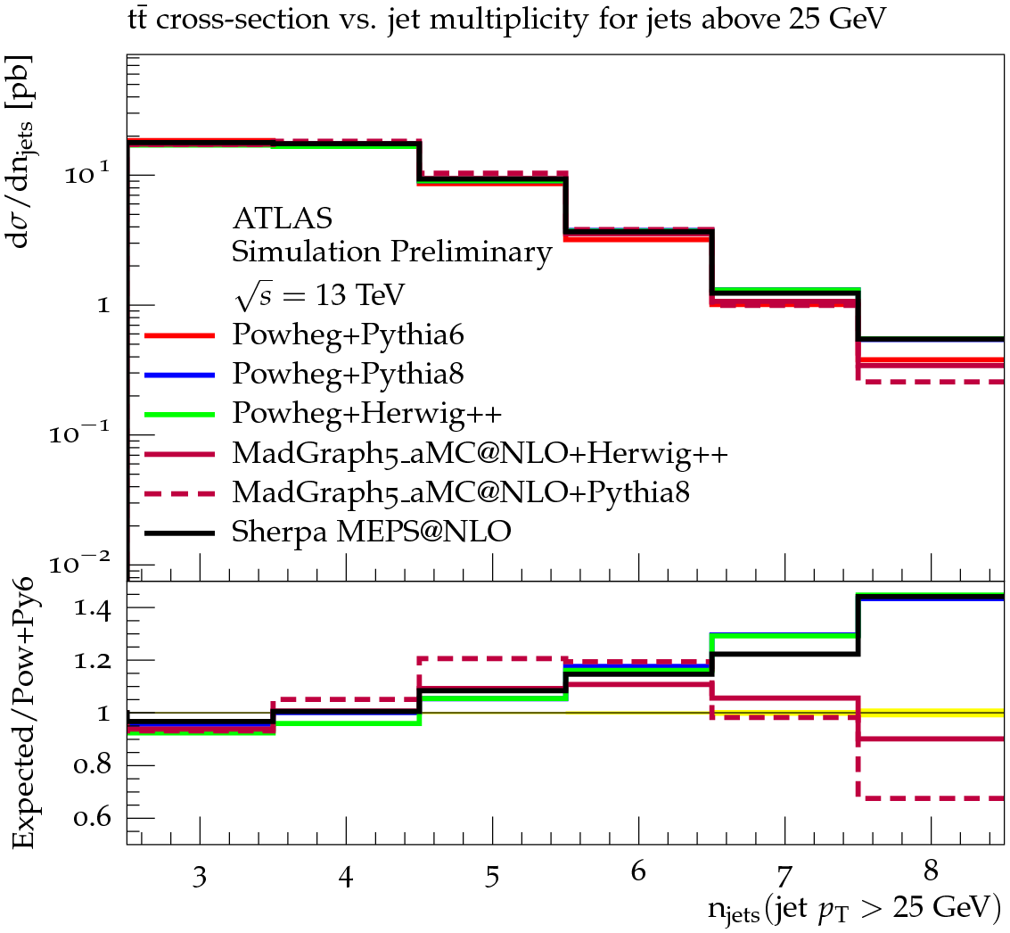
Description of final states at high scales: top pair production
Measure b jets plus decay products of W (single-lepton, di-lepton) and additional QCD radiation
Tune

Slide 43
Simple picture:
MC description of top decay products
Experimental signature b jets plus decay products of W
(single-lepton, di-lepton, all-hadronic)
How to get it from stable particles
in final state?
Top decays before hadronisation*
*Remember: fiducial measurements use stable final state particles!
Intermediate particles (top) are not observable and there is no common agreement what to
Put into the MC event record. Usually, the analyses use the top quark that enters the
decay vertex to W and b for parton level results.

Slide 44
Pseudo-top method
Assumed top decay products:
2 highest p_{t} b-jets, lepton, 2 highest p_{t} jets
Hadronic top:
b-jet,
2 highest p_{t} jets
Leptonic top:
b-jets with lowest dφ(jet,lepton),
lepton, E_{tmiss}
Very good correlation between
reco- and particle level
Some shape differences between particle and parton level

Slide 45
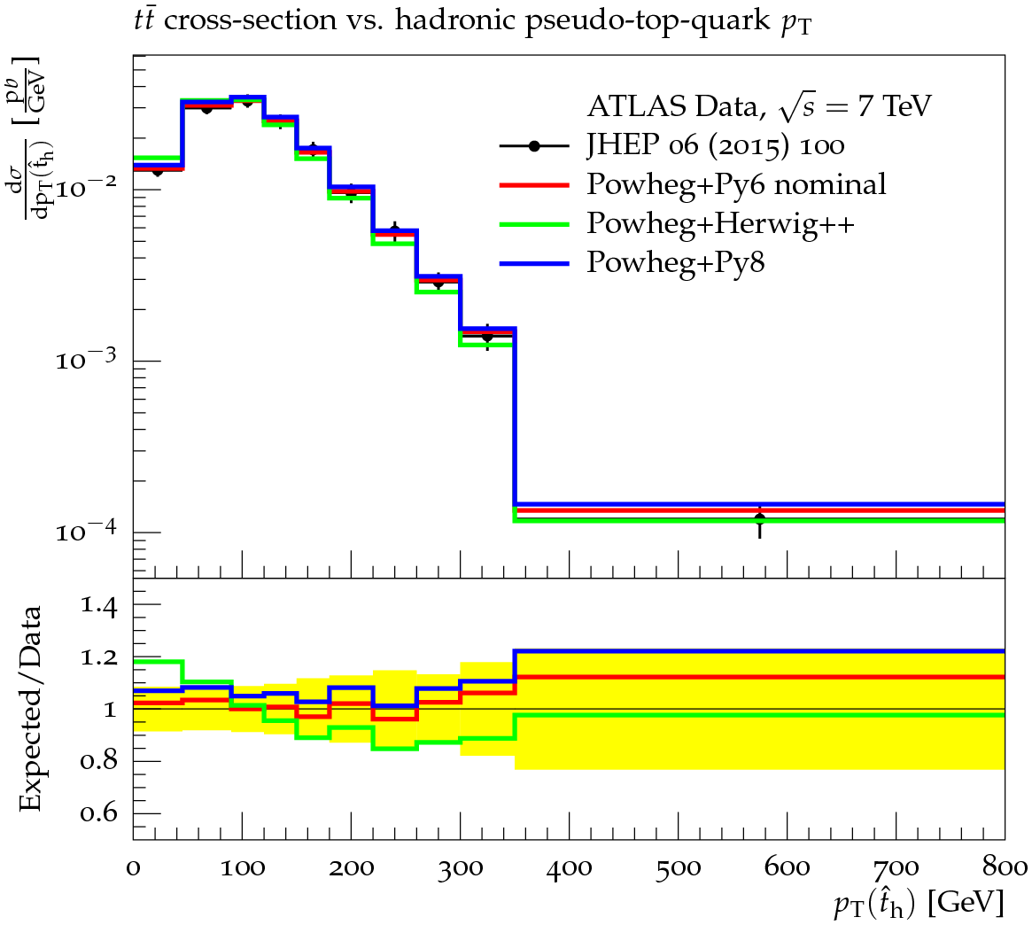
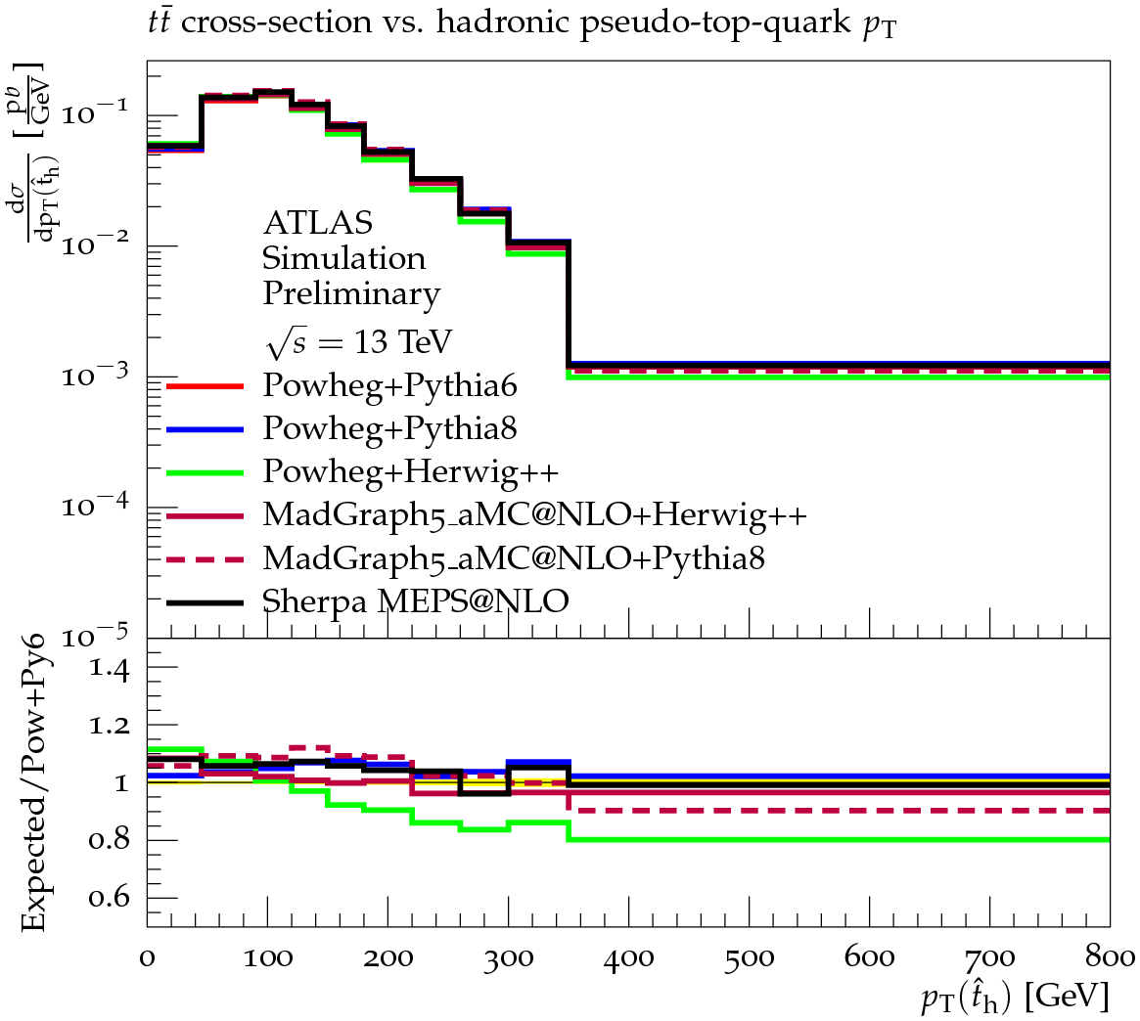
Pseudo top pT at various cms energies
13 TeV
7 TeV
Overall good description by MC
More precise data and larger QCD radiation leads to higher discriminating power of
13 TeV data

Slide 46
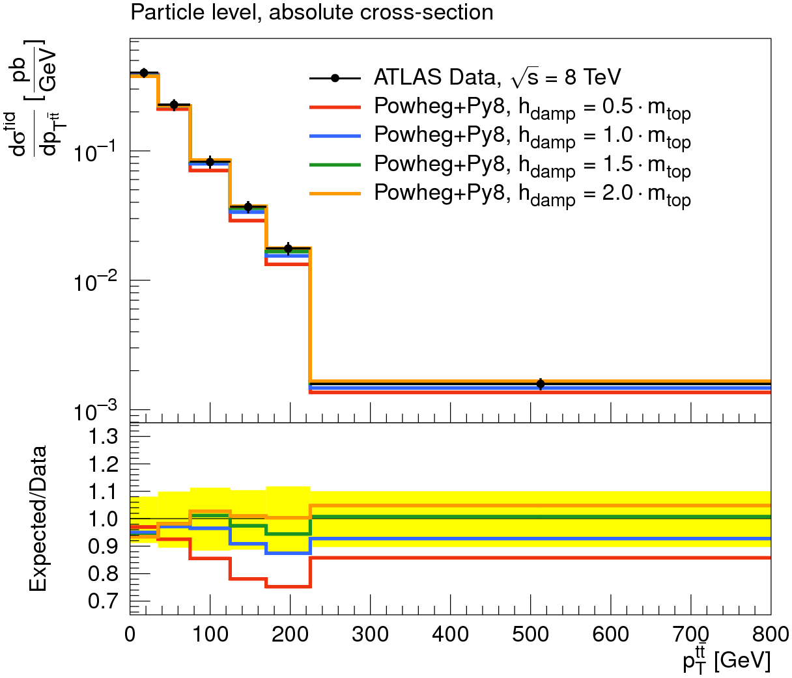
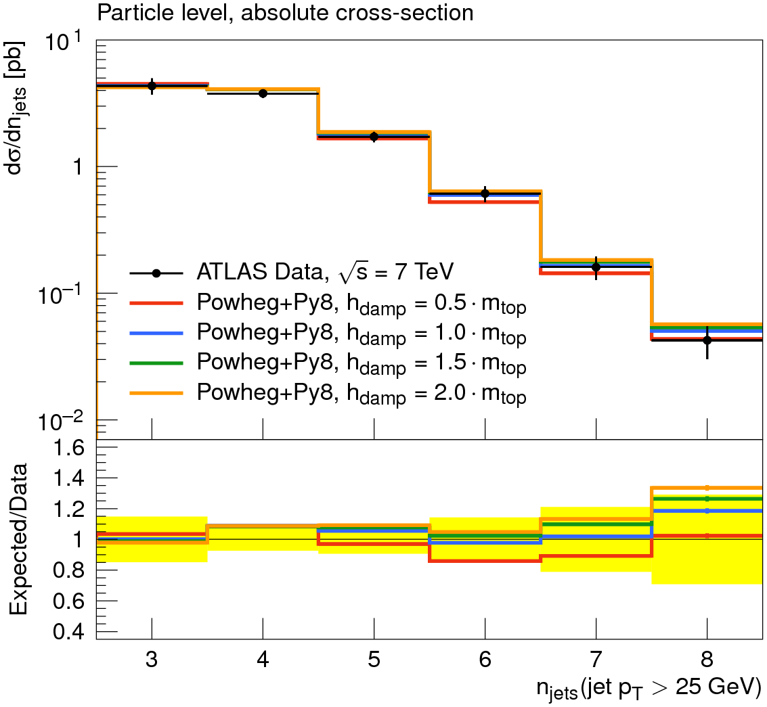
Adjust predictions of PowHeg
POWHEG: NLO ME for top pair, LO ME for first emission, matched to PS
Model parameter to regulate hardness of first radiation (hdamp)
Measurements are sensitive to the setting of this free model parameter
Best description of tt data with hdamp ~ 1.5 m_{top}

Slide 47
Top decay products vs pseudo top
Some of the effects more visible in

Slide 48
Further reading
Overview:
" QCD Monte-Carlo model tunes for the LHC"
Pythia:
"Tuning Monte Carlo Generators: The Perugia Tunes" arXiv:1005.3457
"Tuning PYTHIA 8.1: the Monash 2013 Tune" arXiv:1404.5630
"Energy Scaling of Minimum-Bias Tunes" arXiv:1103.3649
CMS CUET tunes: https://arxiv.org/pdf/1512.00815.pdf
Tuning to multileg generators like alpgen:
"Monte Carlo tuning in the presence of Matching" arXiv:1109.5295
For application to powheg, the following reference introduced the use of vetoed showers:
"Improved Parton Showers at Large Transverse Momenta" arXiv:1003.2384

Slide 49
Summary
Model independence of measurement key issue for tuning
Huge set of (unfolded) data available to adjust free parameters of MC Generators
Precise description of experimental data is essential to perform high precision measurements at LHC

Slide 50

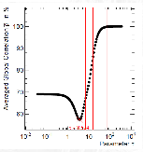
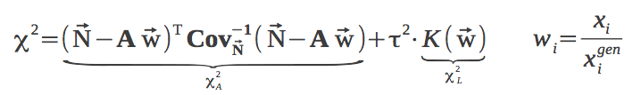
Unfolding
Ill-posed problem: result is not fully constrained
  Matrix A can not be unambiguously inverted
  Data contain no information on structures below detector resolution
  Can lead to drastic fluctuations (and corresponding anti-correlations between neighboring bins
Regularization
  Supplement missing data using assumptions on smoothness of data
  Add penalty term that gets large for large fluctuations
One possible approach:
  Exploit fact that inversion of A is equivalent to minimizing the following expression (where Cov is the covariance matrix)
  Introduce penalty term
  τ is regularization parameter, K(w) is curvature measure
  Choose τ carefully, e.g. by minimizing global correlation
τ

Slide 51
Software & Tools
Rivet (HZTool): analysis libraries for LHC, LEP (HERA) to extract physical observables corresponding to experimental measurements
MCPLOTS (http://mcplots.cern.ch/ ) web-accessible repository of theoretical predictions from various MC generators for experimental data
Professor (Proffit): tuning tool using analytical approximations interfaced to Rivet
MC Generator
Measurments
HepMC events
HepData tables
Rivet
(HZTools)

Slide 52

Simplest case: Bin-by-bin unfolding
correct measured
Distribution back to
Parton level distribution
(unfolding)
  apply efficiency separately in each bin
Features
  simple, fast, robust, statistical errors are well defined sqrt(N), biases included in systematics
  need good description of data, result does not include correlations

Slide 53



Differential Cross Section Measurement
Measure number of events in many intervals
Correct for efficiency, acceptance and resolution effects
Measure bin-averaged cross section in each bins i
  Identify bin-averaged cross section with differential cross section.
  Often use theory to perform bin-center correction, e.g. quote measurement at point in x where
Choice of bins
  make sure there are enough entries in each bin (minimize statistical errors)
  make sure there are enough bins (measure shape of distribution)
  make sure the bin size is large enough w.r.t experimental resolution, i.e. the purity is large
where is the width of bin i

Slide 54
Photons: photons used for final state definitions and for the definition of leptons (electron & muon) should not be from hadron decays. These removes the dependency on the underlying event.
Electron: define 4-momentum from photons and electron within an anti-k_{t} R=0.1, where leptons (electron & muons) are considered for jet clustering. No isolation condition is imposed. In order to choose prompt leptons from W/Z decay in a way safe for all generators currently under consideration, the parent of the electron is required not to be a hadron or quark (u-b). (Expect that future sanitisation of generator record will remove the need for the quark requirement.)
Muon: define 4-momentum from photons and muon within an anti-k_{t} R=0.1, where leptons (electron & muons) and photons are considered for jet clustering. No isolation condition is imposed. In order to choose prompt leptons from W/Z decay in a way safe for all generators currently under consideration, the parent of the muon is required not to be a hadron or quark (u-b). (Expect that future sanitisation of generator record will remove the need for the quark requirement.)
ETmiss/Neutrinos: As an event level variable the missing transverse energy is calculated as the 4-vector sum of neutrinos from W/Z-­boson decays. Tau decays are included. A neutrino is treated as a detectable particle and is selected for consideration in the same way as electrons or muons, i.e. the parent is required not to be a hadron or quark (u-b). (Expect that future sanitisation of generator record will remove the need for the quark requirement.)
Jets: define with anti-k_{t} algorithm. Loop over all stable particles excluding the electrons, muons, neutrinos, and photons used in the definition of the selected leptons. This includes non-prompt muons and neutrinos for a proper b-jet energy scale. Use specific R parameter chosen by experiment: R=0.4 for ATLAS and R=0.5 for CMS.
b-jets: A jet is a b-jet if any rescaled B-hadron is included in the jet. A rescaled B-hadron is treated as a stable B-hadron (that does not oscillate or decay to another B-hadron) for which the 4-momentum is scaled down by to the limit of floating point precision and added to the list of particles for jet-clustering as described above. Only B-hadrons with an initial p_{T} > 5 GeV are considered. This prescription provides an unambiguous way to associate a single jet with a B-hadron.

Slide 55
AZ Tune to ISR observables
q q -> Z -> e e
Zpt and phi*
Intrinsic kt:
kT of partons inside incoming protons
Fermi motion ~200 MeV
“sum of unresovled effect below shower cut-off”
ISR Q_0 cut-off
Alpha_s

Slide 56
Tuning of hardest allowed emission in
ME-PS matching
Top pair p_{T} highly sensitive to QCD radiation

Slide 57
Top decay products vs pseudo top
Fiducial phase space:
>=1 b-jet, 1 lepton, >=3 jets,
1st jet p_{t}>50 GeV, 2nd jet p_{t}>35 GeV
Fiducial phase space:
2 b-jets, 1 lepton, >=4 jets
Consistent data – mc description between the observables

