Slide 1
The MP and FE analysis for low β SRF cavity of China ADS demo facility
业
答
辩
Cong Zhang，Hao Guo，Weiming Yue，Chunlong Li
Shengxue Zhang，Pingran Xiong, Andong Wu
Tiancai Jiang, Shichun Huang, Teng Tan, Shenghu Zhang, Yuan HE
TTC Meetting - June 26– 29, RIKEN, Japan

Slide 2
Outlines
Introduction of China ADS demo facility
1
MP analysis of HWR cavities
2
Field Emission analysis of HWR cavities
3
Summary
4

Slide 3
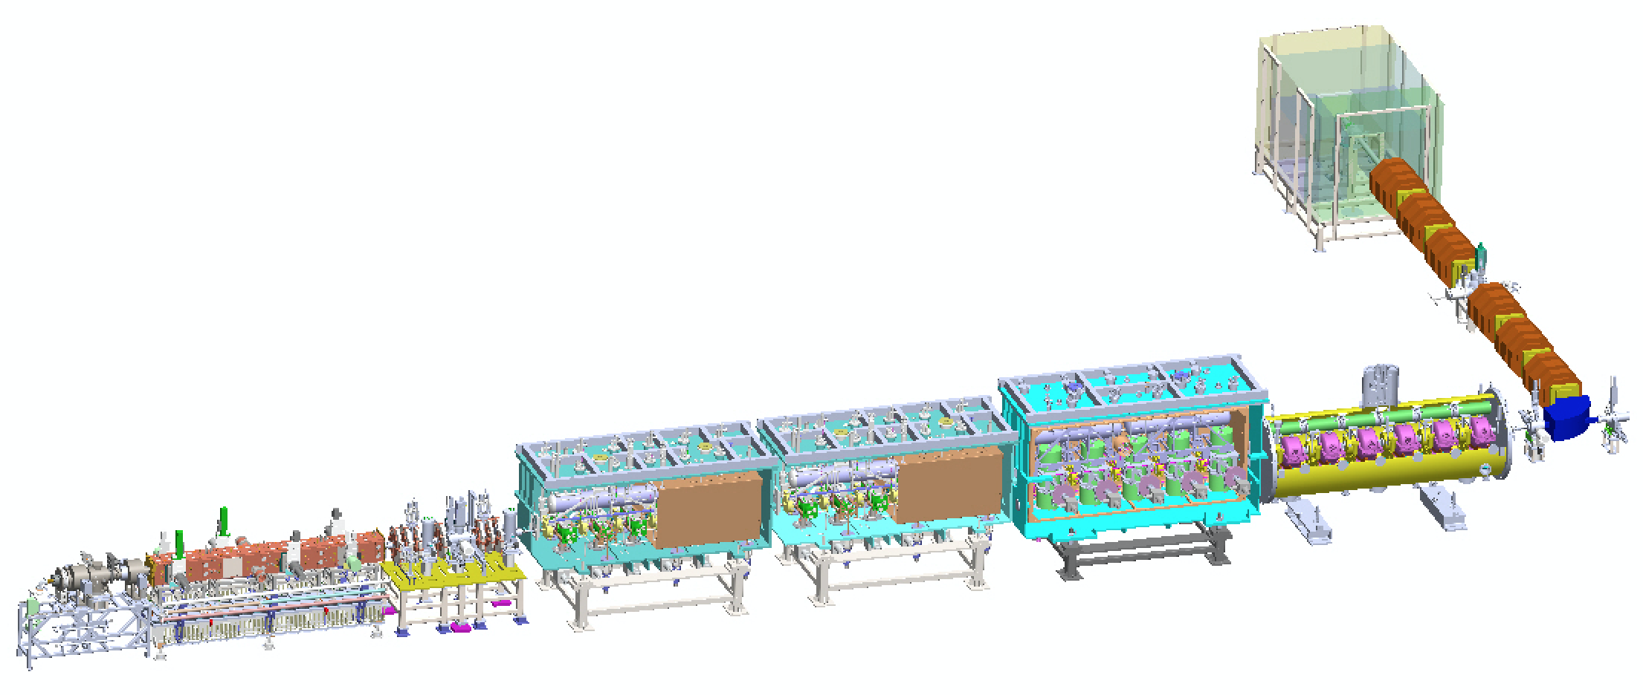
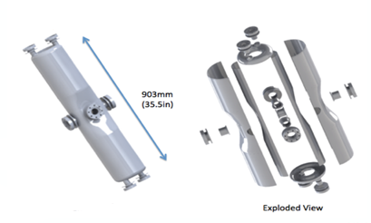
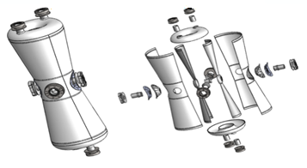
China ADS Demo Facility
162.5 MHz, β=0.10 HWR (IMP)
162.5 MHz, β=0.15 HWR (IMP)
DUMP
HEBT
Chronicle of Events for SRF in IMP
Commission Stage | First Beam | First CW Beam | E Max (MeV) | Beam time (hours) | CW beam time (hours) | Pulse Current Max (mA) | CW Current Max (mA) | CW Power Max (kW)
TCM1 | Sep. 29, 14 | Nov. 24, 14 | 2.55 | 208 | 22.5 | 11 | 11 | 28
TCM6 | Jun. 06, 15 | Jun. 24, 15 | 5.30 | 438 | 11 | 10 | 4 | 21
Injector II | Sep. 09, 16 | Sep. 24, 16 | 10.2 | 735 | 30 | 10.6 | 2.7 | 26
Demo front-end Linac | May 23, 16 | Jun. 06, 17 | 26.2 | 355 | 27 | 12.6 | 0.3 | 5.4

Slide 4
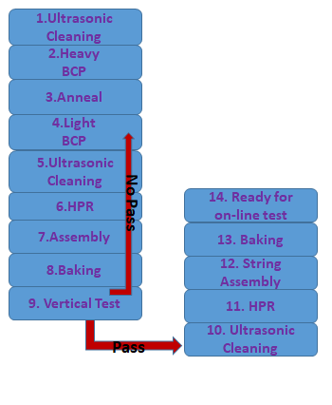
HWR Cavities in IMP
HWR cavities designed by IMP and fabricated in HIT and OTI .
f=162.5MHz, β=0.10 HWR
f=162.5MHz, β=0.15 HWR
Cavity material of RRR>250 by OTI
Cavity fabricated according to the
IMP quality control process
Cavity Treatment Scheme:
f (MHz) | 162.5
β_{opt} | 0.10
Epeak / Eacc | 5.9
Bpeak / Eacc (mT/(MV/m)) | 12.1
G = Rs×Q0 (Ω) | 28.4
R / Q0 (Ω) | 153
f (MHz) | 162.5
β_{opt} | 0.15
Epeak / Eacc | 4.8
Bpeak / Eacc (mT/(MV/m)) | 6.1
G = Rs×Q0 (Ω) | 51
R / Q0 (Ω) | 292

Slide 5
2. MP analysis of HWR cavities

Slide 6
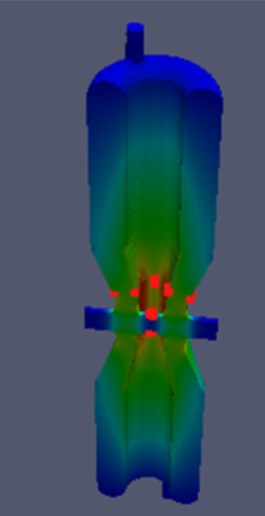
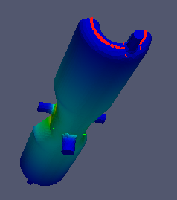
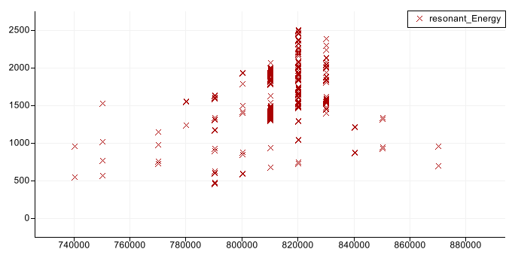
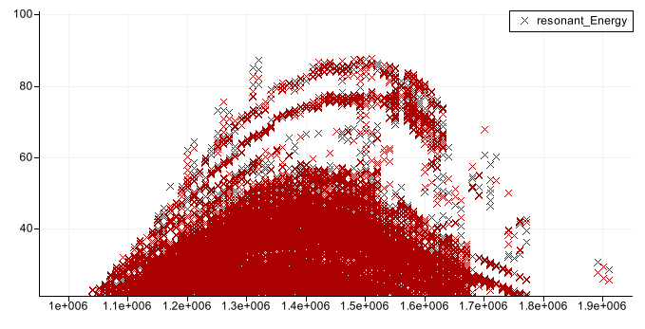
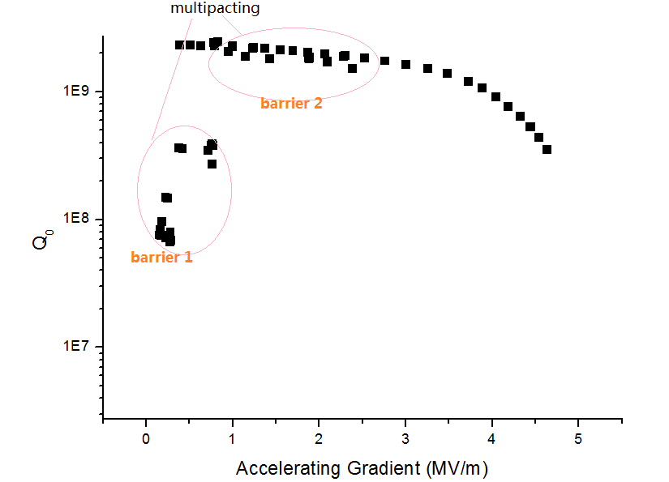
MP analysis for HWR-0.10
CUBIT and parallel codes Omega3P and Track3P developed at SLAC under the support of the DOE SciDAC program, have been used to calculate the electromagnetic field distribution and to localize the MP bands on the NERSC Franklin machine.
MP around Eacc of 0.7~0.8 MV/m@ middle part of HWR-0.10 with resonant energy of 400~2500 eV.
MP around Eacc of 1.0~1.9 MV/m@ shorting plate of HWR-0.10 with resonant energy of <100 eV.
HWR-010 (helium vessel） | Occurrence of MP |  | Target reached |  | Cryomodule
# | Yes | No | Yes | No | CM1 | CM2
002 | √ |  |  | √
003 | √ |  | √ |  | √
004 | √ |  | √ |  | √
006 | √ |  | √ |  | √
007 | √ |  | √ |  | √
008 | √ |  | √ |  | √
009 | √ |  | √ |  |  | √
010 | √ |  | √ |  |  | √
011 | √ |  | √ |  |  | √
012 | √ |  | √ |  |  | √
013 | √ |  | √ |  |  | √
014 | √ |  | √
015 | √ |  | √
016 | √ |  | √
017 | √ |  | √
018 | √ |  | √ |  | √
019 | √ |  | √ |  |  | √
020 | √ |  | √
021 | √ |  | √
Typical vertical test data Q₀ vs. E_{acc} with MP, with hard barrier in low field and soft barrier in medium field.
All HWR-0.10 cavities were troubled by MP in VT.

Slide 7
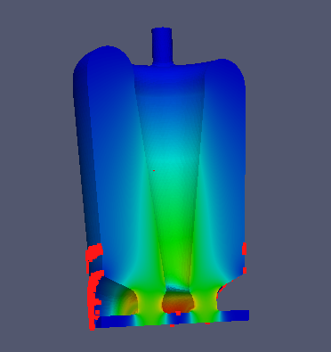
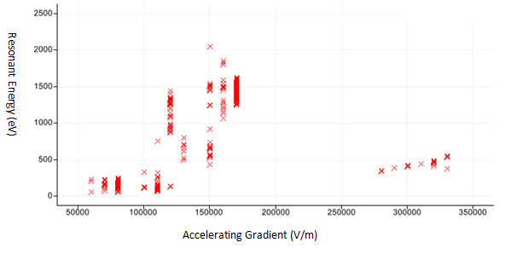
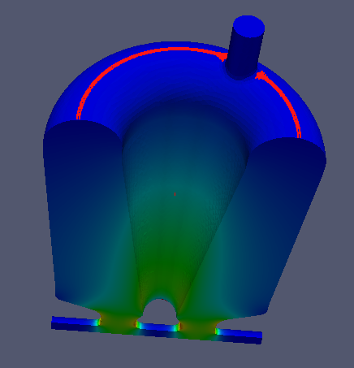
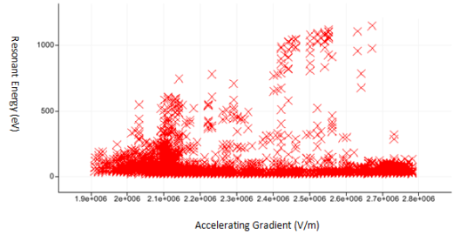
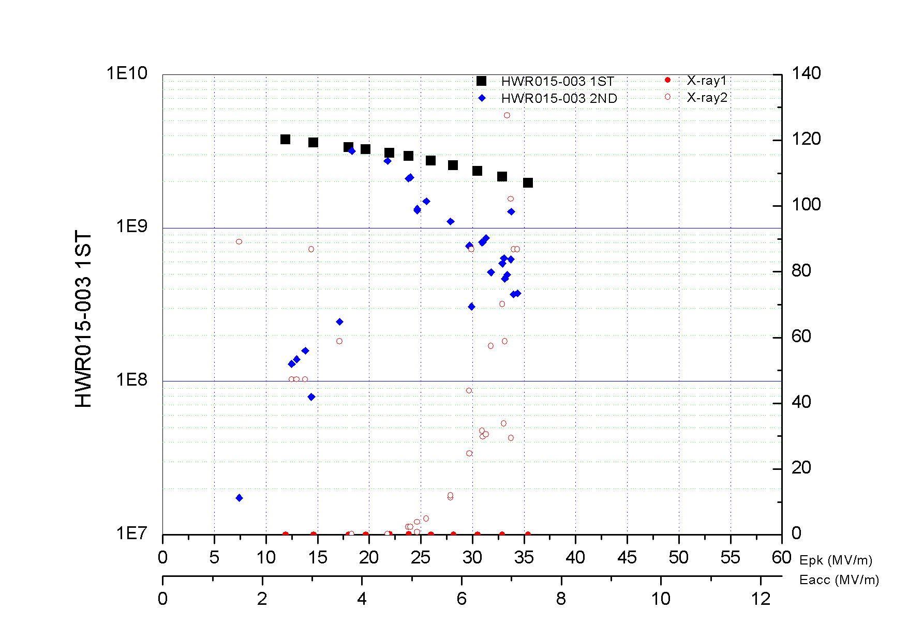
MP analysis for HWR-0.15
MP around Eacc of 0.06~0.34 MV/m@ middle part of HWR-0.15 with Resonant energy of 50~2100 eV.
MP around Eacc of 1.9~2.8 MV/m@ shorting plate of HWR-0.15 with resonant energy of 40~1100 eV.
HWR-015 （helium vessel） | Occurrence of MP |  | Target reached |  | Cryomodule
# | Yes | No | Yes | No | CM3
001 |  | √ |  | √ | √
002 |  | √ | √
003 | √ |  | √ |  | √
004 |  | √ | √ |  | √
005 |  | √ | √ |  | √
006 |  | √ | √ |  | √
007 |  | √ | √
008 |  | √ | √
009 |  | √ | √
010 |  | √ | √
011 |  | √ | √
Only 1/11 HWR-0.15 cavity was encountered by obvious MP in VT.
The vertical test data Q₀ vs. E_{acc} with MP in #3 HWR-0.15
after the helium vessel welded (due to the seal problem)

Slide 8
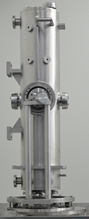
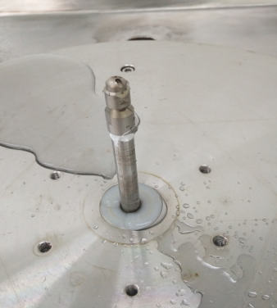
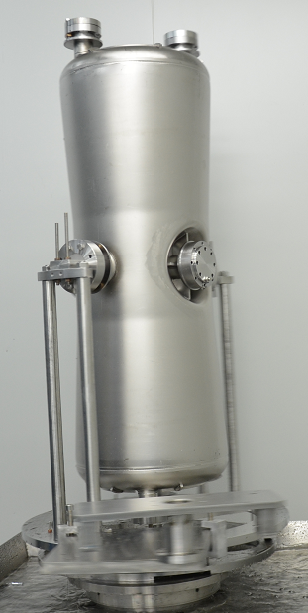
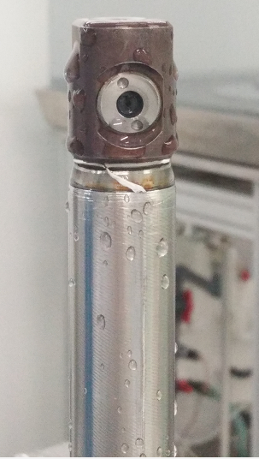
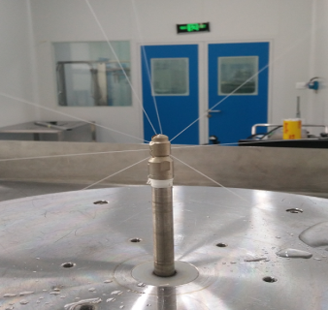
Why MP seems more serious in HWR-0.10?
From the simulation data, the first MP barrier in HWR-0.15 at very low field, so usually be
surmounted.
HWR-0.15 cavity with larger inner space and larger clean port, so a more powerful HPR
system used.
Nozzle for HWR-0.10
Nozzle for HWR-0.15
Cylinder-shaped water column
Fan-shaped water column
HPR for HWR-0.10:
Water supply 5 litre/min
HPR for HWR-0.15:
Water supply 20 litre/min
In general, with our experience in HWR-0.10 and HWR-0.15, the MP is not a limiting factor
to high Q0 and high gradient for both VT and on-line operation, it’ s can be conditioned.

Slide 9
3. Field Emission analysis of HWR cavities

Slide 10
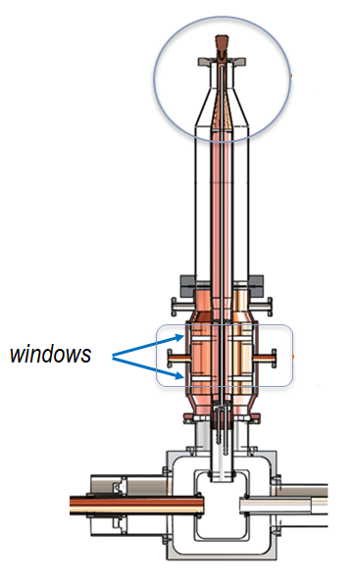
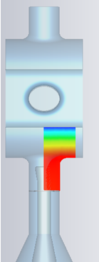
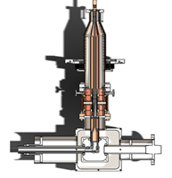
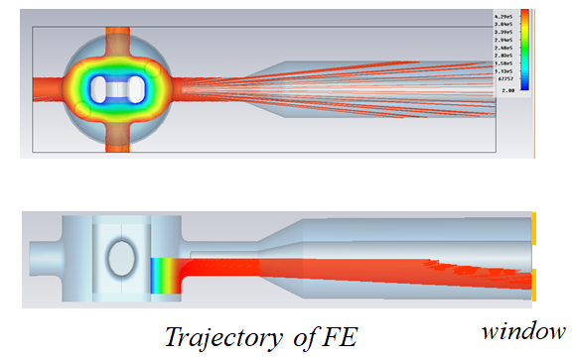
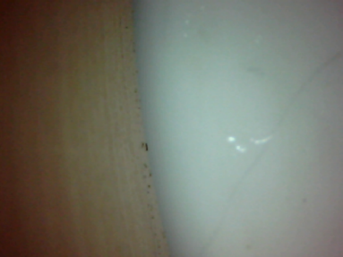
Things Happened in CM1~CM2
2016/5/8: bypass of vacuum interlock, CM1-1, CM1-3,CM1-4,CM2-2,CM2-5 coupler
window leakage
2016/5/24: dose monitor
2016/6~2016/9: mechanical stability test (df/dP, LFD, etc)
2016/9: 5 leaked couplers replaced with dual warm window on string
2016/9~2017/1: helium processing
2017/1: 4 other couplers of CM2 replaced with dual warm window on string, and CM2
replaced CM1, new CM2 of improved assembly process with 6 dual warm
window
single window coupler
crack of ceramic
dual warm window
electron trajectory

Slide 11
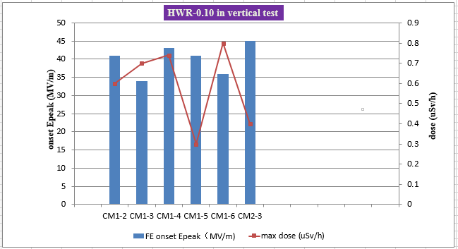
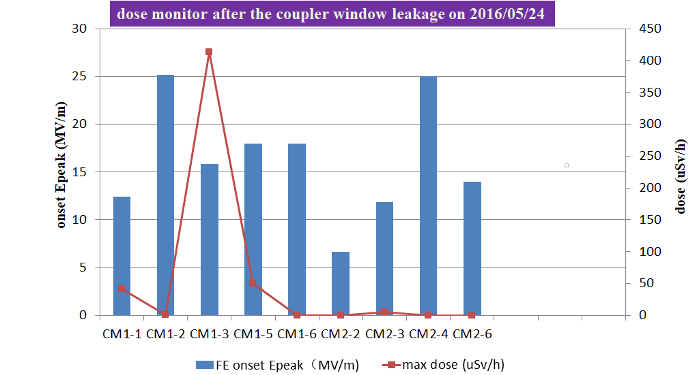
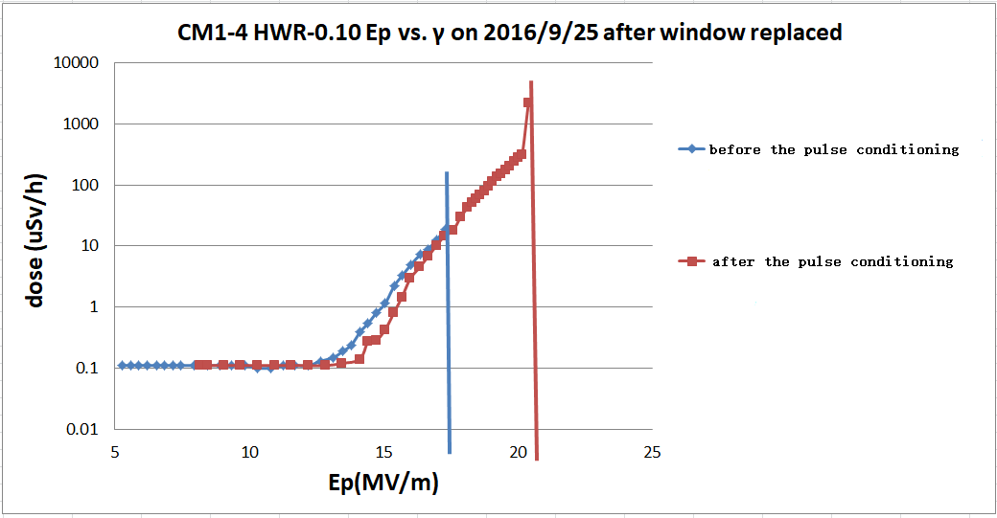
FE Test in CM1~CM2
For HWR-0.10, thermal quench is the main factor of Q drop
Field emission problems for HWR-0.10 on string are much more serious than in vertical test due to the leakage and coupler replacement on line
Pulse conditioning seems no obvious effect in improving the FE problem
Helium processing not always effective to increase the onset Epeak

Slide 12
Things Happened in CM3
The vacuum leakage problem leads to many times of reassembly.
Number of Assembly/Time | Leakage point/Max Leakage Rate
1. (2017.1.20) | CM3-3, CM3-4, CM3-5 coupler window/4E-8mbarL/s
2. (2017.1.21) | CM3-3, CM3-4, CM3-5 coupler window/3.5E-8mbarL/s
3. (2017.1.22) | CM3-3, CM3-4, CM3-5 coupler window/5.5E-8mbarL/s
4. (2017.1.24) | CM3-3, CM3-4, CM3-5 coupler window/1.1E-7mbarL/s
5. (2017.1.25) | CM3-4, CM3-5 coupler window/3.5E-8mbarL/s
6. (2017.2.4) | CM3-3 coupler window/ Leakage rate too serious to be measured
7. (2017.2.8) | CM3-3, CM3-4, CM3-5 coupler window /5.6E-8mbarL/s
8. (2017.2.10) | CM3-4, CM3-5 coupler window/2.1E-7mbarL/s
9. (2017.2.13) | CM3-4, CM3-5 coupler window/5.5E-8mbarL/s
10. (2017.2.16) | CM3-3, CM3-4, CM3-5 coupler window/8.3E-8mbarL/s
11. (2017.2.18) | CM3-3, CM3-4 coupler window/3.7E-9mbarL/s (newly treated CM3-5 cavity)
*Test data from the assembly people of Hao Guo, Pingran Xiong, Yukun Song and Zhixiong Shi.
Lessons Learned:
The DN60 coupler flange in HWR-0.15 causes sealing problem due to the screw holes’ distribution and inappropriate design of Al-Mg alloy ring
The on-line leakage rate requirements for HWR-0.15 cryomodule can be lowered to E-7 mbarL/s

Slide 13
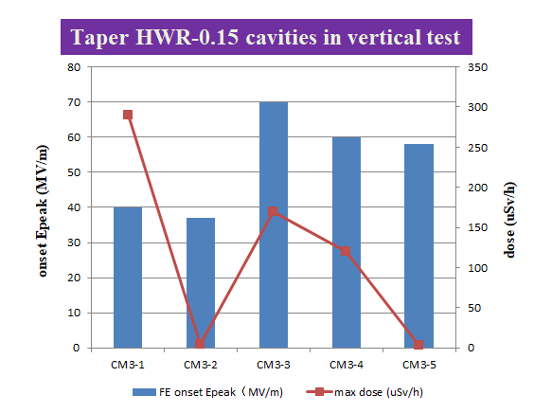
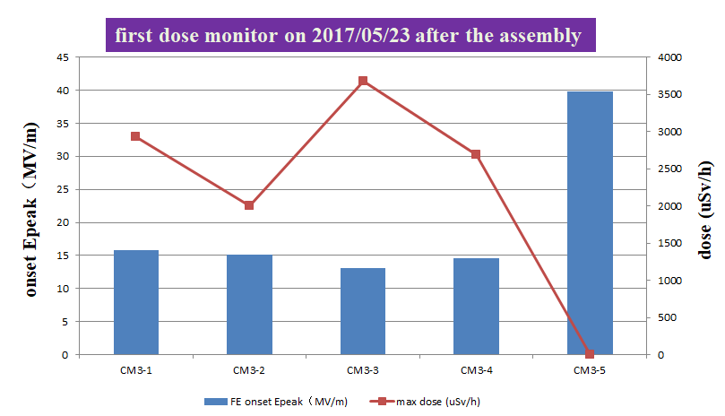
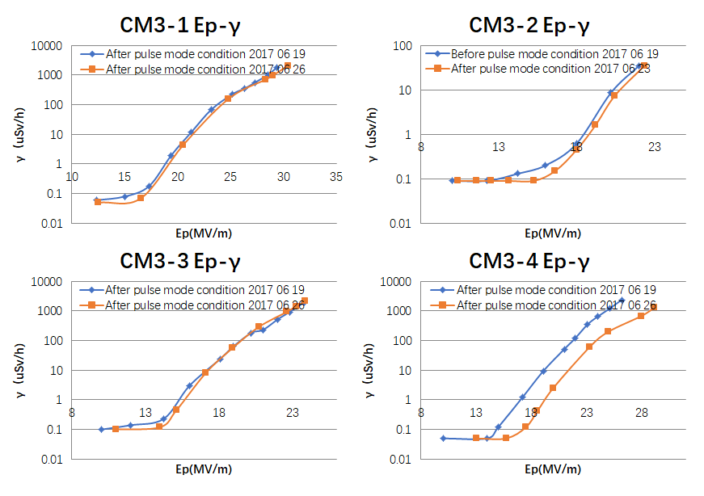
FE Test of CM3 Cavities
After the 11th reassembly
Pulse mode conditioning setting:
RF on/off: 10ms/1s
P_{f}~3.8 kW, E_{peak}~35 MV/m
Q_{ext}: 8.5E5
Fill time: 1.6ms
For HWR-0.15 in VT, FE is main factor of Q drop.
Field emission problems for HWR-0.15 on string are
much more serious than in vertical test.
Multiple reassembly, especially the serious leakage after the 6th reassembly, times of charging and discharging cause the particle migration along the whole string.
The CM3-5 HWR-0.15 cavity is new in the last assembly, so it’s not contaminated and not happen serious FE.
The current pulse mode conditioning method not
effective to depress FE of taper-shaped HWR-0.15.

Slide 14
Summary
MP is not a fatal restriction to high accelerating gradient for HWR
cavities, no hard MP barrier that cannot be conditioned found.
MP simulation code can predict the MP barriers quite precisely.
FE is still a major performance limitation to stable operation and
higher accelerating gradient in our HWR cavities.
The vacuum leakage caused by a variety of reasons seems like the main trigger mechanism.
Pulse RF conditioning and helium processing are of certain limitations to reduce FE, new
methods should be explored.

Slide 15
Acknowledgement
The author would like to thank the Advanced Computations Department of SLAC for providing ACE3P code suite and computing resources in 2012 and 2013.

Slide 16
Thank you for your attention!

