Slide 1

Issues of the prototyping of QWRs and HWRs at RISP
Juwan Kim
Accelerating System team,
Rare Isotope Science Project(RISP)

Slide 2
Outline
  Issues at RISP
  Infrastructure upgrades at RISP
  QWR prototype test results
  HWR prototype test results
  Summary

Slide 3
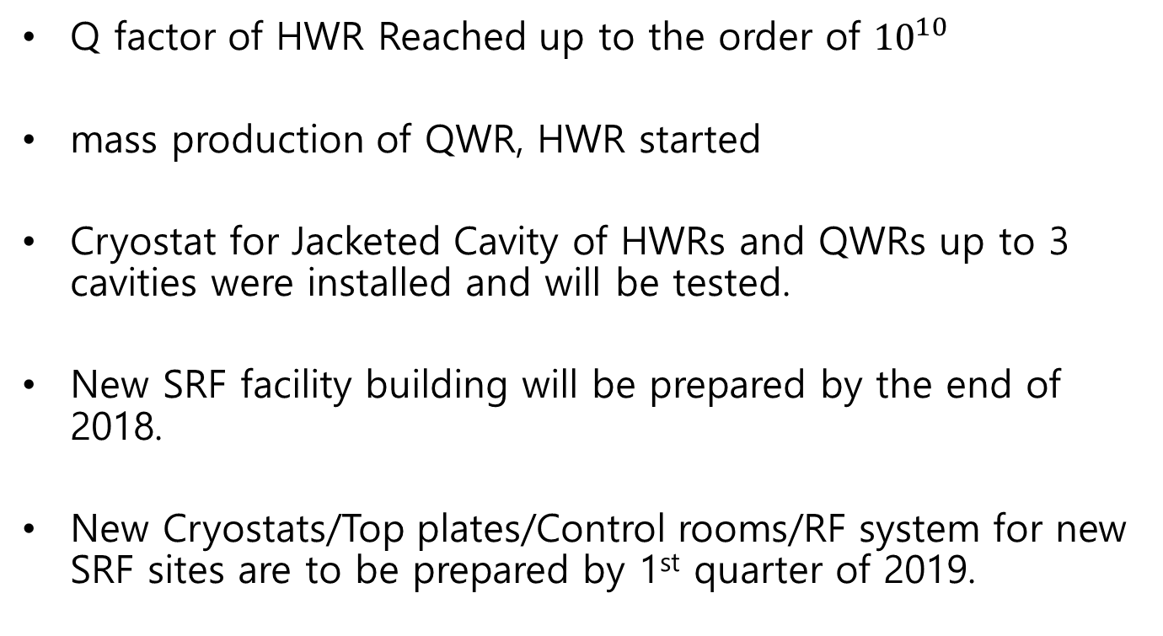
Issues at RISP
Q factor of HWR Reached up to the order of ${10}^{10}$
mass production of QWR, HWR started
Cryostat for Jacketed Cavity of HWRs and QWRs up to 3 cavities were installed and will be tested.
New SRF facility building will be prepared by the end of 2018.
New Cryostats/Top plates/Control rooms/RF system for new SRF sites are to be prepared by 1st quarter of 2019.

Slide 4
SRF Test Infrastructure at RISP
Horizontal Test facility(Munji campus, KAIST)
  in operation
Clean room (Munji campus, KAIST)
  BCP
  High Pressure Rinse
  Vacuum furnace in Operation for hydrogen degassing
  Venting, Pumping down process upgrade using Mass Flow Controller.
Vertical test Bench (Munji campus, KAIST)
  Cryostat for Jacket only were installed and under test
Main SRF Test Facility building will be constructed by the end of 2018
  Hor Test Bunker 3ea
  Cleanroom
  Vertical Test pit 3ea for cryostat
  Cryoplant,

Slide 5
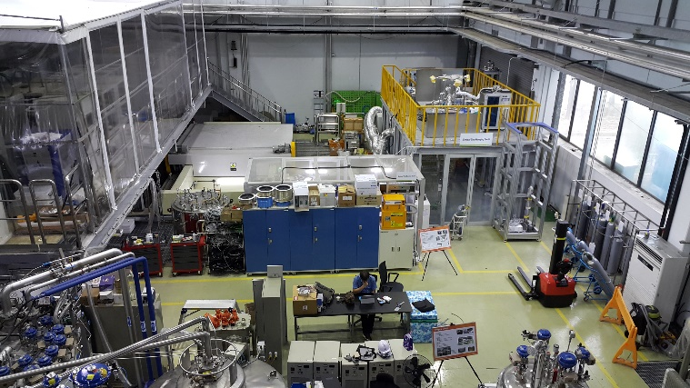
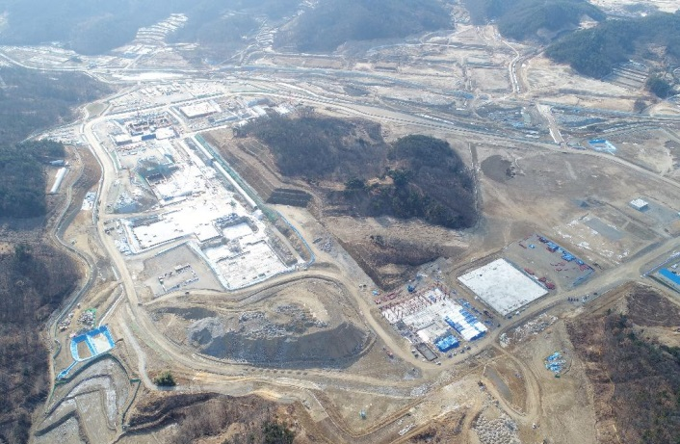
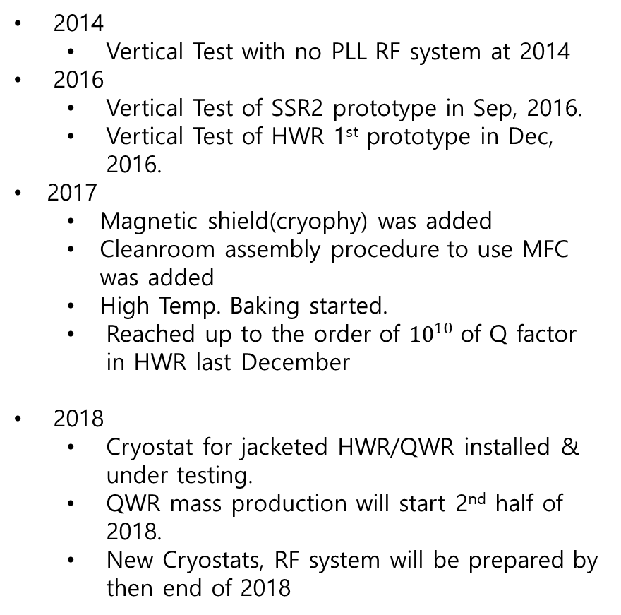
Brief history
2014
  Vertical Test with no PLL RF system at 2014
2016
  Vertical Test of SSR2 prototype in Sep, 2016.
  Vertical Test of HWR 1st prototype in Dec, 2016.
2017
  Magnetic shield(cryophy) was added
  Cleanroom assembly procedure to use MFC was added
  High Temp. Baking started.
  Reached up to the order of ${10}^{10}$of Q factor in HWR last December
2018
  Cryostat for jacketed HWR/QWR installed & under testing.
  QWR mass production will start 2nd half of 2018.
  New Cryostats, RF system will be prepared by then end of 2018
1st SRF test facility :
KAIST Munji Campus
2nd SRF test facility: Sindong LINAC site
in progress

Slide 6
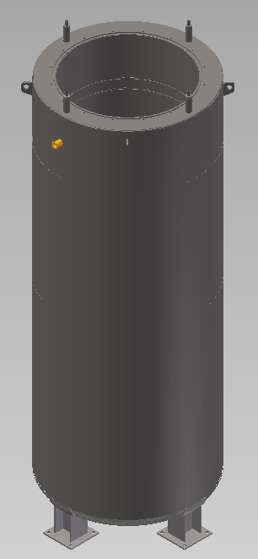
Vertical Test Facility
Cryostat
Cryostat 1
  900mm(ID)x2860mm(H)
  For HWR or QWR 2 cavities
  Static Heat loss ~ 8 W
  Magnetic shield
    Mumetal 1600mm(D)x3300mm(H)
    Cryophy 900mm(D)x2860mm(H)
    <15mG in cavity position
Cryostat 2 ( under test )
  Only for Dressed cavity
  1200mm(ID)x3600mm(H)
  HWR or QWR : up to 3 cavities
  or SSR up to 2 cavities
  Static Heat Load < 10W(goal)
  Magnetic shield(goal)
    Mumetal 1600mm(D)x3300mm(H)
    Cryophy 900mm(D)x2860mm(H)
    <15mG in cavity position
  900mm(ID)x2860mm(H)
  1200mm(ID)x3600mm(H)

Slide 7
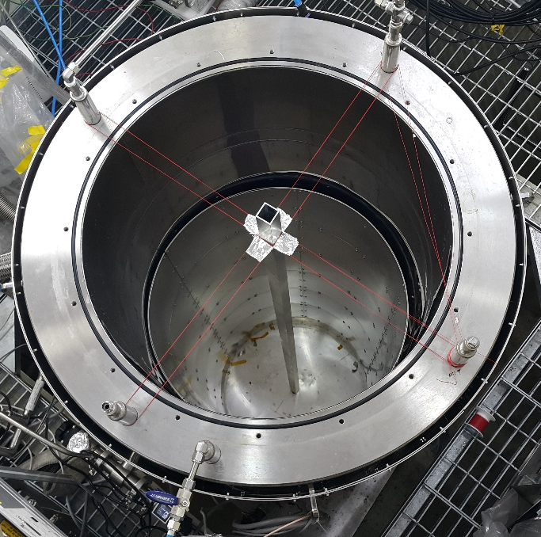
Vertical Test Facility
Magnetic Shield Performance in Room Temp.
: Mumetal (Outer side) + Cryophy(Inner side) + Cryophy(Top Plate)
Cavity Position
Inner Shield
Outer Shield
Strong ambient magnetic field measured over 1000mG inside the pit
Resolved through adding the inner magnetic shield in the cryostat

Slide 8
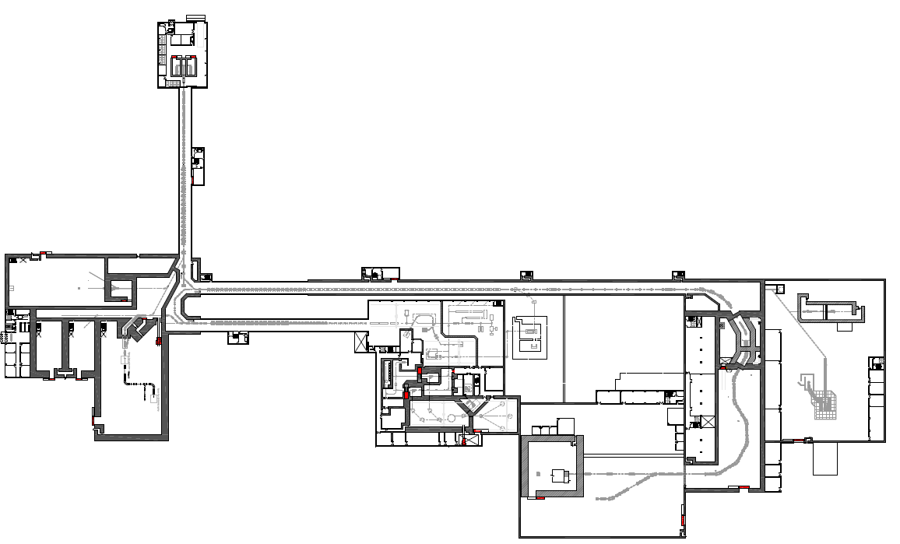
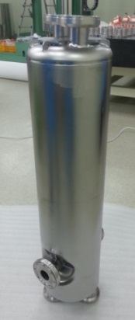
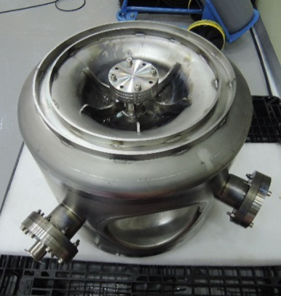
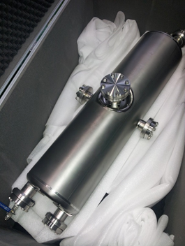
RISP Cavities for Driver Linac
QWR : 22
Module: 22
SSR1 : 71
Module : 24
SSR2 : 144
Module : 25
SCL1
SCL2
SCL3
HWR : 106
Module : 34
Notes:
The greatest achievement is setting up the prototyping for accelerator systems. I’m going to describe CM, cavity, ECR and RFQ.
I’d like to show you status of prototype accelerator systems.

Slide 9
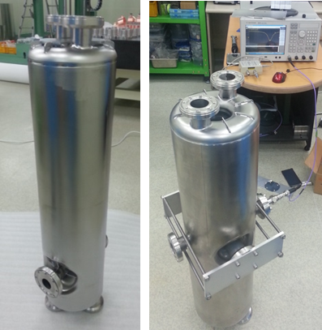
Superconducting Cavity Specification
Parameters | Unit | QWR | HWR
β_{g} | - | 0.047 | 0.12
F | MHz | 81.25 | 162.5
Aperture | mm | 40 | 40
QR_{s} | Ohm | 22 | 42
R/Q | Ohm | 468 | 310
V_{acc} | MV | 1.1 | 1.5
E_{acc} | MV/m | 6.1 | 6.6
E_{peak}/E_{acc} |  | 5.3 | 5.5
B_{peak}/E_{acc} |  | 9.5 | 8.1
Q_{calc}/10⁹ | - | >0.24 | >2
Temp. | K | 4.5 | 2.1
Notes:
Let me shows SC cavity parameters and fabricated through domestic vendors.

Slide 10
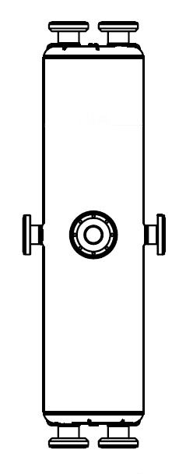
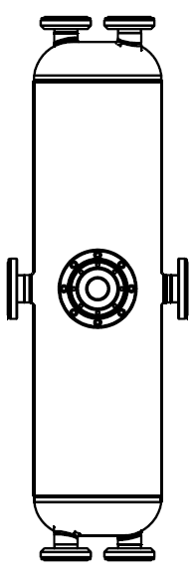
the prototype cavities of QWRs & HWRs
Stage | QWR prototype | HWR prototype
Performance Test (Bare cavity) | #2-2 (RI) #3-1 (VZ) #3-2 (VZ) | #1-1 (RI) #3-1 (VZ) #3-2 (VZ)
Performance Test (Jacketed cavity) | - | #3-1 Round type VZ) #3-2 Round type (VZ) #3-3 Flat type (VZ) #3-4 Flat type(VZ) to be tested
Total | One 2nd (RI) Two Bare Cavity 3rd (VZ) | One 1st (RI) Three 3rd Bare & Dressed(VZ)
Flat type
Round type
Vendor : RI: Research Instruments, VZ: Vitzro Tech

Slide 11
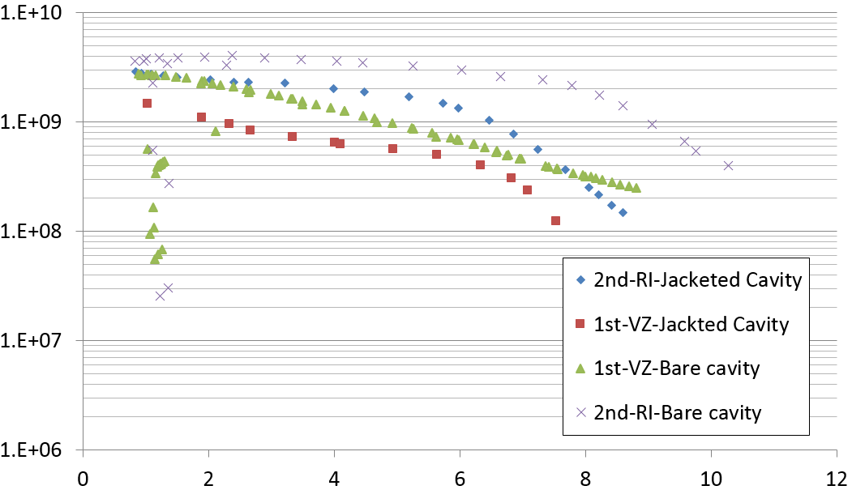
Performance Test Results_QWR
Bare cavity vs. Jacketed Cavity
Q-factor
Multipacting
Q-factor limit
@ Operation point
All cavities are tested in TRIUMF(Canada)
Eacc(MV/m)

Slide 12
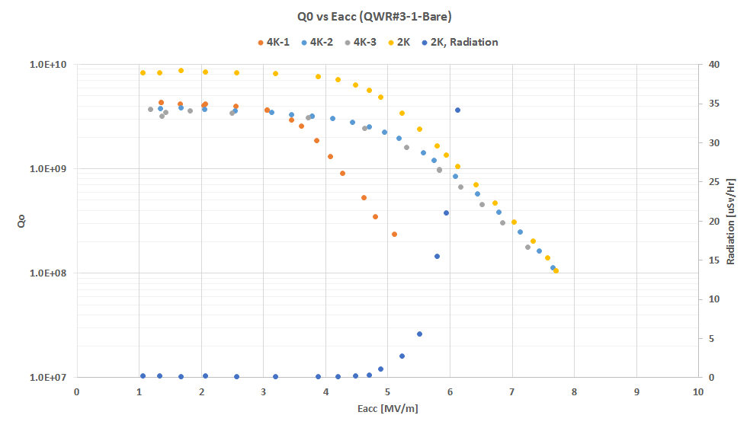
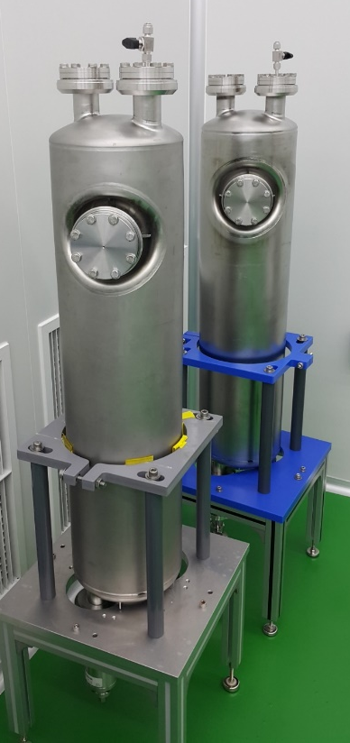
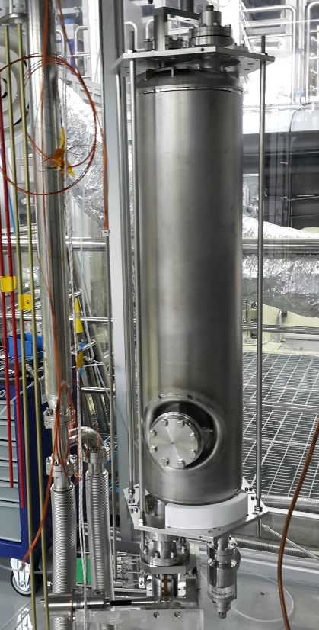
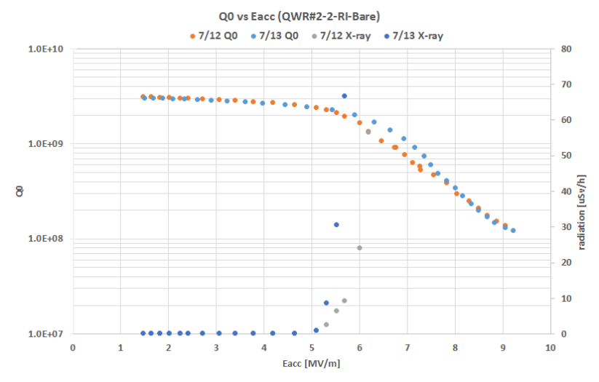
QWR Test Result

Slide 13
HWR Test Result Comparision

Slide 14
HWR Test Result Comparision

Slide 15
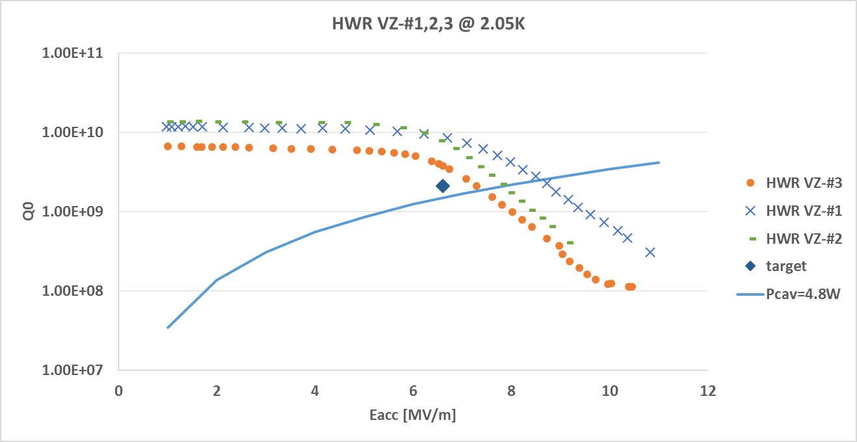
Recent HWR Test Results

Slide 16
Summary
The prototypes of the β=0.047 QWR, two types of β=0.12 HWR have reached the RISP gradient and Q specifications
Improved procedures of cavity preparation including Venting & Pumping down procedures in Cleanroom Assembly and High Temperature Baking allowed to reach high Q in the latest tests with HWRs
Design optimized Round End type HWR cavities showed only low field multipaction in less than 1 MV/m region and are expected to improve the performances in operating gradient region.

Slide 17
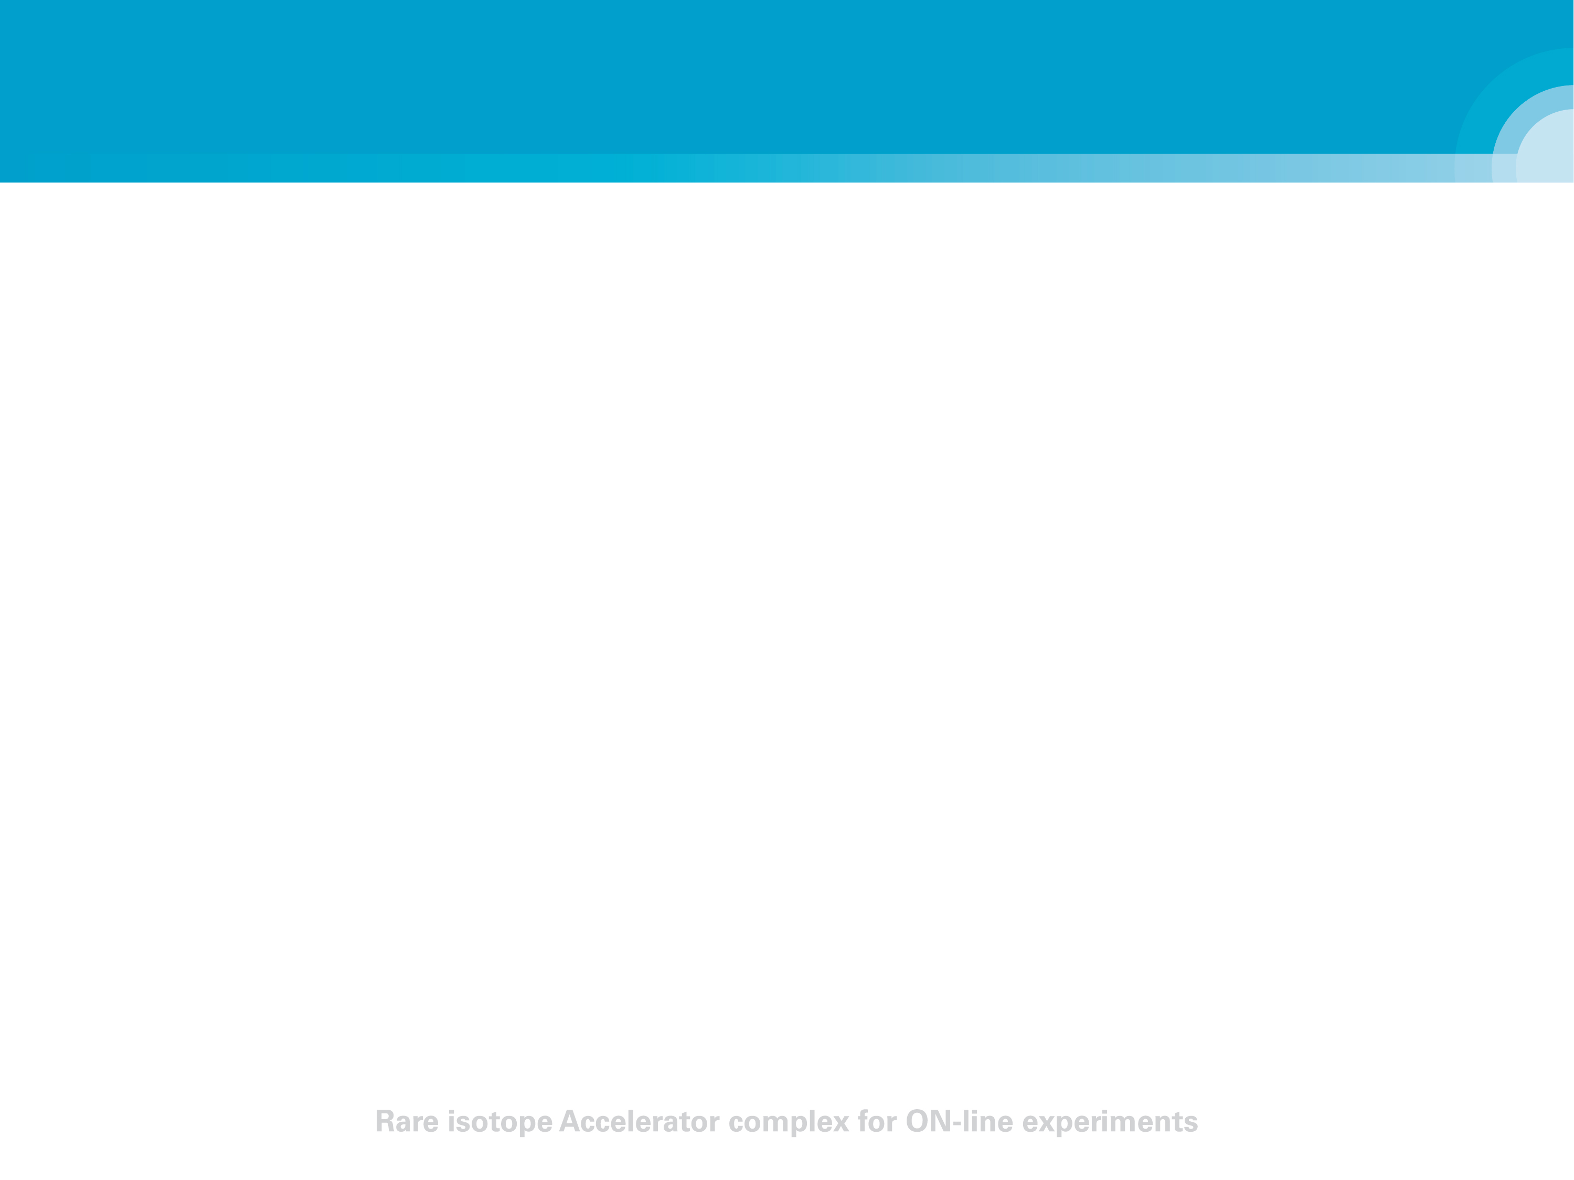
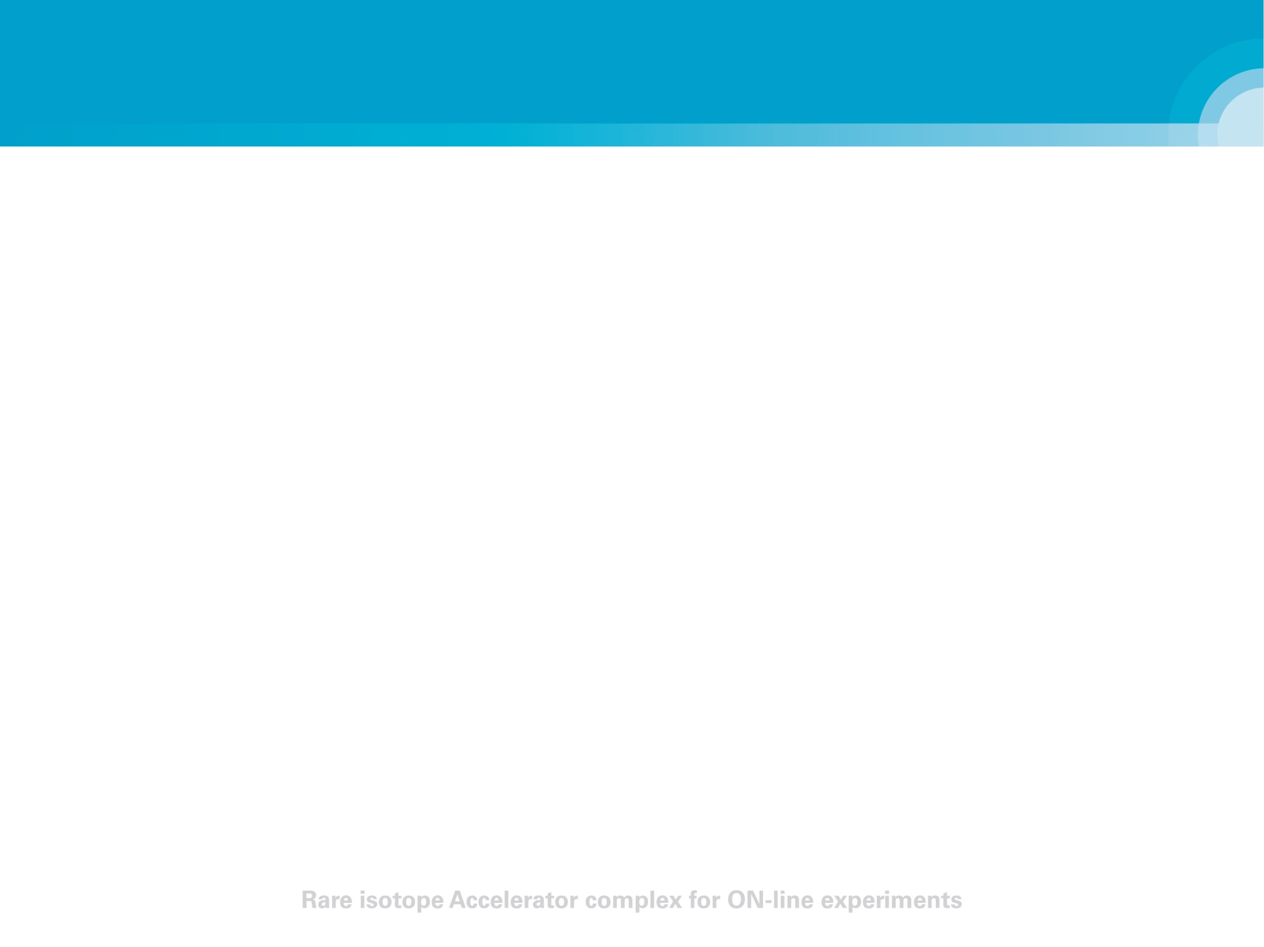
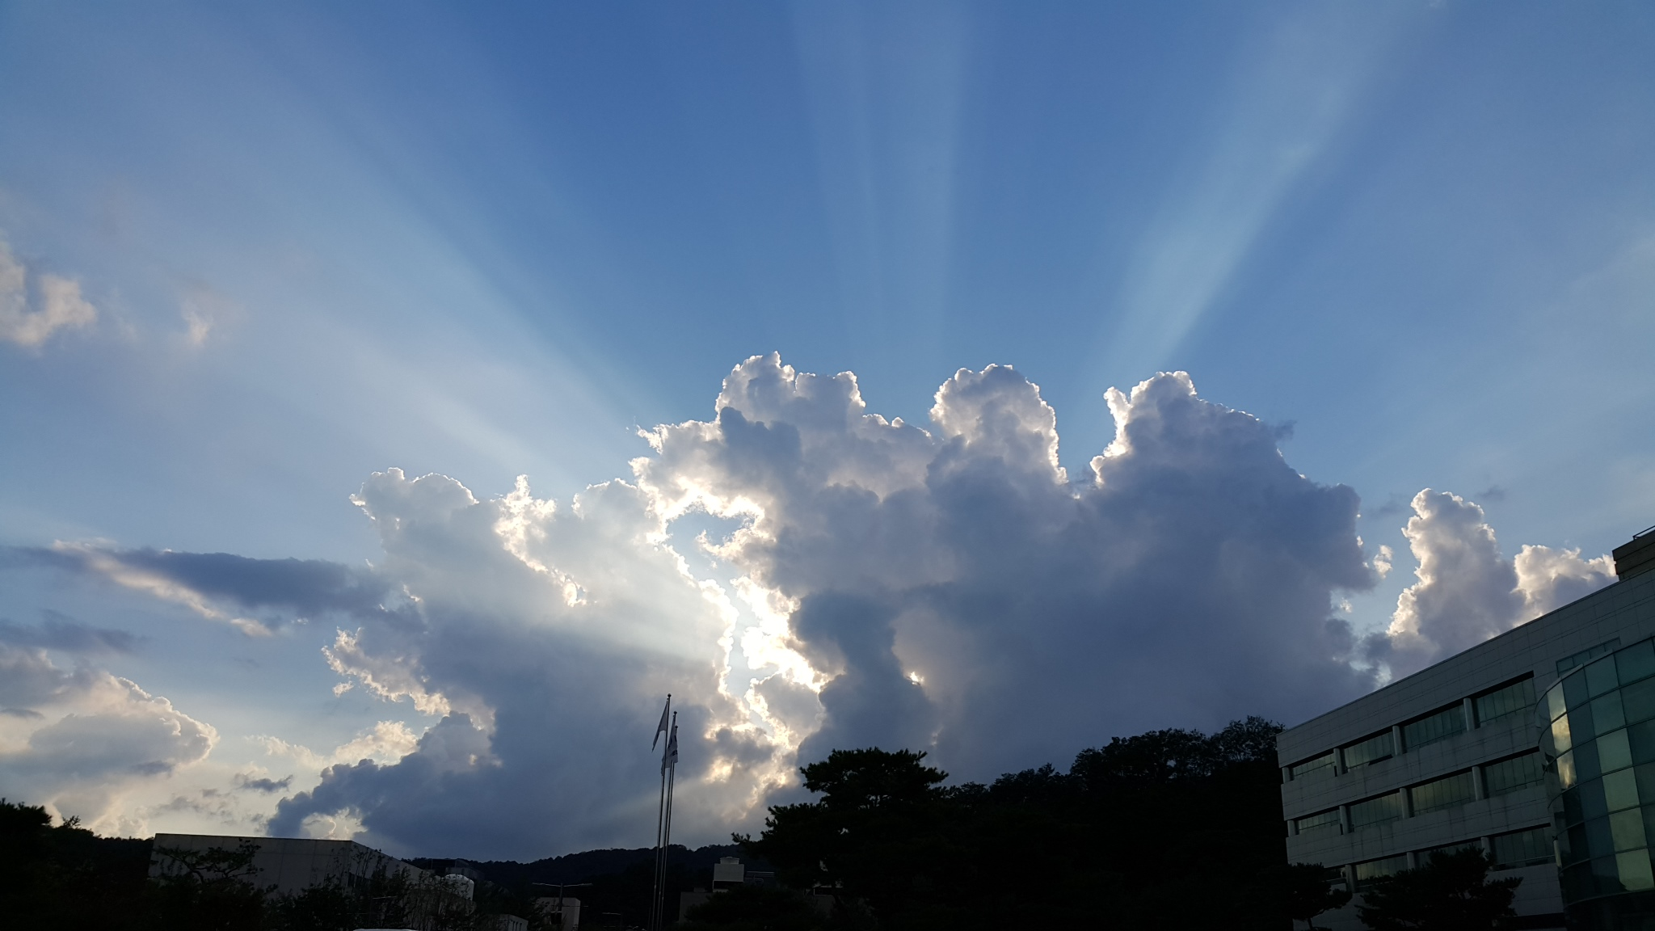
Thank you.

