Slide 1
Eddy Current Scanning of Large Niobium Sheets
Felix Schlander
www.europeanspallationsource.se
27 June 2018

Slide 2
Cavity & cryomodule parameters
352.21 MHz
704.42 MHz
2.4 m
4.6 m
3.8 m
39 m
56 m
77 m
179 m
Target
Source
LEBT
RFQ
MEBT
DTL
Spokes
Medium β
High β
HEBT & Contingency
75 keV
3.6 MeV
90 MeV
216 MeV
571 MeV
2000 MeV
Number of modules | 13 | 9 | 21
Type of cavity | spoke | elliptical | elliptical
Cavities per module | 2 | 4 | 4
Spokes / cells | 2 | 6 | 5
Frequency / MHz | 352.2 | 704.4 | 704.4
Geom. β | 0.5 | 0.67 | 0.86
E_{acc} / MV/m | 8 | 16.7 | 19.9
Cavity supply
Cryomodule supply
Spokes
Medium β
High β

Slide 3
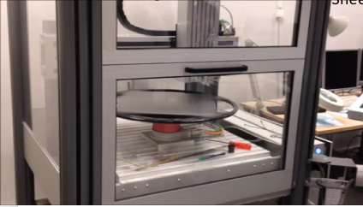
Eddy current scanning at DESY
Quality control of Nb sheets to find inclusions and/or geometrical defects
Up to now the DESY eddy current scanning devices have only been used for 1.3 GHz sheet material:*
European XFEL
LCLS II
…
INFN LASA
* THP013, LINAC2010 A. Brinkmann et al

Slide 4
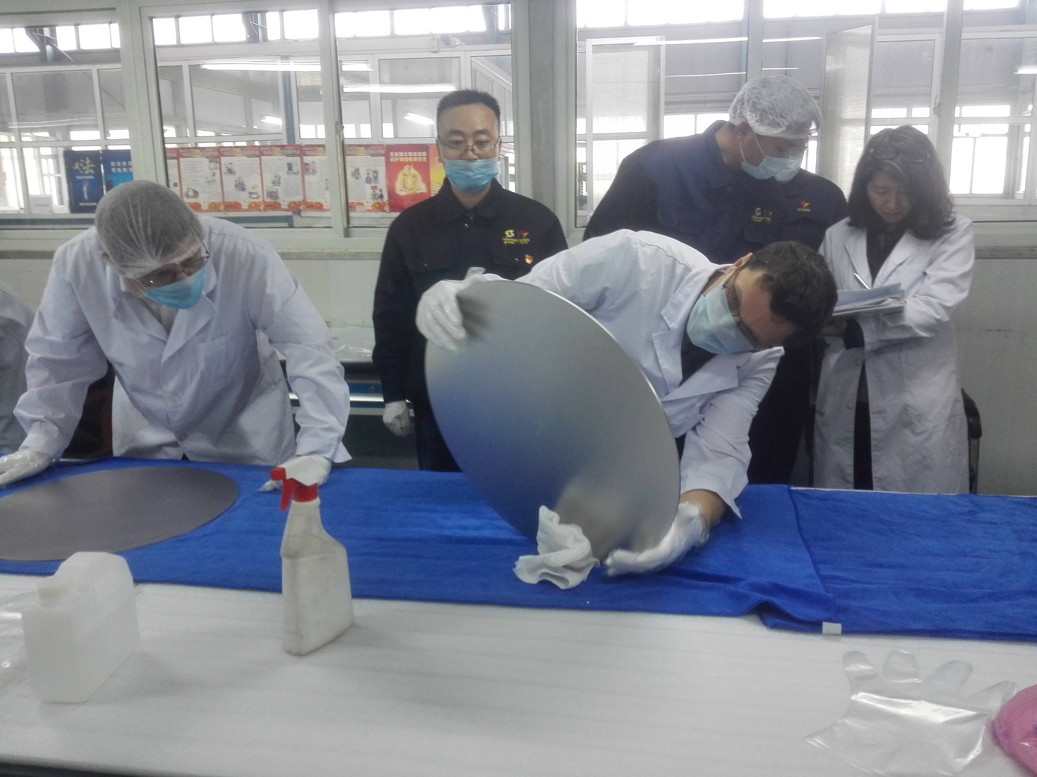
Niobium for elliptical ESS cavities
Risk mitigation wrt. low performing cavities: apply eddy current scanning and additional analyses if needed
Constraint to use DESY machines is a maximum diameter/diagonal of Niobium sheets of 660mm
OK: Medium beta: quadratic sheets edge length 460mm
NOK: High beta: quadratic sheets edge length 500mm
>> use discs with diameter 500mm
STFC

Slide 5
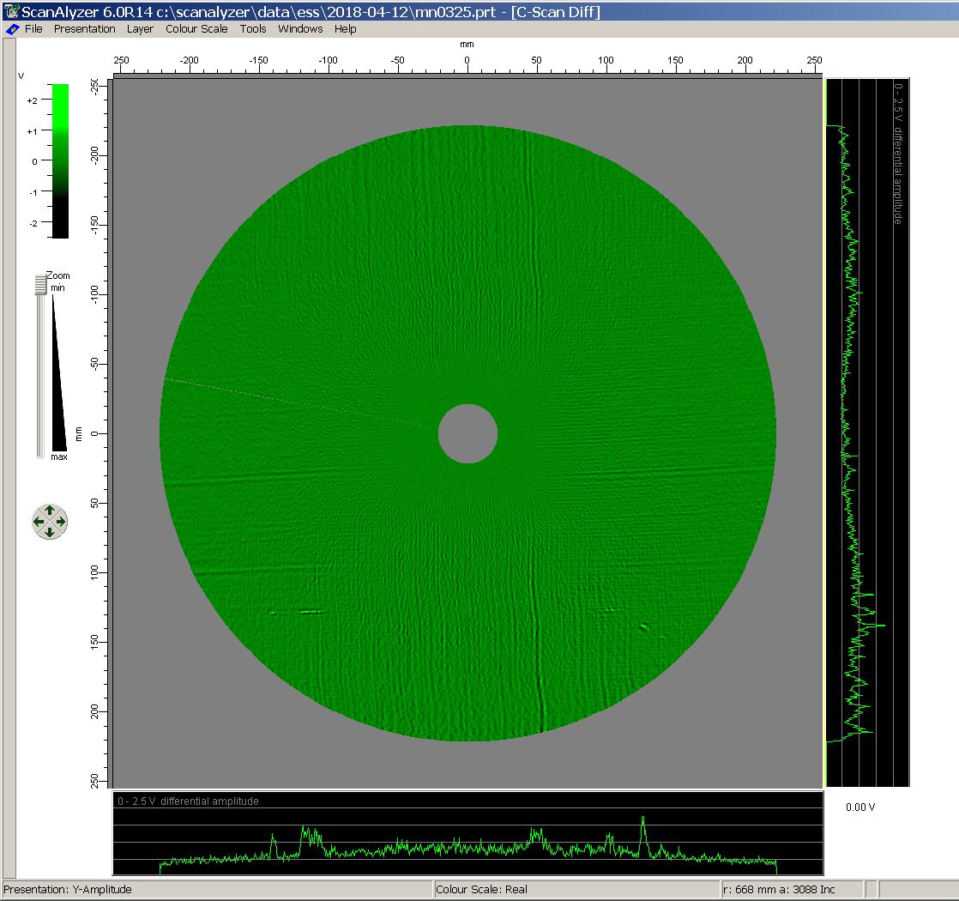
Adaptations to scanning machines
Software update mechanical changes

Slide 6
Inspection flowchart
Scan side 1 ▶︎ OK
▼
Scan side 2 ▶︎ OK
▼
3d microscopy ▶︎ OK
▼
Chemical analysis ▶︎ OK
▼
Out of work/quarantine ▶︎ OK

Slide 7
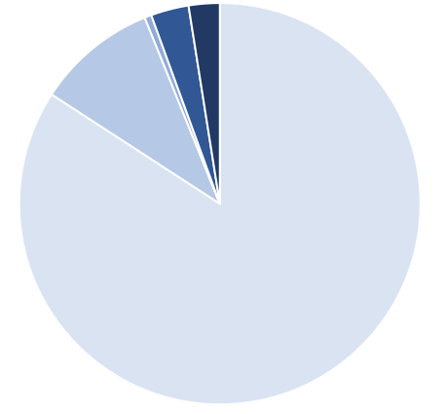
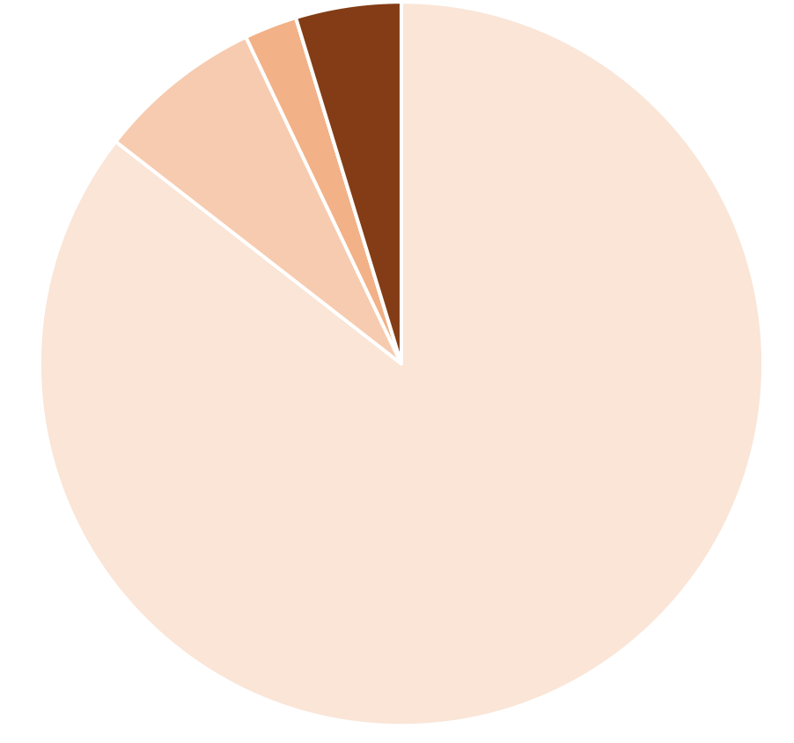
Statistics … (so far)
Analysis of 2nd delivery not complete, number expected to be lower
1% 3.5% 2.5%
3%
4%
10%
1 side
2 sides
Microsopy
Chemical analysis
Quarantine
7%
83%
86%
338 sheets (about 70% of total)
297 discs (about 30% of total)

Slide 8
Conclusion
Eddy current scanning at DESY is beneficial
Material for both medium- and high-beta cavities is provided by Ningxia OTIC, with very good results:
Up to now less than 3% quarantine material (while some are mechanical defects that may be ok after polishing)
No foreign material inclusions found up to now
First time fabrication of fine grain Niobium discs for cavity fabrication
Thanks to all the people involved at DESY, INFN LASA, STFC and ESS!

