Slide 1
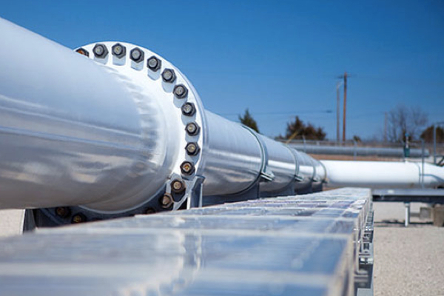



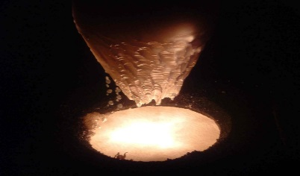
Nióbio e CBMM
Abril/2018
TTC Meeting
RIKEN, Nishina Center
June 26, 2018

Slide 2
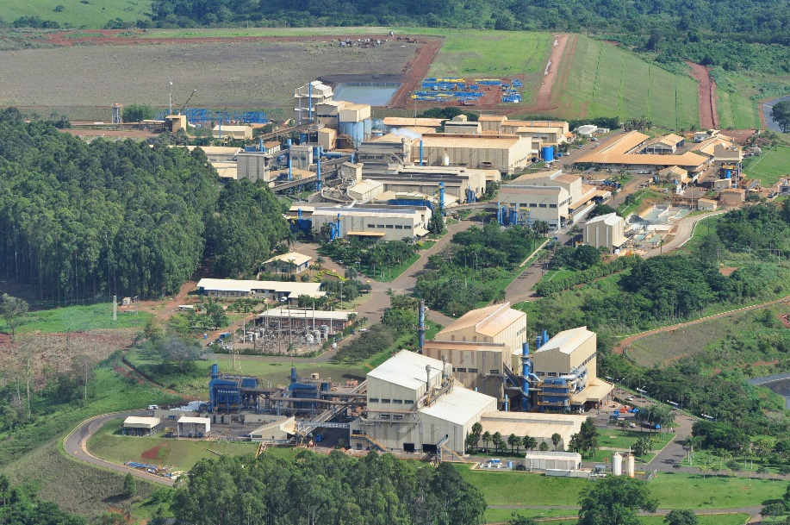
The company

Slide 3

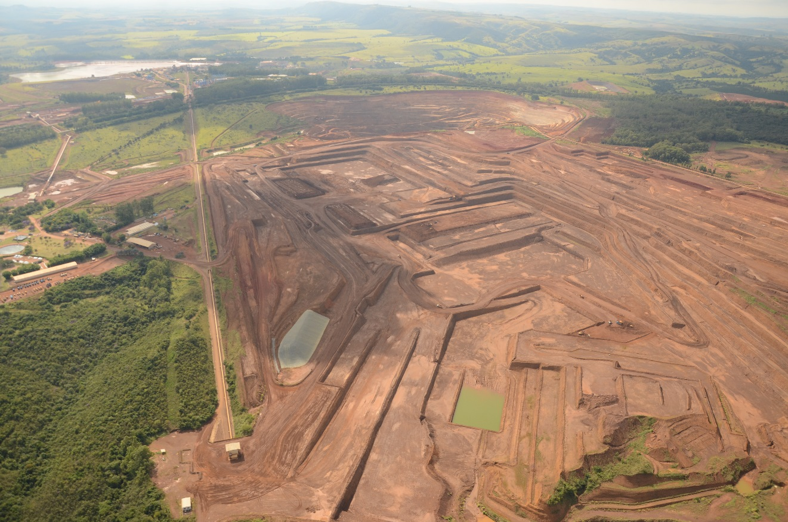
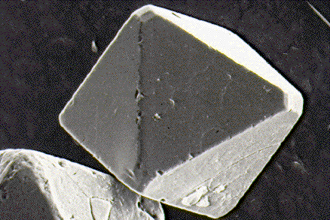
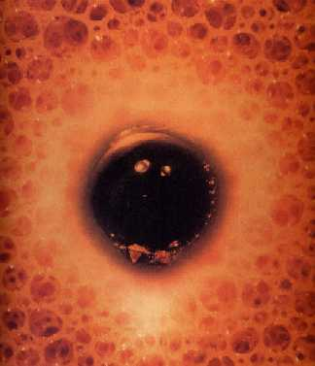
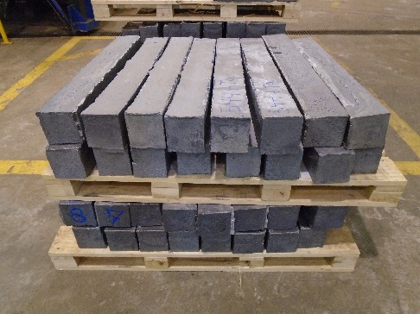
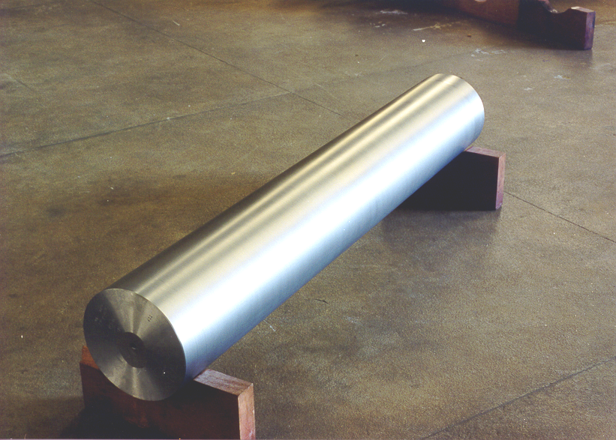
CBMM

Slide 4





Niobium Suppliers
100.000 FeNb tons/year
13.700 FeNb tons/year
9.000 FeNb tons/year
1.500 FeNb tons/year
CBMM is the top worldwide producer of Ferroniobium.

Slide 5
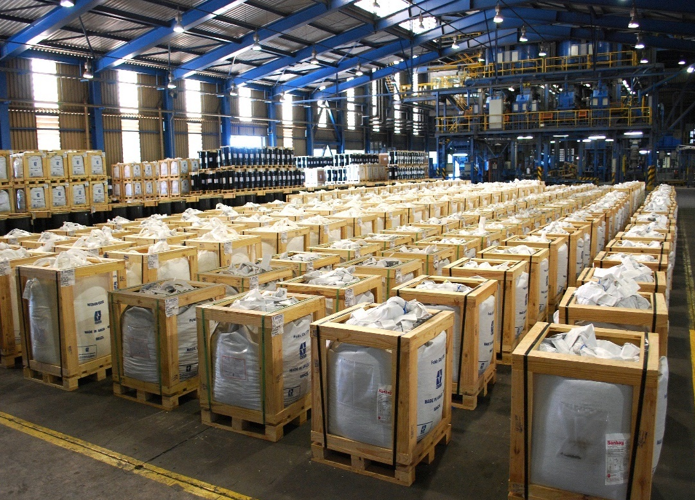
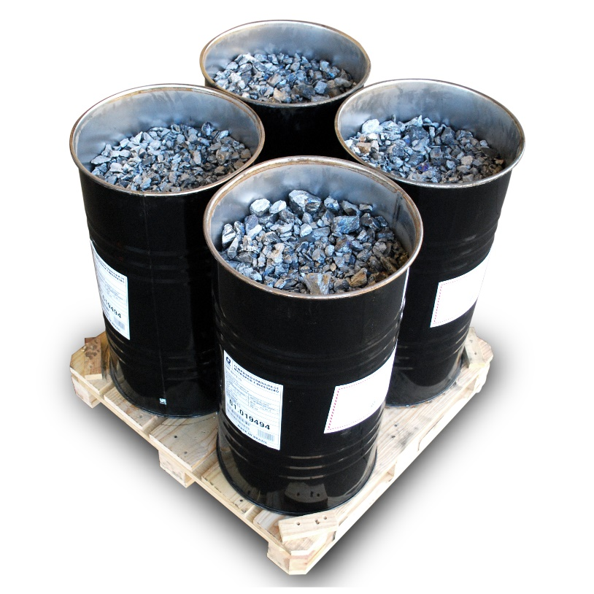
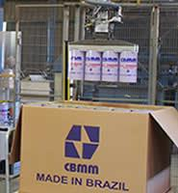
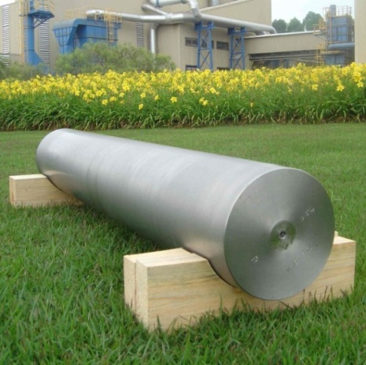
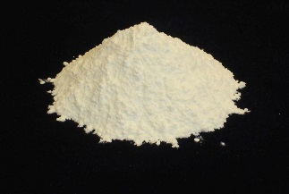
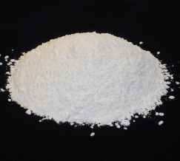
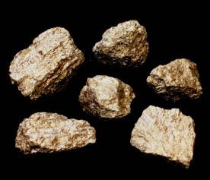
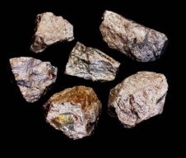
CBMM - Products
Ferroniobium
High Purity Niobium Metal Ingot
Niobium Oxide
Special Alloys
High Purity
Optical grade
NiNb VG
FeNb VG

Slide 6
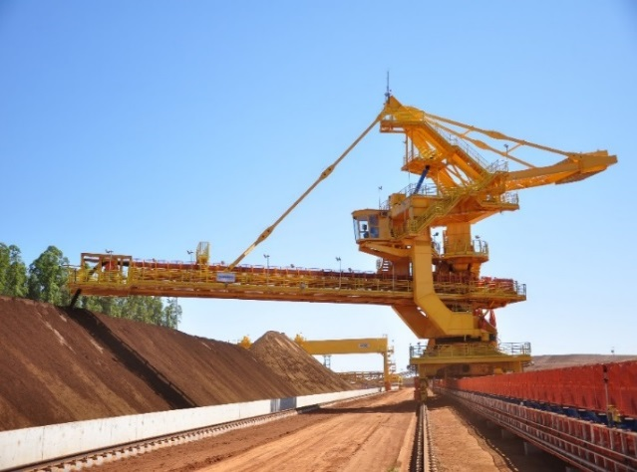
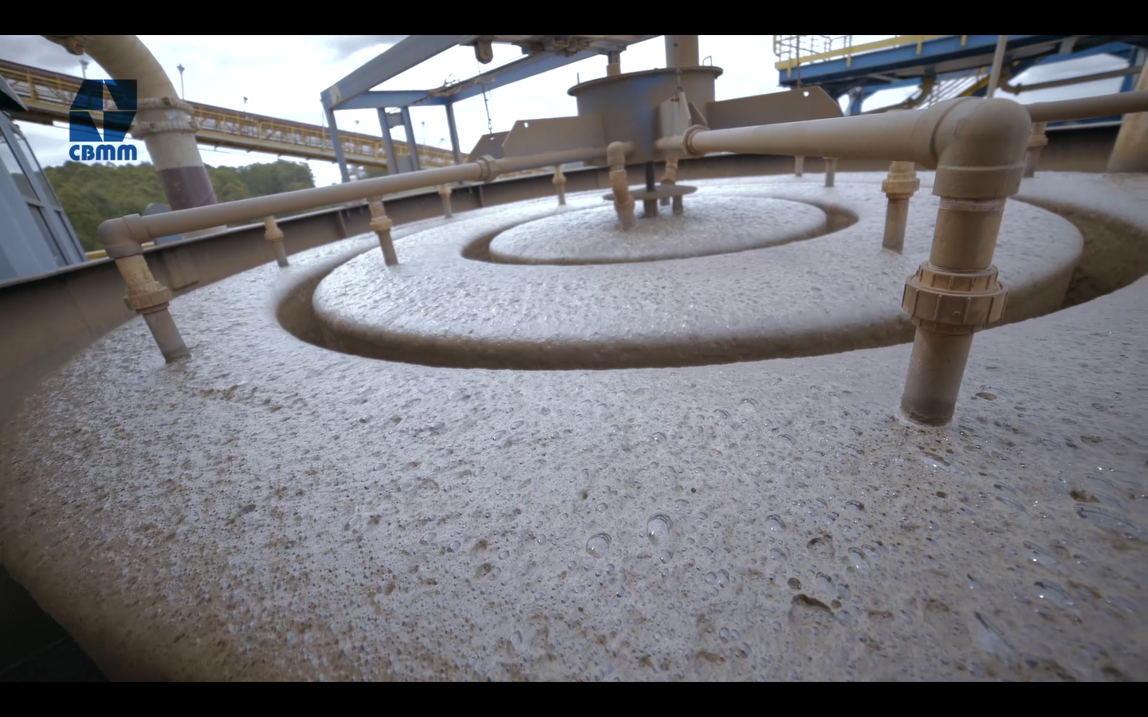
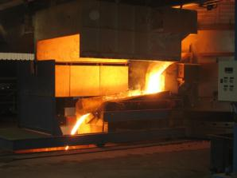
Niobium Metal Refining Process

Slide 7
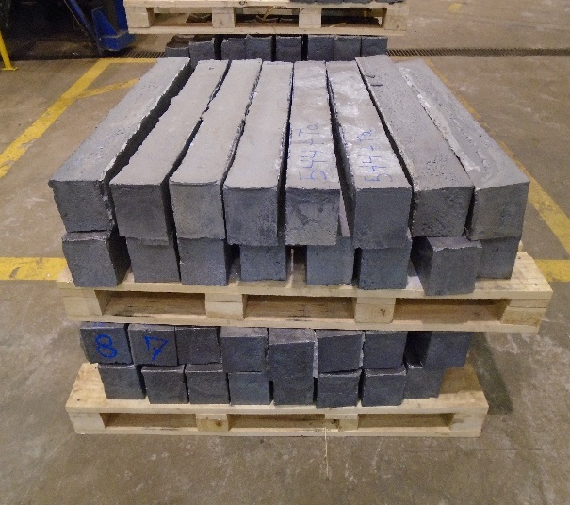
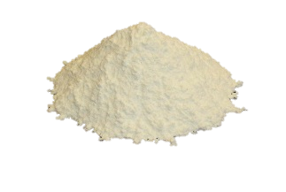
Raw Material
(ATR bars - Global Reaction)
3 Nb₂O₅ + 10 Al = 6 Nb + 5 Al₂O₃
Sojitz
Tóquio - Japão
ATR Bars
Niobium Oxide
High Purity
Typical ATR bar composition
~ 95% Niobium metal
~ 5% Aluminum compounds and ore residual elements

Slide 8
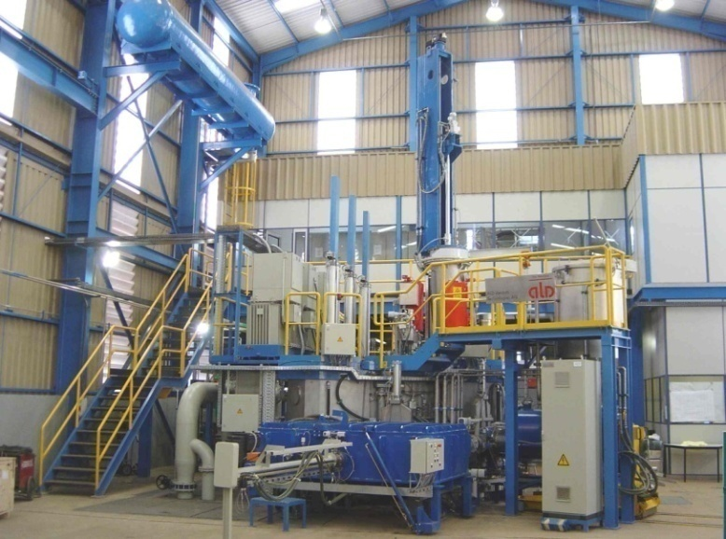
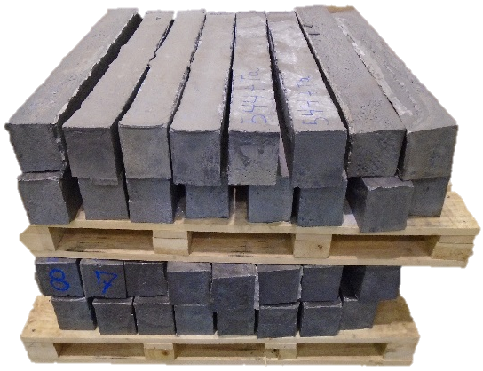
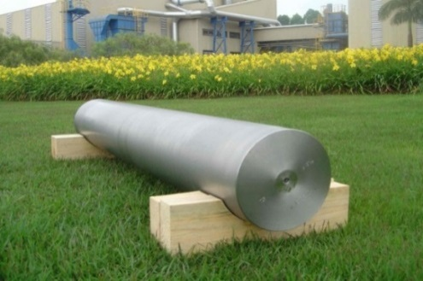
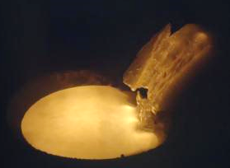
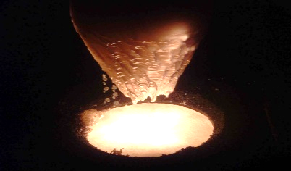
Refining Process – EB melting
Raw material
ATR ~ 95% Nb
High Purity
Niobium Metal
1st melt
Re-melts

Slide 9
Niobium Metal Products
Production Capabilities
  Ingots dimensions:
    Diameter: From 150 mm up to 400 mm
    Length: Up to 2200 mm
  Ingots Specifications
    Reactor grade (Ta < 1000 ppm)
    Commercial grade (1000 < Ta < 2000 ppm)
    RRR grade

Slide 10
Production point of view
Traditional Specification for Niobium Sheet
X
Specification for Ingot Technology

Slide 11
Traditional Specification for Niobium Sheet

Slide 12
Traditional Specification for Nb sheet
Critical points
Ingot required to produce RRR sheets.
RRR > 300

Slide 13
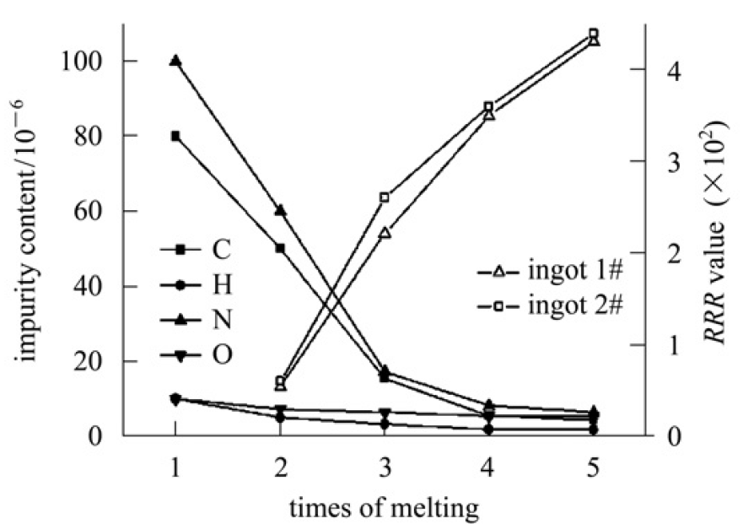
Impacts on production costs
Production Impacts
Multiple melting
Lower material yield due to the high volatilization
Lower melting rate
Low productivity
Higher production cost

Slide 14
Specification for Ingot Technology

Slide 15

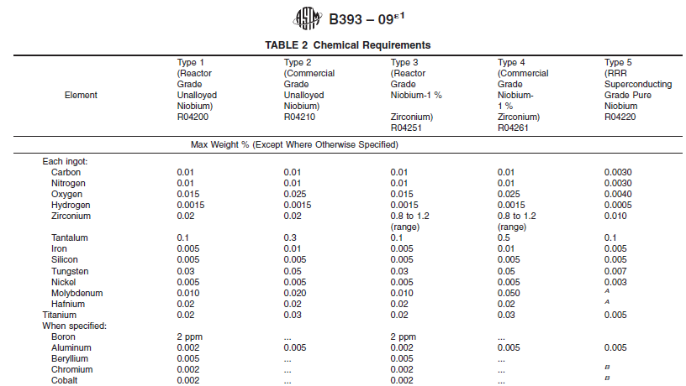
Specification for Ingot Technology
Standard Specification

Slide 16
Impacts on production costs
Production Impacts (Loosen Ta + Lower RRR)
Cost saving with raw material with higher Ta
Fewer melting numbers
Higher yield
Normal melting rate
More productivity
Lower production cost.
Approximately 50% less than higher RRR material
Standard Specification

Slide 17
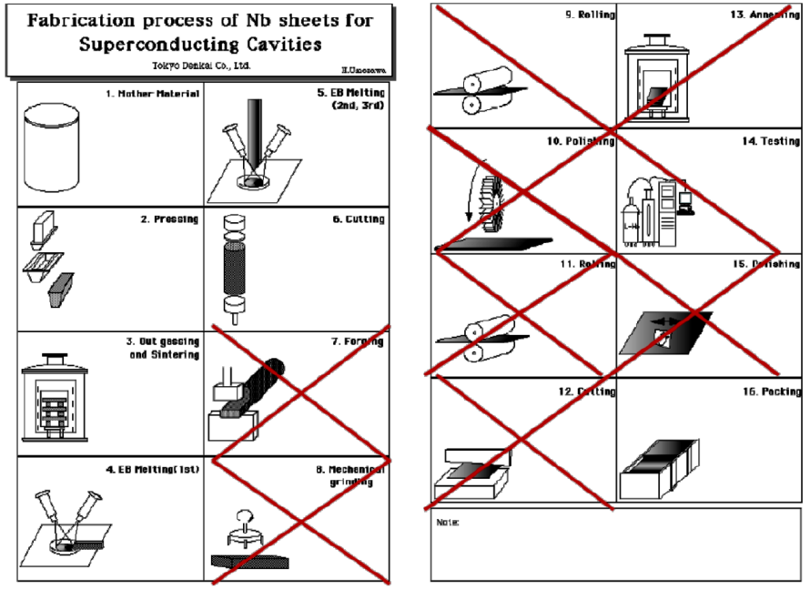
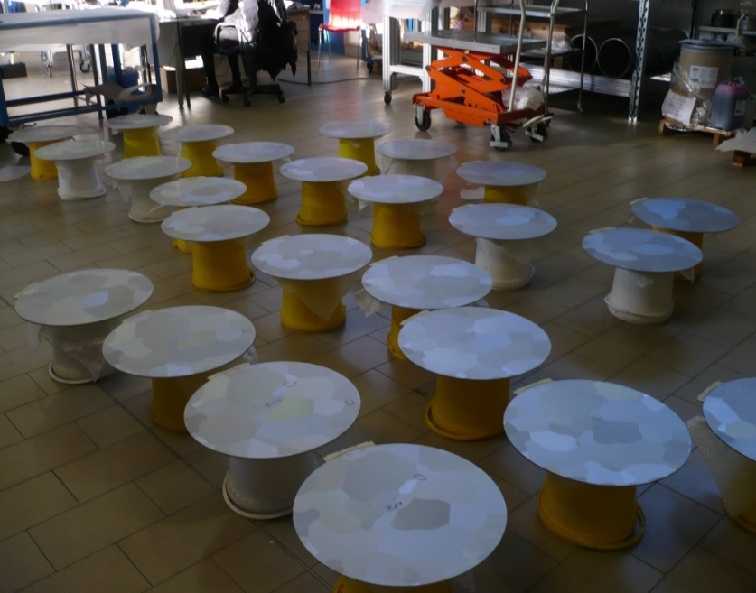
Other potential cost savings
Sojitz
Tóquio - Japão
Reduce the overall cost of manufacturing superconducting cavities by reducing the manufacturing steps (currently 16 steps).

Slide 18

Visite o site: niobium.tech

