Slide 1
TTC WG-2 focusing on
Nb Material
- Properties and Specifications -
2018/6/26
ULVAC, Inc.
Kyoutoshi Miyagi, Hiroaki Masui, Noriyuki Abe,
Seiichi Shinozawa, Tomohiro Nagata
Notes:
送付頂いたご質問に、アルバックより回答します。

Slide 2
Q1: General advices on specifications and/or any specific comments on items causing difficulties?
Advice/Comment/Information:
1. There is a possibility of reducing the number of times of melting process if RRR can be reduced to 250 or less.
2. If Ta content is allowed up to 3000 ppm (ASTM B393 Type 2), the raw material procurement range becomes wider.
3. If specifications such as mechanical properties (YS, TS), crystal grain size, etc. are required only to component parts necessary for processing, cost can be lowered.
For example, parts that do not require mechanical properties, grain size, hardness etc. can be excluded.
Notes:
Q1の一般的なアドバイスについて、回答します。
1. There is a possibility of reducing the number of times of melting process if RRR can be reduced to 250 or less.
2. If Ta content is allowed up to 3000 ppm (ASTM B393 Type 2), the raw material procurement range becomes wider.
3. If specifications such as mechanical properties (YS, TS), crystal grain size, etc. are required only to component parts necessary for processing, cost can be lowered.
For example, parts that do not require mechanical properties, grain size, hardness etc. can be excluded.
Q1の一般的なアドバイスについて、回答します。
１．RRRを250以下に許容できれば、溶解回数を減らせる可能性が有ります。
２．Ta含有量が3000ppm(ASTM B393 Type2)まで許容されれば、原料調達範囲が広くなります。
３．機械特性(YS, TS)、結晶粒径等の仕様は、加工する上で必要な部材のみ要求することで、
COSTが下がる。
例えば、機械特性や結晶粒径、硬さを必要としない部品などは省くことができます。

Slide 3
Q2: Would there be cost-saving for:
- Accepting higher impurity content in the specifications (e.g. loosen tantalum allowance) or for accepting lower RRR?
- Cutting-out Large Grain disks/sheets from the Nb ingot vs Producing fine grain sheets after forging/rolling/polishing? What is the maximum diameter available?
Advice/Comment/Information:
(Please refer NEXT Slide)
Notes:
Q2のcost-savingについて、次のスライド説明します。

Slide 4
Low cost Nb
Proposal for cost effective Nb
1. Utilization of commercial grade Nb (High-Ta)
2. Recycling scrap generated in production
(Reducing 25% or more by sheet)
3. Adopt of seamless tube
(Reducing 25%)
Notes:
We are going to propose the following three points for the cost efficiency of Nb material.
First, cost reduction effect can be accomplished by using commercial grade Nb with high tantalum content.
Second, cost reduction effect of 25% or more can be accomplished by recycling.
Third, cost reduction effect of about 25% can be accomplished by adopting seamless tube.
Nb材のコストについて、下記3点を提案します。
1つ目は、タンタル含有量の高いコマーシャルグレードNbを使用することで、コストダウン効果が得られます。
2つ目は、リサイクルの実施で、25%以上のコストダウン効果が得られます。
3つ目は、シームレスチューブの採用で、25%程度のコストダウン効果が得られます。

Slide 5
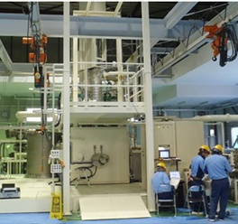
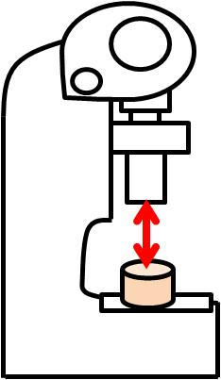
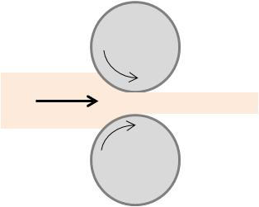
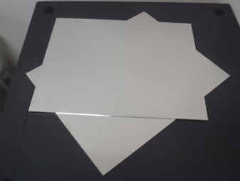
1. Utilization of commercial grade Nb (High-Ta)
Reference: SRF 2017 (prof. Yamanaka)
KEK
ULVAC
EB Melting Furnace
Forging
Rolling
Notes:
First of all, about using commercial grade Nb with high tantalum content.
We were supplied an ingot made by CBMM from KEK. It was melted, forged and rolled in ULVAC and manufactured into a plate.
Then, cavities were manufactured in KEK, and evaluated the acceleration performance.
初めに、タンタル含有量の高いコマーシャルグレードNbの使用です。
KEKから、CBMM製のインゴットを支給頂き、ULVACで溶解、鍛造、圧延して板を製作しました。
その後、KEKで空洞に製作を行い、加速性能を評価しました。

Slide 6
1. Utilization of commercial grade Nb (High-Ta)
Chemical compositions and RRR
Unit : wt ppm except RRR
 | C | O | N | Al | Cr | Fe | Mo | Ni | Si | Ta | Ti | W | Zr | Hf | Co | Be | B | H | RRR
ASTMB391 Type2 | <100 | <250 | <100 | － | － | <100 | <200 | <50 | <50 | < 3000 | <300 | <500 | <200 | <200 | － | － | － | <15 | －
Company C Material | <30 | 26 | 33 | <10 | <10 | <10 | <10 | 10 | <10 | 1194 | 7 | <10 | <10 | <10 | － | － | － | <2 | 60～108
As melt | <10 | <10 | <30 | <10 | <10 | <10 | <10 | 10 | <10 | 1210 | <5 | <10 | <10 | <10 | <10 | <10 | <10 | 1 | 277～298
Reference: SRF 2017; ULVAC analysis data
・RRR increases when commercial grade Nb (High-Ta) was EB melted.
Notes:
This chart presents chemical component values and RRR values before and after melting of the supplied ingot.
The RRR of the supplied ingot was between 60 and 108.
Through melting processes, RRR 298 has been achieved despite the Ta content was over 1000 ppm.
支給されたインゴットの溶解前と溶解後の化学成分値とRRR値を示します。
支給されたインゴットのRRRは、60~108でした。
溶解によって、Ta量が1000ppm以上にもかかわらず、RRR298を達成できました。

Slide 7
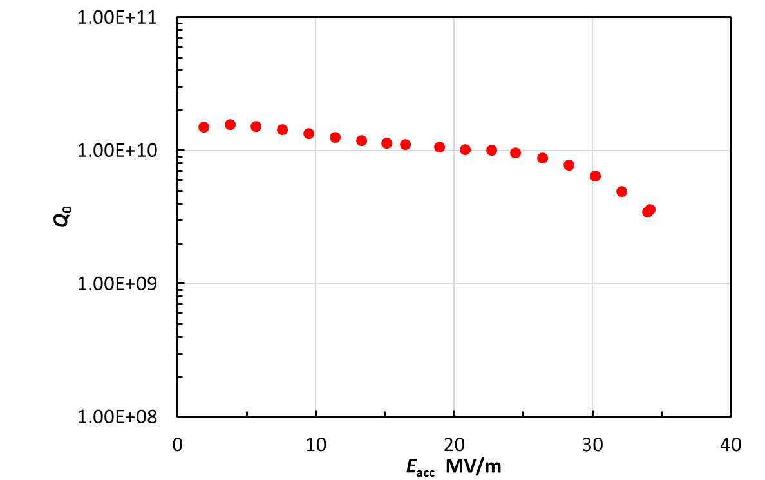
1. Utilization of commercial grade Nb (High-Ta)
Cell
(RRR(Ingot):277-298)
Stiffening Ring (RRR(Ingot):60-108)
Vertical test @ KEK
E_{acc} max. = 35 MV/m @2K
Beam pipe
(RRR(Ingot):60-108)
E_{acc.} max = 35 MV/m
(He Temp. = 2K)
Notes:
Sheets for cells were made from the manufactured RRR 298 ingot.
Beam pipes and strengthening rings were made from Nb materials of RRR 60-108, and manufactured into 3-cell cavities.
The acceleration performance achieved 35MV/m.
セル用のシートは、製作したRRR298インゴットから製作し、
ビームパイプ及び強め輪は、RRR60~108のNb材を使用し、3セル空洞を製造しました。
加速性能は、35MV/mを達成しました。

Slide 8
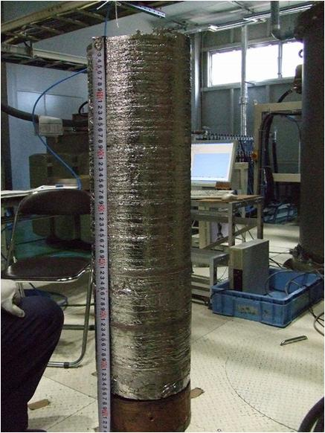

2.Recycling of scrap (ASTM B393 Type5)
Refining
Forging
Deforming
Machining
Recycle
Annealing
Ingot
Material selection
*Small chips cannot be recycled.
*Control required for W, Mo, Ta content.
Melting material
Material process
Notes:
Next, we are going to explain about recycling.
When ingots are manufactured into Nb sheets and beam pipes, scraps are generated.
Using the generated scraps as material, we have conducted experiments to determine whether ingots with high RRR could be produced.
次にリサイクルについて、説明します。
インゴットから、Nbシートやビームパイプを製作する際に、スクラップが発生します。
発生したスクラップを溶解原料として、RRRの高いインゴットが製造できるか実験を行いました。

Slide 9
2.Recycling of scrap (ASTM B393 Type5)
Melting | C | O | N | Al | Cr | Fe | Mo | Ni | Si | Ta | Ti | W | Zr | Hf | Co | Be | B | H | RRR 300K / 9.5K
1st | <10 | 10 | <10 | <10 | <10 | <10 | <10 | <10 | <10 | 30～90 | <5 | <10 | <10 | <10 | <10 | <10 | <10 | 2 | 111
2nd | 10 | 20 | 10 | <10 | <10 | <10 | <10 | <10 | 10 | 60～100 | <5 | 10 | <10 | <10 | <10 | <10 | <10 | ＜１ | 205
3rd | 10 | 10 | <10 | <10 | <10 | <10 | <10 | <10 | 10 | 80～100 | <5 | 10 | <10 | <10 | <10 | <10 | <10 | 1 | 292
*RRR increases upon recycling scrap generated in production. Possible to utilize the scrap for cost efficiency.
RRR | Cost reduction ratio (by sheet)
100 | 0.5
200 | 0.6
250 – 300 | 0.75
Over 300 | 1
For stiffening ring or others？
For sheet, beam pipe?
Nb scrap
Notes:
Here presents the analysis results of the chemical composition and RRR of the ingot manufactured using scraps.
Through three times of repeated melting processes, RRR 292 was achieved.
The result confirms scraps could be used as a raw material.
Depending on application, there seems to be a possibility of using cost effective recycled material.
スクラップを溶解原料として製造したインゴットの化学成分とRRRの分析結果を示します。
3回溶解により、RRR292を達成しました。
溶解原料として、スクラップが使用できることを確認できました。
用途によって、コストダウンしたリサイクル材料の使用の可能性があると考えております。

Slide 10
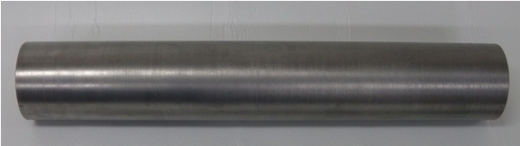
3.Adopt of Seamless Tube
Aiming at cost reduction of Nb material, we are manufacturing and evaluating cavities using seamless tubes collaborating with KEK.
Method | Production cost | Material cost | Total cost | Reduction ratio
Existing (Press + EBW) | 5 | 1 | 6 | -
Hydroforming | 2.5 | 2 | 4.5 | 25%
Cost estimated by KEK
(Prof. Yamanaka)
seamless tube for 3-cell
dia138 x dia131 x 830mm
*Reducing cavity cost (in case of 3-cell)
Notes:
Aiming at cost reduction, we are manufacturing and evaluating cavities using seamless tubes collaborating with KEK.
Compared to the existing manufacturing method from sheet, production cost decreases from 5 to 2.5,
and although the material cost increases from 1 to 2, the total cost decreases from 6 to 4.5.
In total, there is possibility of reducing the cost by about 25%.
KEKと共同で、コストダウンを目指し、シームレスチューブを使用した空洞製作と評価を行っています。
シートからの製法と比べると、製造コストが5から2.5に減少し、材料コストは1から2と増加しますが、トータルでは6から4.5となり、約25%のコストダウンの可能性があります。

Slide 11
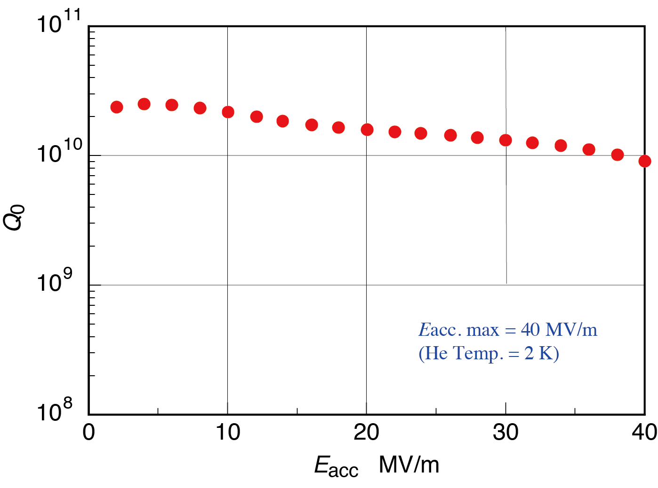
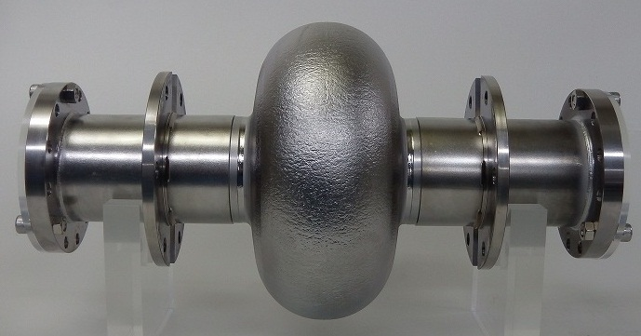
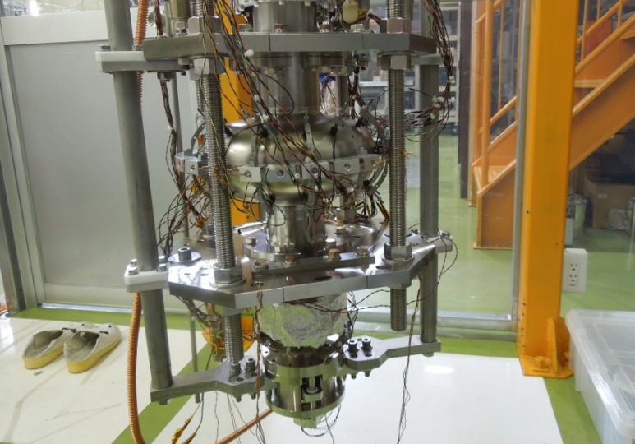
3.Adopt of Seamless Tube
Vertical test @ KEK
E_{acc} max. = 40 MV/m @2K
*Seamless cavity using ULVAC Nb material has accomplished ILC standard.
Notes:
Acceleration of one-cell cavity fabricated using seamless tube is 40 MV/m, which has accomplished ILC standard.
シームレスパイプを使用して製作した1セル加速の加速性は、MV/mとなっており、ILC規格を達成しています。

Slide 12
Q3: What is the maximum recrystallized fraction possible and how measured/ensured?
Would it be helpful to relax any other specifications, to help maximize recrystallized fraction? e.g. grain size? Hardness? Impurity content? Annealing temperature?
Advice/Comment/Information:
· For structure observation, samples are taken at arbitrary positions, which are measured according to ASTM standards.
· If the crystal grain size is relaxed to larger scale, heat treatment control becomes easier.
Notes:
Q3について回答します。
· For structure observation, samples are taken at arbitrary positions, which are measured according to ASTM standards.
· If the crystal grain size is relaxed to larger scale, heat treatment control becomes easier.
Q3について回答します。
・組織観察は任意の位置でサンプルを採取し、ASTM規格に基づき測定をしています。
・結晶粒径を大きい方に緩和すれば、熱処理コントロールが容易となる。

Slide 13
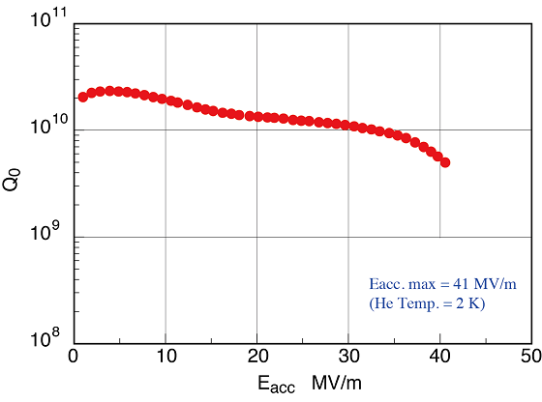
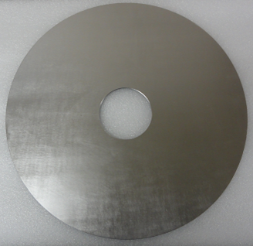
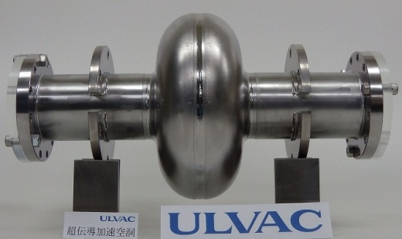
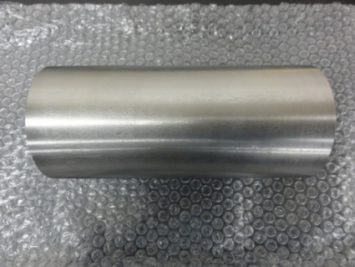
Q4: What is the temperature uniformity of sheets in the furnace during heat treatment after rolling in case of Fine Grain sheets (from a view point of QA/QC)?
Advice/Comment/Information:
・It is about ± 10 °C as actual value.
・As ILC standard of acceleration performance has been achieved, we believe it satisfies the requirement.
Vertical test @ KEK
E_{acc} max. = 41 MV/m @2K
Notes:
Q4について回答します。
・It is about ± 10 °C as actual value.
・As ILC standard of acceleration performance has been achieved, we believe it is enough.
Q4について回答します。
実績値として、±10℃程度となります。
ILC規格の加速性能を達成しておりますので、十分と考えております。

Slide 14
Q5: Would it be possible to determine the damage-layer thickness of completed rolled sheets or sliced disks? If yes, What is the reproducibility of damage-layer thickness?
Advice/Comment/Information:
· Accurate thickness is not available, due to lack of measurement data of damaged-layers.
· Handling scratches are removed in final polishing process before roughness measurement and visual inspection.
Notes:
Q5について回答します。
· Accurate thickness is not available, due to lack of measurement data of damaged-layers.
· Handling scratches are removed in final polishing process before roughness measurement and
visual inspection.
以上が、ULVACの回答となります。
Q5について回答します。
・damage-layer のthicknessの測定データが少なく、正確な厚みは回答できません。
・取扱キズについては、最終工程で研磨を実施することで取り除き、粗さ測定及び目視検査を実施しています。
以上が、ULVACの回答となります。
----------------
以下参考
Additional information:
· Handling scratches are removed in final polishing process before roughness measurement and visual inspection.
· When process is conducted at high temperature to cause oxidation or nitriding, it can be evaluated and confirmed, for damage-layer is thick.
⇒ Evaluation can be done by section hardness test or RRR measurement after the damage-layer removed.
⇒ Processing such as rolling is considered to be difficult to evaluate, for the damage-layer is thin.
参考
・取扱キズについては、最終工程で研磨を実施することで取り除き、粗さ測定及び目視検査を実施しています。
・酸化や窒化するような高温で加工を行った場合は、ダメージ層の厚さがある事から評価や確認する事が出来ます。
⇒断面硬さ試験やダメージ層を取り除いたRRR測定などが実施可能です。
⇒圧延等の加工は、ダメージ層が薄いため評価が難しいと考えます

