Slide 1
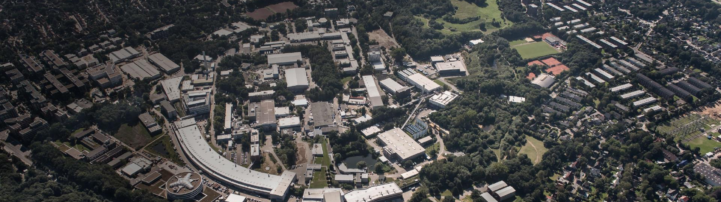
Large Grain Cavities at DESY
TTC Meeting,
Riken, 27 June 2018
Jacek Sekutowicz
for DESY testing team

Slide 2
Outline
Motivation
LG Niobium used at DESY
Performance of LG cavities
XM-3 history
Recent tests
CW upgrade scenario for E-XFEL
Summary

Slide 3



Motivation
An R&D program on SRF cavities at DESY is devoted to cw upgrade of E-XFEL
Injector Section (IS): E=2-2.5 GeV
Undulators
e- gun
3H
BC1
BC2
L0 ; 1CM
cw:16 MV/m
L1; 4CMs
cw:11 MV/m
L2; 12CMs
cw: 15 MV/m
L3; 84 (96) CMs
Before upgrade: 101 CMs in total, 17 in the IS and 84 in L3
After upgrade: New 17 CMs modified for cw will be installed in the IS
113 CMs in total, 17 in the IS and 96 in L3
12 present CMs from the IS will be re-installed at the end of L3

Slide 4
Motivation, cont.
Main goals of the SRF R&D program
CW modification of the 17 CMs in the Injector Section (mainly He distribution and FPCs)
To define “cw” SRF technology for 136 cavities housed in that 17 CMs
Specification of the performance for the 136 cavity
    Eacc 28+ MV/m for operation in the nominal short pulse mode (Pulse 1.3ms, 10Hz)
High Qo at Eacc of 16 MV/m for cw operation
Low sensitivity to the magnetic flux (we want to keep shieldings )
Currently we investigate infusion and large grain

Slide 5
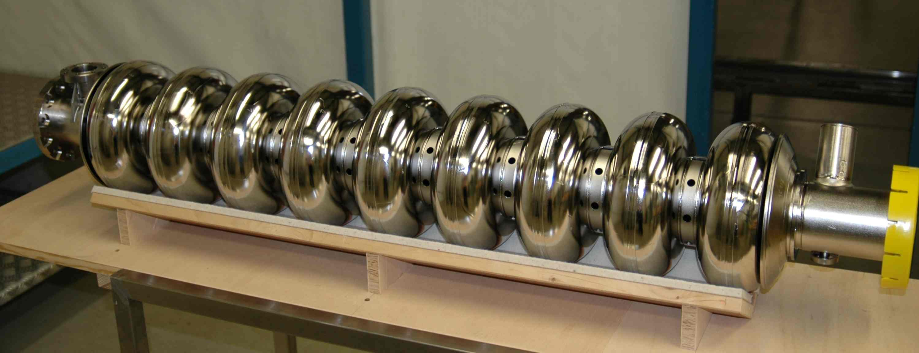
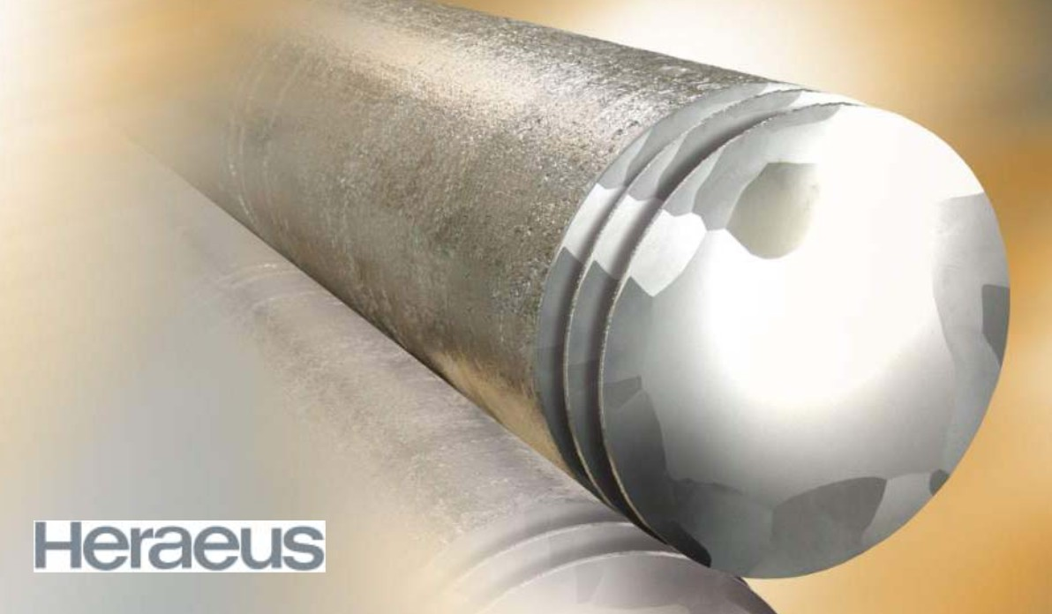
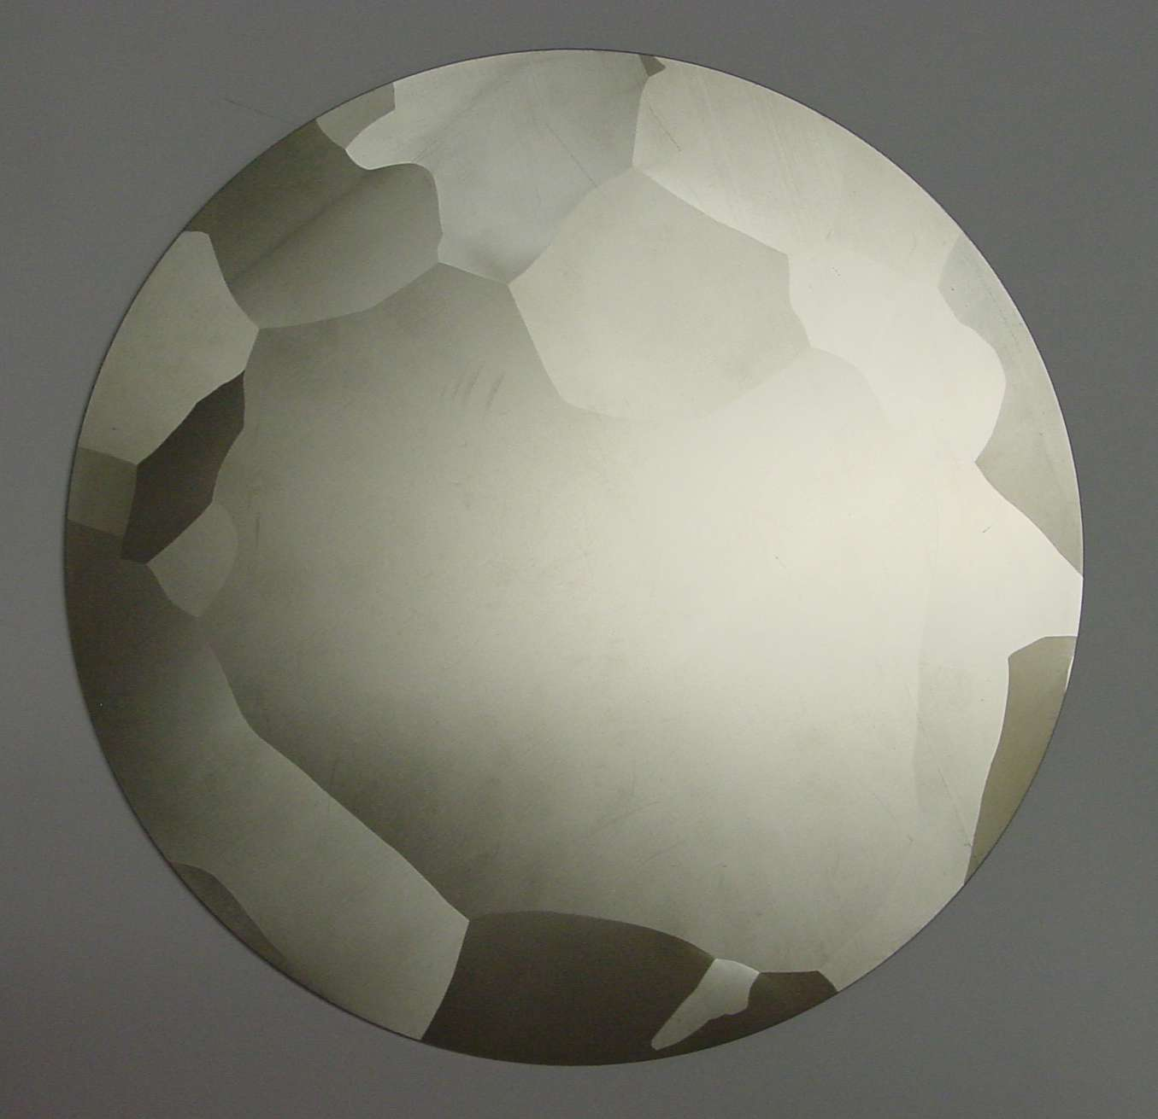
LG Niobium used at DESY
In 2006 ACCEL (now RI) built 11 large grain TESLA cavities made of the Hereaus ingot
Courtesy W. Singer
Courtesy W. Singer
9-cell large grain TESLA cavity

Slide 6
Performance of LG Cavities; Vertical test at 2K
<Qo>=2.26E10@16MV/m
7 LG cavities which have been later assembled in the XM-3 cryomodule

Slide 7
Performance of LG Cavities; Vertical test at 1.8K
<Qo>= 4.1E10@16MV/m
4 LG cavities, 2 marked black/white have been later assembled in the XM-3
Qo at 1.8K increases by ca. 80% as compared to Qo at 2K

Slide 8
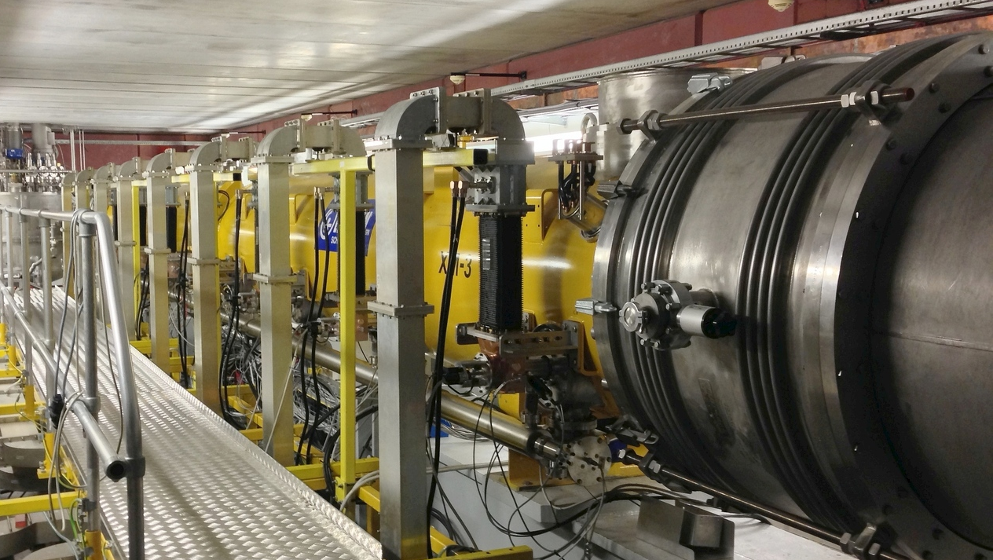
XM-3 History
7 cavities are made of LG niobium, one (Cav#3, AC146) is made of FG grain niobium.
XM-3 was for first time cw tested in 2013, at Eacc << than those demonstrated in the VT.
XM-3 is the mostly tested CM at DESY
XM-3 at CMTB

Slide 9
XM-3 History; Nominal mode tests
Courtesy D. Kostin
Tests in 2013 and 2017; operational <Eacc> = 33.3 MV/m

Slide 10
Recent (2018) XM-3 cw tests at 2K, 1.8K, 1.65K
Qo= 3.6E10@16MV/m
For whole CM Qo at 1.8K increases also ca. 80% as compared to Qo at 2K

Slide 11
Recent (04/2018) cw test of each cavity at 1.8K
<Qo> for 8 cavities is very close to Qo measured for whole XM-3 cryomodule

Slide 12
Recent test; fast and slow cool-down
33%
FCD increases Qo by 45% at 1.8K and 33% at 2K. B expulsion for FCD takes place.

Slide 13
CW upgrade scenario for E-XFEL; parameters
Capacity of present cryo-plant is ca. 2.4 kW. We will need additional one for the IS. The open question is, at what T shall the second plant operate?
T [K] |  | 1.8 | 1.8 | 1.8 | 1.8 | 2.0 | 2.0
 |  | L0 | L1 | L2 | Inj. Sect. L0+L1+L2 | Inj. Sect. L0+L1+L2 | L3 | Total cw | Total lp
Eacc | [MV/m] | 16.0 | 11.0 | 15.0 |  |  | 6.8 |  | L3 at 12.5
Energy/Linac | [GeV] | 0.13 | 0.4 | 1.5 | 2 | 2 | 5.4 | 7.4 | 12.0
HL/CM | [W] | 67 | 31 | 58 |  |  | 20
HL/Linac | [W] | 67 | 123 | 699 | 889 | 1449 | 1880
DF | [%] |  |  |  | 100 | 100 | 100 |  | 24
33%

Slide 14
CW upgrade scenario for E-XFEL;RF vs microphonics

Slide 15
CW upgrade scenario for E-XFEL;RF vs microphonics

Slide 16
Summary
LG Nb seems to be a reasonable choice for the new 136 cavities in the IS
LG Cavities fulfill Eacc spec ( 28+MV/m)
Qo is high at 2K:
  2.26E10@16MV/m (VT)
  2.0E10@16MV/m (CM) as measured with one FG cavity and one “not very clean” cavity#7
  and is 80% higher at 1.8K than at 2K
For cw/lp and I_{beam} of 25µA (100pC and 250kHz) required Prf/cavity @ Q_{load}=4E7 is:
  3.2 kW for L0
  1.6 kW for L1
  3.0 kW for L2
  0.7 kW for L3 (2kW peak in case of lp mode)
Open question: what T is optimal for the IS?
Currently XM-3 is tested by LLRF group for the VS stability at Q_{load} between 2E7 and 6E7

Slide 17
Acknowledgements
I want to express my gratitude to all Colleagues contributing to and supporting the experiments and R&D programs towards cw/lp operation modes
DESY: V. Ayvazyan, J. Branlard, R. Brinkmann, M. Ebert, J. Eschke, A. Gössel, D. Kostin, F. Mittag, W. Merz, W.-D. Möller, C. Müller, R. Onken, K. Przygoda, D. Reschke, R. Rybaniec, I. Sandvoss, H. Schlarb, A. Sulimov, E. Vogel, H. Weise……
TUL: W. Cichalewski, A. Piotrowski
Thank you for your attention

