Slide 1
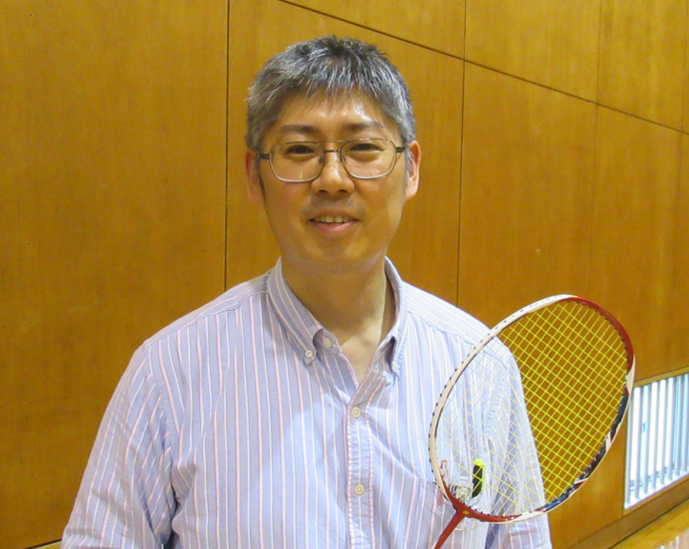
Industrial Applications in compact-ERL at KEK - EUV light source for semiconductor lithography, ⁹⁹Mo production for medical application, and Non-destructive inspection for nuclear security system-
Hiroshi KAWATA
(KEK, Japan)
Hiroshi SAKAI
(KEK, Japan)
Hiroshi KAWATA
(KEK, Japan)

Slide 2
Contents
History of ERL Project in KEK: (CW super conductive accelerator)
KEK Project Implementation Plan (KEK-PIP)
industrial applications
EUV-FEL for Future Lithography
RI manufacturing facility for nuclear medical examination
High resolution X-ray imaging device for medical use
Nuclear security system
Summary

Slide 3
History of ERL project in KEK
Fiscal Year
2005 Institute of Materials Structure Science in KEK decided to start the R&D of 5GeV ERL light source as a future light.
2006 Establishment of ERL Project Office in KEK
2007 The CDR on Compact ERL (cERL) was published
2008 The construction of the infra structure started.
2013 The construction of the cERL was completed and the commissioning of the ERL operation started. (0.01 mA)
2015 The commissioning of the cERL (1mA), bunch compression and high bunch charge operation (7.7pC/ bunch).
2016 The future light source was shifted to the ring-based accelerator, so that there is no back ground to continue the ERL R&D.
2017 ERL project Office was closed in KEK and “Utilization Promotion Team based on Superconductive Accelerator” was in KEK in order to find industrial applications based on superconductive accelerator.

Slide 4
KEK Project Implementation Plan (KEK-PIP)
http://www.kek.jp/ja/NewsRoom/Release/20160802141100/
3-2. Other research projects carried out using general funds of KEK
The following projects have up to now been conducted mainly using general funds of KEK. They will be continued on the condition that greater efforts are made to obtain external funding.
▪ Simulation studies with the existing supercomputer (only up to summer of 2017)
▪ Industrial application of ERL technology
▪

Slide 5
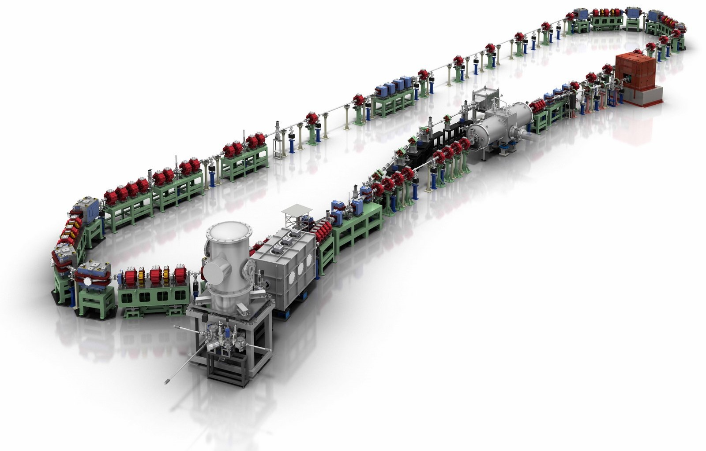
The Compact ERL (cERL)
The cERL contains all important technologies.
The first arc
Injector diagnostic beamline
Recirculation loop
Beam dump
Dump chicane
Main-linac cryomodule
Merger
Circumference: ~ 90 m
The second arc
Injector cryomodule
©Rey.Hori/KEK
Photocathode DC gun (JAEA)

Slide 6
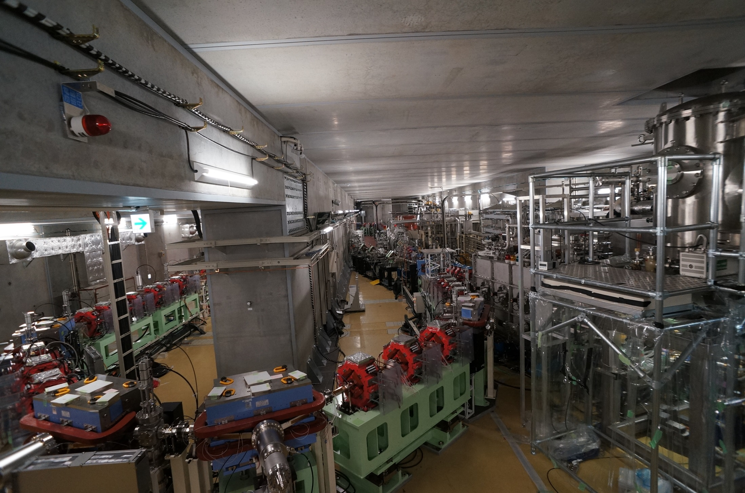
Picture of the cERL
Photocathode DC gun
Injector diagnostic beamline
Main-linac cryomodule
Recirculation loop
Injector cryomodule
6

Slide 7
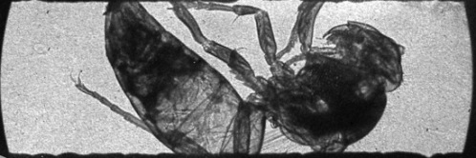
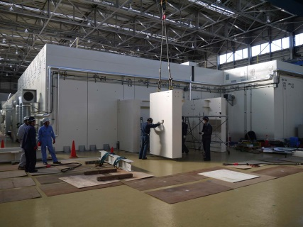
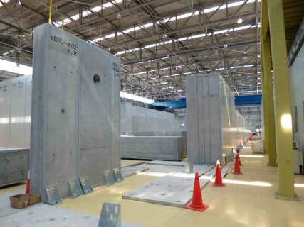
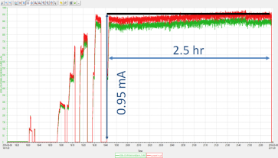
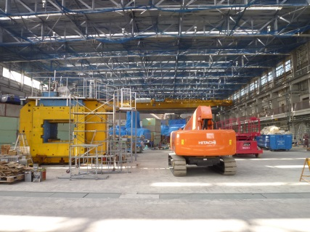
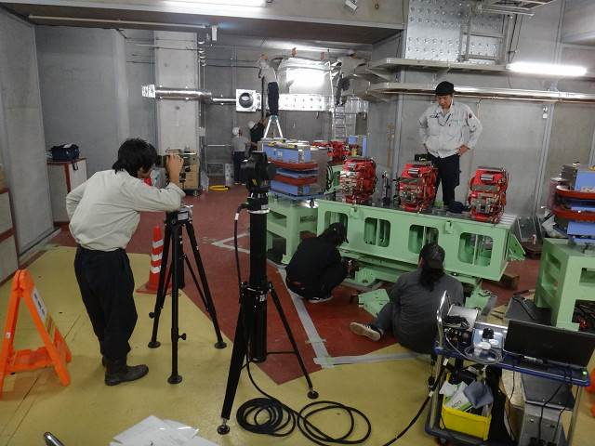
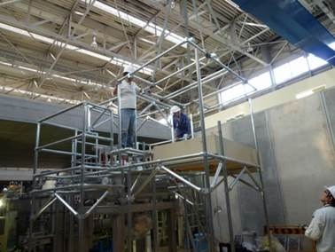
R&D for Industrial application
Construction and Commissioning of cERL
2008 | 2009 | 2010 | 2011 | 2012 | 2013 | 2014 | 2015 | 2016 | 2017
Construction
High bunch charge
Commissioning/Operation
Increasing the beam current
Commissioning of LCS system
Construction of LCS system
Commissioning of cERL (with loop)
Construction of recirculation loop
Commissioning of injector
Construction of
injector
Refurbishment
of building
Clearing radioactive
materials
Construction of
radiation shielding
7

Slide 8
Back Ground
Super conducting accelerator gives us high current linac-based electron beam (~10mA) with high quality of the electron beam such as small emittance, Short pulses.
The unique performance gives us several important industrial applications as follows.
EUV-FEL for Future Lithography
RI manufacturing facility for nuclear medical examination
High resolution X-ray imaging device for medical use
Nuclear security system

Slide 9
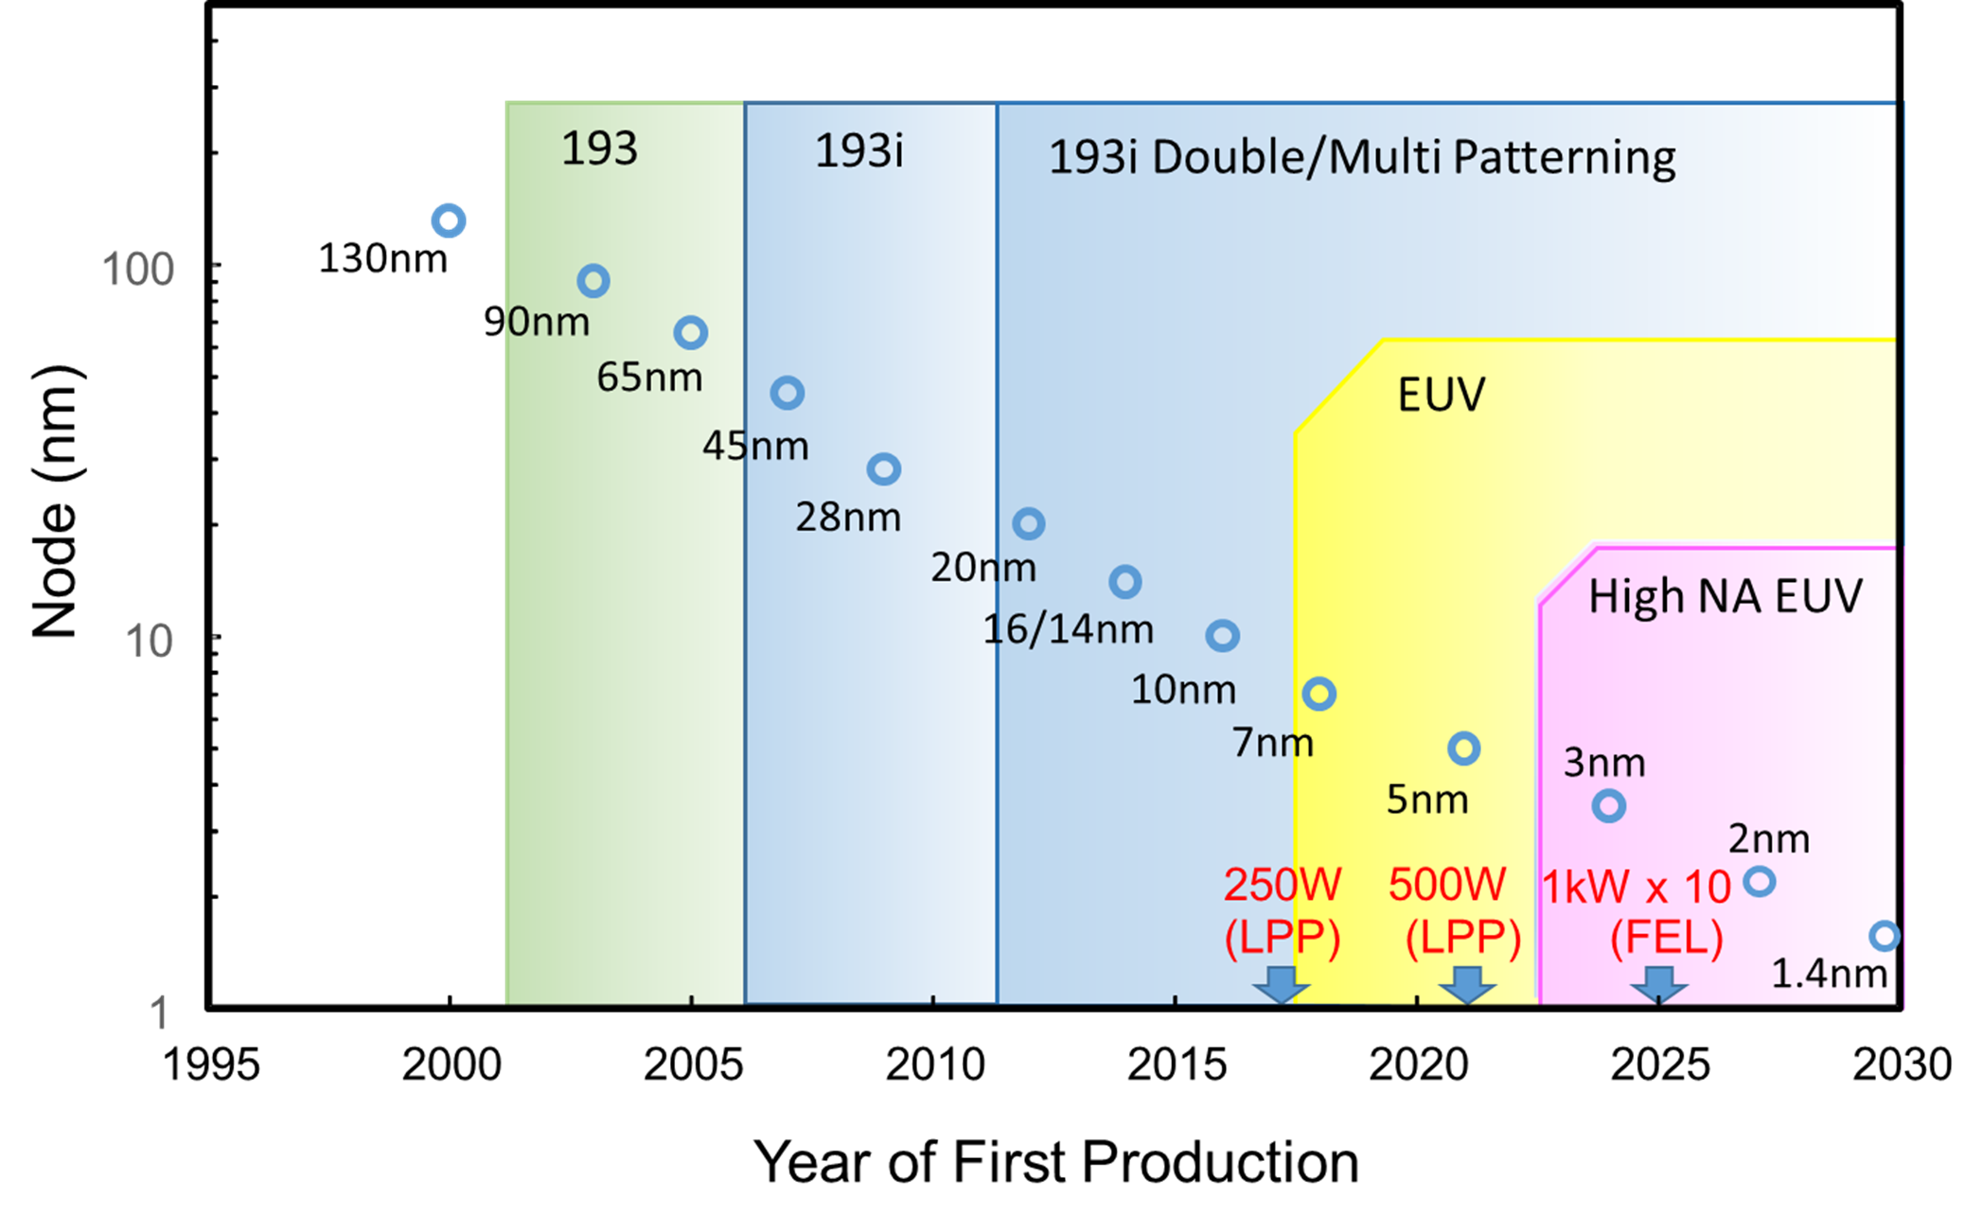
1. EUV-FEL for Lithography (Back ground)
Technology node trend of Logic LSI and expected power on EUV light source

Slide 10
Present Status and Future Development on EUV Lithography
Present Status
The technologies on EUV Lithography system based on LPP light source are progressing, now.
The system based on ~200 W LPP light source is starting point of the production phase.
Future Development
It is expected that these on ~1kW source will be necessary to realize the production less than 3nm node, too.
It is important to develop new type light source to realize higher power than ~1kW.

Slide 11
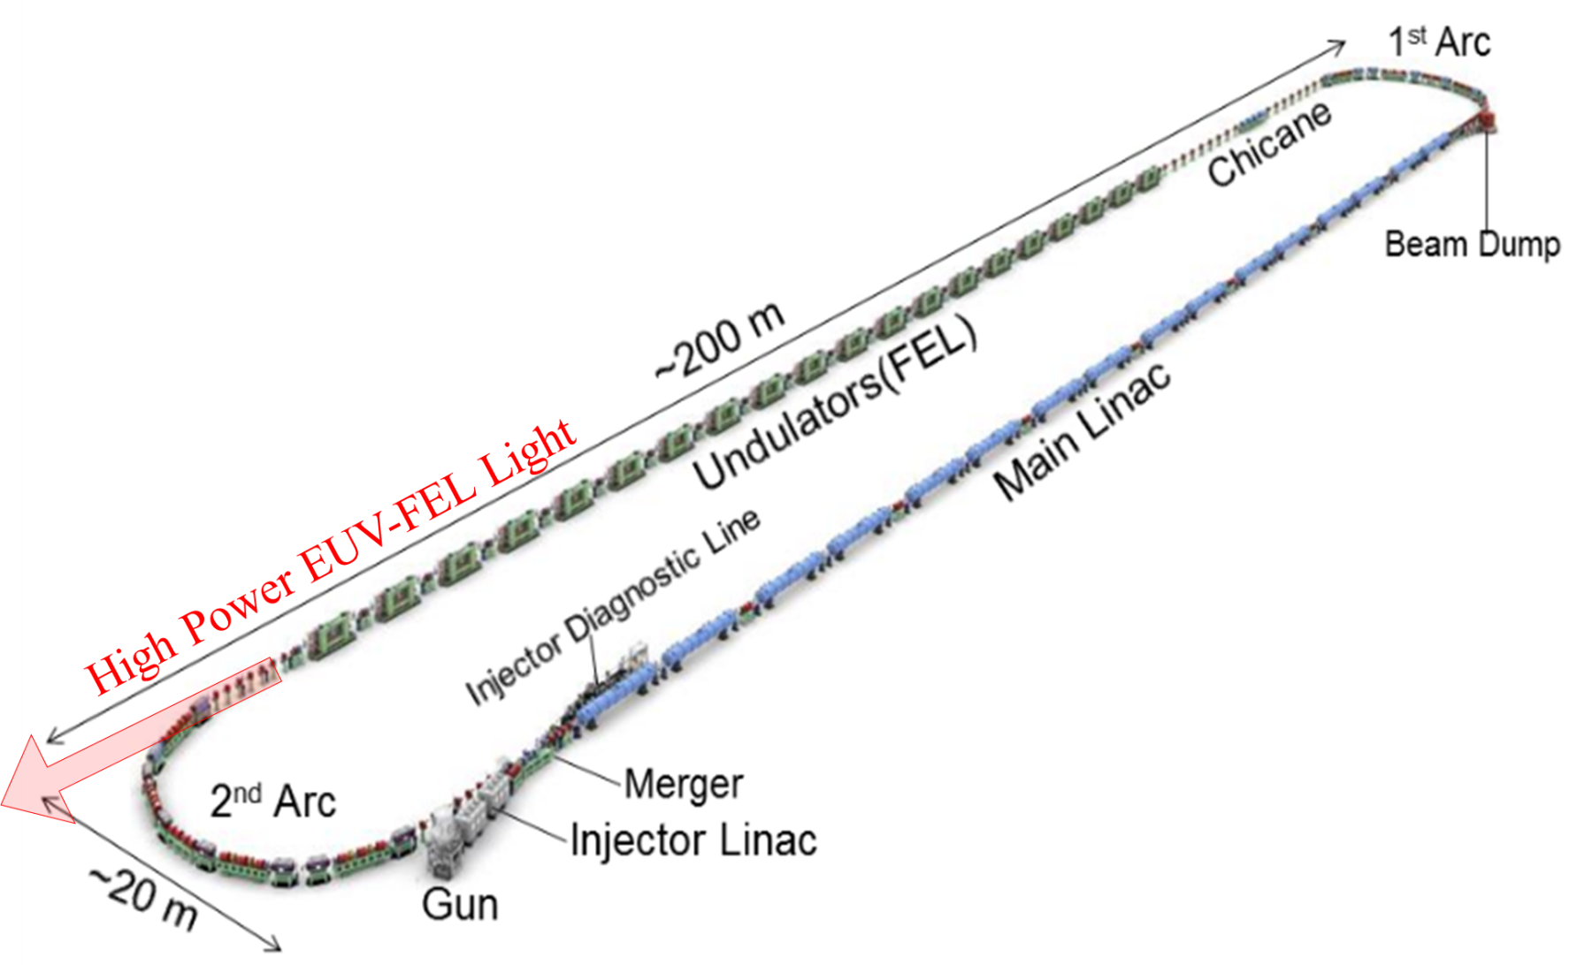
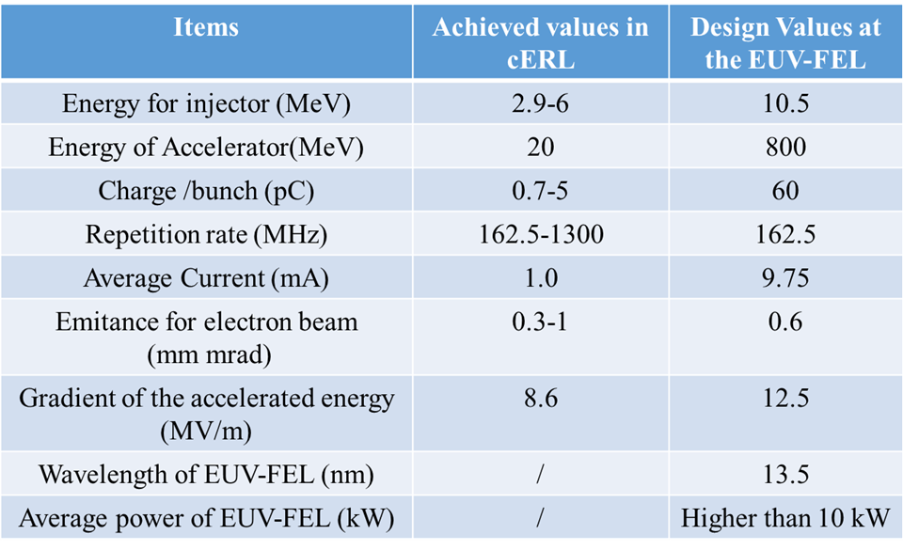
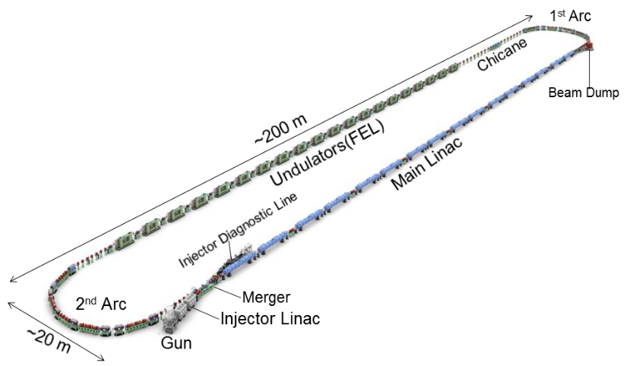
Prototype design of the EUV-FEL
High Power EUV-FEL Light
Fig. 2 Prototype design of the EUV-FEL

Slide 12
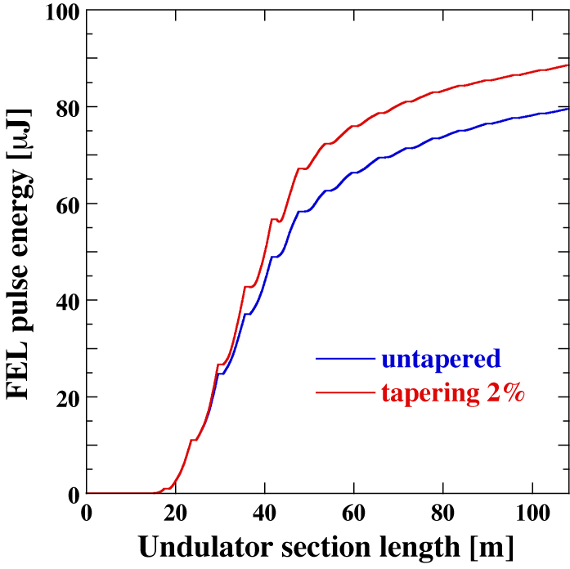
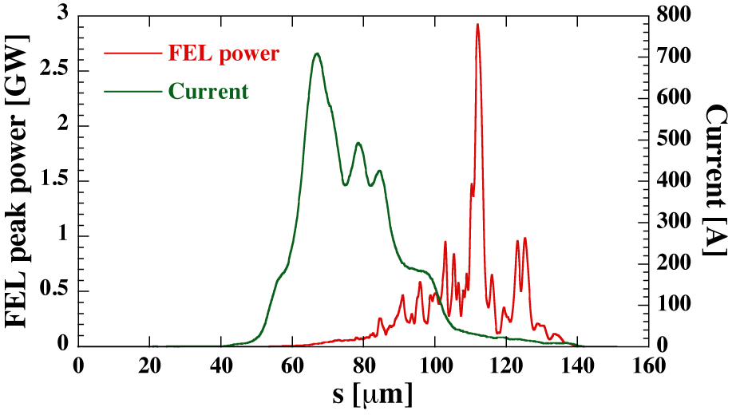
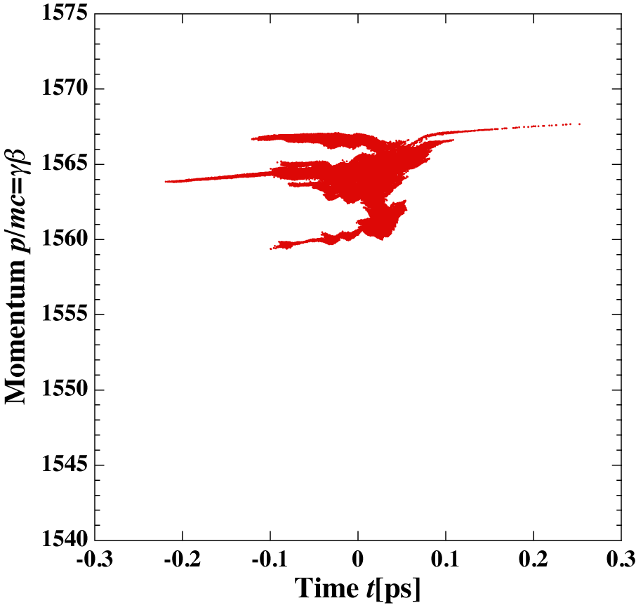
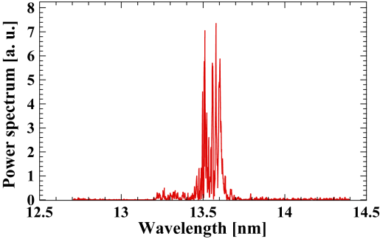
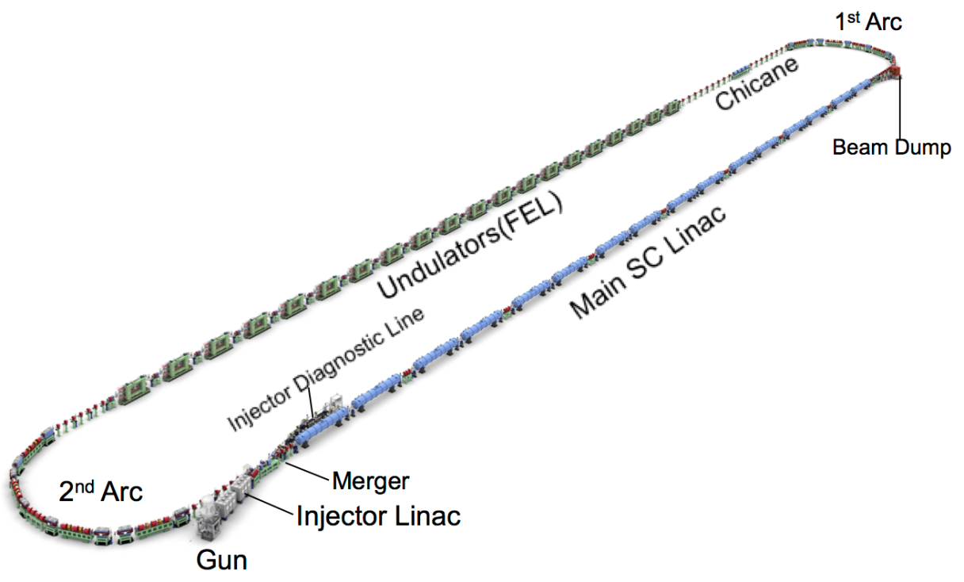
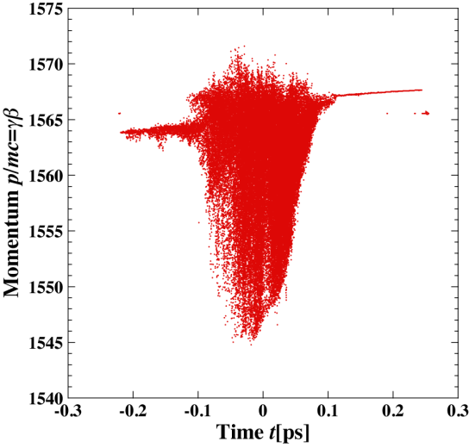
FEL Performance
BY N. Nakamura
88.5μJ
79.5 μJ
<γβ>=1561.1
σ_{t}=48.5 fs
σ_{p}/p=0.299 %
ε_{nx}=1.98 mm·mrad
ε_{ny}=0.71 mm·mrad
FEL power without tapering: 12.9/25.8 kW @ 9.75/19.5 mA (162.5/325 MHz)
FEL power with 2% tapering: 14.4/28.8 kW @ 9.75/19.5 mA (162.5/325 MHz)
(P_{FEL}=84 μJ x 162.5 MHz =13.7 kW, I_{av}=60pC x 162.5 MHz=9.75 mA)
Energy spread is increased.
e⁻
<γβ>=1561.1
σ_{t}=48.5 fs
σ_{p}/p=0.299 %
ε_{nx}=1.98 mm·mrad
ε_{ny}=0.71 mm·mrad
P_{FEL} > 10 kW is achieved.

Slide 13
Rough estimation of the FEL radiation power
 | LCLS | SACLA | FLASH | Euro-XFEL | LCLSII | EUV-FEL
Type of linac | Normal conducting |  | Super conducting
Operation mode | Pulse |  | Long pulse |  | CW
Country | US | Japan | Germany | Germany | US | -------
ERL scheme | No | No | No | No | No | Yes
Repetition rate | 120 | 30～60 | <5000 | <27000 | 1M | 162.5M
Accelerate Energy （MeV) | 14300 | 6000～8000 | 1250 | 17500 | 4000 | 800 0.01@Injection
Minimum wave length (nm) | 0.15 | 0.08 | 4.2-52 | 0.05 | ~0.3 | 13.5
Power/pulse (mJ) | ~10 | ~10 | <0.5 | ~10 | ~1 | ~0.1
Power/s （W) | ~1 | ~1 | <0.6 | ~100 | ~1000 | >10000
Beam dump power （W) | ~1.5k | ~0.5k | ~6k | ~0.5M | ~1M | ~0.1M
Operation/ Construction/ Planning | Operation 2009 | Operation 2011 | Operation 2004 | Start the commissioning 2017 | Construction 2020 | Planning

Slide 14
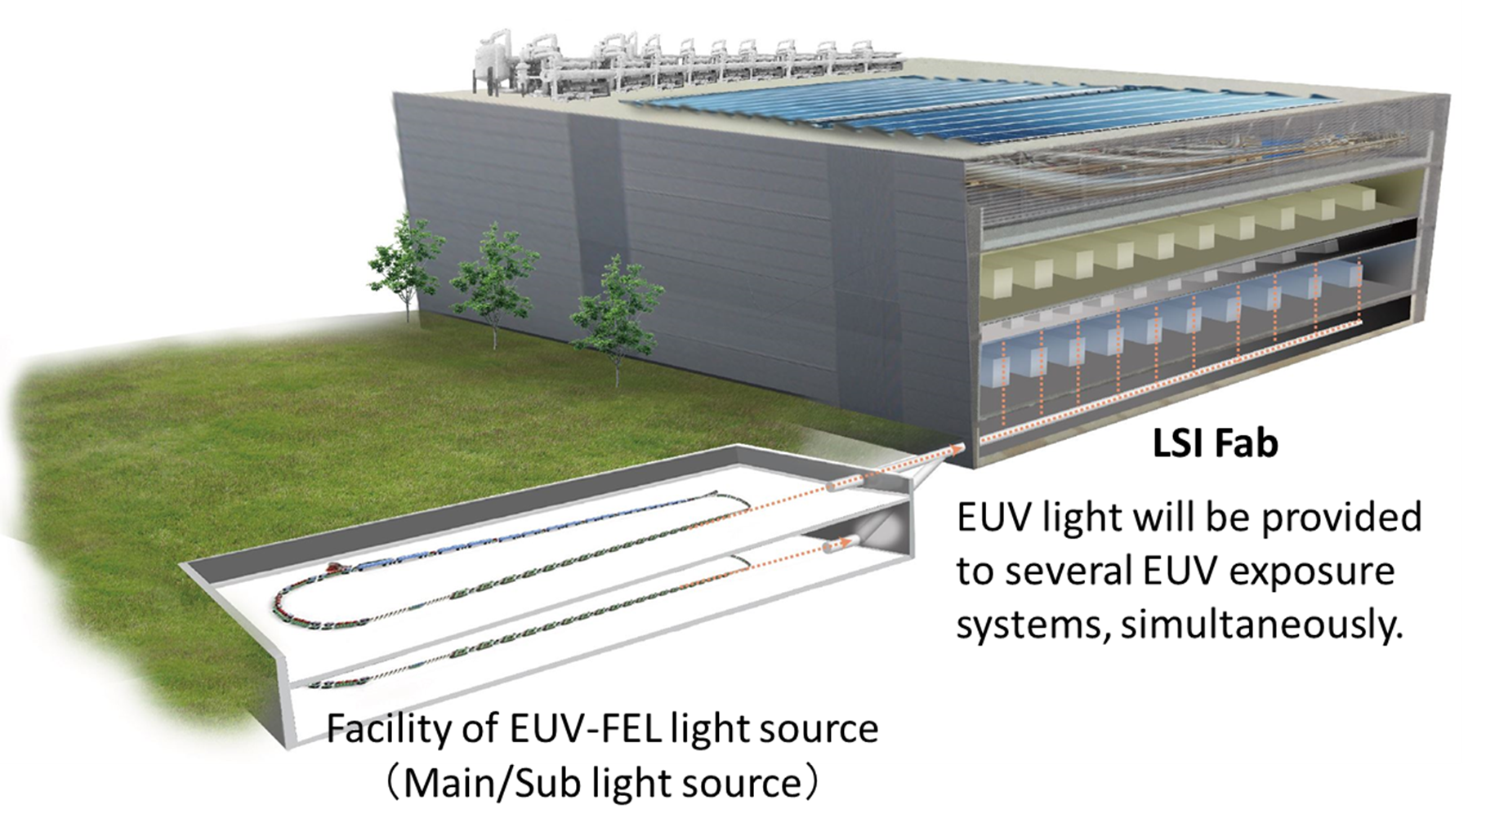
Expected LSI Fab based EUV-FEL

Slide 15
EUV-FEL Light Source Study Group for Industrialization
S. Ishihara (Leader)
Univ. of Hyogo
Osaka Univ.
I. Matsuda
Utsunomiya Univ.
H. Kinoshita
Waseda Univ.
T. Kozawa
T. Higashiguchi
M. Washio
Industries
Industrialization of High Power EUV light source based on ERL@KEK and FEL@QST
R. Hajima
N. Sei
H. Kawata et al.
KEK

Slide 16
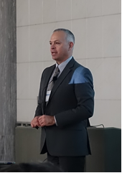
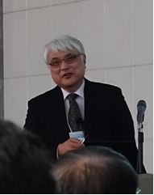
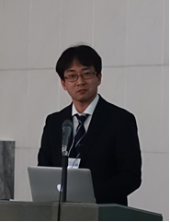
2nd EUV-FEL Workshop
Date: 12/ Dec. /2017 10:00-17:00
Site: Surugadai-kinenkan, Tokyo
Participants : 103 (Source group, tool & material venders, end users etc.)
http://pfwww.kek.jp/PEARL/EUV-FEL_Workshop2/program_eng.html
Invited Speakers
Michael Lercel (ASML)
"EUV industrialization for HVM and future outlook"
Tetsuya Ishikawa (RIKEN SPring-8 Center)
“Laser plasma amplification of SACLA XFEL
beam and its extension to EUV-FEL applications”
Masaharu Nishikino (QST)
“Research on the interaction of a SXFEL with
matter for EUV ultra-precision nano-fabrication”
Notes:
We organized one-day workshop for EUV-FEL with source group, tool and material venders, and end users.

Slide 17
Reduction of Source Size
Higher field gradient of Main SC cavities
Increase of power consumption ∝ E_{acc}²/Q
Development of High-Q SC cavity is essential.
Lower Beam Energy
Shorter undulator period and stronger magnetic field
Increase of current or energy conversion efficiency for the same FEL power
2-loop/2-turn ERL
Optics design for CSR effect suppression
Increase of current for the same FEL power

Slide 18
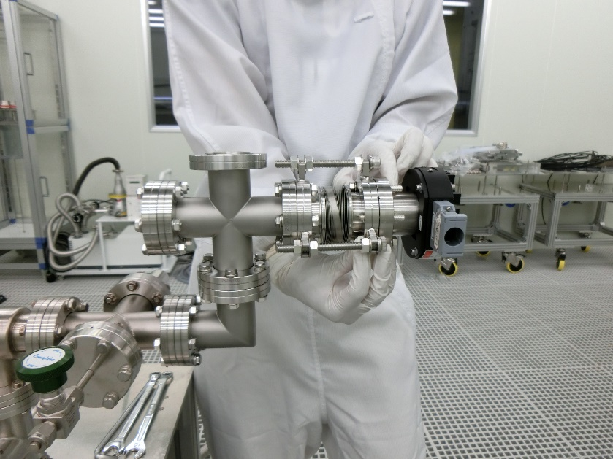
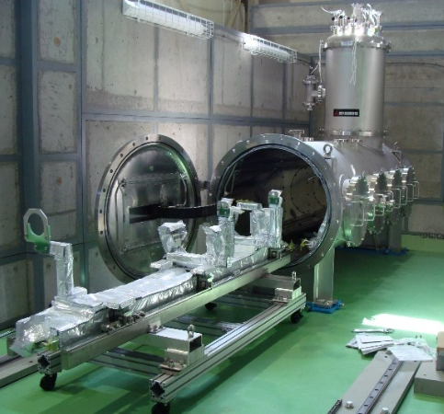
SRF Challenges for Higher-Gradient
Key issue to achieve higher gradient in SRF cavities of CW operation is to suppress field emission caused by dust particles and so on.
Improvement for clean environments with dust free
Set-up of particle measurements in vacuum by using a vacuum particle counter
Test bench to confirm the higher gradient performance of SRF
Horizontal cryostat to improve particle contamination during assembly work

Slide 19
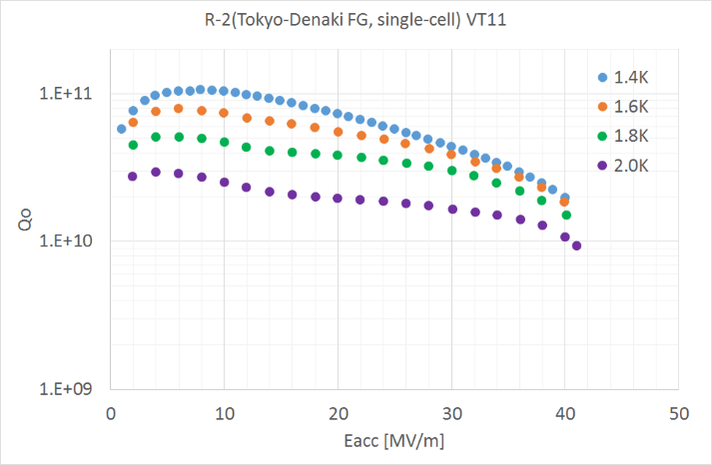
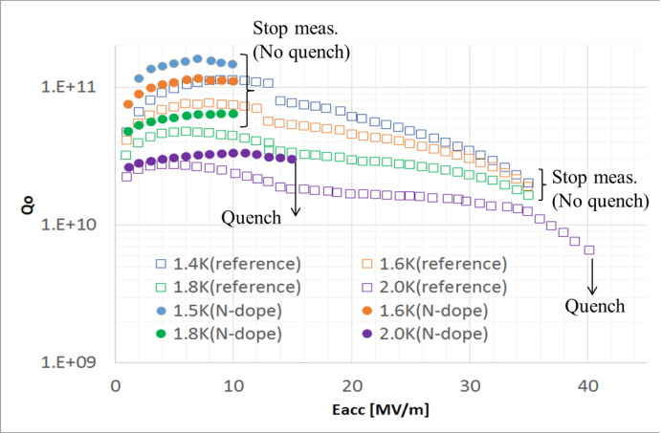
SRF for Higher-Q
power consumption ∝ Eacc²/Q
One of essential factors to achieve higher Q values is to reduce a residual magnetic field around a cavity.
Preliminary DATA 2017
A solenoid coil for cancelling the residual magnetic field
Improvement of Q values from normal processing to nitrogen doping treatment
1x 10¹⁰ 2.5x 10¹⁰ @ 2K
2.5x 10¹⁰ 4x 10¹⁰ @ 2K

Slide 20
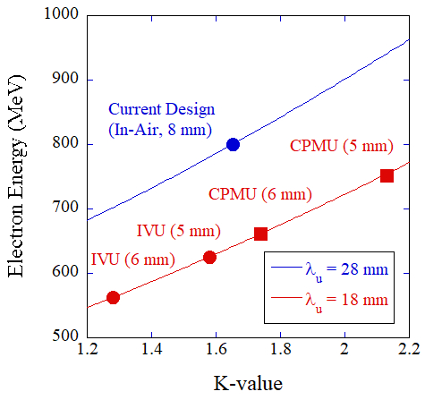
Performance by Introducing Shorter Period Undulators (1)
The performance by introducing shorter period undulators; In-Vacuum Undulators (IVUs), Cryogenic Permanent Magnet Undulators (CPMUs)
Energy spread | 0.1 %
Charge | 60 pC/bunch
Bunch length | 100 fs
Peak current | 600 A
Average current | 9.75 mA
Normalized emittance (εx = εy) | 1.0 π mm mrad
Beta func. (βx = βy) | 5 m
Repetition | 162.5 MHz
Reduction of the accelerator energy
λ=λ_{u} (1+K²/2)/2γ ²
Beam parameters assumed in the calculation

Slide 21
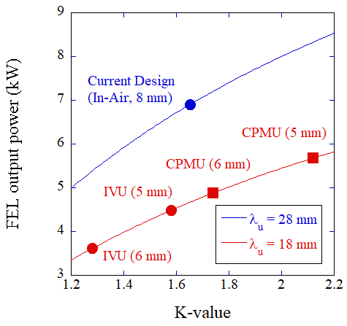
Performance by Introducing Shorter Period Undulators (2)
FEL Output Power
P_{FEL}=η P_{beam}
η=1.6 ρ /(1+Λ)²
ρ : the one-dimensional FEL parameter,
Λ : the correction term due to the effect of an energy spread
Consequently, the introduction of the shorter period undulator gives us the reduction of the accelerator energy, however, the FEL output power also will be reduced.

Slide 22
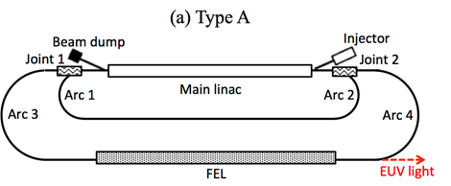
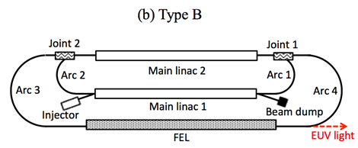
Double-Loop Configuration
Type A: Electron beam is accelerated twice by the same main-inac and the size can be reduced.
The total beam current in the main linac is doubly increased and it may make a problem caused by the higher-order-modes(HOMs).
Type B: Main-linac cavities are placed on both loop sides and the size can be reduced.
There is no problem of the HOMs like Type A.
Double number of main-linac cavities is required compared to the Type-A.
At the both cases, we have to carefully design the joint sections (Joint 1 and Joint2) to reduce the effect of CSR, which makes a damage of the electron quality and also arc sections (Arc 3, and Arc4) should be designed to be able to make bunch compression and decompression.

Slide 23
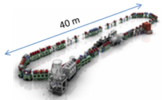
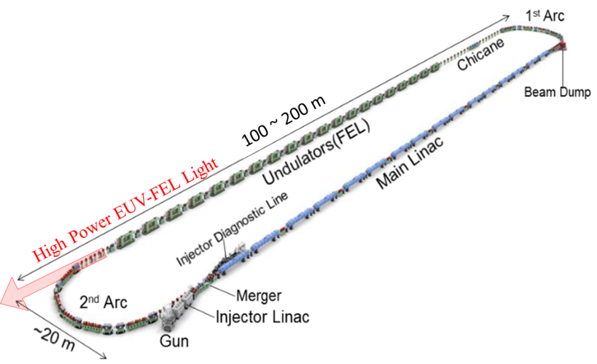
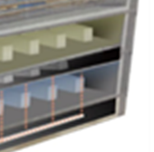
Staging to realize the EUV-FEL light source for Lithography
1st stage:
Development of the feasible technologies
kW-class Infrared FEL
cERL
2nd stage Phase 1:
Establishment of the EUV-FEL Lithography system
EUV-FEL Prototype
2nd stage Phase 2:
International Development Center on the processing of EUV-FEL lithography
EUV-FEL Prototype
Clean room with EUV exposure system
The above concept should be important to realize the EUV-FEL high power light source for EUV Lithography.

Slide 24
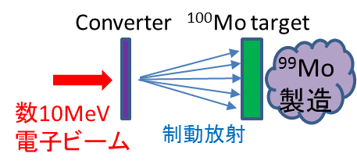
2. RI manufacturing facility for
nuclear medical examination (⁹⁹Mo/^{99m}Tc)
Courtesy of K. Umemori
Concern about the stable supply of ⁹⁹Mo / ^{99m}Tc
⁹⁹Mo is almost 100% imported, even though the largest number of applications in nuclear medicine diagnosis
Problem of the stable air transportation
(Problem caused by volcanic eruption in the past)
Most ⁹⁹ Mo is manufactured in nuclear reactor
Due to the aging of nuclear reactors, stable supply in the future is a big issue
A state of brain blood flow revealed by nuclear medicine diagnosis by 99 ^{m}Tc
Development of RI manufacturing (⁹⁹ Mo / ^{99 m}Tc) by using accelerator for stable supply
Required Specification
for accelerator
20 ~ 50 MeV electron beam
Several mA to 10 mA
⁹⁹Mo
A few 10MeV Electron Beam
Bremsstrahlung

Slide 25
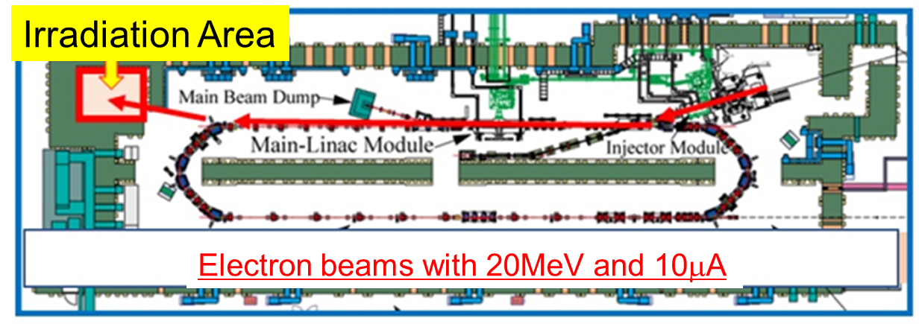
Test Experiment to produce ⁹⁹Mo in cERL is preparing
The test irradiation of electron beams to a multiple molybdenum target will be done at this fiscal year to produce ⁹⁹Mo and check the yield of the production in order to realize a real machine with large electron beam power.
It is necessary to get several knowledge to design a target system for large irradiation power such as a practical technique for ⁹⁹Mo production, target thermal design, shielding radiation design and legal procedures, etc. It is the final objective of this project.

Slide 26
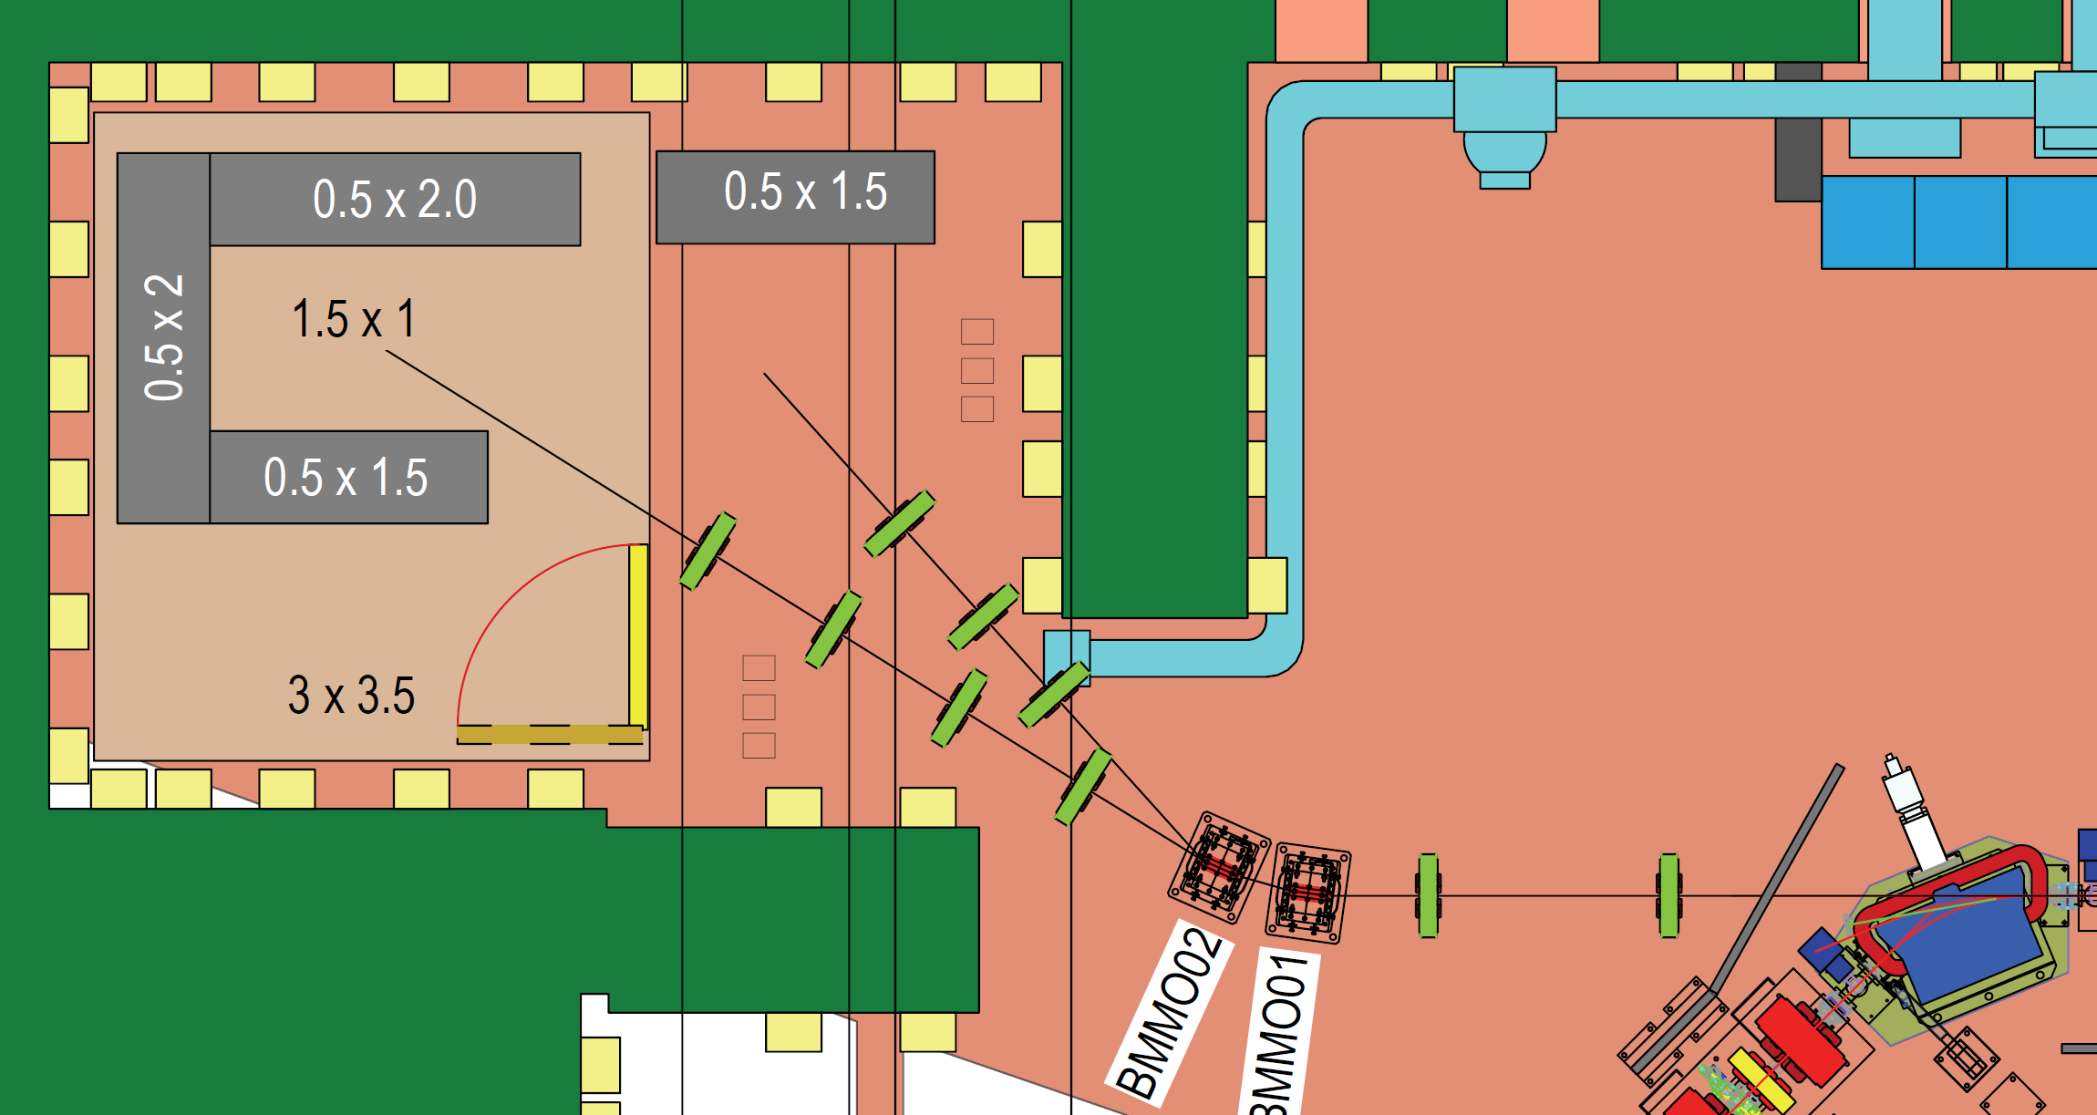
Mo99 Beamline Configuration (Under designing)
Asphalt BL
10MeV 10μA
Mo 20MeV 10μA(maximum)

Slide 27
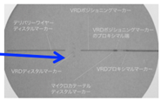
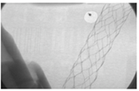
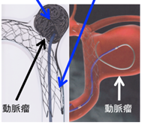
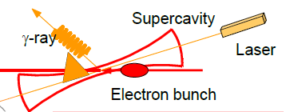
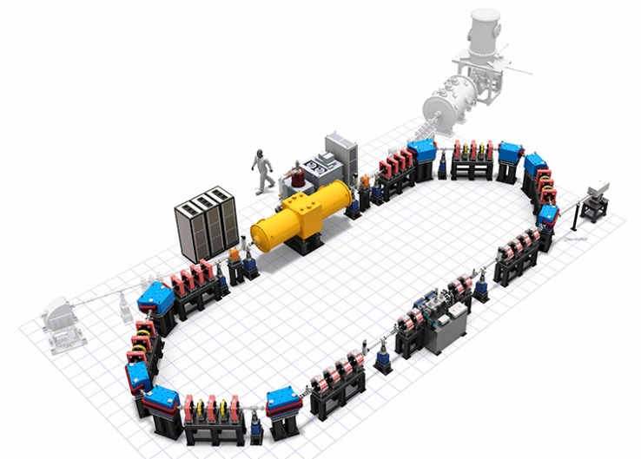
3. High resolution X-ray imaging device for medical use From the view point of neurosurgery
Courtesy of K. Hyodo
Intravascular surgery of
neurosurgery
Using a large synchrotron radiation facility
coil: Stuffed aneurysm and stop bleeding
Stent: Support stabilizing coil
High resolution
Stents can be clearly visualized
Image under surgery
The stent can not be seen
Provided by the Department of
Neurosurgery, University of Tsukuba
If we can make a compact high-resolution X-ray source in a hospital!
Laser Compton scattered X-ray source at ERL
10m
Potential of quasi-monochromatic X-rays for high resolution X-ray imaging by laser Compton scattering (LCS)
Quasi-monochromatic
X-rays for high resolution X-ray imaging
~6m
LCS device

Slide 28
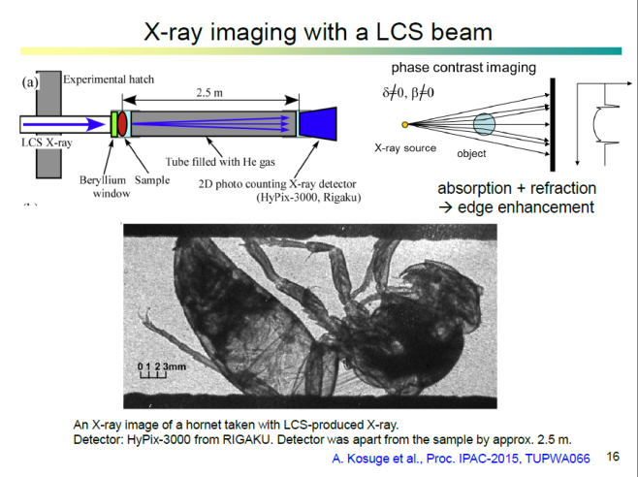
3. High resolution X-ray imaging device for medical use Feasibility from the experimental result on cERL
Success of LCS at cERL (March/2014) (high resolution X-ray imaging)
(20MeV, 0.1 mA, 10kW laser Cavity)
http://www.kek.jp/ja/NewsRoom/Release/20150427150000/
Result of March/2014
X-ray Energy 7keV
Exposure time 600sec
Main issues for medical application
1) Too long exposure time
2) Too low Energy
(50MeV, 10 mA,
>100kW laser Cavity)
X-ray Energy ~40 keV
Exposure time <0.1 sec
Starting point of medical application

Slide 29
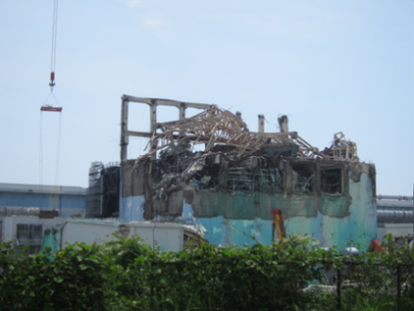
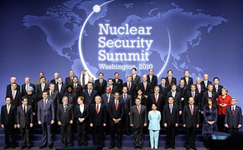
4. Nuclear security system
(Non-destructive Detection and Measurement of Nuclear Material by Laser Compton Scattering Gamma Ray)
Courtesy of R. Hajima
Necessity of non-destructive detection and measurement
of nuclear material
1) Deterrence of terrorism using nuclear material
2) Nuclear nonproliferation
· Confront terrorism with an international framework
(nuclear security summit)
· Border strategy to investigate the nuclear material is essential against nuclear terrorism.
· Melted fuel will be taken from Fukushima Nuclear Power plant from 2021
· Nuclear material measurement of melted fuel is essential

Slide 30
R. Hajima: ERL15

Slide 31
R. Hajima: ERL15

Slide 32
Summary
Super conducting accelerator gives us high current linac-based electron beam (~10mA) with high quality of the electron beam such as small emittance, Short pulses.
following important industrial applications are presented.
EUV-FEL for Future Lithography
RI manufacturing facility for nuclear medical examination
High resolution X-ray imaging device for medical use
Nuclear security system
The cost and size reductions at the accelerator system are also very important for industrial applications, so that the R&Ds for High Q and high temperature system of SRF are essential.

