Slide 1
HOM Damping Couplers for the LHC-HiLumi RF Dipole Crab Cavity
Zenghai Li (SLAC)
Jean Delayen (ODU)
For the LARP and AUP RFD Cavity Team
TTC 2018, RIKEN Nishina Center, 26-29 June 2018

Slide 2
Outline
RFD Cavity
HOM impedance requirements
HOM coupler design
Beam HOM power minimization
HOM coupler tolerance analysis
Summary

Slide 3
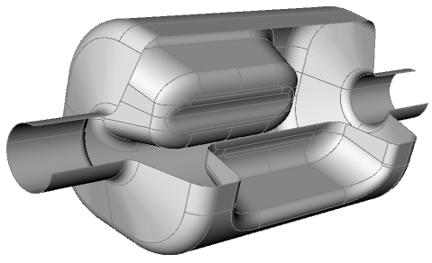
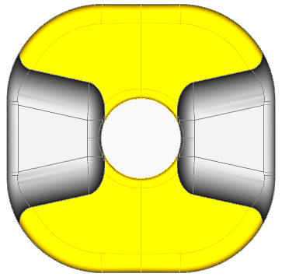
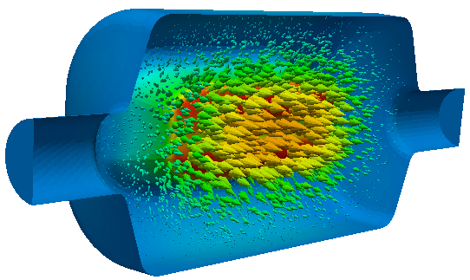
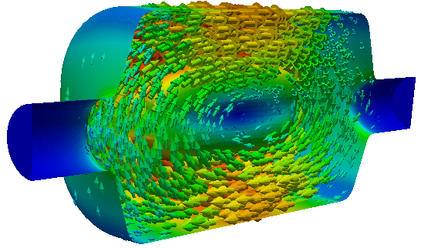
RFD Cavity Parameters
E B
RFD Crab Cavity
Frequency (MHz) | 400
Operating Mode | TE11
Lowest dipole HOM (MHz) | 633
Lowest acc HOM | 715
Iris aperture (diameter) (mm) | 84
Transverse dimension (mm) | 281
Vertical dimension (mm) | 281
Longitudinal dimension (w/o couplers) (mm) | 556
R_{T} (ohm/cavity) | 433
V_{T} (MV/cavity) | 3.34
Bs (mT) | 55.6
Es (MV/m) | 33.4
Deflect mostly by E field
No lower order mode
Compact
Pole face shaped to minimize higher multipole fields

Slide 4
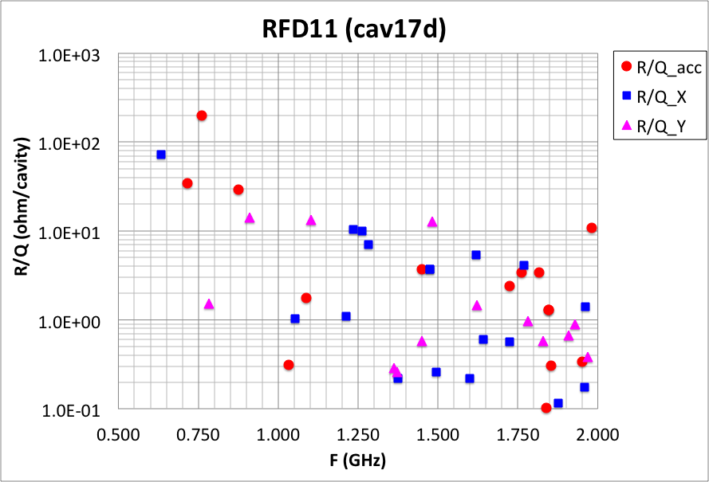
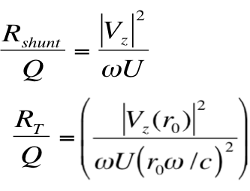
RFD Impedance Spectrum
(R_{shunt}/Q)
Lowest HOM is at 630 MHz, 230 MHz above operating mode frequency
Can use high-pass filter HOM dampers to damp the HOMs

Slide 5
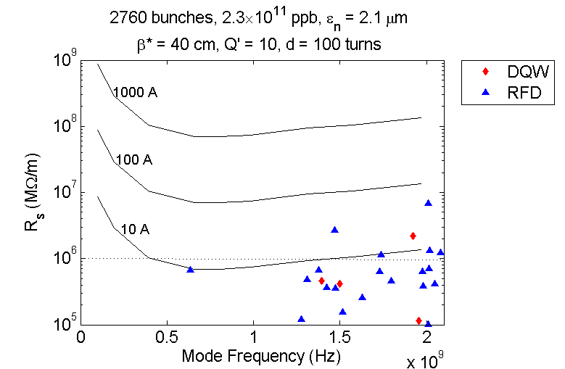
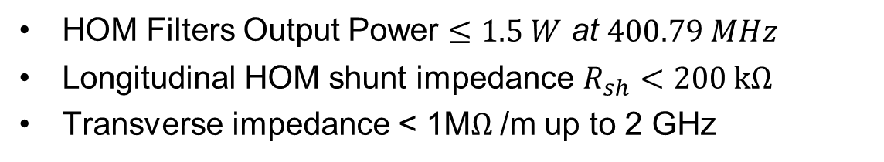
HOM Design Requirements
HOM Filters Output Power $≤1.5 W$ at $400.79 MHz$
Longitudinal HOM shunt impedance $R_{sh}<200 kΩ$
Transverse impedance < 1M$Ω$/m up to 2 GHz
(no other sources of impedance)
(Nov. 2017)
Most HOMs require negligible octupole current, even if they fall on the couple-bunch line
2017 update,
New for AUP RFD design
(LARP RFD)
S. Antipov, D. Amorim, N. Biancacci, X. Buffat, L. Carver, F. Giordano,​ G. Mazzacano, A. Mereghetti, E. Metral, S. Redaelli, B. Salvant​, 7th HL-LHC Collaboration meeting, CIEMAT, Madrid – 15.11.17​ (Nov. 2017)
Require
attention

Slide 6
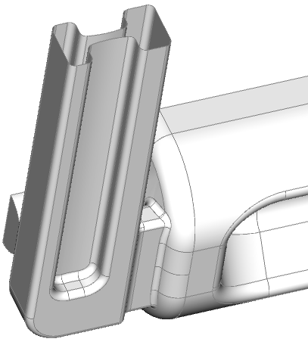
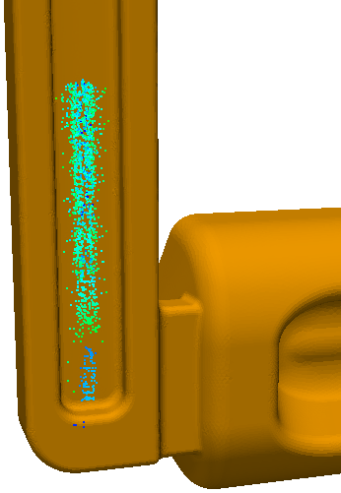
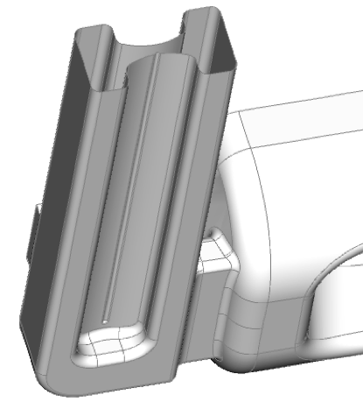
Ridged Waveguide HOM Damper ?
A cutoff waveguide could be an option for HOM damping
Operating mode below cutoff – naturally reject operating mode
Ridged waveguide minimize size, though still relatively large than coaxial type coupler
Achieves effective damping
However multipacting could be an issue, need to add large curvature feather to suppress MP
Thermal leak would be higher due to a large cross-section
NOT adopted for RFD cavity
MP region moves upward at high voltages
MP region at a lower voltage
Large curvature feature needed to suppress MP

Slide 7
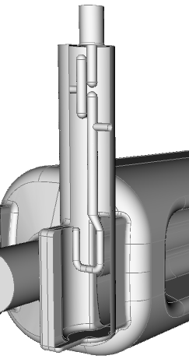
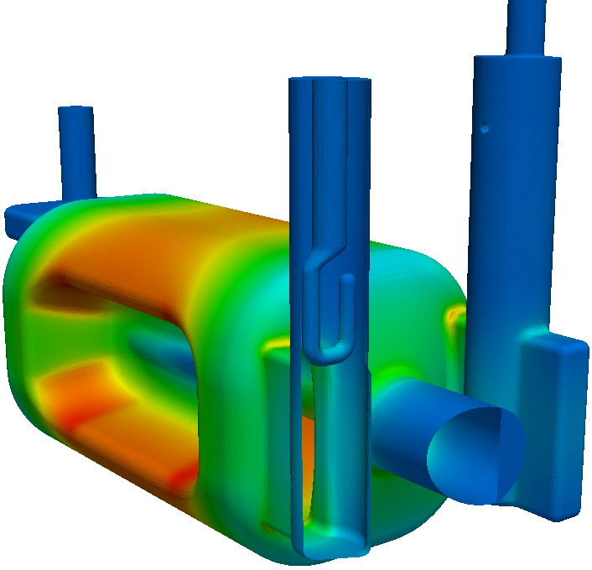
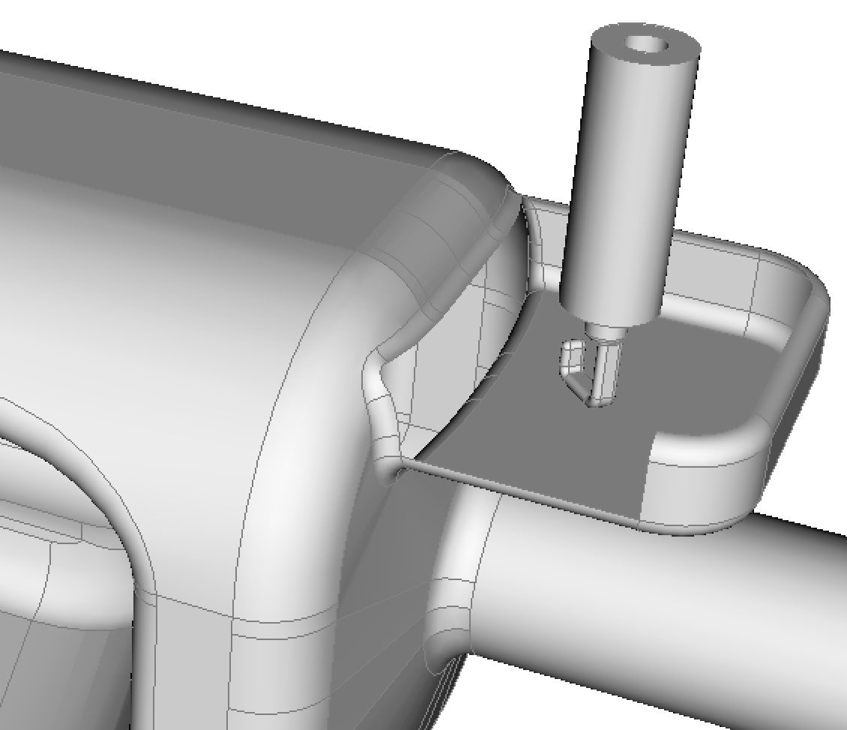
FPC and HOM Couplers for RFD
H-HOM
(Hi-pass filter)
V-HOM
(selective coupling)
FPC
Couplers at low field regions
  Minimized RF heating on the coupler
  Minimized effects on the field asymmetry
High-pass filter H-HOM coupler
Selective coupling V-HOM coupler, no filter needed
Coupler ports oriented to keep clearance for the second beam pipe

Slide 8
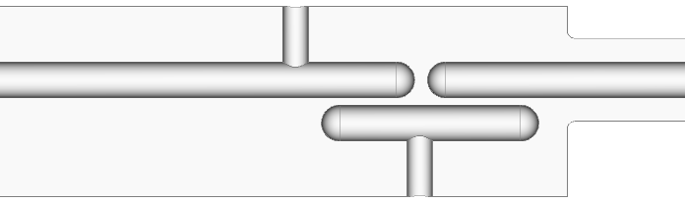
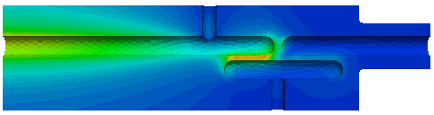
H-HOM Coupler
Cutoff waveguide stub + high-pass filter
rejection of operating mode
HHOM coupler and filter in low field region – minimizes RF heating
Waveguide stub add additional rejection of operating mode – loosening tolerance on filter dimensions

Slide 9
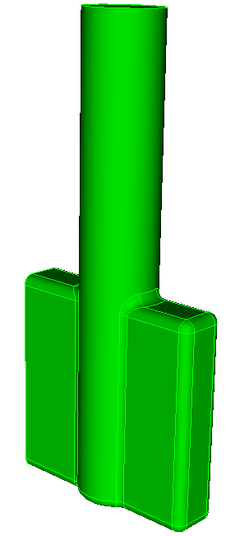
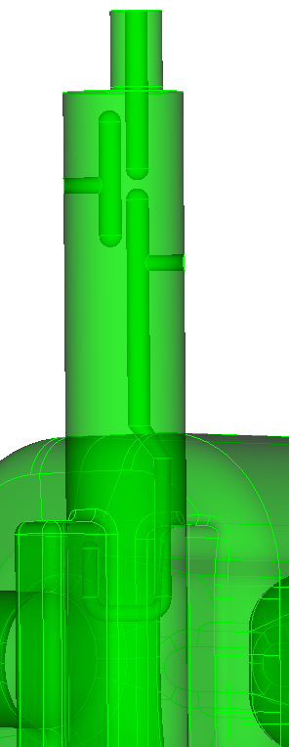
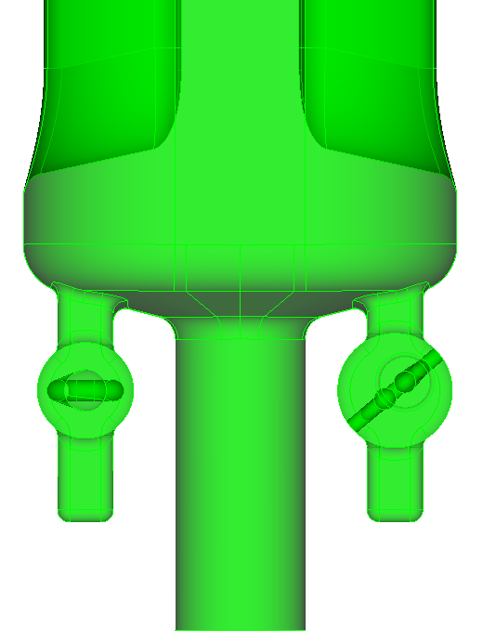
HHOM Coupler optimized for AUP design to Enhance Damping
Transition
+10mm higher
Larger waveguide stub size (170x40)
H-HOM width
+5mm wider
H-HOM hook
35 degree angle
Cutoff WG stub
Hook dimension
Hook angle
Improved damping with minimal change to the LARP prototype HOM coupler design.

Slide 10
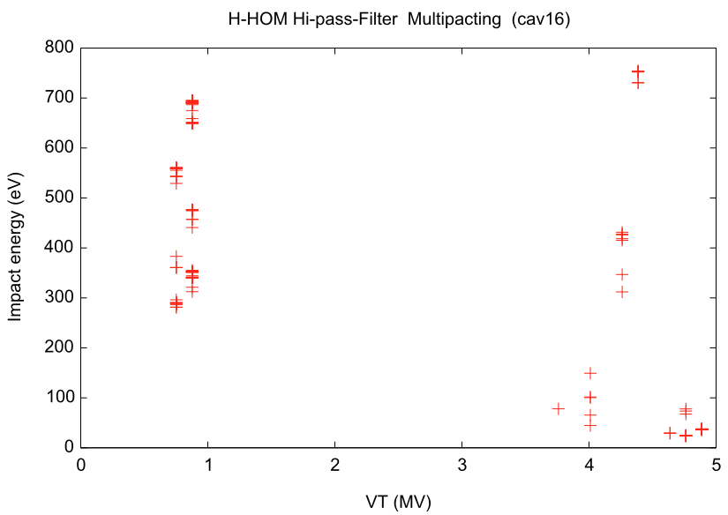
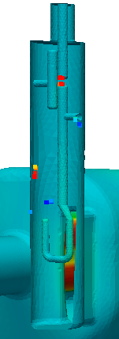
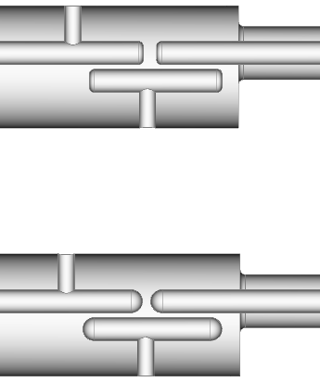
Eliminate Multipacting in H-HOM Hi-pass Filter
MP resonances existed in the filter gap if surfaces are flat
MP eliminated with fully rounded tips
LARP/AUP design
nominal deflecting voltage
MP resonances in the gap eliminated

Slide 11
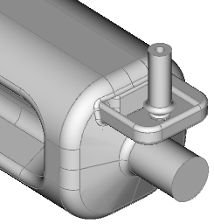
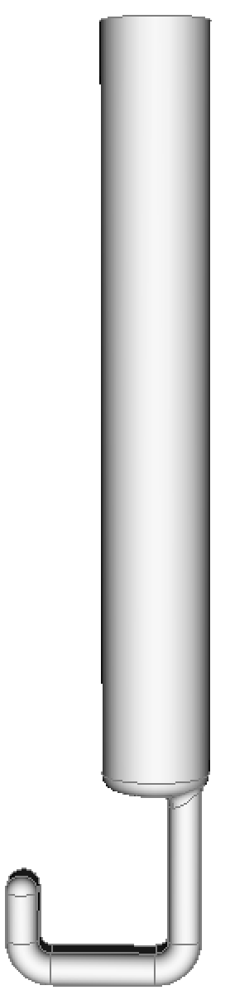
V-HOM Coupler
Cutoff waveguide stub + hook pickup
LARP design (probe)
AUP design (hook)
Waveguide stub rejects operating mode by symmetry, no filter needed
Hook probe provides both electric and magnetic coupling, improving damping of HOMs at higher frequencies
Hook angle optimized for damping at higher frequency

Slide 12
HOM Impedance of the New Design
1 MΩ/m
HOM impedance below 1 MΩ/m up to 2 GHz
Longitudinal shunt impedance < 200 k Ω

Slide 13
Beam HOM Power Issue
Acc. HOM mode at 760.94 MHz too close to beam resonance at 761.50 MHz
Resulting in beam HOM power >10kW
Design spec for beam power: < 1kW
International Review of the Crab Cavity Performance for HiLumi
April 3-5, 2017 CERN
Cavity shape modification (from LARP design) necessary to minimize HOM beam power at 760MHz

Slide 14
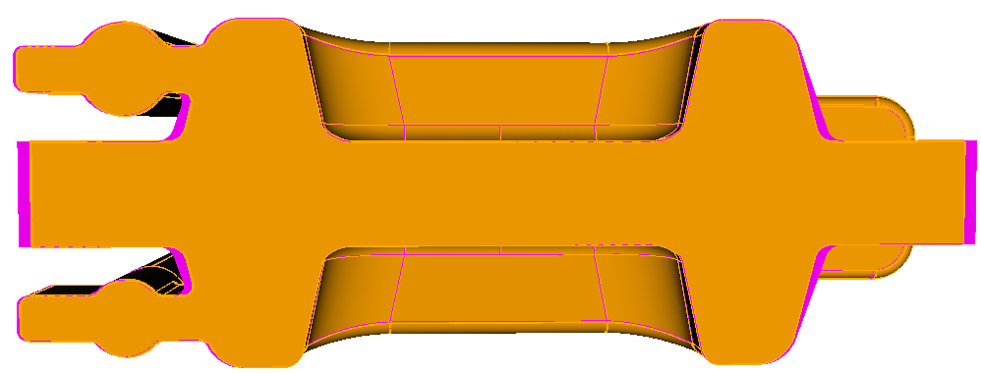
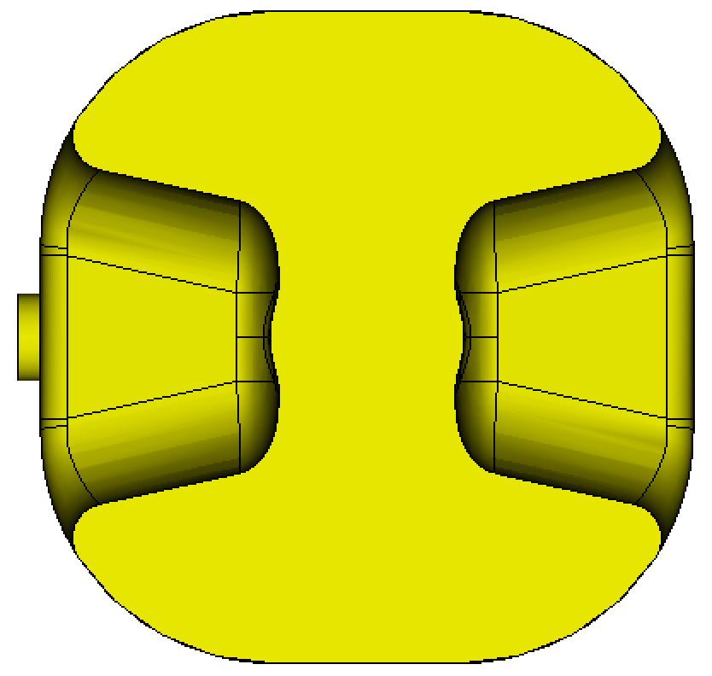
Minimizing 760 MHz Mode beam power, by detuning HOM frequency farther off beam resonance
Beam line spacing: 40.079 MHz, 19th harmonic at 761.5 MHz
R=~102
dR=-1.76mm
Various options explored to detune the 760 mode
Approach adopted: reducing gap volume around beam pipe region
  400 MHz dipole and 760 MHz monopole modes opposite in dF sensitivity
  lowers frequency of 760 mode (target: |dF| > 6MHz)
Operating mode frequency
tuned to 400.79 MHz by adjusting rounding “R” by -1.76mm
Achieved -9 MHz detuning of the 760 MHz mode from beam resonance of 761.5MHz
New frequency of this longitudinal HOM : 752.2 MHz

Slide 15
Beam HOM Power
Reduced from ~10kW to ~ 500W via detuning
HOM power calculated for 1-AM beam
σ_{z}=76mm

Slide 16
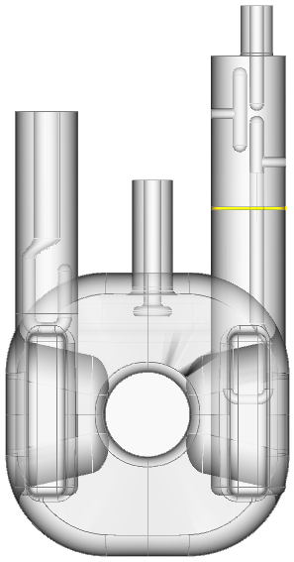
RF Heating on FPC and HOM Couplers
Deflecting mode: 3.4MV
Copper gasket at 2K (R=1mohm)
H-probe
H-T
V-probe
Coupler part | RF Heating (W)
fpc-hook | 6.75E+01
HHOM Cu gasket | 1.07E-01 | 2K
H-hook | 5.99E-04 | 2K
H-T | 1.44E-06 | 2K
H probe | 4.90E-02 | 2K
V-probe | 4.66E-01 | RoomT
Cu Gasket
FPC hook
H-hook
Thermal analysis show no thermal issues in HOM couplers (HyeKyoung)

Slide 17
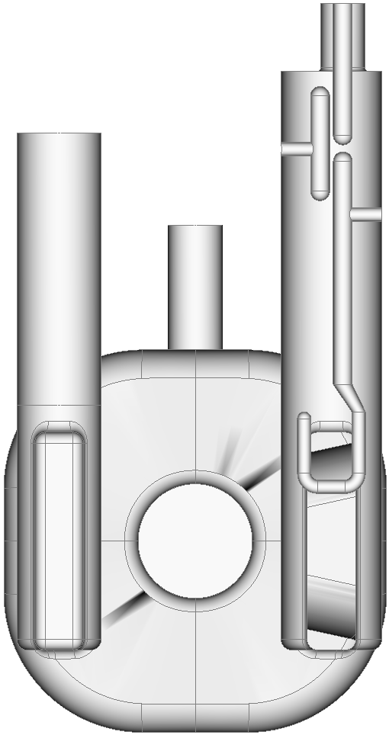
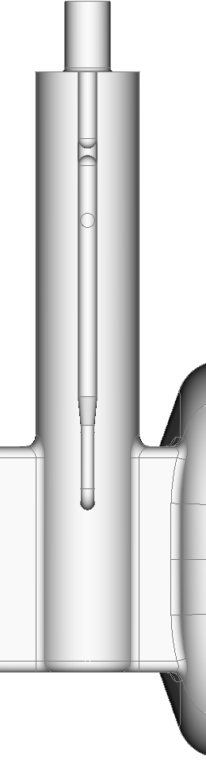
HOM Coupler Sensitivity to Dimension Errors
gap_top
gap_bar
gap_probe
rot_about_x
(+)
rot_about_z
(+)
bar_radius
ytip
tank_radius
Potential effects of coupler dimension errors
HOM damping
Filter performance - rejection of 400.79 MHz operating mode

Slide 18
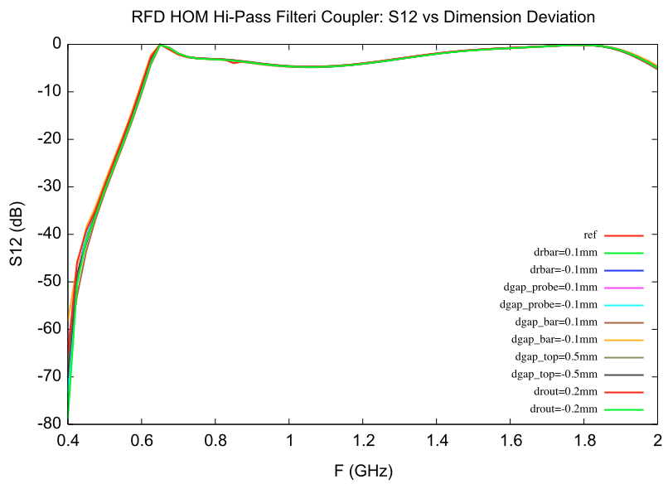
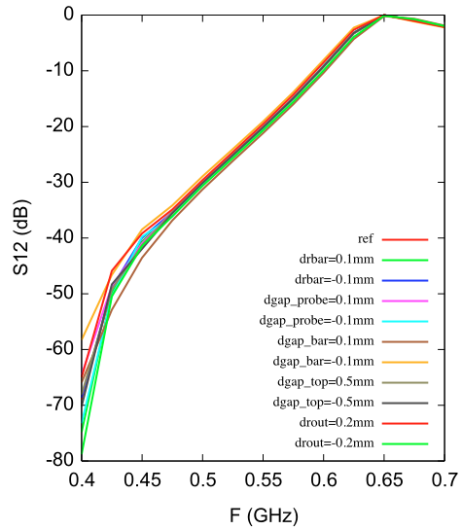
S21 vs High-pass Filter Dimension Deviations
Transmission above 0.65 GHz insensitive to dimension errors
Degradation of operating mode rejection will set tolerance on coupler dimensions

Slide 19
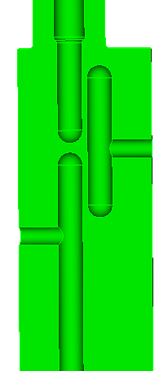
Fundamental Power Leakage Due to HHOM Filter Dimension Errors
Filter dimension errors may weaken rejection of operating mode, lead to RF power leakage
top-gap
tip-Gap
1.5 W total
Bar-Gap
tank radius
bar radius
With achievable filter dimension tolerances, RF power leakage will be contained within 1.5 W

Slide 20
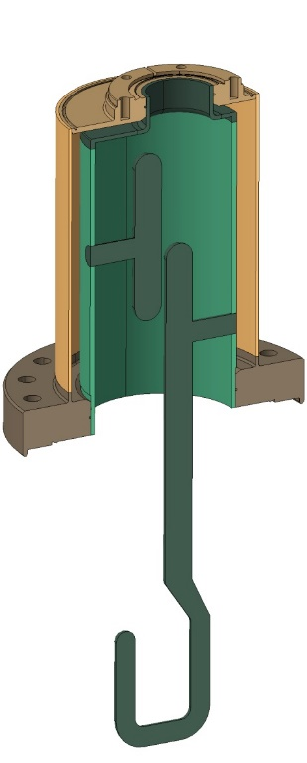
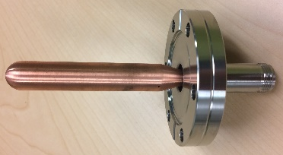
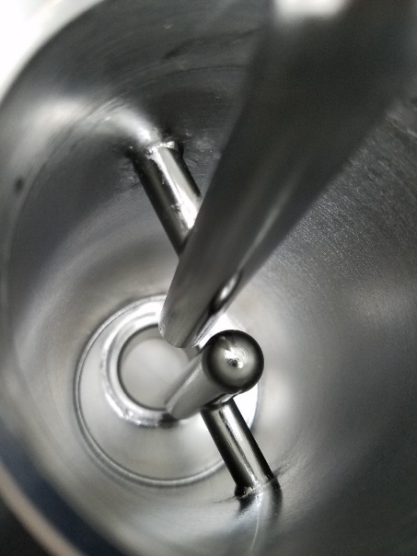
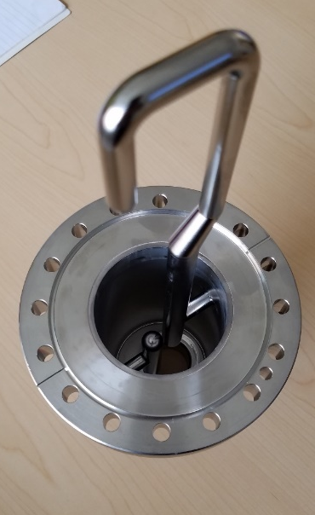
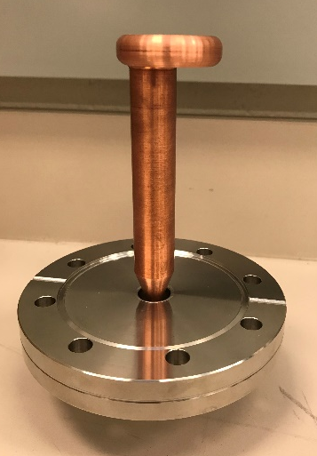
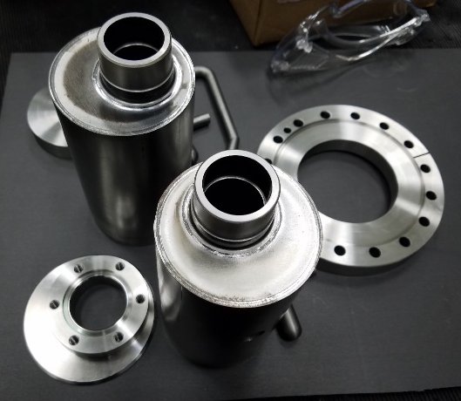
Fabrication of LARP Prototype Cavity HOM Couplers
HOM Damper Design and Fabrication
HyeKyoung Park, Naeem Huque (JLab)
A pre-prototype HHOM coupler was fabricated first to determine the fabrication process
Two sets of HHOM and VHOM couplers are being fabricated at Jefferson Lab
HHOM coupler without Helium jacket was used in cold tests at Jefferson Lab
Second set of couplers are shipped to Fermilab for tests with RFD-CAV-001
Completed prototype HHOM coupler
HHOM coupler with He jacket
(without the probe)
Probe
Completed prototype VHOM coupler
Parts of the HHOM prototype

Slide 21
Test Results of Cavity with HOM Couplers
DF-2
  Second test (May 31, 2018) with HHOM and VHOM couplers
  Cavity was kept under vacuum and retested without any further processing
    Input cable was repaired
    A high power cable was added for VHOM coupler
    Pick up was found shorted and HHOM port was used as pick up
  Q₀ measurement at high power
    With both HHOM and VHOM terminated
  No new multipacting levels
  Cavity achieved a transverse voltage of 5.0 MV
  No quench → Measurements were power limited
  Cavity had a lower Q₀ compared to the bare cavity test
  Strong coupling of fundamental mode through VHOM coupler (Q_{ext} ~2×10⁹)

Slide 22
Summary
RFD cavity was optimized through LARP and AUP programs
HOM damping achieved using a high-pass filter horizontal HOM coupler and a selective vertical HOM coupler
HOM design meet all requirements
  Accelerating mode shunt impedance: < 200 k Ω
  Transverse impedance: <1 MΩ/m
  HOM filter power leakage : within 1.5 W limit
Minimized beam HOM power of the “760MHz” mode by detuning to below 500 W
Engineering design of prototype cavity being developed

